Slide 1
Biodiversity and Ecosystem Functioning
COSMOS
Global Change Biology
1 July 2009

Slide 2
Overview
Biodiversity
What is it?
How is it changing over time?
Ecosystem Functioning
What is it?
How is it related to biodiversity?

Slide 3
Biodiversity
What is it?
Number, variety, variability of living organisms
Diversity within and among organisms
Genetic, species, ecosystem level
Why does it matter
Biophilia
Food and drug production
Ecosystem functioning:
Nutrient cycling / waste disposal / C storage
Soil formation
Climate regulation
Notes:
Humans have modified landscapes, changing the function of ecosystems in regional and global processes
The major components of land use change are forestry, agriculutre, and urbanization.

Slide 4
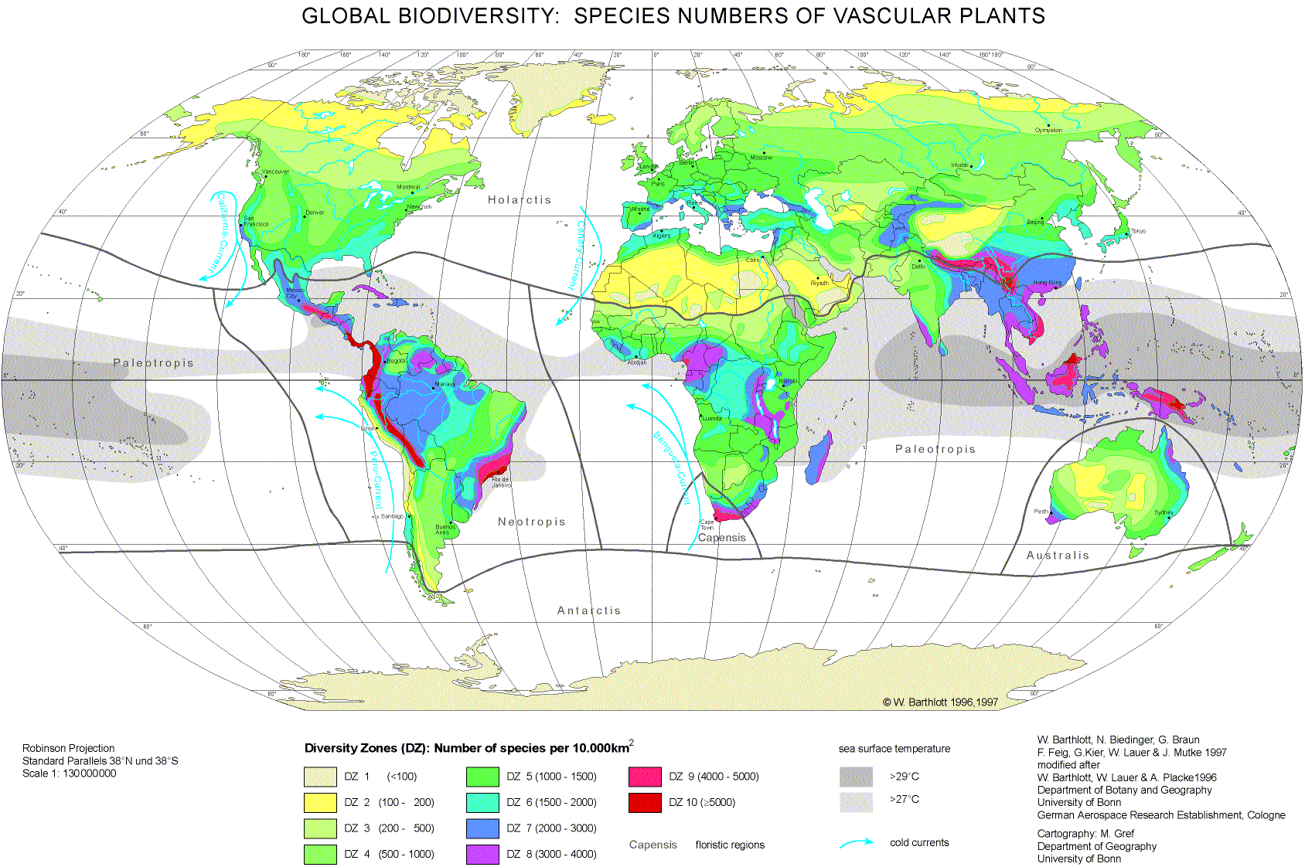
Global Biodiversity: # of plant species per 10⁴ km²
<100
100-200
200-500
500-1000
1000-1500
1500-2000
2000-3000
3000-4000
4000-5000
>5000
Notes:
Tropics have the greatest diversity

Slide 5
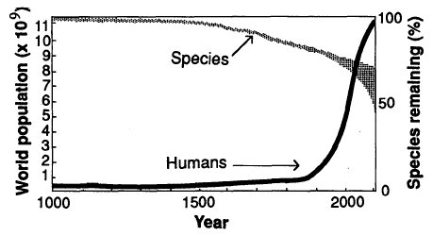
Biodiversity is decreasing with human population growth
http://www.msu.edu/course/isb/202/ebertmay/predicting_change/diversity_loss.jpg

Slide 6
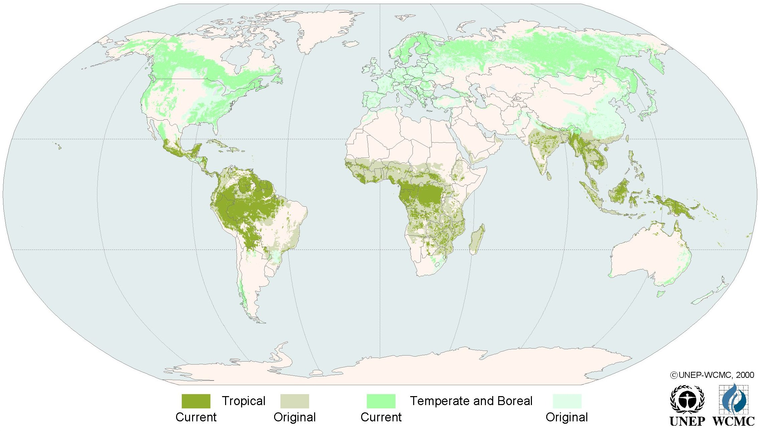
Global Distribution of Original and Remaining Forests
Notes:
15% cover decline since pre-history
dominant land use change: forest to crop / pasture

Slide 7
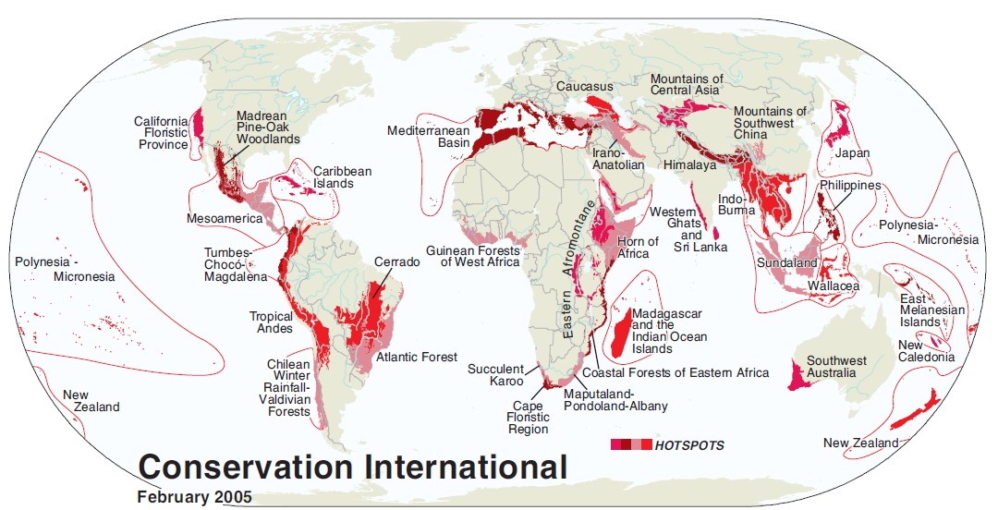
Biodiversity Hotspots (n=34)
Criteria:
1. contain 0.5% or 1500 plant species as endemics
2. has lost >70% of its primary vegetation
Result:
2.3% of total land surface
Contain >50% of plant species
Notes:
This is a set of 25 biodiversity hotspots
Facilitate prioritization for conservation
Two criteria:
1. contains 0.5% or 1500 plant species as endemics (def: found only there) and
2. has lost >70% of its primary vegetation
These sites contain nearly 60% of plant, bird, mammal, reptile, and amphibian species
Account for only 2.3% of total land area

Slide 8
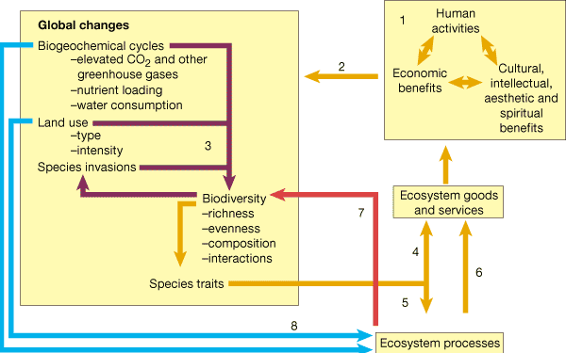
Causes and Consequences of Changing Biodiversity
Chapin et al. (2000), Nature
Notes:
Although biophilia may lead to conservation of Biodiversity for its own sake, as scientists, we must determine / justify investment in maintenance of Biodiversity.
Humans
Cause Global Change
Many mechanisms then affect biodiversity
Affects Ecosystem Goods and Services
Feedback to us
Human activities that are motivated by economic, cultural, intellectual, aesthetic and spiritual goals (1) are now causing environmental and ecological changes of global significance (2). By a variety of mechanisms, these global changes contribute to changing biodiversity, and changing biodiversity feeds back on susceptibility to species invasions (3, purple arrows; see text). Changes in biodiversity, through changes in species traits, can have direct consequences for ecosystem services and, as a result, human economic and social activities (4). In addition, changes in biodiversity can influence ecosystem processes (5). Altered ecosystem processes can thereby influence ecosystem services that benefit humanity (6) and feedback to further alter biodiversity (7, red arrow). Global changes may also directly affect ecosystem processes (8, blue arrows). Depending on the circumstances, the direct effects of global change may be either stronger or weaker than effects mediated by changes in diversity. We argue that the costs of loss of biotic diversity, although traditionally considered to be 'outside the box' of human welfare, must be recognized in our accounting of the costs and benefits of human activities.

Slide 9
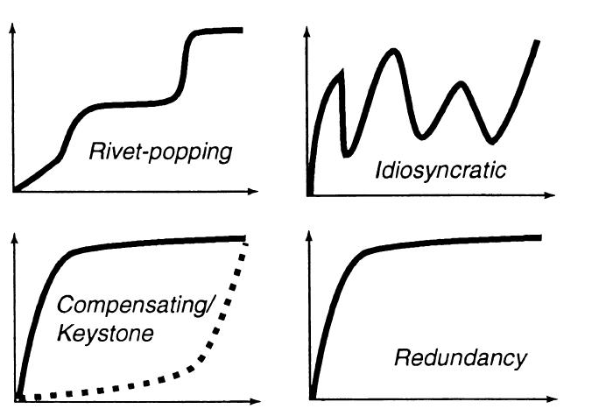
Relationships between Biodiversity and Ecosystem Functioning
Ecosystem Function
Biodiversity

Slide 10

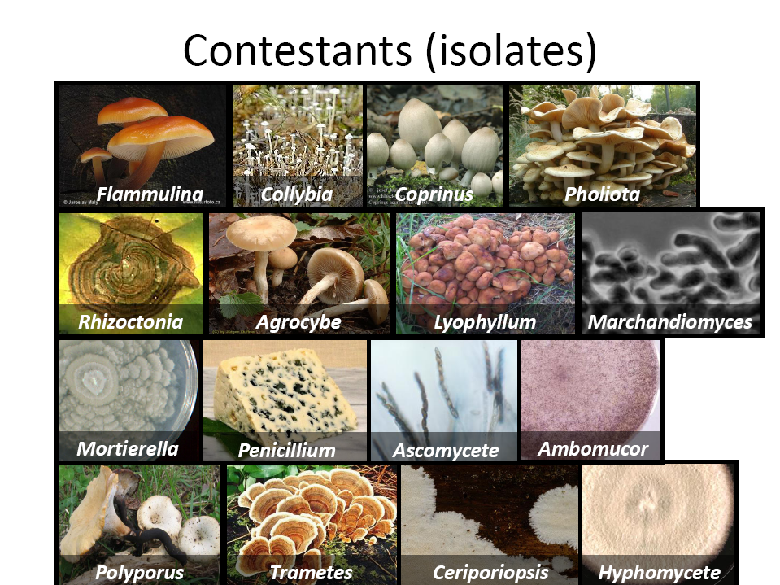


Niche Partitioning: resource use increases with species #
Niche Space
Sp 3
Sp 1
Resource 1
[e.g. Cellulose]
Sp 4
Low High
Sp 7
Sp 5
Sp 2
Sp 6
Low High
Resource 2
[e.g. Lignin]
Tilman, et. al, 1997 & Tilman, 2000. Nature
Notes:
<ANIMATE>
We have a theory here to explain why there should be a link, but mostly tested on plants
<Fig 1> This is a diagram of “niche space”, two dimensions of a multi-dimensional space
The space is the
Axes represent concentration of two resources in a substrate.
Lignin and Cellulose account for most of NPP
Species differ in their use of these two resources.
<Fig 2>
If you imagine that the proportion of Fig 1 covered by circles represents the use of these two resources, the next figure plots CO2 evolution expected (on Y axis) as a function of the number of species present (on X axis)
CO2 is a measurable flux that represents the rate of decomposition
CO2 should increase with diversity if species are able to fill a larger proportion of the niche space in a substrate, in my study I use aspen litter.

Slide 11
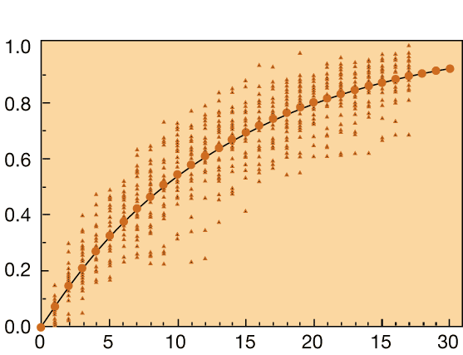
Biodiversity and Ecosystem Function
Function
# Species
Tilman (2000)

Slide 12
What links biodiversity and function?
1. Sampling Effect: “Physical”
High diversity plots more likely to contain high yield species
2. Complementarity : “Biological”
Differences in resource use enable overyielding
Facilitation and inhibition may also occur
Notes:
The physical effect is considered a statistical artifact by some, but others consider it biological- falling under the rubric of community assembly
The biological,

Slide 13
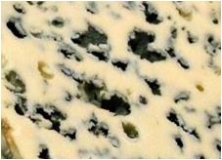
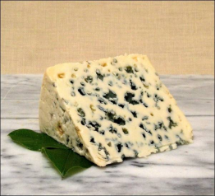
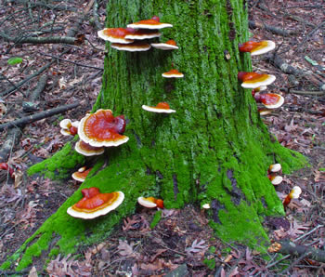

Sampling Effect
Decomposition Rate
1 2
# Isolates

Slide 14
Complimentarity:
D_{t}
Decomposition Rate
E
1 2
# Isolates

Slide 15
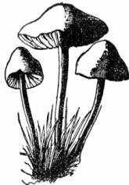
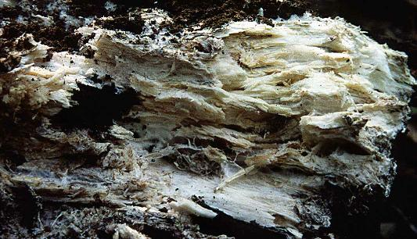
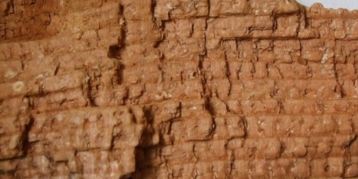
Hypotheses
Total decomposition will increase with species number
Cellulose and lignin degrading enzyme activities will increase with species number
cellulose
Total
lignin
Notes:
I predicted the first hypothesis, because this has been observed in a number of previous studies
But the next two hypotheses – that cellulose and lignin decomposition would increase w/ sp number, had not yet been tested.
Positive effects are frequently observed for biomass, but the response of non-biomass functions may be neutral or negative

Slide 16



16 fungal isolates
Notes:
Fungi are a highly diverse group and I picked 16 from our field sites in Alaska.
Decomp carried out by microbes = bacteria and fungi; I am focusing on fungi because they tend to degrade some of the more recalcitrant compounds like lignin.

Slide 17
Experimental design
Treatments:
1, 2, 4, or 8 isolates, random and unique combinations
Substrate:
Aspen litter + sand
Responses:
CO₂ release: total decomposition
BG (β-Glucosidase): cellulose degrading enzyme
PPO (Polyphenol Oxidase): lignin degrading enzyme
Notes:
From these sixteen isolates, I chose random and unique combinations because the primary interest was in diversity effects per se, not species effects
I measured CO2 and the activities of two enzymes
One that decomposes lignin, and one that decomposes cellulose
Discuss EEA: BG decomposes Cellulose, PPO decomposes lignin

Slide 18
CO₂ release increases with species number
30
20
CO₂ release
(mg C g⁻¹ litter)
10
0
0
2
4
6
8
Species Number
Notes:
As I hypothesized, co2 increased with species number

Slide 19
Cellulase activity increases with species number
4
3
β-glucosidase activity
(μmol g⁻¹ litter)
2
1
0
0
2
4
6
8
Species Number

Slide 20
Species number had no effect on lignin degradation
5
4
3
Polyphenol Oxidase activity
(μmol g⁻¹ litter)
2
1
0
0
2
4
6
8
Species Number
Notes:
Not Why no effect on PPO? More variable among species, bg more freq trait

Slide 21
Three species increased BG; CO₂ & PPO not affected
Species Present
8
Species Absent
6
**
β-glucosidase activity
(μmol g⁻¹ litter)
*
*P<0.05, **P<0.001
4
*
2
0
Ascomycete
Flammulina
populicola
Trametes
versicolor
Notes:
Two on right are basically white rot fungi, but it is unclear if they produce more BG on their own, or if it is because they free up some cellulose

Slide 22
Consequences for C Storage?
Short term, but not long term pools may be affected
Increased
Nitrogen
Availability
Reduced
Decomposer
Species
-
Decomposition
Notes:
My results imply that short term C storage may be affected, but lignin decomposition appeared insensitive to enzymes
-maybe the polyphenol oxidase is biologically re-activated?

Slide 23
Summary
Litter and cellulose decomposition declines at low species number
Lignin decomposition not affected
Lignin is the most important carbon pool on decade to century timescales
Notes:
My results imply that short term C storage may be affected by declining species number, but there was no effect on longer term carbon pools.

