Slide 1
Cell Migration and the Cytoskeleton
Haptotaxis
3/7/13
Lecture 9, ChE 590B

Slide 2
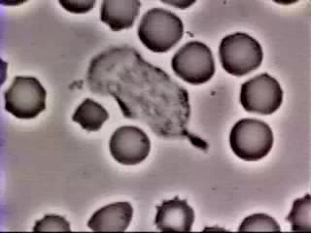
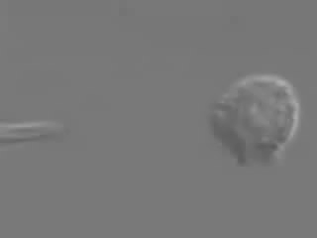
When, Where, Why do cells migrate?
1. Neutrophil Migration to Battle Infection

Slide 3
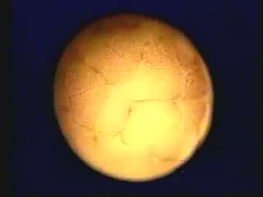
2. Development

Slide 4
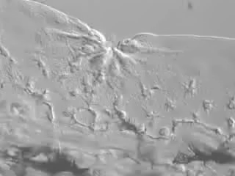
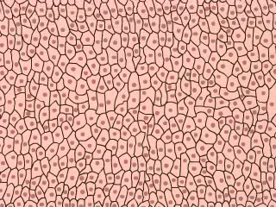
3. Wound Healing

Slide 5
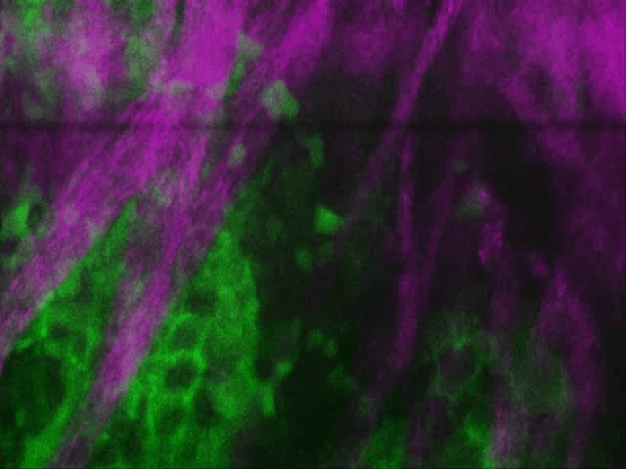
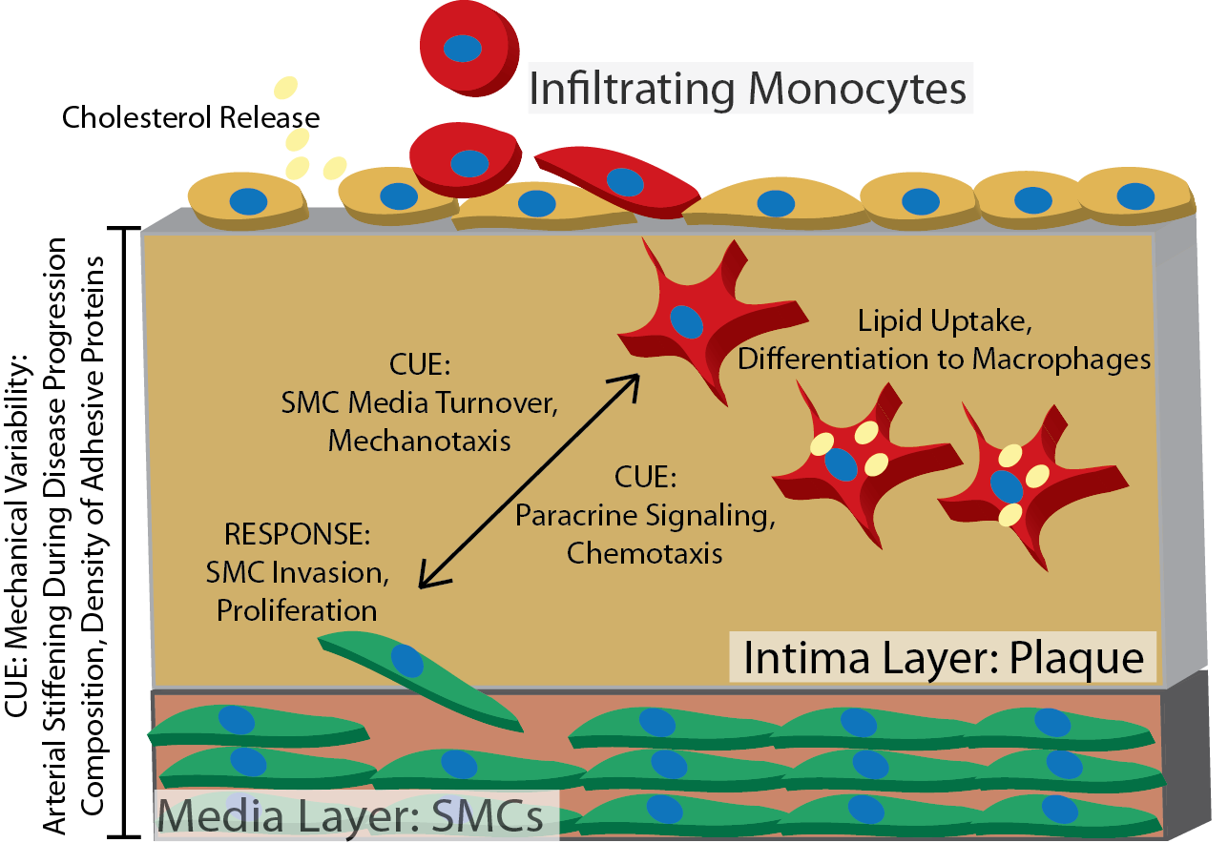
4. Disease
Tumor cell metastasis
Courtesy E. Roussos

Slide 6
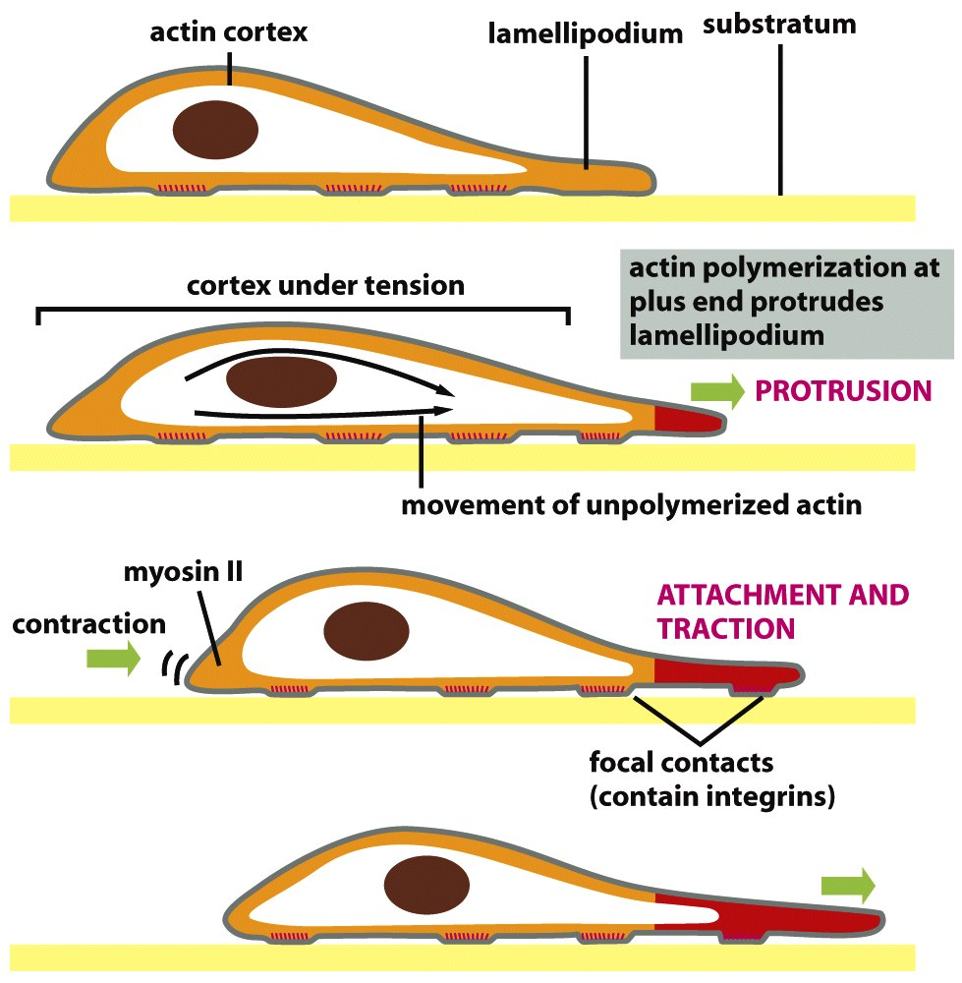
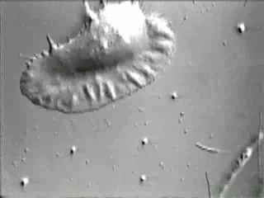
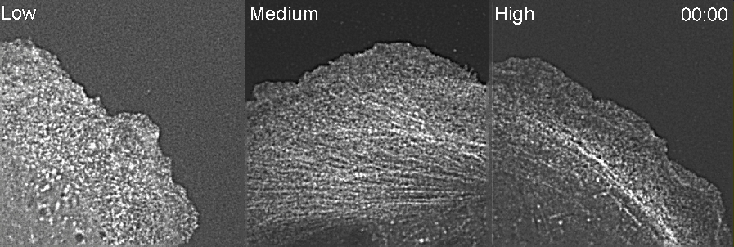
Basic Migratory Process Observed through Time-Lapse microscopy
Longer timepoints (min-hr):
Cell locomotion observed
Migrating Keratinocyte
Molecular Biology of the Cell
Very short timepoints (sec):
Actin treadmilling observed

Slide 7
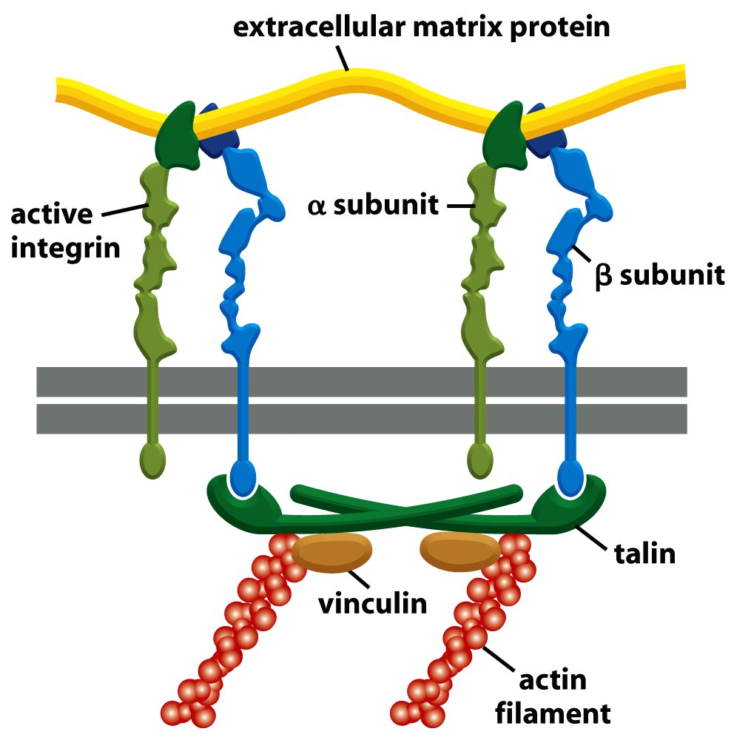
Reminder: Integrins connect to ECM
Transmit force and movement in cell via cytoskeleton and focal adhesions

Slide 8
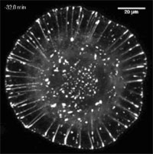
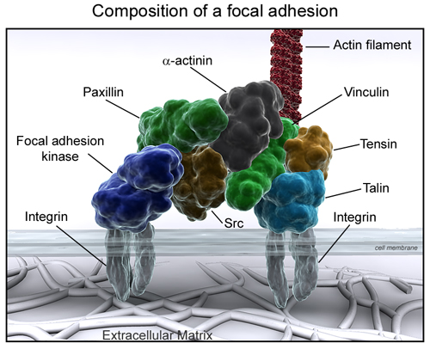
Focal Adhesions: Connect Integrins to Cytoskeleton
S=structural
P=signaler
S
P
S
Zyxin staining
Wang lab, CMU
S
P
S
S
P
S

Slide 9
The Cytoskeleton

Slide 10
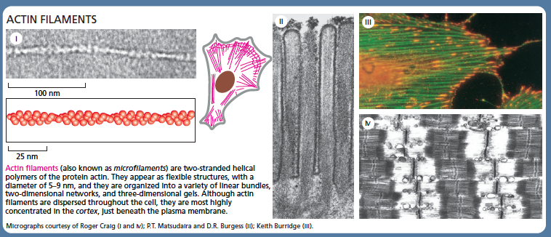
Actin filaments: double helix with 5-9nm diameter, connect to integrins (indirectly via focal adhesion proteins)

Slide 11
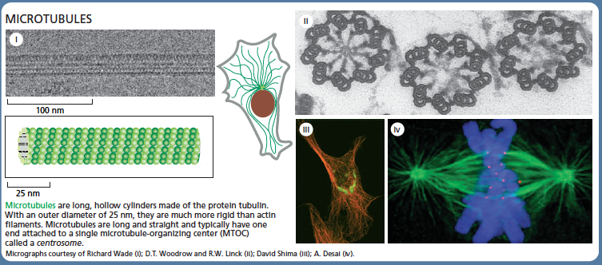
Microtubules: cylinders, 25nm diameter, critical role in mitosis

Slide 12
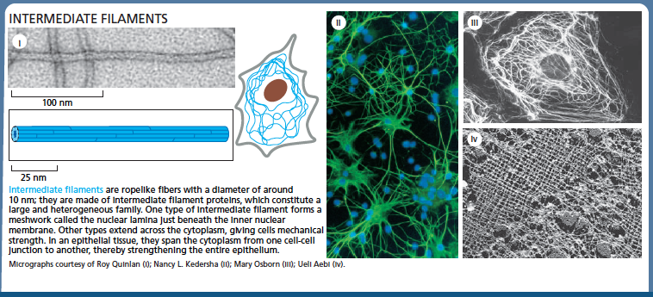
Intermediate Filaments: 10nm ropes, cell-cell junctions

Slide 13
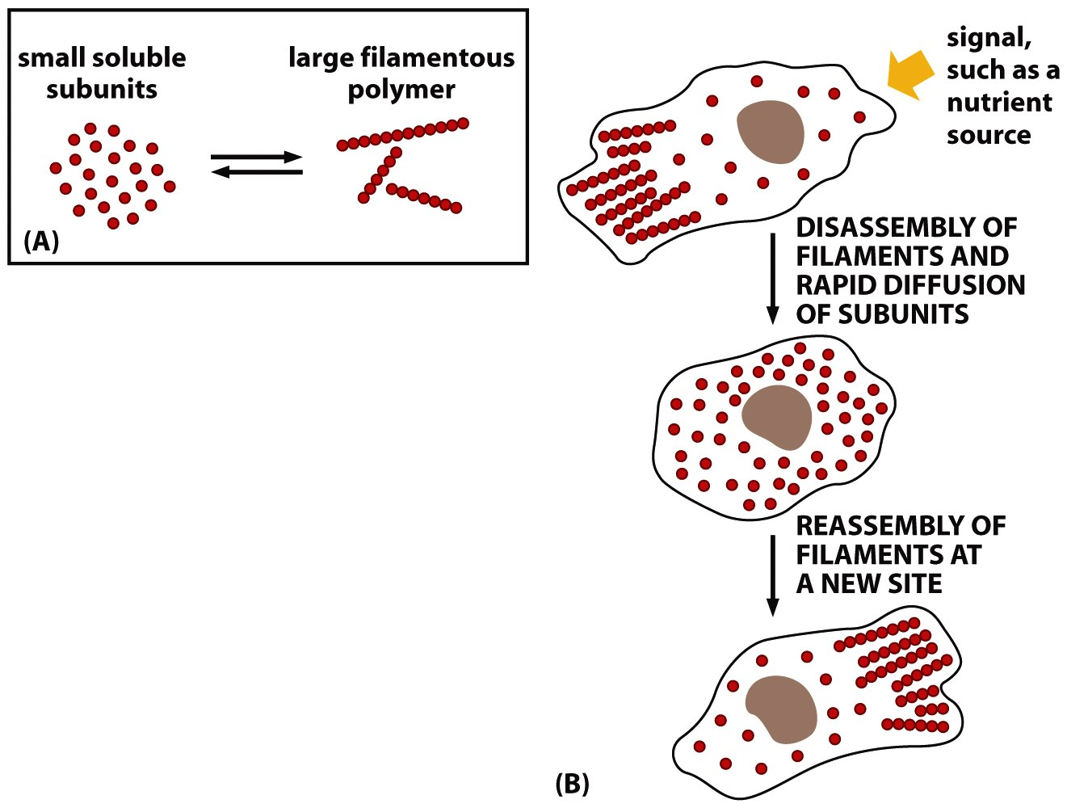
Each class of filaments is a polymer:
- made up of smaller, soluble subunits
Cells using ATP energy to polymerize and depolymerize monomers when needed

Slide 14
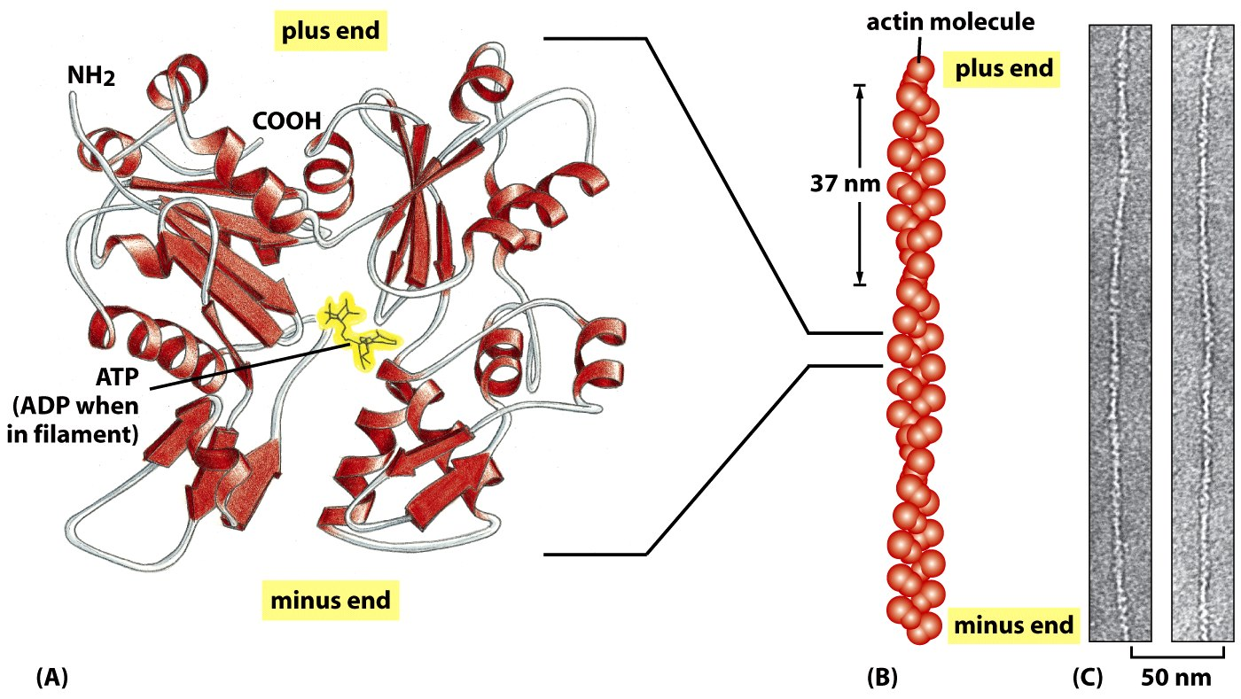
Actin subunits make up single helix
Figure 16-12 Molecular Biology of the Cell (© Garland Science 2008)

Slide 15
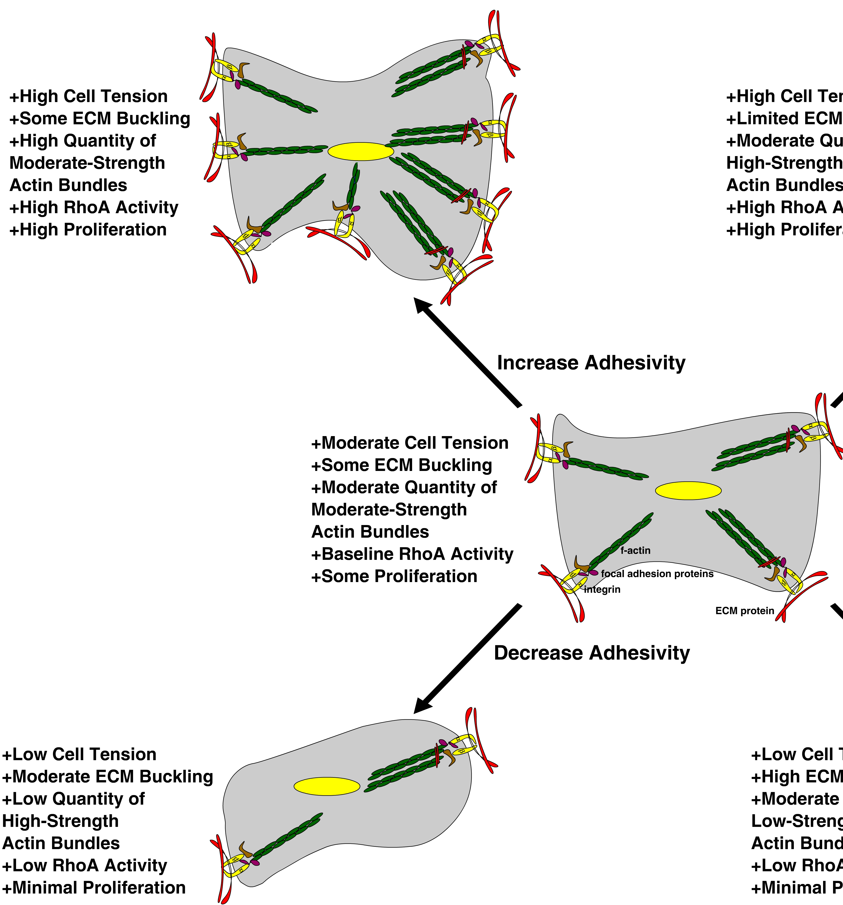
How does actin transmit force and movement?
Ligand Density of the ECM Regulates cell motility
  Ligand density of ECM alter contractility
  Contractility defines behavior
If more, or stronger, focal adhesions on one side of cell, induce polarization, haptotaxis
Notes:
So in summary of my work so far at Irvine, we hypothesize that ECM mechanics regulates cytoskeletal assembly and, in turn, signaling cascades that mediate SMC motility, proliferation, matrix deposition, and differentiation.
This picture that Dr. Putnam and I created for a review paper outlines what we think is happening to cells as a function of chemistry and mechanics. On a substrate, a cell makes attachments to the substrate through integrins and adhesions and accordingly sets up a cytoskeletal network. When we increase rigidity of the substrate, a cell adjusts the force balance by polymerizing additional f-actin, increasing RhoA activity and increasing proliferation. In contrast, if the substratum is weaker, the cell depolymerizes some of its actin, leading to lower RhoA activity and less proliferation. These changes in RhoA activity can also alter some other cellular processes downstream. Similar things happen when you alter the ligand density of the matrix as well, which are the pictures on the left side.
By building a 3-D model system that closely mimics SMC’s surroundings in vivo, we’re hoping to gain a better understanding of the relationship between SMCs and their environment with relevance to treatment of cardiovascular disease.

Slide 16
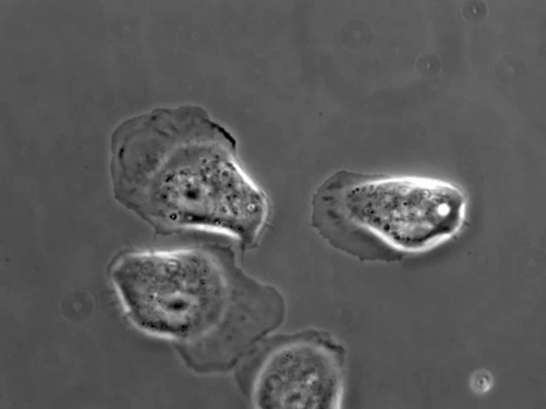
Lamellipodia
Rat mammary carcinoma cells
10 min, images every 20 seconds
Michele Balsamo, Gertler lab MIT

Slide 17
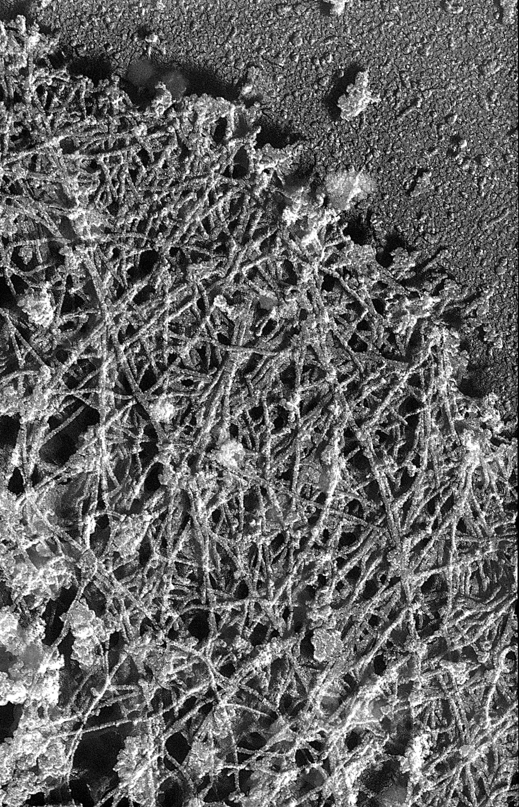
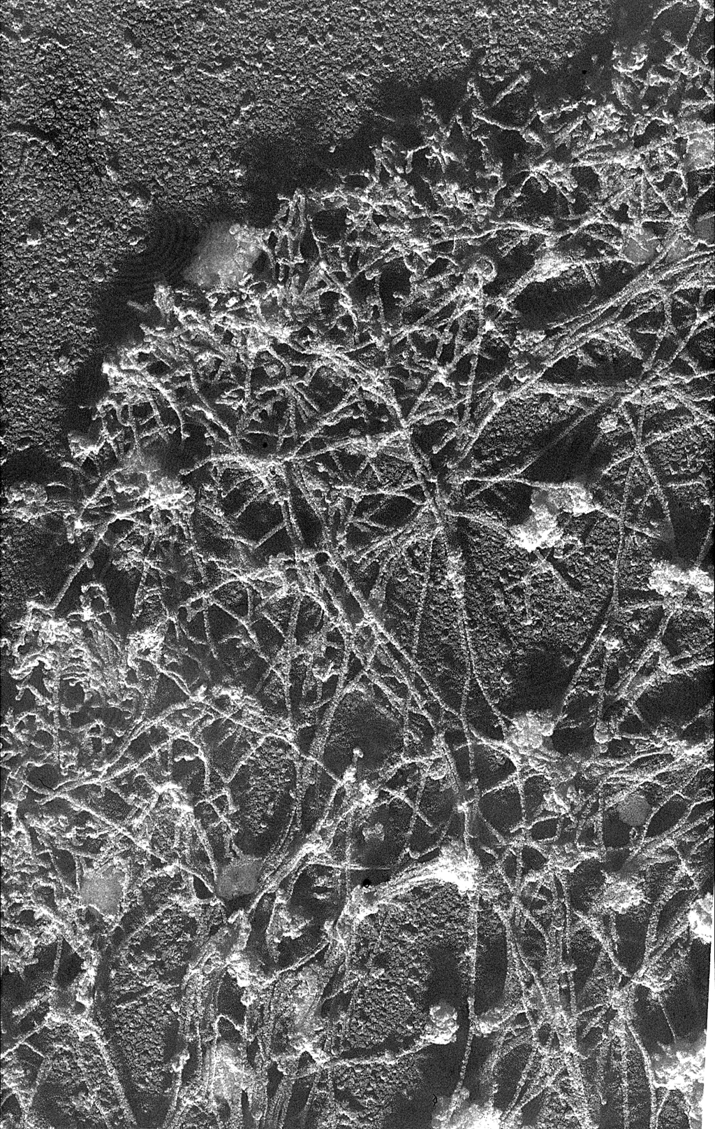
Electron Micrograph view of the Actin cytoskeleton in Lamelipodia
Mena
Mena11a
Michele Balsamo & Leslie Mebane, Gertler Lab, MIT

Slide 18
Actin dynamics are regulated by density of matrix proteins
Speckle Microscopy: Individual actin monomers are stained at sub-maximum concentration
Can see individual monomers move within a filament to watch dynamics

Slide 19
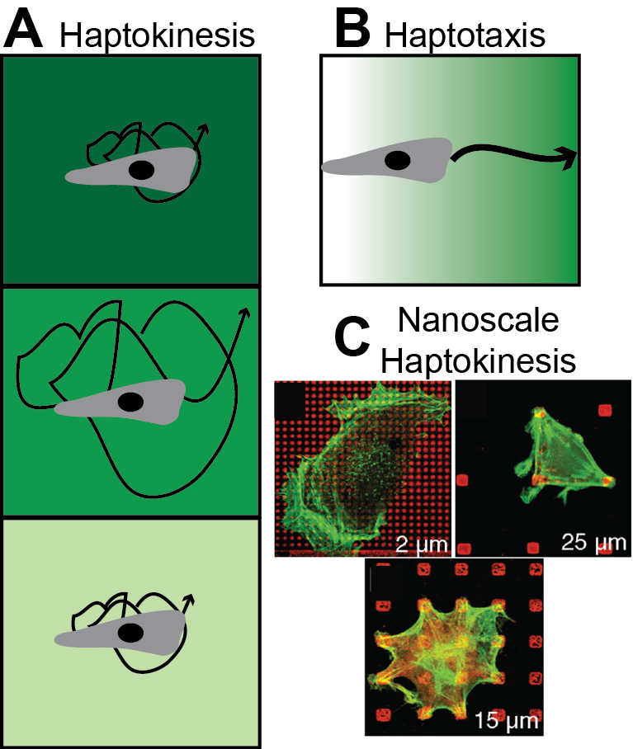
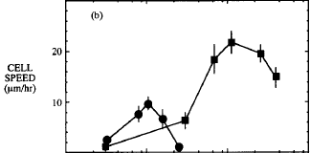
Haptokinesis vs Haptotaxis
Increasing Protein Concentration
(FN or Collagen IV)
DiMilla et al., JCB 1993

Slide 20
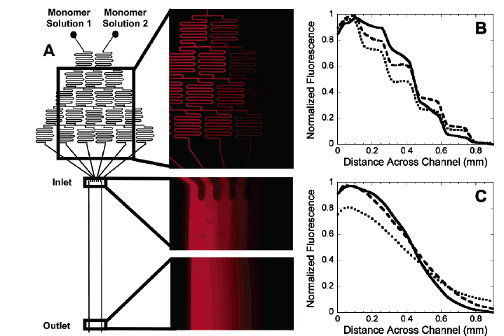
Adapting microfluidics to create haptotaxic gradients
Burdick et al., Langmuir 2004

Slide 21
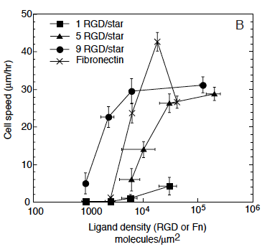
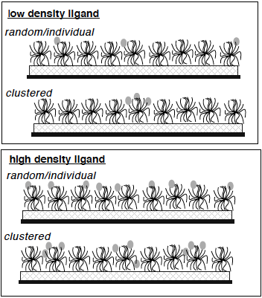
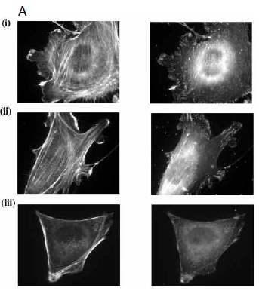
Integrin clustering vs. number of adhesions
FN
RGD, clustered
Same density
RGD, uniform
Maheshwari et al., JCB 2000

