Slide 1
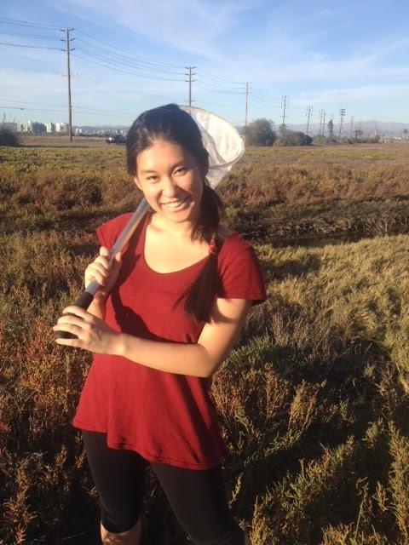
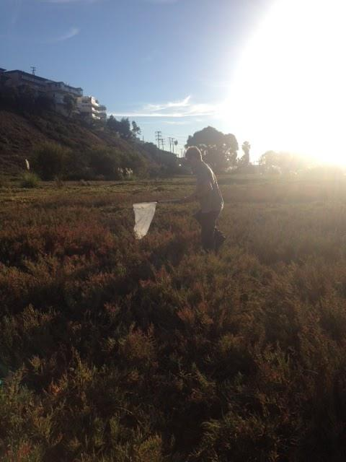
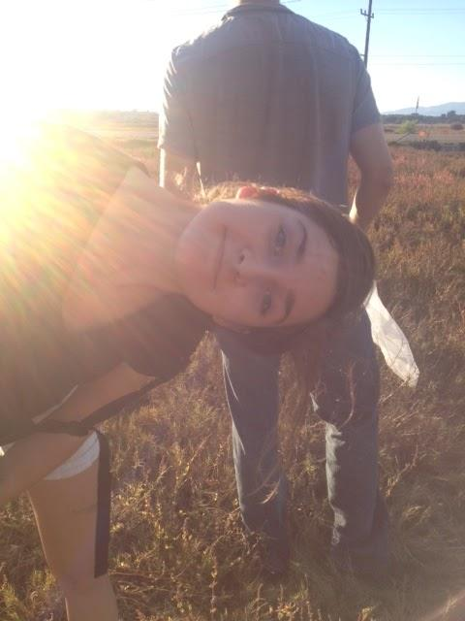
The Biology of Heavy Metals in Ballona Insects
William Gendron, Maria Shibatsuji, Katherine Wikholm

Slide 2
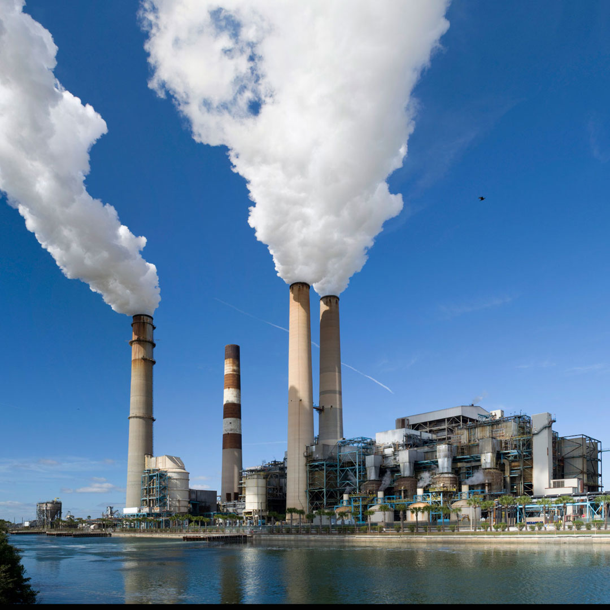
Introduction
Introduction
- Heavy Metals
- Salt Marshes
-
Methods
-
-
-
Results
-
-
-
Discussion
-
-
-
Introduction
- Heavy Metals
- Salt Marshes
Methods
- Collection
- Imaged
- ICP-MS
- Statistical Analysis
Results
- Sites
- Morphospecies
- Feeding Guilds
- Hue
Discussion
- DIfferences in site and morphospecies
- Hue differences
- Big Picture for moths
Heavy Metals
What are they?
How do they enter the environment?
Uptake by plants and animals.
Effects/ potential harm.
http://www.republicsales.com/Industries/chemical-industry.asp

Slide 3
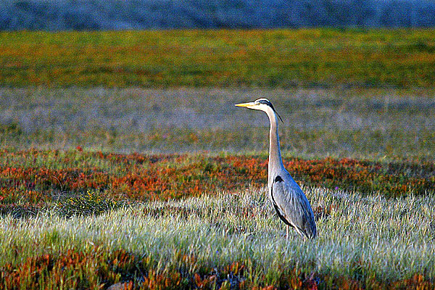
Introduction
Introduction
- Salt Marshes
- Heavy Metals
Methods
Results
Discussion
Introduction
- Heavy Metals
- Salt Marshes
-
Methods
-
-
-
Results
-
-
-
Discussion
-
-
-
Introduction
- Heavy Metals
- Salt Marshes
-
Methods
- Collection
- Imaged
- ICP-MS
- Statistical Analysis
Results
-
-
-
Discussion
-
-
-
Introduction
- Heavy Metals
- Salt Marshes
Methods
- Collection
- Imaged
- ICP-MS
- Statistical Analysis
Results
- Sites
- Morphospecies
- Feeding Guilds
- Hue
Discussion
- DIfferences in site and morphospecies
- Hue differences
- Big Picture for moths
Ballona Wetlands
= Salt Marsh
Environmental Role
Retention of nutrients
Retention of Metals
Concerns
City Scape effects on ecosystems and diversity
Gaps in Research
Insects
http://latimesblogs.latimes.com/lanow/2013/01/50-million-interpretive-center-planned-at-ballona-wetlands-ecological-reserve.html

Slide 4
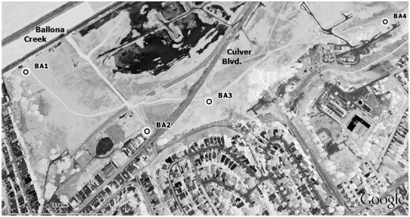
Methods: Collection
Introduction
Methods
Collection
Results
Discussion
Introduction
- Heavy Metals
- Salt Marshes
-
Methods
- Collection
- ICP-MS
- Statistical Analysis
Results
-
-
-
Discussion
-
-
-
Introduction
- Heavy Metals
- Salt Marshes
-
Methods
- Collection
- Imaged
- ICP-MS
- Statistical Analysis
Results
-
-
-
Discussion
-
-
-
Introduction
- Heavy Metals
- Salt Marshes
Methods
- Collection
- Imaged
- ICP-MS
- Statistical Analysis
Results
- Sites
- Morphospecies
- Feeding Guilds
- Hue
Discussion
- DIfferences in site and morphospecies
- Hue differences
- Big Picture for moths
Insects were collected with nets on November 4th in the afternoon.
Collected at sites 1, 2 and 3 using nets.
Figure 1. Map of Ballona Wetlands where insects were collected.

Slide 5
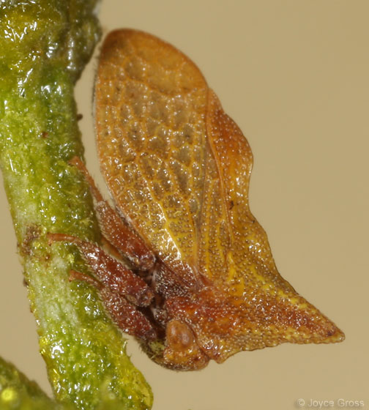
Methods: Collection
Introduction
Methods
Collection
Results
Discussion
Introduction
- Heavy Metals
- Salt Marshes
-
Methods
- Collection
- ICP-MS
- Statistical Analysis
Results
-
-
-
Discussion
-
-
-
Introduction
- Heavy Metals
- Salt Marshes
-
Methods
- Collection
- Imaged
- ICP-MS
- Statistical Analysis
Results
-
-
-
Discussion
-
-
-
Introduction
- Heavy Metals
- Salt Marshes
Methods
- Collection
- Imaged
- ICP-MS
- Statistical Analysis
Results
- Sites
- Morphospecies
- Feeding Guilds
- Hue
Discussion
- DIfferences in site and morphospecies
- Hue differences
- Big Picture for moths
3 Species Consistently Collected amongst the sites
Lepidoptera sp1 Lepidoptera sp2 Heteroptera sp1
https://encrypted-tbn3.gstatic.com/images?q=tbn:ANd9GcTEyCWX9tH5N7kPqCYgT3-86qUQS7FJuIpBRjVFxLyujrg7iJrd

Slide 6

Methods: Imaging
Introduction
Methods
Collection
Results
Discussion
Introduction
- Heavy Metals
- Salt Marshes
-
Methods
- Collection
- Imaging
- ICP-MS
- Statistical Analysis
Results
-
-
-
Discussion
-
-
-
Introduction
- Heavy Metals
- Salt Marshes
Methods
- Collection
- Imaged
- ICP-MS
- Statistical Analysis
Results
- Sites
- Morphospecies
- Feeding Guilds
- Hue
Discussion
- DIfferences in site and morphospecies
- Hue differences
- Big Picture for moths
iPhone Camera
Analyzed average hues of one wing on each Lepidoptera using Digital Image Analysis
Top of wing for Lepidoptera 1
Underside of wing for Lepidoptera 2
http://en.wikipedia.org/wiki/Pixel#mediaviewer/File:Closeup_of_pixels.JPG

Slide 7
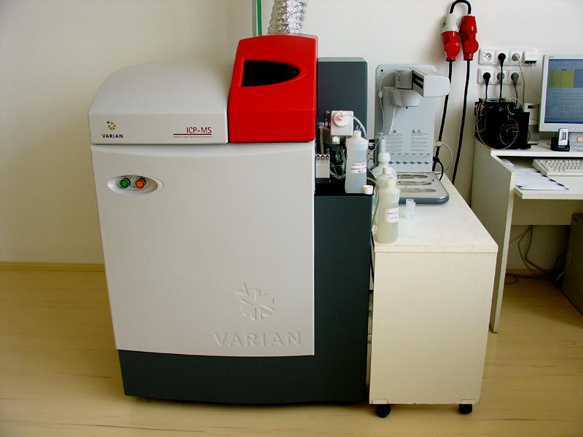
Methods: ICP-MS
Introduction
Methods
Collection
Results
Discussion
Introduction
- Heavy Metals
- Salt Marshes
-
Methods
- Collection
- Imaged
- ICP-MS
- Statistical Analysis
Results
-
-
-
Discussion
-
-
-
Introduction
- Heavy Metals
- Salt Marshes
Methods
- Collection
- Imaged
- ICP-MS
- Statistical Analysis
Results
- Sites
- Morphospecies
- Feeding Guilds
- Hue
Discussion
- DIfferences in site and morphospecies
- Hue differences
- Big Picture for moths
Inductively Coupled Plasma-Mass Spectrometry
Identifies individual atoms in the samples
Lengthy Process of Preparation
Weighing/Drying
Dissolving/Microwaving
Dilution and Sample Running
Analysis of Metal values per weight(mg/kg or parts per million)

Slide 8
Methods: Statistical Analysis
Introduction
Methods
Collection
Results
Discussion
Introduction
- Heavy Metals
- Salt Marshes
-
Methods
- Collection
- Imaged
- ICP-MS
- Statistical Analysis
Results
-
-
-
Discussion
-
-
-
Introduction
- Heavy Metals
- Salt Marshes
Methods
- Collection
- Imaged
- ICP-MS
- Statistical Analysis
Results
- Sites
- Morphospecies
- Feeding Guilds
- Hue
Discussion
- DIfferences in site and morphospecies
- Hue differences
- Big Picture for moths
Heavy metals in comparison to site -Kruskal-Wallis
Heavy metals in comparison to morphospecies -Kruskal-Wallis
Heavy metals in comparison to feeding guilds -Mann Whitney U
Heavy metals in comparison to hues -Spearman’s rank correlation

Slide 9
Results:
10 Heavy metals differed significantly among sites
Introduction
Methods
Results
Discussion
Introduction
- Heavy Metals
- Salt Marshes
-
Methods
-
-
-
Results
-
-
-
Discussion
-
-
-
Introduction
- Heavy Metals
- Salt Marshes
Methods
- Collection
- Imaged
- ICP-MS
- Statistical Analysis
Results
- Sites
- Morphospecies
- Feeding Guilds
- Hue
Discussion
- DIfferences in site and morphospecies
- Hue differences
- Big Picture for moths
Site 1 | Site 2 | Site 3
Li7
Ca43
V51
Fe57
Zn66
Sr88
Ag109
In115
Ba137
Bi209
Figure 1. Map of Ballona Wetlands where insects were collected.

Slide 10
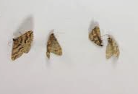
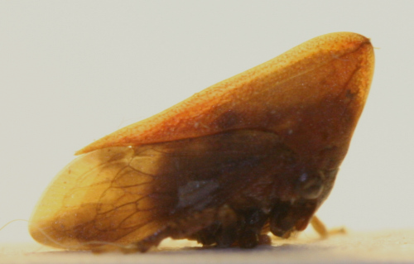
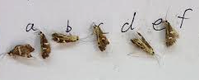
Results: Morphospecies Comparison
Introduction
Methods
Results
Discussion
Introduction
- Heavy Metals
- Salt Marshes
-
Methods
-
-
-
Results
-
-
-
Discussion
-
-
-
Introduction
- Heavy Metals
- Salt Marshes
-
Methods
- Collection
- Imaged
- ICP-MS
- Statistical Analysis
Results
-
-
-
Discussion
-
-
-
Introduction
- Heavy Metals
- Salt Marshes
Methods
- Collection
- Imaged
- ICP-MS
- Statistical Analysis
Results
- Sites
- Morphospecies
- Feeding Guilds
- Hue
Discussion
- DIfferences in site and morphospecies
- Hue differences
- Big Picture for moths
Lepidoptera sp.1 | Lepidoptera sp.2 | Heteroptera sp.3
V51 | Cu63
Mn55 | Cu65
Se-182
http://scrubmuncher.files.wordpress.com/2009/11/img_5748.jpg?w=500

Slide 11
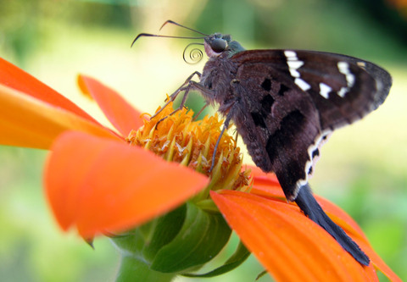
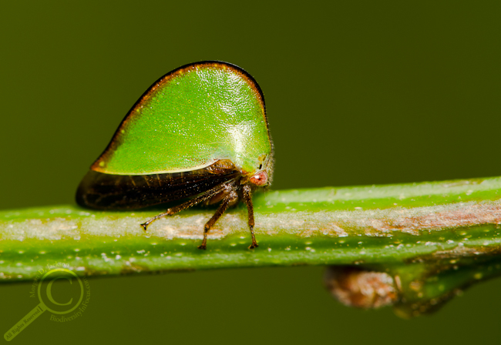
Results: Guild Comparison
Introduction
Methods
Results
Discussion
Introduction
- Heavy Metals
- Salt Marshes
-
Methods
-
-
-
Results
-
-
-
Discussion
-
-
-
Introduction
- Heavy Metals
- Salt Marshes
-
Methods
- Collection
- Imaged
- ICP-MS
- Statistical Analysis
Results
-
-
-
Discussion
-
-
-
Introduction
- Heavy Metals
- Salt Marshes
Methods
- Collection
- Imaged
- ICP-MS
- Statistical Analysis
Results
- Sites
- Morphospecies
- Feeding Guilds
- Hue
Discussion
- DIfferences in site and morphospecies
- Hue differences
- Big Picture for moths
http://talesfromthelaboratory.typepad.com/tales_from_the_microbial_/images/2008/10/04/longtailed_skipper_moth_4_october_2.jpg
http://www.biodiversityinfocus.com/blog/wp-content/uploads/2012/05/Budding-membracid20110627.jpg
Nectar Feeders | Phloem Feeders
Mn55
As-75

Slide 12
Results:
Hue Comparison among
all Lepidoptera
Correlation found between Hue Intensity and Presence of the Metals Barium and Titanium
Introduction
Methods
Results
Discussion
Introduction
- Heavy Metals
- Salt Marshes
-
Methods
-
-
-
Results
-
-
-
Discussion
-
-
-
Introduction
- Heavy Metals
- Salt Marshes
-
Methods
- Collection
- Imaged
- ICP-MS
- Statistical Analysis
Results
-
-
-
Discussion
-
-
-
Introduction
- Heavy Metals
- Salt Marshes
Methods
- Collection
- Imaged
- ICP-MS
- Statistical Analysis
Results
- Sites
- Morphospecies
- Feeding Guilds
- Hue
Discussion
- DIfferences in site and morphospecies
- Hue differences
- Big Picture for moths
 | Ba137 | Ti205
Green Intensity | Negatively | Negatively
Blue Intensity | Negatively | Negatively
Red Intensity | NS | Negatively
Average/Total Intensity | Negatively | Negatively

Slide 13
Results:
Hue Comparison among
Lepidoptera Species
Lepidoptera Sp. 1: No correlation
Lepidoptera Sp. 2: Positive Correlation
Introduction
- Heavy Metals
- Salt Marshes
-
Methods
- Collection
- Imaged
- ICP-MS
- Statistical Analysis
Results
-
-
-
Discussion
-
-
-
Introduction
- Heavy Metals
- Salt Marshes
Methods
- Collection
- Imaged
- ICP-MS
- Statistical Analysis
Results
- Sites
- Morphospecies
- Feeding Guilds
- Hue
Discussion
- DIfferences in site and morphospecies
- Hue differences
- Big Picture for moths
 | Se82 | Cd111
Green | Positively | Positively
Blue | Positively | Positively
Red | Positively | Positively
Average/Total | Positively | Positively

Slide 14
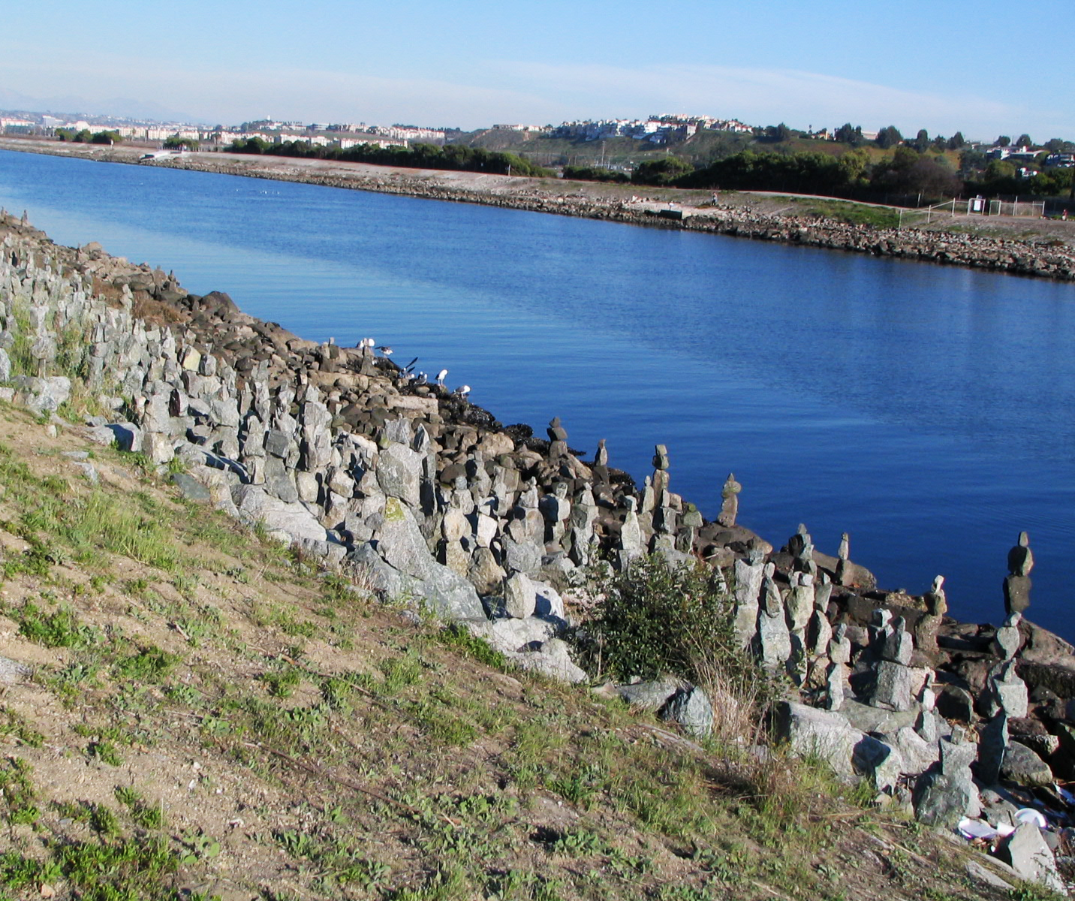
Site Differences Discussion
Introduction
Methods
Results
Discussion
Introduction
- Heavy Metals
- Salt Marshes
-
Methods
-
-
-
Results
-
-
-
Discussion
-
-
-
Introduction
- Heavy Metals
- Salt Marshes
-
Methods
- Collection
- Imaged
- ICP-MS
- Statistical Analysis
Results
-
-
-
Discussion
-
-
-
Future Studies
Introduction
- Heavy Metals
- Salt Marshes
Methods
- Collection
- Imaged
- ICP-MS
- Statistical Analysis
Results
- Sites
- Morphospecies
- Feeding Guilds
- Hue
Discussion
- DIfferences in site and morphospecies
- Hue differences
- Big Picture for moths
Highest levels at site 1
Closest to Ballona Creek
Metals may come from
runoff
Muddier habitat

Slide 15
Morphospecies Discussion
Introduction
Methods
Results
Discussion
Introduction
- Heavy Metals
- Salt Marshes
-
Methods
-
-
-
Results
-
-
-
Discussion
-
-
-
Introduction
- Heavy Metals
- Salt Marshes
-
Methods
- Collection
- Imaged
- ICP-MS
- Statistical Analysis
Results
-
-
-
Discussion
-
-
-
Future Studies
Introduction
- Heavy Metals
- Salt Marshes
Methods
- Collection
- Imaged
- ICP-MS
- Statistical Analysis
Results
- Sites
- Morphospecies
- Feeding Guilds
- Hue
Discussion
- DIfferences in site and morphospecies
- Hue differences
- Big Picture for moths
Different species accumulate heavy metals differently
Lepodoptera sp1 had significantly higher Vanadium, Selenium and Manganese
Food source differences
Lepodoptera sp2 had significantly higher Copper (63 and 65)
Hemocyanin is a hemoglobin homologue in insects which uses copper

Slide 16
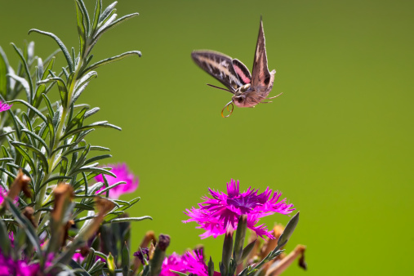
Feeding Guilds Discussion
Introduction
Methods
Results
Discussion
Introduction
- Heavy Metals
- Salt Marshes
-
Methods
-
-
-
Results
-
-
-
Discussion
-
-
-
Introduction
- Heavy Metals
- Salt Marshes
-
Methods
- Collection
- Imaged
- ICP-MS
- Statistical Analysis
Results
-
-
-
Discussion
-
-
-
Future Studies
Introduction
- Heavy Metals
- Salt Marshes
Methods
- Collection
- Imaged
- ICP-MS
- Statistical Analysis
Results
- Sites
- Morphospecies
- Feeding Guilds
- Hue
Discussion
- DIfferences in site and morphospecies
- Hue differences
- Big Picture for moths
Highest heavy metal presence in nectar feeding guild
These nectar feeding insects are more mobile than the phloem feeding insects
Larvae phase may have been at different location than location of captured adults
Different heavy metal amounts depending on food source
Arsenic and Manganese

Slide 17
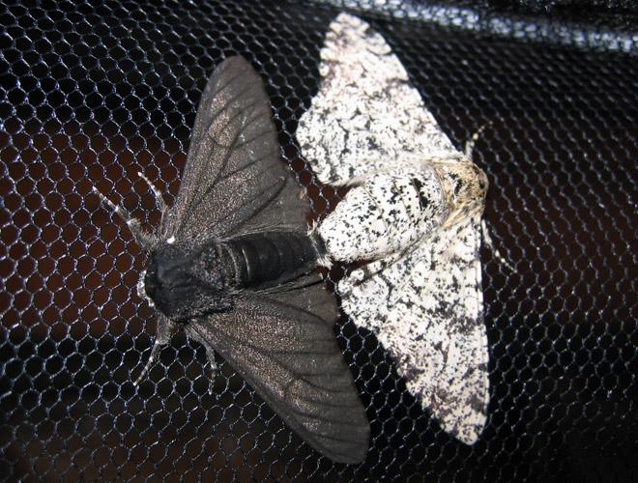
Discussion: Changes in Hue
Introduction
Methods
Results
Discussion
Introduction
- Heavy Metals
- Salt Marshes
-
Methods
-
-
-
Results
-
-
-
Discussion
-
-
-
Introduction
- Heavy Metals
- Salt Marshes
-
Methods
- Collection
- Imaged
- ICP-MS
- Statistical Analysis
Results
-
-
-
Discussion
-
-
-
Future Studies
Introduction
- Heavy Metals
- Salt Marshes
Methods
- Collection
- Imaged
- ICP-MS
- Statistical Analysis
Results
- Sites
- Morphospecies
- Feeding Guilds
- Hue
Discussion
- DIfferences in site and morphospecies
- Hue differences
- Big Picture for moths
Sexual Selection
Human Driven Selection
Natural selection
Pepper Moth Experiment
Positive and Negative Frequency
We may be directly affecting their evolution!

Slide 18
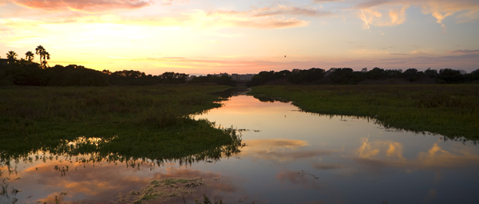
Future Studies
Introduction
- Heavy Metals
- Salt Marshes
-
Methods
- Collection
- Imaged
- ICP-MS
- Statistical Analysis
Results
-
-
-
Discussion
-
-
-
Introduction
- Heavy Metals
- Salt Marshes
Methods
- Collection
- Imaged
- ICP-MS
- Statistical Analysis
Results
- Sites
- Morphospecies
- Feeding Guilds
- Hue
Discussion
- DIfferences in site and morphospecies
- Hue differences
- Big Picture for moths
Test to see why there are differences among sites, morphospecies, and feeding guilds.
Test the water/soil: Ballona Creek and tributaries
Investigate physiological differences among morphospecies, track location of lepidoptera most common feeding sites, the location of their larvae, and food sources/food chain
Investigate how differences in hues affect mating success and predation

Slide 19
Special Thanks
Introduction
Methods
Results
Discussion
Introduction
- Heavy Metals
- Salt Marshes
-
Methods
-
-
-
Results
-
-
-
Discussion
-
-
-
Introduction
- Heavy Metals
- Salt Marshes
-
Methods
- Collection
- Imaged
- ICP-MS
- Statistical Analysis
Results
-
-
-
Discussion
-
-
-
Introduction
- Heavy Metals
- Salt Marshes
Methods
- Collection
- Imaged
- ICP-MS
- Statistical Analysis
Results
- Sites
- Morphospecies
- Feeding Guilds
- Hue
Discussion
- DIfferences in site and morphospecies
- Hue differences
- Big Picture for moths
Dr. Victor Carmona
Dr. Yong-Jun Li
Dr. Martina Ramirez
The insects that sacrificed their lives for science

