Slide 1
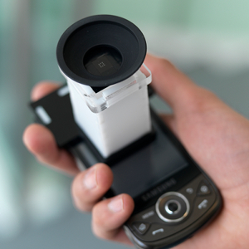

NETRA: Interactive Display for Estimating Refractive Errors
Vitor F. Pamplona^{1,2}, Ankit Mohan¹, Manuel M. Oliveira^{1,2}, Ramesh Raskar¹ Proc. of SIGGRAPH, 2010
¹Camera Culture Group – MIT Media Lab
²Instituto de Informática -UFRGS
http://web.media.mit.edu/~pamplona/NETRA/
Manuel Legrand³
Jacqueline Söegaard³
³Department of Biological Engineering, MIT

Slide 2
The human eye
Vision and refractive errors

Slide 3
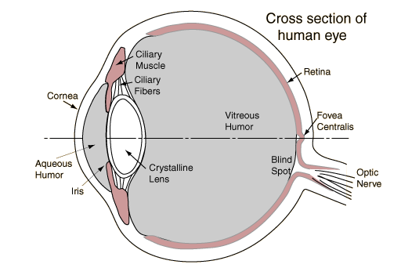
http://hyperphysics.phy-astr.gsu.edu/hbase/vision/eye.html
The human eye refracts incident light.
Cornea fixed
Crystalline lens adjustable
It can dynamically adjust it’s refractive power to focus at a wide range of distances.
Light is focused on the retina.
Notes:
The eye’s thoroughly adjustable refractive index comes from two locations with refractive power:
Air-cornea interface: fixed refractive index, depends on shape of cornea
Crystalline lens: adjustable refractive power. Lens shape can change from more planar (far focus) to more spherical (near focus) in order to focus objects at varying distances

Slide 4
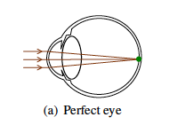
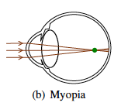
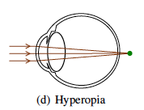
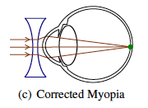
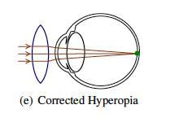
Refractive errors of the eye
The refractive power of lenses (D) is expressed in diopters (defined as the reciprocal of the lens’s focal length expressed in meters).
"NETRA: Interactive Display for Estimating Refractive Errors and Focal Range," Proc. of SIGGRAPH 2010

Slide 5
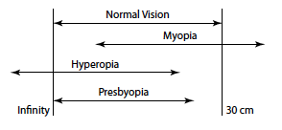
Range of focus
"NETRA: Interactive Display for Estimating Refractive Errors and Focal Range," Proc. of SIGGRAPH 2010
Notes:
Refractive disorders due to imperfections:
Myopia- shifts focal range closer, causing poor far focusing
Hyperopia- shifts focal range farther, causing poor near focusing, lens fatigue
Presbyopia- reduces focal range, moves nearest plane of focus away from eye
Astigmatism- radially non-symmetric focusing ranges

Slide 6
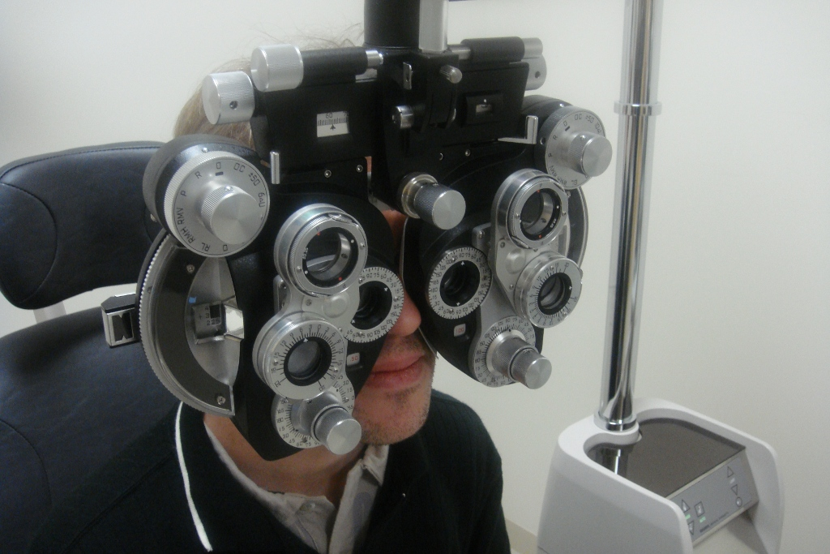
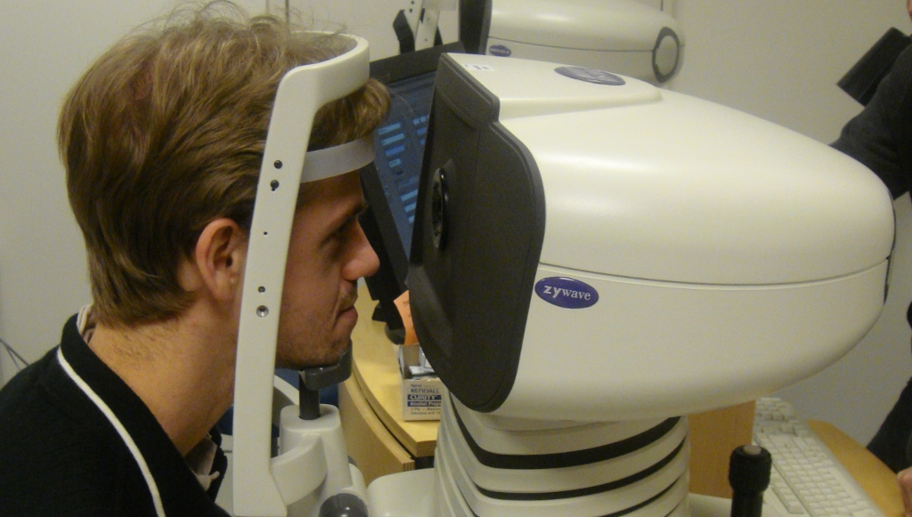
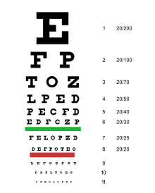
Methods for measuring refractive errors
Subjective (verification)
Objective (estimation)
Mechanically moving parts
Light setup
E.g. Shack-Hartmann technique for wavefront sensing
http://web.media.mit.edu/~pamplona/NETRA/
Notes:
Subjective Methods: reliant on user’s judgment. Usually relevant to sharpness or blurriness of items, such as a Snellen eye chart. Rough and arbitrary.
Objective Methods: Require mechanics to gauge ray vergence or divergence.

Slide 7
Shack-Hartmann wavefront sensor
Laser
Spot Diagram
Planar Wavefront
Sensor
Microlens Array
Slides, Vitor Pamplona, NETRA in SIGGRAPH 2010, http://www.slideshare.net/vfpamp/netra-on-siggraph-2010

Slide 8
Effect of refractive errors
Laser
Spot Diagram
Sensor
Displacement = Local Slope of the Wavefront
Slides, Vitor Pamplona, NETRA in SIGGRAPH 2010, http://www.slideshare.net/vfpamp/netra-on-siggraph-2010

Slide 9
Comparison of optometry methods
 | Retino scope w/ Lenses | Auto-refracto-meter | Chart with Lenses | In-Focus: Focometer | Optiopia | Solo-health: EyeSite
Technology | Shining Light plus lenses | Fundus Camera |  | Moving lenses + target | Moving lenses + target | Reading chart on monitor
Cost to buy | $2,000* | ~$10,000 | ~$100 | ~$495 | ~$200 | --
Cost per test | ~$36 | ~$36 | ~$5 | -- | -- | --
Data capture | No | Comp. | No | No | No | Comp.
Mobility | <500g | >10Kg | 2kg | 1kg | <5kg | >10Kg
Speed | Fast | Fast | Medium | Medium | -- | Fast
Scalability | No | No | No | Yes | Probably | No
Accuracy | 0.15 | 0.15 | 0.5 | 0.75 | -- | --
Self evaluation | No | No | Yes | Yes | Yes | Yes
Electricity Req | No | Yes | No | No | -- | Yes
Astigmatism | Yes | Yes | Yes/No | No | -- | Yes
Network | No | Yes | No | No | No | Yes
Training | High | High | High | Medium | Medium | Low
Slides, Vitor Pamplona, NETRA in SIGGRAPH 2010, http://www.slideshare.net/vfpamp/netra-on-siggraph-2010

Slide 10
The Problem
2B have
refractive errors
0.6B have URE
4.5B have a
cell phone
7 Billion
people
600 million with undiagnosed refractive errors (URE)
However, cell phones with high-resolution displays abound.
Slides, Vitor Pamplona, NETRA in SIGGRAPH 2010, http://www.slideshare.net/vfpamp/netra-on-siggraph-2010

Slide 11
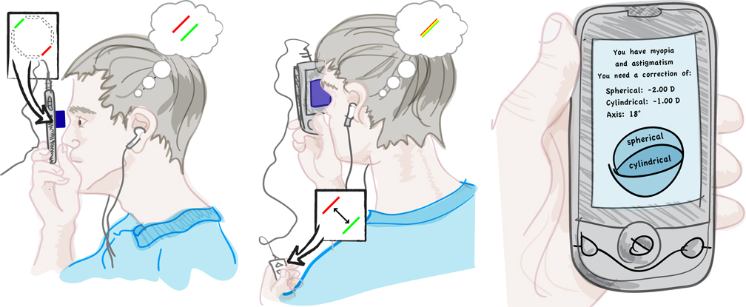
Near-Eye Tool for Refractive Assesment
Components:
High resolution mobile display (cell phone)
Inexpensive lens clip-on ($1-2)
Software app with interactive GUI
http://web.media.mit.edu/~pamplona/NETRA/
Notes:
The ability to understand refractive correction in the human eye requires the use of a multi-million dollar machine
In third-world countries, these machines are not affordable, and the services charged by people who actually can afford them become unaffordable for the patient
The inability for third world youth to obtain eye correction can lead to educational impairment
The authors have proposed a high-resolution programmable display, combined with an inexpensive optical attachment, that provides an interactive, portable solution for estimating refractive errors in the human eye

Slide 12
NETRA uses inverse of Shack-Hartmann
Microlens Array
Spot Diagram on LCD
Cell Phone Display
Eye Piece
Slides, Vitor Pamplona, NETRA in SIGGRAPH 2010, http://www.slideshare.net/vfpamp/netra-on-siggraph-2010
Notes:
Process uses the inverse Shack-Hartmann wavefront sensing approach:
-Places a microlens array or a pinhole array over an LCD display
-User looks into the display at a very close range

Slide 13
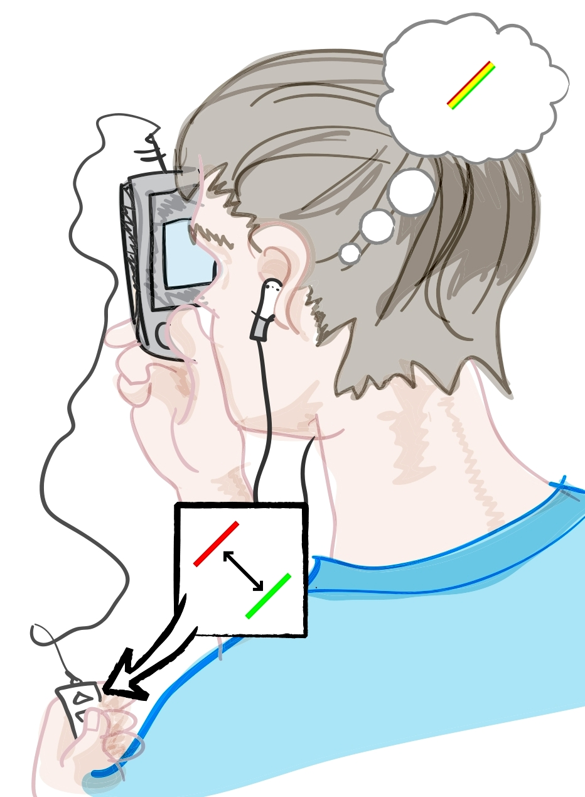
NETRA users with refractive errors
Microlens Array
Spot Diagram on LCD
Slides, Vitor Pamplona, NETRA in SIGGRAPH 2010, http://www.slideshare.net/vfpamp/netra-on-siggraph-2010
Notes:
User aligns displayed patterns, pre-warps ray-space. The pre-warp indicates the aberrations and the corrections.

Slide 14
To show you how this works…

Slide 15
Myopia example
Eye
Pinholes
Red point at infinity
Note how the rays converge before the retina. This causes bad far sight.
Slides, Vitor Pamplona, NETRA in SIGGRAPH 2010, http://www.slideshare.net/vfpamp/netra-on-siggraph-2010
Notes:
The idea of using parallel rays is to simulate points at infinity, leaving only an eye with vision that does not require correction to be able to focus this point without correction.

Slide 16
Now add the display…
Eye
Display
A
Distinct
image
points
Virtual red point at infinity
B
Slides, Vitor Pamplona, NETRA in SIGGRAPH 2010, http://www.slideshare.net/vfpamp/netra-on-siggraph-2010
Notes:
The idea of using parallel rays is to simulate points at infinity, leaving only an eye with vision that does not require correction to be able to focus this point without correction.

Slide 17
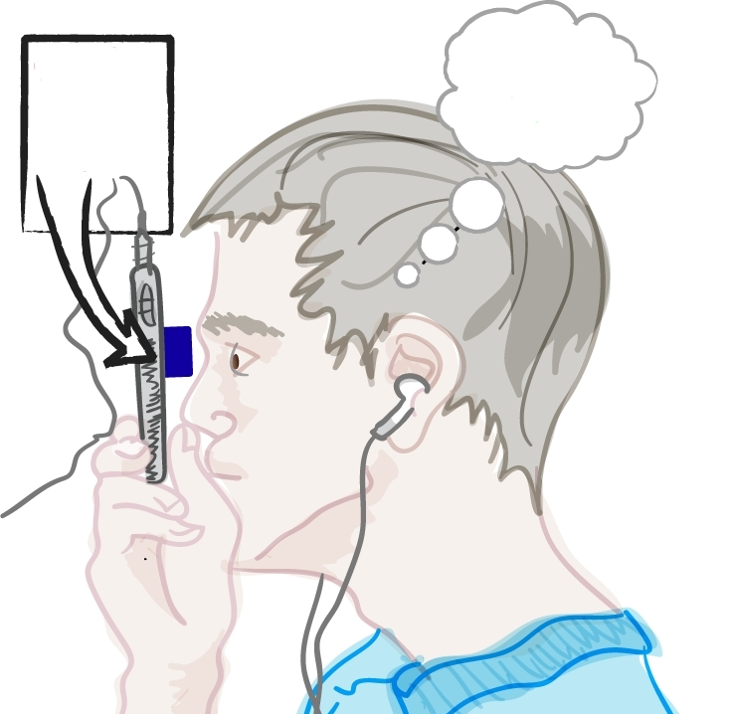
User moves points until…
Eye
Move spots towards each other (for myopic user)
Display
A
Distinct
image
points
Virtual red point at finite distance
B
Slides, Vitor Pamplona, NETRA in SIGGRAPH 2010, http://www.slideshare.net/vfpamp/netra-on-siggraph-2010
Notes:
Changing the position of one of the points will change the vergence of the rays produced by the pinholes. Moving them together causes the points to diverge, accounting for myopia. The amount of shift allows to compute the refractive error.

Slide 18
…alignment is achieved!
Eye
Display
Move spots towards each other
A
Points
Overlap!
Virtual red point at finite distance
B
Slides, Vitor Pamplona, NETRA in SIGGRAPH 2010, http://www.slideshare.net/vfpamp/netra-on-siggraph-2010

Slide 19
NETRA uses microlenses to inrease light
Microlens array
Patterns on an LCD
a
f
t
Slides, Vitor Pamplona, NETRA in SIGGRAPH 2010, http://www.slideshare.net/vfpamp/netra-on-siggraph-2010
Notes:
Microlens array set at a distance f from the display
Bundle of parallel rays (introduces a focus ambiguity): the eye can focus either at the virtual point at distance d, or at infinity to focus the parallel bundle of rays at the retina.

Slide 20
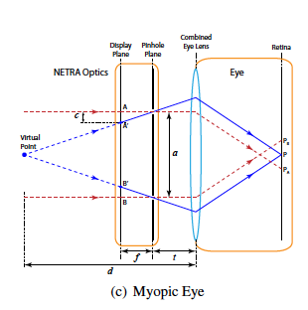
Converting shift to refractive correction
The amount of shift c on the display necessary to create a virtual source at distance d from the eye is:
The power of the diverging lens needed to fix myopia, in diopters, is:
c = f ( a/2 ) / (d – t)
D = (1/d)
= 1000 / ( f (a/2)/c + t )
"NETRA: Interactive Display for Estimating Refractive Errors and Focal Range," Proc. of SIGGRAPH 2010
Notes:
C = shift = pixel pitch
d = distance from virtual source
a = spacing between pinholes/lenses
t = distance from pinhole/microlense array to the eye = focal length of lenselets in microarray based setup

Slide 21
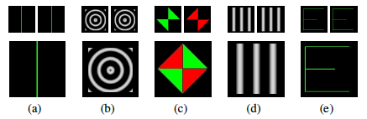
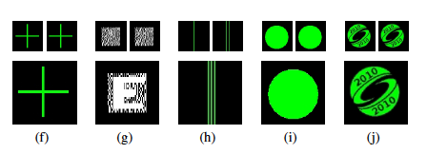
Choosing the best patterns
"NETRA: Interactive Display for Estimating Refractive Errors and Focal Range," Proc. of SIGGRAPH 2010
Pair of line segments (a) produced the best results in terms of repeatability of alignment results.
Notes:
CONVERT TASK OF BLUR ASSESMENT TO THE EASIER TASK OF PATTERN ALIGNMENT
Ask subjects to align patterns while observing them through probes
Each pair was aligned 3 times by each subjects, and only 1D (horizontal) translation was alowed.
Recorded the time to align patters as well as error (in diopters) all pa between repetitions.
- µ alignment time was approximatedly the same for patterns (~10 seconds).

Slide 22
Prototypes and Evaluation
24’’ LCD Screen (1920x2000 pixels)
Approximately 0.16 diopters per displaced pixel
Vuzix iWear VR 920 head-mounted display
0.35 diopters per displaced pixel when a = 3.5mm
Cell Phone Setups
Samsung Behold II:
180 DPI, 540 DPI with three color channels in 1D
0.71 diopter per displaced pixel
Google Nexus One:
250 DPI, 750 DPI with three color channels in 1D
0.4 diopter per displaced pixel
Study focuses on cell phone prototypes
Notes:
LCD Screen - close to the limit of size of cone cells in the human eye

Slide 23
User Evaluation
13 volunteers (ages 21 to 57)
Refraction correction:
Average absolute error: < 0.5 diopter (σ = 0.2)
Eye Accommodation Range
Viewers asked to focus a sinusoidal pattern at various distances
Closest achievable focal distance measured
Focusing time also measured
Notes:
Most optometrists prescribe in multiples of 0.25 diopter, so the difference would fall within ranges of optometry.
Sinusoidal patterns are most appropriate for inducing accommodation changes within the system
Average absolute error of cylindrical axis: < 6 degrees

Slide 24
NETRA’s capabilities
NETRA can measure the refractive error for myopia, hyperopia, and astigmatism.
For hyperopia, the user will move the points on the display further apart. Thus moves the virtual point away from the eye until the lens is completely relaxed but the image is still focused.
Astigmatism involves an irregularly shaped cornea or lens that leads to both spherical and cylindrical aberrations.
To deal with that added challenge, the researchers used moving line segments oriented perpendicular to the line joining two special lenslets.
NETRA can also be used to measure the accommodation range, as well as focusing range and speed.
Notes:
The spacing at which the lines were perceived by the user as overlapping gives the power along the corresponding meridian.

Slide 25
NETRA’s Limitations
Subjective Feedback
Accuracy
Crosstalk between microlenses
Chromatic aberrations in the eye and microlens
Pupil size
Diopter resolution
Notes:
1. Subjective feedback in individuals that must reliably perform required tasks in order to obtain data
-Not a big factor because subjectivity is also present in most eye exams
2. Accuracy is limited by the focal length of the microlens array and by dot pitch of the underlying display
3. In crosstalk, a pattern may unexpectedly cross over to an adjacent microlens to produce additional images. This problem is addressed by skipping every other lenslet.
4. Aberrations may produce different virtual points at different depths
-The use of color patterns is encouraged to increase effective display resolution
5. Pupil size limits maximum spacing between lenslets
6. Diopter resolution is limited by size of cone cells in the eye and the eye’s focal length

Slide 26
How does NETRA compare?
 | Retino scope w/ Lenses | Auto-refracto-meter | Chart with Lenses | In-Focus: Focometer | Optiopia | Solo-health: EyeSite
Technology | Shining Light plus lenses | Fundus Camera |  | Moving lenses + target | Moving lenses + target | Reading chart on monitor
Cost to buy | $2,000* | ~$10,000 | ~$100 | ~$495 | ~$200 | --
Cost per test | ~$36 | ~$36 | ~$5 | -- | -- | --
Data capture | No | Comp. | No | No | No | Comp.
Mobility | <500g | >10Kg | 2kg | 1kg | <5kg | >10Kg
Speed | Fast | Fast | Medium | Medium | -- | Fast
Scalability | No | No | No | Yes | Probably | No
Accuracy | 0.15 | 0.15 | 0.5 | 0.75 | -- | --
Self evaluation | No | No | Yes | Yes | Yes | Yes
Electricity Req | No | Yes | No | No | -- | Yes
Astigmatism | Yes | Yes | Yes/No | No | -- | Yes
Network | No | Yes | No | No | No | Yes
Training | High | High | High | Medium | Medium | Low
NETRA
Cellphone + eyepiece
$300
~$1
Phone
<100g
Fast
Yes
<0.5
Yes
No
Yes
Yes
Low
Slides, Vitor Pamplona, NETRA in SIGGRAPH 2010, http://www.slideshare.net/vfpamp/netra-on-siggraph-2010

Slide 27
Closing the gap with NETRA
Interactive technique for measuring refractive error
Uses a high-resolution display and near-eye optic in combination with a GUI
Employs an inverse of the Shack-Hartmann technique
Inexpensive and requires little training
Accesibility would allow for self-assesment, longitudinal monitoring, and deployment in the developing world.
Looking forward …
CATRA - Cataract Mapping
Clinical research and validation
Corrective displays
Distribution in developing countries
Notes:
At under $2, we have the cheapest accurate eye test ever. Given the 4.5 billion portable phones out there, we think it is an ideal solution in developing countries.
Cataracts are the leading cause of blindness
• Computer graphics techniques can greatly benefit from a multi-focus display.
o Creation of displays with built-in optical correction
• Diagnosing other diseases such as cataract, retinal stray light, and amblyopia.
• 0.71 diopter accuracy on a mobile phone display
• Thermometer for visual performance

Slide 28
Sources
VF Pamplona, A Mohan, MM Oliveira, R Raskar. "NETRA: Interactive Display for Estimating Refractive Errors and Focal Range," Proc. of SIGGRAPH 2010 (ACM Transactions on Graphics 29, 4), 2010.
Slides, Vitor Pamplona, NETRA in SIGGRAPH 2010, http://www.slideshare.net/vfpamp/netra-on-siggraph-2010
Camera Culture Group –NETRA Website. http://web.media.mit.edu/~pamplona/NETRA/

