Slide 1
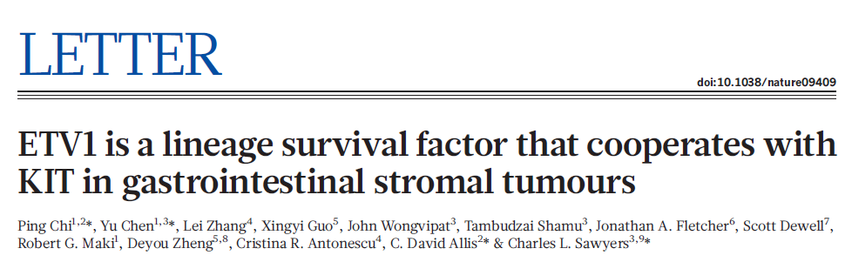

Mahnaz Janghorban
CANB610
3/8/2012

Slide 2
ETV1 and GIST Pathogenesis
Gastrointestinal stromal tumors (GISTs) arise from the interstitial cells of Cajal (ICC) in the gastrointestinal tract
Most GISTs have oncogenic mutations in either KIT or platelet-derived growth factor receptor-α (PDGFRA); ~80-85%
ETV1 is highly expressed in the specific types of ICC that give rise to GIST (developmental programming)
ETV1 cooperates with mutant KIT in forming GIST
Reducing ETV1 decreases GIST proliferation and tumorigenecity

Slide 3
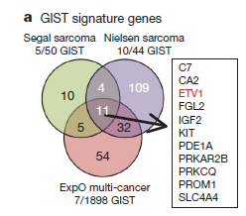
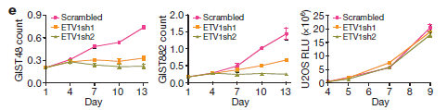
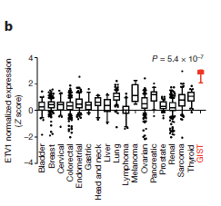
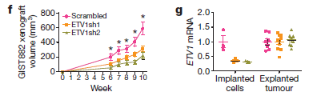
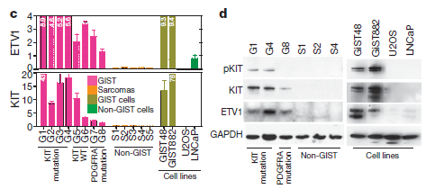
Fig1: ETV1 is universally highly expressed and required for tumor growth and survival in GIST
GIST-signature genes from three data sets
containing both GIST and non-GIST malignancies
Imatinib resistant
Imatinib sensitive
Osteosarcoma cell line

Slide 4
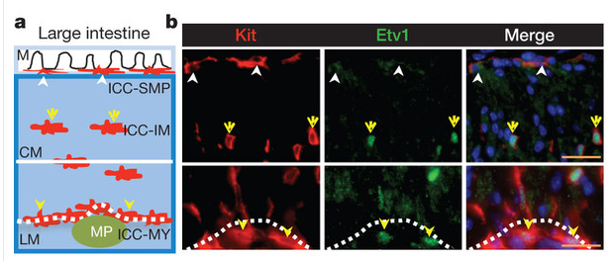
Fig 2: Etv1 is expressed in the subtypes of ICCs susceptible to oncogenesis and is required for their development
High ETV1 and no obvious genomic alteration
mucosa
Submucosal-ICC
intramuscular -ICC
circular muscle
Myenteric-ICC
longitudinal muscle
neuronal myenteric plexus

Slide 5
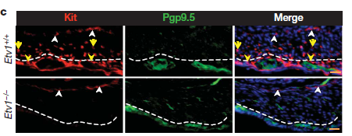
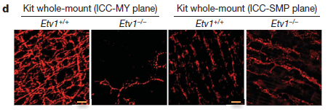
ETV1 is required for ICCs (MY and IM) development
neuronal marker
deconvoluted
whole-mount

Slide 6
Conclusions so far
ETV1 is expressed in the subtypes of ICC that give rise to GIST

Slide 7
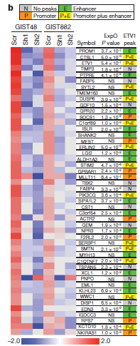
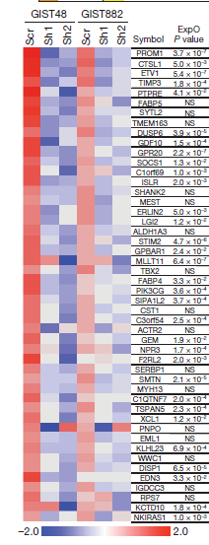
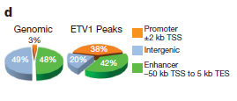
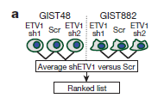
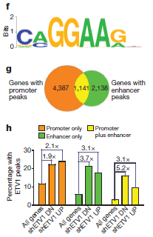
Fig3: ETV1 regulates GIST-signature genes predominantly through enhancer binding
Notes:
Enhancer binding (enhancer+promoter binding) is predicative of transcriptional activation.
Because enhancers are cell lineage specific, the data suggests that these ICC-GIST –specific genes are regulated by ETV1 binding to enhancer

Slide 8
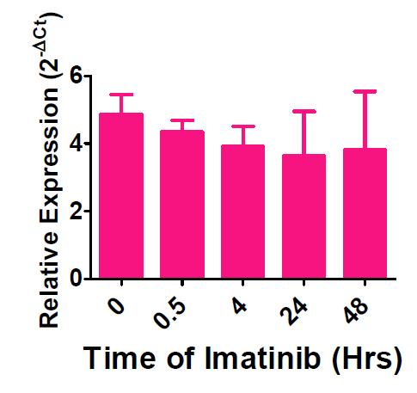
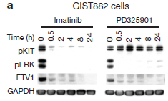
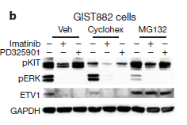
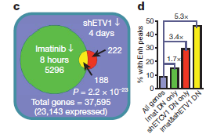
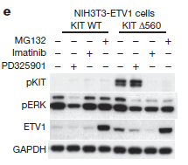
Fig 4: KIT signaling synergizes with ETV1 in GIST tumorigenesis by stabilization of ETV1 protein
mRNA level of ETV1 by qRT- PCR in GIST882

Slide 9
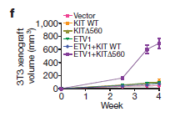
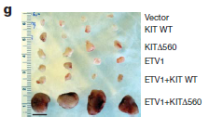
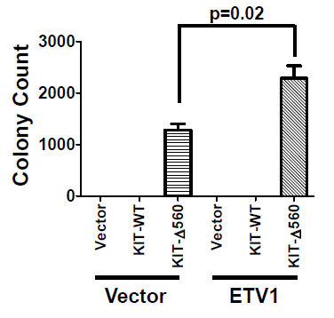
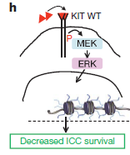
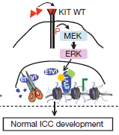
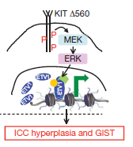
Fig 4. KIT signaling synergizes with ETV1 in GIST tumorigenesis in vitro and in vivo

Slide 10
Conclusions
KIT Signaling Stabilizes ETV1 Protein Expression
Mutant KIT Signaling Synergizes with ETV1 Overexpression

Slide 11
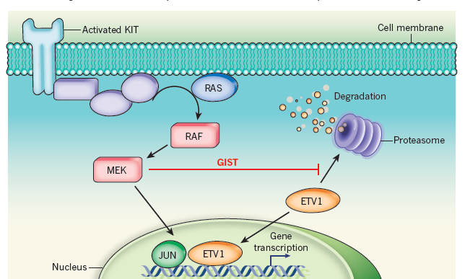
Summery
ETV1 is highly expressed in GIST
ETV1 is required for ICCs (MY and IM) development
ETV1 is a master regulator of an ICC-GIST-specific transcription network mainly through enhancer binding
ETV1 is regulated by activated KIT; by prolonged ETV1 protein stability
Activated KIT cooperates with ETV1 to promote tumorigenesis
Michael C . Heinrich & Christopher L . Corless, 2010

Slide 12
Future direction
ETV1: A New Therapeutic Target in GIST
ETV1 as diagnostic marker for GIST
Inhibition of ETV1 expression decreases the growth of imatinib-sensitive and resistant GIST cells
Long-term: Therapies that directly target ETV1 activity or downstream targets may improve GIST treatment
Short-term: Therapies that target MAPK pathway will decrease ETV1 protein expression and may have promise in drug-resistant GIST

Slide 13
Thank You!

