Slide 1
Cloning the Progesterone 5 beta- reductase gene (P5βR) from Selaginella moellindorffii (Spike Moss)
Project 17
Amanda Brase, Charlie Chase, &
Sheree Harper

Slide 2
Developing our project
Our original project idea was to isolate the toxin gene from butterflys that tastes bad to birds and can induce vomiting.
We soon found that the Butterfly we chose (the Monarch) does not actually produce the toxin itself but rather sequesters it from its food source, the Milkweed, as a larvae and pupa.
The milkweed itself did not have a gene on file that we could isolate so we did some research on what exactly this toxin was and did.
We found that we were looking for cardenolide steriods, which have a group within them called cardiac glycosides, which have toxic and heart arresting properties. As well as foul taste and an emissary (vomit) response from most birds.
We then sought to find this steroid produciton pathway elsewhere in other organisms. We soon learned that Animals, protists and Plants have ways of producing this steroid but protists and animals have a differently shaped pathway than plants do. Our job now was to find a plant that had this pathway.
We found a plant called Spike Moss or Selaginella moellendorffii, that had this pathway and also had the gene on file.

Slide 3
P5βR
Gene is responsible for a small part of the chemical biosynthesis pathway for production of cardenolide/cardiac glycoside→ toxin produced in some plants, as well as, insects and used as protection from predators.
Accession # NW_003314261;
region 1813976-1815160 → 1185 bp
Contains no Introns

Slide 4
Internal Restriction Sites
NEB Cutter
- 1 restriction enzyme→ Xba1 located between bases #27 & #28
- Site directed mutagenesis at base #30 in amino acid following RE site was accounted for in primer design.; T→C in position 3 of that amino acid keeps it Serine.

Slide 5
Primer Design
Site directed mutagenesis
-Change of base
#30: T→C
-Amino Acid
Position #3;
remains Serine
Regular:
17_ P5βR a-F:
atgtgctcactgcttcctctctgctgctccagaacagag
17_ P5βR b-R:
tcagctggtccaaaatttgtcgtc
With biobrick extentions:
17_ P5βR c-F:
gaattcgcggccgcttctagatgtgctcactgcttcctctctgctgctccagaacagag
Not ordering → Exceeds 50 bp in length
17_ P5βR b-R:
tactagtagcggccgctgcagtcagctggtccaaaatttgtcgtc
Xba1
RE Site
39 bp
24 bp
59 bp
46 bp

Slide 6
5’ 3’
atgtgctcac tgcttcctct ctgctgctcc agaacagag
1 atgtgctcac tgcttcctct ctgctgctct agaacagagc ccccggaggc cgccagcaaa
61 cacgatggtc acaacgaagc tctcattgtt ggagtgaccg gcatagttgg caatagcctg
121 gtcgaagctt tgcagcgtcc cgacgcaccc ggagccccgt ggagaatccg cggcatcgct
181 cgccggccca ggccccgctg gttcgagcac ccggacgtcg actatatcca gtgtaacctg
241 ctgaatctgt ccgaagtcac acccaagctc tccagcctcg acggagtgac tcatgtattc
301 tgggttgcct gggaaaagaa gagcaccgag gaggagaact gcgaagccaa tggtttcatg
361 ctgcgatctg tcctccaaac gctgctacca gttgccaaga aactcaagca cgtctgcctc
421 caaaccggtg tcaagcacta cctgggaccg tattttcact tcggcaccat caagcactat
481 cggcctccat tccgcgagga cctgccccaa gtccccggcc ttccaaactt ctactacact
541 ctggaggata tcttgttcga ggcatgctcg ccgtcgtcgg gcataacgtg gtccgtccac
601 cggcctaaca taatcttcgg ctttgctcct cggaaccacg ccaacgttct tggcagcttg
661 gccatatatg ctgctatttg caaacaccag aagctcagct ttaattttcc aggaaaccgg
721 cagtcgtggg agacgcttac gaacgtttcg gatgccgacc ttgttgcgga gcaggagctg
781 tgggctgcga cgaatccaag agccaagaat gaggcgttta acgttgccga cggagactgc
841 acgagctggg agaggctctg ggctgtcatg gctcgggagt tcaagcttga gtgtccggtg
901 tacgatggaa agccagtcag tctcgatcag cttctgaaga ataagaaaaa cgtgtgggag
961 cagatcgttg tcgagaacgg ccttctcgag acggcagtac aggacgagac gtggtgggct
1021 gtcgatttgt gcctcaactt cccgttccag gtagtcagct gcatgaacaa gagcaaagaa
1081 cacggcttcc tcagttacag gaacagtgaa aagtccgtaa tctactggat acgaaagatg
1141 aaagagaaga atatcttacc agacgacaaa ttttggacca gctga
ctgctgttt aaaacctggtcgact
3’ 5’
5’
3’

Slide 7
Affinity for Folding of Primers
Reverse primers with and without biobrick extentions look promising
Problem: Forward primers have high negative
G Values
Possible solution: Increase the annealing temperature during PCR amplification

Slide 8
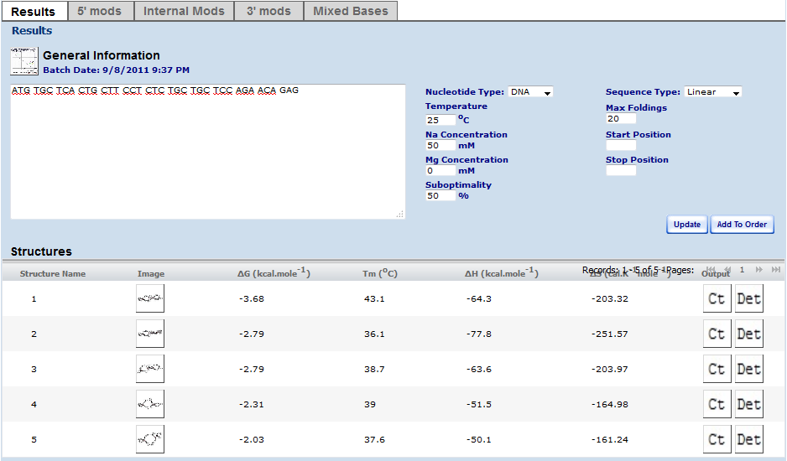
Forward primer without Bio-brick extentions

Slide 9
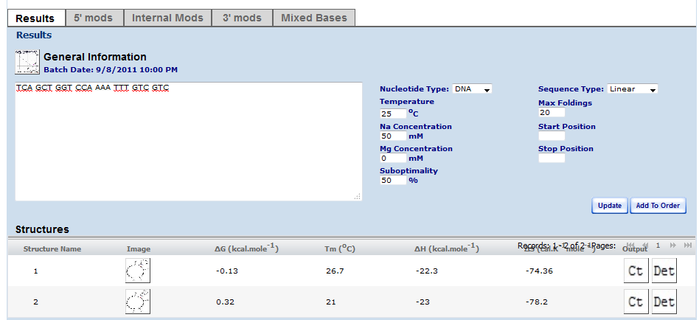
Reverse primer without bio-brick extensions

Slide 10
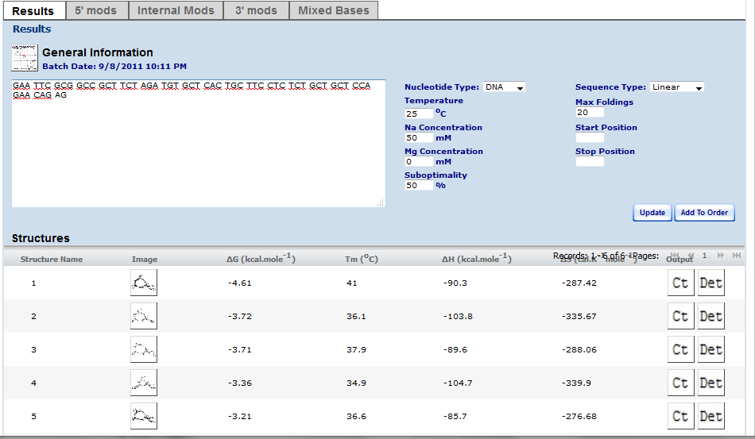
Forward Primer with bio-brick extension (Not using since it exceeds 50 BPs)

Slide 11
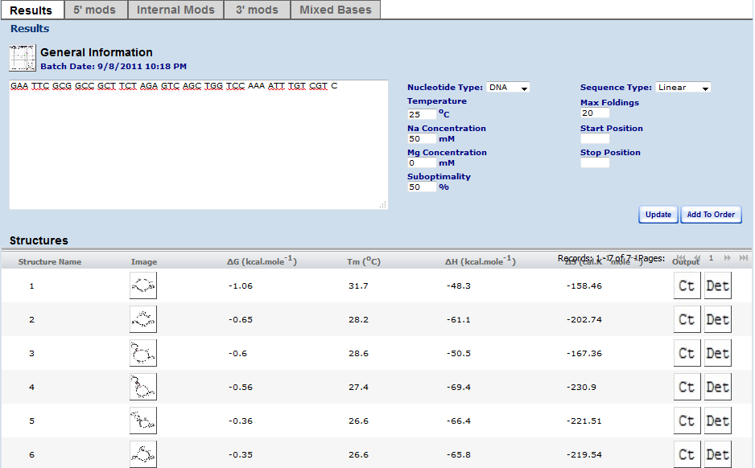
Reverse Primer with Bio-brick extensions

Slide 12
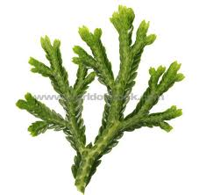
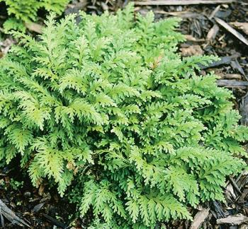
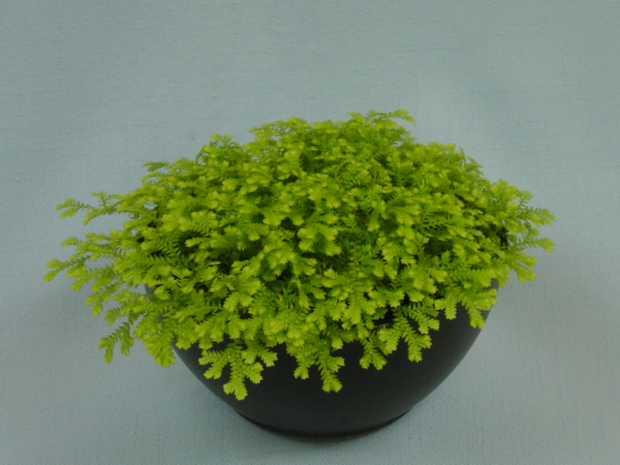

Selaginella moellendorffii (Spike Moss)
Selaginella plants are ascendant plants, meaning they tent to creep along the ground. They have branching stems where which have scale-like leaves. The roots also arise from these branching stems. They are very simmilar to ferns and have had their genome sequenced by US department of Energy‘s Joint Genome Institute.

Slide 13

Obtaining source DNA
Selaginella moellindorffii
Online Purchasing from Plant Delights Nursery, Inc
Perennial Gemmiferous Spikemoss
http://www.plantdelights.com/Selaginella-moellendorffii-Perennial-Gemmiferous-Spikemoss/productinfo/3228/
Item # 3228
Cost = $13.00
Estimated S & H = $18.75

Slide 14
DNA Isolation Protocol
A Rapid Method to Isolate Plant Genomic DNA
* Use from 0.01 - 0.1 g plant material.
* Grind the plant material with liquid N2 in a mortar. We normally use some alumina to crush hard tissue.
* Transfer the ground tissue to an eppendorf tube.
* Add 1 mL extraction buffer (100 mM Tris-HCl pH 8.0, 50 mM EDTA pH 8.0, 500 mM NaCl + 0.07% 2-mercaptoethanol). Mix well.
* Add 130 µL 10% SDS, invert/shake the tube a few times. Incubate at 65°C for 15 min.
* Add 300 µL 5M potassium acetate. Mix well. Keep the solution on ice for 30 min (allows for precipitation of proteins).
* Spin down the precipitations at 7000 rpm, 5 min. Transfer 300 µL of the supernatant to a new eppendorf tube.
* Add 900 µL NaI (GeneClean II), + 20 µL "glass milk" (silica particles) to the supernatant, (total volume of 1220 µL). Mix well and incubate at RT for 5 min.
* Spin down the silica particles for 5 s, remove supernatant (the DNA in the solution will now hopefully be bound to the silica particles).
* Wash the silica pellet with 800 µL wash solution (from the GeneClean II kit).
* Repeat the wash two times.
* Dry the pellet (with bound DNA).
* Resuspend the pellet in 50 µL distilled water. Incubate at 50-65°C for 5 min.
* Spin down pellet and transfer the eluted DNA to a new eppendorf tube.
At this point you should have enough DNA to run 10-20 PCR reactions.
Optional: You can check 10 µL of the eluate on an agarose gel. If you use 0.1 gram plant material you should be able to see the DNA on the gel.
http://boneslab.bio.ntnu.no/old_root/quickprepdna.htm

Slide 15
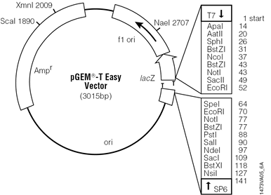

pGEM-T Easy Vector
Insert gene into T Vector
Amplify out with primer that includes BioBrick Prefix (EcoRI and XbaI restriction sites)
Cut at PstI restriction
site

Slide 16
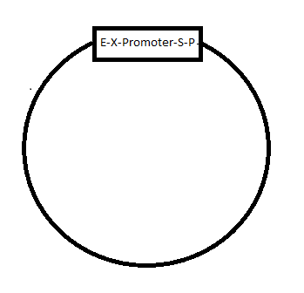

BioBrick Vector
Insert into BioBrick Vector with promoter
Cut vector at SpeI and PstI
Cut gene strand at XbaI

Slide 17
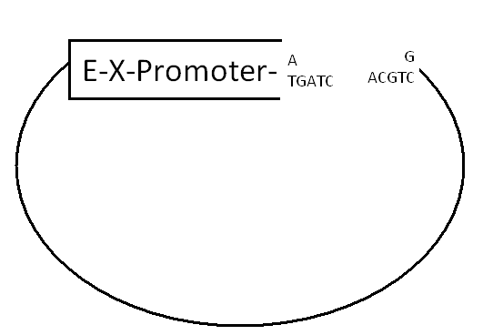
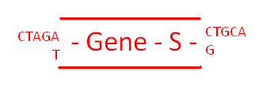
BioBrick Vector
Ligate together

Slide 18
Promoters
LacI Promoter
BBa_K091110
LacIQ Promoter
BBa_K091111
pLacI/ara-1
BBa_ K094120
Inducible: IPTG or arabinose

Slide 19
Bacterial transformation
We plan to make E.coli cells competent and then transform our plasmid vector into the E.coli cells.
Grow bacteria on selective plating (choose selection plates based on which promoter is being used)

Slide 20
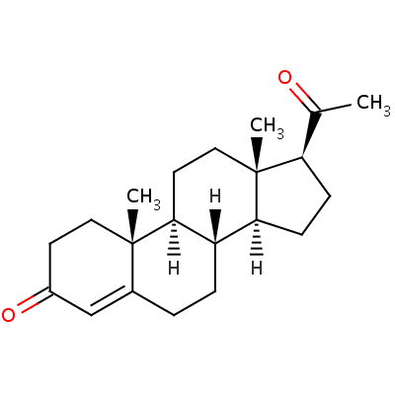
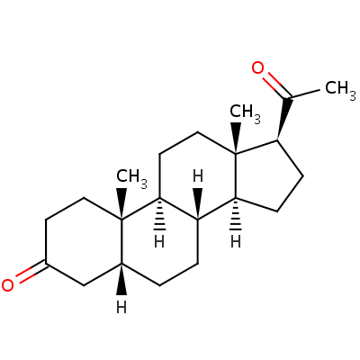
Partial Biosynthesis Pathway in Conversion of Cardenolides (Cardiac Glycosides)
progesterone
5 β-reductase
(P5βR)
progesterone
5β-pregnane-3,20-dione

Slide 21
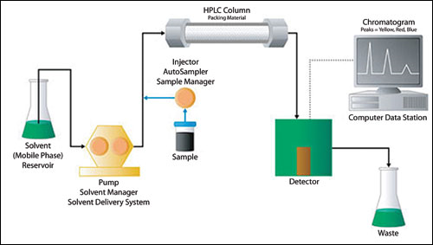
Assay for production of 5β-pregnane-3,20-dione
High Performance Liquid Chromatography (HPLC)
- Polar silica column with non-polar solvent, non polar compounds will pass through column and be separated out and compared to known travel distances of the desired chemical

Slide 22
Reference Articles
1. “Evolution of steroid-5-alpha-reductases in comparison of their function with 5ß-reductase” DOI: 10.1016/j.ygcen.2009.08.004
2. “Localization of Heart Poisons in the Monarch Butterfly”
Author(s): Lincoln P. Brower and Susan C. Glazier
Source: Science, New Series, Vol. 188, No. 4183 (Apr. 4, 1975), pp. 19-25
Published by: American Association for the Advancement of Science
Stable URL: http://www.jstor.org/stable/1740001 .

