Slide 1
Cloning of Atrolysin A from Crotulas atrox
AJ Goos and Kayla Ohrt

Slide 2
Atrolysin A
This venom comes from Crotalus atrox which is the Western Diamondback Rattlesnake.
We have found a tissue sample coming from the Kentucky Reptile Zoo.
Atrolysin A works by not allowing platelet adhesion, and works only in a neutral pH.
This is called a hemorrhagic toxin.
In acidic conditions the venom denatures.

Slide 3
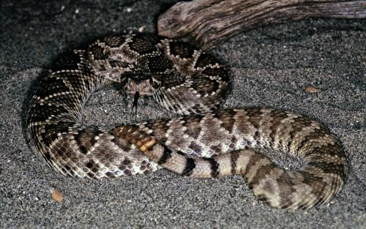
Western Diamondback
The Western Diamondback is an ambush hunter.
Its venom falls in the PIII-SVMP class which accounts for 27.3% of total venom protiens.
This venom is a protein.

Slide 4
The Atrolysin A has been sequenced in mRNA form. The Genbank accession number is U01234.
The mRNA is 1640 base pairs and the coding region is 1263 base pairs. The coding region starts at base pair 1 and codes to 1263.
We must clone the gene with PCR and make sure it does not grow more than the 1260 base pairs.

Slide 5
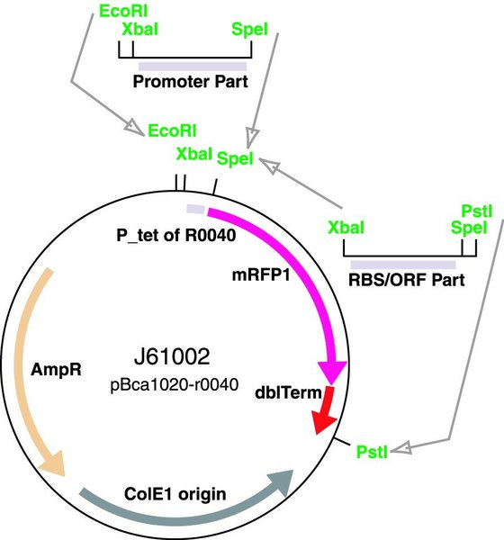
Vector
We decided to use E. coli as the bacteria of choice for the vector.

Slide 6
Promoters
J23100 (Unregulated)
J23109 (Unregulated)
Bba_10500 (Inducible by agarose)
We chose these promoters due to the high yield of protein and the high range of variability.

Slide 7
Primers Sequence
- 5‘gaattcgcggccgcttctagag atg gaaagactca ccaaaagata tgttgacctt gtcatagtt 3'
5' gaaagactca ccaaaagata tgttgagctt gtcatagttg cggatcaccg aatgttcacg aaatacaacg gcaatttaaa aaagataaga aaatggatat atcaaattgt caacactata aatgagattt acataccttt gaatattcgt gtcgcactgg ttcgcctaga aatttggtcc aacggagatt tgattgatgt gacatcagca gcaaatgtta ctttgaagtc atttggaaac tggagagtga caaatttgct gaggcgcaaa agtcatgata atgctcagtt actcacggcc attgatcttg atgaagaaac tttaggattg gctcctttgg gcaccatgtg tgacccgaag ctttctatag gaattgttca ggatcatagt ccaataaatc ttttggttgc agttacaatg gcccatgagc tgggtcataa tctgggcatg gttcatgatg aaaatcggtg tcattgcagt actcccgcat gcgttatgtg tgctgtgcta aggcaacgac cttcctatga gttcagcgat tgtagtctga atcactatcg aacgtttatt atcaattata acccacaatg cattctcaat gaacccttgc aaacagatat aatttcacct ccagtttgtg gaaatgaact tttggaggtg ggagaagaat gcgactgtgg ctctcctaga acttgtcgag atccatgctg tgatgctgca acctgtaaac tacactcatg ggtagagtgt gaatctggag agtgttgtca gcaatgcaaa tttacgagtg caggaaatgt atgccggcca gcaaggagtg agtgtgacat tgctgaaagc tgcactggcc aatctgctga ctgtcccaca gatgacttcc ataggaatgg aaaaccatgc ctacacaact tcggttactg ctacaatggg aattgcccca tcatgtatca ccaatgttat gctctctggg ggtcaaatgt aactgtggct ccagatgcat gttttgatat taaccagagc ggcaataatt ctttctactg cagaaaggaa aatggtgtaa atattccatg
Forward Mutagen 5'ggcaataattctttctactgcagaaaggaaaatggtgtaa 3'
Reverse Mutagen 5'ttacaacattttcctttctgcagtagaaagaattattgcc 3'
tgcacaagag gatgtaaagt gtggcaggtt attctgcaat gttaatgatt ttctatgccg acacaaatat tcagatgatg gaatggttga tcatggaaca aaatgcgcag atggaaaggt ctgcaaaaac aggcagtgtg ttgatgtgac tacagcctac aaatcaacct ctggcttctc
3'atgtcggatg tttagttggag acggaagag
tcagatttga 3'
Agtctaaact gacgtcgccggcgatgatcat 5'-suffix

Slide 8
PCR Primer Sequence
Forward: 5’ ATG GAA AGA CTC ACC AAA AGA TAT GTT GAC CTT GTC ATA GTT G 3’
Reverse Primers: 5’ TCA AAT CTG AGA GAA GCC AGA GGT TGA TTT GTA GGC TGT A 3’
Mutagen Forward Site 5’- GGC AAT AAT TCT TTC TAC TGC AGA AAG GAA AAT GTT GTA A - 3’
Mutagen Reverse Site 5'- TTA CAA CAT TTT CCT TTC TGC AGT AGA AAG AAT TAT TGC C -3'

Slide 9
Finding introns
If in the cloning process the gene grows longer than its initial 1260 base pairs it has introns.
We then have to sequence the gene from mRNA and see where these are coming into play and see how many there are.

Slide 10
Procedure
1. Extract DNA
Using the sample of snake skin we plan on using a technique that yields high amounts of DNA
Procedure http://www.springerlink.com/content/kw1716u555371764/fulltext.pdf

Slide 11
Procedure
2. To see if there is DNA present, we will need to run some of the sample on agarose gel electrophoresis
AGE procedure:
http://openwetware.org/wiki/Agarose_gel_electrophoresis

Slide 12
Procedure
3. Once we know that the DNA is present we need to amplify it with PCR. Since we are working with a eukaryote organism, will need to see if there are introns in the sequence.
PCR Procedure: http://openwetware.org/wiki/PCR

Slide 13
Procedure
4. If introns are present we must remove them with site directed mutagensis. We also have a restriction site (PstI) in the gene sequence so it also has to be removed.
Procedure of Site Directed Mutagenesis
http://en.wikipedia.org/wiki/Site-directed_mutagenesis

Slide 14
Procedure
5. Once we have the final piece of the gene, we will amplify it along with the biobrick parts through PCR.
6. Then the gene can be added into the E. coli vector and grown.

Slide 15
Testing
For testing we plan on finding the length of the control E. coli cell on SDS PAGE gel and compare it to the length of the experiment E. coli cell.

Slide 16
References
http://scholar.google.com/scholar?hl=en&q=getting+DNA+from+snake+skin&btnG=&as_sdt=1%2C16&as_sdtp
http://en.wikipedia.org/wiki/Site-directed_mutagenesis
http://www.springerlink.com/content/kw1716u555371764/fulltext.pdf
http://partsregistry.org/wiki/index.php?title=Part:BBa_J23100

