Slide 1
Cloning and expression of neutral protease gene from B. Stearothermophilus
Yang, Maliha , Srikanth
Group-20

Slide 2
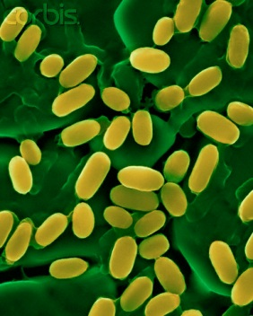
Table of Contents
Introduction of initial project
Generally overview
Flow of Experiment
Results and Conclusions

Slide 3
Introduction of initial project
GOI: nprT
nprT neutral thermostable protease
Size of gene: 1881 bp
Designing the cloning model for the production of thermostable neutral protease
Bio brick Part chosen: BBa_K09112

Slide 4
Overview of Project
Transformation in E.coli cells
Sequencing
PCR with Biobrick compatible primers
Transformation into E.coli cells
Detection of Enzyme
PCR
Primers F-
Primer R-
Extraction of Bacterial genome
T-Vector ligation
Electrophoresis
Promoter selection and transformation
Isolation of Plasmid
Restriction digestion
Glycerol stock
nprT Bio brick Construction

Slide 5
Promoters construction
Trial 1
Trial 2
BBa_K091112: pLacIQ1 promoter
Dissolved parts and half of the amount used for transformation
Plates used:
  Two transformation
  One +ve control
  One–ve control
Results:
Transformation failed
  Amp ineffective
BBa_K091112 : pLacIQ1 promoter
Remaining amount were used for transformation with new stock antibiotics and plates.
Plate used:
  Two transformations
  One +ve control
  One –ve control
Results:
Transformation failed
  Low promoter concentration
  Long term exposure

Slide 6
Promoters construction
Trial 3
We have used 3 bio brick parts
BBa_K091112(2009 Amp^{r}): pLacIQ1 promoter
BBa_I0500(2011 Kan^{r}): Inducible pBad/araC promoter
BBa_K206001(2011 Amp^{r}): pBAD weak
Transformation
  No +ve control
Results:
BBa_K206001 worked
  Glycerol stocks

Slide 7
Restriction digestion
Trial 1
Trial 2
Restriction enzymes: X+P combination
Expected size: 130 bp
Restriction enzymes:
  X+S combination
  E+P combination
Expected Size:130 bp
10
9
8
5
7
4
3
2
1
100bp
E+p
1
1
2
3
4
5
7
8
9
10
100bp
X+s
+ve
E+p
+ve
3000bp
100bp

Slide 8
Extraction of BS Chromosomal DNA
Trial 1
Trial 2
8 tubes of culture.
Not enough growth observed in overnight
Unable to visualize DNA precipitation
Inoculated two new tubes
3 tubes were two week old
Electrophoresis.

Slide 9
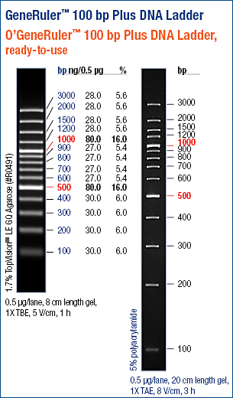
Electrophoresis of Extracted DNA
 | 4 | 3 | B3 | 2 | 1 | Ladder
Results of Trial 2:
B3 normal
Used 1,2 and B3

Slide 10
PCR
Primer used | BP | Tm(ºC) | ΔG | GC%
For 5’ ATG AAC AAA CGG GCG ATG C | 19 | 57 | +ve (0.64- 1.34) | 52.6
Rev 5’ TTA ATA CAC TCC AAC CGC ATT G | 22 | 54 | -ve (0.33) | 40.9
Biobrick-For 5’ GAATTCGCGGCCGCTTCTAG ATG AAC AAA CGG GCG ATG C | 39 | 69.5 | -ve (3.08-6.04) | 56.4
Biobrick-Rev 5’ TACTAGTAGCGGCCGCTGCAG TTA ATA CAC TCC AAC CGC ATT G | 43 | 68.4 | -ve (1.75-3.39) | 51.2
5’ATGAACAAACGGGCGATGC 3’
5’ATGAACAAACGGGCGATGCTCGGGGCGATCGGGCTGGCGTTCTTCGGCGAAGGGGGAATCGATCGTCTGGAACG…………………………………………TACTATTTGACGCCGACGTCGAACTTCGTGCCGCCTGCGTGCAAGCGGCCGCTGATTTGTACGGGTCGACAAGCCAAGAAGTCAACTCGGTGAAACAGGCGTTCAATGCGGTTGGAGTGTATTAA 3’
3’ GTTACGCCAACC TCACATAATT 5’

Slide 11
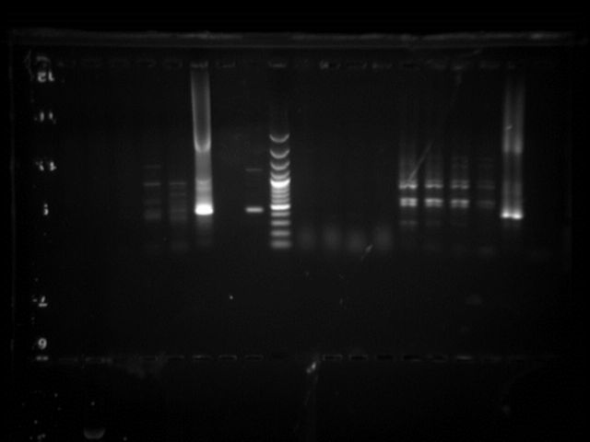
PCR
Ladder | 2(45.0) | 2(48.6) | 2(52.9) | 2(55.0) |  | B3(45.0) | B3(48.6) | B3(52.9) | B3(55.0) | +ve | -ve
Trial 1
Used 4 sets of DNA 2
4 sets of DNA B3
Annealing temps 45→ 55
+ve & -ve control
Results:
Proper Amplification can be seen at 45 and 48 degree Celsius
Set B3 DNA worked
1900bp
Why continue to Trial 2?

Slide 12
Ladder | 1(38.0) | 1(38.7) 1(40.0) 1(42.0) 1(44.6) 1(46.7) 1(48.1) 1(49.0) B3 B3 B3 B3 B3 B3 B3 B3 +ve -ve
Trial 2
Used 8 sets of DNA 1
and 8 sets of B3.
Changes in annealing temps : 38→49
+ve and –ve controls
Results:
Non Specific Bands with ↓ temp.
1900bp

Slide 13
+ve -ve B3(59.1) B3(57.6) B3(55.3) B3(52.4) B3(50.3) B3(48.8) |  |  |  |  |  |  |  |  |  |  |  |  |  | Ladder
Trial 3
Used 6 sets of DNA B3
6 different temps
Changes annealing temp: 48→60
+ve and –ve controls
Results
Faint bands with ↑ temp
No nprT
Continue with exp.

Slide 14
PCR Products Purification
Two ways of purification: Intensity of bands
Direct PCR Product Purification: labeled A to D
Gel Purification: labeled 1 to 13
1
2
A
B
3
4
5
6
7
9
8
11
D
C
10
12
13
PCR Trial 1
PCR Trial 2
PCR Trial 3

Slide 15
Gel Purification
100bp
13
12
11
10
1
2
100bp
9
8
7
6
5
4
3
4
3
2
7
1
6
5

Slide 16
Purification Confirmation
Ladder | 1 | 2 | 3 | 4 | 5 | 6 | 7 | Ladder | Direct | Direct | Direct | Direct
1500bp
200bp

Slide 17
Ligation and Transformation
Trial 1
Trial 2
Ligation:
  7 Rxn
  3µL DNA
  No Controls
Transformation:
  7 ligation samples
  Two +ve Controls
  One -ve control
  Two plate without amp (+ve control)
Results
Ligation failed
Ligation:
  9 Rxn
  25 µl DNA
  Controls
Transformation:
  Nine ligation samples
  one ligation +ve control
  one +ve control
  one –ve control
Results
Blue and white colonies observed

Slide 18
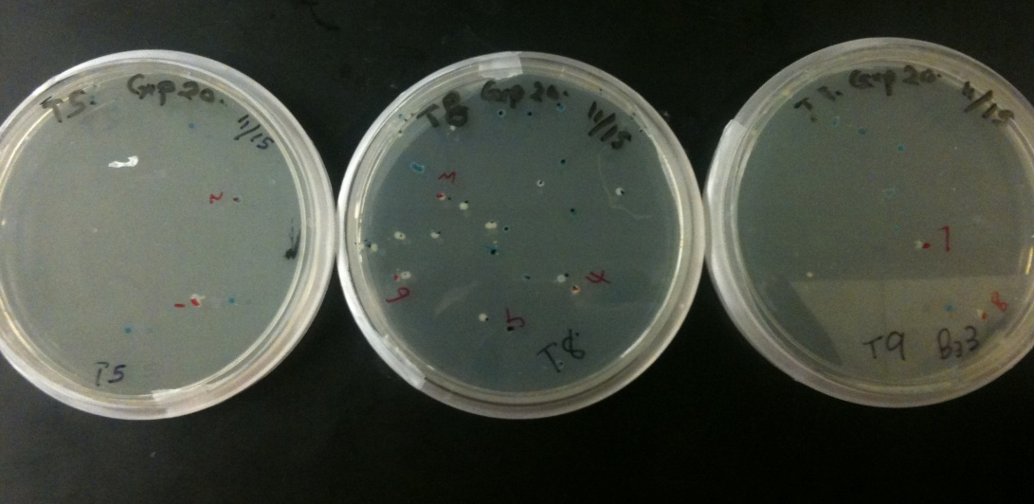
Extraction & Sequencing
Total of 8 colonies from selected plates only
Subjected for overnight growth
Plasmid extraction and send for sequencing
Transformation- 2
Plates | Colonies
 | White | Blue
1 | 0 | 2
2 | 0 | 0
3 | 0 | 0
4 | 0 | 0
5 | 0 | 6
6 | 0 | 2
7 | 0 | 0
8 | 15 | 8
9 | 3 | 8
10 | 0 | 13
11 | Many | 0
12 | 0 | 0
13 | 0 | 0

Slide 19
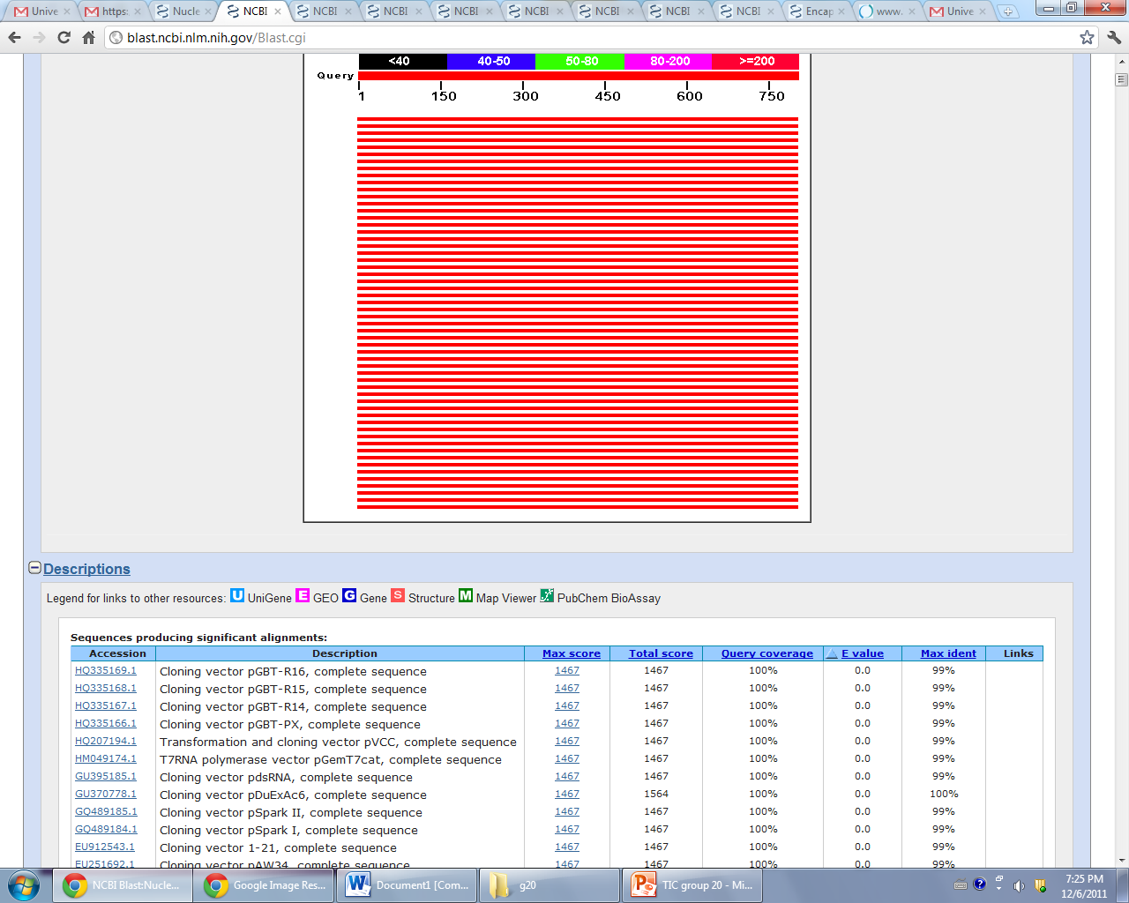
Sequencing Data
Alignment Matches:
2 sequences showing alignment with Cloning vector pGBT-R16
Both Blue colonies

Slide 20
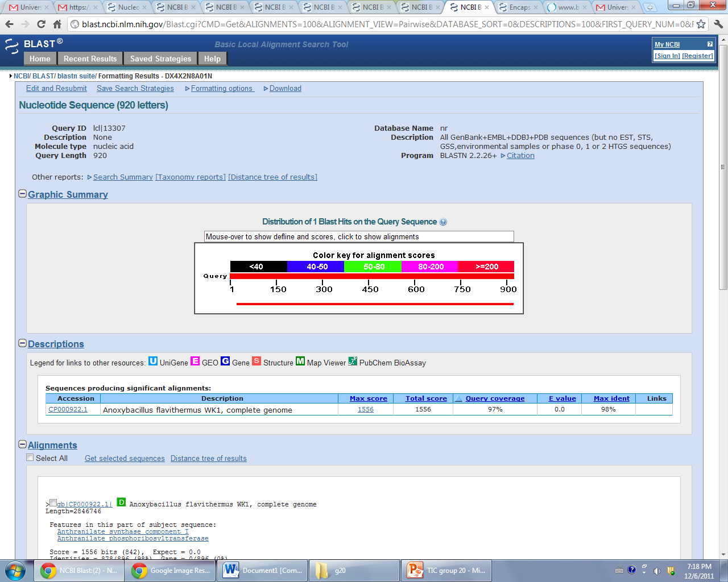
Sequencing Data
Alignment Matches:
6 sequences showing alignment with Anoxybacillus flavithermus WK1, complete genome

Slide 21
Conclusion
Unsuccessful cloning of nprT gene.
Successful cloning of Bio brick promoter
  BBa_K206001
Successful cloning of unknown gene.
  Anoxybacillus flavithermus WK1

