Slide 1
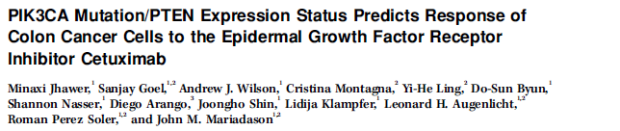
Advanced Cancer Topics
Journal Review
4/16/2009 AD

Slide 2
The Epidermal Growth Factor Receptor (EGFR) is a therapeutic target in many cancers
In head and neck, colorectal, non-small cell lung, and other cancers, overexpression of EGFR can contribute to tumorigenesis.
Therapeutic targeting of EGFR includes monoclonal antibodies that block ligand binding to the receptors and small-molecule tyrosine kinase inhibitors.

Slide 3
Cituximab (Erbitux) is a EGFR monocolonal antibody which inhibits ligand binding
Preclinical Trials Indentified multiple mechanisms for Cituximab inhibition of tumor growth:
Inhibition of cell cycle progression;
inhibition of survival pathways;
(3) inhibition of tumor cell motility and invasion;
(4) inhibition of angiogenesis; and
(5) Interruption of EGFR-activated survival and proliferation signaling by cytotoxic drugs or radiation

Slide 4
There are no good predictive markers for positive clinical response to Cituximab therapy
The average treatment cost of cetuximab is about $61279 per patient
The incremental cost per quality adjusted life-year gained is ~$57,608
Predictive tests would allow patients and physicians to make more informed care decision
British Journal of Cancer (2007) 96, 206–212

Slide 5
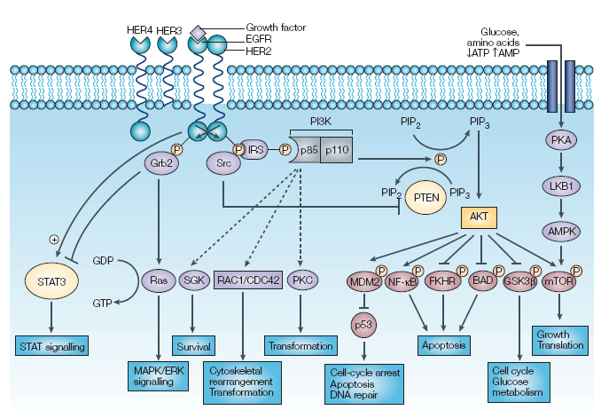
PI3K/AKT Signaling Pathway
Hennessy BT, et al. Nat Rev Drug Discov (2005)

Slide 6
Figure 1: Differential sensitivity of colon cancer cell lines to cetuximab treatment

Slide 7
Figure 2: Cell cycle analysis of cetuximab-sensitive and cetuximab-resistant colon cancer cell lines.

Slide 8
Figure 3: Basal EGFR mRNA and protein expression does not correlate with cetuximab response

Slide 9
Figure 3: Basal EGFR copy number does not correlate with cetuximab response

Slide 10
Figure 4: EGF selectively stimulates cell growth in cetuximab-sensitive cell lines

Slide 11
Figure 4: EGF selectively stimulates cell growth in cetuximab-sensitive cell lines

Slide 12
Figure 5: PIK3CA/PTEN mutation status predicts response to cetuximab in vitro

Slide 13
Conclusions
This study confirms retrospective clinical reports sugguesting that cetuximab therapy should not be limited only to patients with EGFR-overexpressing tumors
Identification of a potential predictive therapeutic marker (PTEN null) for Cituximab response
This is expected (a.k.a. Not that novel) because PTEN has previously been characterized downstream of EGFR and its loss is known to play a role in tumorigenesis
These studies need further validation in vivo and correlations of PTEN mutational status to clinical outcomes data

