Slide 1
Genetic Similarities Between HIV-1 Viruses in the Onset of AIDS
Isabel Gonzaga
BIOL 368-01: Bioinformatics Laboratory
Loyola Marymount University
October 1, 2014

Slide 2
Outline
HIV is a precursor for AIDS
HIV sequences were compared in respect to their AIDS developmental status
Viral strains mutated according to AIDS status
Diversity between groups show the direction of mutation

Slide 3
Outline
HIV is a precursor for AIDS
HIV sequences were compared in respect to their AIDS developmental status
Viral strains mutated according to AIDS status
Diversity between groups show the direction of mutation

Slide 4
HIV is a precursor for AIDS
Acquired Immune Deficiency System
HIV-1 attaches to CD4 T-Cell, inserts and replicates
  Reduces functioning T-Cells
  AIDS status: <200 CD4 T-Cells
  May attack T-Cell recovery and replication processes
Long Term Survivors successful due to:
  Host Genetic factors
  Unique Host Defenses
  Differences in HIV-1 Variants
Cohen et al. (2008)

Slide 5
HIV is a precursor for AIDS
Acquired Immune Deficiency System
HIV-1 attaches to CD4 T-Cell, inserts and replicates
  Reduces functioning T-Cells
  AIDS status: <200 CD4 T-Cells
  May attack T-Cell recovery and replication processes
Long Term Survivors successful due to:
  Host Genetic factors
  Unique Host Defenses
  Differences in HIV-1 Variants
Cohen et al. (2008)

Slide 6
Outline
HIV is a precursor for AIDS
HIV sequences were compared in respect to their AIDS developmental status
Viral strains mutated according to AIDS status
Diversity between groups show the direction of mutation

Slide 7
Examining the differences between the HIV-1 Variants
Question:
  Is there a relationship between the genetic identities in the viral strains present in Subjects with or progressing towards AIDS diagnosis, compared to subjects who are not?
Hypothesis:
  High diversity between AIDS Diagnosed and No Trend
  Higher diversity within the AIDS diagnosed and Progressing
  ‘No trend' group less diverse

Slide 8
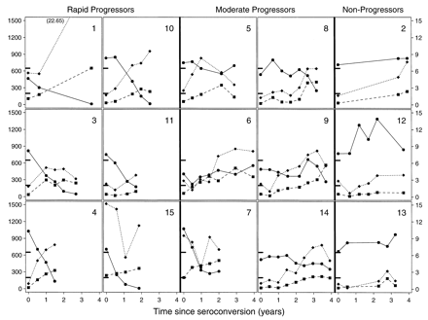
Sequences selected from Markham et al. (1998)
Three Groups:
  AIDS
    (<200 TD4 C Cell Counts at final visit)
  AIDS Progressing
    Subjects 8 & 14 developed AIDS 1 year after final visit
  No Trend
Two Times:
  First Visit (initial seroconversion)
  Final Visit

Slide 9
Outline
HIV is a precursor for AIDS
HIV sequences were compared in respect to their AIDS developmental status
Viral strains mutated according to AIDS status
Diversity between groups show the direction of mutation

Slide 10
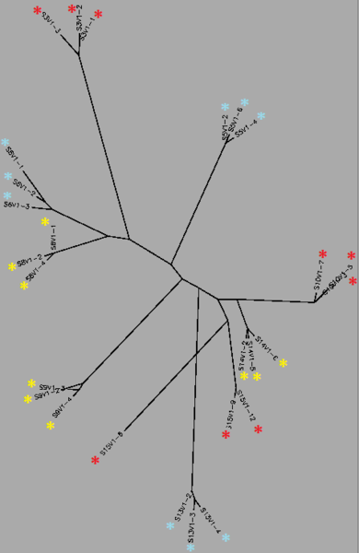
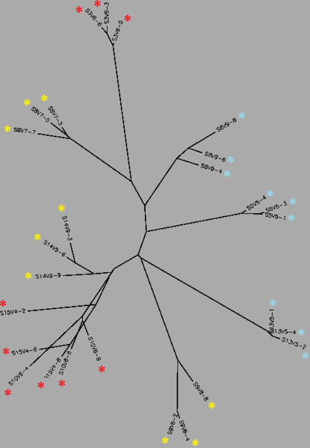
Unrooted trees show mutations differentiating AIDS status
Figure 1. Unrooted tree for Visit 1 Sequences
Figure 2. Unrooted tree for Final Visit Sequences. Sub 9 did not develop AIDS

Slide 11
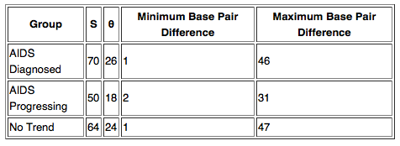
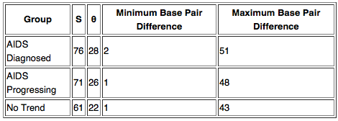
Intragroup diversity changed over time
Table 1: Visit 1 Intragroup Diversity
Table 2: Final Visit Intragroup Diversity
Diagnosed and Progressing groups became more diverse
  Progressors maintained highest diversity
Non-Trending viral strains became more homogenous

Slide 12
Outline
HIV is a precursor for AIDS
HIV sequences were compared in respect to their AIDS developmental status
Viral strains mutated according to AIDS status
Diversity between groups show the direction of mutation

Slide 13
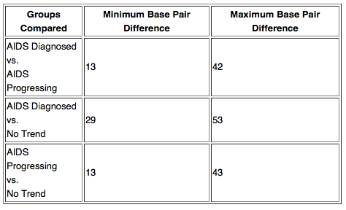
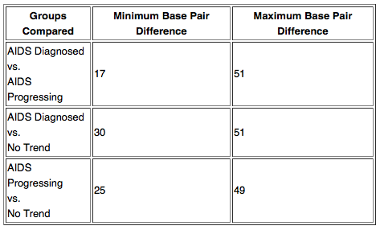
Diversity between groups increased in final visit
Table 3: Visit 1 Intergroup Diversity
Table 4: Visit 1 Intergroup Diversity
Consistently, largest divergence between Diagnosed and No Trend
Progressing group mutates more closely to Diagnosed group
  Subject 3 causes the high divergence

Slide 14
HIV mutations show different developmental trends
Groupings similar to Markham et al (1998)
  Exception: Non-Trending
Diagnosed and No Trend groups: high intergroup diversity
AIDS Progressing groups developed towards Diagnosed group
  Exception: Subject 9
Non-Trend groups: lower intragroup diversity over time
Diagnosed and Progressing groups: had high diversity, increased over time

Slide 15
Limitations and Further Questions
Limited sample
Causation
  Does this trend cause AIDS or does AIDS cause this?
Ignores other factors of AIDS development
  Present work is strictly at molecular level
Statistical analyses needed, not observations

Slide 16
HIV sequences mutate according to AIDS status
HIV-1 Variant plays a role in determining AIDS development
Viral strains mutated towards their AIDS status group
HIV sequences may be used as a predictive factor in AIDS development
Further analyses should analyze more data, prove significance and determine causation

Slide 17
Acknowledgments
I’d like to thank…
Dr. Dahlquist (and the Bioinformatics Lab)
Loyola Marymount University
Los Angeles, CA
Biology Workbench
BEDROCK HIV Problem Space

Slide 18
References
Cohen, M., Hellman, N., Levy, J., DeCock, K., & Lange, J. (2008). The spread, treatment and prevention of HIV-1: evolution of a global pandemic. J Clin Invest. 2008;118(4):1244-1254. doi:10.1172/JCI34706.
Markham, R.B., Wang, W.C., Weisstein, A.E., Wang, Z., Munoz, A., Templeton, A., Margolick, J., Vlahov, D., Quinn, T., Farzadegan, H., & Yu, X.F. (1998). Patterns of HIV-1 evolution in individuals with differing rates of CD4 T cell decline. Proc Natl Acad Sci U S A. 95, 12568-12573. doi:10.1073/pnas.95.21.12568

