Slide 1
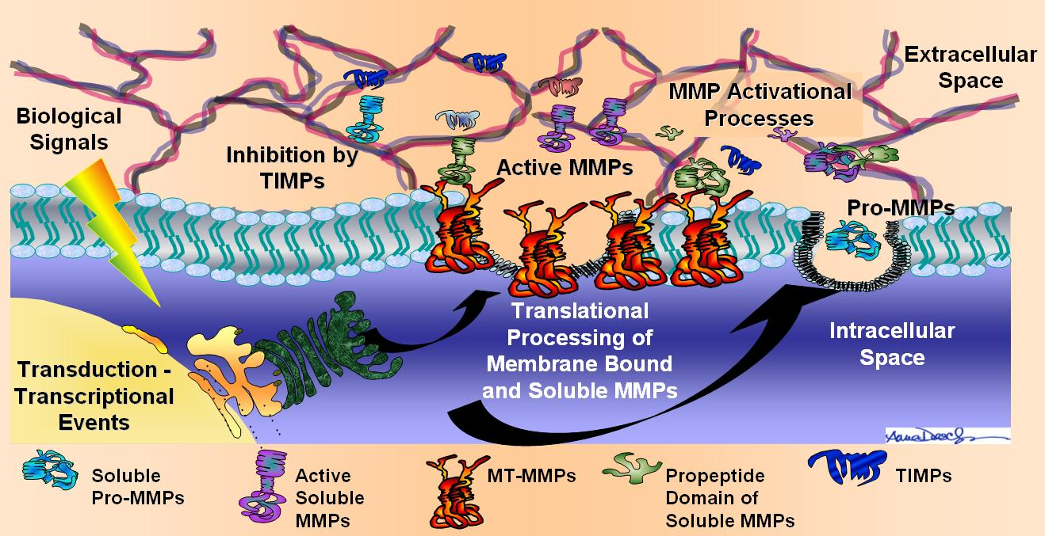
Matrix Metalloproteinases
MMPs
Group Meeting
9/30/13
Lauren Jansen
Notes:
Pictue: http://academicdepartments.musc.edu/surgery/research/ctresearch/spinale_research.htm

Slide 2
MMPs are secreted and cell surface enzymes
Utilize metal ions for catalytic activity
Process and Degrade substrates
  Proteinases
  proteinase inhibitors
  clotting factors
  chemotactic molecules
  latent growth factors
  growth factor–binding proteins
  cell surface receptors
  cell-cell adhesion molecules
  virtually all structural ECM proteins

Slide 3
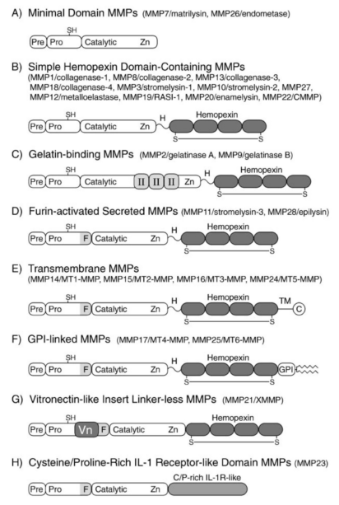
Classification of MMP
25 human MMPs
  The 6 MMPs with transmembrane domains are expressed as cell surface enzymes.
Originally grouped according to their ECM specificity
  Ex. collagenases, gelatinases, stromelysins and matrilysins
Now grouped according to structure
  8 distinct groups, 5 secreted, three membrane-type MMP
  See Figure
TIMPs- tissue inhibitors of metalloproteinases
Notes:
Group based on modular domain of the protein

Slide 4
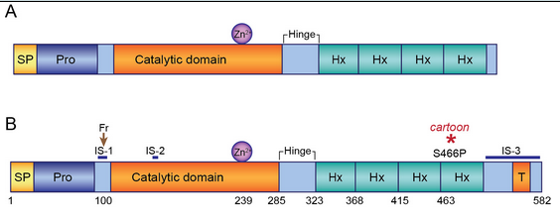
Basic Structure
Pro-peptide domain-must be removed for the enzyme to become active
  “Cysteine” switch
Catalytic domain- Zn+2 bound by 3 histidine residues
Haemopexin-like C-terminal domain- determines substrate specificity and is the site for interaction with TIMPs (absent in some MMPs)
Notes:
Picture: http://mutagenetix.utsouthwestern.edu/phenotypic/phenotypic_rec.cfm?pk=219
Propeptide domain- This contains a conserved cysteine residue that interacts with the zinc in the active site and prevents binding and cleavage of the substrate, keeping the enzyme in an inactive form
The catalytic domain is connected to the C-terminal domain by a flexible hinge or liker region that is 75 AA long.
Figure 2. A 'typical' MMP and MMP14 have conserved domains. (A) The domains of a 'typical' released MMP family (B) The domains of membrane-bound mouse MMP14. The cartoon mutation is a serine to proline change at amino acid 466 and is indicated by a red asterisk. Abbreviations: SP, signal peptide; Pro, propeptide region; Fr, furin cleavage site; IS, insertion site; Zn2+, zinc binding site; Hx, hemopexin-like repeat; T, transmembrane domain.

Slide 5
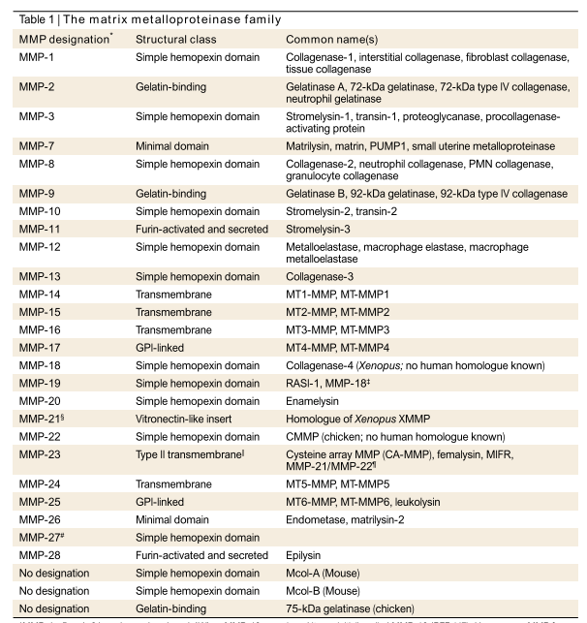
Table of MMP Family
Fun Fact: MMP -4, MMP-5, MMP-6 have been abandoned

Slide 6
MMP Inhibition
α2-Macroglobulin- main inhibitor in tissue fluids
  an abundant plasma α2-macroglobulin binds to MMPs allowing it to bind a scavenger receptor which irreversibly clears it by endocytosis.
Tissue inhibitors of MMPs (TIMPs)- four protease inhibitors
  Often inhibition proceeds after activation
  MMP-2 and MMP-9 form complexes with TIMPs when enzymes are in the latent form
Active MMP
TIMP
MMP activity inhibited
Notes:
Ex: Complex of latent MMP-2 with TIMP-2 which activate pro-MMP2 with help from MT1-MMP (MMP-14)

Slide 7
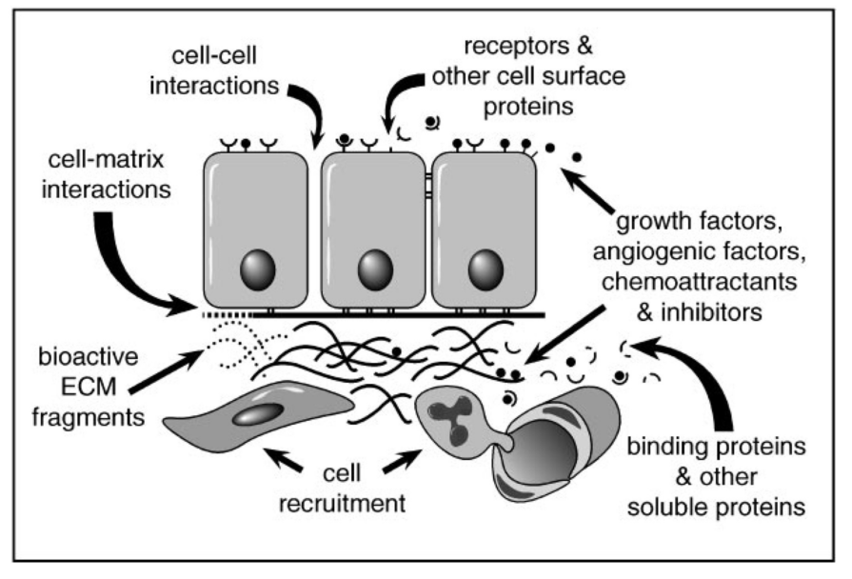
Potential mechanisms of MMP-mediated cellular signaling
Notes:
Picture: Egeblad, M., Werb, Z. New Functions for the Matrix Metalloproteinases in Cancer Progression. Nature Reviews Cancer. 2002. 2: p. 161
Because extracellular matrices regulate such basic processes as cell shape, movement, growth, differentiation, and survival by controlling cell adhesion and the cytoskeletal machinery (reviewed in Lukashev & Werb 1998). By extension, MMPs also influence these same processes by altering the composition and structural organization of the ECM, thereby altering matrix-derived signals.

Slide 8
Examples of MMP-mediated cellular signaling
Cell migration regulation
  MT-MMPs degrade cell surface tissue transglutaminase that promotes the adhesion and spreading of cells on fibronectin
Cleave cell surface receptors and release cell surface molecules
  MMP-2 cleaves fibroblast growth factor (FGF) receptor 1 from the cell surface and releases it as a soluble receptor fragment that can still bind FGF
  MMP-2 and MMP-9 can activate latent TGF-β
  MT4-MMP can cleave membrane-bound pro-TNF-α to generate active soluble TNF-α
Regulates the availability of paracrine signals
  Insulin-like growth factor (IGF) binding proteins (IGF-BPs) degradation by MMPs indirectly increases the availability of IGF survival
  MMP2 inactivates monocyte chemoattractant protein-3 generating a chemokine receptor-binding antagonist that impedes inflammation
Notes:
In addition to causing the activation and release of cytokines and growth factors, MMPs can also cleave their cell surface receptors.
the degradation of insulin-like growth factor (IGF) binding proteins (IGF-BPs) 3 and 5 by MMPs 1, 2 and 3, and of IGFBP-1 by MMP11, indirectly increases the availability of IGF survival and growth factors
MMP2 can cleave monocyte chemoattractant protein-3, thereby inactivating it and generating a chemokine receptor-binding antagonist that further impedes inflammation (McQuibban et al. 2000) and, perhaps, immune surveillance against cancer

Slide 9
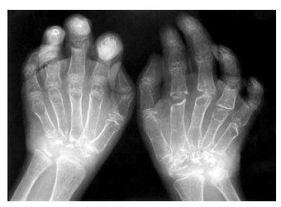
MMPs in Bone Development Bone
Functional loss of MMP-2 causes nodulosis, arthropathy, and osteolysis (NAO) syndrome, “disappearing-bone” disorder
MMP-9-null mice show a delay in bone tissue creation (specifically endochondral ossification)
Targeted inactivation of the MT1-MMP gene in mice causes severe defects in all bone formation processes
  MT1- MMP activates MMP-2
Notes:
Picture-http://download.springer.com/static/pdf/255/art%253A10.1007%252Fs00247-001-0649-4.pdf?auth66=1380730461_cf58b88bcbeb38a2ab40e2471688a68a&ext=.pdf
the absence of a matrix-degrading enzyme leads to progressive bone loss suggesting that MMP-2 is not a critical bone matrix-dissolving
MMP-2, MMP-9, and MT1-MMP, influence bone development and homeostasis
DP radiograph of both hands demonstrates marked bilateral osteolysis (bone loss) of the carpi (small bones in the main part of the forearm) and digital contractures

Slide 10
MMP Cancer progression
Increasingly bad prognosis with increase in MMPs
  ECM regulates cell behavior by the proteins breaking down in the surrounding area which could regulate the tumour microenvironment
  Activation is increased in almost all cancers over normal tissue
  Some MMPs are synthesized by cancer cells, but many other MMPs are predominantly made by stromal cells
Transcriptional changes rather than genetic alterations
  Two reported genetic alterations in cancer cells
MMPs promote malignant behavior in cancer cells
Key agonists in tumor invasion, metastasis, and angiogenesis, including MMPs 1, 2, 3, 9, and 14
Notes:
The only two reported genetic alterations in cancer cells are translocation of the MMP23genes in neuroblastoma48 and amplification of the MMP24 gene4
Benign cells acquire malignant properties when MMP activity is increased or TIMP activity diminished
Highly malignant cells are made less aggressive by reducing their MMP levels or suppressing their MMP activity

Slide 11
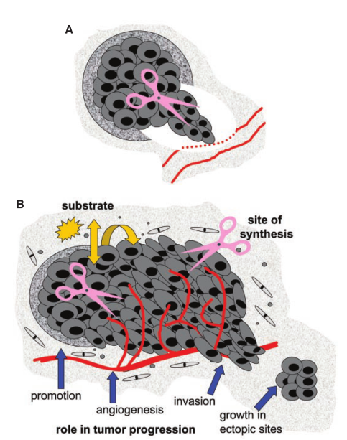
Matrix Metalloproteinase Inhibitors and Cancer: Trials and Tribulations
MMP levels rise rapidly when tissues undergo remodeling
  Inflammation
  Wound healing
  Cancer
Known to contribute to multiple steps of tumor progression
  Invasion
  Tumor promotion
  Angiogenesis
  Metastasis
Synthesized by tumor cells and surrounding stromal cells
Create gaps in matrix barriers
Solubilize cell surface and matrix-bound factors
  Influences growth, death, and migration
Notes:
Picture: Coussens, L., Fingleton B. , Matrisian, L.. Matrix Metalloproteinase Inhibitors and Cancer: Trials and Tribulations. Science. 2002 295(5565): p. 2387
(A) Early view of MMP action in cancer. MMPs (scissors) were classically viewed as being produced and secreted by tumor cells , degrading basement membrane and extracellular matrix components, thereby facilitating tumor cell invasion and metastasis. (B) Current view MMP action in cancer. MMPs are now known to contribute to multiple steps of tumor progression in addition to invasion, including tumor promotion, angiogenesis, and the establishment and growth of metastatic lesions in distant organ sites. In addition, it is recognized that MMPs not only can be synthesized by tumor cells but are frequently produced by surrounding stromal cells, including fibroblasts and infiltrating inflammatory cells. Finally, although creating gaps in matrix barriers remains a role for MMp activity, MMPs are also known to solubilze cell surface and matrix-bound factors that can then sct in an autocrine or paracrine manner to influence cellular properties such as growth, death, and migration.

Slide 12
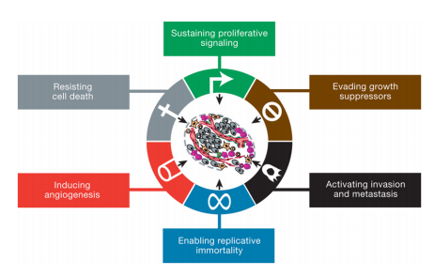
Hallmarks of cancer and MMP involvement

Slide 13
MMP role in primary tumor formation
Stromal influences promote cancer development and MMP-overexpressing mice develop more cancers than usual
Literature Examples:
  Fibroblasts lacking MMP-11 do not foster the growth of human cancer cells in nude mice
  Cancer cells are less capable of colonizing the lungs of MMP-2- or -9-deficient mice than the lungs of wild-type mice
  MMP-1 or -7 leads to hyperproliferative disease and increased cancer susceptibility
  Expression of MMP-3 or -14 in the mammary gland results in spontaneous breast cancers
  Transplanting MMP-9 expressing bone marrow cells causes squamous-cell carcinomas in the MMP-9-null mice
Notes:
MMP-11 null fibroblasts do not support the in vivo growth of breast cancer cells

Slide 14
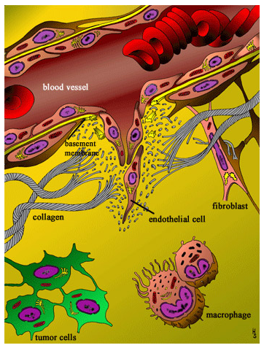
MMPs in Vascular Remodeling
MMPs can contribute to angiogenesis by:
Disrupting ECM barriers allowing for cell migration through tissues
Cleaving positive angiogenic factors
Generating anti-angiogenic breakdown products
Literature Example:
  Downregulation of MMP-2 suppresses
  tumor- induced angiogenesis
  Genetic removal of MMP-9 suppresses
  angiogenesis and tumor growth
Notes:
Picture- http://www.amplab.de/angiogenesis.html

Slide 15
MMPs in cell invasion and apoptosis
Break down the structural barriers so cells can cross tissue boundaries and invade
MMP-mediated disruption matrices can induce apoptosis in anchorage-dependent cells
  Plays an important role in normal physiologic cell death
  Cancer can select for anchorage-independent and apoptosis- resistant mutants
Literature Examples:
  Cleavage of E-cadherin and CD44 results in the release of fragments of the ECM domains and increases invasive behavior
  Cleavage of the αv integrin subunit precursor by MMP-14 enhances cancer-cell migration.

Slide 16
Metastasis
MMPs are thought to facilitate invasion and metastasis by degrading structural ECM components
Invasive behavior is associated with the upregulation of MMPs in virtually all human cancers
Literature Examples:
MMP-2 deficient mice show diminished lung mets after intravenous injection of cancer cells
Intravital videomicroscopy shows TIMP1-overexpressing cancer cells exiting vasculature at the same rate as their parental counterparts, but these cells yield fewer and smaller metastases

Slide 17
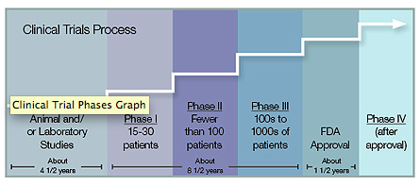
Clinical trials
MMP Inhibitors- Small molecules containing both hydroxamate and non-hydroxamate zinc binding sites, as well as natural products such as tetracyclines and their derivatives
Among the ﬁrst group of anticancer drugs that were ‘‘molecularly targeted agents’’
>50 MMP inhibitors have been pursued
Phase I
  skeletal pain and
  inflammation
Phase II
  MMPs were cytostatic
Phase III
  most focus on patients in advanced phases of metastasis because of the regulation of invasion
  At this point it was decided that there was no therapuetic benefit in human cancer
Notes:
Picture- http://www.mdanderson.org/patient-and-cancer-information/cancer-information/clinical-trials/phases-of-clinical-trials/index.html
Cytostatic—growth arrested
In phase I trials, the goal is to determine the safety of the drug and to ﬁnd the best dose to be used in subsequent phases. Phase I trials are typically small, involving 20–60 people, and of limited duration.
phase II, is for establishing effectiveness of the treatment as well as further analysis of safety and toxicity.
The main test of drug efﬁcacy is in phase III where the new drug is tested usually in large numbers of patients often in a blinded, randomized fashion against either a placebo or the currently used treatment.

Slide 18
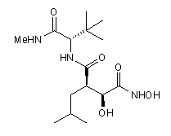
Tested MMP Inhibitors
Batimastat (BB94)
  inhibited most MMPs
  Not orally bio-available
  Phase I
Marimastat (BB2516)
  broad spectrum inhibitor, also inhibited related enzyme families
  Phase III
  Improved survival but awful quality of life
Prinomastat (AG3340)
  Designed to remove side effects
  MMP-9, MMP-2, MMP-1
  Dose-dependent Pain
  Phase III
Notes:
Picture: http://www.tocris.com/dispprod.php?ItemId=5207#.UkmPrGSDTFY

Slide 19
Why did MMP Inhibitors fail?
Dose-limiting Toxicities
Lack of Efﬁcacy-vast difference between mouse models and human models
TIMPs may block some aspects of cancer, while promoting other aspects of cancer
  Focus was on the late steps of tumor progression
  Recruited by stromal cells over cancer cells
  Suggestions for Improvements:
  Potential anti-angiogenic agents for primary that can help to maintain small clusters of metastatic cells in a dormant state.
Notes:
One of the most perplexing aspects of the MMPI story has been the disconnection between very promising preclinical studies with these drugs and the complete failure of the same drugs when tested clinically
MMPs were shown to be up-regulated and present in an active form in neoplastic tissue before the destruction of basement membrane and emergence of malignant tumors, which suggests that MMPs do more than merely create gaps in basement membranes through which tumor cells escape.

Slide 20
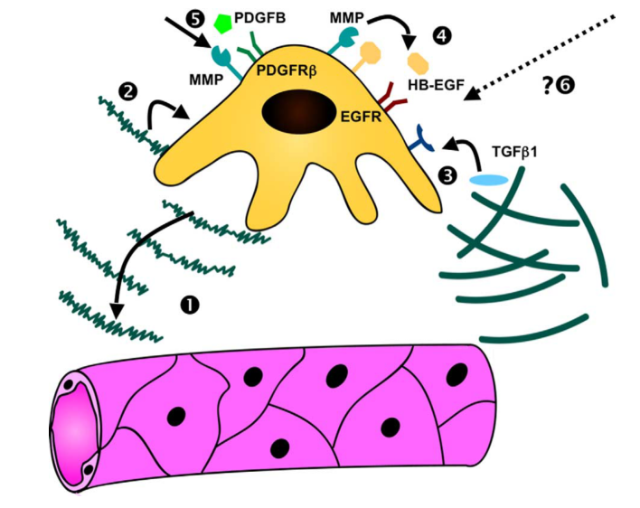
Participation of MMPs in Tumour Pericyte Recruitment
Levels of Recruitment
Promotion of pericyte invasion by ECM degradation
ECM modification stimulates pericyte proliferation and protection against apoptosis
Releases GFs bound to ECM and activates pericytes
Increased gene expression of angiogenic cell surface receptor
Promotes angiogenic signalling
Recruits bone marrow-derived stem cells
Notes:
Chantrain, C., et al. Menchanisms of pericyte recruitment in tumour angiogenesis: a new role for metalloproteinases. European Journal of Cancer. 2006. 42(3): p. 310
Blood vessel maturation involves the recruitment of mural cells and the deposition of a perivascular extracellular matrix (ECM).
Pericytes help support the EC cells that support the vasculature forming to support the tumor microenvironment reduction of pericyte recruitment resulting from MMP inhibition is associated with decreased tumour vessel perfusion.
In human glioma and breast cancer, MMP-9 is ex- pressed by VSMC and in particular by pericytes at the proliferating tumour borders.
In a human neuroblas- toma xenotransplanted model, pericyte coverage along tumour microvessels is decreased by half in tumours grafted to MMP-9 deficient mice and transplantation with MMP- 9-expressing bone marrow cells restores the formation of mature tumour vessels.
In several tumour models in vivo, inflammatory cells-derived MMP-9 has been shown to pro- mote tumour angiogenesis by releasing ECM-bound angio- genic factors such as VEGF

Slide 21
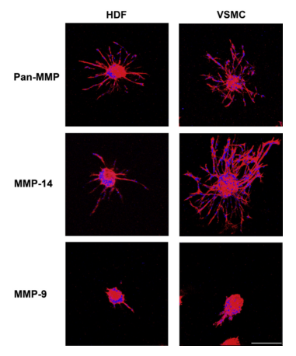
Cell specific ingrowth in hydrogels
HDF - human dermal fibroblasts
VSMC - human vascular smooth muscle cells
MMP-14 - critical to cellular invasion of matrices
MMP-9- more specific expression in cells such as keratinocytes, monocytes and tissue macrophages
Pan-MMP a sequence that is cleaved by a wide range of MMPs

Slide 22
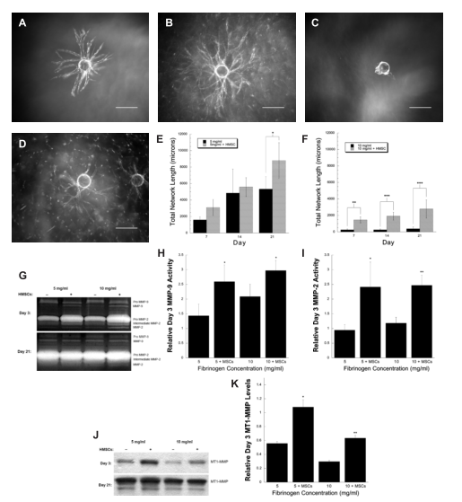
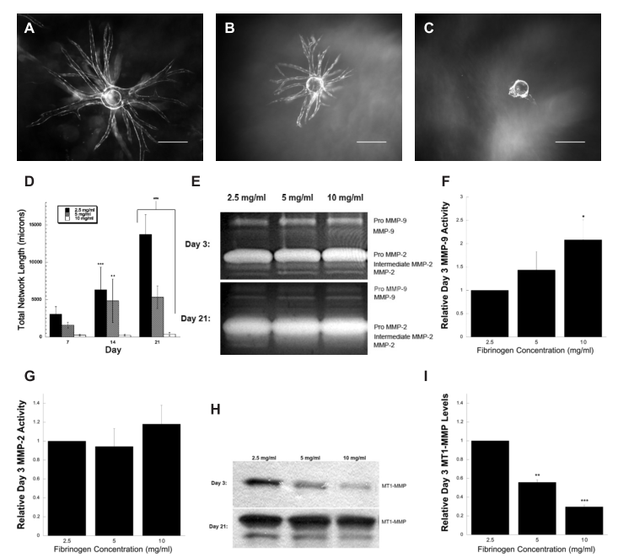
Mesenchymal Stem Cells Enhance Angiogenesis in Mechanically Viable Prevascularized Tissues via Early Matrix Metalloproteinase UpregulationCYRUS
Notes:
Pictures-Ghajar, C., et. al. Mesenchymal Stem Cells Enhance Angiogenesis Early Matrix Metalloproteinase Upregulation. Tissue Engineering. 2006. 12(10): p. 2875
Figure 3
Increasing fibrin concentration diminishes total network formation(A) 2.5 mg/mL, (B) 5 mg/mL, and (C) 10mg/mL fibrin gels used for quantification of total network length. Scale bar¼500 mm.
(D) At 3 separate time points (days 7, 14, and 21), a total of 5 such beads per condition were quantified for total capillary network length and averaged
A standard for MMP-2 and -9 was used to identify bands for pro-MMP-9 (92 kDa), active MMP-9 (88 kDa), pro-MMP-2 (72 kDa), intermediate MMP-2 (64 kDa), and active MMP-2 (62 kDa). Three such images were quantified via scanning densitometry. Resulting quantification of (F) active MMP-9 and (G) active MMP-2 bands at day 3 are shown. Values presented are normalized within each image by the value for the 2.5mg/mL
(H) Representative Western blots (n¼3) for samples probed at days 3 and 21 with an antibody for MT1-MMP. Lysates from MCF-7 carcinoma were used as a positive control to identify the relevant band (not shown).
Two such blots were quantified via scanning densitometry. Day 3 values presented are normalized within each blot by the value obtained for the 2.5mg/mL condition.
Figure 2
(A,B)5and(C,D)10mg/mLgels (A,C) completelylacking or (B,D)containing 50,000HMSCs dispersed throughout thematrix (white specs throughout the image). Scale bar¼500mm.
At 3 separate time points (days 7, 14, and 21), a total of 5 such beads per condition were quantified and averaged for the (E) 5mg/mL and (F) 10mg/mL samples.
(G) Representative images of zymograms (n¼4) performed at days 3 and 21 (days 7 and 14 not shown).Three such images were quantified via scanning densitometry.
Resulting quantification of (H) activeMMP- 9and (I) activeMMP-2bands at day 3 are shown. Values presented are normalizedwithin eachimage by the value for the 2.5mg/mLculture at this time point (though not shown, a 2.5mg/mL sample was also run on these gels). *p<0.05 and **p<0.01 compared to the correspondin gcondition void of HMSCs.
(J)Representative Western blots (n¼3) for samples probed at days 3 and 21 with an antibody forMT1-MMP. Samples were obtained and identified in a manner identical to that described in the caption for Fig. 3. (K) Two such blots were quantified by scanning densitometry.
Quantification of day3MT1-MMPlevels are presented normalized to the value obtained for the corresponding 2.5mg/ mL culture (also contained on these blots, though not shown). *p<0.05 compared to the corresponding condition void of HMSCs and the 10mg/mL condition containing HMSCs. **p<0.01 compared to the corresponding condition void of HMSCs.2884

Slide 23
Questions?
Notes:
----- Meeting Notes (9/30/13 14:09) -----
Environmental context of MMPs
MMPs (ALL) with respect to different breast cancer lines
Magpix---how do we make these beads

Slide 24
References
Egeblad, M., Werb, Z. New Functions for the Matrix Metalloproteinases in Cancer Progression. Nature Reviews Cancer. 2002. 2: p. 161
Chantrain, C., et al. Menchanisms of pericyte recruitment in tumour angiogenesis: a new role for metalloproteinases. European Journal of Cancer. 2006. 42(3): p. 310
Coussens, L., Fingleton B. , Matrisian, L.. Matrix Metalloproteinase Inhibitors and Cancer: Trials and Tribulations. Science. 2002 295(5565): p. 2387
Bracher, M., et al. Cell Specific Ingrowth Hydrogels. Biomaterials. 2013. 34: p. 6797
Ghajar, C., et. al. Mesenchymal Stem Cells Enhance Angiogenesis Early Matrix Metalloproteinase Upregulation. Tissue Engineering. 2006. 12(10): p. 2875
Hanahan, D. et al. Hallmarks of Cancer: The Next Generation. Cell. 2011. 144(5): p. 646.
Fingleton, B. MMP Inhibitor Clinical Trials-The Past, Present, and Future. The Cancer Degradome. 2008. P. 759
academicdepartments.musc.edu/surgery/research/ctresearch/spinale_research.htm
www.wikipedia.org
http://mutagenetix.utsouthwestern.edu/phenotypic/phenotypic_rec.cfm?pk=219
http://www.tocris.com/dispprod.php?ItemId=5207#.UkmPrGSDTFY
Zucker, S. Selective matrix metalloproteinase (MMP) inhibitors in cancer therapy: Ready for prime time?. Cancer Biol Ther. 2009. 8(4): p. 2371

