Slide 1
Prodigiosin Production in E. Coli
Stephanie Vondrak
Brian Hovey

Slide 2
Review
Our goal was to clone the pigI gene from Serratia marcescens into E. Coli
Just to review:
Prodigiosin is a secondary metabolite of various strains of Serratia, and other Gram negative gammaproteobacteria.
It is responsible for the red pigment produced by Serratia marcescens.
Produced under the control of 14 genes(pigA-pigN)
We chose prodigiosin because of the recent attention to its newfound benefits
  Benefits such as: antibacterial, antifungal, antiprotozoal, antimalarial, immunosuppressive, and anticancer properties

Slide 3
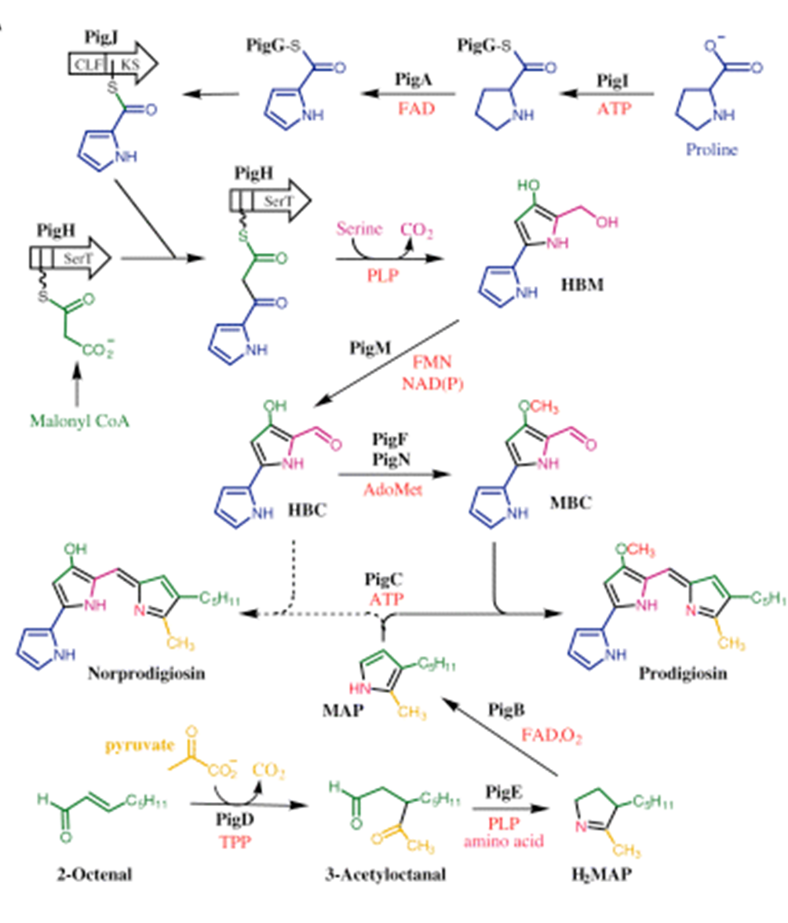
Review
Gene of Interest
- We chose pigI because it is involved in one of the beginning pathways of MBC(4-methoxy-2,2`-bipyrrole-5-carbaldehydе)
- This is a precursor of prodigiosin

Slide 4
Review
Experimental Approach:
Growth of S. marcescens
Extraction of DNA
PCR Amplification of gene of interest
Site directed mutagenesis
Insertion of gene of interest into vector
Transformation of vector into E. Coli
Selection of vector through Arabinose activation and ampicillin
Check for gene of interest in vectors taken up by E.Coli via SDS-PAGE or sequencing

Slide 5
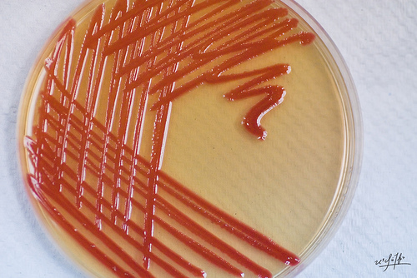
Growth of S. marcescens
S. marcescens culture obtained from Dr. Walter
Grew on a streak plate to see if culture was viable
Culture then grown overnight in LB at 37°C
Flasks were quite turbid so we proceeded to DNA extraction

Slide 6
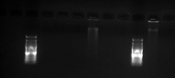
Extraction of DNA
DNA was first extracted according to protocols obtained from the USDA
  Amounts were reduced by a factor of 10 or more in most cases (Ex: 500ml to 5ml)
Potential DNA (at least protein) was precipitated
DNA samples ran through simple gel electrophoresis
  Digested and undigested samples run
We assumed that these bands represented DNA because a streak showed up in a digestible lane (lane 7)
We proceeded to PCR amplification to confirm the presence of DNA (and our target gene)

Slide 7
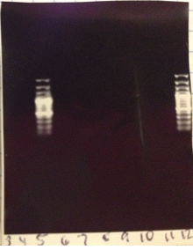
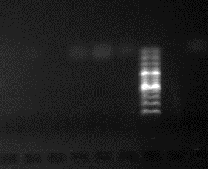
PCR Amplification
On our first PCR run, the positive control failed, so we couldn’t conclude anything from our results
Temperatures:
  Lane 3 – Biobrick oligo control
  Lane 4 – No Biobrick oligo control
  Lane 5 – Marker
  Lane 6 – Biobrick 50 C
  Lane 7 – Biobrick 52.9 C
  Lane 8 – Biobrick 62 C
  Lane 9 – Nobiobrick 50 C
  Lane 10 – Nobiobrick 52.9 C
  Lane 11 – Nobiobrick 62 C
  Lane 12 – Marker
  Annealing time – 1 min 30 sec
Positive Control (or lack thereof)

Slide 8
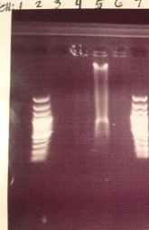
DNA Concentration
After consulting with Dr. Schwekendiek, we noticed that our DNA may have been over diluted (we had our samples suspended in 1ml of solution, when Dr. Schwekendiek noted 100µl was the usual dilution)
To rectify this, we concentrated our DNA in a Speed Vacuum Concentrator overnight
After running our samples through the Speed Vacuum Concentrator, we ran them through simple gel electrophoresis
Sample 3 (lane 5) was the only sample that showed up in with any significant brightness, so we only used that sample for testing for the rest of our experiments (with our first extraction)

Slide 9
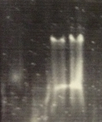
DNA Confirmation
- Only sample 3 produced visible bands and we wanted to confirm the presence of DNA, so we ran a undigested and digested sample 3 through simple gel electrophoresis
- As you can see, the gel was faulty, but we decided that there was a clear enough distinction between undigested and digested to proceed to PCR confirmation
Sample 3

Slide 10
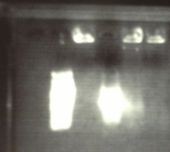
DNA Confirmation
Our positive control worked (4th lane from the left), but our samples (lanes 5 and 6 from the left) did not display the expected brightness. It is important to note that our annealing time was only 1 minute 30 seconds and our target gene is 1473 b.p., so that may have an effect on our results.
We decided to run PCR again to see if the annealing time had an effect on our outcome
Annealing time = 1 min 30 sec
Lane 2 – Marker
Lane 3 – Negative Control
Lane 4 – Positive control
Lane 5 – Bio (Sample 3) 50 C
Lane 6 – NoBio (Sample 3) 50C

Slide 11
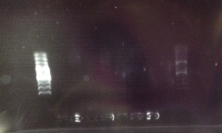
DNA Confirmation
- An hour after we started our second PCR run, we discovered that we incorrectly set our PCR cycle order, stopped it, fixed the protocols and ran it again.
Annealing time = 3 minutes
Lane 3 – Marker
Lane 4 – Pos control
Lane 5 – Neg Control
Lane 6 – Sample 3 Bio 55C
Lane 7 – Sample 3 NoBio 55C
Lane 8 – Sample 3 Bio 58.7 C
Lane 9 – Sample 3 NoBio 58.7 C
Lane 10 – Sample 3 Bio 65 C
Lane 11 – Sample 3 NoBio 65 C
Our positive control failed, so we were unable to draw any conclusions about the quality of our DNA
We decided that while we could confirm these results by running another simple gel electrophoresis, we felt that the DNA obtained through the USDA extraction protocols was faulty, so we prepared for another DNA extraction using protocols from Open WetWare

Slide 12
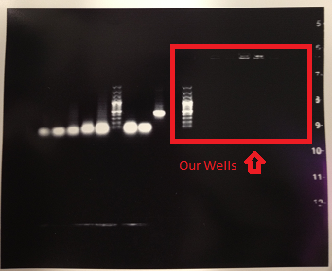
DNA Extraction
We grew up another culture from a set of streak plates provided by Dr. Walter
We extracted DNA from this culture using Open WetWare protocols and then ran it through simple gel electrophoresis
We had no visible bands
  We suspected this is because we didn’t let our DNA properly dissolve in solution at the end of extraction, due to rushing to electrophoresis
  We decided to run another gel electrophoresis after we let the DNA fully dissolve

Slide 13
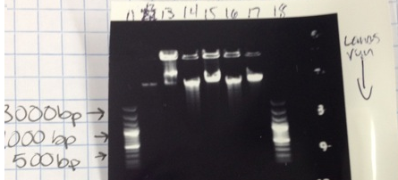
DNA Confirmation
- The results of our gel electrophoresis (undigested and digested samples were run) were as follows:
- These results correspond with digestible DNA, so we took what we determined to be the best sample (sample 2) and ran it through PCR

Slide 14
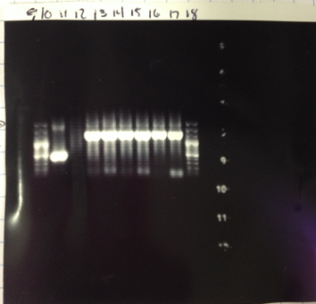
DNA Confirmation
Annealing time = 3 minutes
Temperatures
  Lane 9 – Marker
  Lane 10 – Positive control
  Lane 11 – Neg Control
  Lane 12 – NoBio 55 C
  Lane 13 – Bio 55 C
  Lane 14 – NoBio 58.7 C
  Lane 15 – Bio 58.7 C
  Lane 16 – NoBio 65 C
  Lane 17 – Bio 65 C
  Lane 18 - Marker
The results show a strong band at around 1500 b.p., which corresponds to the size of our target gene (pigI)

Slide 15
Experimental Approach Alteration
We decided that because time was limited we would alter our experimental protocol as follows:
  Growth of S. marcescens
  Extraction of DNA
  PCR Amplification
  DNA Purification
  T-Vector Ligation
  T-Vector Transformation
  Growth of Transformed Cells (DH5α)
  Plasmid Extraction
  DNA confirmation
  Sequencing
We are here at this point

Slide 16
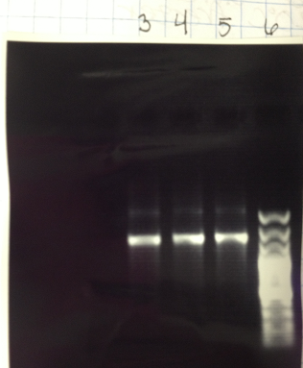
DNA Purification
Since the PCR showed bright bands at the range our target gene should be at (~1500 b.p.) we excised the DNA from the gel and purified it with a GeneJet Gel Extraction Kit
We then ran the DNA through a simple gel electrophoresis
- We had bright bands show up at around 1500 b.p. again, so we felt confident that our target gene had been successfully purified

Slide 17
T-vector ligation and transformation
We proceeded to T-vector ligation with our target gene using a pGEM-T Easy Vector kit
We then add DH5α (E. coli) to the ligated T-Vectors and grew the solution on ampicillin plates to find potentially viable colonies
Our results were:
  3Amp: 2 colonies (only one was present at the time of picking)
  2Amp: 0 colonies
  1Amp: 0 colonies
  +Amp: 20 colonies
  -Amp: 0 colonies
  -NoAmp: plate completely covered.
5 colonies from the positive control and the one colony from Amp 3 plate were picked and incubated in 5ml of LB overnight
Growth was observed in all tubes

Slide 18

Plasmid Extraction and DNA Confirmation
We used a GeneJet Plasmid Miniprep Kit to extract the plasmid from the DH5α cells
We then ran this through gel electrophoresis
We have a bright band at approximately 3000 b.p. which corresponds to the size of our vector (~3200 b.p.)
We did not notice a band for our target gene, but we sent it off for sequencing confirmation

Slide 19
DNA Sequencing
- Our results came back Tuesday
- Comparing the pGEM T-Easy Vector sequence to our sequenced PCR showed that the sequences were identical – there was no sign of our target gene

Slide 20
References
    Neil R. Williamson, 1 Henrik T. Simonsen, 2 Raef A. A. Ahmed, 2 Gabrielle Goldet, 2 Holly Slater, 1 Louise Woodley, 1 Finian J. Leeper 2 and George P. C. Salmond 1 *. "Biosynthesis of the Red Antibiotic, Prodigiosin, in Serratia : Identification of a Novel 2-methyl-3-n-amylpyrrole (MAP) Assembly Pathway, Definition of the Terminal Condensing Enzyme, and Implications for Undecylprodigiosin Biosynthesis in Streptomyces." (n.d.): n. pag. Print.
Serratia Marcescens., 2011. Web. 3 Sept. 2012. www.serratiamarcescens.net
http://microbewiki.kenyon.edu/index.php/Serratia_marcescens
Harris, A. K. P. "The Serratia Gene Cluster Encoding Biosynthesis of the Red Antibiotic, Prodigiosin, Shows Species- and Strain-dependent Genome Context Variation." Microbiology 150.11 (2004): 3547-560. Print.
Williamson, Neil R., Peter C. Fineran, Tamzin Gristwood, Suresh R. Chawrai, Finian J. Leeper, and George PC Salmond. "Anticancer and Immunosuppressive Properties of Bacterial Prodiginines." Future Microbiology 2.6 (2007): 605-18. Print.

