Slide 1
Global network analysis of drug tolerance, mode of action and virulence in methicillin-resistant S. aureus
Bobby Arnold
Alex Cardenas
Zeb Russo
Loyola Marymount University
Biology Department
16 November 2011

Slide 2
Outline
Staphylococcus aureus – human pathogen.
Treatments are important and antimicrobial peptides seem promising.
Responses modules when exposed to ranalexin showed varying regulation in genes.
Virulence factors inferred from experiments are collected.
Where scientists go from here.

Slide 3
Staphylococcus aureus is a human pathogen
Also referred to as MRSA (Methicillin Resistant Staphylococcus aureus) causes morbidity and mortality.
Strains are becoming resistant to treatments and is becoming a global problem.

Slide 4
Antimicrobial peptides fight against MRSA
AMPs seem to be a source of treatment to fight resistant bacteria (MRSA).
Produced by all living creatures for defense.
  Ranalexin – 20 a.a. peptide that has potent activity against Staphylococcus aureus.
Understanding transcriptome and proteome profiling is crucial to understanding mechanisms for antimicrobials.
  As these alter cell function by differing mRNA and protein profiles.
MRSA-252 genes studied by taking wide approach.

Slide 5
Outline
Staphylococcus aureus – human pathogen.
Treatments are important and antimicrobial peptides seem promising.
Responses modules when exposed to ranalexin showed varying regulation in genes.
Virulence factors inferred from experiments are collected.
Where scientists go from here.

Slide 6
Responses of MRSA when exposed to ranalexin
Upon ranalaxin exposure, genes downregulated secretion system components, which are vital to pathogenesis for MRSA.
  MRSA-252 ESAT-6 systems.
Genes associated with cell wall secretion and anchorage were also RanaDown.
Exposure results in repression of virulence factor expression

Slide 7
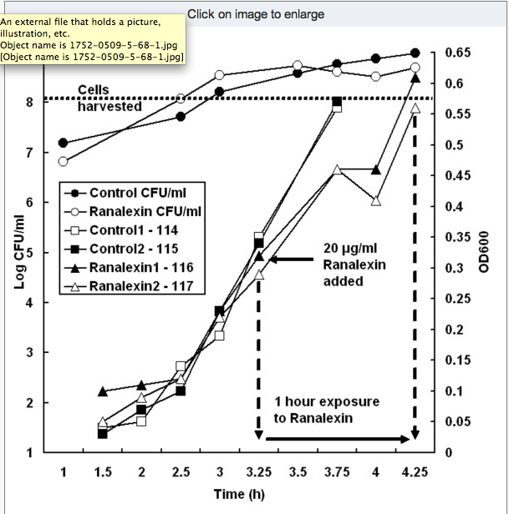
Impaired growth of MRSA when exposed to ranalexin

Slide 8
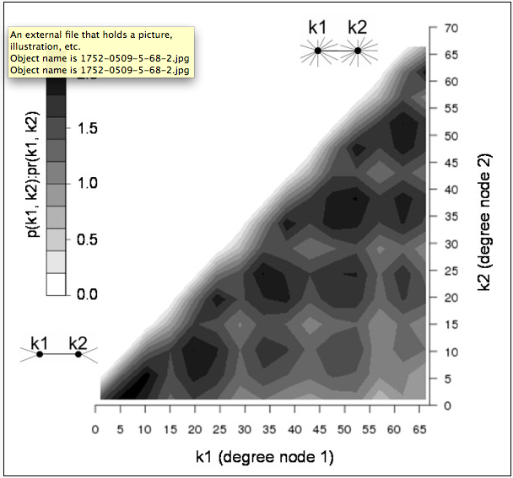
Gene functional association network
Probability of observing interacting pair of nodes in MRSA network.
Varying degrees are seen – k1, k2 and pr(k1,k2)
Bottom left shows low degree values.
Top right shows high degree values.

Slide 9
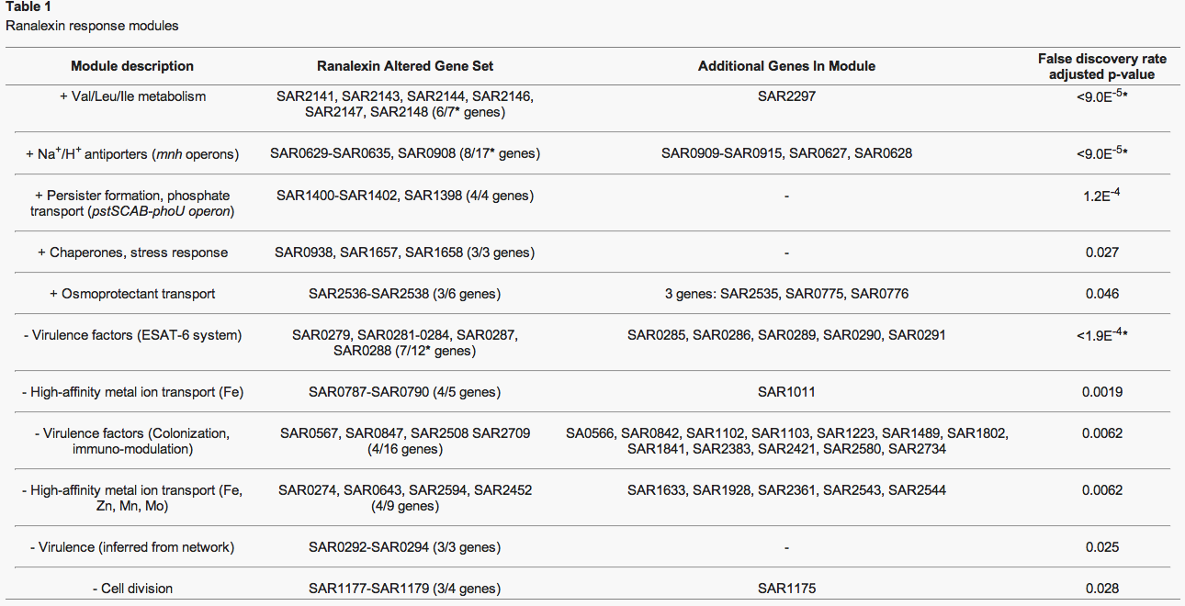

Slide 10
Ranalaxin shows impact on virulence and novel determinants
Significant module included 5 ESAT-6 components → the 6th gene not being assigned to a module.
SAR0288 predicted 6 transmembrane regions; SAR0287→ secreted or cell wall anchored. These two genes matched virulence-associated families.
Correspondence with operon structure that was predicted showed that genes may be co-regulated with ESAT-6 system.

Slide 11
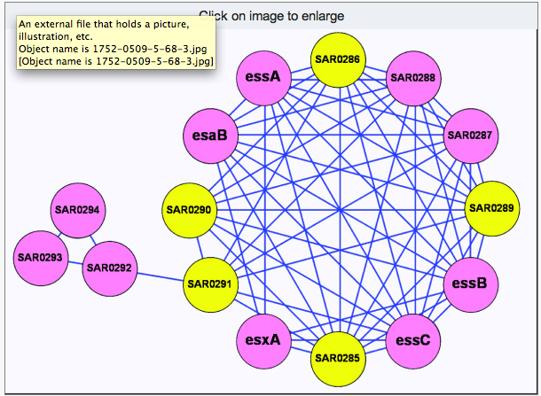
ESAT-6 downregulated virulence factors
Significantly downregulated genes are shown in pink, others genes are shown in yellow.

