Slide 1
Statistics
Or
Do our Data mean Diddly?

Slide 2
Why are stat important
Sometimes two data sets look different, but aren’t
Other times, two data sets don’t look that different, but are.

Slide 3
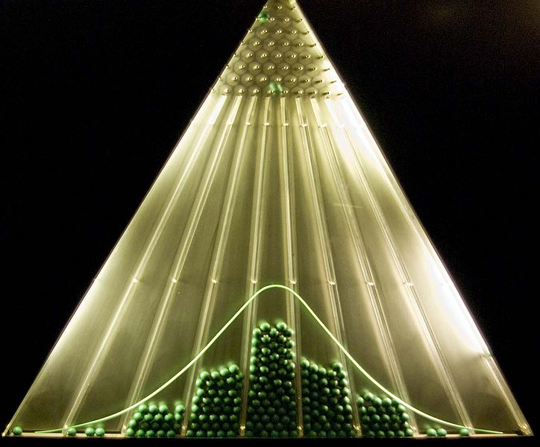
Normal Distribution
The data are centered around the mean
The data are distributed symmetrically around the mean
http://en.wikipedia.org/wiki/File:Planche_de_Galton.jpg
Notes:
For example, the average height for adult men in the United States is about 70 inches (178 cm), with a standard deviation of around 3 in (8 cm). This means that most men (about 68 percent, assuming a normal distribution) have a height within 3 in (8 cm) of the mean (67–73 in (170–185 cm)), whereas almost all men (about 95%) have a height within 6 in (15 cm) of the mean (64–76 in (163–193 cm)). If the standard deviation were zero, then all men would be exactly 70 in (178 cm) high. If the standard deviation were 20 in (51 cm), then men would have much more variable heights, with a typical range of about 50 to 90 in (127 to 229 cm).

Slide 4
Mean μ vs
The entire population mean is μ
Sample population mean is
As your sample population gets larger,
Data Set
  2, 3, 4, 4, 5, 5, 6, 6, 7, 7, 8, 9
Mean

Slide 5
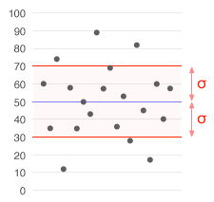
Standard Deviation
Describes how data are expected to vary from the mean
σ is s.d. of population
s is s.d. of sample
  μ = 50
  σ = 20
http://en.wikipedia.org/wiki/File:Standard_deviation_illustration.gif

Slide 6
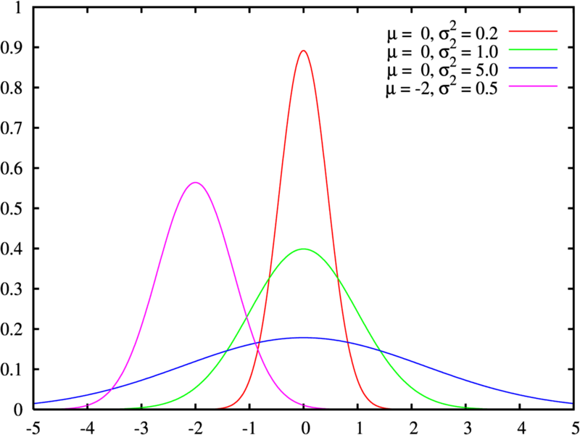
Meaning of Standard Deviation
Red, Green, Blue all same mean
Different standard deviation

Slide 7
Meaning of Standard Deviation
Data with a larger spread (blue and green) have a larger Standard Deviation

Slide 8
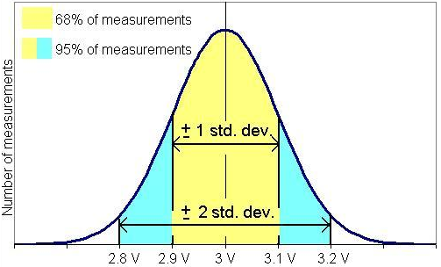
Standard Deviation
68% of values are within 1 standard deviation
95% of values are within 2 standard deviations of the mean

Slide 9
T-tests
Assumptions
  Data are normally distributed
  The mean is independent of the standard deviation
    μ ≠ f(σ)
Various types
  One sample t-test
    Are these data different than the entire population?
  Two sample t-test
    Do these two data sets come from different populations?
  Paired t-test
    Do individual changes show an overall change?

Slide 10
Use t-test to compare means
We have and
  Do they come from different populations?
    Are and different?
Null Hypothesis H_{o}:
  =
Alternative Hypothesis H_{a}:
  >
t statistic tests H_{o}. If t < 0.05, then reject H_{o} and accept H_{a}

Slide 11
Application
Hawks | Cyclones
9 | 4
8 | 6
7 | 5
6 | 2
7 | 4
8 | 5
X₁ 7.5 | X₂ 4.3
s₁ 1.0 | s₂ 1.4
t_{calc} = 4.6
t₉₅ = 2.2
t_{calc} > t₉₅
HAWKS WIN!
Go to table in notes to find t₉₅ with 11 degrees of freedom (12-1)
(The excel sheet does a different comparison)

Slide 12
Exercise 99%
MIT | Harvard
100 | 46
87 | 54
56 | 76
87 | 92
98 | 87
90 | 60
X₁ 86.3 | X₂ 69.2
s₁ 15.9 | s₂ 18.6
t=?
t_{calc} = 1.79
t₉₉ = ?
t_{calc} ? T₉₉
Go to table in notes to find t₉₉ with 11 degrees of freedom (12-1)
(The excel sheet does a different comparison)

Slide 13
Confidence Intervals
Use t to find interval containing μ if is known
Example:
t₉₅ = 2.6
6.4 < μ <8.6
I am 95% confident that the population mean lies between 6.4 and 8.6
Hawks | Cyclones
9 | 4
8 | 6
7 | 5
6 | 2
7 | 4
8 | 5
X₁ 7.5 | X₂ 4.3
s₁ 1.0 | s₂ 1.4

Slide 14
Exercise
You find confidence interval of μ₁ at the 99% confidence interval
t₉₉ = ?
Hawks | Cyclones
9 | 4
8 | 6
7 | 5
6 | 2
7 | 4
8 | 5
X₁ 7.5 | X₂ 4.3
s₁ 1.0 | s₂ 1.4
4.032
?< μ < ?
5.85 < μ < 9.15

Slide 15
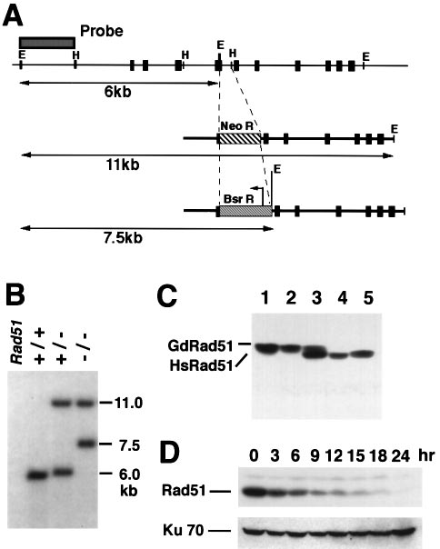
Figure 2

Slide 16
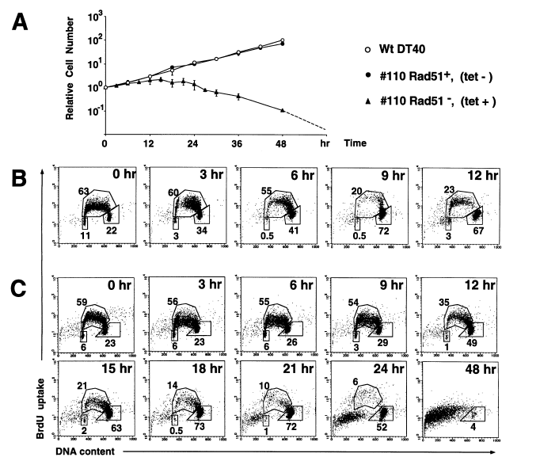
Notes:
RAD51 is being knocked out by adding tet. TET KOs RAD51
We are comparing how WT cells react to gamma irridation to knocking out te

Slide 17
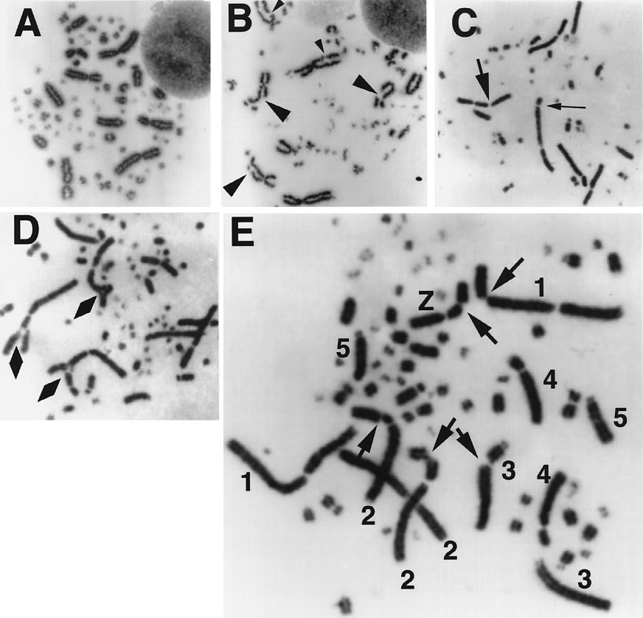

Slide 18
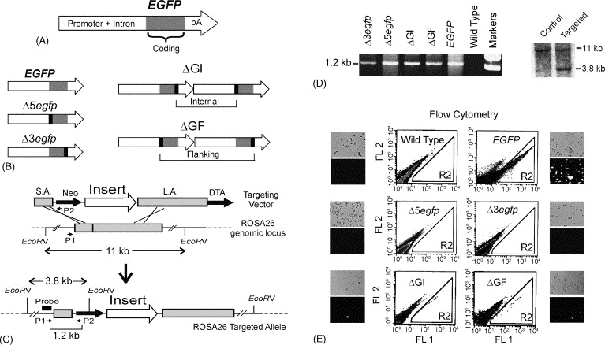
Targeted cells showed green fluorescence via flow cytometry at expected frequency.
Jonnalagadda, et al. 2005 DNA Repair. (4) 594-605.

