Slide 1
Cloning the Cstps-1 gene from Citrus sinensis: Team 19: Orange you glad we didn’t say banana?
Orijit Kar
Beth Anderson
Cassidy Albertson

Slide 2
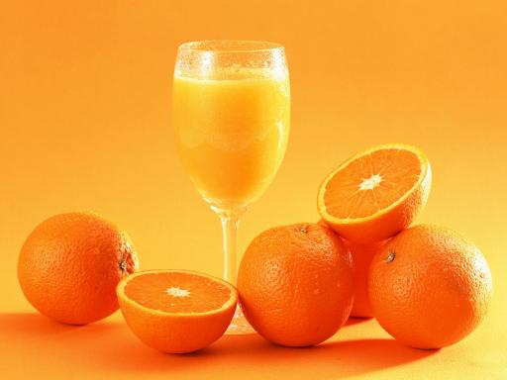
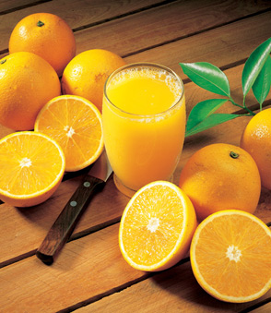
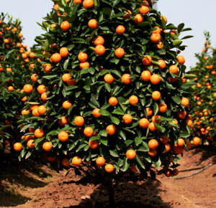
Citrus sinensis: The Valencia Orange
Oranges are the most popular tree fruit, originating in South and Southeast Asia.
Valencia oranges developed in the 19th century in California
Used largely for juice production.

Slide 3
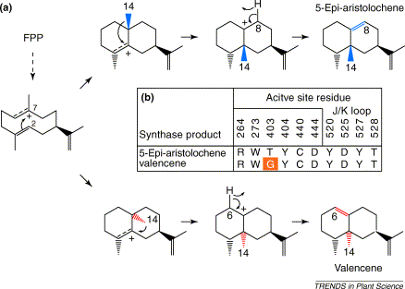
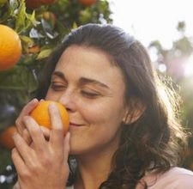
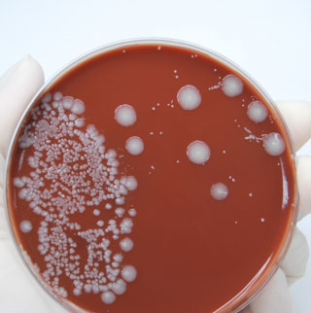
Biochemical goals
In Citrus sinensis, the Cstps-1 gene codes for the production of the enzyme Citrus Valancene Synthase (CVS).
In vivo, CVS reacts with farnesyl pyrophosphate (FPP) to produce the characteristically fragrant valencene (as well as 5-Epi-aristolochene).
Valencene is one of the compounds responsible for the characteristic “orange” smell.

Slide 4
Initial Plan
Isolate DNA
Amplify w/PCR
Sequence
Ligate into T-Vector
Introns?
Yes
Design new Primers
No
Transfer to Biobrick Vector
Test w/ Substrate
Select Recombinants
Transform

Slide 5
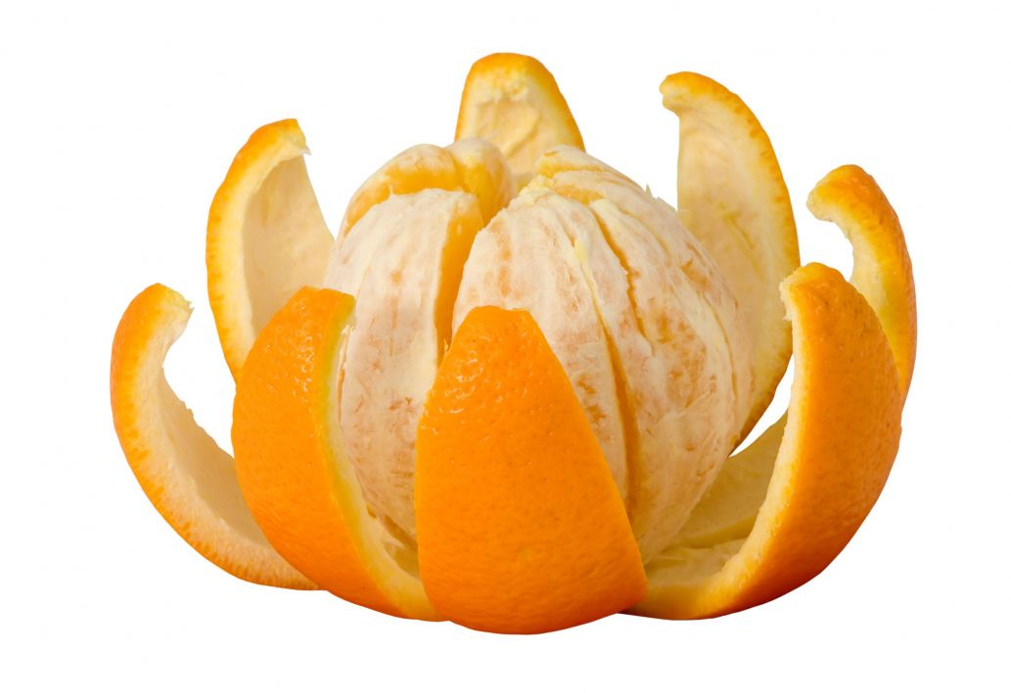
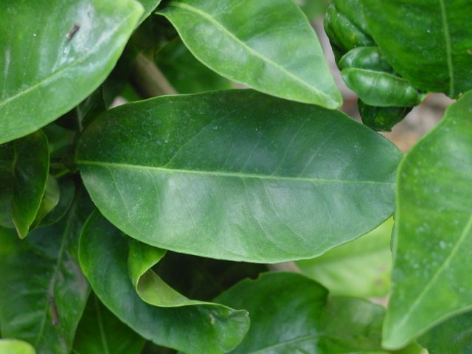
DNA Isolation
Attempt 1
Extraction of DNA from 2 sources: • Pulverized Fruit Tissue
• Pulverized Fruit Peel
Attempt 2
Extraction of DNA from same 2 sources
- Identified procedural error in Attempt 1
- Extra care was taken to avoid human errors
Fruit
Likely Polysaccharide Contamination
Peel
Leaf
http://beautynust.blogspot.com/2010/12/citrus-fruits-natural-remedy-during.html
Attempt 3
• Obtained Leaf tissue from live plant
• Pulverized → Extracted → Success!
http://www.hort.purdue.edu/ext/senior/fruits/orange3.htm

Slide 6
Isolations from Fruit & Peel (9/15-9/27)
-
Attempt 1 (9/15-9/20)
Gel Analysis & Visualization
1.4% agarose gel-electrophoresis (45m @ 150 V)
2.0µL EtBr added to gel- allowed visualization under UVB light
GeneRuler™ 100bp Plus DNA Ladder used for calibration [100-3000bp]
Attempt 2 (9/22-9/27)
+
Results: No DNA
Attempt 2
+
Several grams of fruit and peel tissue were excised from a fresh orange
Tissue samples flash-frozen with liquid nitrogen and pulverized
Qiagen® DNEasy™ Plant Mini protocol used for DNA Extraction
-

Slide 7
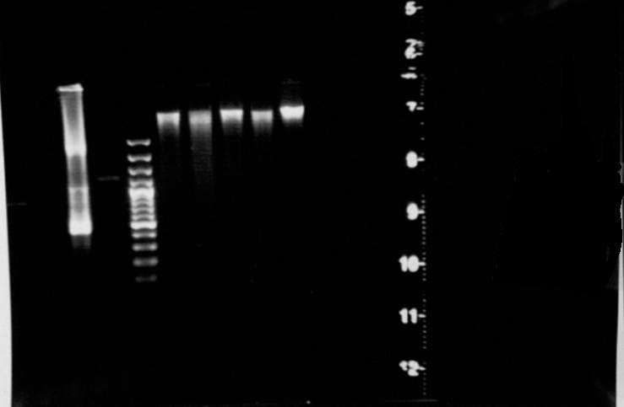
Isolation from Leaf Tissue (10/4-10/6)
Several fresh leaves procured from live Citrus sinensis at a local nursery
Tissue was flash-frozen with liquid nitrogen and pulverized using mortar & pestle
Qiagen® DNEasy™ Plant Mini Kit used for extraction
Gel Analysis & Visualization
1.4% agarose gel-electrophoresis (45m @ 150 V)
2.0µL EtBr added to gel- allowed visualization under UVB light
GeneRuler™ 100bp Plus DNA Ladder used for calibration [100-3000bp]
-
Digestible DNA
Conclusions
Leaf tissue contained less polysaccharide “junk” than fruit or peel.
Excess polysaccharides can impede a successful DNA extraction
+

Slide 8
PCR Amplification
20µL/rxn
4-7 reactions/PCR,
+C, -C, -/-C used
Storage: -20ºC (except Template = -80ºC)
Prepared on ice
Annealing Thermogradient (ºC)
A | B | C | D | E | F
59.2 | 56.3 | 52 | 46.5 | 42 | 40
Final Reaction Ingredients
Ingredient | Quantity
Kit-ready Mastermix (+TaqP), 2x | 10 µL
Forward Primer (19_orange1_F), 10µM | 0.8 µL
Reverse Primer (19_orange2_R), 10µM | 0.8 µL
Water (dd, UVGI) | 7.4µL
Template DNA | 1.0µL
D
E
A
72ºC,
5m
94ºC, 30s
30s
H
15ºC,∞
30x
• Results elucidated & analyzed via 1.0% agarose gel electrophoresis (@150V, 45m)

Slide 9
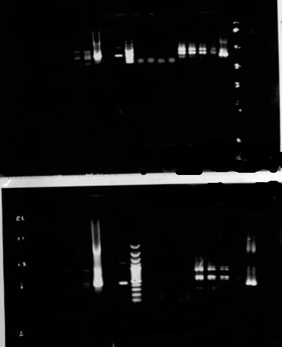
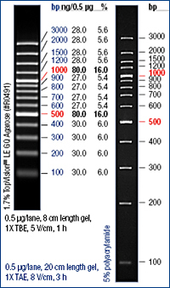
Initial PCR Amplification (10/11-10/13)
Annealing Thermogradient (ºC)
Visualized using 1.0% Agarose Gel + EtBr
Under UVB Light
A | B | C | D | E | F
61 | 59.2 | 56.3 | 52 | 46.5 | 42
After 45 min
46.5 °
-
D
Conclusions
Lanes A-D = no amplification
Lanes E-F = some amplification
E
42°
+
A
72ºC,
2m
94ºC 30s
30s
After 90 min
H
Now What?
Try longer extension time per cycle ~ more amplification
30x
15ºC,∞
+C
Ladder
-C
-/-C

Slide 10
Cycle-Time Optimized PCR (10/18-10/20)
D
E
Ladder
42°
A
72ºC,
5m
-C
59.2°
94ºC, 30s
+C
30s
H
30x
15ºC,∞
3000 bp
1500 bp
Annealing Thermogradient (ºC)
A | B | C | D | E | F
61 | 59.2 | 56.3 | 52 | 46.5 | 42
After 60 min
Visualized using 1.0% Agarose Gel + EtBr
Under UVB Light
Lane B amplified fragment ~ 3000 bp
Now What?
Perform another amplification to determine whether this 3000 bp fragment is significant or just a rogue
Optimize conditions further by tweak the annealing temperature gradient
Results & Conclusions:
Improved band definition
Lane F amplified like last time
Once again, too small

Slide 11
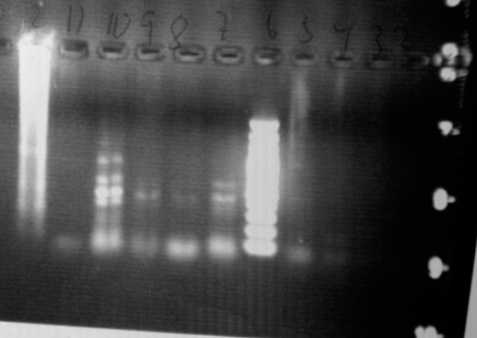
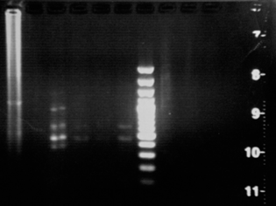
PCR #3 (10/27-11/1)
Optimized Annealing Thermogradient (ºC)
Time: 30 minutes
A | B | C | D | E | F | G | H
59.2 | 58.2 | 56 | 52.7 | 48.5 | 45.3 | 43.2 | 42
Results:
Promising bands in lanes E and H.
Run Gel longer for more defined bands.
Results
DNA is amplified but fragments too small. (< 1000 bp )
Hopeful band from previous PCR turned out to be an anomaly since it did not show up again.
Time: 60 minutes
Now What?
Attempt amplification using double DNA volume (8µL)
This may produce more clear and more precise results

Slide 12
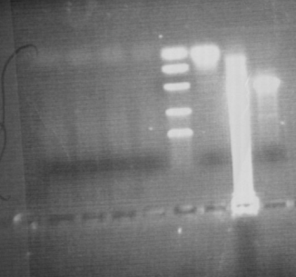
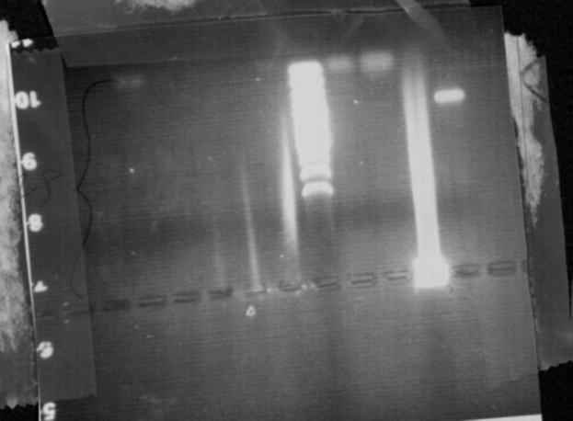
Double DNA PCR#1 – 2 (11/3-11/10)
*A
*B *C
*D
*E
DD PCR #1
11/3 – 11/8
Visualized using 1.0% agarose gel + EtBr under UVB light
DD PCR #2
11/8 – 11/10
Visualized using 1.0% agarose gel + EtBr under UVB light
Results
*D) PCR did not work again (i.e. no amplification)
*E) Negative control not contaminated this time
Neither extraction produced results: problem is not from DNA extraction problems.
Conclusions
No results have been obtained using 8 microliters of DNA whereas results have been obtained using 4 microliters.
Next: amplify both extractions using both 1 and 4 microliters of DNA in hopes of results to cut out and purify.
Now What?
We need amplified DNA to proceed
Since 4µL DNA/Reaction = some results, run another PCR with 4µL.
Simultaneously run reactions using 1µL DNA
Results
*A) Our amplified products appear to contain no DNA
*B) The incorrect calibration ladder was used.
*C) The negative control is not pure since it contains DNA
Conclusions
Causes: too little DNA hinders amplification, to much can do the same.
- Impure DNA can amplify the incorrect pieces and DNA is not visible
- We used an extraction of DNA that was not valid.
Primers did not work
Now What?
In next PCR: use samples from both extractions

Slide 13
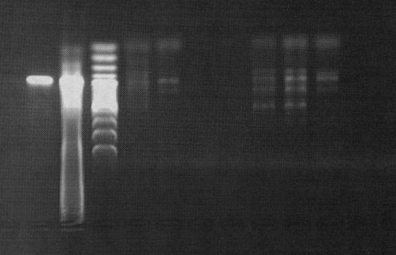
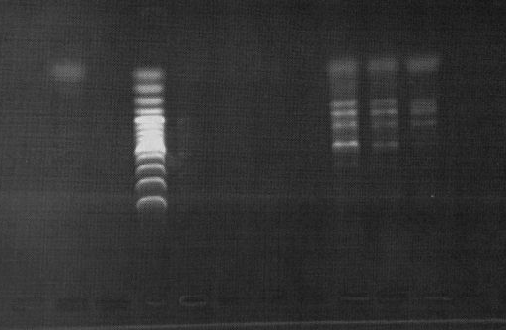
Final Product Analysis, New Attempts, Complications
1.0% agarose gel-electrophoresis (45m @ 150 V)
2.0µL EtBr added to gel- allowed visualization under UVB light
GeneRuler™ 100bp Plus DNA Ladder used for calibration [100-3000bp]
+
1µL DNA
-
+
• 3 of 5 total PCR attempts yielded results
• Length of amplified product consistently too small!
Gene ~1650 bp
-

Slide 14
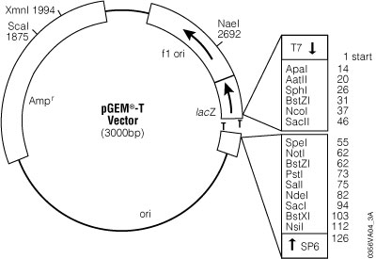
DNA Purification & T-Vector Ligation (11/17)
• Strongest bands from final PCR physically cut from gel
Purified using pGEM T-Easy vector protocol
• Analyzed with nano-spectophotometer
• DNA concentrations: ~ 6-8 ng/µL
• Ligation via dA-dT cloning to pGem-EasyT® vector
Reagent | Volume
2x Rapid Ligation Buffer | 1.0µL
pGEM® T Easy Vector | 1.0µL
PCR Product | 2/3µL
T4 DNA Ligase | 1.0µL
Water (dd, UVGI) | 6/5µL

Slide 15
Transformation and Innoculation (11/29 – 11/30)
Our final step we were able to attempt was transformation into competent E. coli cells.
After an incubating error our E. coli appeared to be in the beginning stages of growth.
This would have lead to another purification, ligation, and retry on transformation.

Slide 16
Conclusion
With a trial and error system in place. We successfully attempted multiple steps many times. However, due to our error in transformation it is inconclusive if our gene was the DNA we extracted.

Slide 17
Acknowledgements
Dr. Axel Schwekendiek and UNI Biology
Integrated DNA Technologies, Coralville
Jordan’s Nursery, Cedar Falls
UNI Dining Services
Promega Protocols
Fermentas
Qiagen

Slide 18
References
Chappell, Joe (2004), “Valencene synthase – a biochemical magician and harbinger of transgenic aromas.” Trends in Plant Science, Vol. 9, No. 6, June 2004.
Cheng, Yun-Jiang, et. al. (2003), An efficient protocol for genomic DNA extraction from Citrus Species.” Plant Molecular Biology Reporter,
21: 177a-177g, June 2003.
Sharon-Asa, et. al. (2003), “Citrus fruit flavor and aroma biosynthesis: isolation, functional characterization, and developmental regulation ofCstps1, a key gene in the production of the sesquiterpene aroma compound valencene.” The Plant Journal, 36: 664–674.

