Slide 1
Within Strain ANOVA for All Strains
ANOVA | WT | dCIN5 | dGLN3 | dHAP4 | dSWI4
p < 0.05 | 2377 (38%) | 1995 (32%) | 1856 (30%) | 2387 (39%) | 2583 (42%)
p < 0.01 | 1531 (25%) | 1157 (19%) | 1007 (16%) | 1489 (24%) | 1679 (27%)
p < 0.001 | 850 (14%) | 566 (9.1%) | 398 (6.4%) | 679 (11%) | 869 (14%)
p < 0.0001 | 449 (7.3%) | 280 (4.5%) | 121 (2.0%) | 240 (3.9%) | 446 (7.2%)
B & H p < 0.05 | 1673 (27%) | 1117 (18%) | 889 (14%) | 1615 (26%) | 1855 (30%)
Bonferroni p < 0.05 | 226 (3.7%) | 109 (1.8%) | 20 (0.3%) | 61 (1.0%) | 179 (2.9%)

Slide 2
Modified T-Test for Wild-type
 | Cold Shock |  | Recovery
t test | t₁₅ | t₃₀ | t₆₀ | t₉₀ | t₁₂₀
Average Log Fold Change > 0.25 and p < 0.05 | 582 (9.4%) | 865 (14%) | 933 (15%) | 439 (7.1%) | 230 (3.7%)
Average Log Fold Change < -0.25 and p < 0.05 | 486 (7.9%) | 717(12%) | 867 (14%) | 309 (5.0%) | 274 (4.4%)
Total p < 0.05 | 1075 (17%) | 1587 (26%) | 1814 (29%) | 749 (12%) | 509 (8.2%)
Total B & H p < 0.05 | 0 (0%) | 85 (1.4%) | 0 (0%) | 0 (0%) | 1 (0.016%)
Total Bonferroni p < 0.05 | 0 (0%) | 1 (0.016%) | 0 (0%) | 0 (0%) | 1 (0.016%)

Slide 3
Modified T-Test for All Strains
 | Cold Shock |  | Recovery
P<0.05 | t₁₅ | t₃₀ | t₆₀ | t₉₀ | t₁₂₀
wt | 1075 (17%) | 1587 (26%) | 1814 (29%) | 749 (12%) | 509 (8.2%)
dCIN5 | 1393 (23%) | 756 (12%) | 1250 (20%) | 634 (10%) | 351 (5.7%)
dGLN3 | 1027 (17%) | 1622 (26%) | 628 (10%) | 558 (9.0%) | 403 (6.5%)
dHAP4 | 1197 (19%) | 1772 (29%) | 2006 (32%) | 234 (3.8%) | 515 (8.3%)
dSWI4 | n/a | 1497 (24%) | 1757 (28%) | 1075 (17%) | 705 (11%)

Slide 4
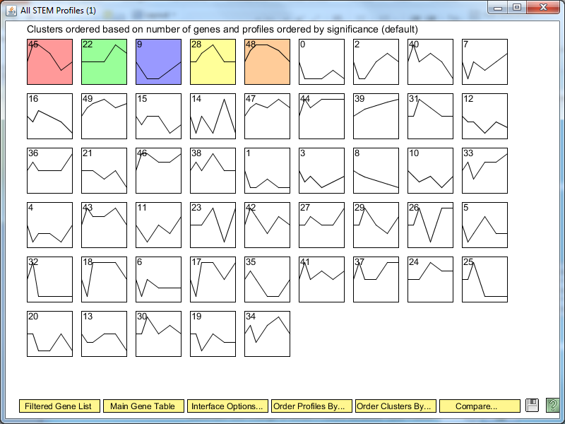
STEM Profiles based on Wild-type Data

Slide 5
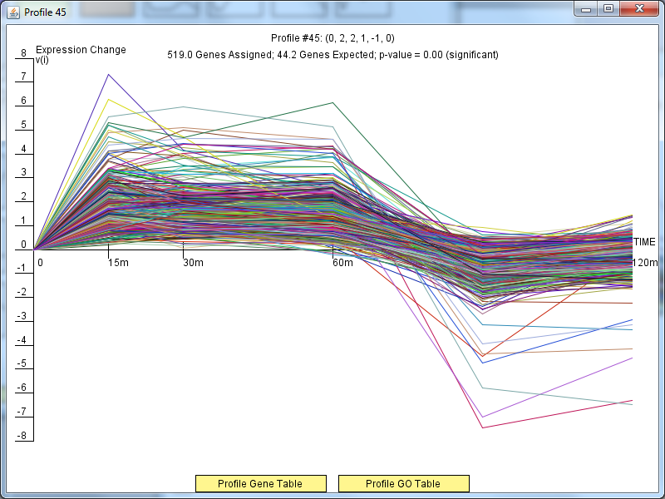

Slide 6
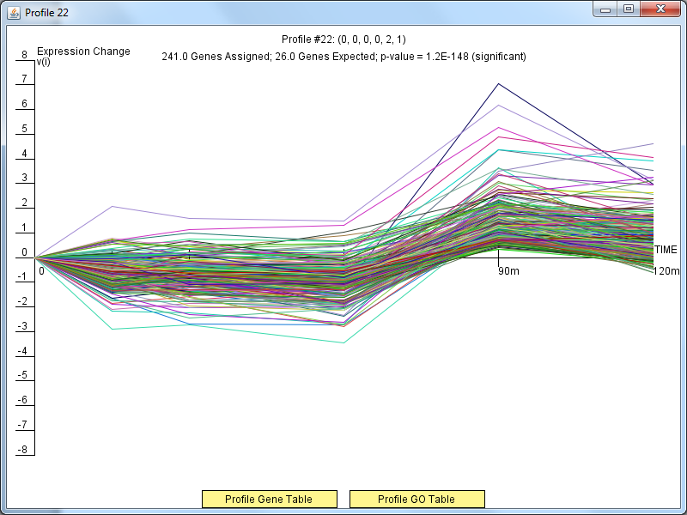

Slide 7
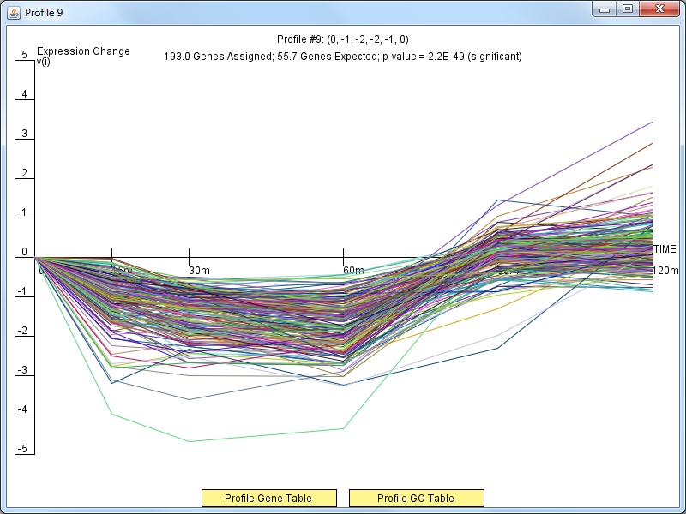

Slide 8
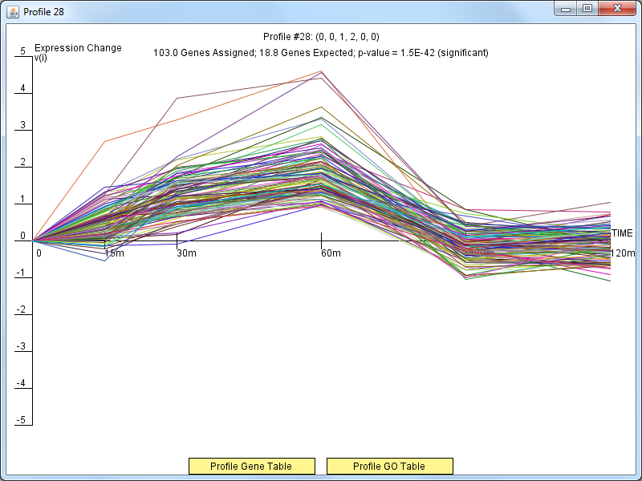

Slide 9
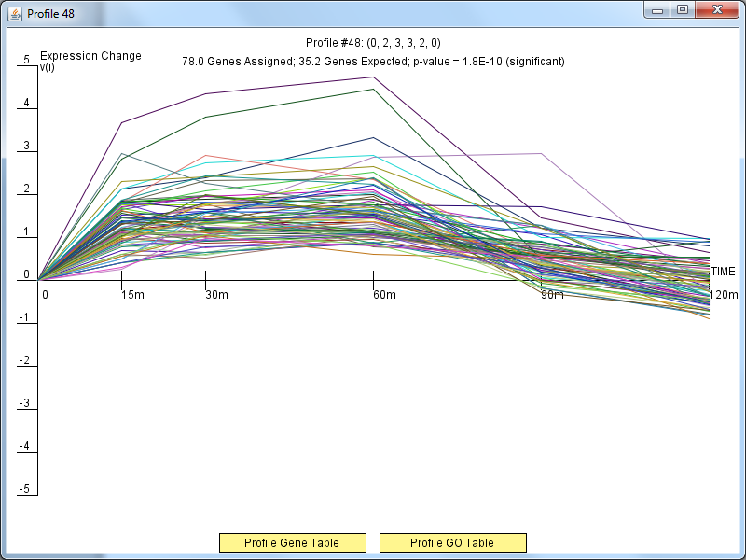

Slide 10
Between Strain ANOVA with All Strains vs. Wild-type
Comparison | P<0.05 | B-H p<0.05
Wt vs. dCIN5 | 563 (9.1%) | 4 (0.065%)
Wt vs. dGLN3 | 720 (12%) | 36 (0.58%)
Wt vs. dHAP4 | 640 (10%) | 23 (0.37%)
Wt vs. dHMO1 | 556 (9.0%) | 5 (0.081%)
Wt vs. dZAP1 | 553 (8.9%) | 31 (0.50%)
Wt vs. Spar | 1498 (24%) | 703 (11%)

Slide 11
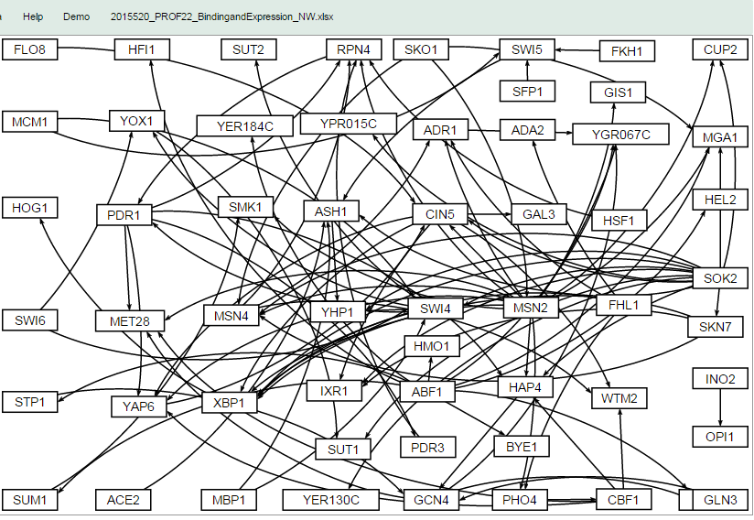

Slide 12
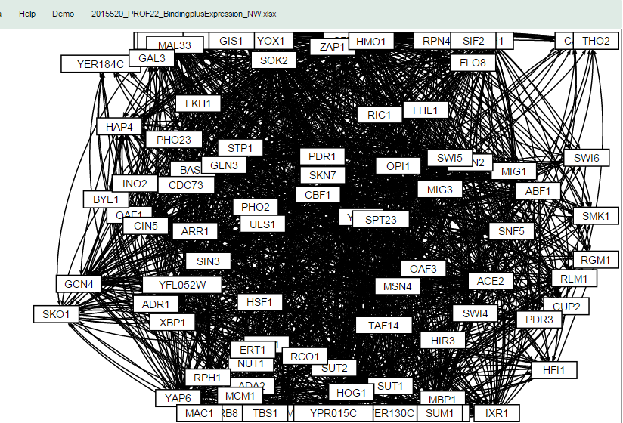

Slide 13
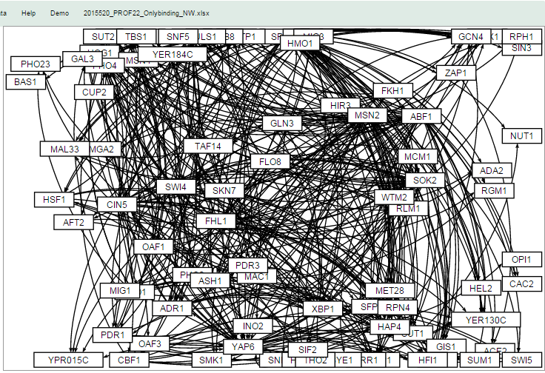

Slide 14
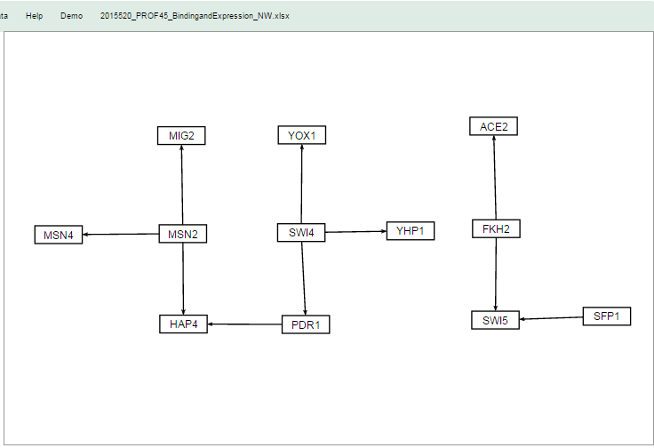

Slide 15
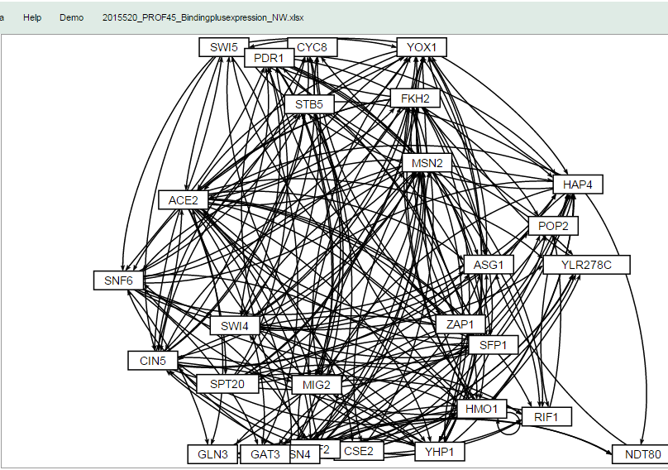

Slide 16
