Slide 1
Unit 4
Medical Biotechnology I

Slide 2
Lesson 1
Disease Detection
Lecture- Model organisms, biomarkers, Human Genome Project contribution to disease detection.
Create a concept map demonstrating how designated terms and concepts are related.

Slide 3
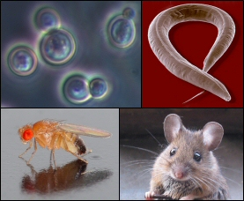
Disease Detection
Models of Human Disease
Many medical biotechnology treatments in disease are made possible because of model organisms.
We share a large number of genes with other organisms.
Genes in other organisms that have sequence similarities to humans are called homologues
A number of genetic diseases occur in model organisms.

Slide 4
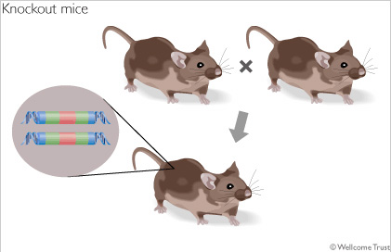
Disease Detection
When researchers study homologues for diseases, they are interested in two things.
What does the gene do? i.e. proteins and molecules that contribute to the disease.
What happens if gene transcription is disrupted.? i.e the disease trait can be eliminated from the organism.
Genes that have been eliminated are called knockouts.

Slide 5
Disease Detection
Knockouts
Knockouts are genetically engineered.
The active gene is either replaced or disrupted with an inactive DNA sequence.
Depending on where the inactive DNA sequence is inserted into the gene, there can be a variety of outcomes.
Most often, the trait expression is eliminated.

Slide 6
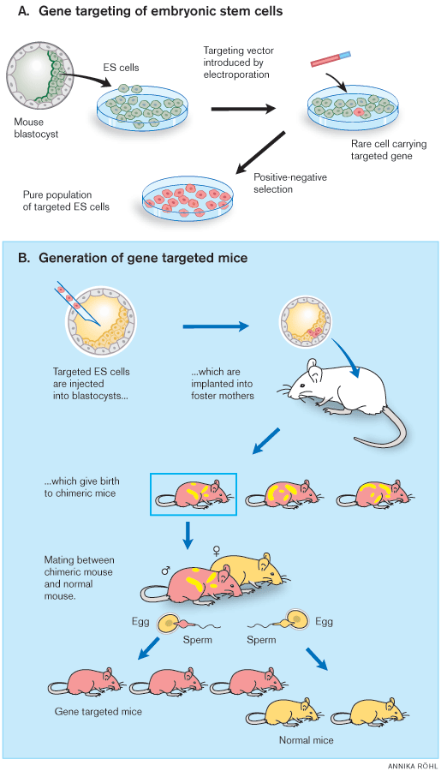
Disease Detection
Knockouts
Engineered genes are inserted into a blastocyst and it is implanted into a female mouse.
Off spring are bred through 2-3 generations until a knockout mouse, homozygous for the knockout genes, is produced.
Often drugs are tested on the knockout mice. The expectation is that the drug would have an effect on a diseased mouse and no effect on a knockout mouse.
If the knockout mouse is effected, it can indicate there would be side effects in humans.

Slide 7
Disease Detection
http://learn.genetics.utah.edu/content/tech/transgenic/
Knockout Mice

Slide 8
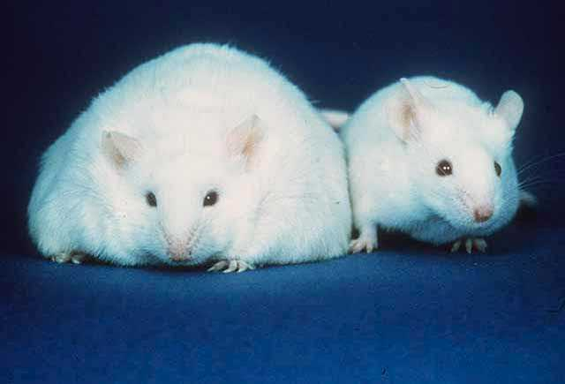
Disease Detection
Examples of model organisms in detection.
Ob gene is linked to obesity. Mice without the Ob gene become obese. Ob codes for leptin, which regulates hunger telling the body when it is full.
This discovery led to treating obese human children with leptin and they have responded well in preliminary studies.

Slide 9
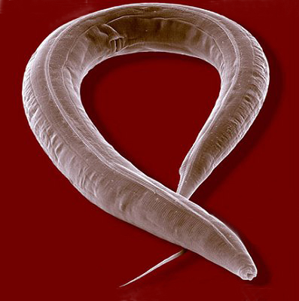
Disease Detection
Examples of model organisms in detection.
In developing embryos, some cells must die to make room for others (apoptosis). How is this determined?
A study of C. elegans, a roundworm, allowed scientists to determine the fate or lineage of all of its embryonic cells. Understanding programmed cell death has application to Alzheimer disease, Huntington disease, and Parkinson disease.

Slide 10
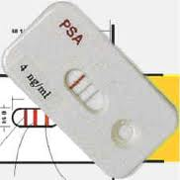
Disease Detection
Biomarkers
For many diseases, early detection is critical.
One detection approach is to look for biomarkers as indicators of disease.
Biomarkers are proteins whose production is increased in diseased tissues.
Many biomarkers are released into blood and urine as a product of cell damage.
EX. A protein called prostate specific antigen (PSA) is released into the blood when the prostate gland is inflamed.
Elevated PSA levels indicate inflammation and even cancer.
Many companies are working on a variety of biomarkers that can be used in disease detection.

Slide 11
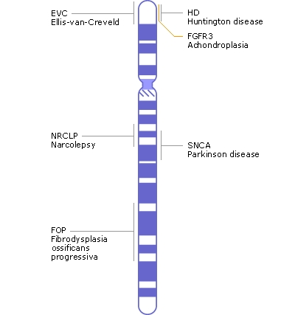
Disease Detection
Human Genome Projects
Prior to the Human Genome Project, about 100 disease could be tested for.
Now there are genetic tests for over 2,000 diseases.
The HGP developed chromosome maps showing locations of normal and diseased genes.
Chromosome 4

Slide 12
Lesson 2
Disease Detection: Testing
Work in groups of 4. Read powerpoint on amniocentesis, RFLP analysis, SNPs, and microarray.
Discuss content with your group and respond to questions.
Watch animation for Amniocentesis , RFLP analysis, SNPs
Complete Questions
Complete SNP activity.
Complete Microarray Simulation

Slide 13
Genetic Testing
Amniocentesis
Until recently, most genetic testing occurred on fetuses to identify gender and genetic diseases.
Amniocentesis is one technique used to collect genetic material for genetic testing.
When the developing fetus is around 16 weeks of age, a needle is inserted into the mother’s abdomen into a pocket of amniotic fluid that surrounds and cushions the fetus. Amniotic fluid is removed.
The fluid contains cells from the fetus, such as skin cells.
Skin cells are cultured to increase their number.
Mitotic chromosomes are removed and stained to create a karyotype
http://www.youtube.com/watch?v=bZcGpjyOXt0

Slide 14
Genetic Testing
Chorionic Villi Sampling
Chorionic villi Sampling (CVS) can also be done to diagnose genetic disease in fetuses who are 8 -10 weeks in age.
A suction tube removes a layer of cells called the chorionic villus, tissue that helps make up the placenta.
CVS collects enough cells so a karyotype can be made from the cells retrieved.
http://video.about.com/pregnancy/Chorionic-Villus-Sampling.htm

Slide 15
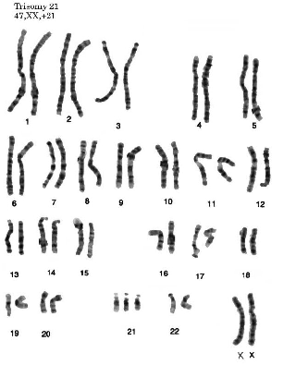
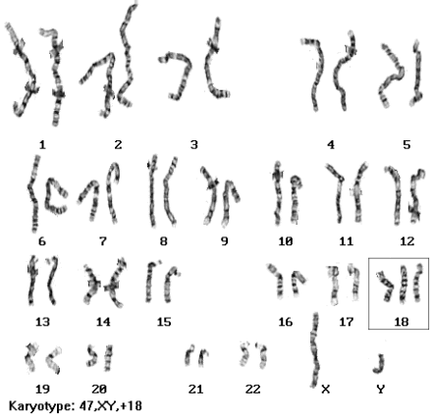
Genetic Testing
Karyotypes

Slide 16
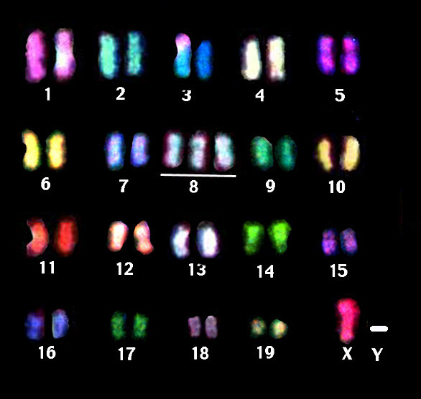
Genetic Testing
Karyotyping can be carried out with adults.
Typically blood is drawn and white blood cells are used.
Fluorescence in situ hybridization(FISH) is used.
Chromosomes are hybridized with fluorescent probes.

Slide 17
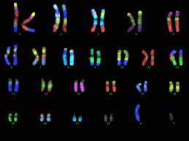
Genetic Testing
Karyotypes
FISH can be performed with probes that fluoresce different colors.
This is called spectral karyotyping.
It is very useful in identifying missing parts of chromosomes, extra chromosomes, and translocation mutations.

Slide 18
Genetic Testing
RFLP Analysis
Most genetic diseases result from gene mutations rather than chromosomal abnormalities
The basic idea behind restriction length polymorphisms analysis (RFLP) is that a defective gene may be cut differently than its normal counterpart by restriction enzymes.
If DNA from a healthy individual (HBB gene) and DNA from an individual (HBB gene) with sickle cell disease are cut by restriction enzymes, the fragments will be different sizes because the base sequences are different.
DNA from a patient is subjected to restriction enzymes and the DNA fragments undergo gel electrophoresis.
Patient DNA fragment length is compared to normal fragment lengths to diagnose disease
http://highered.mcgraw-hill.com/olcweb/cgi/pluginpop.cgi?it=swf::535::535::/sites/dl/free/0072437316/120078/bio20.swf::Restriction%20Fragment%20Length%20Polymorphisms

Slide 19
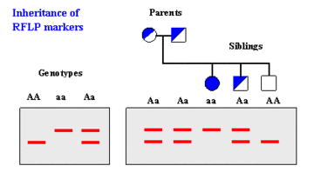
Genetic Testing
RFLP Analysis

Slide 20
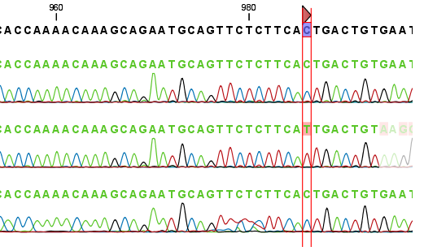
Genetic Testing
Single Nucleotide Polymorphisms
99.9% of DNA sequencing is identical in humans.
One of the common forms of genetic variations (in the .1%) in humans is called the single nucleotide polymorphism.
SNPs are single nucleotide changes that vary from person to person.
SNPs occur about every 100 to 300 base pairs and most of them are in non coding regions of DNA.
If a SNP occurs in a gene sequence, it can produce disease or confer susceptibility for a disease.

Slide 21
Genetic Testing
SNPs
Because SNPs occur frequently throughout the genome, they are valuable markers to identifying disease related genes.
SNPs are being used to predict stroke, cancer, heart disease, and behavioral illnesses.
Many groups of SNPs on the same chromosome are called a haplotype.
The HapMap project is identifying and cataloguing the chromosomal location of over 1.4 million SNPs present in 3 billion base pairs of the human genome.
Complete the SNP activity. http://www.pbs.org/wgbh/nova/teachers/activities/0302_01_nsn.html

Slide 22
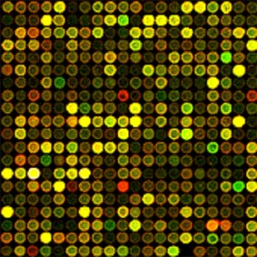
Genetic Testing
DNA Microarray
DNA microarrays are called gene chips.
They are a key techniques to studying genetic diseases.
Researchers use microarrays to screen a patient for a pattern of genes that might be expressed in a particular disease.

Slide 23
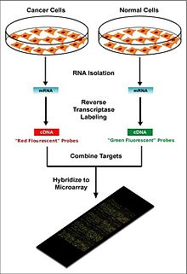
Genetic Testing
DNA Microarray
An example of a use for DNA microarray would be a comparison of healthy and cancer cell DNA.
mRNA from both types of cells is isolated.
c DNA is synthesized from the mRNA in each cell type using reverse transcriptase.
cDNA is labeled with a fluorescent dye and is applied to a microarray slide; different color dye is used for cancer and healthy cells.
The slide has up to 10,000 “spots” of DNA on it; each represents unique sequences of DNA for a different gene.
The slide is incubated overnight and the cDNA hybridizes to complimentary DNA strands on the microarray slide.

Slide 24
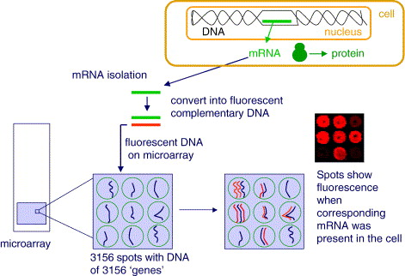
Genetic Testing

Slide 25
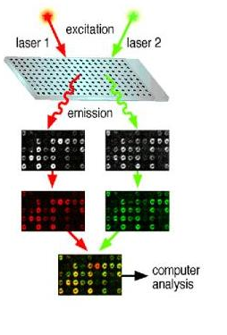
Genetic Testing
DNA Microarray
The slide is scanned by a laser that causes the dye to fluoresce when cDNA binds to gene DNA on the slide.
The fluorescent spots indicate which genes are expressed in the cells of interest.
Gene expression patterns from each of the cell types is compared to see which genes are active in a healthy cell and which are active in a cancer cell.
Results of microarray studies can be used to develop new drugs to combat cancer and other diseases.

Slide 26
Genetic Testing
http://learn.genetics.utah.edu/content/labs/microarray/
Visit the virtual DNA microarray simulation for a detailed description of the procedure.

Slide 27
Lesson 3
Case Study: Pharmacogenetics.
Powerpoint introduction
Work in groups of 4 to read and discuss each section of the pharmacogenetics case study.
Respond to case study questions.
Whole class discussion of responses.

Slide 28
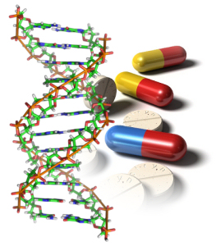
Pharmacogenetics
Pharmacogenetics
With information from genomics and genetic testing such as SNPs and microarray, a new field that studies how the genome is affected by and responds to different drugs has emerged.
This new field is called pharmacogenetics.
Pharmacogenetics uses genetic testing information to design a personal drug treatment plan based on an individual’s genetic variations.
Genome tailored drug treatments could reduce drug side effects, drug interactions, and even death.
http://sonet.nottingham.ac.uk/rlos/cetl/pharmacogenetics/

Slide 29
Lesson 4
Treatments for Disease
Lecture- Nanotechnology, Artificial Blood, and Monoclonal Antibodies.
Powerpoint presentation of content.

Slide 30
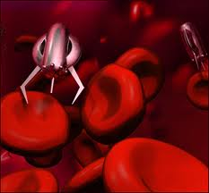
Nanotechnology
For homework:
Visit the following website and respond to questions.
http://www.nano.gov/nanotech-101

Slide 31
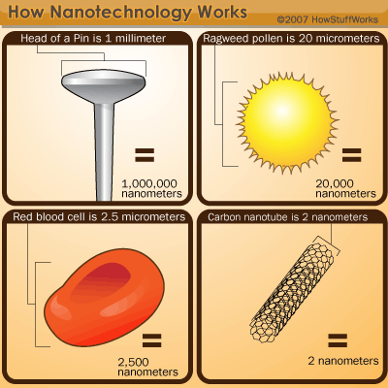
Nanotechnology
Nanotechnology : Understanding and controlling of matter at the nanoscale; dimensions between approximately 1 and 100 nanometers, where unique phenomena enable novel applications.
Encompassing nanoscale science, engineering, and technology, nanotechnology involves imaging, measuring, modeling, and manipulating matter at this length scale.

Slide 32
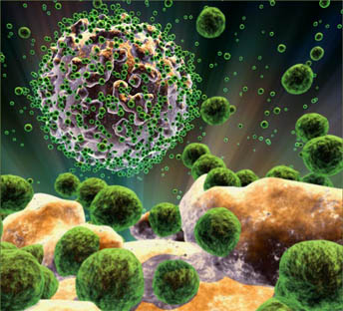
Nanotechnology
Matter such as gases, liquids, and solids can exhibit unusual physical, chemical, and biological properties at the nanoscale, differing in important ways from the properties of bulk materials and single atoms or molecules.
Some nanostructured materials are stronger or have different magnetic properties compared to other forms or sizes or the same material.
Others are better at conducting heat or electricity. They may become more chemically reactive or reflect light better or change color as their size or structure is altered.

Slide 33
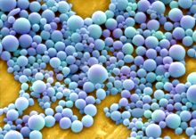
Nanotechnology
Nanoparticles such as
Iron
Gold
Liquid crystals
And others
Are nanoparticles that can be used in medical applications.
Some of these compounds can be inert at the “macro” level but become catalysts at the nanoscale. In addition, they easily penetrate cells (soluable) and interact with cellular molecules.

Slide 34
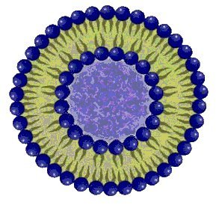
Nanotechnology
A nanoparticle called a microsphere is of particular interest in medicine.
It is composed of a phospholipid bilayer to which drugs can be attached.
The microspheres can target specific cells and deliver needed drugs.
Advantage: They can dissolve in the body.
Examples
Researchers are investigating ways to implant microspheres holding anticancer drugs next to tumors.
Researchers are working on ways to attach microspheres to wafers for pain anesthetics
Microspherse called liposomes are being used in gene therapy.

Slide 35
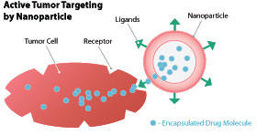
Nanotechnology
View the animations about nanotechnology
http://nano.cancer.gov/learn/understanding/video_journey.asp
http://www.azonano.com/nanotechnology-video-details.aspx?VidID=437
http://www.azonano.com/nanotechnology-video-details.aspx?VidID=480
http://www.azonano.com/nanotechnology-video-details.aspx?VidID=469

Slide 36
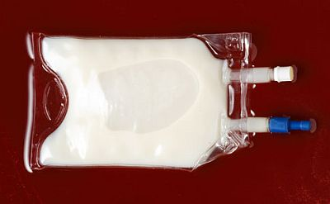
Artificial Blood
Blood transfusions in the United States are routinely screened for pathogens like the HIV virus, and the Hepatitis B and C virus.
In other parts of the world, blood screening procedures are not as good.
This has prompted scientists to develop artificial blood or blood substitues.

Slide 37
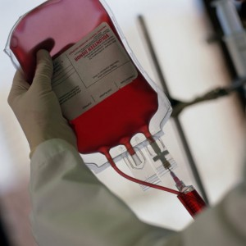
Artificial Blood
Major Advantages of Artificial Blood
It is a disease free alternative.
It is in constant supply without shortages.
Available for emergency situations.
Can be stored for a long period of time. (Blood needs to be refrigerated and lasts 42 days. Artificial blood can last up to 3 months unrefrigerated.
There would be no recipient rejection as there are no antigenic molecules in artificial blood.

Slide 38
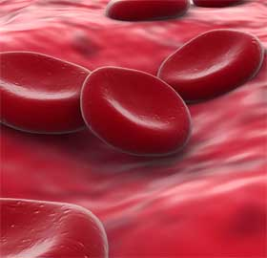
Artificial Blood
Major Disadvantage
Artificial Blood serves one primary purpose; it is designed to carry oxygen.
Normal red blood cells have other functions. In addition to carrying oxygen, they are a source of iron and have a role in eliminating carbon dioxide from the blood.

Slide 39
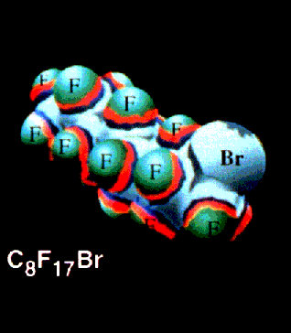
Artificial Blood
Currently there are 2 major types of artificial blood:
Hemoglobin based: Made from cow or human blood. Blood is process and hemoglobin is purified.
Fluorocarbon based: Fluorocarbon emulsions are made with particles about 1/40 size the red cells. The fluorcarbon binds to oxygen in a fashion similar to hemoglobin. →
There is some newer research which is combining the oxygen carrying portion of the hemoglobin molecule with a polymer shell!

Slide 40
Monoclonal Antibodies
Monoclonal antibodies are specific antibodies targeted towards the specific molecular structure on an antigen (epitope) that causes the immune response
Treating patients with monoclonal antibodies can be effective in transplant rejection, cardiovascular disease, some allergies, and certain cancers like breast cancer.

Slide 41
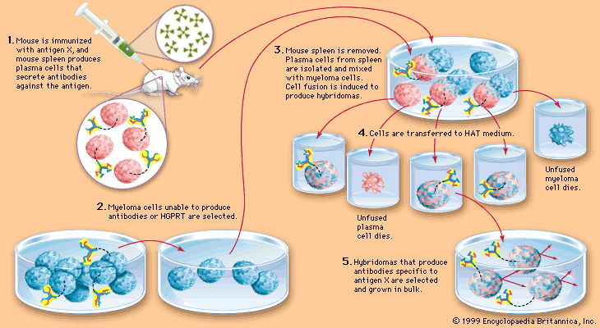
Monoclonal Antibodies How they are made

Slide 42
Monoclonal Antibodies
A mouse is injected with an antigen and B cells (plasma cells) produce antibody.
The spleen of the mouse is removed and the B cells are mixed with myeloma cells (cancerous). Myeloma cells won’t stop dividing.
B cells and myeloma cells merge and become hybridomas.
Hybridomas are antibody manufacturing factories.
Antibodies are isolated and given to patients.
http://highered.mcgraw-hill.com/sites/0072556781/student_view0/chapter32/animation_quiz_3.html

Slide 43
Lesson 5
Webquest: Gene Therapy
We will be visiting the website listed below:
http://learn.genetics.utah.edu/content/tech/genetherapy/
Research University of Utah Genetics website to study multiple aspects of gene therapy.
Respond to questions on your handout.

Slide 44
Lesson 6
Gene Therapy Project – Market a Vector
Using information from gene therapy webquest, you will work with a partner and design a powerpoint and brochure to market a gene therapy vector to research scientists.
You will present your powerpoint to class and distribute brochures.
Refer to your handout for details.

Slide 45
Lesson 7
Group work – Stem Cells
The topic of stem cells has been addressed in introductory biology . This lesson is a review and refresher for previously learned content.
Work in groups of 4 to review the powerpoint on assigned section of content. Develop review questions for content.
Teacher will approve all review material.
Reassign one “expert” from each group assignment to a new grouping.
New group will review powerpoint together, discuss content and review questions.
Teacher will provide a written quiz at the end of the assignment.

Slide 46
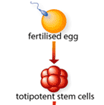
Stem cells
Totipotent Stem Cells
These are the most versatile of the stem cell types. When a sperm cell and an egg cell unite, they form a one-celled fertilized egg. This cell is totipotent, meaning it has the potential to give rise to any and all human cells, such as brain, liver, blood or heart cells. It can even give rise to an entire functional organism. The first few cell divisions in embryonic development produce more totipotent cells.

Slide 47

Stem Cells
Pluripotent Stem Cells (Embryonic Stem Cells)
These cells are like totipotent stem cells in that they can give rise to all tissue types. Unlike totipotent stem cells, however, they cannot give rise to an entire organism. On the fourth day of development, the embryo forms into two layers, an an outer layer which will become the placenta, and an inner mass which will form the tissues of the developing human body. These inner cells, though they can form nearly any human tissue, cannot do so without the outer layer; so are not totipotent, but pluripotent. As these pluripotent stem cells continue to divide, they begin to specialize further.

Slide 48
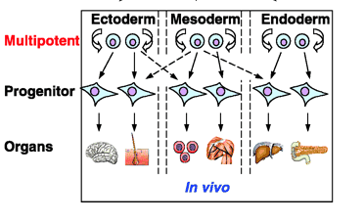
Stem Cells
Multipotent Stem Cells
These are less plastic and more differentiated stem cells. They give rise to a limited range of cells within a tissue type. The offspring of the pluripotent cells become the progenitors of such cell lines as blood cells, skin cells and nerve cells. At this stage, they are multipotent. They can become one of several types of cells within a given organ. For example, multipotent blood stem cells can develop into red blood cells, white blood cells or platelets

Slide 49
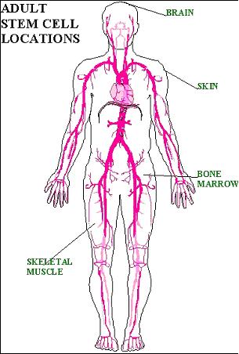
Stem Cells
Adult Stem Cells
An adult stem cell is a multipotent stem cell in adult humans that is used to replace cells that have died or lost function. It is an undifferentiated cell present in differentiated tissue. It renews itself and can specialize to yield all cell types present in the tissue from which it originated.

Slide 50
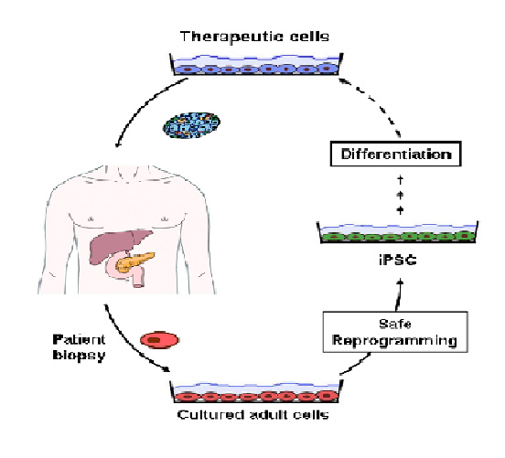
Stem Cells
Induced Pluripotent Stem Cells (IPsCs)
IPSCs are differentiated cells that have been reprogrammed back to pluripotent stem cells.
The introduction of 4 genes OCT3/4, SOX2, c-MYC, and KLF4 by a retrovirus into cells reprograms the cells into an earlier stage of differentiation similar to embryonic stem cells.
These genes encode transcription factors involved in cell development.

Slide 51
Stem Cells - IPSCs

Slide 52
Stem Cells
IPSCs
IPSCs can be used for patient specific therapies without the risk of cell rejection.
Cells could be taken from a patient, reprogrammed into an IPC, and then differentiated into a cell that could combat disease in the patient.
There would be no need for embryonic stem cells.

Slide 53
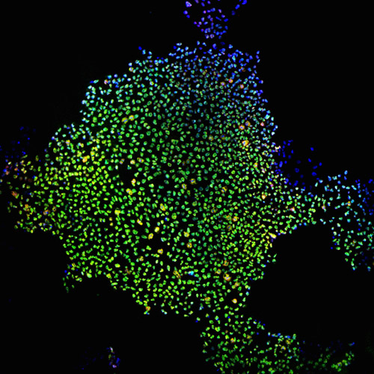
Stem Cells
IPSCs
Scientists still do not fully understand how to control induced pluripotent stem cells.
They do not understand the degree of pluripotency in these cells.
Producing them is inefficient. 1 in 1000 cells exposed to a reprogramming approach becomes an IPSC.
The cells require constant feeding in cell culture.
The cells have low viability after they have been frozen for storage.
The cells are prone to forming tumors.
Occasionally, IPSCs spontaneously revert to differentiated cells.

Slide 54
Stem Cells
Stem Cell Therapies
Potential and promise are two words frequently used to describe stem cell therapies.
The most promising application to date has been for leukemia.
Patients receive chemotherapy or radiation to destroy cancerous white blood cells.
Patients receive WBC stem cells which proliferate to normal cells.

Slide 55
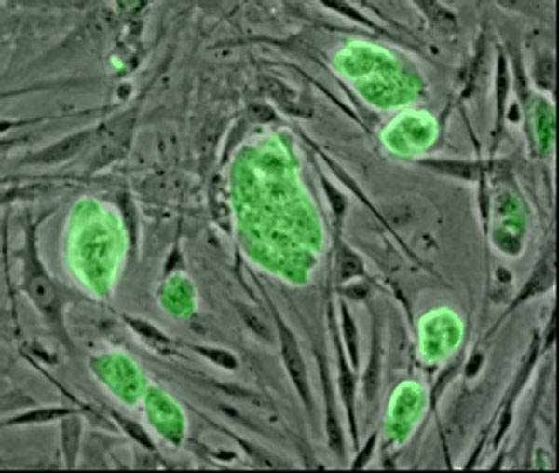
Stem Cells
Stem Cell Therapy
Researchers have injected stem cells from different sources into damaged heart tissue of mice (heart tissue does not repair itself well). The stem cells developed into cardiac muscle and improved heart function by 35%. This work shows promise for human heart attack victims.

Slide 56
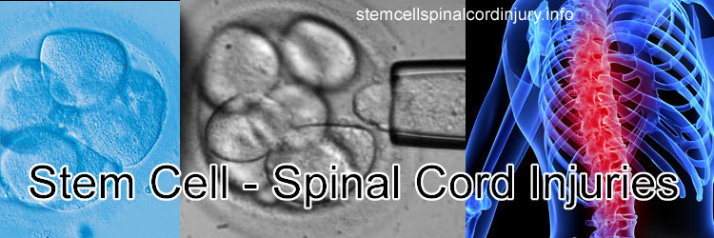
Stem Cells
Stem Cell Therapy
Researchers have demonstrated that embryonic stem cells can be differentiated to form neurons in mice to show improvement in spinal cord injuries. The FDA has approved the first clinical trial for the use of embryonic stem cells to treat humans with spinal cord injuries.

Slide 57
Stem Cells
Challenges for stem cell therapy
Controlling differentiation –When stem cells are injected scientists cannot control the spread of cells to other places in the body nor can they control the differentiation of stem cells into tissues other than those that were intended.
Injected human embryonic stem cells tend for form tumors.
Chromosomal abnormalities – Abnormality in chromosome number( trisomy) occurs frequently when stem cells differentiate
The most promising therapy appears to be differentiating the stem cells in vitro and them injecting them.

Slide 58
Stem cells
Visit these websites
http://www.sumanasinc.com/webcontent/animations/content/stemcells_scnt.html
http://www.dnalc.org/resources/animations/stemcells.html
http://www.youtube.com/watch?v=cPvidAvzmx0

Slide 59
Lesson 8
Leukemia Webquest
Research leukemia website. https://sites.google.com/site/stemcellsinaction/home/stem-cell-webquest-directions
Respond to questions.
Write one paragraph: Why has leukemia stem cell therapy been successful while other types of stem cell therapies have failed?

Slide 60
Lesson 9
Debate: Should embryonic stem cells be used as research tools?
Work with a partner and read research articles on stem cell social policy. Discuss the pros and cons of the argument with partner.
Work in groups of 4 on assigned topic. Research on computer additional information to support your topic. Develop a 5 minute argument defending your position.
Debate: One person from each group will present pro or con argument. Instead of rebuttal, members of the audience will each have to speak about their opinion on stem cell social policy. Class will vote at end of debate.

