Slide 1
575 Lecture 11
Paper Review
Nuclear Deformability Constitutes a Rate-Limiting Step During Cell
Migration in 3-D Environments
3/8/16

Slide 2
Introduction to Paper/Motivation
Cell migration involved in many biological processes, both healthy and disease.
Cell migration in 3D and 2D environments likely very different, but most studies have been done on 2D surfaces.
These authors developed a microfluidic device to study migration in 3D.
They found that nucleus deformability is a major factor in controlling 3D cell migration.

Slide 3
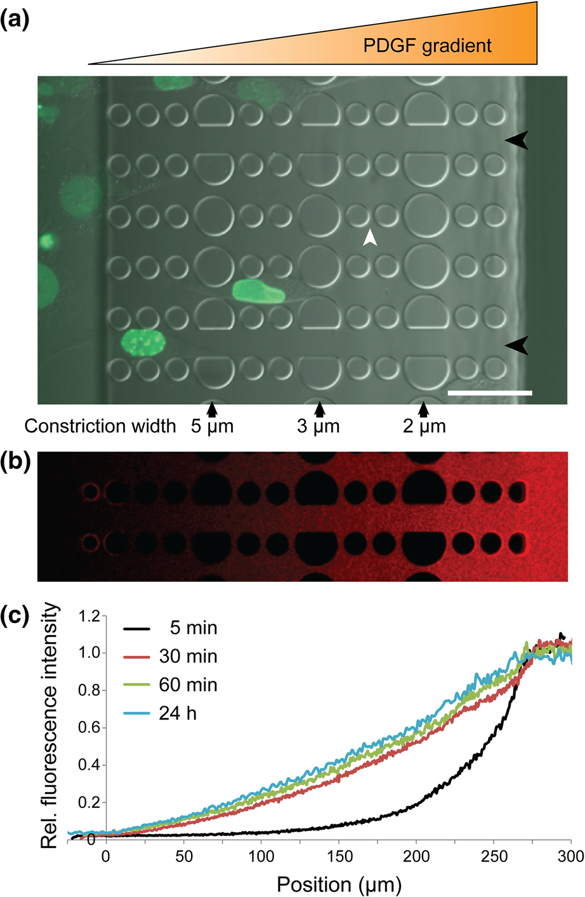
Figure 1a: William Doherty

Slide 4
Figure 1b-c: Cory Thomas

Slide 5
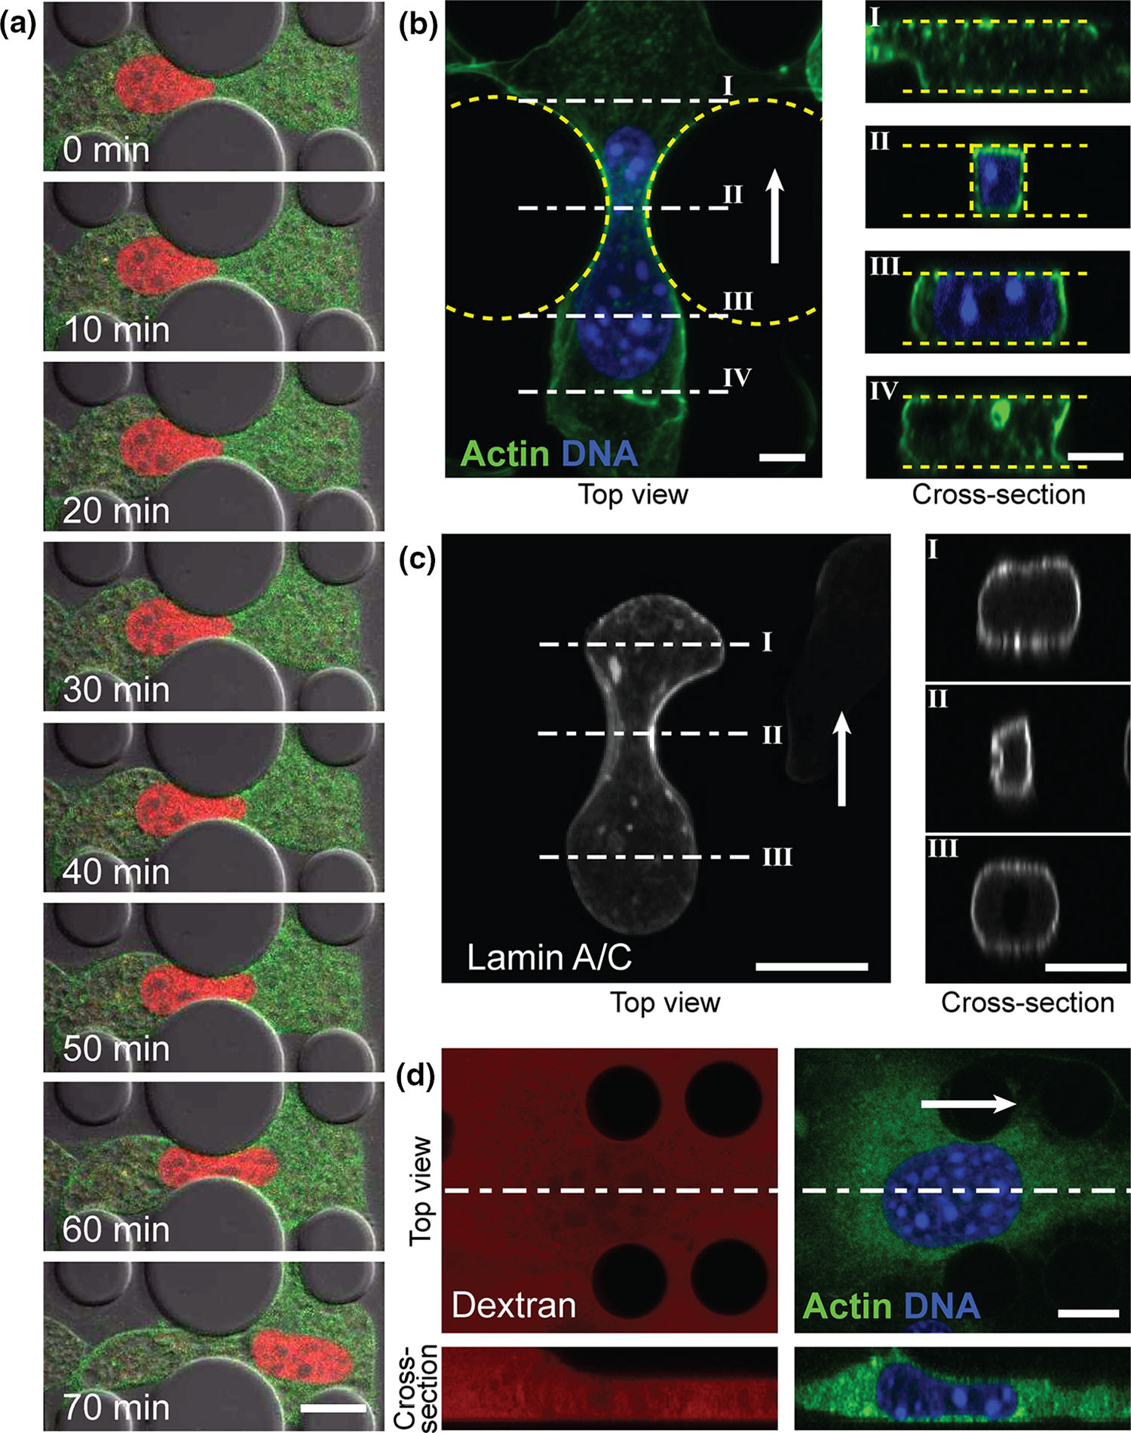
Figure 2a-b: Mark Pagkaliwangan

Slide 6
Figure 2c-d: Veronica Murray

Slide 7
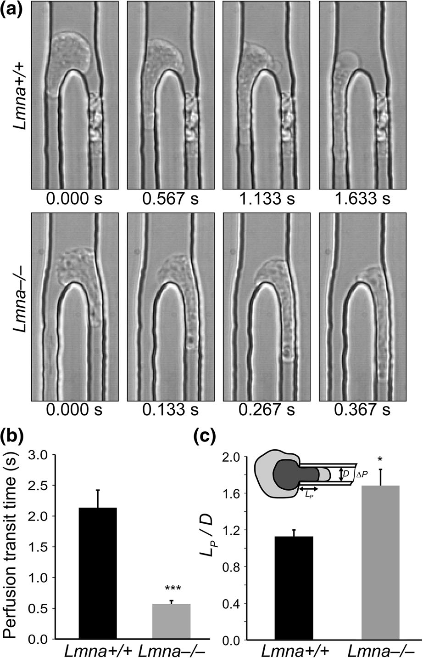
Figure 3: Adlina Hasni

Slide 8
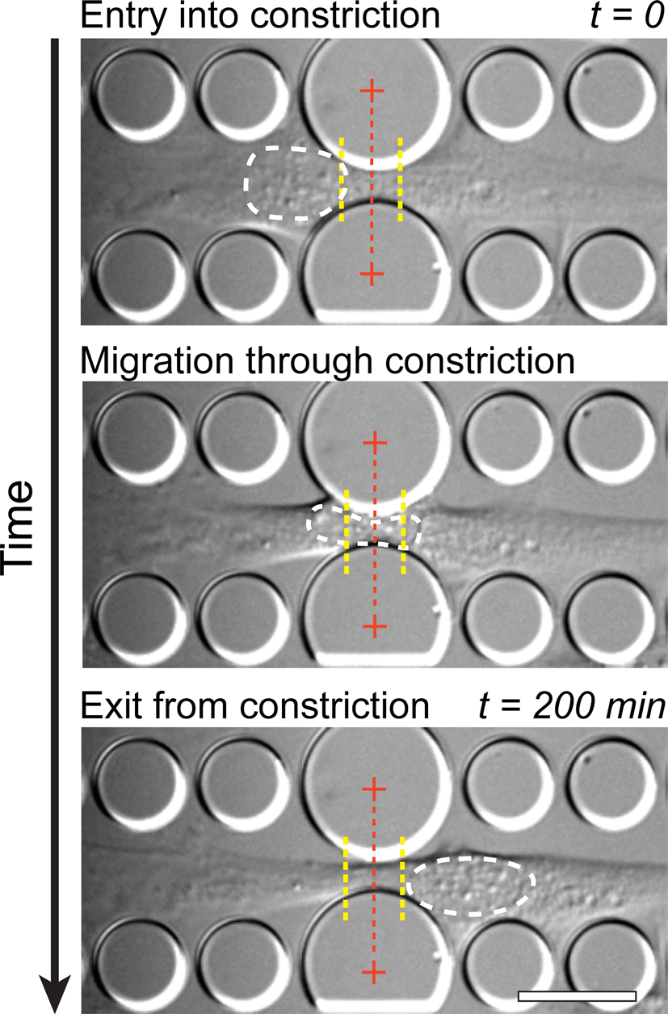
Figure 4: Jason Ballenas

Slide 9
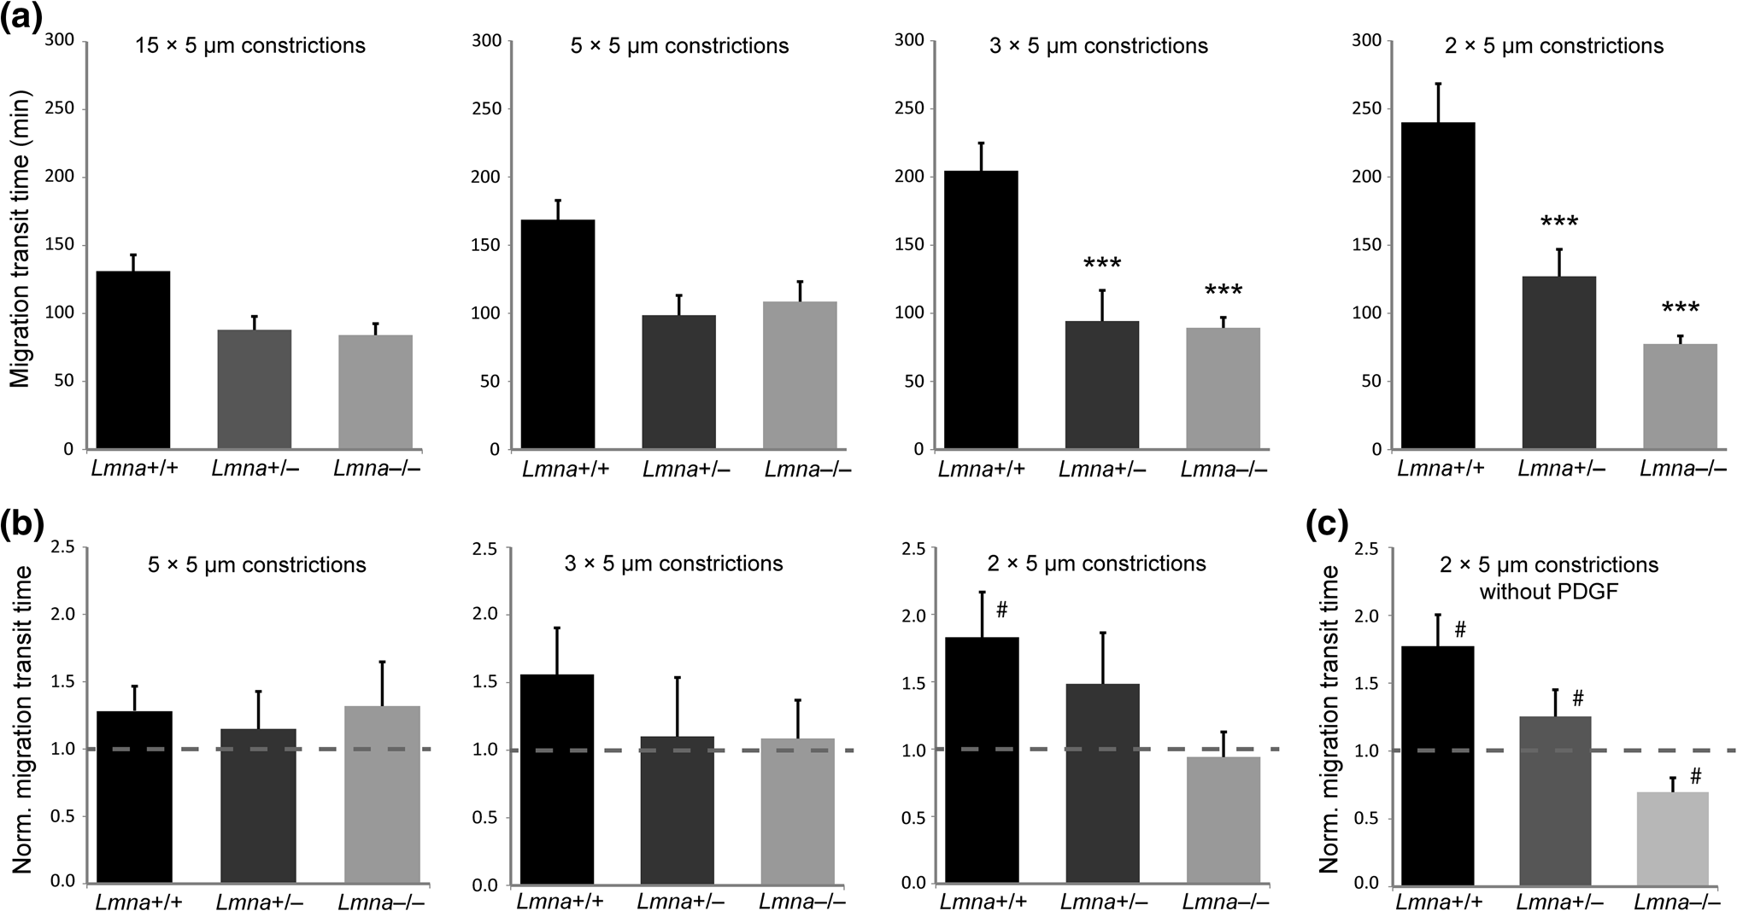
Figure 5a: Emma Klinkhamer

Slide 10
Figure 5b-c: Shayna Nolan

Slide 11
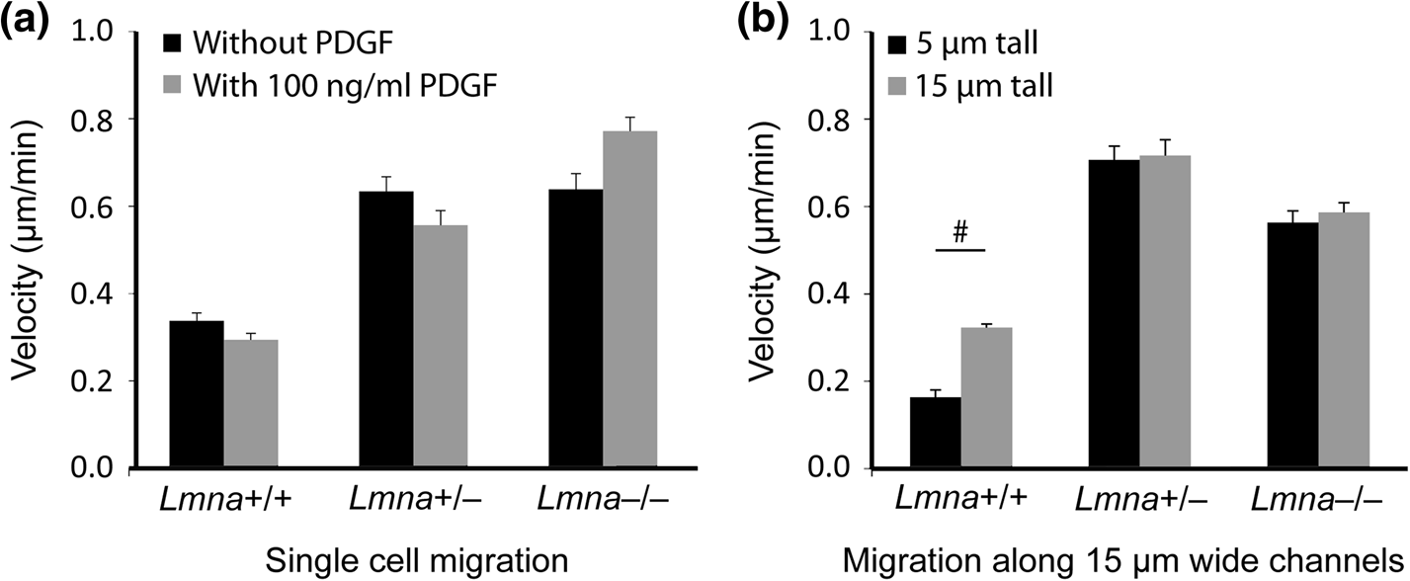
Figure 6a: John Vetrano

Slide 12
Figure 6b: Daniel Kosteva

Slide 13
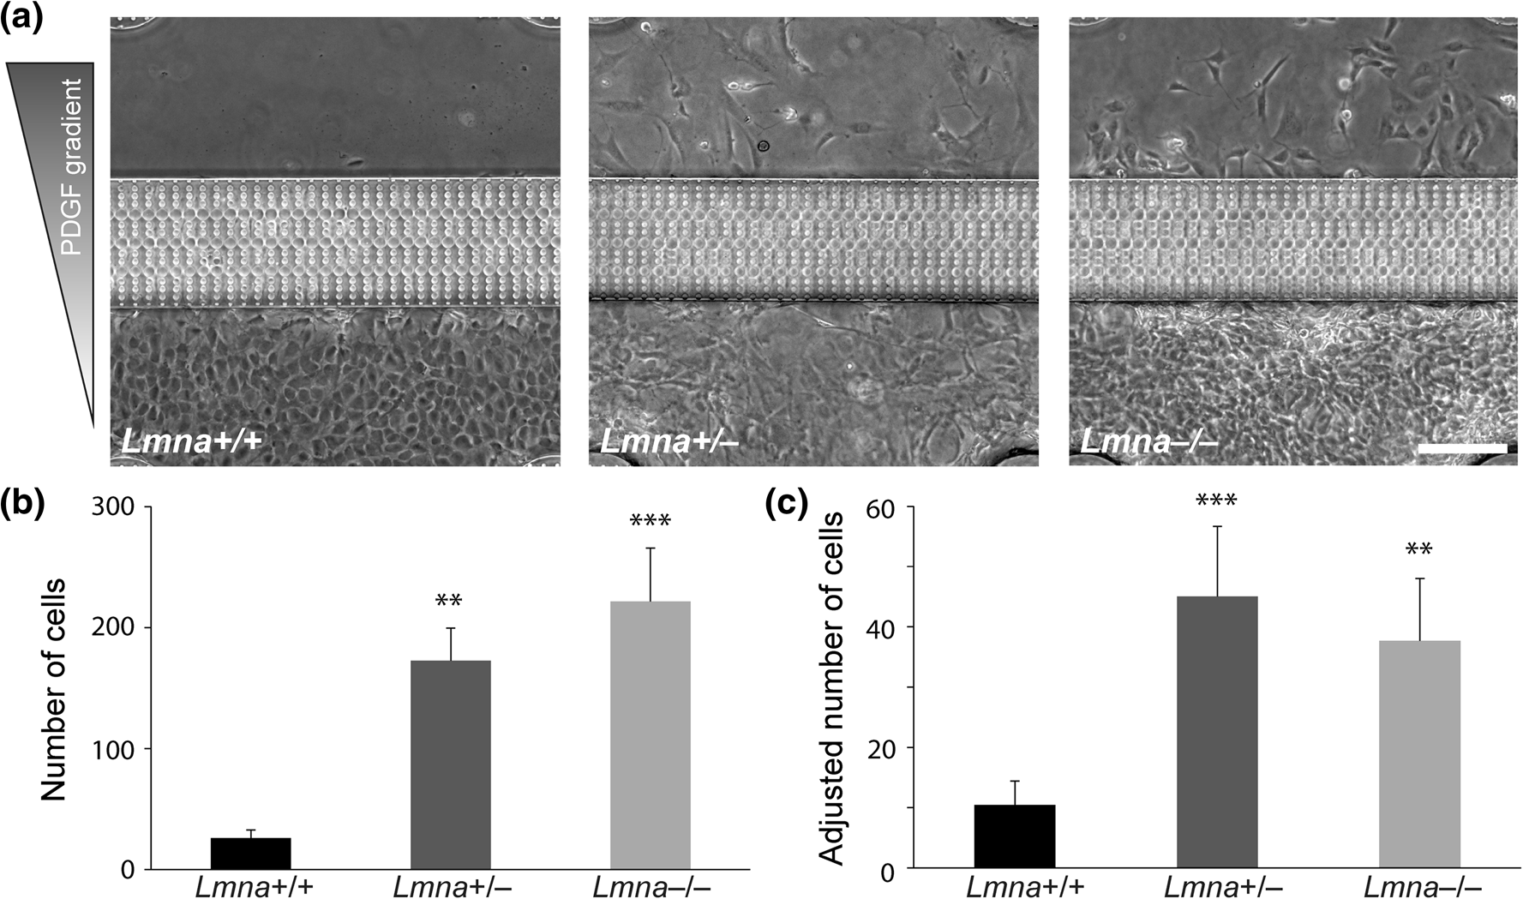
Figure 7a: Brian Cain

Slide 14
Figure 7b: Julie Boshar

Slide 15
Conclusions, from paper and from class discussion
Fill these in with the class.

