Slide 1

Chemotaxis Guiding bacteria with small molecules and RNA
X.G.Liu

Slide 2
Chemotaxis is the phenomenon in which somatic cells, bacteria, and other single-cell or multicellular organisms direct their movements according to certain chemicals in their environment.

Slide 3
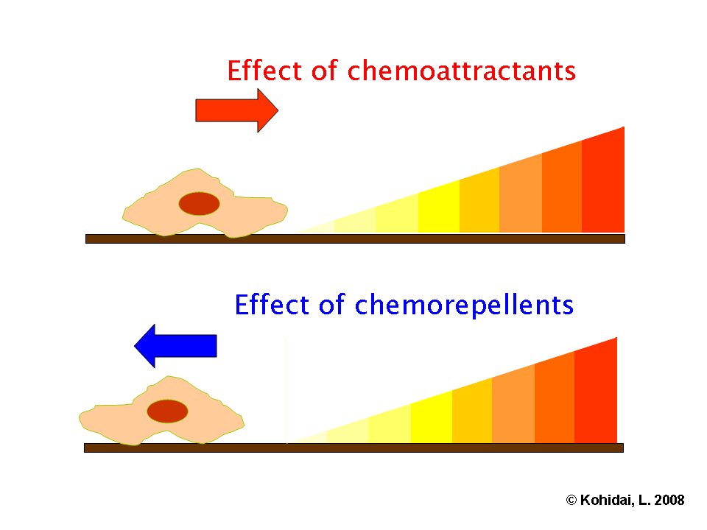
Chemoattractants and chemorepellents

Slide 4
Chemotactic bacteria navigate their chemical environment by coupling sophisticated information processing capabilities to molecular motors that propel the cells forward.
A general method to reprogram the ligand sensitivity of the bacterial chemo-navigation system would enable the production of cells that autonomously follow arbitrary chemical signals, such as pollutants or disease markers.

Slide 5
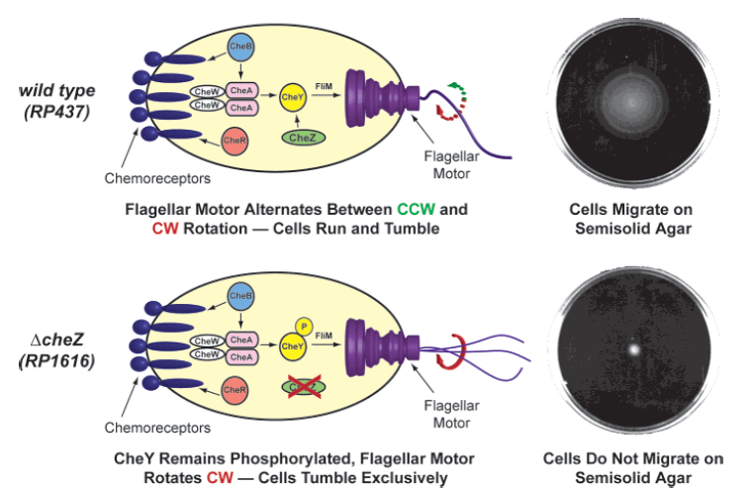
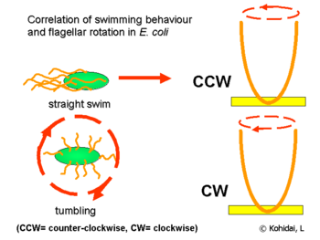

Slide 6
A defining feature of E. coli chemotaxis is that individual cells do not simply respond to the absolute concentration of a stimulus at a given time.
Rather, individual E. coli cells integrate the concentration of a chemical stimulus over a 1-3 s period² and migrate up attractant gradients by adjusting the frequency of tumbling based on the concentration differences between these time points.
We anticipated that using a ligand-inducible expression system to control the production of CheZ would enable us to guide cells toward higher concentrations of a new ligand in a process known as pseudotaxis.
This system would differ from classical E. coli chemotaxis in that cell motility toward the new ligand would be dictated by the absolute ligand concentration at a specific time, rather than the concentration differences between two points in time.

Slide 7
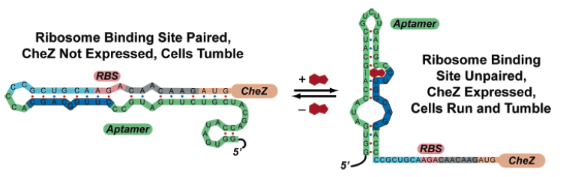
In contrast to inducible expression systems that use proteins to recognize ligands, riboswitches control gene expression in a ligand-dependent fashion by using RNA aptamers to recognize ligands. Using powerful in vitro selection techniques, it is possible to generate aptamers that tightly and specifically recognize new ligands without the need for a pre-existing RNA scaffold.

Slide 8
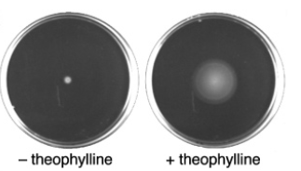
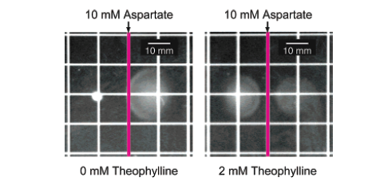
Here we show that a synthetic riboswitch can guide E. coli toward a new, nonmetabolized ligand without protein engineering. These reprogrammed cells migrate preferentially up a ligand gradient and have the unique ability to localize to a specific chemical signal, which enables precise spatial patterning.

Slide 9
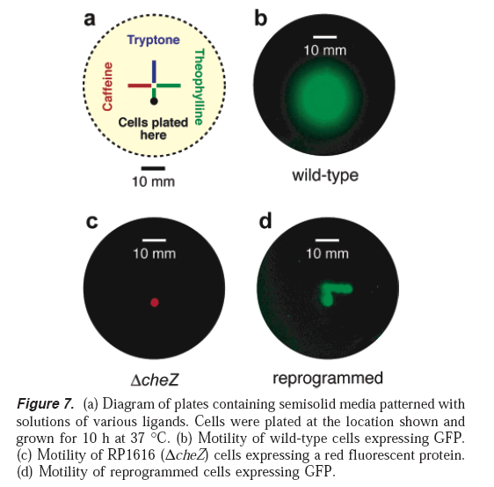
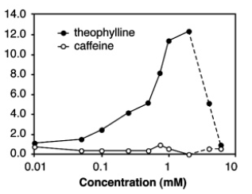
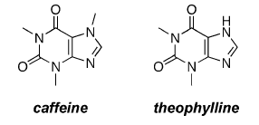

Slide 10
Q & A

