Slide 1
Tissue Engineering
Lecture 3
Paper Review
Caplan
Journal of Cellular Physiology
2007

Slide 2
An Introduction to the Regenerative Power of Mesenchymal Stem Cells
3 Major types of stem cells covered in this class: Embryonic, Induced Pluripotent, and Mesenchymal.
Mesenchymal stem cells found in all tissues, at particularly high density in adipose tissue and the bone marrow.
Roles in tissue engineering:
Immunosuppression
Tissue Repair and Regeneration (directly and indirectly)
Drawn to sites of injury
Can differentiate down many different cell pathways (are multipotent)
Not totipotent!
All people have MSCs, though the # and regenerative capacity of these cells decreases with age.

Slide 3
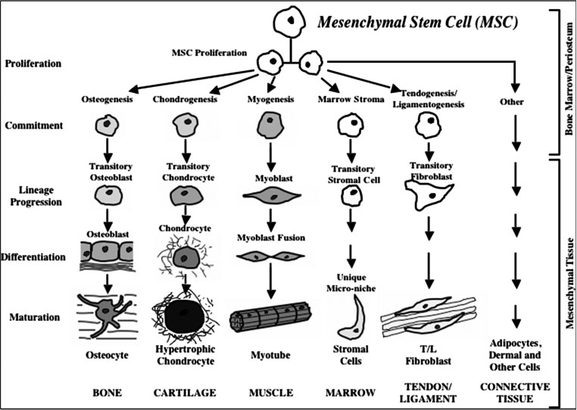
Figure 1: William Doherty

Slide 4
All these cells have the same genes
So why do we get different cell types?
Gene expression
Controlled by transcription factors and epigenetics
“Stemness” genes are turned off
Sox, Wnt, PDGF, Stro-1, a number of receptors
“differentiation-specific” genes are turned on
OPN, Collagen, RunX2 (Bone), others for different cell types.
We now know this differentiation capability differs between patients and with age (unlike what the paper states on page 343.

Slide 5
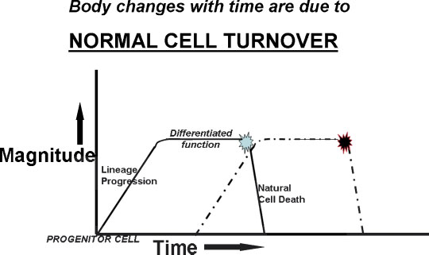
Figure 2: Sydney Phillips
Cell Turnover: the process of new cells forming to replace dead cells

Slide 6
Figure 2
Turnover allows new fresh, functioning tissue to replace non-functioning or mutated cells
Allows for small changes in key structures of our bodies
Each cell has a set half-life
As the original cells dies the new cell must just be reaching maturity
If the dashed line in the figure were moved to the right it would cause anemia (lack of RBCs)

Slide 7
Figure 3: Colton Kenny
Shows a quantification of Mesenchymal Stem Cells per Bone Marrow Cells
titers ≈ concentration
Decrease in 3 orders of magnitude from newborn to 80 years old
Reason for decreased healing ability

Slide 8
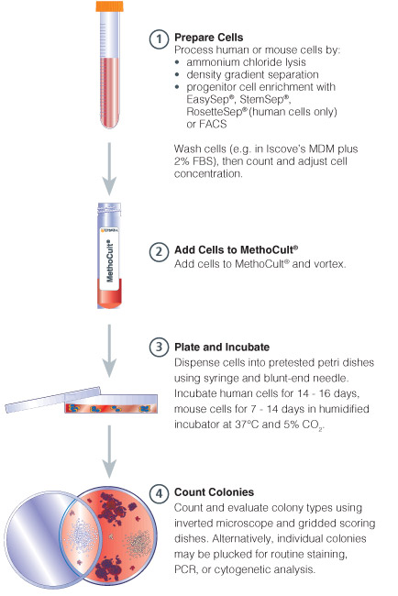
Methodology
CFU-f (colony forming units fibroblastic) assay measures amount of actively colonizing cells
Yu et al. , 2015
http://www.stemcell.com/en/Products/All-Products/MethoCult-H4034-Optimum.aspx

Slide 9
Challenge in MSC Quantification & Location
The general trend of rapid decrease seen but many things still unknown:
Mechanism that causes sharp decline in MSCs
MSC Niche or where MSC’s reside within bone marrow
No unique marker for MSC’s

Slide 10
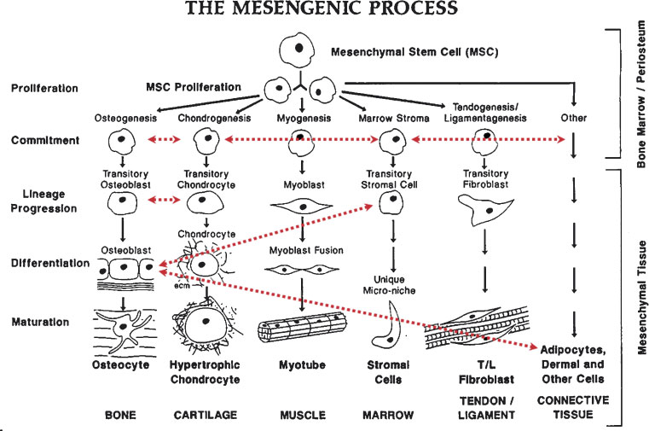
Figure 4: Tom McCarthy

Slide 11
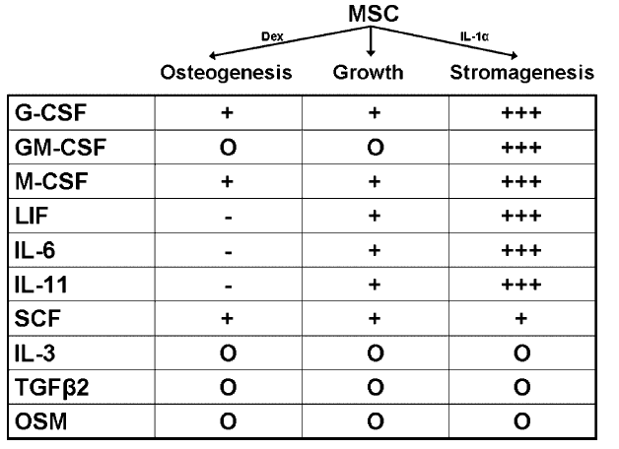
Figure 5: Chelsea Orefice

Slide 12
Understanding the Different Cytokines
G-CSF
GM- CSF
M-CSF
Stimulates the production of neutrophils
Hematopoietic growth factor/immune modulator
Influences human stem cells (HSC) to differentiate into macrophages
LIF
Cytokine named for its ability to suppress spontaneous proliferation of lymphoid stem cells
IL - 6
Plays a role in growth and differentiation of B-cells and T-cells
***All definitions cited from: Farlex Partner Medical Dictionary © Farlex 2012

Slide 13
Understanding the Different Cytokines
IL-11
IL-3
Stimulates the proliferation of hematopoietic stem cells and progenitor cells (increases platelet production)
A cytokine that promotes the differentiation of hematopoietic stem cells into other types of cells
Supports the growth/ proliferation of a broad range of hematopoietic cell types
TGFβ2
Multifunctional peptides that up/down regulate proliferation, differentiation, adhesion, migration, death and other functions in many cell types
OSM
A cytokine from macrophages, T cells, and some marrow and tumor cells, possessing various differentiation (in macrophages), cell proliferation (in hematopoietic precursors and some tumor types), and maturation (in fetal hepatocytes) effects.
SCF
***All definitions cited from: Farlex Partner Medical Dictionary © Farlex 2012

Slide 14
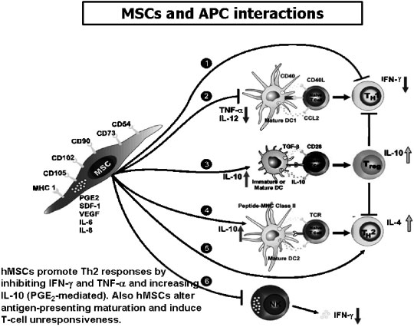
Figure 6: Charit Tippareddy

Slide 15
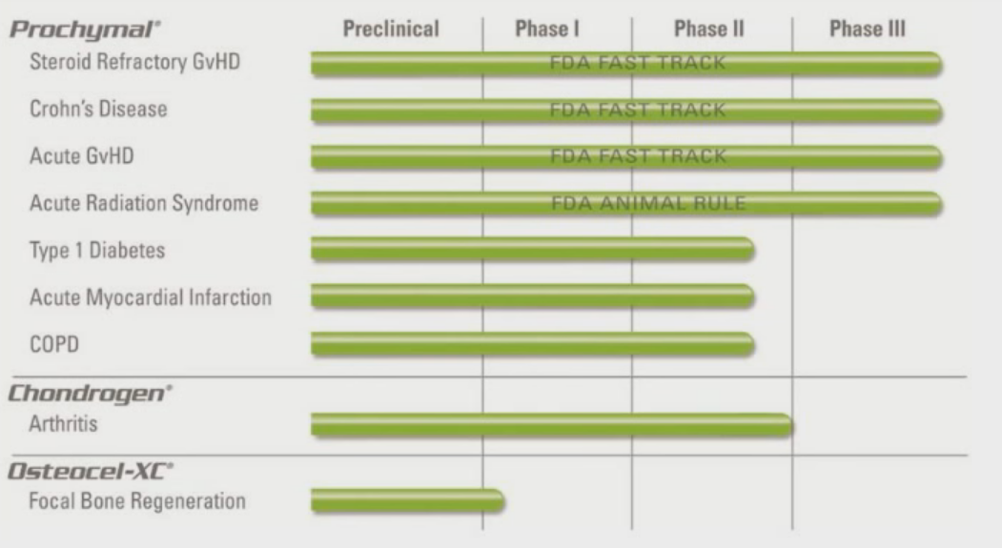
MSC Treatments
Caplan, A. I. (2013). The Science of MSCs and Regenerative Medicine [PowerPoint slides]. Retrieved from the Stem Cell Institute: http://www.cellmedicine.com

Slide 16
Conclusions, Perspectives
MSCs play a large role in tissue regeneration all over the body.
What type of person would have the most MSCs and where?
For implantation, what do you need to consider for sourcing MSCs?
Do you need the cells or would certain secreted factors be enough?
Could you stimulate the host MSCs to grow and migrate to the site of injury instead of a new implant?

