Slide 1
Dahlquist Lab Joint Research Meeting
Trixie Anne M. Roque
June 17, 2015

Slide 2
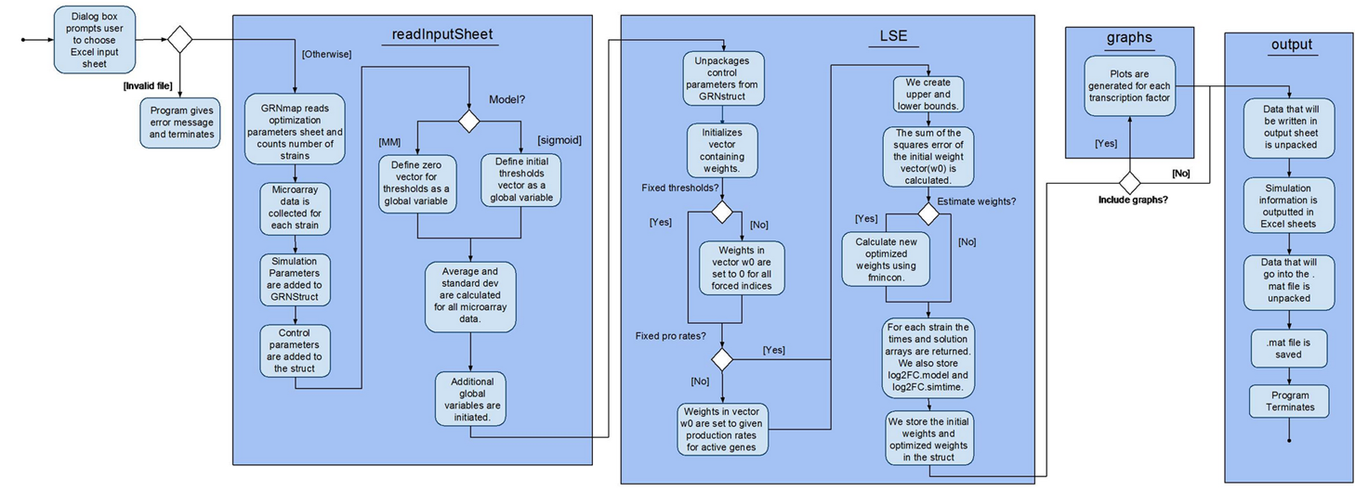
Previous Activity Diagram Separates the “graphs” Function from the “output” Function

Slide 3
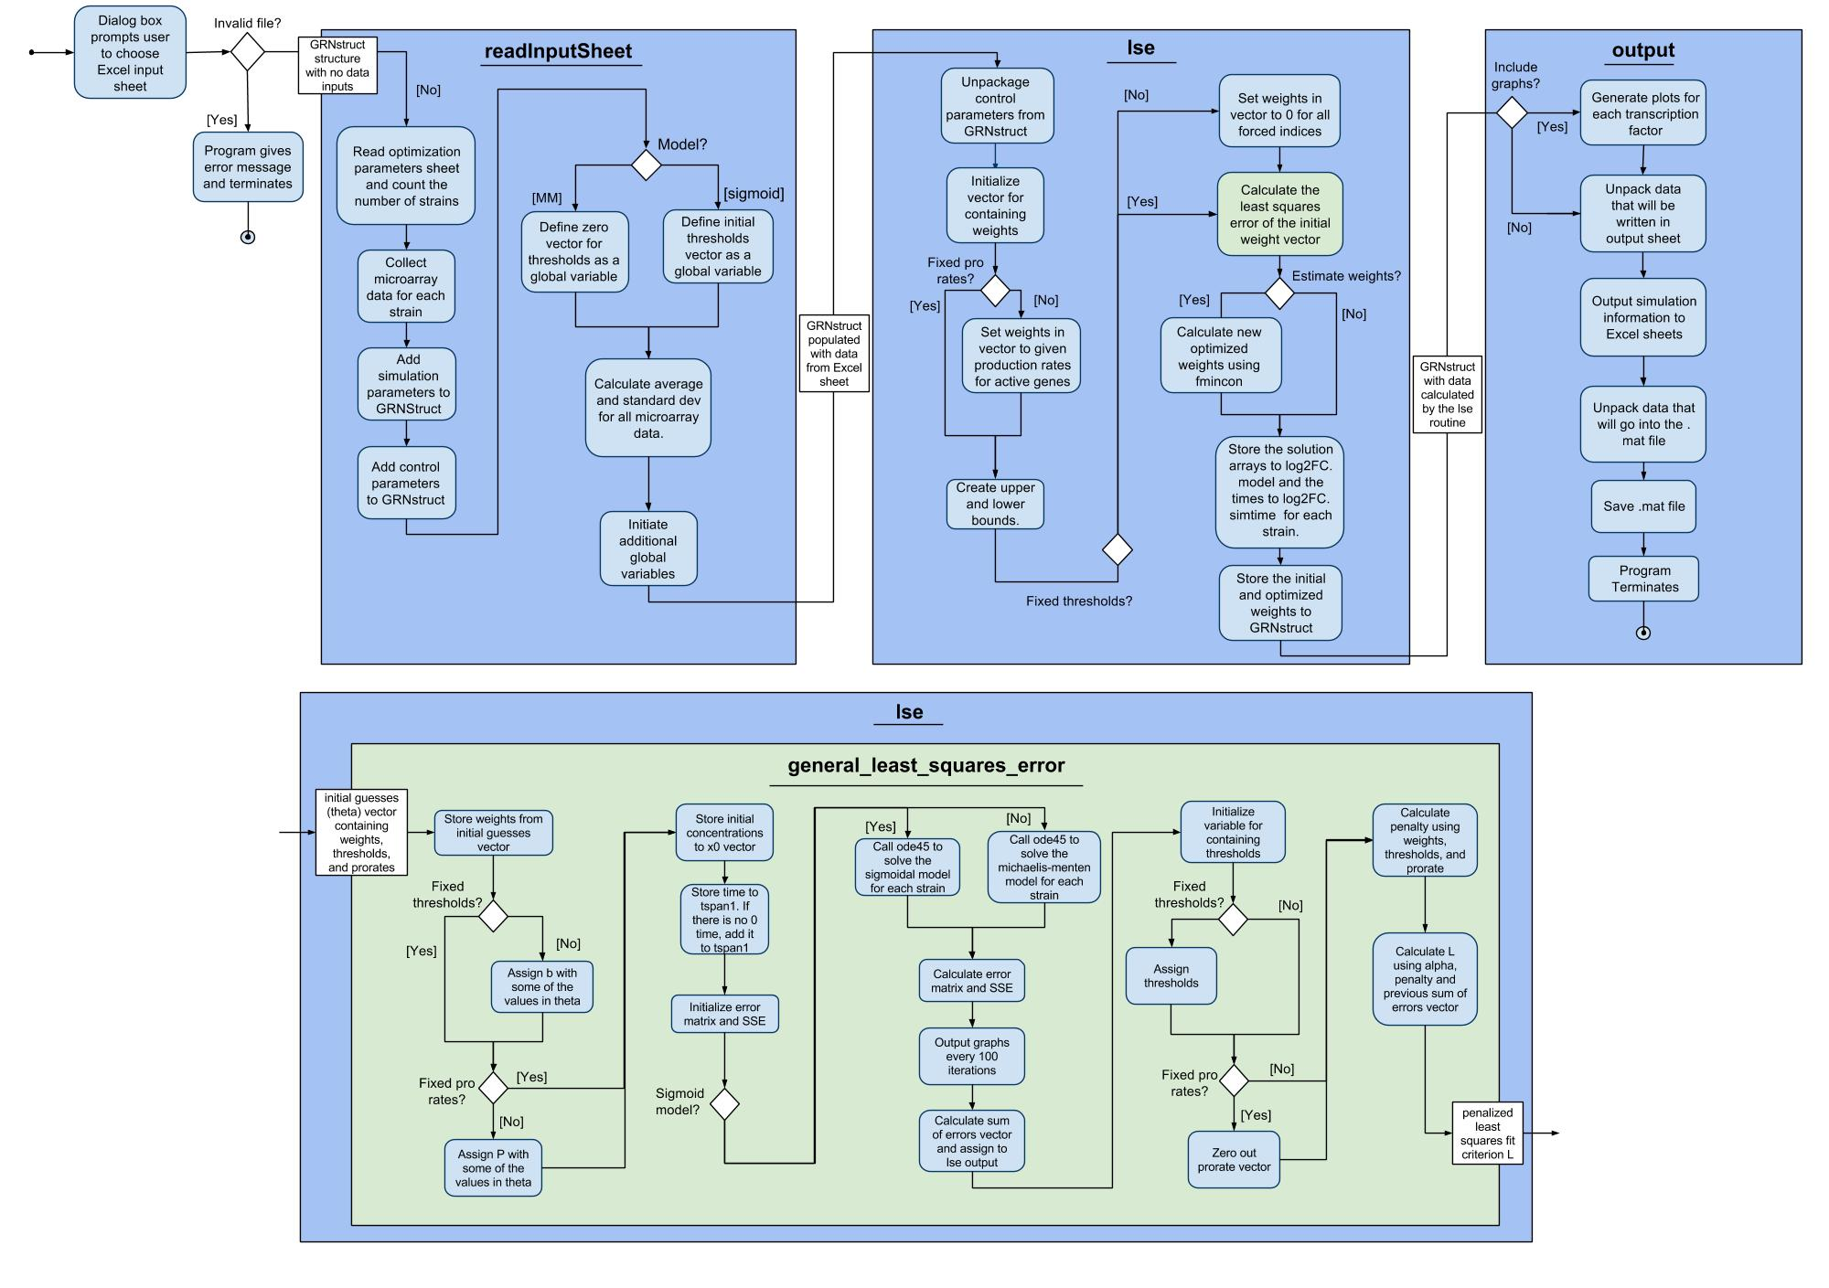
Revised Activity Diagram Includes “general_least_squares_error”

Slide 4


Side-by-side Comparison

Slide 5
Update on Unit Testing Framework
Integrated 16 tests that Tessa made (4-genes_6-edges)
So far only tests if worksheets read correctly and output sheets exist
Input sheets should be copied over
Updated sixteen tests in test_suite as a result
Need to test if LSE is correct and various other more complicated mathematical computations

