Slide 1


Slide 2
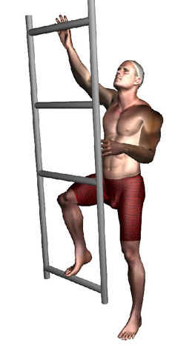


BIOMECHANICAL VALIDATION OF DIGITAL HUMAN MODELS:
A POSTURE AND MOTION STUDY WITH DIGITAL HUMAN MODELS
Sourav S Patnaik*, John McGinley, Gary McFadyen,
Kari Babski- Reeves, Daniel Carruth
Human Factors and Ergonomics (HFE) Research Group,
Centre for Advanced Vehicular Systems (CAVS),
Mississippi State University

Slide 3
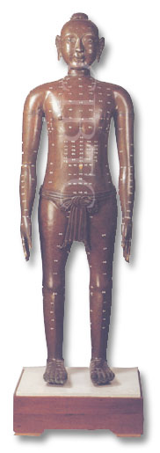
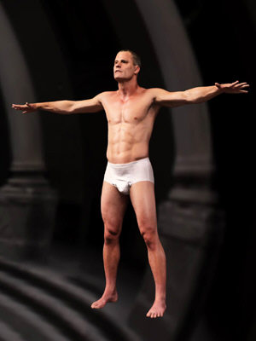
v
What is a “ Digital Human Model”
A computerized replica of a human being for various real life simulations and research studies.
1000 A.D
2000 A.D +
Doctor Wei-Yi Wang
Song dynasty
Bronze
had all the organs
of the human body

Slide 4
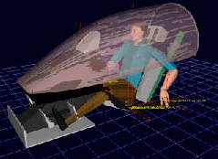
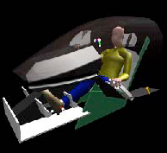
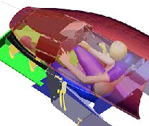
Digital human model : Types
Static models - 3D scans
Dynamic models
  For Visualization (e.g. Jack)
  Biomechanics - crash dummy
  (e.g. Madymo)
  Interface with CAD for workplace
  assessment (e.g. Safeworks)
  For comfort assessment (e.g. RAMSIS)
  Human performance models (e.g. IUSS)
JACK
RAMSIS
Safeworks

Slide 5
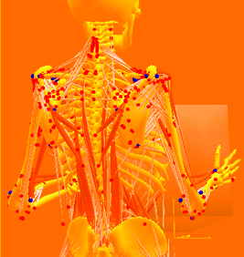
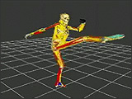
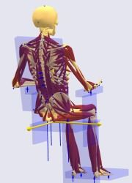
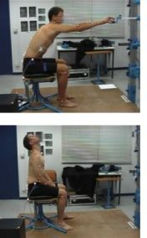
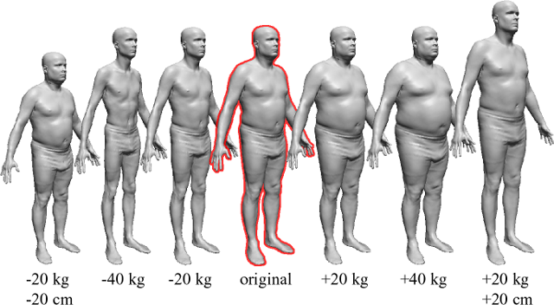
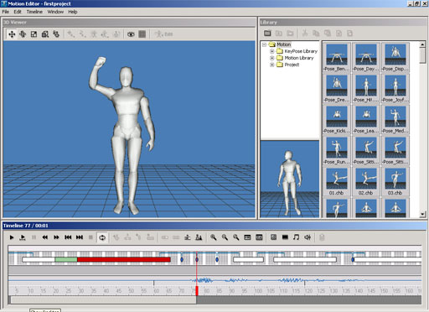
http://www.rdc.imi.i.u-tokyo.ac.jp/robotbrain/ img/movies/yamane_05.jpg
http://www.somadynamics.com.au/images/body/lift.gif
http://www.anybodytech.com/116.0.html?&tx_ttnews%5Btt_news%5
D=25&tx_ttnews%5BbackPid%5D=37&cHash=76ad7f12dc
Research around the globe
http://grail.cs.washington.edu/projects/digital-human/fedit.png
www.softsland.com/3d.html
http://www.inrets.fr/ur/lbmc/english/Ergo/themes3.html#rpx

Slide 6
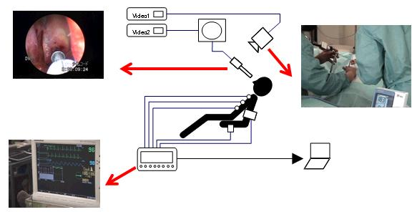
Why digital human models
Medical
  Gait analysis
  Joint diseases
  Surgical Operations

Slide 7
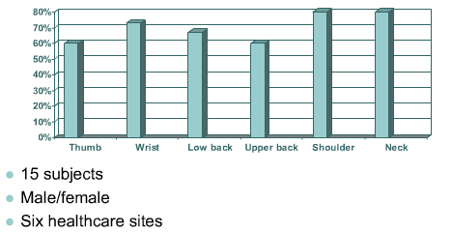
FACTS about Pipetting
http://www.humanics-es.com/pipettinginjuries.htm

Slide 8
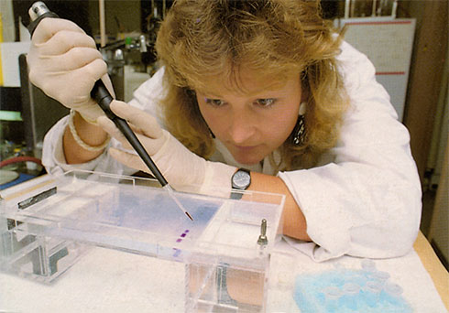
Why digital human models
Laboratory
  Repetitive Pipetting
  Biosafety Cabinets and Laboratory Workbenches
  Links
http://www.cdc.gov/od/ohs/Ergonomics/labergo.htm
http://www.ergonomics.ucla.edu/Tips_Users.html

Slide 9
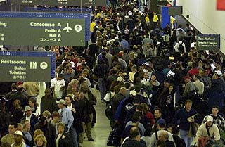
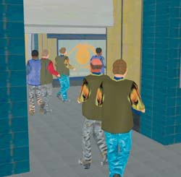
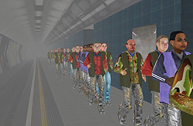
Why digital human models
Transportation
  Airport Pedestrian modeling
  Cockpit Design
  Behavior of humans in zero gravity

Slide 10

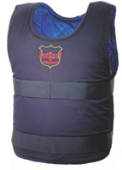
Military
- Body Armor
- Space Suit
Firefighters Uniforms
Why digital human models

Slide 11
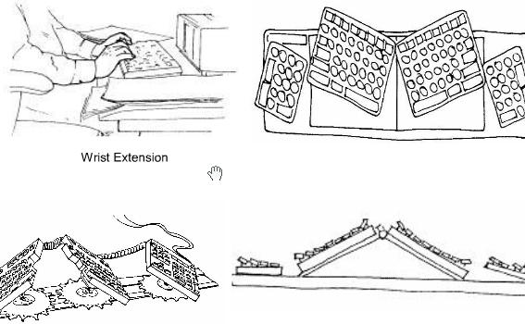
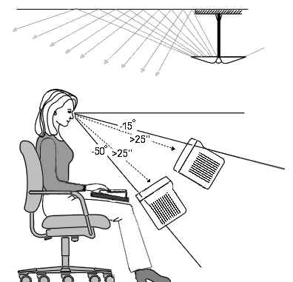
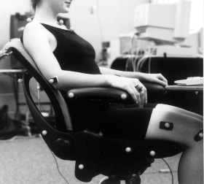
Why digital human models
Workstation / Office
Keyboards/Mouse

Slide 12
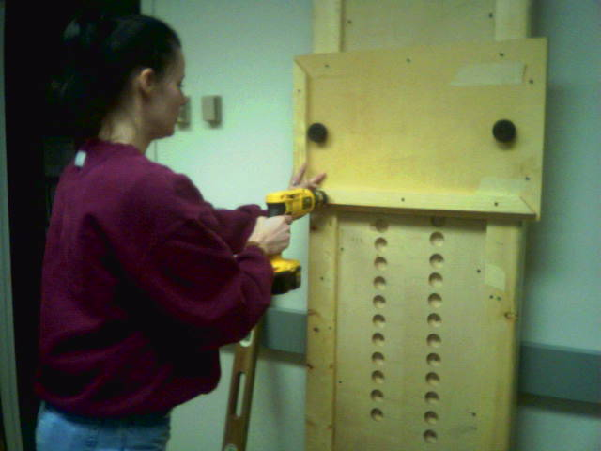
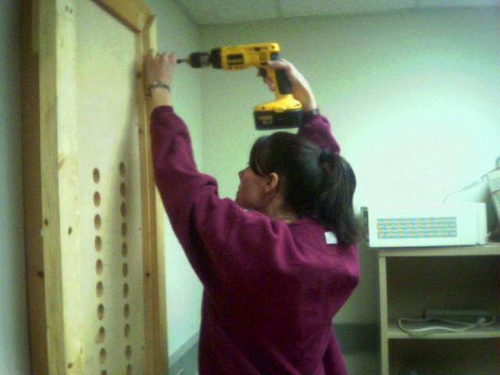
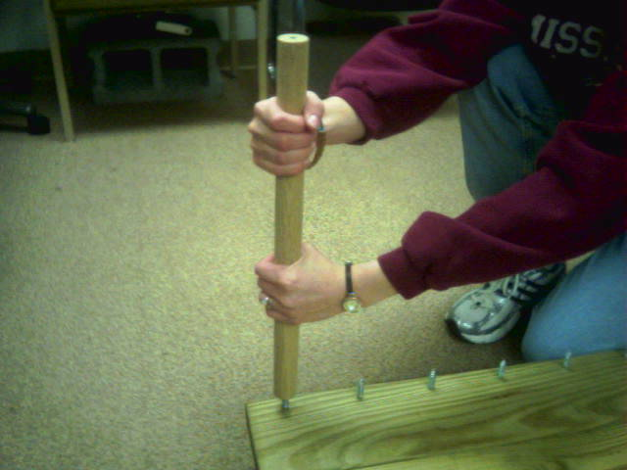
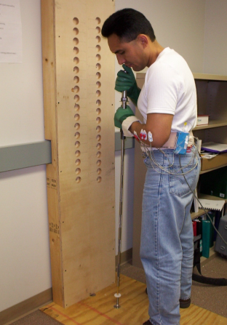
Why digital human models
Industrial
  Quantifying Fatigue
  Occupational biomechanics
  Work Related Musculo-Skeletal Disorders

Slide 13
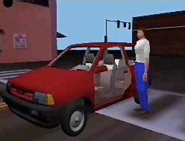
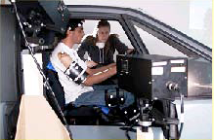
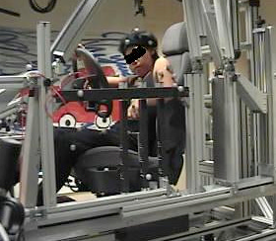
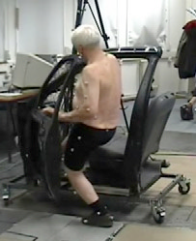
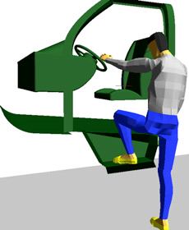
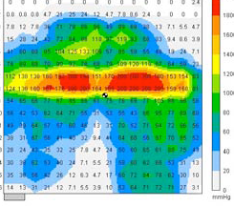
Why digital human models
Discomfort Modeling
Real life Simulation
Mobility Testing
Safety / Crash test
Seat Pressure
Seat design
Interior design
Design of driver
interface devices
Posture analysis

Slide 14
Validation Study
Range of Motion
+
Reach Task
Pull Push Task
Gait Analysis

Slide 15
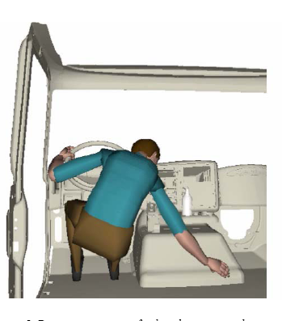
Biomechanical Analysis Methodology
Model fitting
Data comparison
Data acquisition

Slide 16
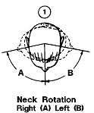
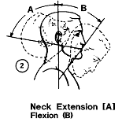
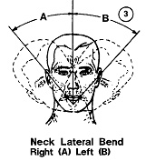
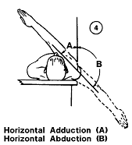
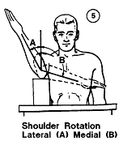
Range of Motion

Slide 17
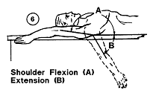
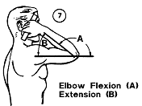
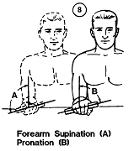
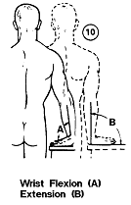
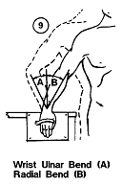
Range of Motion (Contd)

Slide 18
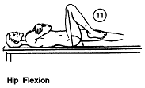
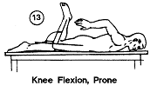
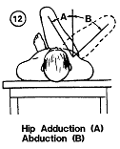
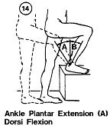
Range of Motion (Contd)

Slide 19
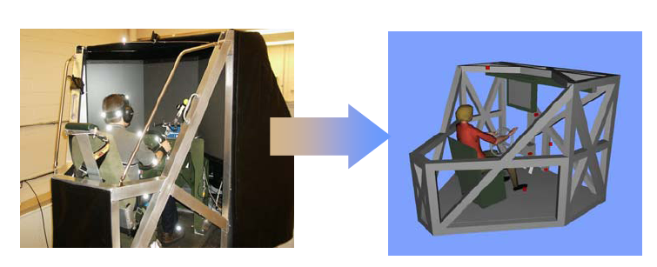
Motion Capture Data to Kinetic model

Slide 20
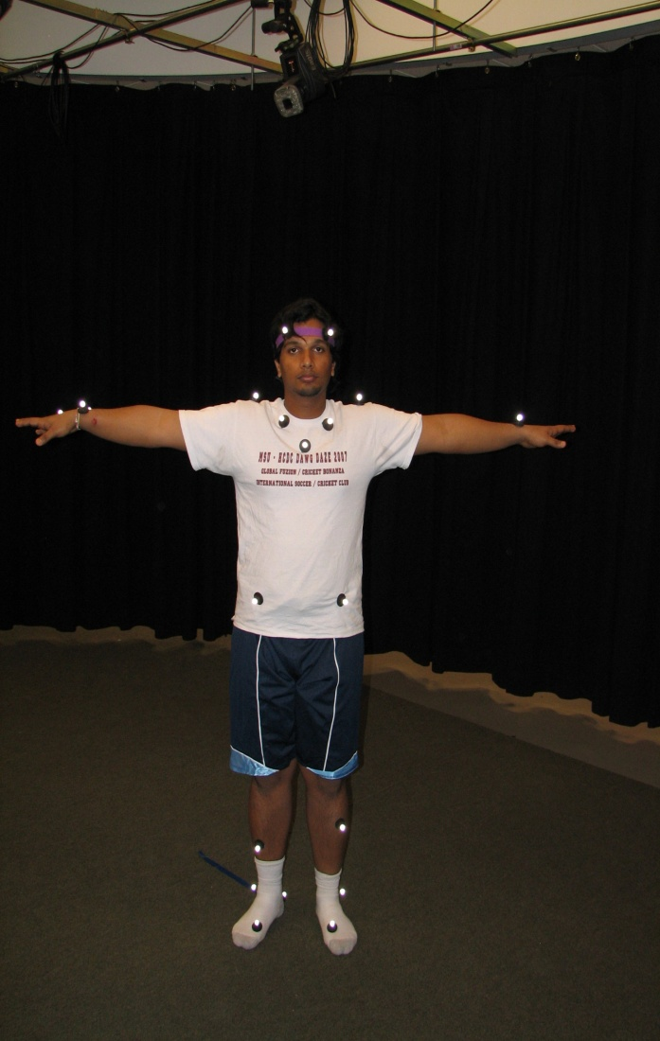
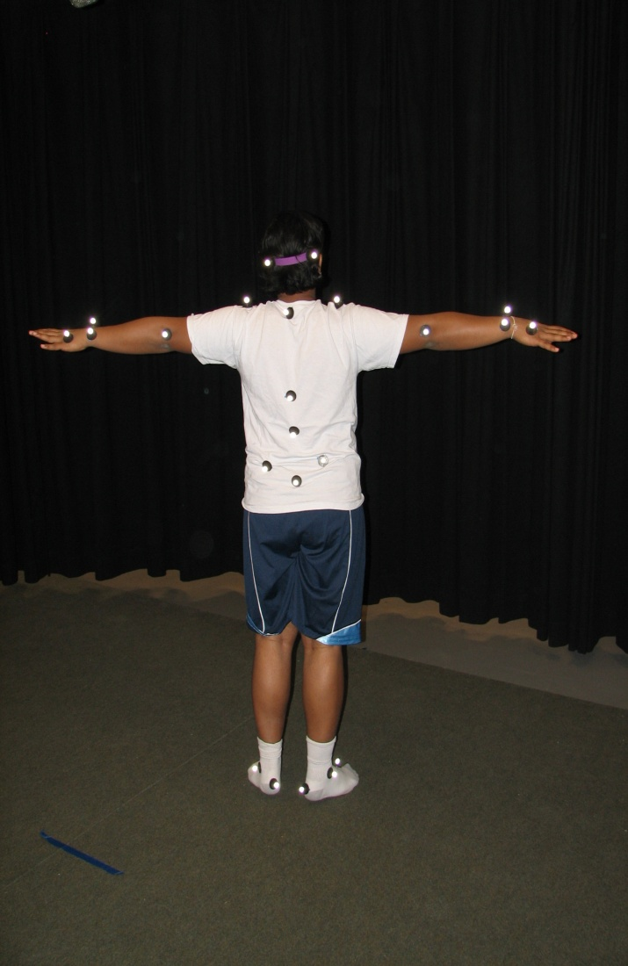

Reflective Markers are placed on anatomical landamarks

Slide 21


Position of the cameras and view of the MOCAP software

Slide 22


MOCAP software distinguishes virtual markers by color coding and nomenclature
T Pose – Calibration of cameras
Markers are joined to form kinetic model

Slide 23


Standing – single arm reach task

Slide 24


Standing – Double arm reach task

Slide 25




Seated tasks
Seated Left arm reach
Seated double arm reach
Seated right arm reach
Seated
T – Pose

Slide 26

MOCAP software view of the seated right handed task

Slide 27


Feet Motion

Slide 28

Results : ROM Data

Slide 29
Conclusion
ROM data collection is in process.
Motion capture data is being analyzed for 3D joint maximum range of motion of the main upper body joints.
Owing to large volume of data, removal of error and other analysis takes lot of time.
All data would be plugged in for model fitting.
Drawback
  Difficult to analyze, if the digital model is not based on anthropometric data viz. robotic motions.
  Not as accurate as static models, owing to various errors like phantom markers, noise etc.

Slide 30

Questions ??????
My PATENT :
ERGONOMIC SLEEPING™ ® ©

