Slide 1
Protein Engineering by PCR
Module 2 Day 1
Tuesday Oct 7th

Slide 2
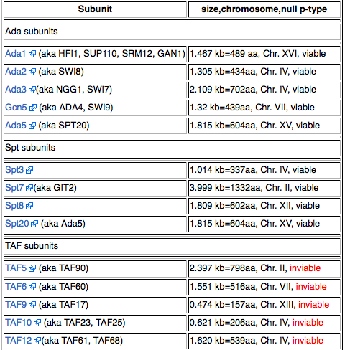
Quick introduction to SAGA
19 subunits in SAGA

Slide 3
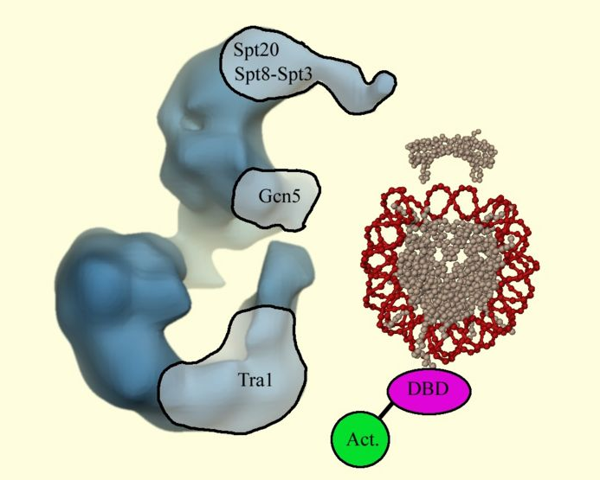
Quick introduction to SAGA
19 subunits in SAGA

Slide 4
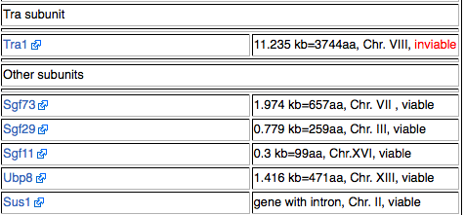
You might choose one of the SAGA subunits…

Slide 5
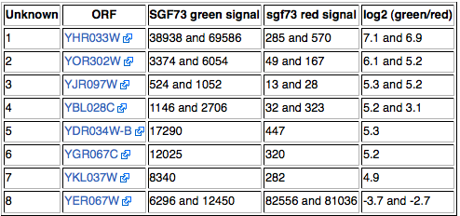
Alternatively….
You might choose to tag a gene that’s regulated by SAGA
You will become the world expert on these uncharacterized open reading frames

Slide 6
The MOST IMPORTANT thing to know about your work for this module…

Slide 7
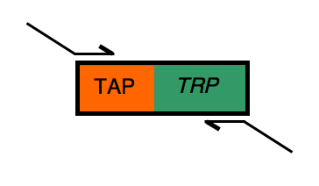
Designing your primers today

Slide 8
Designing your primers today

Slide 9
For next time…
Get started really learning about the complex you’re studying. Use the time today to do this or you’ll be cursing me as you do your homework later.
e.g. start your wiki pages to keep track of your references
e.g. read the abstract of at least 5 relevant papers
e. g. try to imagine what total success as well as total failure could look like and know that we have alternatives at the ready in the instances that experiments are pesky…

