Slide 1
Deletion of ZAP1 as a transcriptional factor has minor effects on S. cerevisiae regulatory network in cold shock
Kara Dismuke and Kristen Horstmann
May 7, 2015
BIOL 398-04: Biomathematical Modeling
Loyola Marymount University
Notes:
minor- ACE2 primarily?

Slide 2
Zap1 Deletion from S. cerevisiae
Background of ZAP1 was explored to better understand its activation roles.
Significant STEM output profile (profile 45) were examined, resulting in ontology terms.
Transcription factors were pruned with addition of deleted strains, resulting in 20 genes to study.
Models of MATLAB, Excel, and GRNsight were run and outputs were analyzed (esp. ACE2).
Regulatory genes and external environment could be manipulated to learn more about ZAP1’s role.
Notes:
Emphasize: ONLY WORKING WITH HYPOTHESES

Slide 3
ZAP1’s main role is to regulate zinc levels in yeast cells
Deletion of ZAP1
  Zinc-response Activator Protein
  “central player in yeast zinc homeostasis because it activates expression of… 80 genes in zinc-limited cells” (Eide, 2009)
  chosen from regulation of multiple cold-shock genes with zinc ion upregulated with cold shock
ACE2
  Controls cell division and mitosis
Notes:
ADD EQUATION
“ONLY” on Yeastract (binding experiments)
...(PLUS→ “or” condition→ yielded too many), (AND→ intersection of binding & expression→ too constrained)
BINDING: which TFS find to which genes
EXPRESSION: experiments similar (wt vs deleted strain to observe difference...genes different→ must have influence)

Slide 4
ZAP1’s main role is to regulate zinc levels in yeast cells
  “Zap1p activates the transcription of its target genes in zinc-limited but not in zinc-replete yeast cells”
    (Eide, D. J., 2001)
ZAP1 does not affect growth in cold environments
  transporter protein depends on membrane flexibility
ACE2
  Cell division and fluidity of membrane

Slide 5
As p-value became more stringent, the gene expression decreases
ANOVA | WT | dZAP1
p < 0.05 | 2378/6189 (31.42%) | 2264/6189 (36.58%)
p < 0.01 | 1527/6189 (24.67%) | 1445/6189 (23.35%)
p < 0.001 | 860/6189 (13.90%) | 792/6189 (12.80%)
p < 0.0001 | 460/6189 (7.43%) | 414/6189 (6.69%)
B-H p < 0.05 | 1656/6189 (26.76%) | 1538/6189 (24.85%)
Bonferroni p < 0.05 | 228/6189 (3.68%) | 192/6189 (3.10%)
Notes:
How many genes had an expression profile that was significantly different than zero at any timepoint at the different p-value cutoffs?
Significance= p<.05
For wildtype: 2378/6189 genes with p<.05 (31.4%)
For dZAP1: 2264/6189 (36.6%)
Interpreted p-values
Bonferroni-adjusted p-value was the most selective with 3.7% of genes had p-value<.05
Expected as data became more specific as p-value became more stringent

Slide 6
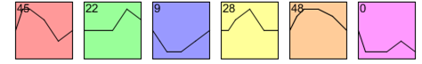
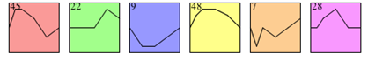
Wild Type and dZAP1 share 5/6 of the same significant STEM profiles
Wild Type STEM Results
dZAP1 STEM Results
Fig. x- Overall profiles for wildtype (left) and dZAP1 (right) corresponding to model expression profile. Wild type and dZAP1 have ⅘ of the same statistical significant profiles (colored), although some in different order. They are arranged from most to least significant p-value
Notes:
Each box corresponds to a model expression profile.
Colored profiles have a statistically significant number of genes assigned; they are arranged in order from most to least significant p value.
Profiles with the same color belong to the same cluster of profiles.
The number in each box is simply an ID number for the profile.
NOTE: deletion of zap1, oreder of significance for 28 and 48 changed, changed 1 significant profile (0- sig for WT, 7- sig for dzap1)
-further research: look at profiles 0 and 7

Slide 7
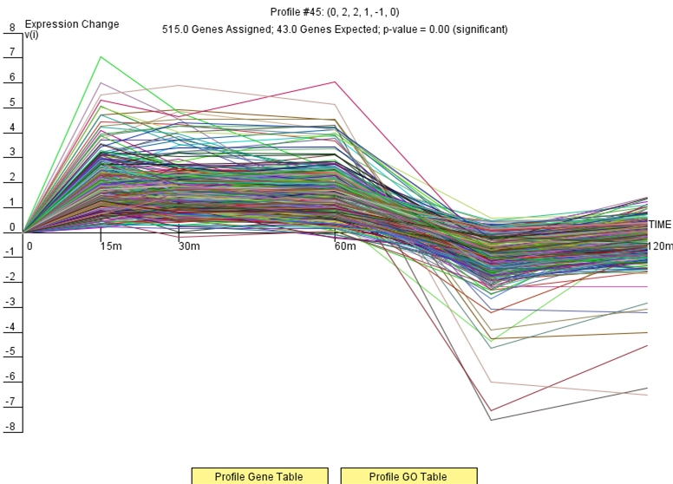
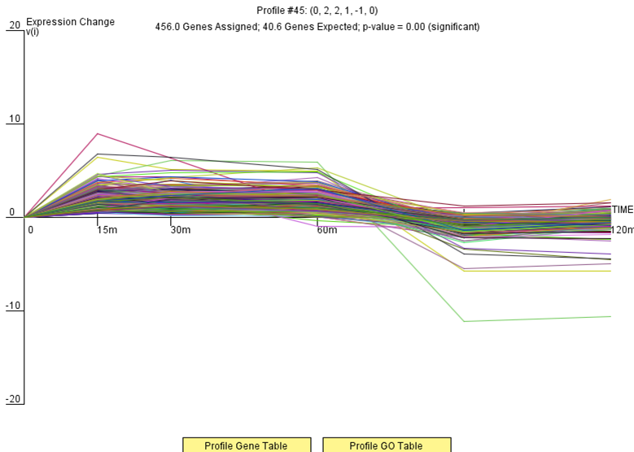
STEM Profile 45 showed the most significance for both wild type and dZAP1 strains
Notes:
note outlier...effect on y-axis and scaling
-pROFILE 28 VS 45
-10 GO terms were chosen frm the list of terms after the corrected p-value filter was applied

Slide 8
Gene Ontology terms demonstrate strong amino acid synthesis
Filtered p-value: 229/803 records
Corrected p-value: 21/803 records
Amino acid synthesis
                Colder, stiffer membrane
“Heat-induced signal… generated in response to weakness in the cell wall created under thermal stress… perhaps as a result of increased membrance fluidity” (Kamada et al, 1995)
Attempting to return to homeostasis
GO number | Basic definition
GO:0008652 | Cellular amino acid biosynthesis process
GO:1901605 | Alpha-amino acid metabolic process
GO:0009067 | Aspartate family amino acid biosynthetic process
GO:0009064 | Glutamine family amino acid metabolic process
GO:1901566 | Organonitrogen compound biosynthetic
GO:0006082 | Organic acid metabolic process
Notes:
-cold shock may be decreasing amino acid, so cell overcompensates
- definitions had both positive and negative regulation
-delete defintions
-note: glutamine (JOURNAL CLUB 2- mention)
KRISTEN

Slide 9
20 Transcription Factors were analyzed for repression and activation after “pruning”
Table 1- All 20 transcription factors used for the rest of this experiment after “pruning” away those that showed no repression or activation. CIN5, GLN3, HMO1, and ZAP1 do not have p-values as they were added to the list after the transcription factors were run through YEASTRACT. These transcription factors were chosen as they were shared between two STEM profiles
TF | P-value |  | TF | P-value |  | TF | P-value
SFP1 | 0.00E+00 |  | ACE2 | 1.48E-13 |  | PDR1 | 4.11E-06
YHP1 | 0.00E+00 |  | MSN2 | 5.74E-13 |  | GAT3 | 1.91E-05
YOX1 | 0.00E+00 |  | STB5 | 2.99E-12 |  | CIN5 | n/a
FKH2 | 0.00E+00 |  | ASG1 | 3.58E-09 |  | GLN3 | n/a
CYC8 | 0.00E+00 |  | SWI5 | 5.07E-08 |  | HMO1 | n/a
YLR278C | 5.90E-14 |  | MIG2 | 5.95E-08 |  | ZAP1 | n/a
RIF1 | 8.50E-14 |  | SNF6 | 1.83E-06

Slide 10
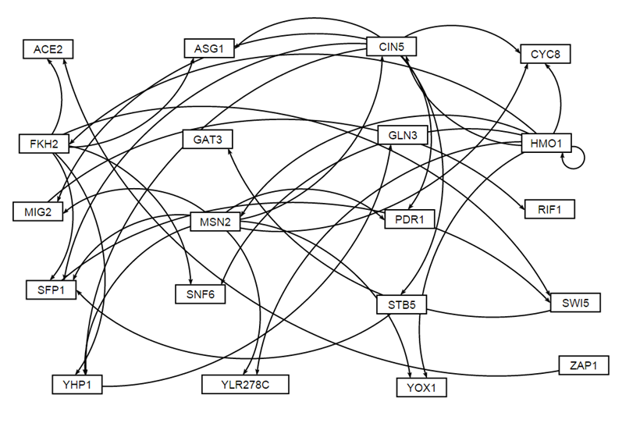
Unweighted transcription factor network of the 20 significant genes

Slide 11
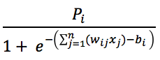
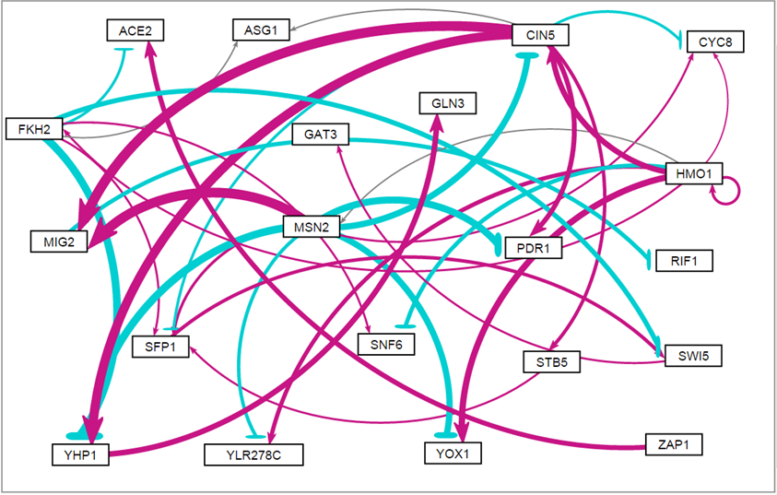
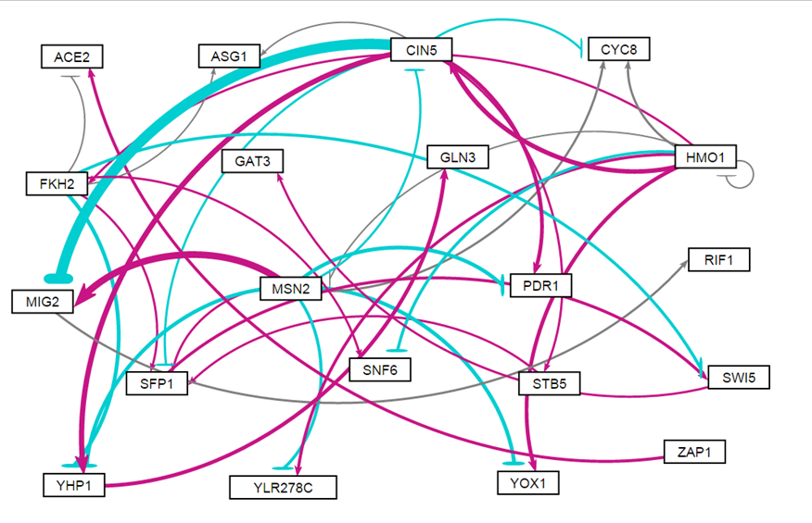
Weighted transcriptional gene regulatory networks with a fixed-b (left) and estimated-b (right)
Production Expression
=
Notes:
talk aouut cin5 vs mig 2 and zap 1 vs ace 2
ALL GENES HAVE FITS WITH NEGLIGIBLE DIFFERENCES, EXCEPT MIG2

Slide 12
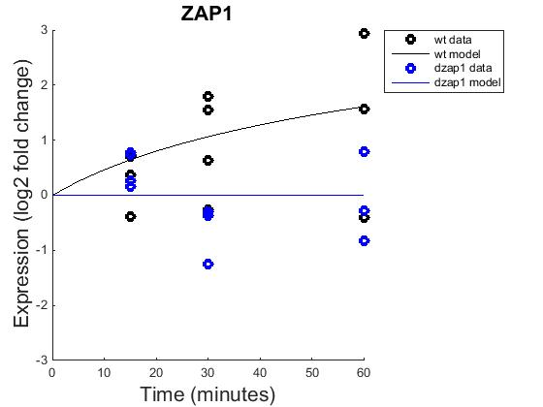

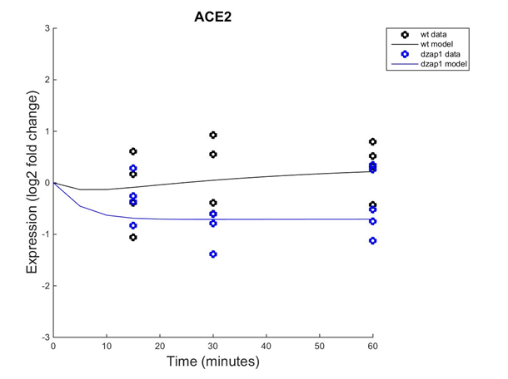
Deletion of ZAP1 from the network eliminates ZAP1’s effects on it
“Non-Estimated b”
“Estimated b”
Notes:
CIN5 activates (see in non-estimated b network), but also represses (estimated b network)
-other than ACE2, this is the only TF that shows great change in terms of model results

Slide 13
ZAP1 only exhibits influence on ACE2 (activation)
Notes:
talk aouut cin5 vs mig 2 and zap 1 vs ace 2

Slide 14
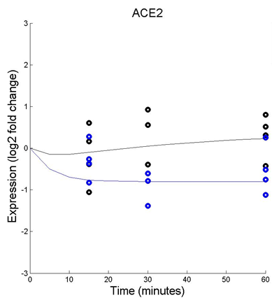
Deletion of ZAP1 causes repression of ACE2 in our network
“Non-Estimated b”
“Estimated b”
Notes:
cells stop dividing in cold…. If ACE2= cell division,

Slide 15
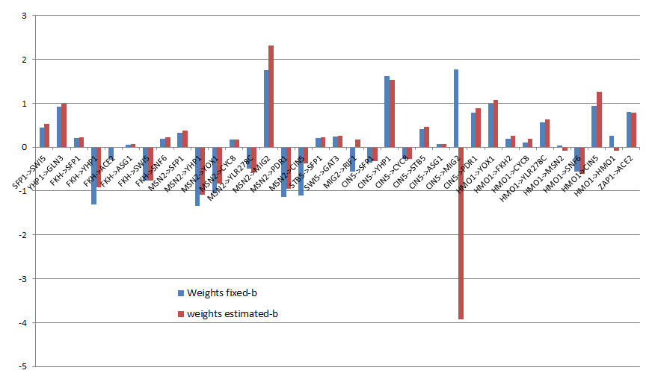

Comparison of Weights between fixed and estimated b-values for each regulatory pair

Slide 16
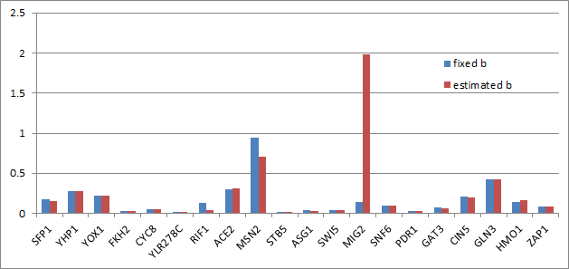


Production Rates for fixed & estimated b transcription factors, with MIG2 showing the most change

Slide 17
MIG2 changes from being strongly activated to being strongly repressed
Notes:
major difference between models...not only does it go from being activated to repressed, it does so big-time (weight values are large)

Slide 18
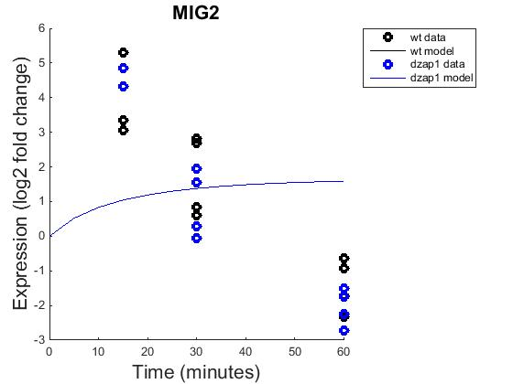
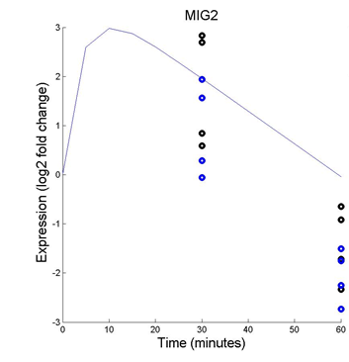
Overall, models of MIG2 poorly fit the data, though improved with estimation of b
“Non-Estimated b”
“Estimated b”
Notes:
CIN5 activates (see in non-estimated b network), but also represses (estimated b network)
-other than ACE2, this is the only TF that shows great change in terms of model results
-b-value= -2.1223 (estimated b)
-WORST FIT
-note different axes’
-MIG2 showed largest dynamics over time points

Slide 19
Large dynamics of MIG2 over time course is reflected in p-values.
MIG2 p-values from
ANOVA Analysis
ANOVA | WT | dZAP1
p < 0.05 | 2378/6189 (31.42%) | 2264/6189 (36.58%)
p < 0.01 | 1527/6189 (24.67%) | 1445/6189 (23.35%)
p < 0.001 | 860/6189 (13.90%) | 792/6189 (12.80%)
p < 0.0001 | 460/6189 (7.43%) | 414/6189 (6.69%)
B-H p < 0.05 | 1656/6189 (26.76%) | 1538/6189 (24.85%)
Bonferroni p < 0.05 | 228/6189 (3.68%) | 192/6189 (3.10%)
Wild Type
-p-value: 7.68x10-5
-B-H p-value: .00113
-Bonferroni p-value: .487
dZAP1
-p-value: 6.236x10-7
-B-H p-value: 5.01x10-5
-Bonferroni p-value: .00366
Notes:
-upon p-value analysis from ANOVA, p-value in
dzap1 ANOVA…
0.00385935 (Bonferoni p-value...one of the most stringent)
(3.10%...192/6189 genes)
wild type ANOVA…
7.86x10-5 (p-value)
B-H: .001129
-MIg2… ANOVA p-value spreadsheet. magnitude of change
-CYC8 no change and small variance
p-value is affected by 1) spread of data (was a lot for MIG2), 2) # replicates (same (4) for all), 3) magnitude of log fold change

Slide 20
YHP1 and CYC8 Production Rates show virtually no change between the two runs
Notes:
-MIg2… ANOVA p-value spreadsheet. magnitude of change
-CYC8 no change and small variance

Slide 21
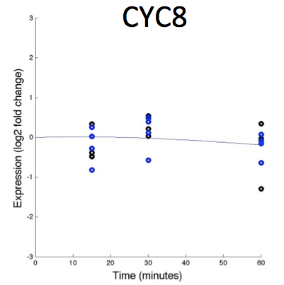
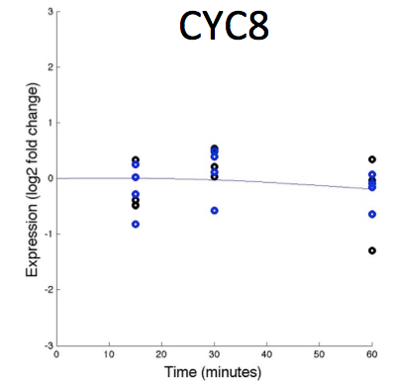
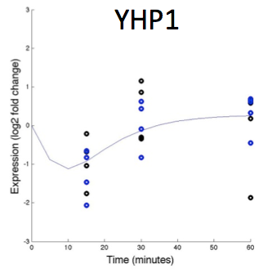
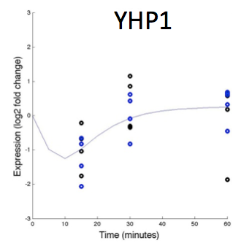
CYC8 and YHP1 models closely fit with data
“Non-Estimated b”
“Estimated b”
“Non-Estimated b”
“Estimated b”
Notes:
CIN5 activates (see in non-estimated b network), but also represses (estimated b network)
-other than ACE2, this is the only TF that shows great change in terms of model results
-b-value= -2.1223 (estimated b)
-WORST FIT
A FEW EXPLANATIONS WE HAVE FOR THIS CLOSE FIT
fit of data (CYC8- lot of overlapping points)...less variance→ (hope for it to be) more precise
limited number of outliers
in terms of our network, incidentally after we IDed these two has having two of the best fits, we looked at our network and saw they both had 3 things controlling it (inputs were activating and repressing it)- more control for model...more votes→ finer control

Slide 22
CYC8 and YHP1 both have the most number of inputs in our network
Notes:
talk about cin5 vs mig 2 and zap 1 vs ace 2
-MIg2… ANOVA p-value spreadsheet. magnitude of change
-CYC8 no change and small variance

Slide 23
Future directions
Deletion of other transcription factors to explore if they show bigger changes
  CIN5 and MSN2 based off GRNsight network
Troubleshoot ZAP1 and MIG2 relationship (esp. in terms of models)
Could examine ZAP1 in heavy-metal environment
Examine wild type Stem Profile 0 vs dZAP1 Stem Profile 7
Investigate what genes ACE2 regulates
Deletion of ZAP1 as a transcriptional factor has minor effects on S. cerevisiae regulatory network in cold shock
Notes:
Investigate what genes ACE2 regulates
as a means of measuring the influence deleting zap1 has on the network

Slide 24
Zap1 Deletion from S. cerevisiae
Upon research of ZAP1, zinc-related effects were explored especially with its possible effects on ACE2.
Most significant STEM profile, 45, gave rise to the ontology terms which generated the hypothesis of amino-acid relationship.
Models of MATLAB, Excel, and GRNsight were run with the 20 transcription factors, showing ZAP1’s only role to be activation of ACE2 in this network.
  MIG2, CYC8, and YHP1 were further examined.
This project could be expanded to explore ZAP1’s relationships with other transcriptional factors and environmental stresses.
Notes:
Emphasize: ONLY WORKING WITH HYPOTHESES

Slide 25
Acknowledgments
We would like to thank Dr. Dahlquist, Dr. Fitzpatrick, and our BIOL 398 classmates for their consistent help and support.

Slide 26
References
Eide, D. J. 2009. Homeostatic and adaptive responses to zinc deficiency in Saccharomyces cerevisiae. J.Biol. Chem. 284:18565–18569
Eide, D. J. (2001). Functional genomics and metal metabolism. Genome Biol,2(10), 1-3.
Kamada, Y., Jung, U. S., Piotrowski, J., & Levin, D. E. (1995). The protein kinase C-activated MAP kinase pathway of Saccharomyces cerevisiae mediates a novel aspect of the heat shock response. Genes & development,9(13), 1559-1571.

