Slide 1
Mesenchymal and Tissue-Specific Stem Cells
ChemEng 590B: Tissue Engineering
Lecture 4
January 31st, 2013

Slide 2
Reminder: Tissue Replacement Strategy
These can be stem cells!

Slide 3
Stem Cells vs. Primary Cells in TE
Primary Cells
Stem Cells
Harvest and grow cell type of interest
Not all cell types expand well in culture
  e.g. Smooth muscle, Nerves, Cardiomyocytes
Difficult to find a good source for all cells
  Limited number, what if those cells aren’t healthy? Donor?
Can be differentiated down correct pathway?
  Depends on the cell derived and the stem cell source
Expansion properties known, but often loss of “stemness”
  Start to differentiate (lose stemness) immediately in culture
Sources of many stem cells are controversial within public eye

Slide 4
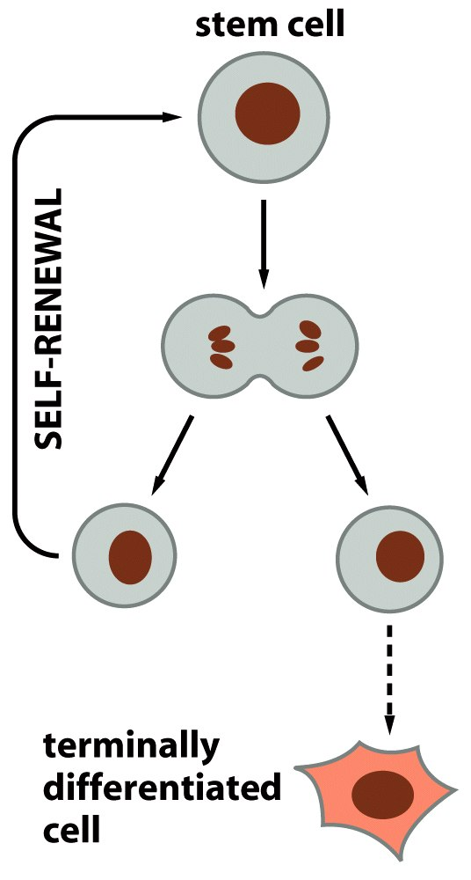
Stem cells asymetrically divide
Figure 23-5 Molecular Biology of the Cell (© Garland Science 2008)

Slide 5
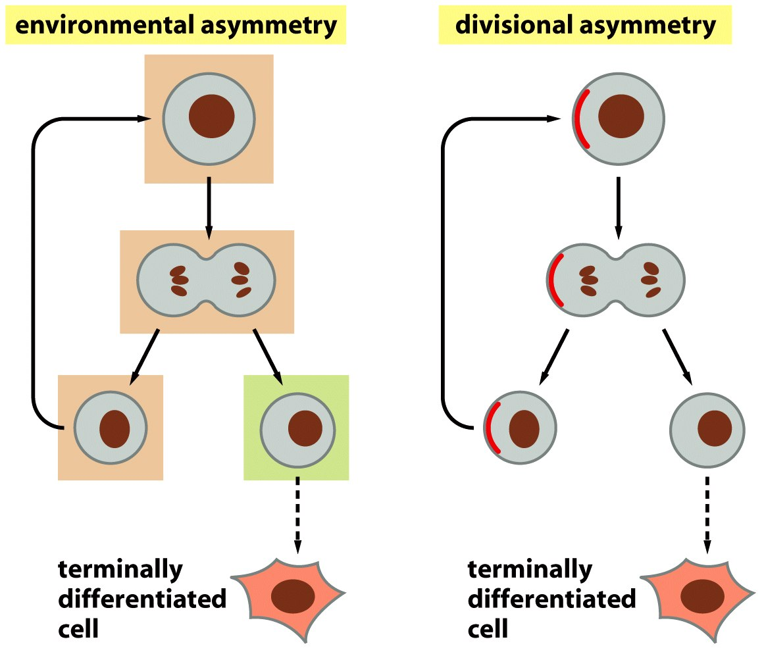
Extra and intra-cellular forces cause asymmetric division
Figure 23-6 Molecular Biology of the Cell (© Garland Science 2008)

Slide 6
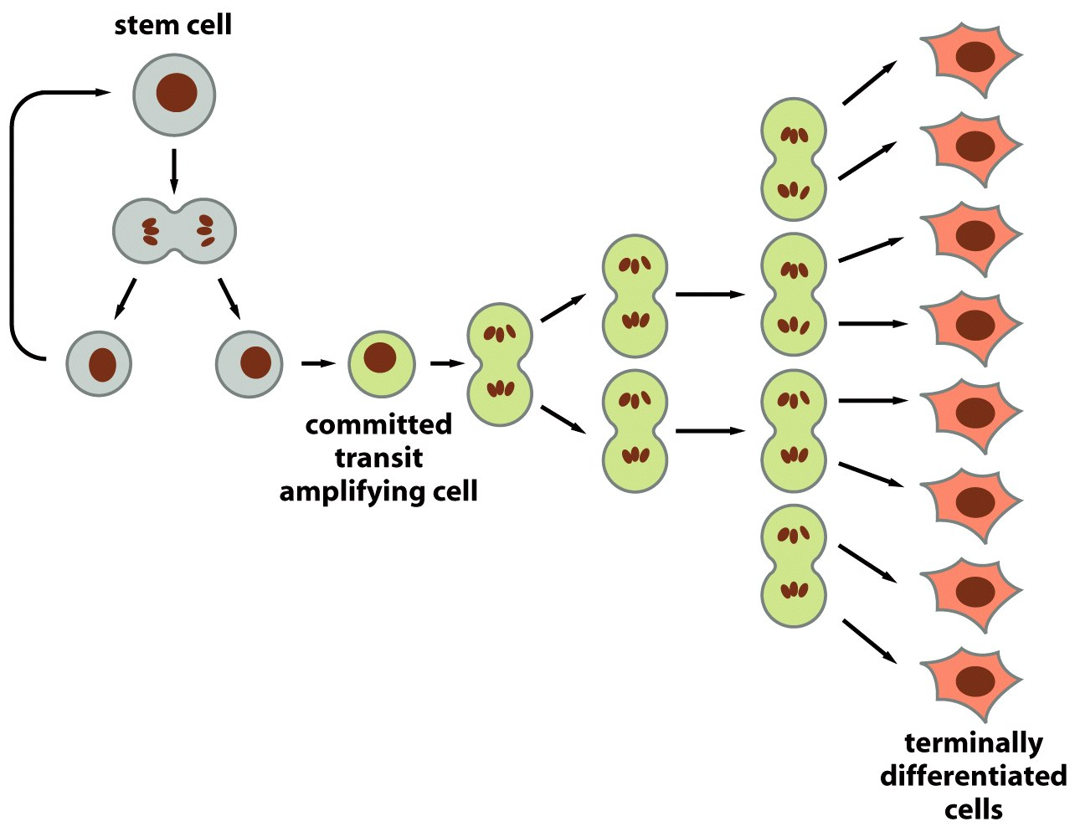
Many steps between stem cell and differentiated cell
Engineering design challenge: how do you get cells to go through all these different steps??
Are all these steps in culture? Does a biomaterial you want to use cause these steps? Or, do you “let the body” do the work? (in vivo bioreactor)
Figure 23-8 Molecular Biology of the Cell (© Garland Science 2008)

Slide 7
Mesenchymal Progenitors
Bone marrow, fetal and adult tissues (adipose, cord blood, bone)
Surface Markers
  CD105, CD73, CD90
  CD44. CD71, CD106, CD166, CD129 (also accepted)
  Not CD34, CD14, CD45, CD11a, CD31 (vascular and hematopoietic progenitors)
Plastic adherence
Differentiation

Slide 8
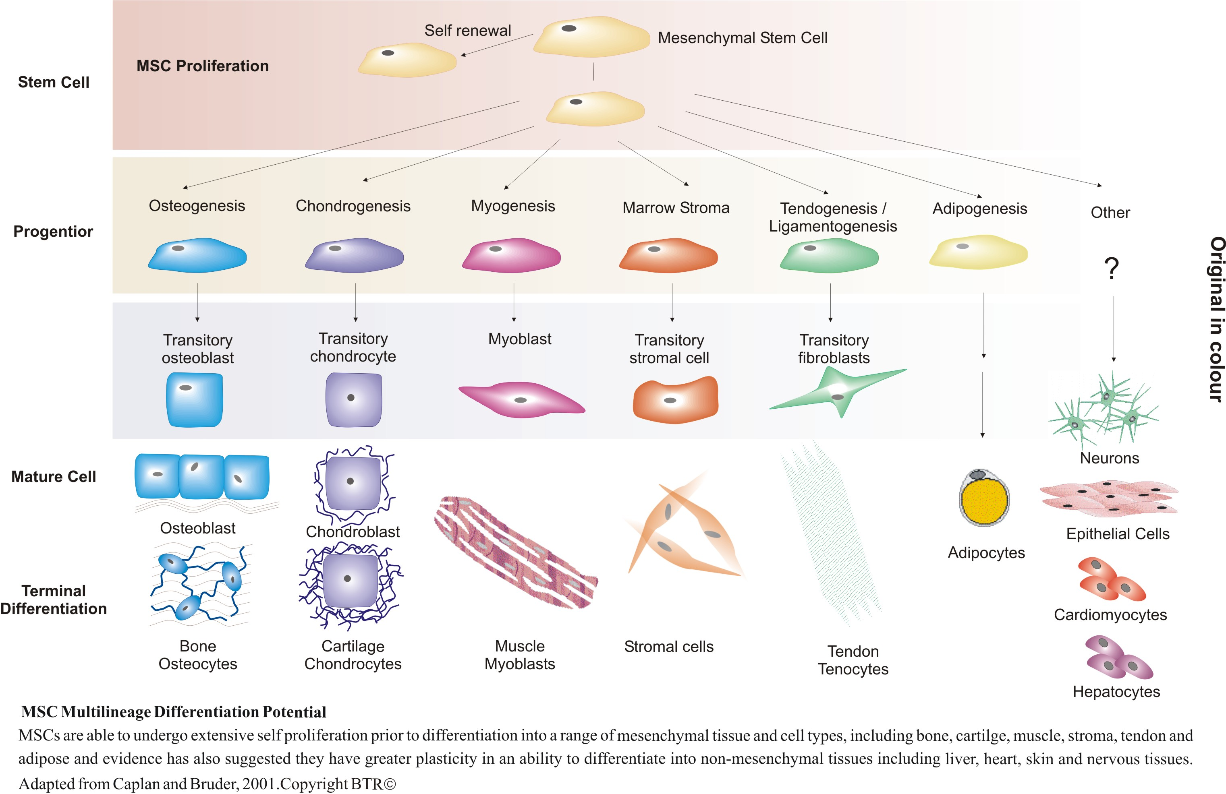
Differentiation Potential of Mesenchymal Stem Cells

Slide 9
Mesenchymal Progenitors
Migrate and home to injured sites
Secretion of growth factors (VEGF, PDGF), paracrine mediators
Modulate immune responses
  PGE2, TGFβ – inhibit NK cell proliferation
  IL-10, IL-1, M-CSF suppresses dendritic cell differentiation
  CCL5, IL-17B - Promote cell motility

Slide 10
MSCs from Fresh Marrow Differentiate, but not an Efficient Process
Marrow Aspirate
  Skeletal stem & progenitor cells
  Hematopoietic stem & progenitor cells
  Lineage committed cells
  Mature hematopoietic cells including red cells
chondrocytes
About 1:20,000 cells in marrow aspirate
skeletal stem cell
osteoprogenitor
pre-osteoblast
osteoblast
osteocyte
adipocytes

Slide 11
Growth Factor Cues can Enhance Differentiation
“Colony forming cell”
CFC
CFC
CFC
EGF
HB-EGF
FGF-2
EGF
PDGF
CFC
TGF-β
EGF
PDGF
Osteoprogenitors
Osteoblasts
Osteocytes
Epidermal growth factor (EGF) receptor ligands exert multiple effects on homeostasis in vivo and CFC behavior in vitro
Adipocytes
Chondrocytes
Notes:
EGF effect depends strongly upon other culture conditions: serum, adhesion conditions, concentration, type of MSC cell line

Slide 12
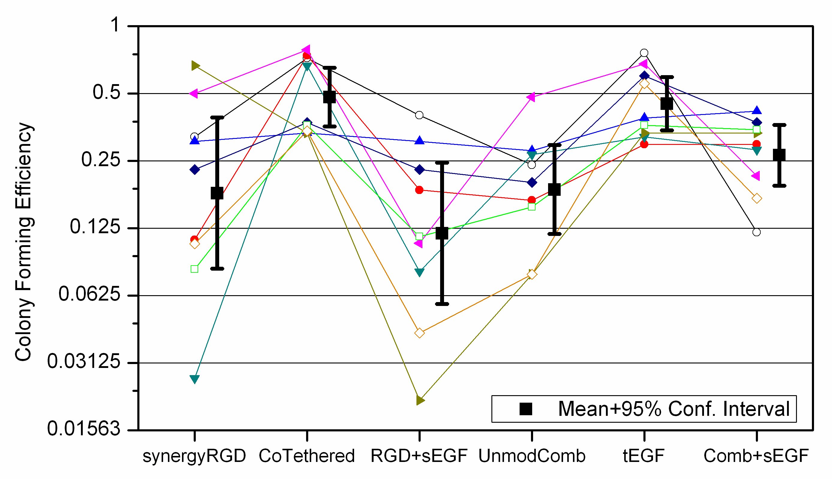
Even With Extensive Cues, Differentiation is Patient-Specific and Heterogeneous
p=.03079
p=..00204
n=9

Slide 13
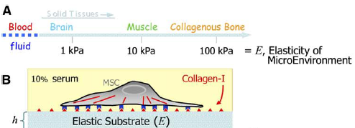
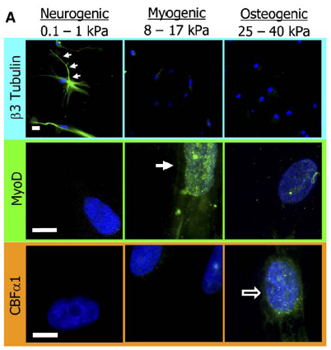
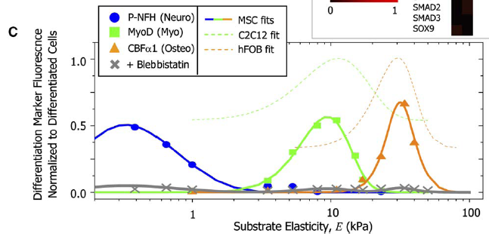
Insoluble Cues: Stiffness of Microenvironment Effects MSC Differentiation
Engler et al., Cell 2006

Slide 14
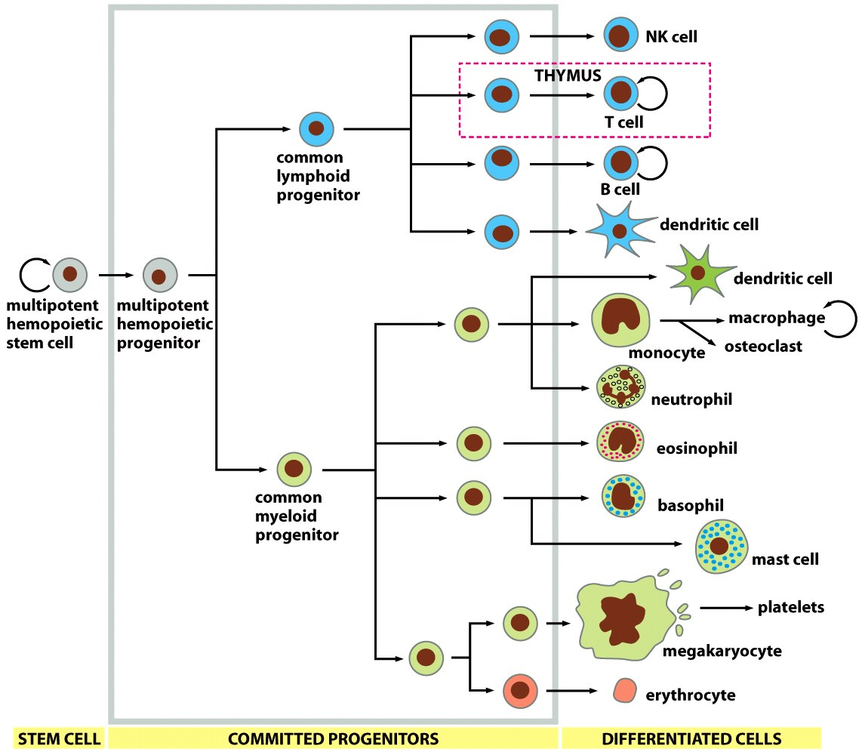
Hematopoietic Stem Cells
(Immune System, blood, endothelium)
Figure 23-42 Molecular Biology of the Cell (© Garland Science 2008)

Slide 15
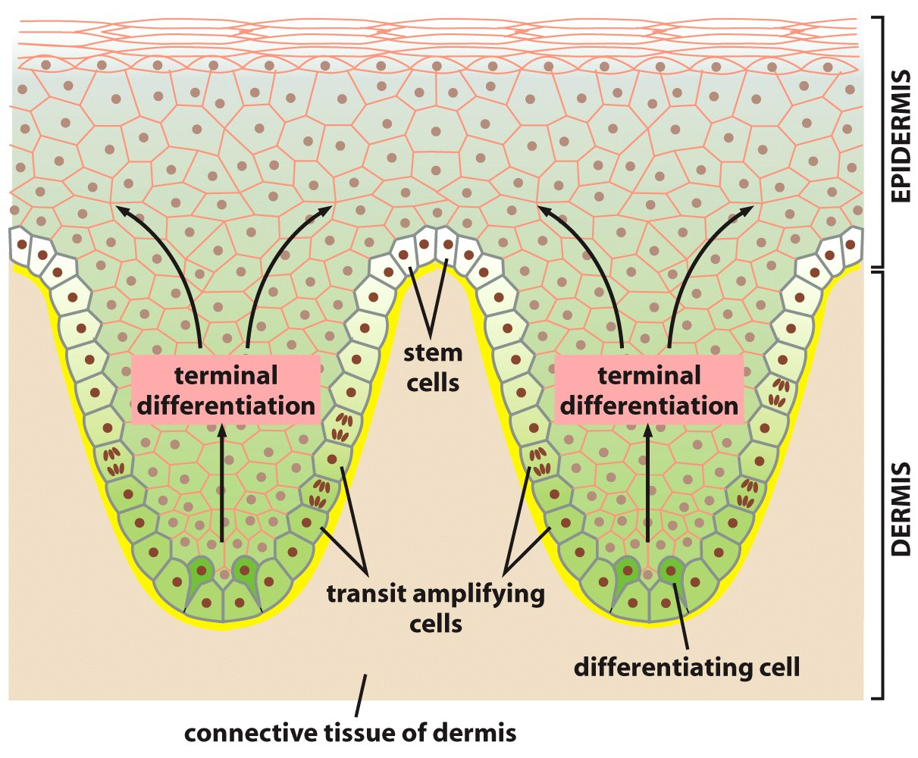
Transitory steps in vivo in skin
Skin stem cells!
Figure 23-7 Molecular Biology of the Cell (© Garland Science 2008)

Slide 16
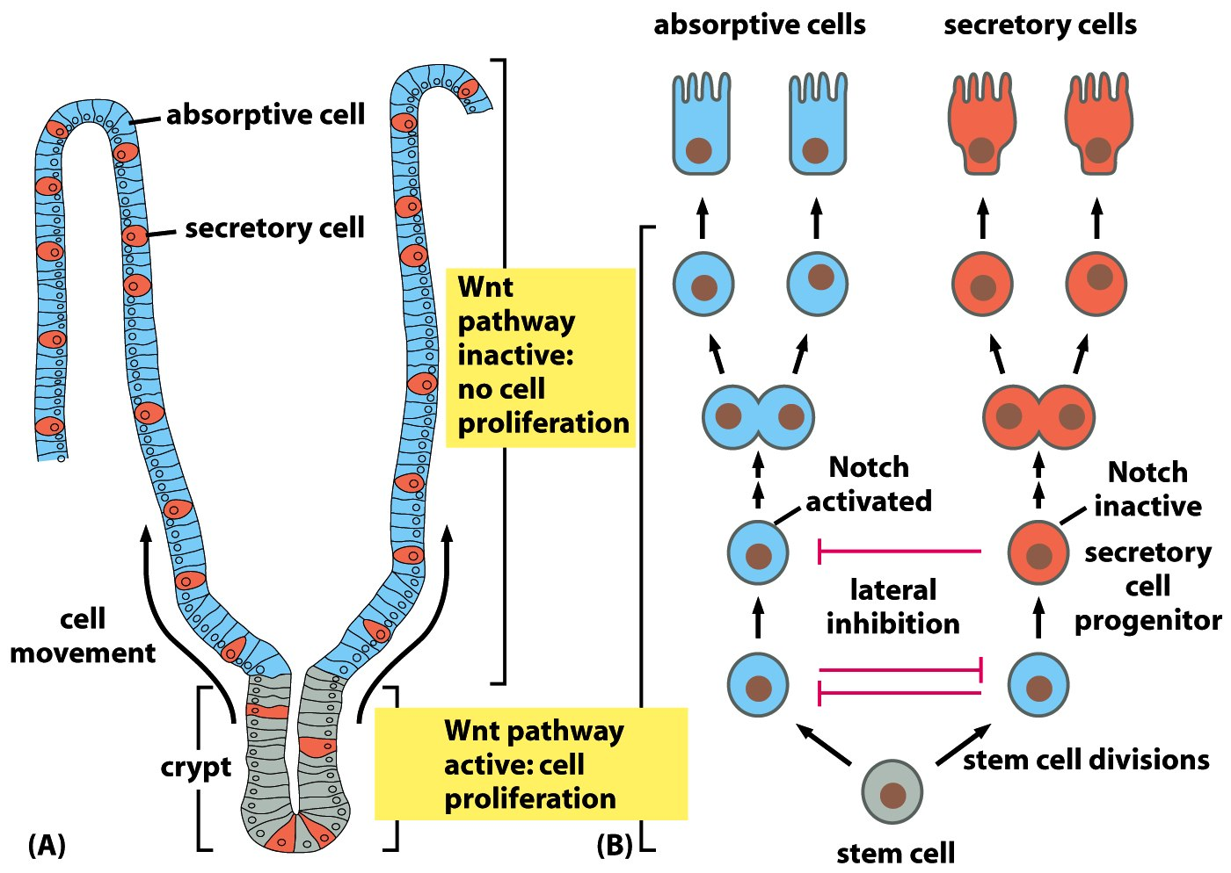
Transitory steps in vivo in the gut
Gut stem cells!
Figure 23-24 Molecular Biology of the Cell (© Garland Science 2008)

Slide 17

Mesenchymal Progenitors & Cancer
Good, Bad, or Both?
Primary tumor growth & metastatic process
Differentiation into tumor-associated fibroblasts and vascular pericytes
Shown to increase the in vivo growth of colon cancer, lymphoma, melanoma
Shown to decrease tumor growth in colon cancer, Kaposi sarcoma, liver, pancreas, breast cancer (Klopp, et al 2011. Stem Cells)

Slide 18
Mesenchymal Progenitors & Cancer
Good, Bad, or Both?
Why the discrepancy?
1. Cell isolation techniques
2. Cell populations and heterogeneity
3. Different tumor models
4. Dose of MSCs
5. Timing of MSC delivery
6. Patient environment (genetic, disease states, exposures)

Slide 19
Ohlsson, et al, 2003
D0
D3
5d-post implant
7d-post implant
14d-post implant
Cells grown in vitro
3-4x proliferation
Matrix implanted
gelatins removed
frozen
sectioned
IHC
Colon cancer (H1D2)/stem cells (MPC1cE) cell studies (D5, 7, 14, 30)
H1D2 only
MPC1cE only
H1D2 + MPC1cE (1:1, 1:6, 1:10)
gelatin w/o cells = control

Slide 20
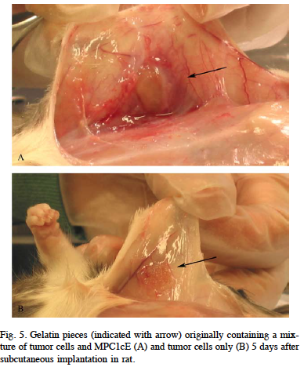

Slide 21
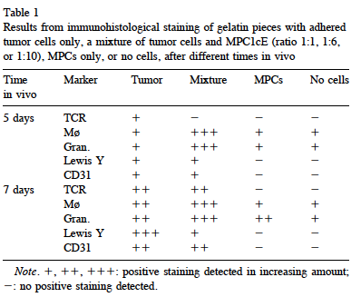

Slide 22
Wiki Presentations start next week!
http://openwetware.org/wiki/590B_Wikis

