Slide 1
Comparison of the wild type of S. cerevisiae and S. paradoxus
Karina Alvarez and Natalie Williams

Slide 2
The WT of S. cerevisiae shows a higher percentage of significance with all p-values in the NSR1 gene than in S. paradoxus’.
 | S. cerevisiae | S. paradoxus
p < 0.05 | 38.42 % | 36.55%
p < 0.01 | 24.67% | 22.62%
p < 0.001 | 13.90% | 11.05%
p < 0.0001 |  | 5.073%
B-H p < 0.05 | 26.76% | 24.25%
Bonferroni p < 0.05 | 3.86% | 2.343%

Slide 3
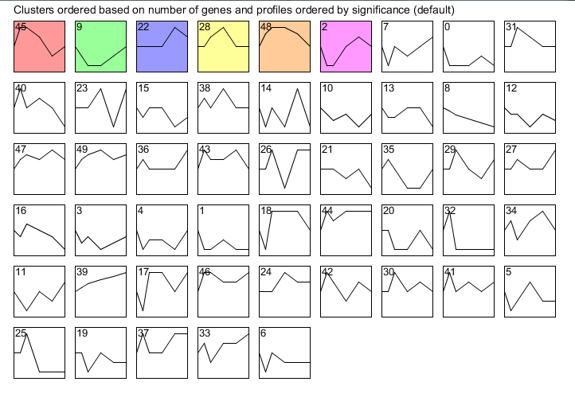
Results of stem show 6 different profiles, signifying that S. par has a collection of genes that reacts to cold shock.

Slide 4
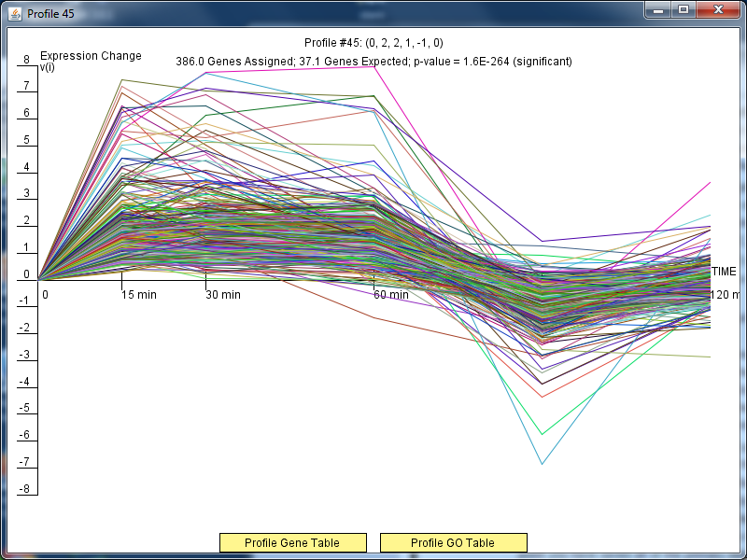
Profile #45 contains genes that are activated during cold shock and then are repressed during the recovery phase. S. paradoxus

Slide 5
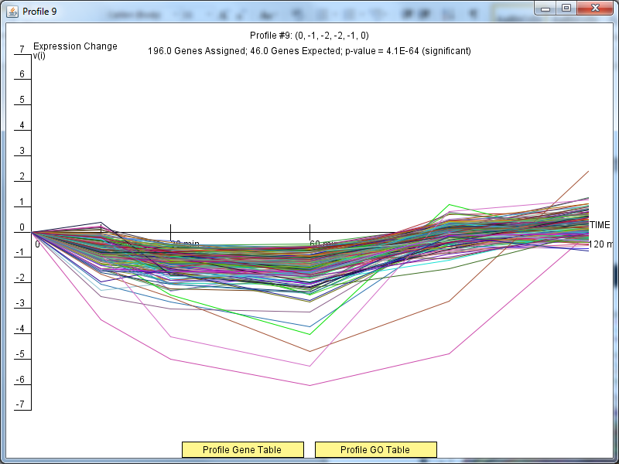
Profile #9 shows genes that are generally repressed throughout the cold shock and gradually reach activation later in the recovery phase. S. paradoxus

Slide 6
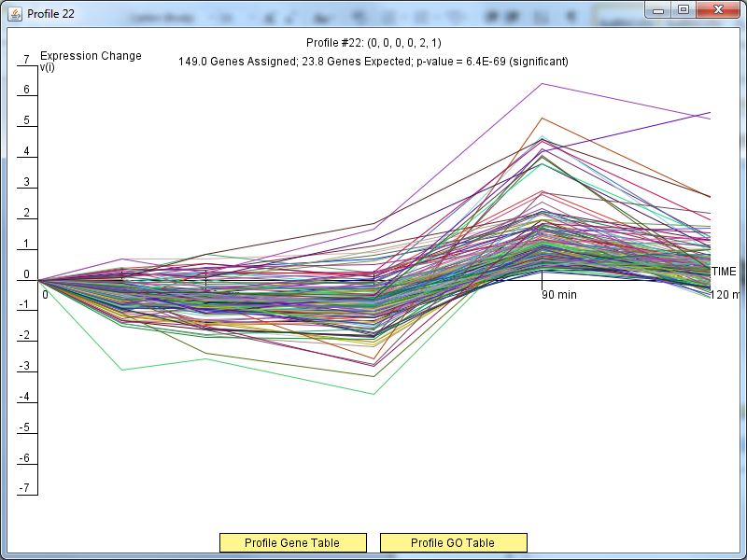
Profile #22 shows genes that do not have a significant level of expression during cold shock, but in the recovery phase, they are highly activated. S. paradoxus

Slide 7
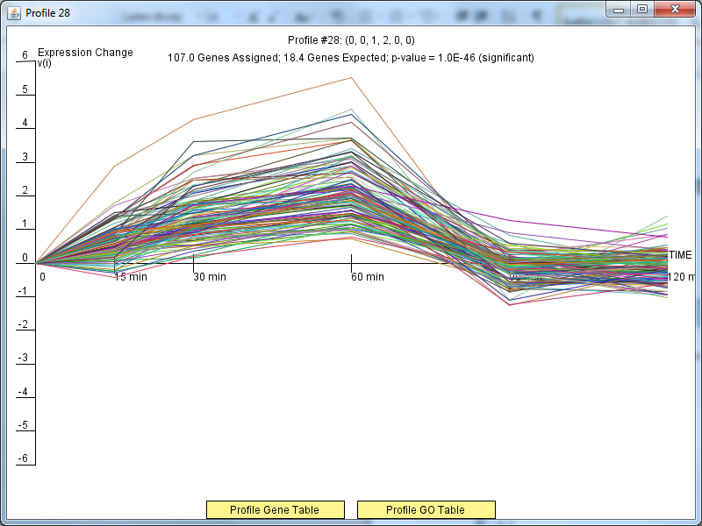
Profile #28 shows genes that are activated and then reach a level of steady expression close to 0 or no expression. S. paradoxus

Slide 8
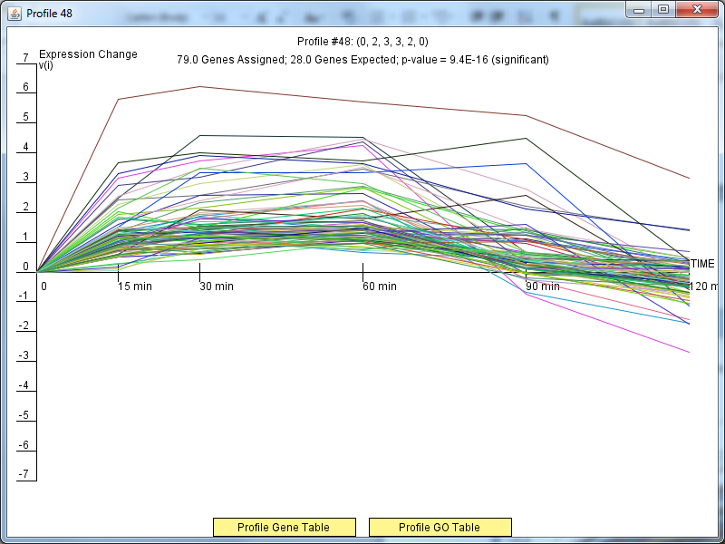
Profile #48 shows fewer genes than previous profiles and that those genes are activated before reaching decreased expression levels. S. paradoxus

Slide 9
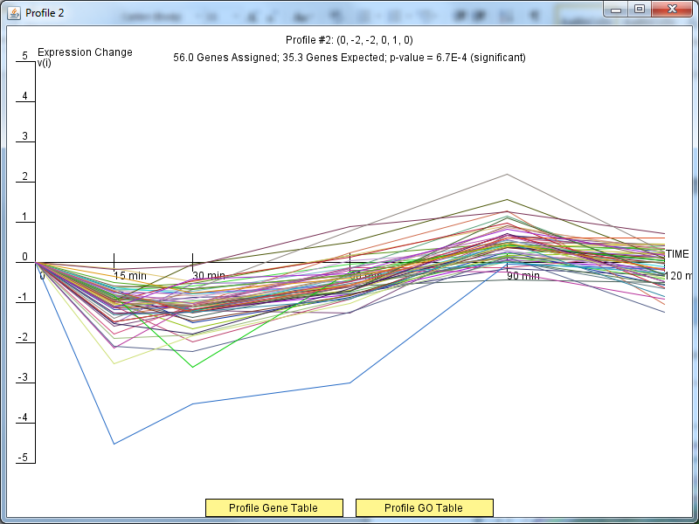
Profile #2 shows genes that are decreased initially in cold shock and during recovery phase are activated. S. paradoxus

Slide 10
The amount of transcription factors responsible for gene regulation decreases with the varying criteria for the test.
Restrictions/Settings | Nodes | Edges
DNA binding plus expression | 41 | 384
ONLY DNA binding | 38* | 102*
DNA binding and expression | 20* | 23*
* Amounts before alterations were done to see the visualized GRN in GRNSight

Slide 11
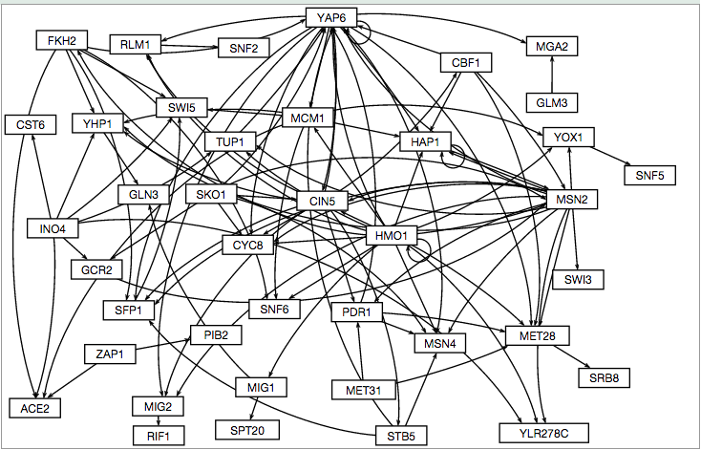
Original GRNSight visualization of the GRN resulting from the Only DNA binding evidence

Slide 12
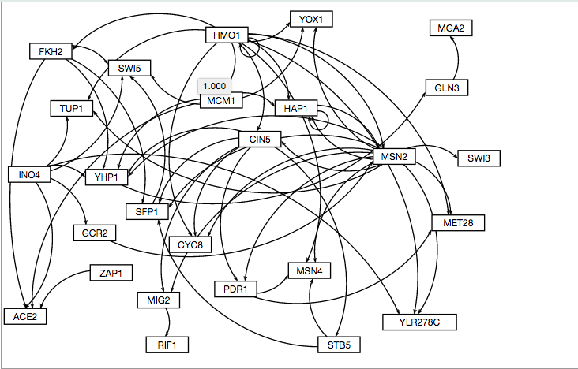
Modified GRN from Only DNA binding evidence with a few strains deleted from the Original visualization.
Deleted:
SRB8
RLM1
SPT20
MIG1
CST6
MET31
SPT2
SNF5
PIB2
SNF6
SNF2
CBF1
SSN2
SKO1
YAP6

Slide 13
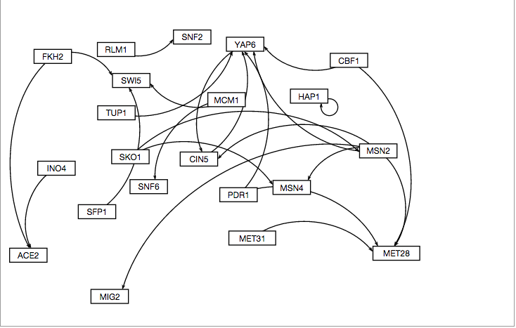
GRN visualized from the DNA binding evidence and expression data.

Slide 14
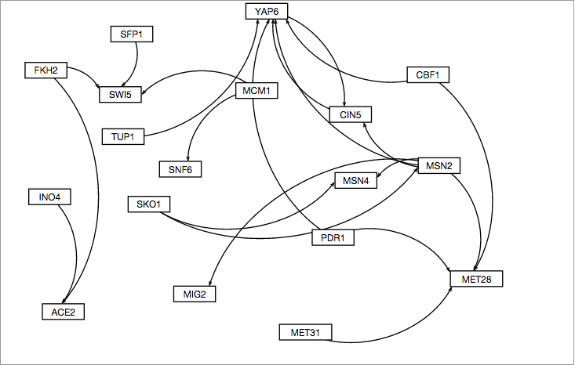
GRN visualized from the modified DNA binding evidence and expression data.
Deleted:
HAP1
RLM1
SNF2

Slide 15
The altered table that depicts the amount of transcription factors responsible for gene regulation.
Restrictions/Settings | Nodes | Edges
DNA binding plus expression* | 41 | 384
ONLY DNA binding | 29 | 58
DNA binding and expression | 17 | 21
* A visualization was not able to be produced due to the number of nodes and edges.

Slide 16
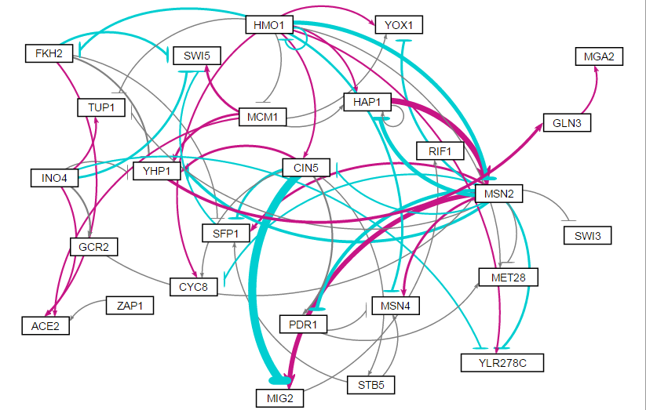
Visualization of the GRN when the parameters and production rates were optimized with a fixed b – threshold – value.

Slide 17
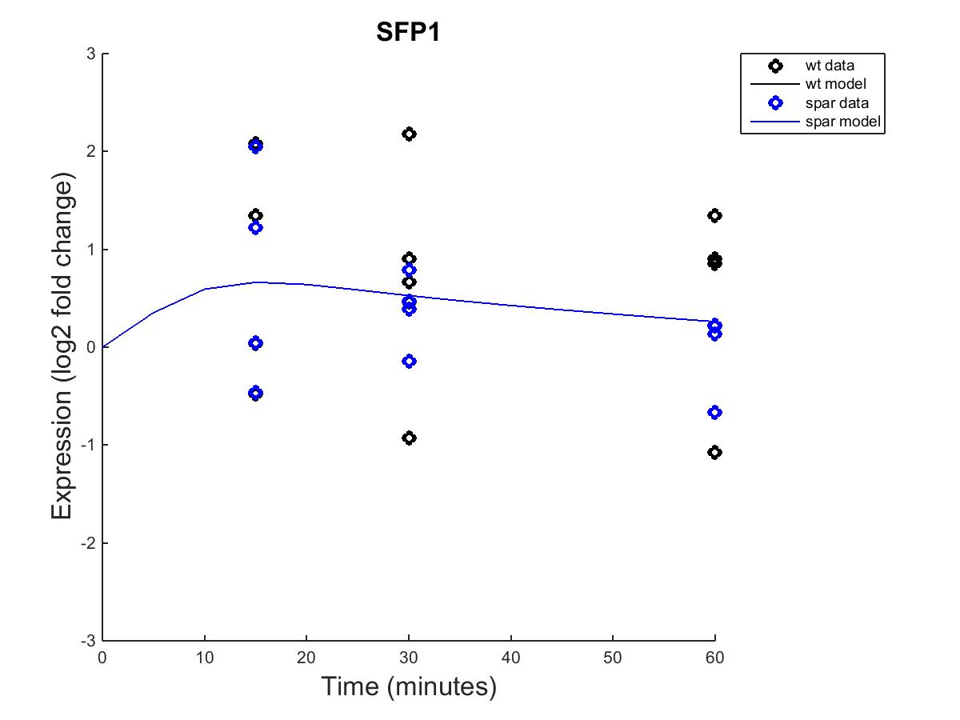
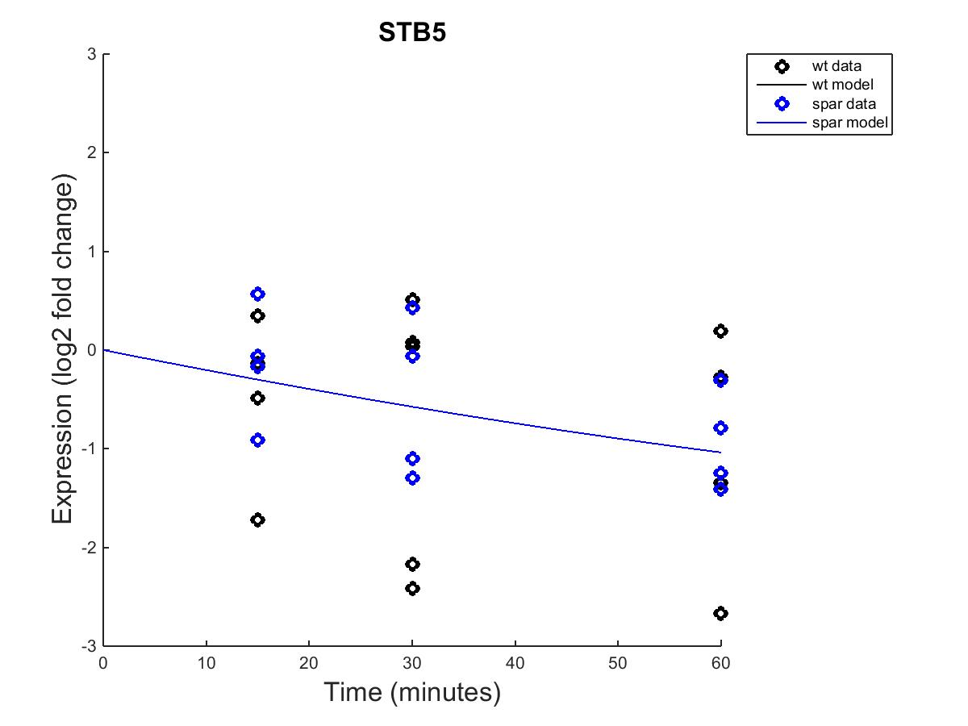
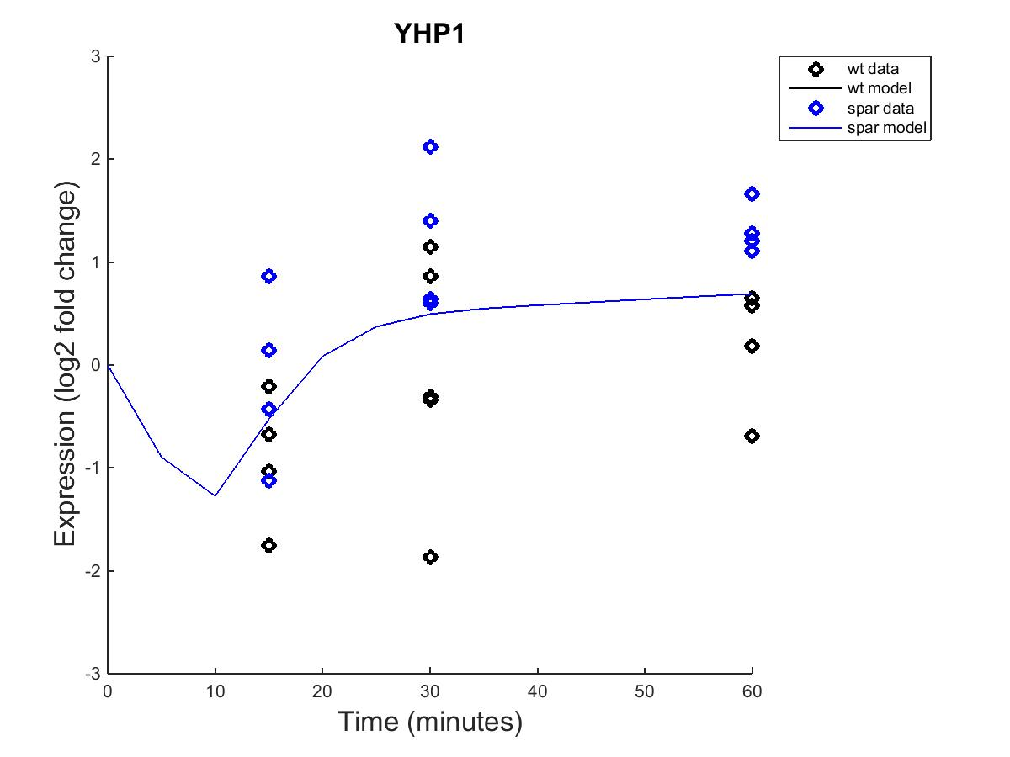
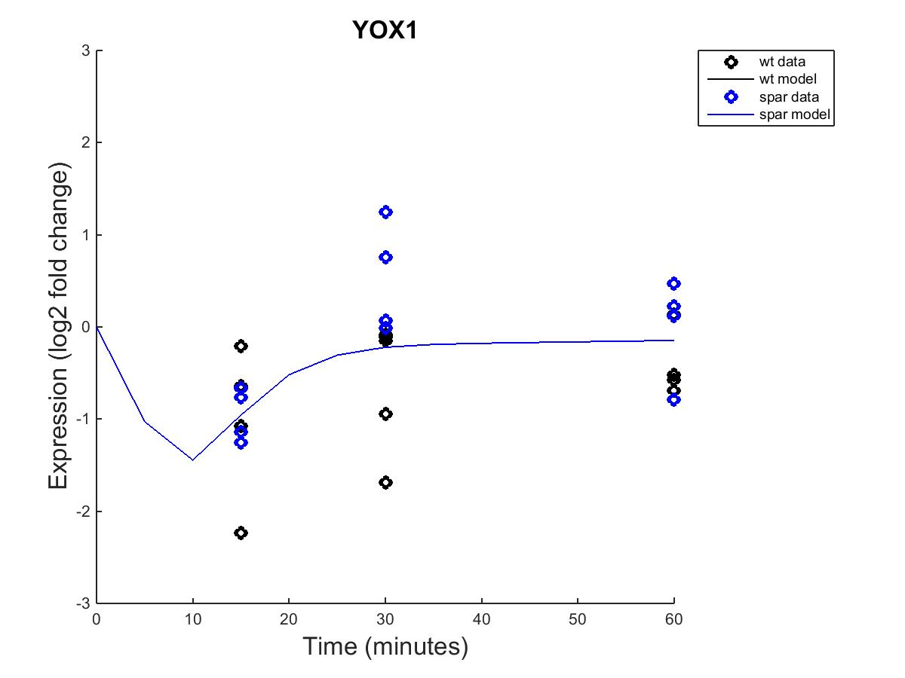
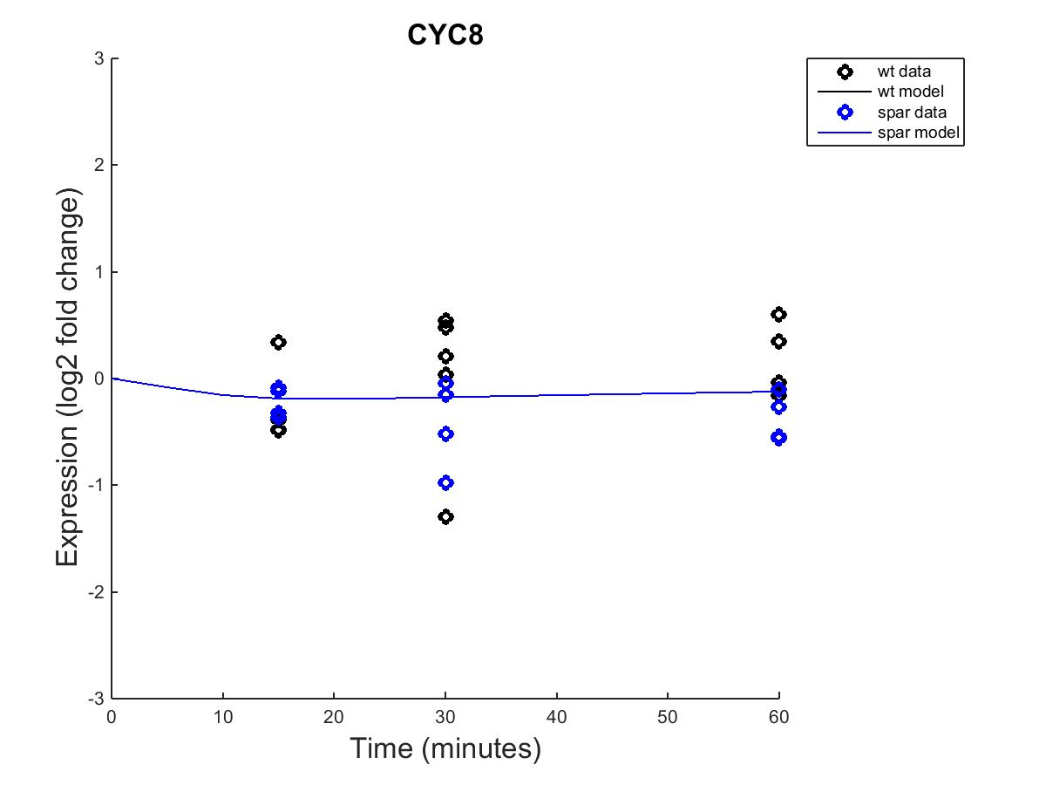
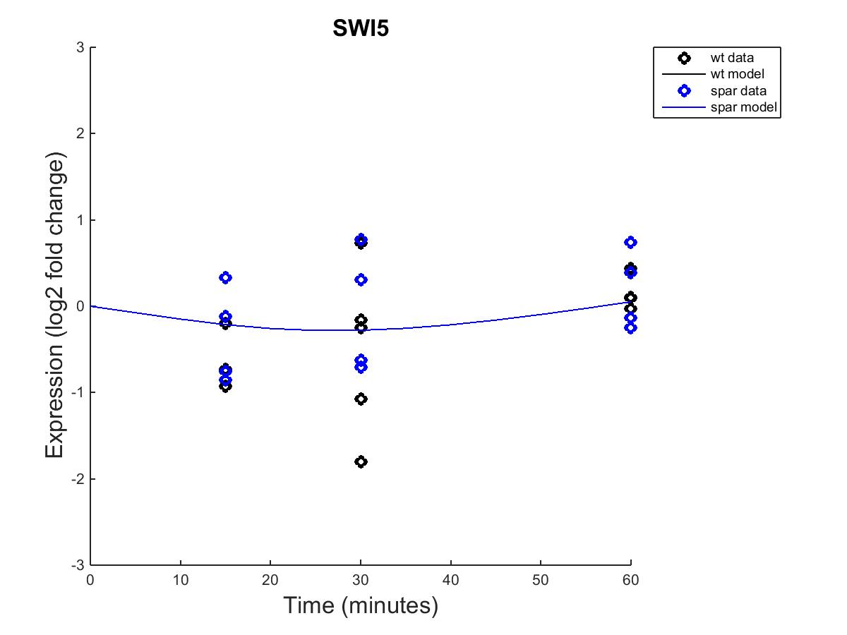
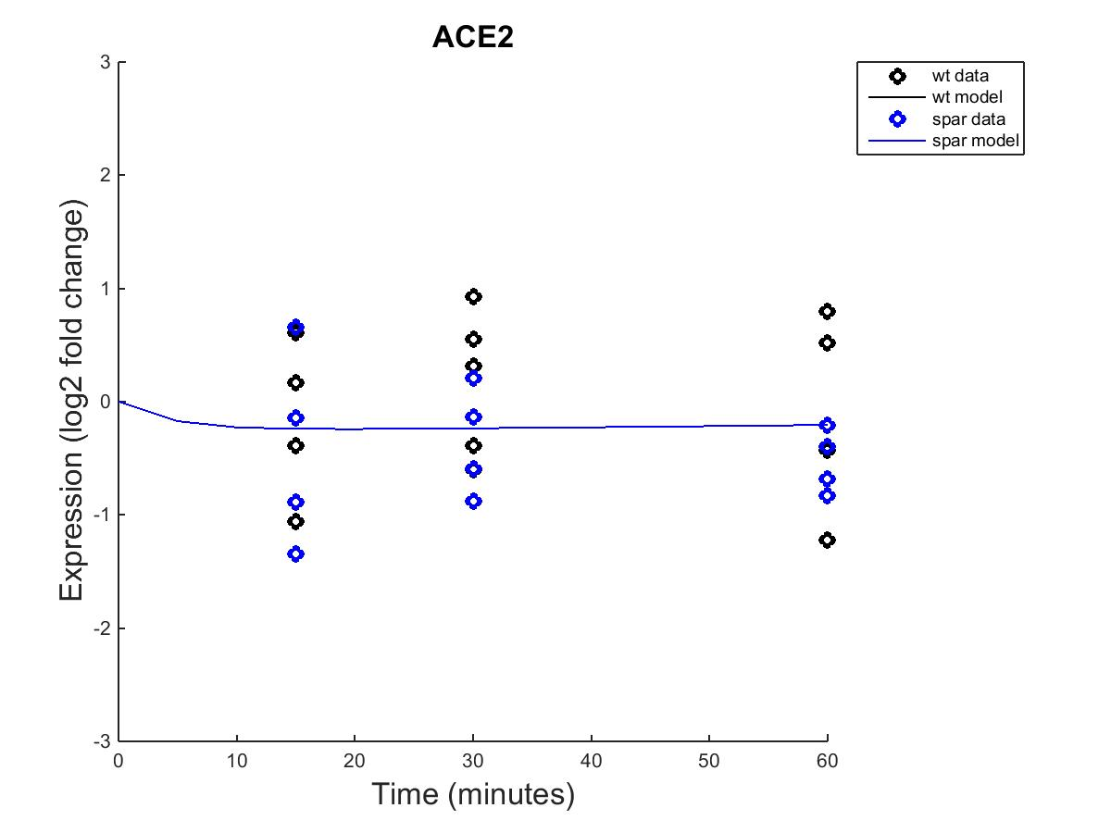
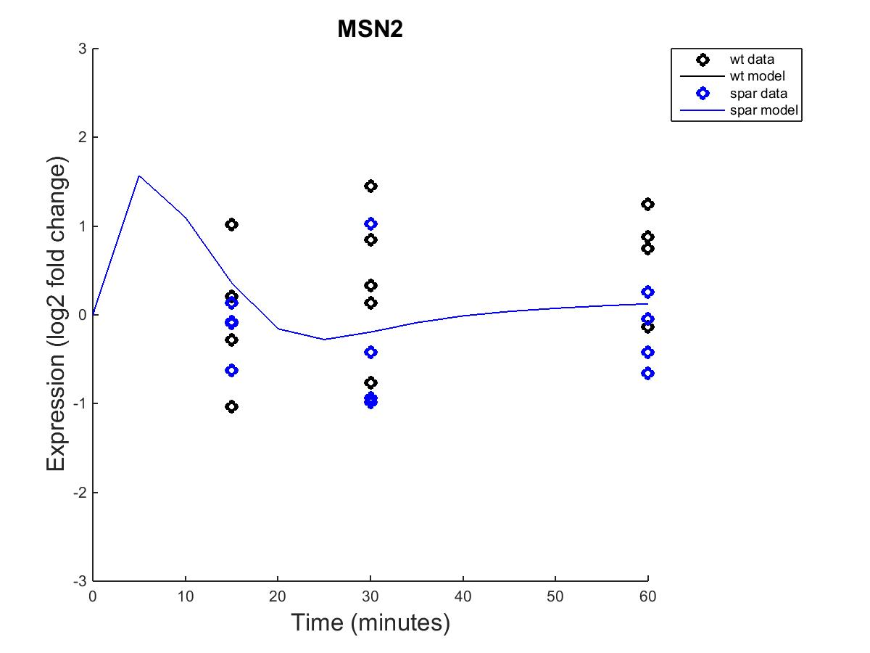
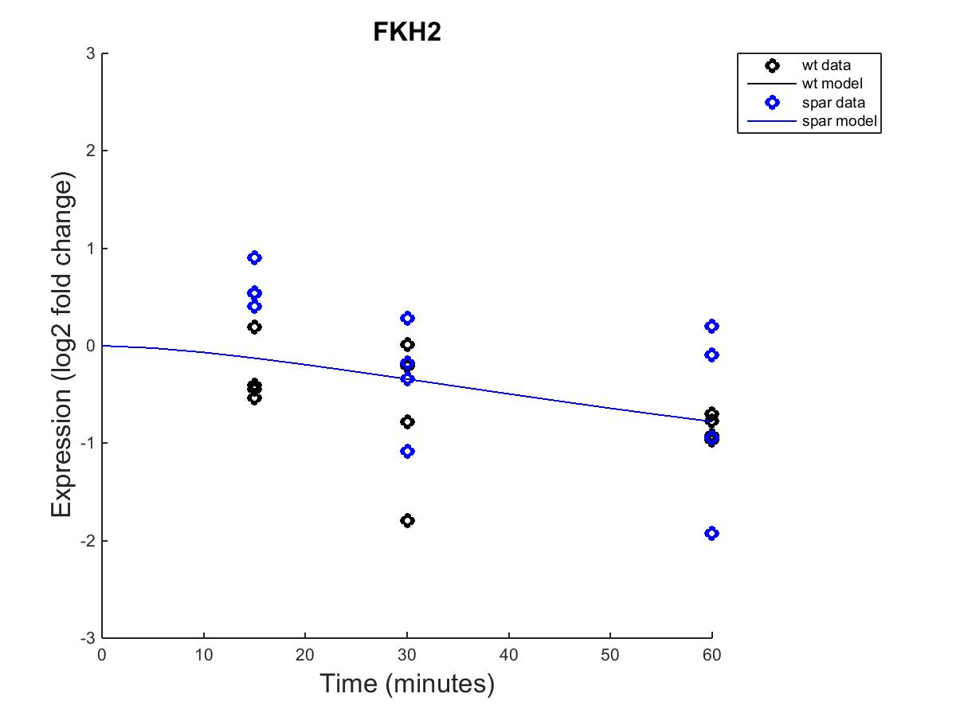
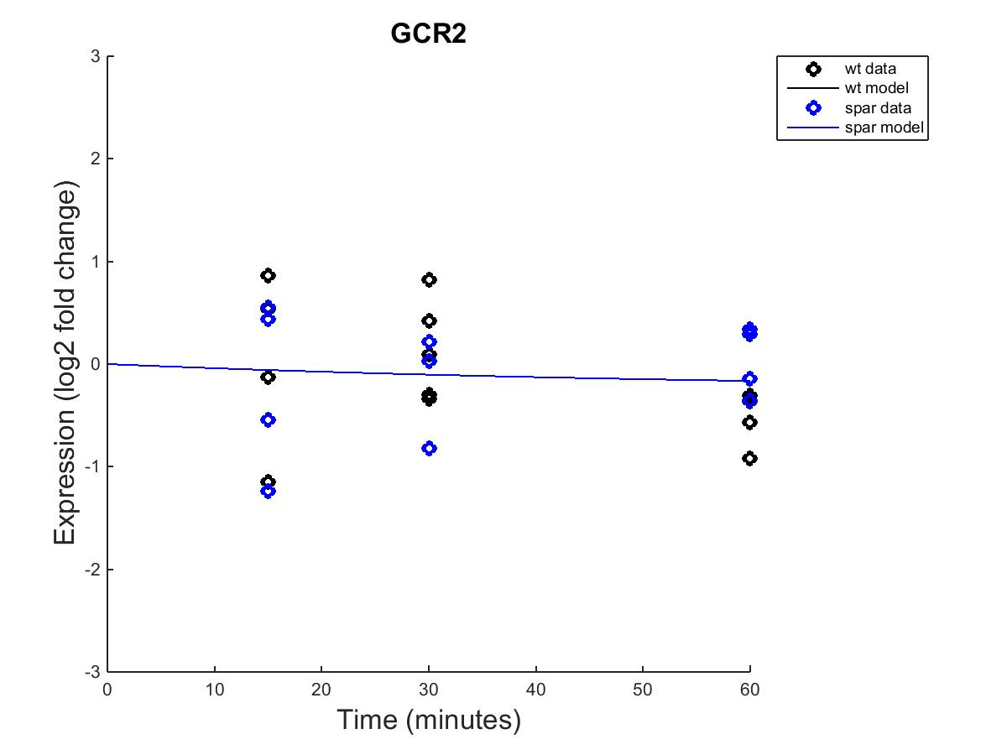
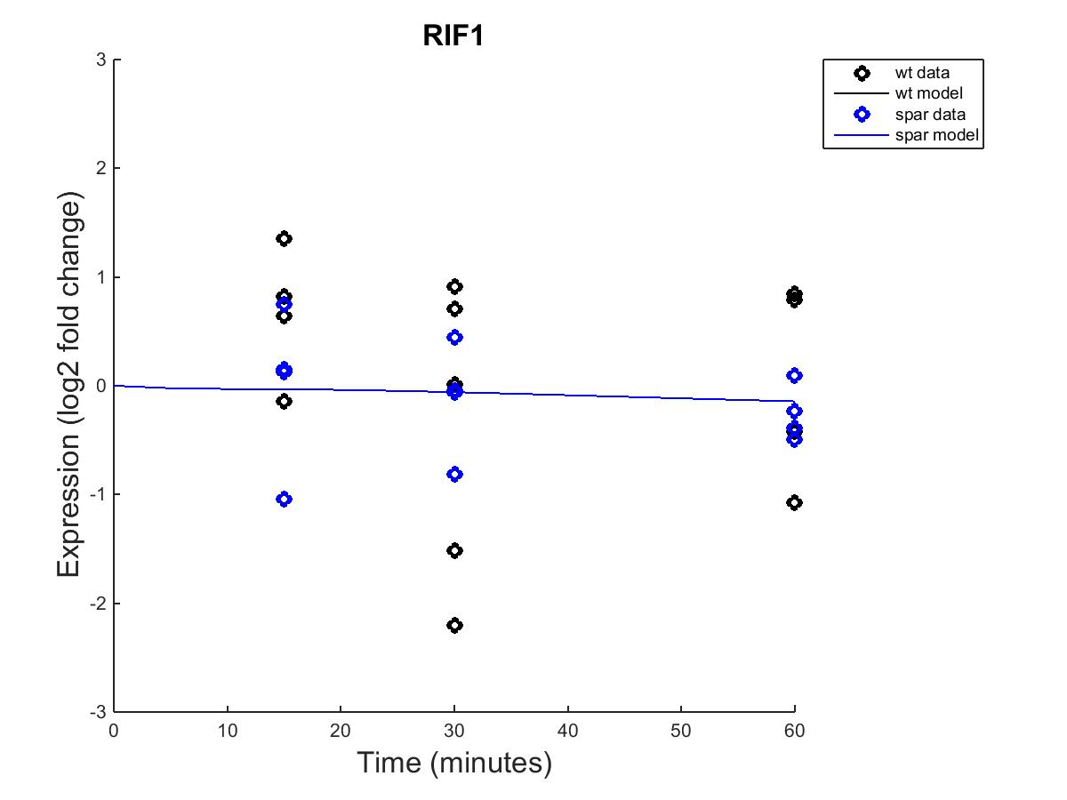
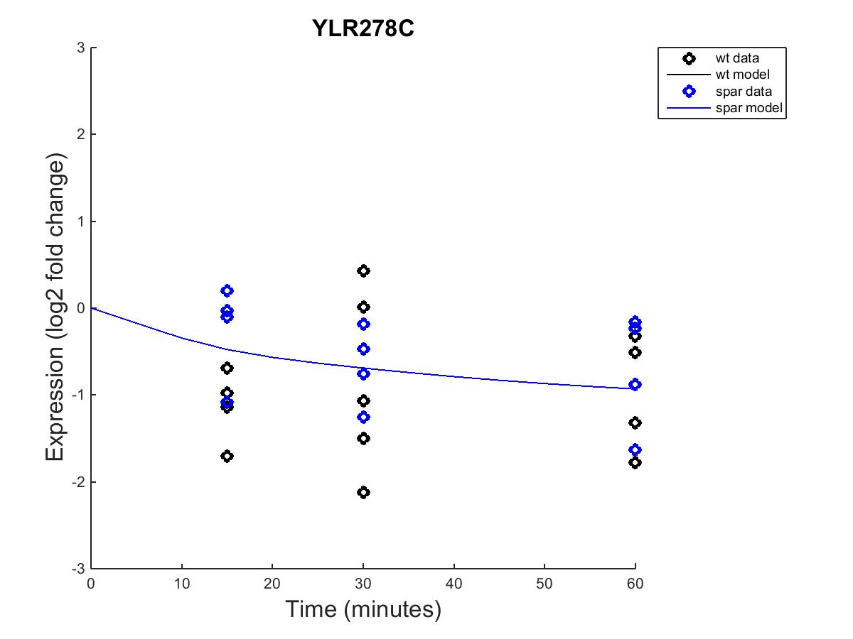
Output from Fixed b values

Slide 18
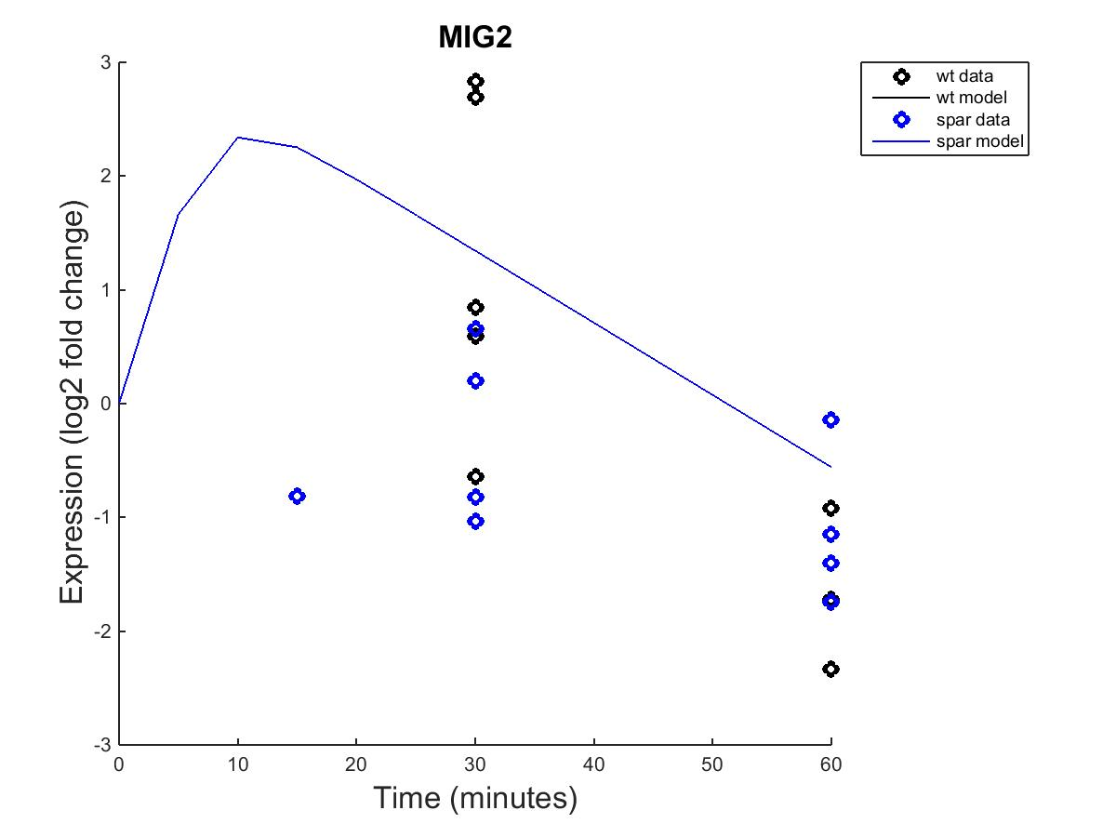
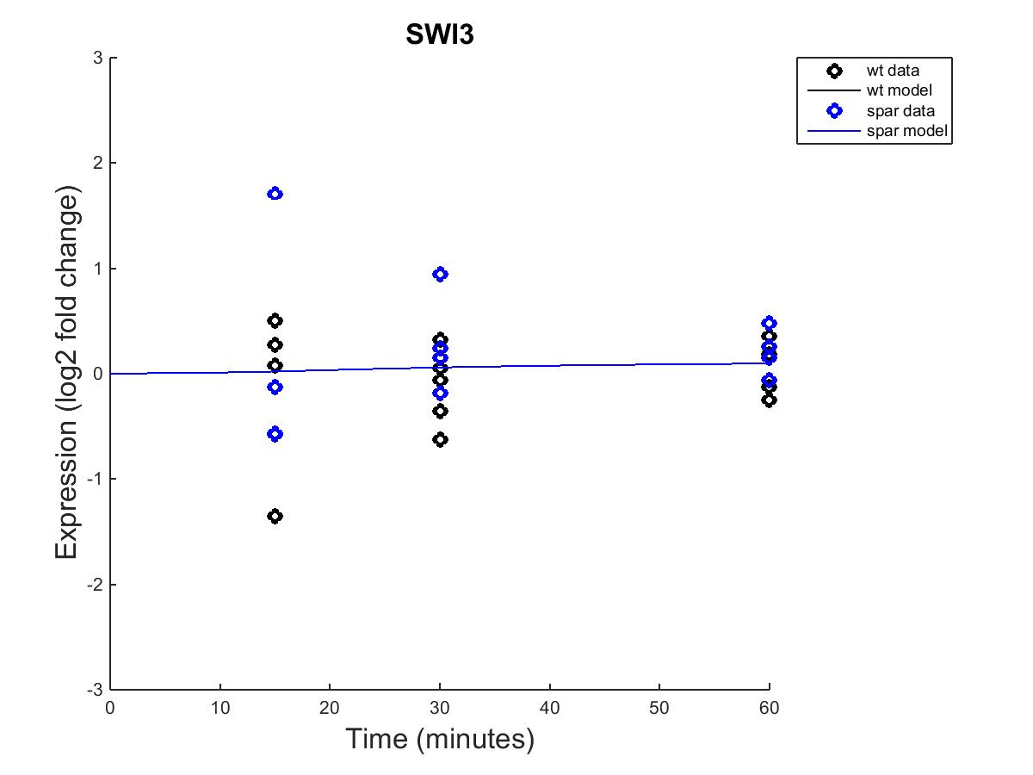
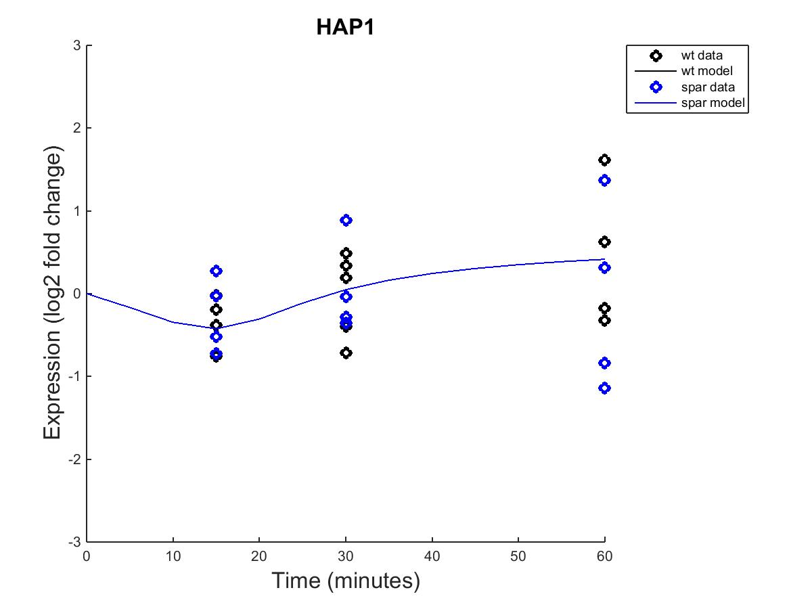
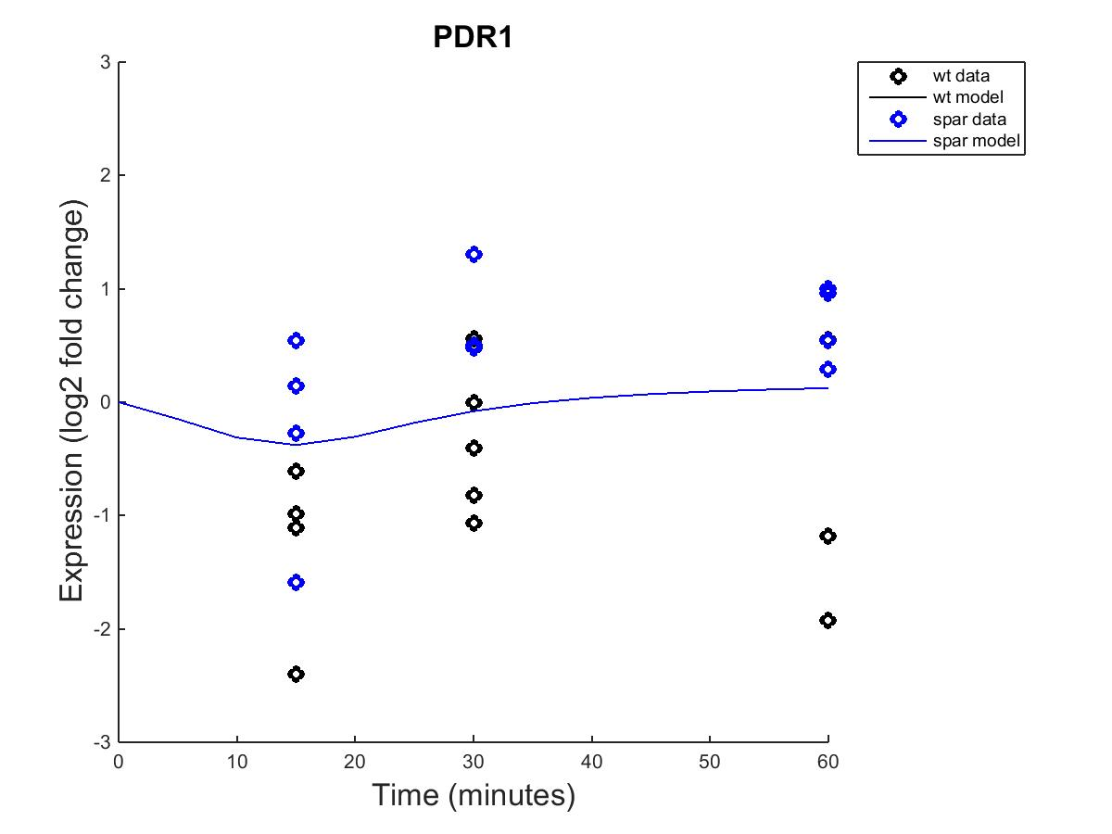
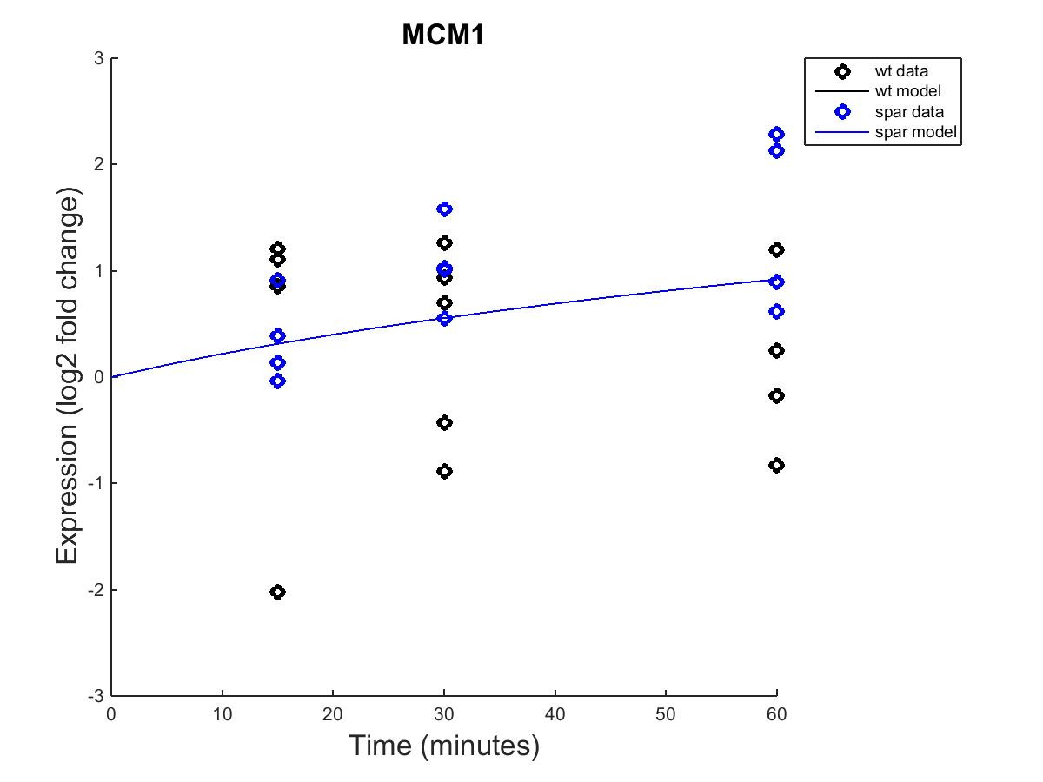
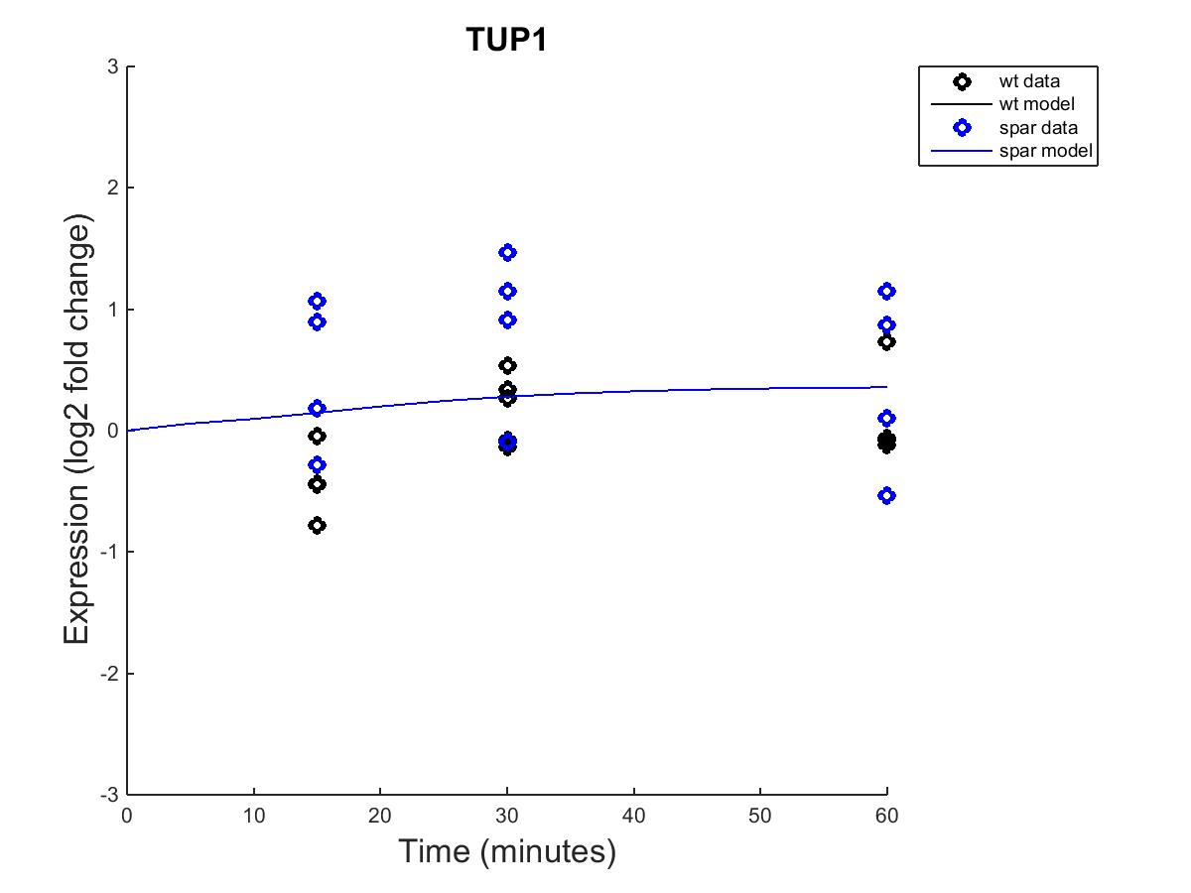
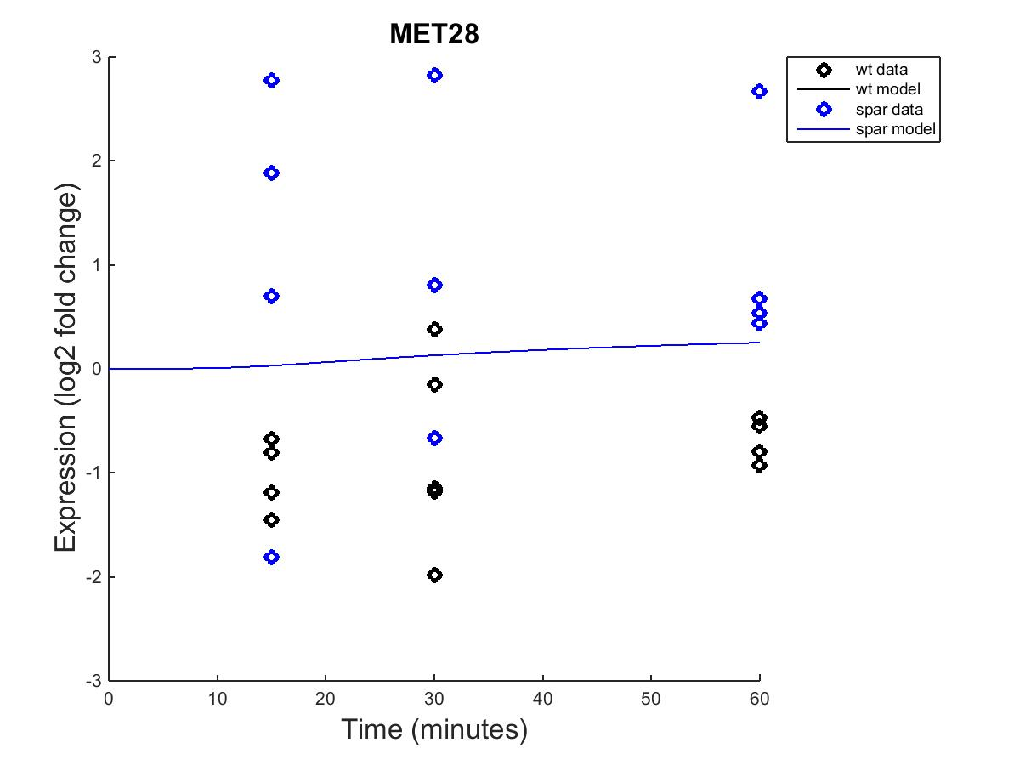
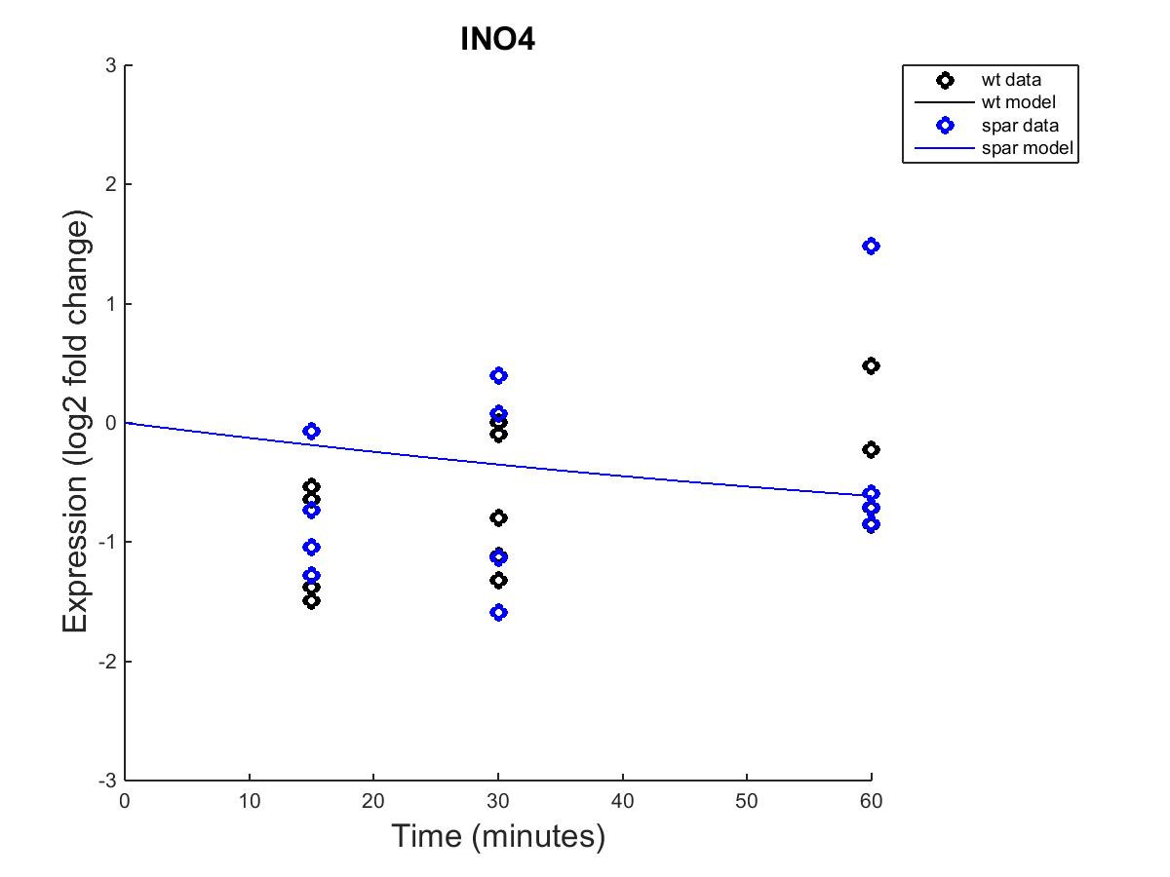
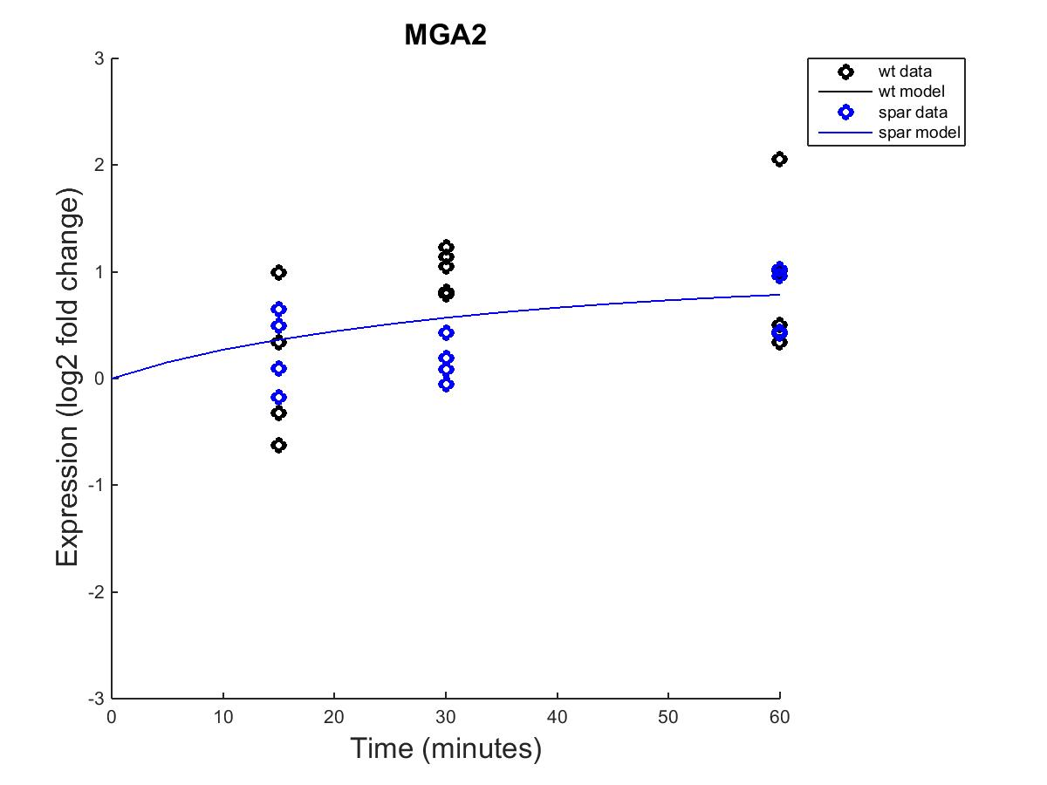
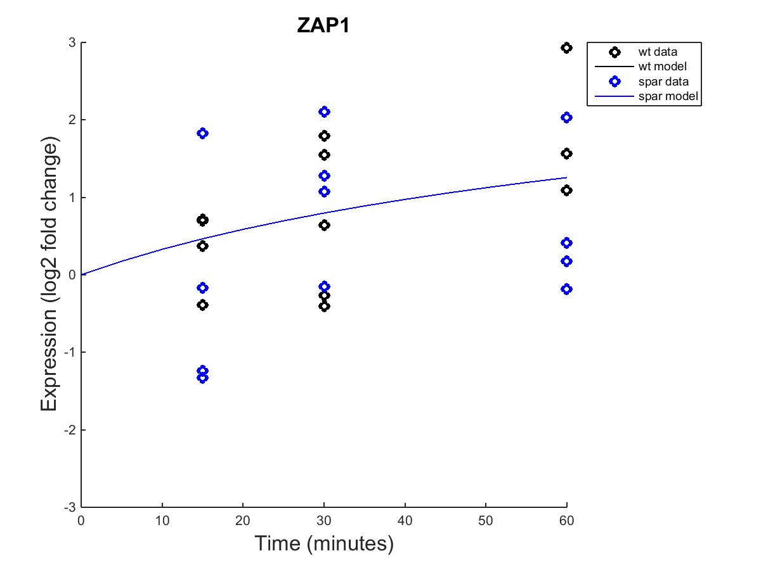
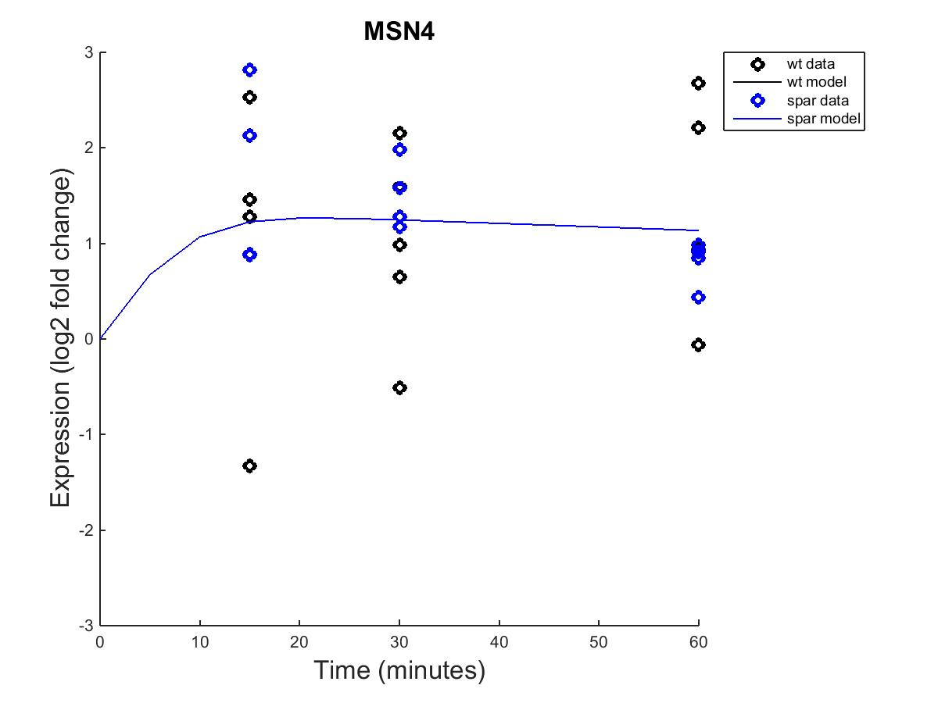
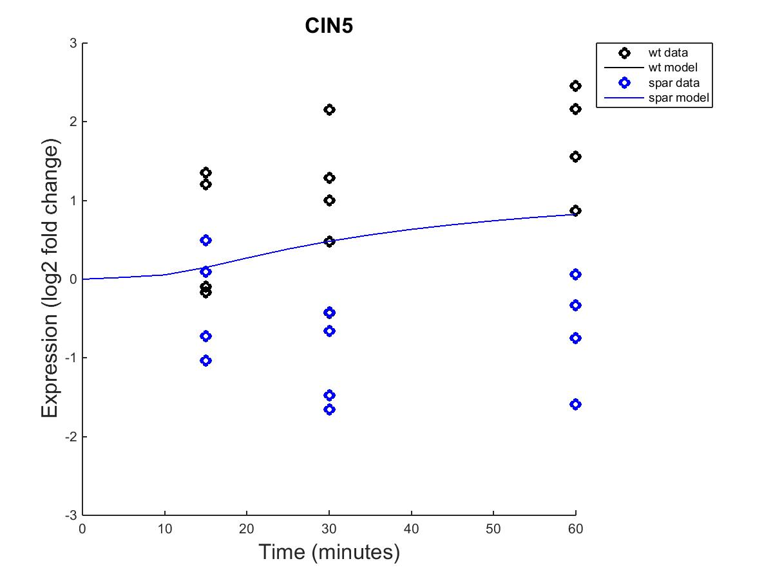
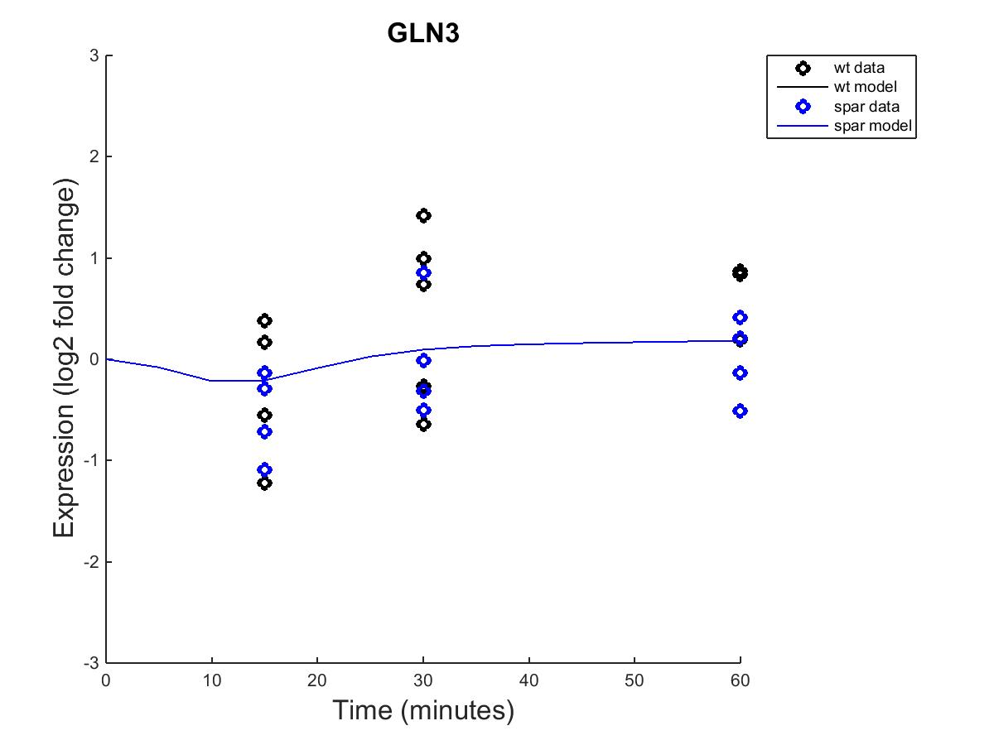

Slide 19



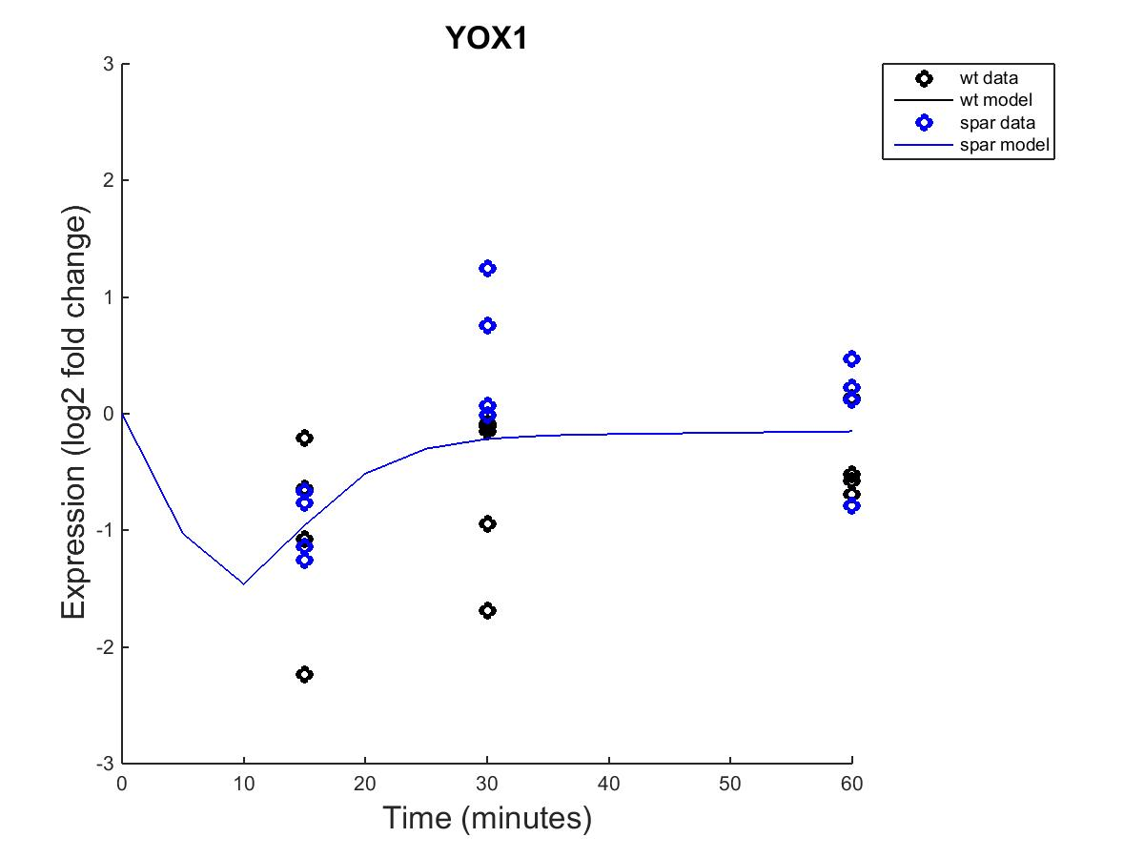


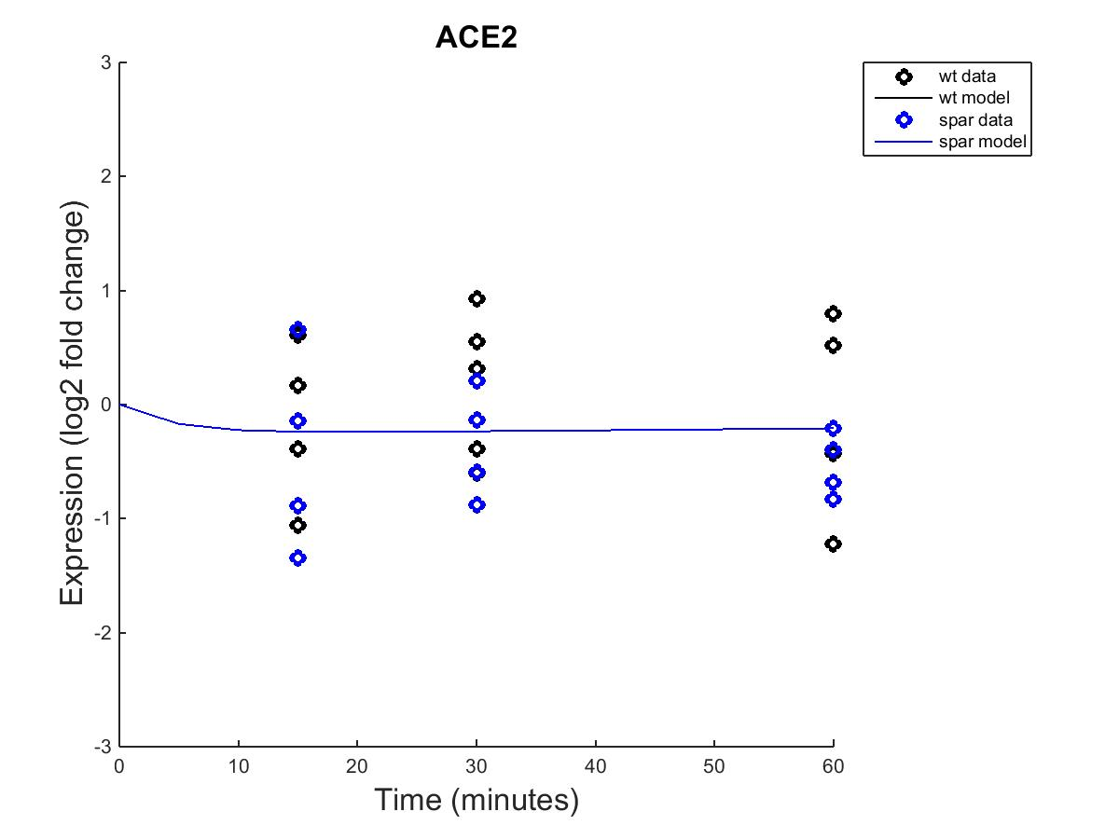
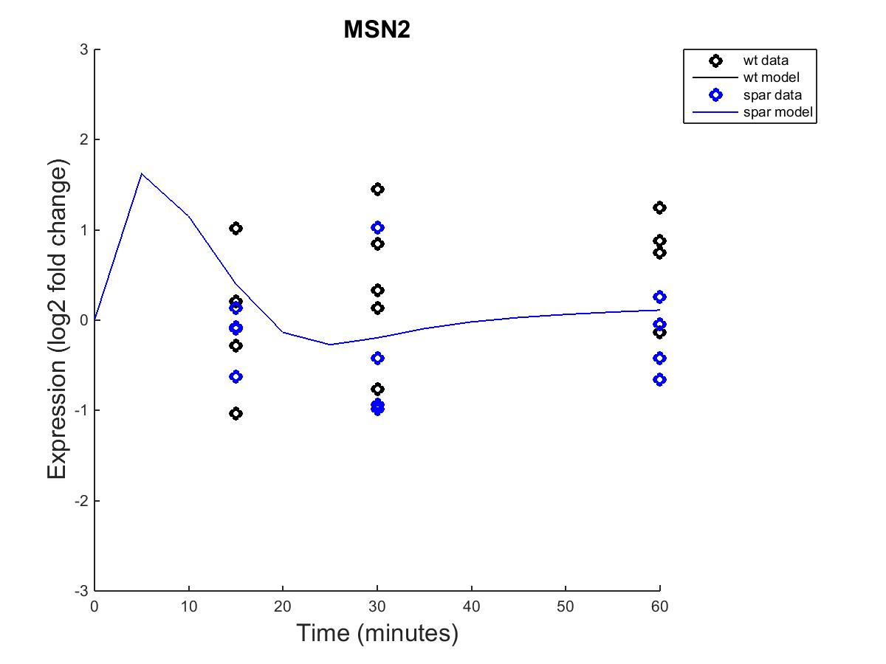




Output from Estimated b values

Slide 20
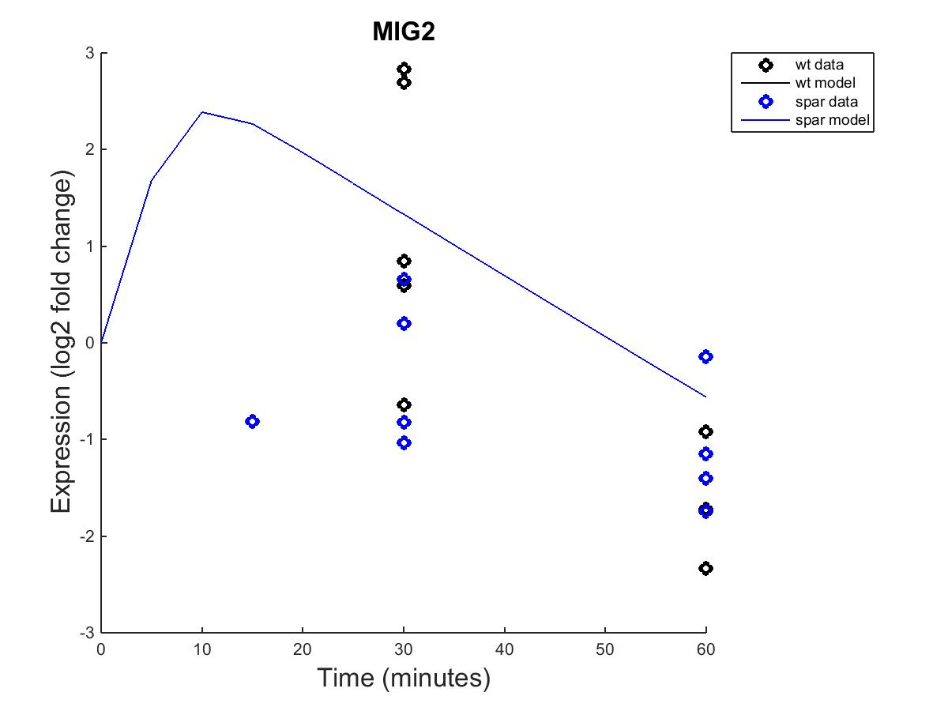






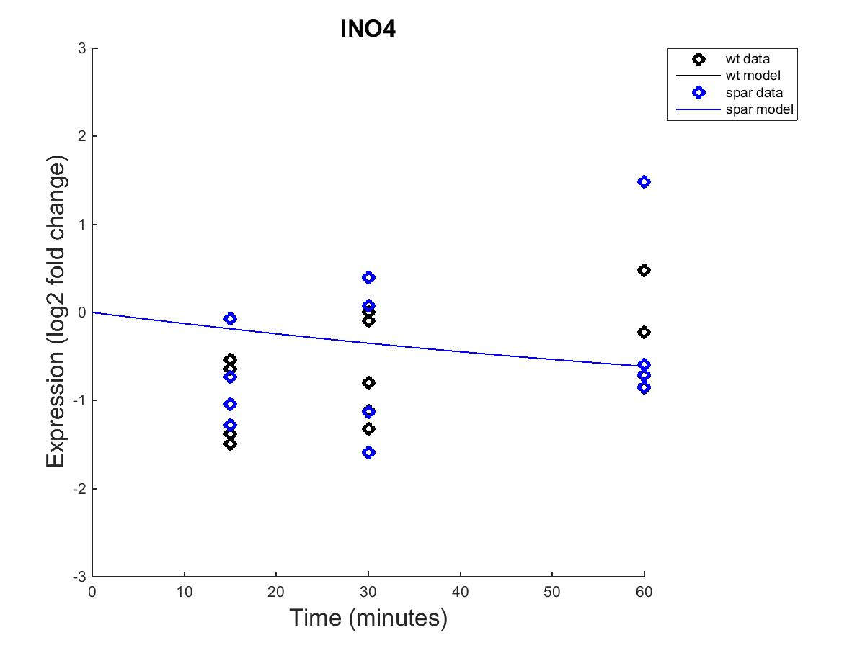


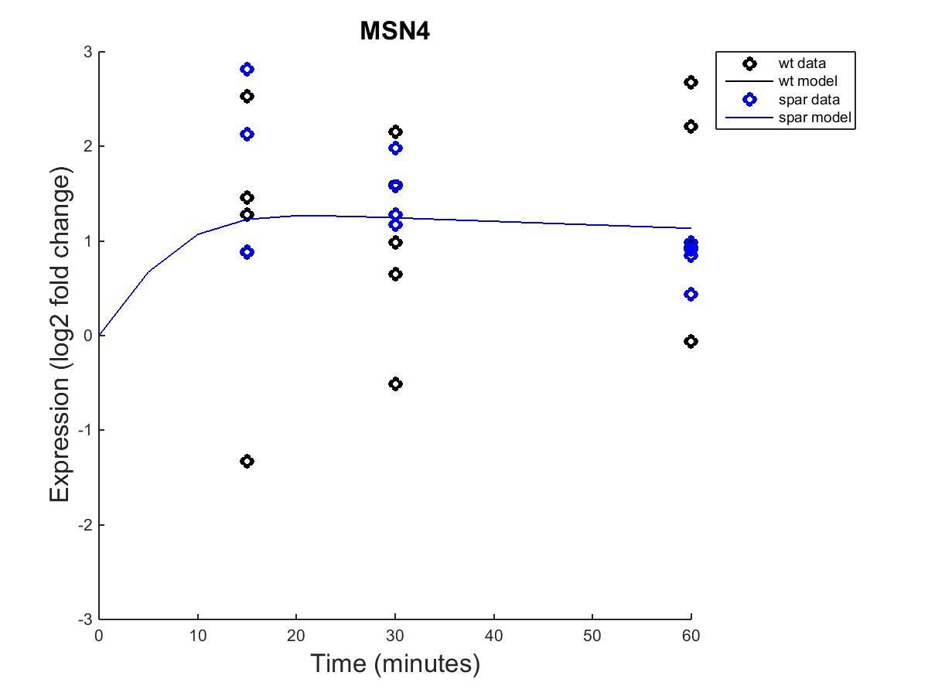
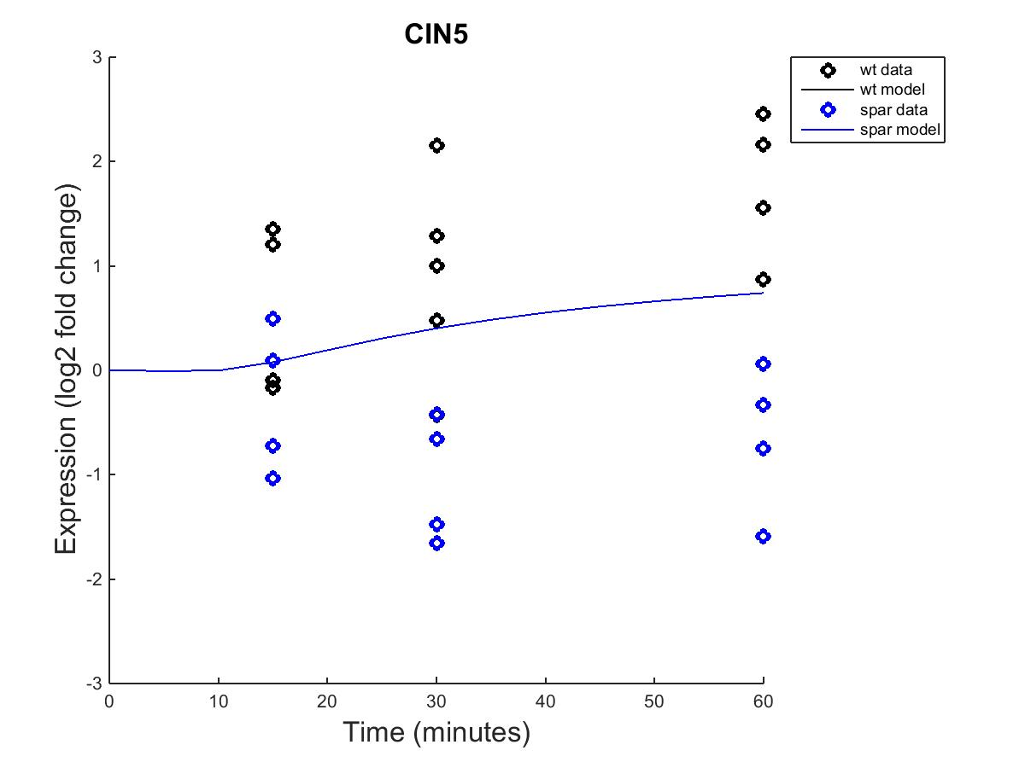


Slide 21
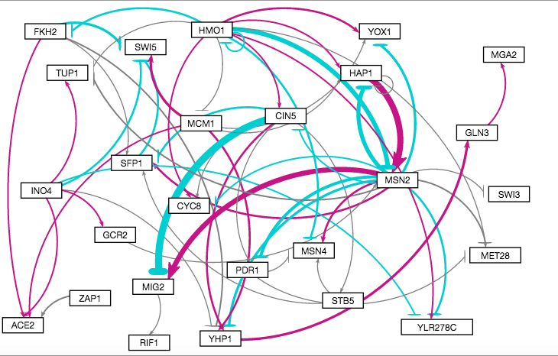
Visualization of the GRN when the parameters and production rates were optimized with estimated b values.

Slide 22
There was little difference in optimized weight parameters that MATLAB gave when the threshold was fixed vs. when it was estimated.

Slide 23
There was little differences seen among the various production rates that were estimated under the conditions of “b” being a fixed value vs. being estimated.

