Slide 1
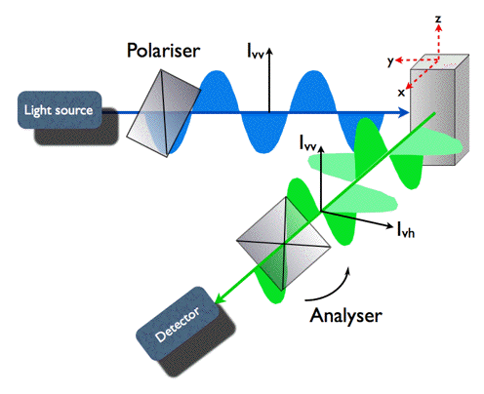
Fluorescence Polarization
Djoshkun Shengjuler (JOJO)
Cameron Lab
Feb. 25th, 2015
PSU-BMB

Slide 2
Outline
History
Measurement
Principle
Advantages/Disadvantages
Applications
Case studies (3)
Special Considerations

Slide 3
History
Fluorescence polarization (FP) is 89 years old.
Perrin, M.F. Polarization de la luniere de fluorescence. Vie moyenne de molecules dans l’etat excite”, J. Phys. Radium, 7, 390-401, 1926. (first paper on FP)
Lakowicz, J.R., Principles of Fluorescence Spectroscopy, Springer, New York, USA, 1999. (FP Bible)
FP is used as a tool for studying molecular interactions.
Because FP measurements are taken in real-time, experiments are not limited to equilibrium binding studies. Kinetic analysis of association and dissociation reactions are routine with fluorescence polarization.
FP is a truly homogeneous technique, so it does not require the separation of bound and free species.
FP is used as a high-throughput screening (HTS) method.

Slide 4
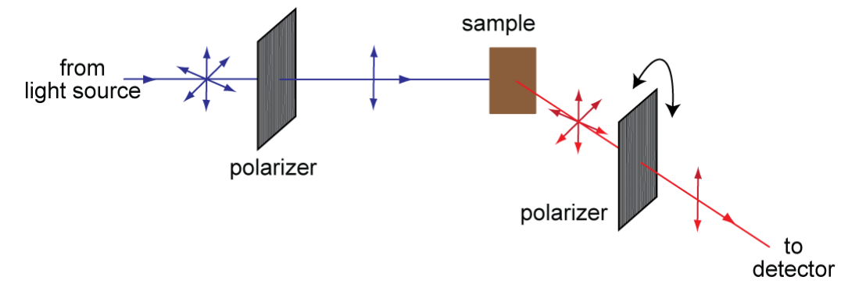
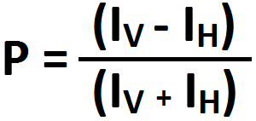
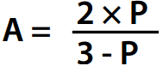
Measurement
Experiments are not dependent on probe intensity, i.e. probe concentration does not matter…not true! Think twice!
Anisotropy (A) and polarization (P) are mathematically related and easily interconverted.
They share the same content of information.

Slide 5
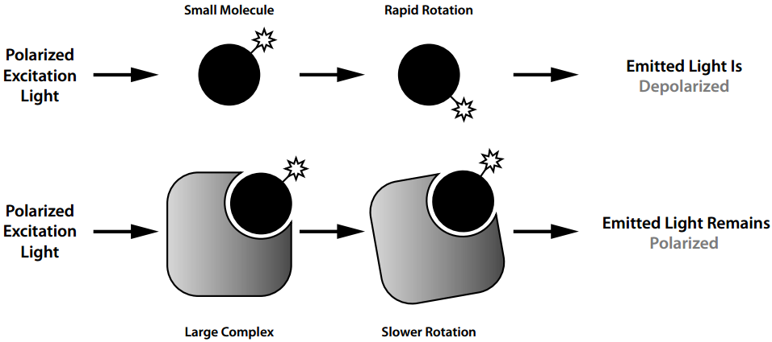

Principle
η = viscosity
T = absolute temperature
V = molecular volume
R = gas constant
Protein needs to be large.
Fluorescently labeled molecule should be small.

Slide 6
Advantages/Disadvantages
Advantages | Disadvantages
Low limit of detection | Combination of lifetime of the dye, size of the probe, and size of the receptor
No need to separate bound vs. unbound form of the receptor | Can suffer from autofluorescence
No radioactive waste is generated | Expensive instrumentation
Insensitive to variations in probe concentration
Rapid response

Slide 7
Applications
Protein-small molecule
Protein-DNA
Protein-RNA
Protein-Lipid
Protein-Peptide
Protein-Protein
Kinase Assay
Phosphatase Assay
Protease assays

Slide 8
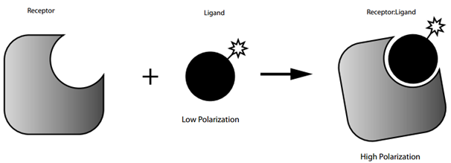
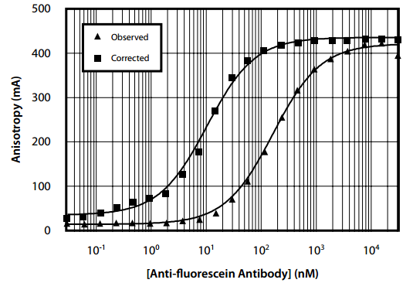
Case Study #1: α-Fluorescein:Fluorescein Binding
[protein] range = 5 x <Kd and 5 x >Kd
Maximum value?
Minimum value?
Lesson: Watch the intensity

Slide 9
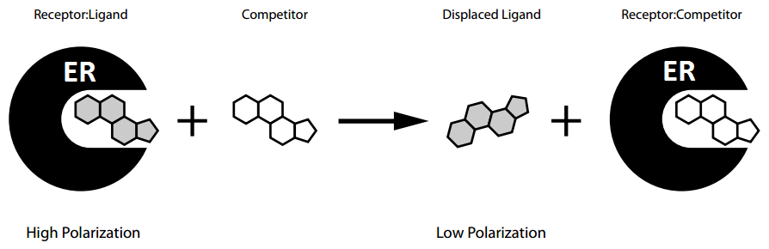
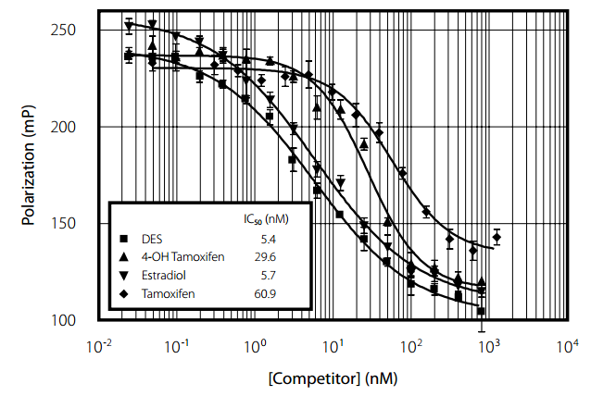
Case Study #2: Estrogen Competitor Screening
Set [protein] @ 50% bound (Kd)

Slide 10
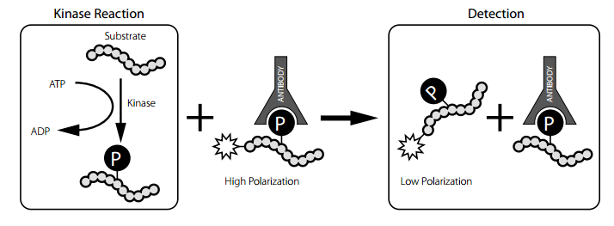
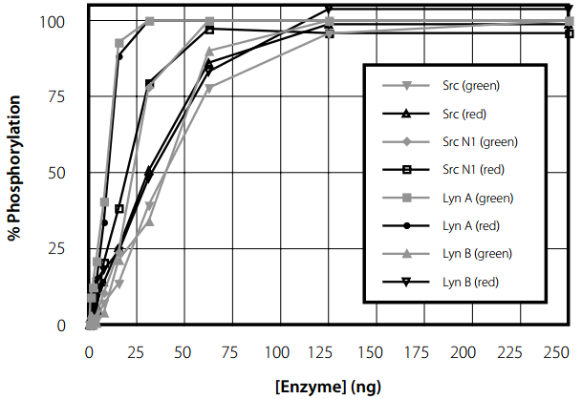
Case Study #3: Tyrosine Kinase Assay
Phosphatase Assay?

Slide 11
Considerations Before Starting a New Experiment
Equilibration time - kinetic analysis
Temperature - 25°C, 37°C etc.
Protein & probe/ligand size - protein = large; ligand = small
Protein concentration range - 5x >Kd, 5x <Kd
Protein Purity & Contaminants - reproducibility issue
Protein Mono/Poly-dispersity - specific/non-specific binding
Buffer composition - make your protein happy
Cofactor(s) - small molecules, divalent cations etc.
Probe concentration - 1 nM or below
Precipitation indicators - high intensity
Blank - background subtraction
Competition experiments with unlabeled ligand - control
Binding experiments with fluorescent probe only - control
Watch the intensity change - increase may indicate precipitation

Slide 12
Where is the equipment?
There are 2 FP capable instruments in 206 Althouse:
1 dedicated single tube instrument
1 FP capable plate reader with 96-well plate option
Single tube instrument is easy to use and easy to get trained on.
Need permission from Craig E. Cameron:
cec9@psu.edu
Can provide manuals if you are interested in using FP in your research.
Contact me if you have any questions:
dxs1006@psu.edu

