Slide 1
Project Proposal:
Cloning and expression of the thermostable neutral protease of B.Stearothermophilus
Yang, Srikanth and Maliha

Slide 2
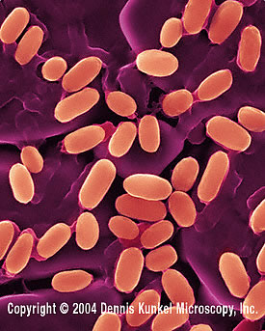
Bacillus Stearothermophilus
Genus - Bacillus or Geobacillus
Species - strearothermophilus
Gram +ve , Spore Forming
Grow in a temperature range of 45-75ºC
Widely distributed in soil, hot springs, ocean sediment, and is a cause of spoilage in food products

Slide 3
GOI : nprT
Accession # M11446.1
Consists of 1881 bp, 548 aa
Responsible for the production of thermostable neutral protease.
Industrially significant.
No introns & Restriction sites

Slide 4
Process flow:
Extraction of nprT gene
Gel electrophoresis
PCR
Gel electrophoresis
Transformation into E.coli
Biobrick construction
Detection of enzyme

Slide 5
PCR
Primer used | BP | Tm(ºC) | ΔG | GC%
For 5’ ATG AAC AAA CGG GCG ATG C | 19 | 57 | +ve (0.64- 1.34) | 52.6
Rev 5’ TTA ATA CAC TCC AAC CGC ATT G | 22 | 54 | -ve (0.33) | 40.9
Biobrick-For 5’ GAATTCGCGGCCGCTTCTAG ATG AAC AAA CGG GCG ATG C | 39 | 69.5 | -ve (3.08-6.04) | 56.4
Biobrick-Rev 5’ TACTAGTAGCGGCCGCTGCAG TTA ATA CAC TCC AAC CGC ATT G | 43 | 68.4 | -ve (1.75-3.39) | 51.2
5’ATGAACAAACGGGCGATGC 3’
5’ATGAACAAACGGGCGATGCTCGGGGCGATCGGGCTGGCGTTCTTCGGCGAAGGGGGAATCGATCGTCTGGAACG…………………………………………TACTATTTGACGCCGACGTCGAACTTCGTGCCGCCTGCGTGCAAGCGGCCGCTGATTTGTACGGGTCGACAAGCCAAGAAGTCAACTCGGTGAAACAGGCGTTCAATGCGGTTGGAGTGTATTAA 3’
3’ GTTACGCCAACC TCACATAATT 5’

Slide 6
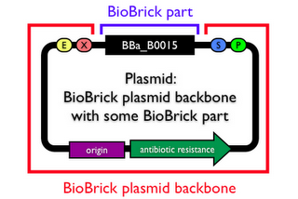
Biobrick Construction
Promoters :
BBa_K360041 : Minimum Blue Light Receptor Promoter
BBa_K258005 : Oxygen promoter-Vitreoscilla hemoglobin(VHb) promoter in E. coli.
BBa_K118011 : PcstA (glucose-repressible promoter)
Transformation to competent E.Coli and Expression of gene
Detection of Thermostable neutral Protease enzyme

Slide 7
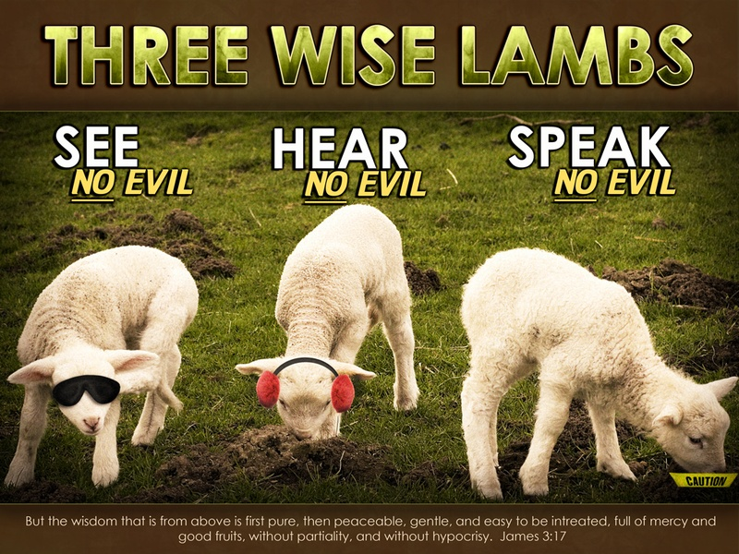
Thank you

