Slide 1
  Global network analysis of drug tolerance, mode of action and virulence in methicillin-resistant S.aureus
  Overton et al., 2011 I.M. Overton, S. Graham, K.A. Gould, J. Hinds, C.H. Botting, S. Shirran, G.J. Barton, P.J. Coote Global network analysis of drug tolerance, mode of action and virulence in methicillin-resistant S. aureus
Chloe Jones
Loyola Marymount University
BIOL368: Bioinformatics Laboratory
October 28, 2014

Slide 2
Outline
MRSA infections rising due to resistant strains
Antimicrobial peptides are a potential solution to combat resistant bacteria
Microarrays measure response of MRSA to Ranalexin
The introduction of ranalexin: reduced growth rates, downregulated genes (‘RanaDown’), and upregulated genes (‘RanaUp’)
  Mechanistic value of the regulation of genes
Ranalexin exposure induces sensitivity to hyposmotic stress
Continuing mechanisms of drug tolerance in MRSA

Slide 3
MRSA infections are rising due to strains resistant to existing treatments
MRSA=Methicillin Resistant Staphylococcus aureus
Major global problem
  Prevention and treatment strategies are imperative
Notes:
Methicillin Resistant Staphylococcus aureus also known as MRSA is a human pathogen that has become a major problem because: strains resistant to existing treatments continue to emerge which is a global concern
-because of MRSA ability to adapt, treatment strategies are necessary to discover the mechanism of the microbe

Slide 4
Antimicrobial peptides are a potential solution to combat resistant bacteria
Antimicrobial peptides are part of the innate immune response
Ranelexin is a 20 a.a. peptide isolated from a bullfrog
  Activity against Gram-positive bacteria,especially S. Aureus, in vitro
  Therapeutic potential against MRSA
Notes:
-AMPS are produced by virtually all living creatures as part of there innate defenses
-your body producing a defense mechanism in the presence of microbes, essentially human antibiotics ..more pertinent because they reside in your body so know there way around

Slide 5
Outline
MRSA infections rising due to resistant strains
Antimicrobial peptides are a potential solution to combat resistant bacteria
Microarrays measure response of MRSA to Ranalexin
The introduction of ranalexin: reduced growth rates, downregulated genes (‘RanaDown’), and upregulated genes (‘RanaUp’)
  Mechanistic value of the regulation of genes
Ranalexin exposure induces sensitivity to hyposmotic stress
Continuing mechanisms of drug tolerance in MRSA

Slide 6
Overton et al (2011) used DNA microarrays to measure response of MRSA to ranalexin
Understanding the mechanism of antimicrobials leads to developing new therapeutic strategies
Transcriptome profiling
  Examines the expression level of mRNAs in a given cell population
  “RanaUp” or “Ranadown”
mRNA generated in response to antimicrobial stress reflect the change in particular cell functions, provide marker for the type of stress
Notes:
genes classified as “rana up” “rana down”

Slide 7
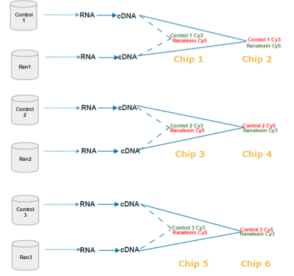
Experimental Design
Used samples form MRSA-252
Hybridized 6 microarray chips: they performed three biological replicates, with each having two technical replicates
Paired samples on the chip were: Control 1 and Ranalexin 1, Control 2 and Ranalexin 2, Control 3 and Ranalexin 3
Notes:
-inverting the red and green dye

Slide 8
Outline
MRSA infections rising due to resistant strains
Antimicrobial peptides are a potential solution to combat resistant bacteria
Microarrays measure response of MRSA to Ranalexin
The introduction of ranalexin: reduced growth rates, downregulated genes (‘RanaDown’), and upregulated genes (‘RanaUp’)
  Mechanistic value of the regulation of genes
Ranalexin exposure induces sensitivity to hyposmotic stress
Continuing mechanisms of drug tolerance in MRSA

Slide 9
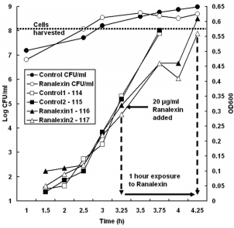
Ranalexin treatment produces a temporary reduction in growth rates
MRSA-252 exposed to sublethal ranalexin concentration ( 20μ/ml)
Showed that in the presence of ranalexin had a brief reduction in growth rate
Notes:
Sublethal ranalexin concentration (20ug/ml) determined, impaired but did not abolish growth of MRSA- 252
-show the point where ranalexin was produced

Slide 10
Global function association network, Linking disease associations with regulatory information
Shows pathway relationships for 95% of S. aureus MRSA-252 genes
Final network contained 2494 nodes(genes) and 19076 edges (connections between genes).
11 modules showed that there was a significant altered expression in MRSA-252 cultures exposed to ranalexin
  5 were upregulated, 6 downregulated
  58 nodes, classified as intermodular hubs that are important regulators of system behavior.
Notes:
-constructed by Bayesian logistic regression
In the article they established a global function association network, based on their own data because the experiment was discovery driven (the network was based on their findings)

Slide 11
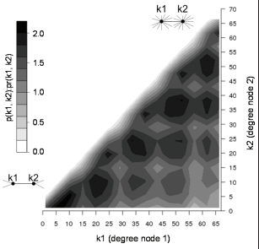
Degree of Interacting Nodes (Genes)in the global gene functional association network
Bottom left can be considered low degree values (less interaction), top right higher degree values (more interaction). Z-axis is the ratio.
Notes:
The darker the color the more interactivness

Slide 12
FtsH is a drug target for MRSA pathogenicity
FtsH is upregulated in response to ranalexin
An intermodular hub that regulates system behavior
  Highest in betweeness, with a degree of 74 and did not fall in a module which indicates a key role in regulating the system behavior of MRSA
Notes:
-connect to different biological modules,
-chaperon required for incorporation of penicillin binding proteins (pbp2) into cell membrane.
-pbp2 was RanaUp and is part of a cell wall stimulon
-upregulation of Ftsh in concert with the cell wall stimulon further supports action of ranalexin at the cell wall

Slide 13
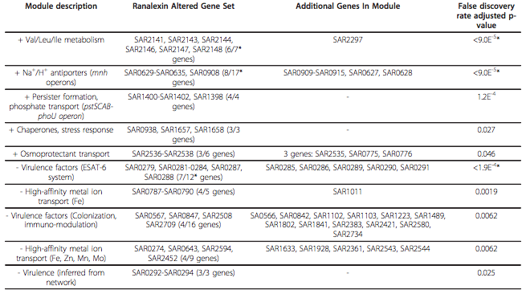
Ranalexin response modules that had significantly altered expression due to ranalexin treatment
Notes:
-5 are upregulated denoted by “+”, and 6 were downregulated denoted y “-.“
-in the ranaexlin altered column set is where we genes that were altered due the introduction of ranalexin
-in the additonal gene module these are genes that are part of the module, but were not altered in the presence of ranalexin
-PhoU acts as a persister switch, so that is the bacteria trying to combat the presence of the antimicrobial peptideso that’s why ranaup
-MRSA gets antimicrobial resistance by adopting a PhoU-mediated persister phenotype…Persister bacteria show a thicker wall
-cation transport unregulated as well because trying to disturb the membrane and make more permeable
-Val/Leu/Ile synthesis which utilizes pyruvate and therefore may allow for greater glycolytic flux in powering ranalexin stressed cells.
-osmoprotectant transport-cation influx, hyposomotic fragility and disruption of cell intergrity

Slide 14
Genes were downregulated with the introduction of ranalexin
MRSA-252 ESAT-6 secretion system componenets
SAR0787 and SAR0790, significant RanaDown modules, because associated with high affinity metal ion transport
Notes:
-crucial for the establishment of the disease, sst iron-uptake operon
-high-affinity metal ion transport which is crucial for establishment of infection
-ESAT-6 secretion system componenets , which are essential to S. aureus pathogenesis
- Success depends on their ability to maintain metal ions, because metal ions play a critical role in the lively hood of the cell

Slide 15
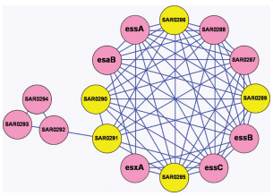
ESAT-6 system plays important role in pathogenesis
Genes downregulated by ranalexin (RanaDown) are shown in pink, other in yellow
If named considered a gene that has been characterized, otherwise locus identifier
Seven uncharacterized genes in ESAT- 6 module
Notes:
-ESAT-6 is a ranadown module, with some majority of the genes partcipting in ranadown when exposed to ranalexin shown in pink.
-there are seven uncharacterized genes which have no name and characterized by the beginning be es, these are just locus identifiers , point

Slide 16
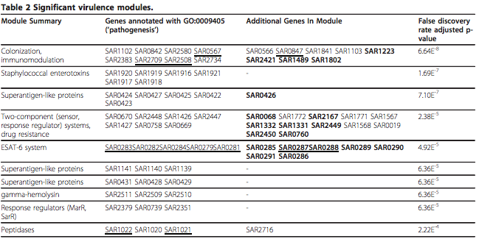
Virulence factors were mapped onto the modules
Notes:
Modules that are significant in virulence
If underlined downregulated. If bolded candidate novel virulence factors….see ESAT 6 system which we discussed earlier
Peptidases: An enzyme that catalyzes the hydrolysis of peptides into amino acids.

Slide 17
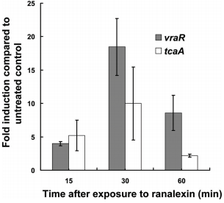
Upregulation of vraR and tcaA by Ranalexin
Showing the upregulation of vraR and tcaA expression at different exposure times when exposed to ranaflexin
Observed at 15 minutes, peaked at 30 minutes (upregulation) and then declined after an hour
VraR: involved in the control of the cell wall peptidoglycan biosynthesis
Notes:
-there wasn’t as big of a difference between that of tcaA mutant and parent strain
-showing exposure to ranalexin at intervals, not as effective in the beginnign or as time increased
-vraR is ranaup, regulator protein of the vancomycin-resistance associated two-component
-cell is trying to upregulate in order to combat ranalexin trying to enter, VraR helps with cell wall biosynthesis

Slide 18
Antimicrobials peptides kill MRSA by multiple actions
Ranalexin makes cell wall permeable, cation antiport upregulated
  permeabilisation leads to cation(+) influx and dissipation of transmembrane electrochemical gradient
membrane and cell wall complementary kill MRSA -252
Upregulation of dlt operon increased positive charge at cell surface and reduced peptide binding
Notes:
-chaperones and stress response genes. As well
-when microbe membrane is too permeable it will die
-want to damange the cell wall or membrane so their nutrients leak out and no longer avaliabel persist and regenerate new bacteria

Slide 19
Outline
MRSA infections rising due to resistant strains
Antimicrobial peptides are a potential solution to combat resistant bacteria
Microarrays measure response of MRSA to Ranalexin
The introduction of ranalexin: reduced growth rates, downregulated genes (‘RanaDown’), and upregulated genes (‘RanaUp’)
  Mechanistic value of the regulation of genes
Ranalexin exposure induces sensitivity to hyposmotic stress
Continuing mechanisms of drug tolerance in MRSA

Slide 20
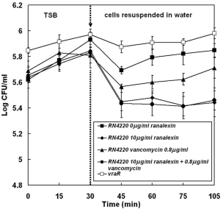
Ranalexin exposure induces sensitivity to hyposmotic stress
Hyposomotic stress (swelling) in response to ranalexin and/or vancomycin at different concentrations
Control experienced the least amount of stress
Combination of vancomycin and ranalexin or ranalexin only showed most stress
Notes:
-osmotic fragility decreases the resistance of the bacteria allowing for it to swell and eventually, so longer have the ability to sequesters its nutrients

Slide 21
Outline
MRSA infections rising due to resistant strains
Antimicrobial peptides are a potential solution to combat resistant bacteria
Microarrays measure response of MRSA to Ranalexin
The introduction of ranalexin: reduced growth rates, downregulated genes (‘RanaDown’), and upregulated genes (‘RanaUp’)
  Mechanistic value of the regulation of genes
Ranalexin exposure induces sensitivity to hyposmotic stress
Continuing mechanisms of drug tolerance in MRSA

Slide 22
Continuing mechanisms of drug tolerance in MRSA
PhoU mediated persistor and VraS/VraR two-component regulatory system, aids in drug tolerance
MRSA gets antimicrobial resistance by adopting a PhoU-mediated persister phenotype
  Persister bacteria show a thicker wall and loss of virulence factors
VraR is “RanaUp” by activating a cell-wall–stress stimulon in response to ranalexin
Notes:
-Strong upregulation of proteins encoded by pstSCAB-phoU operon PstS, PstC, PstA, PhoU, and PstB when exposed to ranalexin.
-

Slide 23
Summary
Antimicrobial peptides combat resistant bacteria by increasing the permeability of the cell wall and membrane through osmotic stress
Microarrays provided insight on what genes were RanaUp and Ranadown in the presence of Ranalexin
  Transcriptome profiling
Global Function association network show the association between the genes and classified modules to be examined
FtsH membrane chaperone -- upregulated in response to ranalexin , potential drug target
VraRS -- may be two component staphylococcal response regulator that is involved with cationic peptide resistance
Evidence for PhoU-mediated persister switching as a mech. of drug tolerance in MRSA

Slide 24
Acknowledgments
Loyola Marymount University
Kam D. Dahlquist, PhD
Stephen, TA

