Slide 1
SURP 2015 Presentation draft
15 minutes

Slide 2
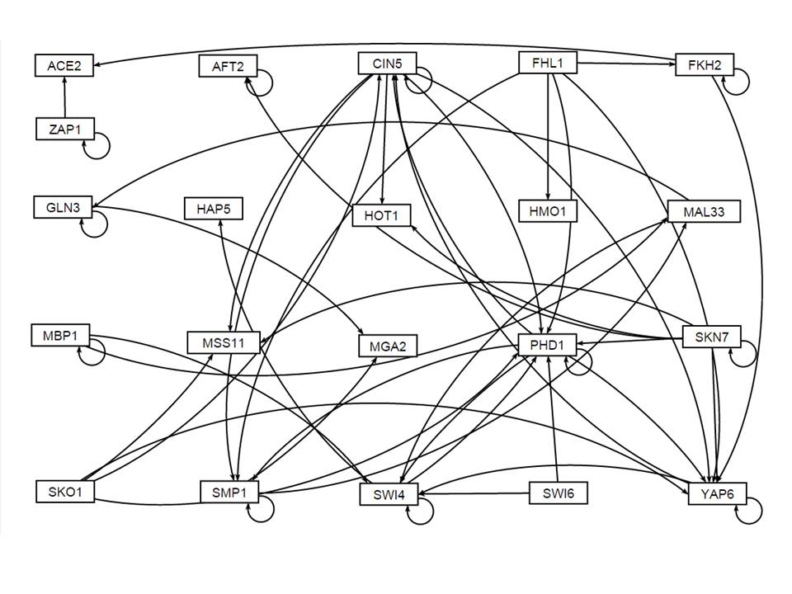

Slide 3
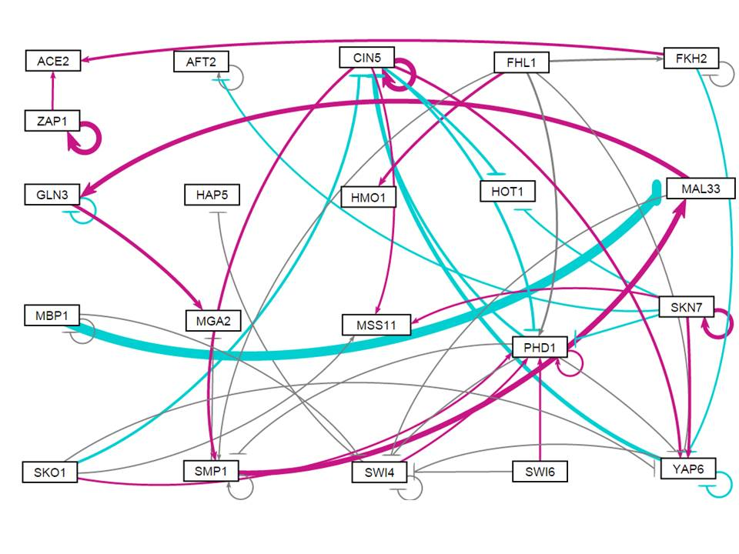
Wt, initial weight 1 run

Slide 4
Evaluating how the network is modeled
Looking at each gene in its entirety (including its regulators)

Slide 5
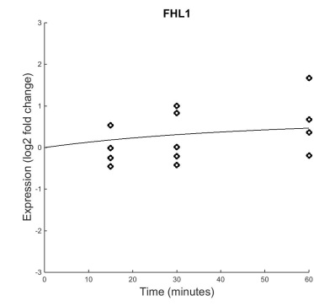
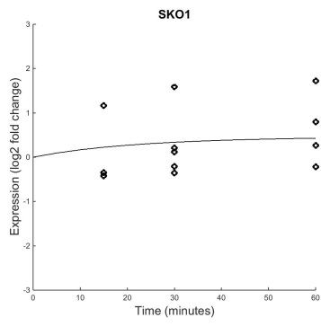
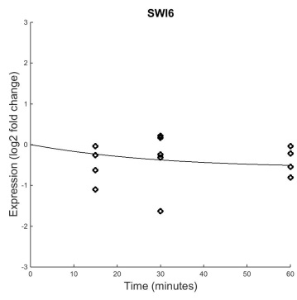
Genes with no Inputs (FHL1, SKO1, SWI6)
B&H p=0.4454
B&H p=0.1330
B&H p=0.1178
Good fit
No significant change, but maybe because of large variance
Modeled well, could have an activator
Good fit
No significant change
Modeled well
Fair fit
No significant change, but some
Modeled fairly well, may have a missing repressor
Notes:
These genes should have no significant dynamics, given nothing is up or down-regulating them

Slide 6
Pick one gene from above category and look at its regulators in more detail --- does it make sense? If so, it is probably wired correctly. If not, it needs another input

Slide 7
Because these genes are not regulated by any other genes, they should have no significant dynamics.
This is reflected in their p-values (they should also be unaffected by deletion strains… check on this)
Genes with no inputs are modeled well

Slide 8
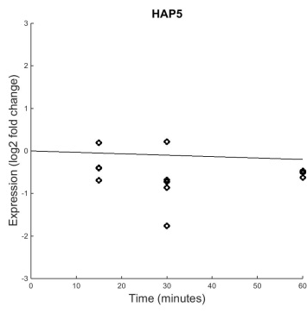
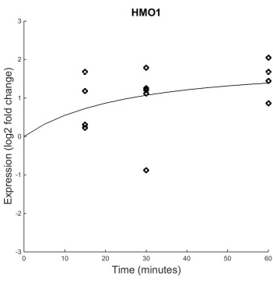
Genes with One Input (HAP5, HMO1)
B&H p=0.1539
B&H p=0.0409
Poor fit
No significant dynamics
Good fit
Significant upward dynamics

Slide 9
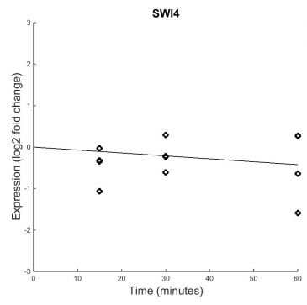
HAP5
Regulator: SWI4
B&H p=0.6367
B&H p=0.1539
Weight: -4.4E-5
Because the dynamics of HAP5’s only regulator are not significant, it is difficult to estimate HAP5’s w and b. SWI4 seems to have essentially no effect on HAP5.

Slide 10
HMO1
Regulator: FHL1
B&H p=0.4454
B&H p=0.0409
Weight: 0.24
Although FHL1 has insignificant dynamics, making parameters difficult to estimate, it does produce the correct output in HMO1. HMO1 is probably modeled well
Notes:
NOTE: largest weight (for wt w0 run) was -1.44

Slide 12
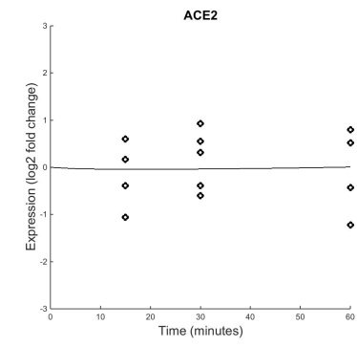
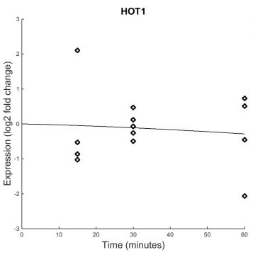
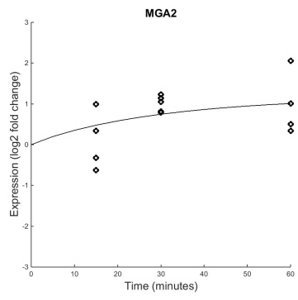
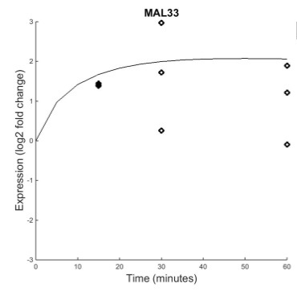
Genes with Two Inputs (ACE2, HOT1, MGA2, MAL33)
B&H p=0.8702
B&H p=0.6387
B&H p=0.1028
B&H p=0.0101
Decent fit
No significant dynamics
Okay fit, given large variance
No significant dynamics
Fairly good fit
No statistically significant dynamics, but visible upward trend
Poor fit, large variance
Significant dynamics

Slide 13
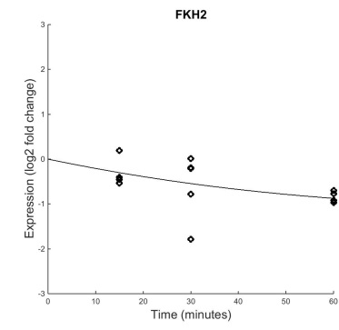
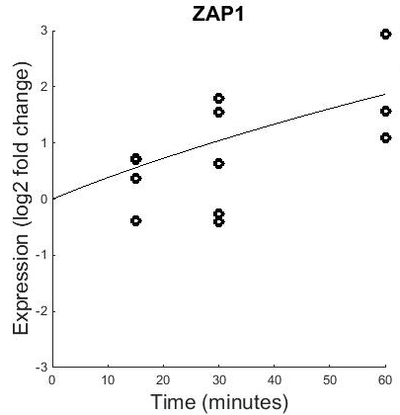
ACE2
Regulators: ZAP1 and FKH2
B&H p=0.1274
Weight: 0.22
B&H p=0.8702
Weight: 0.082
B&H p=0.0086
W and b parameters of ACE2 are easier to estimate because both its regulators have dynamics
Both regulators activate ACE2 in the network. If this was true, ACE2 should show significant upward dynamics

Slide 14
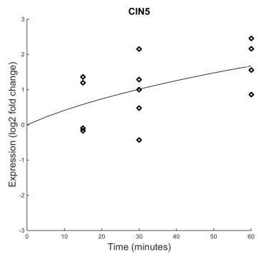
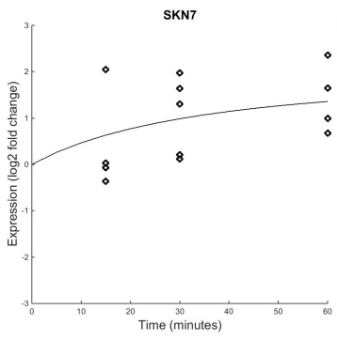
HOT1
Regulators: CIN5 and SKN7
B&H p=0.0642
Weight: -0.19
B&H p=0.6387
B&H p=0.0228
Weight: -0.078
Both regulators show significant dynamics, so it is easier to estimate HOT1’s parameters
Given that both regulators increase their expression, HOT1’s expression should decrease more towards then end of the time series
Unsure… variance of data makes it tricky to determine problem

Slide 15
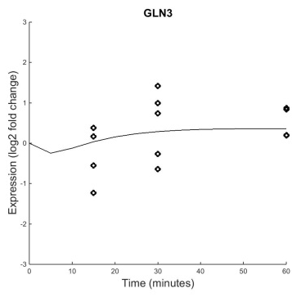
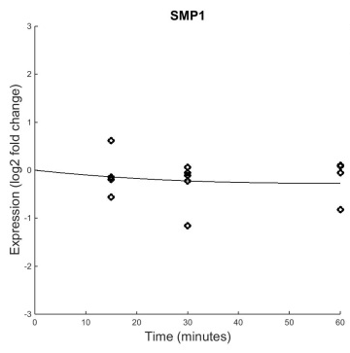
MGA2
Regulators: GLN3 and SMP1
B&H p=0.4125
B&H p=0.1028
Weight: 0.33
B&H p=0.6046
Weight: -0.028
Regulators do not have significant dynamics. MGA2’s parameters are difficult to estimate.

Slide 16
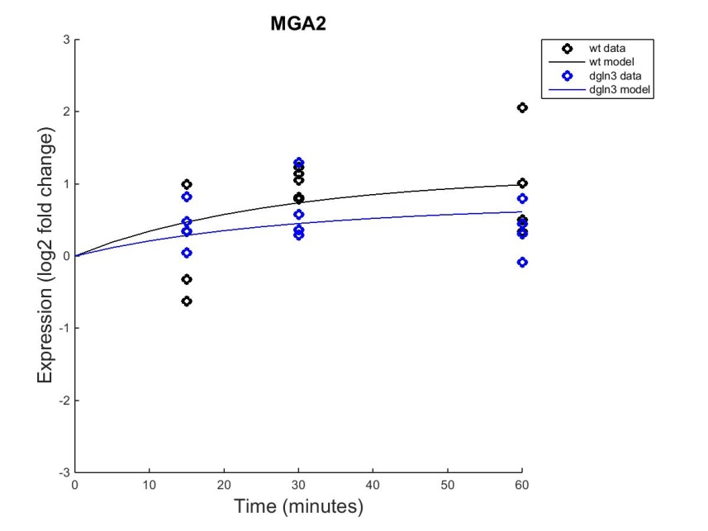
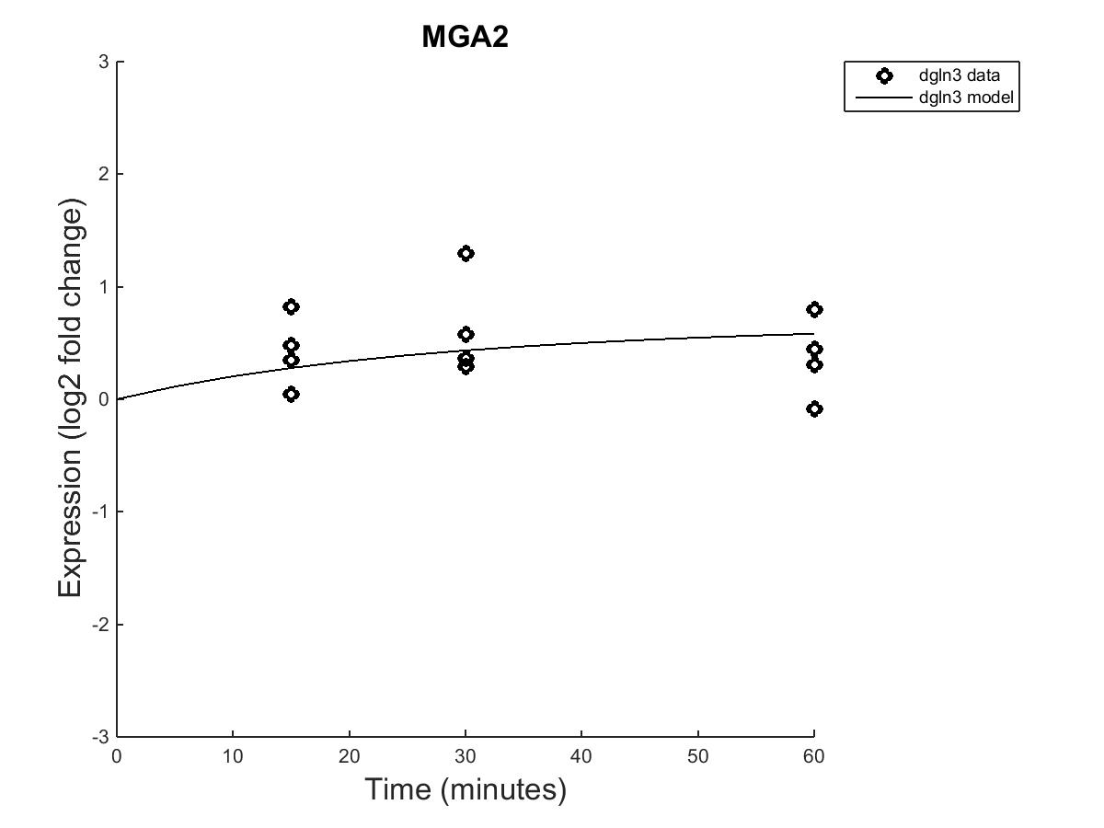
MGA2 with dGLN3
Wt B&H p=0.1028
dGLN3 B&H p=0.4322
Deleting GLN3 decreases the expression of MGA2
MGA2’s wiring to GLN3 is modeled correctly

Slide 17
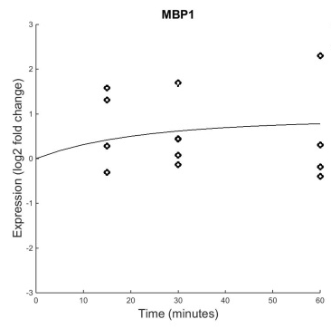
MAL33
Regulators: MBP1 and SMP1
B&H p=0.5240
B&H p=0.0101
Weight: -1.45
B&H p=0.6046
Weight: 0.77
Production rate is huge relative to other genes. The model is attempting to fit the large initial spike
Are these dynamics due to a regulator we’re not seeing?
Why does MBP1 repress MAL33?
Because inputs have no dynamics, it is difficult to estimate w’s and b
Unsure of MAL33 connection

Slide 19
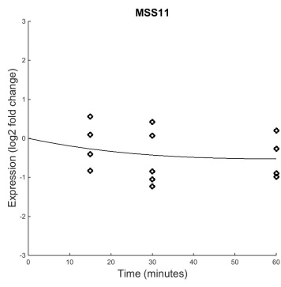
Genes with Three Inputs (MSS11)
Regulators: SKO1, CIN5 and SKN7
B&H p=0.1330
B&H p=0.4275
Weight: 0.024
B&H p=0.0642
Weight: 0.16
Weight: 0.078
Good fit
No significant dynamics
Inputs have some significant dynamics, weights are probably estimated well
Given this, why is there a downward expression?
Estimated production rate is about the same as degradation… this is causing downward model line
Weights are probably good… a good example of why we need to find production and degradation rates from literature
Validity of connection is uncertain
B&H p=0.0228

Slide 21
Genes with Self-Regulation Only (MBP1, SKN7, ZAP1)
B&H p=0.5240
B&H p=0.0228
B&H p=0.0086
Decent fit, large variance though
No significant dynamics
Decent fit, large variance though
Significant upward dynamics
Good fit, large variance though
Significant upward dynamics

Slide 22
MBP1 Self Regulation
B&H p=0.5240
B&H p=0.5240
Weight: -0.03
Upward trend of model described by estimated production rate 4X that of degradation rate
Weight can be almost anything because MBP1 has no significant dynamics… the model made it small so it would fit the up-ish trend of the dat
Because of variance of data, it is difficult to tell if MBP1 is missing an activator (it’s probably not wired correctly though… we really need production rates to tell)

Slide 23
SKN7 Self Regulation
B&H p=0.0228
B&H p=0.0228
Weight: 0.50
Because of SKN7’s significant dynamics, we can be fairly confident in the validity of the weight value
Model appears fits the positive feedback connection in the network...
However, the trend looks as if it’s leveling off, which should not be the case with complete positive feedback (see ZAP1) – unless weight is smallish and degradation rate kicks in
SKN7 may have a repressor that levels this off… or a larger degradation rate
Fit is uncertain

Slide 24
ZAP1 Self Regulation
B&H p=0.0086
B&H p=0.0086
Weight: 0.77
Because of ZAP1’s significant dynamics, we can be a little more confident in the validity of this weight. ZAP1 seems to be exhibiting a positive feedback cycle trend, which matches the continuous upward trend in expression
The strength of this weight could be masking other activators, but other than this ZAP1 seems to be modeled well

Slide 26
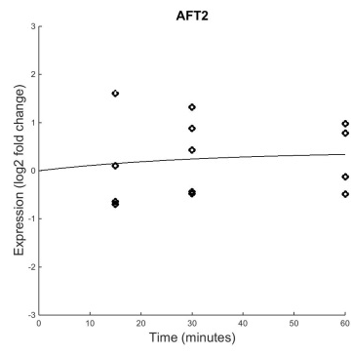
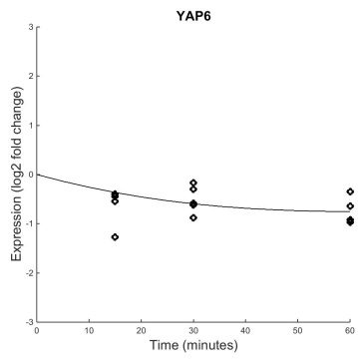
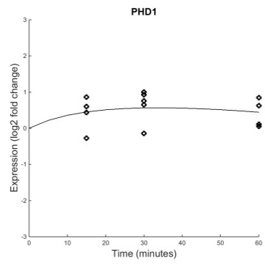
Genes with Self Regulation and Other Inputs (FKH2, AFT2, GLN3, CIN5, SMP1, SWI4, YAP6, PHD1)
B&H p=0.1274
B&H p=0.7161
B&H p=0.4125
B&H p=0.0642
B&H p=0.6046
B&H p=0.6367
B&H p=0.0003
B&H p=0.0017

Slide 27
AFT2 (Two regulators)
Regulators: AFT2 and SKN7
B&H p=0.7161
B&H p=0.7161
Weight: 0.045
B&H p=0.0228
Weight: -0.094
AFT2 has a decent fit, no significant dynamics
Weights are too small to see any effect.
Uncertain of AFT2’s connectivity… because of its dynamics it looks like we’re modeling noise

Slide 28
FKH2 (Two regulators)
Regulators: FKH2 and FHL1
B&H p=0.1274
B&H p=0.1274
Weight: -0.014
Weight: 0.062
B&H p=0.4454
FKH2 has a fairly good fit with statistically insignificant dynamics, but a visible downward trend
Because FKH2’s regulators do not have much dynamics, it is difficult to estimate w’s and b
Degradation rate is higher than production rate… model decreased P in attempt to fit data
Unsure of connection validity… no glaring errors, but having a literature production rate would help elucidate weights

Slide 29
GLN3 (Two regulators)
Regulators: GLN3 and MAL33
B&H p=0.4125
B&H p=0.4125
Weight: -0.18
Weight: 0.55
B&H p=0.0101
GLN3 has an okay fit with no significant dynamics
Slight self repression may work to keep levels stable… not enough data points to tell
Regulator MAL33 has a relatively large weight and increased levels of expression…. GLN3 should exhibit more increased expression. Perhaps GLN3 is missing a repressor.
GLN3 is probably missing an input, although variance gives unceratinty.

Slide 30
CIN5 (Four regulators)

Slide 31
SMP1 (Four regulators)

Slide 32
SWI4 (Four regulators)

Slide 33
YAP6 (Seven regulators)

Slide 34
PHD1 (Seven regulators)

Slide 36
General Conclusions
We definitely need to get literature production and degradation rates
It is difficult to make any conclusive statements about the connections in the network without knowing the production and degradation rates… too many parameters to take into consideration

