Slide 1
Build-a-Gene
Edit
X

Slide 2
Two projects
Traditional method
Using site-directed mutagenesis to edit a gene
Make red fluorescent protein brighter
Weeks 1,2,4,5
New method
Using CRISPR to edit a gene (within the genome)
Edit the CAN1 gene of yeast so that yeast cells become resistant to a toxic chemical
Weeks 3,4,5

Slide 3
What is the relationship between DNA, chromosomes, genes, and the genome?

Slide 4
Using minipreps to extract DNA from cells
DNA is used for long-term storage of information in cells
Minipreps can be used to extract DNA from many cell types:
Animal cells or tissue (patient samples)
Plant cells or tissue
Whole blood
Yeast cells
Bacterial cells

Slide 5
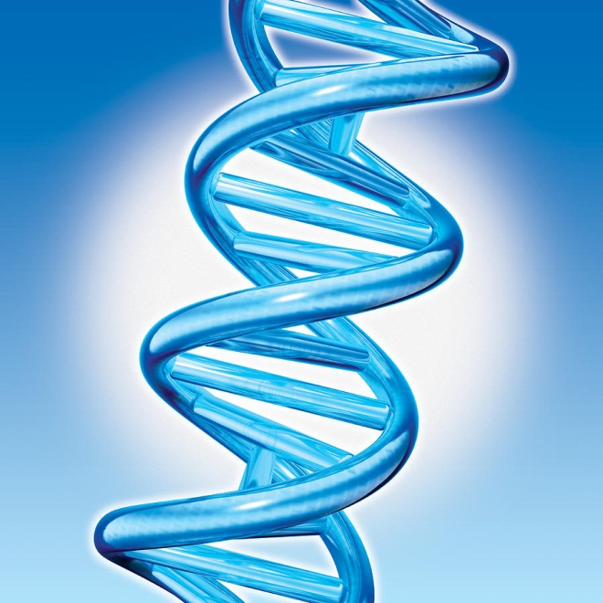
Why extract DNA from cells?
Clinical applications
Tissue typing for organ transplant
Detection of pathogens
Human identity testing
Downstream research applications (additional experiments)
Determine DNA sequence
Combine different DNAs together (make recombinant DNA)
Change or alter the DNA sequence

Slide 6
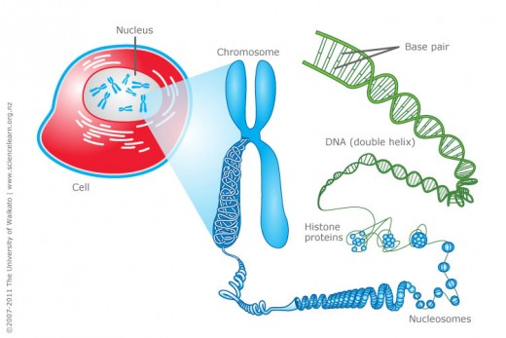
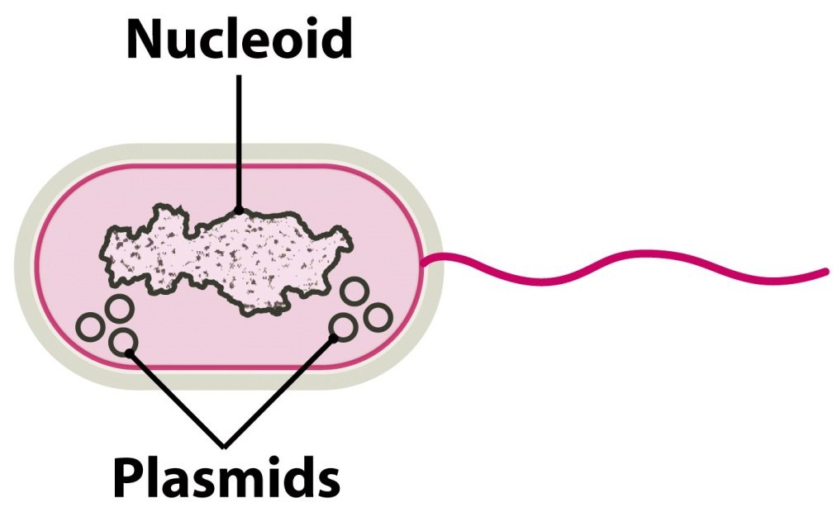
Where is the DNA located in cells?
Genomic DNA (chromosome(s)) is located in the nucleus
Plasmid DNA is located in the cytoplasm in bacterial and yeast cells
Genomic DNA (chromosome)

Slide 7
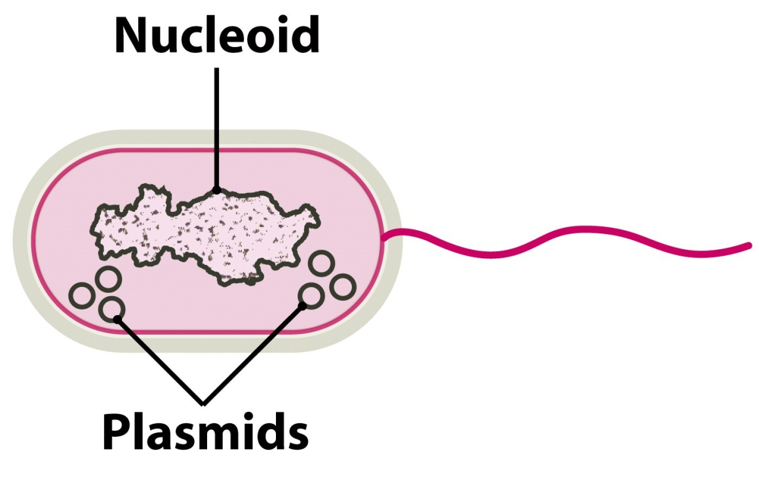
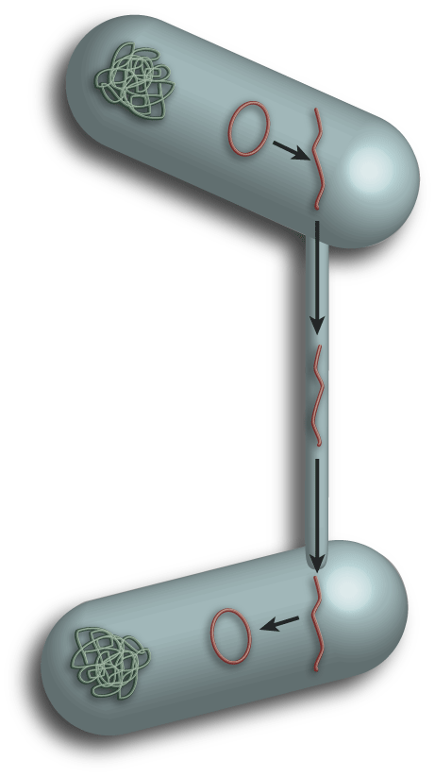
What are plasmids?
Genomic DNA (chromosome)
Plasmids are small circles of DNA (they contain genes)
Some plasmids can have hundreds of copies/cell
They can be transferred between cells

Slide 8
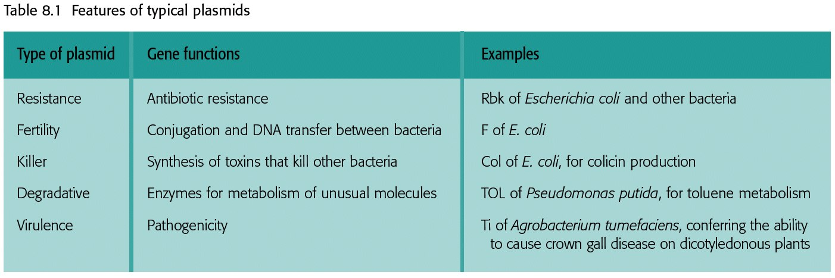
Cells have plasmids because they give the cells useful properties
Table 8.1 Genomes 3 (© Garland Science 2007)

Slide 9
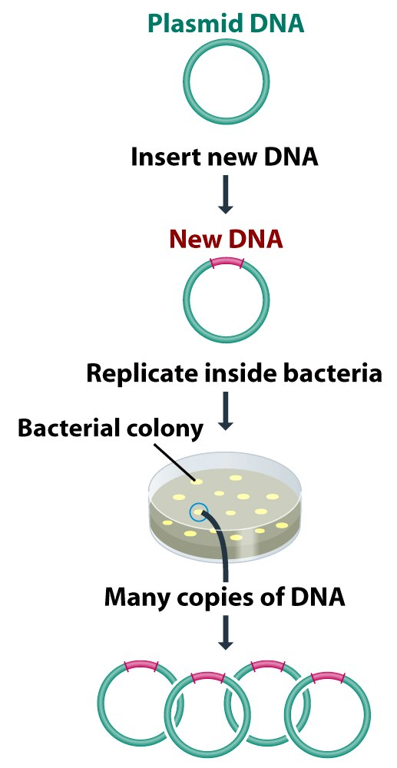
Why are plasmids useful to us?
They can be put into cells and taken out of cells easily
We can insert a DNA of interest into a plasmid to make a recombinant DNA
This new DNA can be inserted back into the cells
The cells will copy the new DNA and make many copies of our DNA
The DNA on plasmids can be easily manipulated in the lab

Slide 10
Okay, let’s stop and talk technique

Slide 11
Use good lab technique
Wear gloves
Do not leave bottles, etc. open
Change pipet tips between each sample
If your pipet tip touches anything besides your sample, change it
Wash hands after using bacteria

Slide 12
Micropipettes
Minimum volume is….
P20
P200
P1000
0
0
0
1
2
2
0
0
0
(1.0 μl)
(20 μl)
(200 μl)
Maximum volume is…
P20
P200
P1000
2
2
1
0
0
0
0
0
0
(20.0 μl)
(200 μl)
(1000 μl)

Slide 13
Back to minipreps….

Slide 14
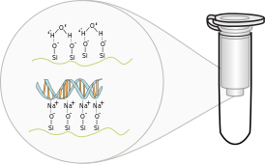
Spin columns are the most common method for extracting DNA from cells
Four steps:
Lysis
Binding
Washing
Elution

Slide 15
Step 1: Lysis
Break down the cell membrane with detergent and NaOH
Remove proteins by denaturing them (changing their shape) with salts
Genomic DNA (chromosome)

Slide 16
Step 2: Binding
DNA must be separated from the cell’s debris
Uses selective binding of DNA to solid support (silica)
In high salt, DNA binds silica
In high salt, protein does not bind (flows through column)
DNA
Proteins

Slide 17
Step 3: Wash
Most protein has washed through, but some might be left
Wash column 1-2X to remove these impurities
DNA
Proteins

Slide 18
Step 4: Elute
Elution buffer (low salt) releases the DNA from the membrane
Now the DNA will flow through and be collected in the tube
DNA

Slide 19
Gel electrophoresis

Slide 20
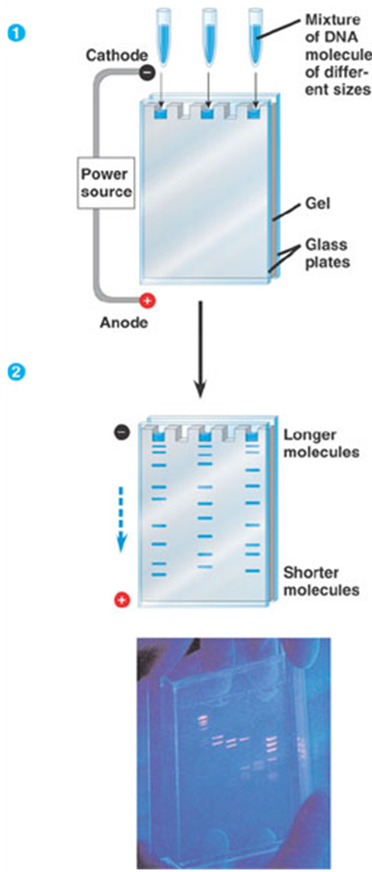
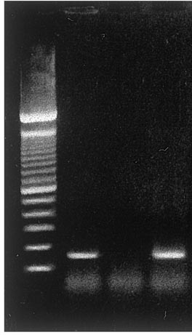
We can determine the quantity and quality of our nucleic acid using gel electrophoresis

Slide 21
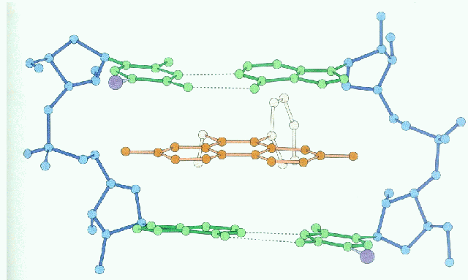
Pouring a Gel
The gel is made out of an agarose matrix
Agarose is clear and colorless; we can see DNA by incorporating ethidium bromide or GelRed, which inserts into the DNA and fluoresces

Slide 22
Serial Dilutions
In a serial dilution, the concentration decreases by the same amount in each successive step
Serial dilutions are multiplicative
A 1:5 dilution followed by a 1:5 dilution =1:25
Why is it crucial to change pipet tips when performing dilutions?
When performing serial dilutions, why is it crucial to mix thoroughly at each step?

Slide 23
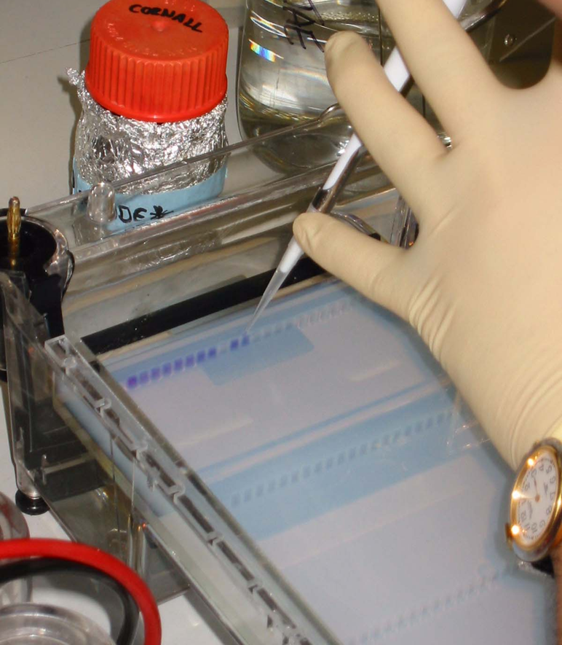
Preparing your samples
To get the clear and colorless DNA into the gel we mix it with loading dye

Slide 24
Running a Gel
Cover the gel with buffer
Hover over the well and pipet gently; do not push all the way down on pipet!
Be sure to load a DNA ladder into one lane
DNA ladder

Slide 25
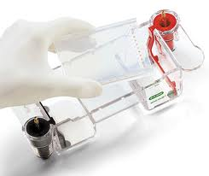
Viewing your Gel
Remove carefully!
Compare to the DNA ladder to determine DNA length
DNA ladder
Sample 1
Sample 2
Sample 3

