Slide 1
The V3 Region Expresses More Diversity in Amino Acid Sequence in AIDS Diagnosed Patients than in Non-Trending and AIDS Progressing Patients
HIV Structure Project
Chloe Jones, Isabel Gonzaga, and Nicole Anguiano
BIOL368: Bioinformatics Laboratory
October 28, 2014

Slide 2
Outline
V3 region of gp120 protein plays a critical role in HIV entry to CD4 T-Cells
Examining the V3 structure between the HIV-1 variants provide insight on level of progressiveness
V3 region and protein structure changes over time in respect to each group
Analysis of how the progressor group affected the diversity and secondary structure of the V3 region
Notes:
will finish when everybody imputs data

Slide 3
V3 region of gp120 protein plays a critical role in HIV entry to CD4 T-Cells
Third variable region (V3)
Conformational Changes important for coreceptor binding: CCR5 or CXCR4 (necessary for viral entry)
Spikes on envelope allows for binding of receptors and virus entry, “molecular hook”
Studying the V3 structure, the HIV virus it can be further examined and analyzed towards progression and neutralization
Neutralization targets V3 region

Slide 4
Examining the V3 structure between the HIV-1 variants
Question: How does HIV status (diagnosed, progressing or non-trending) affect the structure of the V3 protein region?
Hypothesis: Diagnosed groups will express greater variability in the V3 region in their protein structure, in comparison to the non-trending groups.
*Know that progressing groups expressed greater genetic variability
Notes:
, also may be true of V3 region affecting the host's ability to adapt to the changes and generate sufficient immune response.

Slide 5
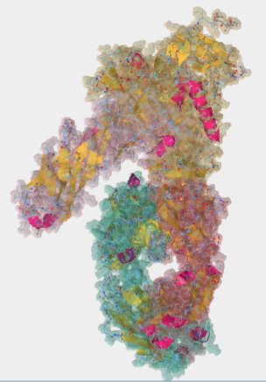
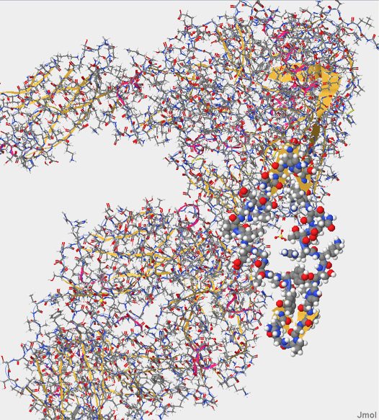
V3 region lies on the G domain of the gp120 protein
Four domains:
Glycoprotein
CD4 cell surface
X5 Heavy Chain
X5 Light Chain

Slide 6
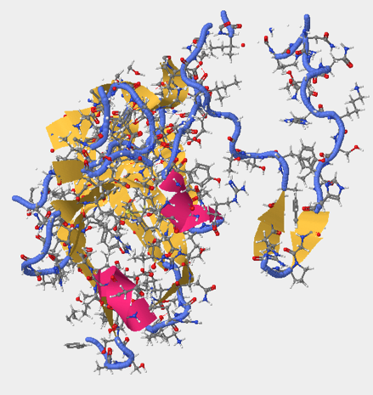
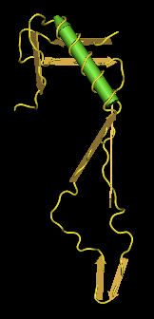
V3 sequence located and deduced from the gp120 structure
V3 Region on gp120: 296:G and 331:G
Sequence:
C T R P N Q N T R K S I H I G P G R A F Y T T G E I I G D I R Q A H C

Slide 7
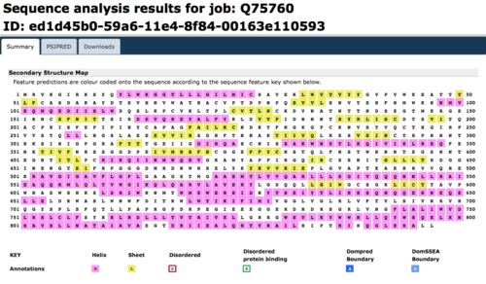
V3 region secondary structure prediction contains 1 beta sheet and alpha helix
V3: 293 - 326 on gp120
Beta sheet: 20 - 22; Alpha helix: 30 - 33

Slide 8
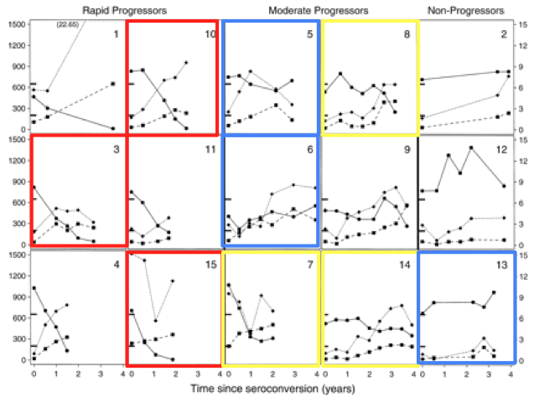
Progression groups defined from Markham et al. (1998)
AIDS Diagnosed
<200 TD4 C Cell Counts at final visit
AIDS Progressing
Developed AIDS within 1 year after final visit
No Trend
Two Times:
First Visit (initial seroconversion)
Final Visit
Sequences selected at random

Slide 9
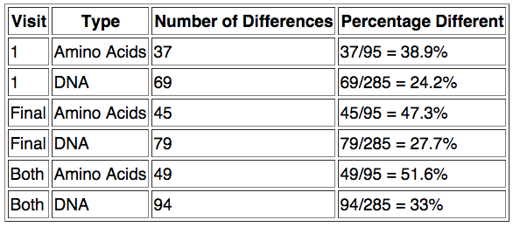
AIDS Diagnosed groups show rapidly increased diversity over time

Slide 10
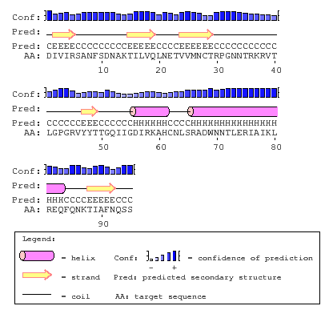

Subject 3 and Subject 10 share a similar PsiPred secondary structure prediction
Subject 3
Subject 10

Slide 11
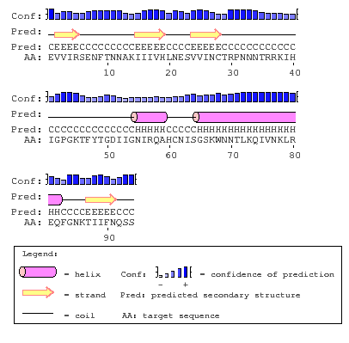
Subject 15 had no beta sheet and a shortened alpha helix
Missing sheet amino acid sequence: Phe-Tyr-Thr
Same amino acid sequence as subject 10
Missing portion in alpha helix has same AA sequence as both other subjects

Slide 12
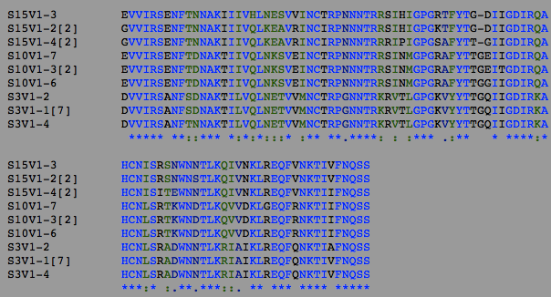

Diagnosed group initial visit secondary structure highlights amino acid changes
Location of missing beta sheet (20-22) has no fully conserved residues
Alpha helix (55-59): 1 difference
Gln vs Lys

Slide 13
Location of missing beta sheet has no fully conserved residues
Missing beta sheet (20-22):
20: Arg (+) vs Lys (+) vs Ser (polar)
21: Thr (polar) vs Ala (nonpolar) vs Val (nonpolar)
22: Phe (nonpolar) vs Tyr (polar)

Slide 14
Alpha helix has one residue that is strongly conserved
Alpha helix (55-59): 1 difference
58: Gln vs Lys
polar → (+)

Slide 15
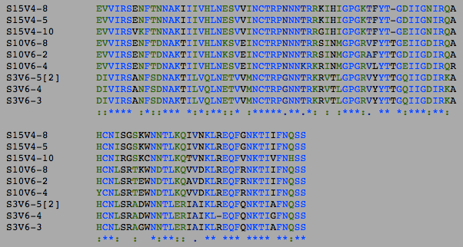
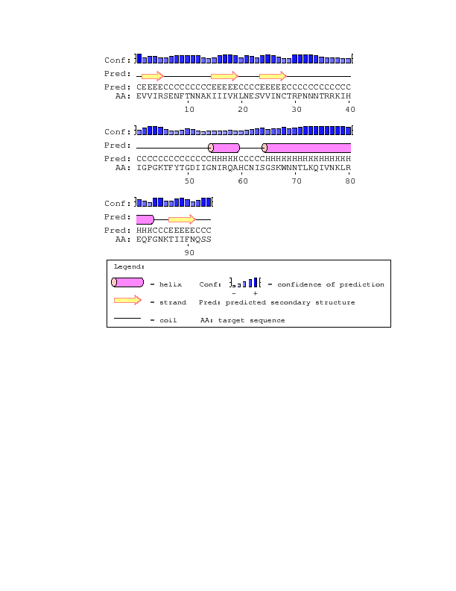
Diagnosed group final visit diversity affects secondary structure
Location of missing beta sheet (20-22) still has no fully conserved sequences
Alpha helix (55-59): 3 differences at residues 55, 58, and 59

Slide 16
Location of missing beta sheet in diagnosed group has no fully conserved residues
Missing beta sheet (20-22):
20: Arg (+) vs Lys (+)
21: Thr (polar) vs Ala (nonpolar) vs Val (nonpolar)
22: Phe (nonpolar) vs Tyr (polar) vs Leu (nonpolar)

Slide 17
Diagnosed group alpha helix loses consensus from the first to the final visit
Alpha helix (55-59): 3 differences
55: Asn (polar) vs Asp (-)
58: Gln (polar) vs Lys (+)
59: Ala (nonpolar) vs Arg (+)

Slide 18
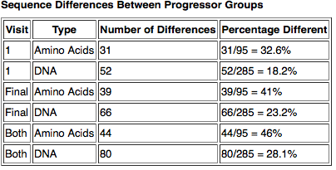
AIDS progressing groups show increased diversity over time

Slide 19
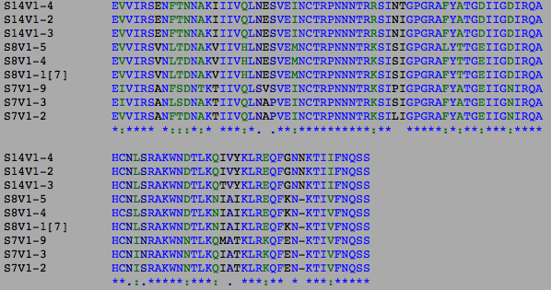
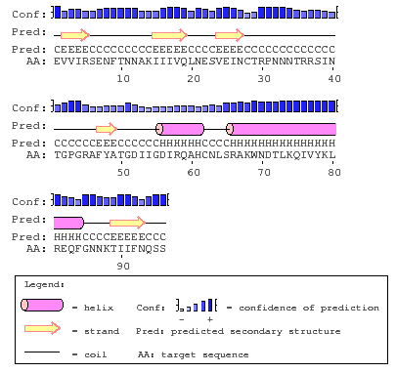
Progressing group initial visit secondary structure highlights amino acid changes
Beta sheet (20-22): 2 differences
20: Phe vs Lys
22: Ala vs Thr
Alpha helix (56-61): 1 difference
56: Asp vs Asn

Slide 20
Progressing group initial visit secondary structure highlights amino acid changes
Beta sheet (20-22): 2 differences
20: Phe vs Lys
nonpolar, aromatic → (+)
22: Ala vs Thr
nonpolar → polar

Slide 21
Progressing group initial visit secondary structure highlights amino acid changes
Alpha helix (56-61): 1 difference
56: Asp vs Asn
(-) → polar

Slide 22
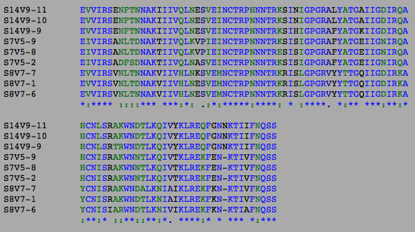
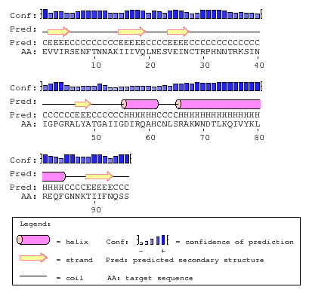
Progressing group final visit diversity affects secondary structure
Beta sheet (20-22): 2 a.a. differences
no more conservation at residue 20
Alpha helix (56-61): 3 a.a. differences
New strong conservation at 59 and 61

Slide 23
Progressing group loses consensus at B-sheets over time
Beta sheet (20-22): 2 differences
20: Phe vs Lys vs Tyr
np, arom → (+) → polar arom
22: Ala vs Thr
nonpolar → polar

Slide 24
Progressing group alpha helix loses consensus over time
Alpha helix (56-61): 3 differences
56: Asp vs Asn
59: Gln vs Lys: polar → (+)
61: His vs Tyr: (+) → polar, arom

Slide 25
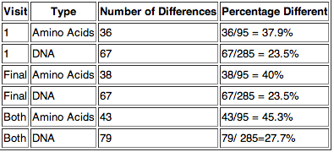
Non-Trending group shows little change in diversity over time
Table 1. The calculated percentage differences of amino acid and DNA residues for non-trending groups at the initial visits, final visits, and combined visits.
Notes:
DNA more conserved

Slide 26
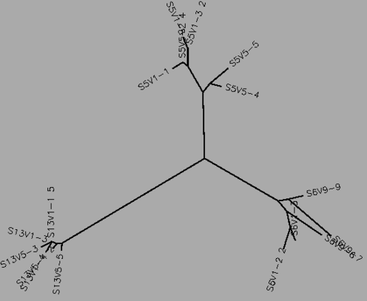
No diversity or divergence present in phylogenetic tree of Non-trending groups
Figure 1. Phylogenetic tree comparing all
non-trending subjects from the first to final visit.
-Clones from the same virus were more genetically
similar to each other, than to clones from other
subjects.
-Each subject stayed with in a particular region
-no divergence

Slide 27
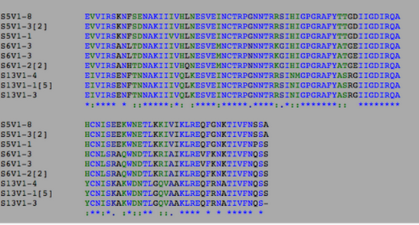
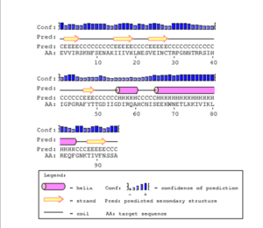
Non-trending group initial visit secondary structure highlight amino acid changes
V3 region is 29-63 denoted by color in Red

Slide 28
Non-trending group initial visit secondary structure highlight amino acid changes
Beta sheet (47-49): Denoted by yellow
49: Thr (polar) vs. Ala (nonpolar)
Alpha helix (56-60): Denoted by pink
56: Asp (polar) vs. Asn (polar)

Slide 29
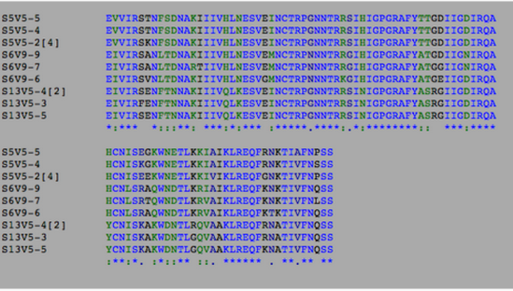
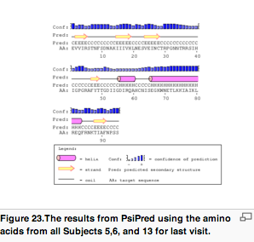
Non-trending group final visit secondary structure highlight amino acid changes
V3 region denoted by Red

Slide 30
Non-trending group final visit secondary structure highlight amino acid changes
Beta sheet (47-49): Denoted by yellow
49: Thr (polar) vs. Ala (nonpolar)
Alpha helix (56-60): Denoted by pink
no change

Slide 31
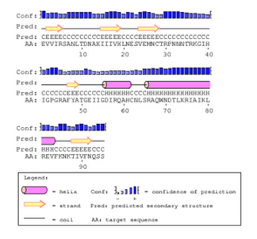
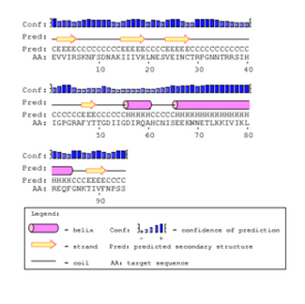
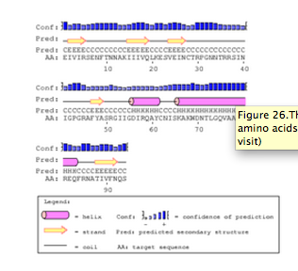
Subject 5
Subject 6 and subject 13 shared the same PsiPred secondary structure prediction
Subject 6 Subject 13

Slide 32
AIDS diagnosed group showed higher diversity in V3 region than the other groups
Number of differences in the V3 Region:
Aids diagnosed group
First Visit: 15 (4 in alpha helix/beta sheet)
Final Visit: 16 (6 in alpha helix/beta sheet)
Aids progressing group
First Visit: 7 (3 in alpha helix/beta sheet)
Final Visit: 12 (5 in alpha helix/beta sheet)
Non-trending group
First Visit: 10 (2 in alpha helix/beta sheet)
Final Visit: 10 (1 in beta sheet)

Slide 33
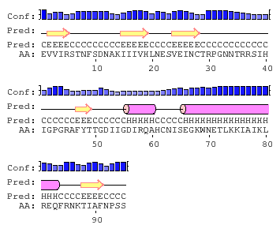
V3 secondary structure does not change greatly between groups
Non-trending
Progressing
Diagnosed
Diagnosed group missing beta sheet
Alpha helix varies in size between groups by 1-2 residues

Slide 34

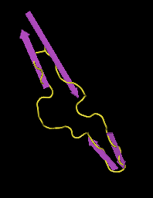
The PsiPred secondary structure prediction was incorrect for the V3 region
There is no alpha helix in the V3 loop
Low confidence of prediction may account for the discrepancy

Slide 35
Further study needs to be done to come to a concrete conclusion
A more efficient secondary structure prediction software is needed to be able to reliably predict secondary structure
Performing a larger study with a larger number of subjects in each group may help to see if differences such as those seen in subject 15 are uncommon

Slide 36
Citations
Huang, C. C., Tang, M., Zhang, M. Y., Majeed, S., Montabana, E., Stanfield, R. L., Dimitrov, D. S., Korber, B., Sodroski, J., Wilson, I. A., Wyatt, R., & Kwong, P. D. (2005). Structure of a V3-containing HIV-1 gp120 core. Science, 310(5750), 1025-1028. DOI: 10.1126/science.1118398
Markham, R.B., Wang, W.C., Weisstein, A.E., Wang, Z., Munoz, A., Templeton, A., Margolick, J., Vlahov, D., Quinn, T., Farzadegan, H., & Yu, X.F. (1998). Patterns of HIV-1 evolution in individuals with differing rates of CD4 T cell decline.Proc Natl Acad Sci U S A. 95, 12568-12573. doi: 10.1073/pnas.95.21.12568

Slide 37
Acknowledgments
Dr. Kam Dahlquist
Stephen Louis

