Slide 1
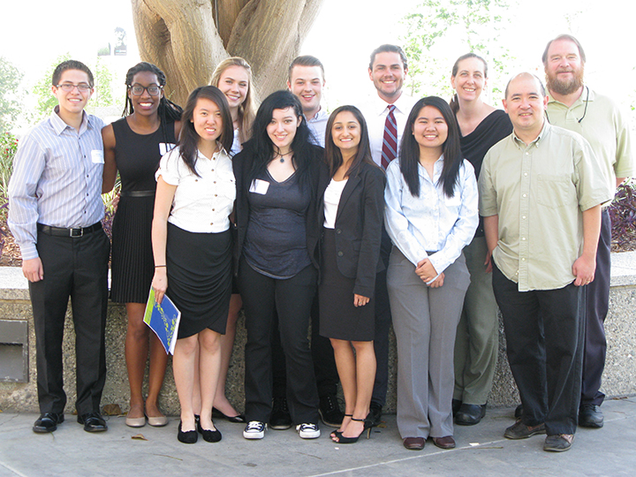
Determining the Identity and Dynamics of the Gene Regulatory Network Controlling the Response to Cold Shock in Saccharomyces cerevisiae
June 24, 2015

Slide 2
Systems Biology Workflow
DNA microarray data:
wet lab-generated
New experimental questions
Statistical analysis,
clustering
Generate gene regulatory network
Visualizing the results
Modeling dynamics of the network

Slide 3
Systems Biology Workflow
DNA microarray data:
wet lab-generated
Monica Hong
Kevin Wyllie
New experimental questions
Statistical analysis,
clustering
Generate gene regulatory network
Visualizing the results
Modeling dynamics of the network

Slide 4
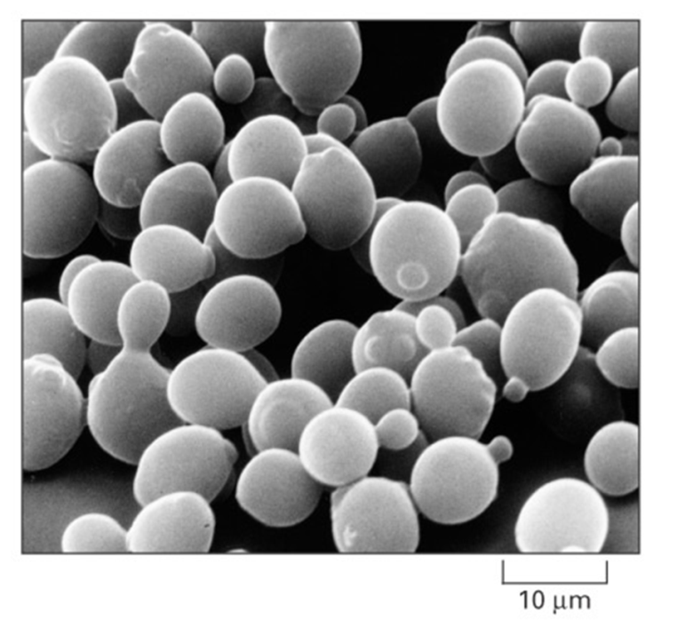
Budding Yeast, Saccharomyces cerevisiae, is an Ideal Model Organism for Systems Biology
Budding yeast has a small genome of approximately 6000 genes.
These 6000 genes are regulated by roughly 250 transcription factors.
Deletion strain collections and other molecular genetic tools are readily available.
Alberts et al. (2004)

Slide 5
Cold Shock Is an Environmental Stress that Is Not Well-Studied
Heat shock
Cold shock
response less well-characterized
decrease fluidity of membranes
stabilize DNA and RNA secondary structures
impair ribosome function and protein synthesis
decrease enzymatic activities
no equivalent set of cold shock proteins that are conserved in
all organisms
response very well-characterized
proteins denature due to heat
induction of heat shock proteins (chaperonins), that assist in protein folding
conserved in all organisms (prokaryotes, eukaryotes)

Slide 6
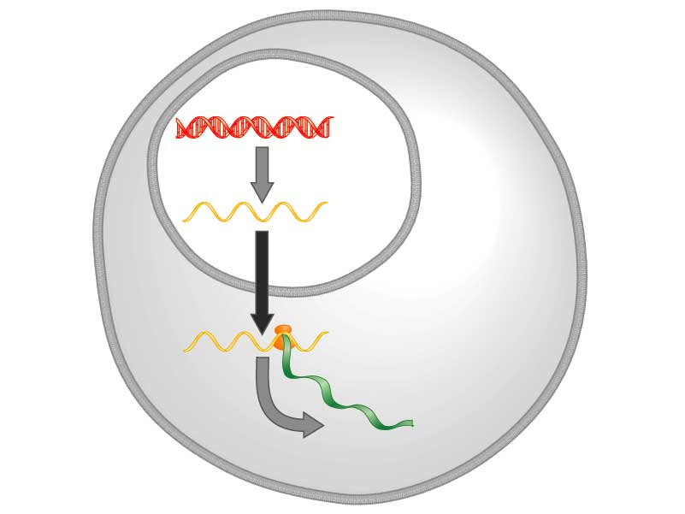
Yeast Respond to Cold Shock by Changing Gene Expression
DNA
Transcription
mRNA
Translation
Protein
Freeman (2003)
How is this regulated?
Notes:
Figure: 11.6
Caption:
In the cells of some organisms, DNA is found only in a membrane-bound structure called the nucleus. In these cells, proteins are manufactured outside the nucleus. Biologists proposed that the information coded in DNA is carried from inside the nucleus to ribosomes outside the nucleus by a molecule called messenger RNA (mRNA). Question: Why was the choice of the term messenger appropriate?

Slide 7
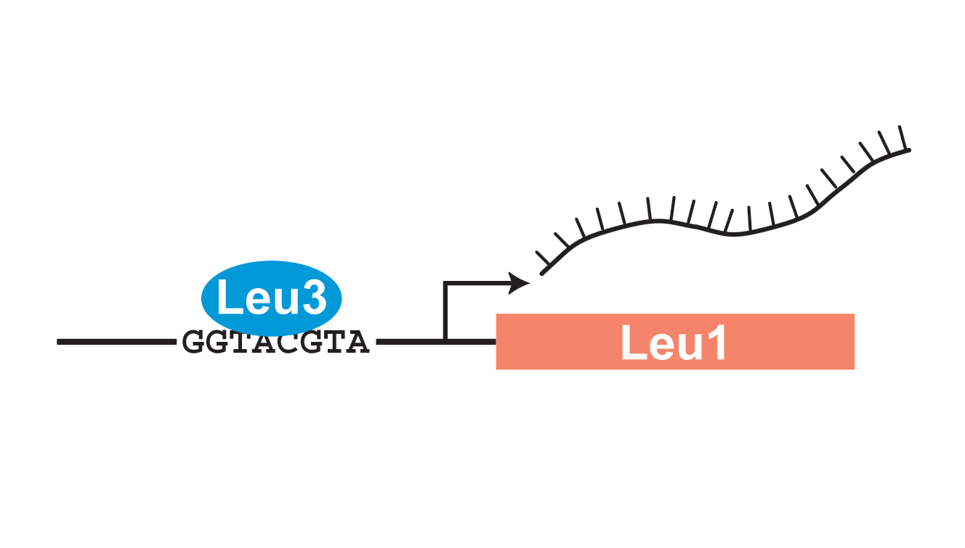
Transcription Factors Control Gene Expression by Binding to Regulatory DNA Sequences
Activators increase gene expression
Repressors decrease gene expression
Transcription factors are themselves proteins that are encoded by genes
Which transcription factors regulate the cold shock response in yeast?

Slide 8
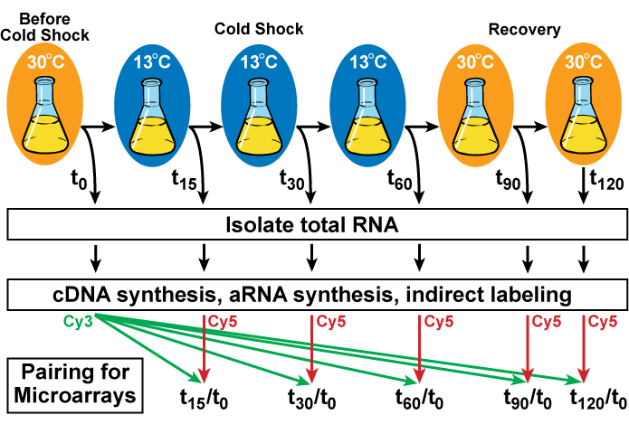
Yeast Cells Deleted for a Particular Transcription Factor are Harvested Before, During and After Cold Shock and Recovery

Slide 9
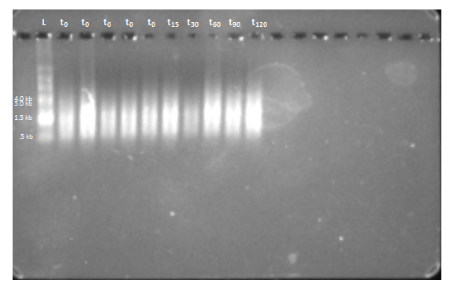
Gel Electrophoresis Can be Used to Show the High Quality of Purified aRNA Samples
Gel Electrophoresis Results for ∆yap1, Flask 4 aRNA
aRNA shows up as a smear because it is derived from genes of different lengths.

Slide 10
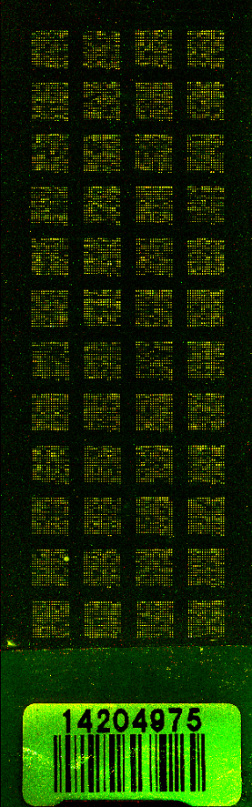
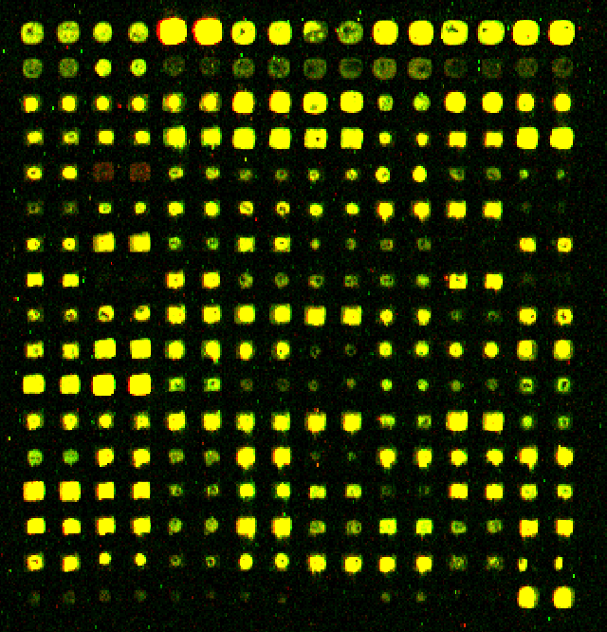
DNA Microarray Results Show Changes in Expression of All Genes in the Genome
Each spot contains DNA from one gene, which hybridizes to the fluorescently-labelled aRNA.
Red spots indicate an increase in gene expression relative to the control (t₀).
Green spots indicate a decrease in gene expression relative to the control (t₀).
Yellow spots indicate no change in expression.
Δyap1, t₆₀, replicate 1, 06/23/15

Slide 11
Systems Biology Workflow
DNA microarray data:
wet lab-generated
New experimental questions
Statistical analysis,
clustering
Tessa Morris
Generate gene regulatory network
Visualizing the results
Modeling dynamics of the network

Slide 12
Statistical Analysis Was Used to Build A Gene Regulatory Network
Indicates which genes had significant changes in expression at any time point
Clustering Genes with Similar Expression Profiles
Selected genes with a corrected p < 0.05 from the within-strain ANOVA
Clusters of genes with similar profiles also assigned a p value for significance
YEASTRACT Database
Selected genes from significant clusters (profiles)
Identified which transcription factors regulate the genes in the clusters
Within-strain ANOVA

Slide 13
Within-strain ANOVA Indicates Which Genes Had Significant Changes in Expression at Any Timepoint
Within-strain ANOVA
Clustering
YEASTRACT
ANOVA | WT | dCIN5 | dGLN3 | dHAP4 | dSWI4
p < 0.05 | 2377 (38.4%) | 1995 (32.2%) | 1856 (30.0%) | 2387 (38.6%) | 2583 (41.7%)
p < 0.01 | 1531 (24.7%) | 1157 (18.7%) | 1007 (16.3%) | 1489 (24.1%) | 1679 (27.1%)
p < 0.001 | 850 (13.7%) | 566 (9.15%) | 398 (6.43%) | 679 (11.0%) | 869 (14.0%)
p < 0.0001 | 449 (7.25%) | 280 (4.52%) | 121 (1.96%) | 240 (3.88%) | 446 (7.21%)
B & H p < 0.05 | 1673 (27.0%) | 1117 (18.1%) | 889 (14.4%) | 1615 (26.1%) | 1855 (30.0%)
Bonferroni p < 0.05 | 226 (3.65%) | 109 (1.76%) | 20 (0.32%) | 61 (0.99%) | 179 (2.89%)

Slide 14
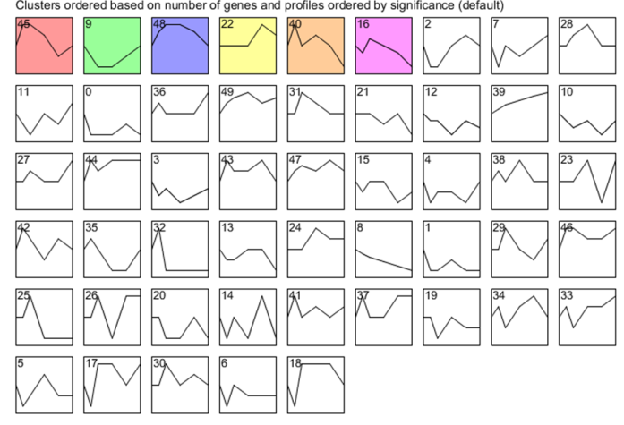
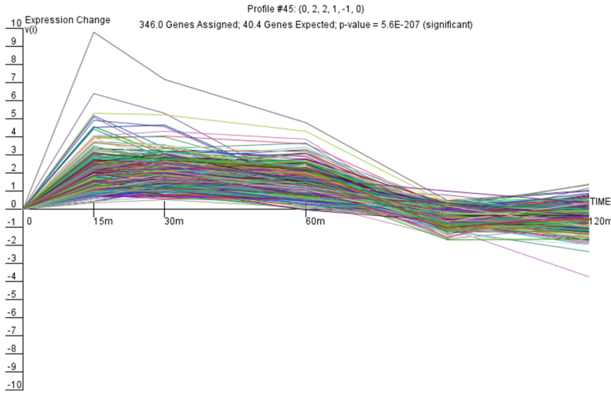
STEM Software Groups Genes with Similar Expression Profiles and Assigns P values to Clusters
Within-strain ANOVA
Clustering
YEASTRACT

Slide 15
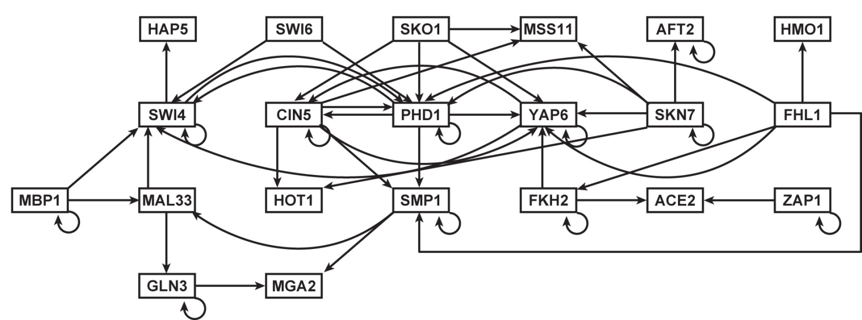
YEASTRACT Identifies Which Transcription Factors Regulate the Genes in the Clusters and Generates a Gene Regulatory Network
Within-strain ANOVA
Clustering with STEM
YEASTRACT
Each node is a transcription factor
Each edge is a regulatory relationship

Slide 16
Systems Biology Workflow
DNA microarray data:
wet lab-generated
New experimental questions
Statistical analysis,
clustering
K. Grace Johnson
Trixie Roque
Tessa Morris
Generate gene regulatory network
Visualizing the results
Modeling dynamics of the network

Slide 17
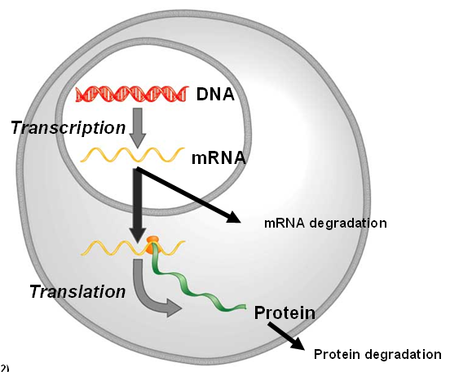
GRNmap Uses Ordinary Differential Equations to Model Dynamics of Each Gene in the Network
Parameters are estimated from DNA microarray data.
Weight parameter, w, gives the direction (activation or repression) and magnitude of regulatory relationship.

Slide 18
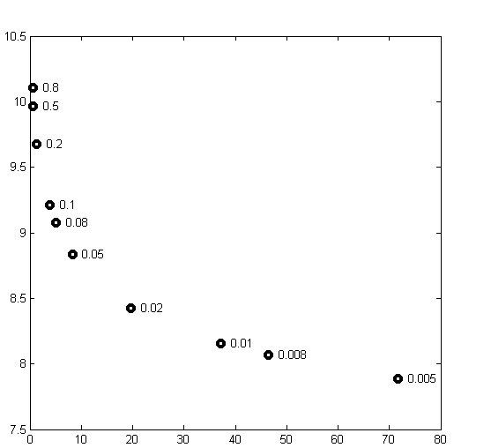
A Penalized Least Squares Approach is Used to Estimate Parameters
Least Squares Error
Plotting the least squares error function showed that not all the graphs had clear minima.
We added a penalty term so that MATLAB’s optimization algorithm would be able to minimize the function.
θ is the combined production rate, weight, and threshold parameters.
α is determined empirically from the “elbow” of the L-curve.
Parameter Penalty Magnitude

Slide 19
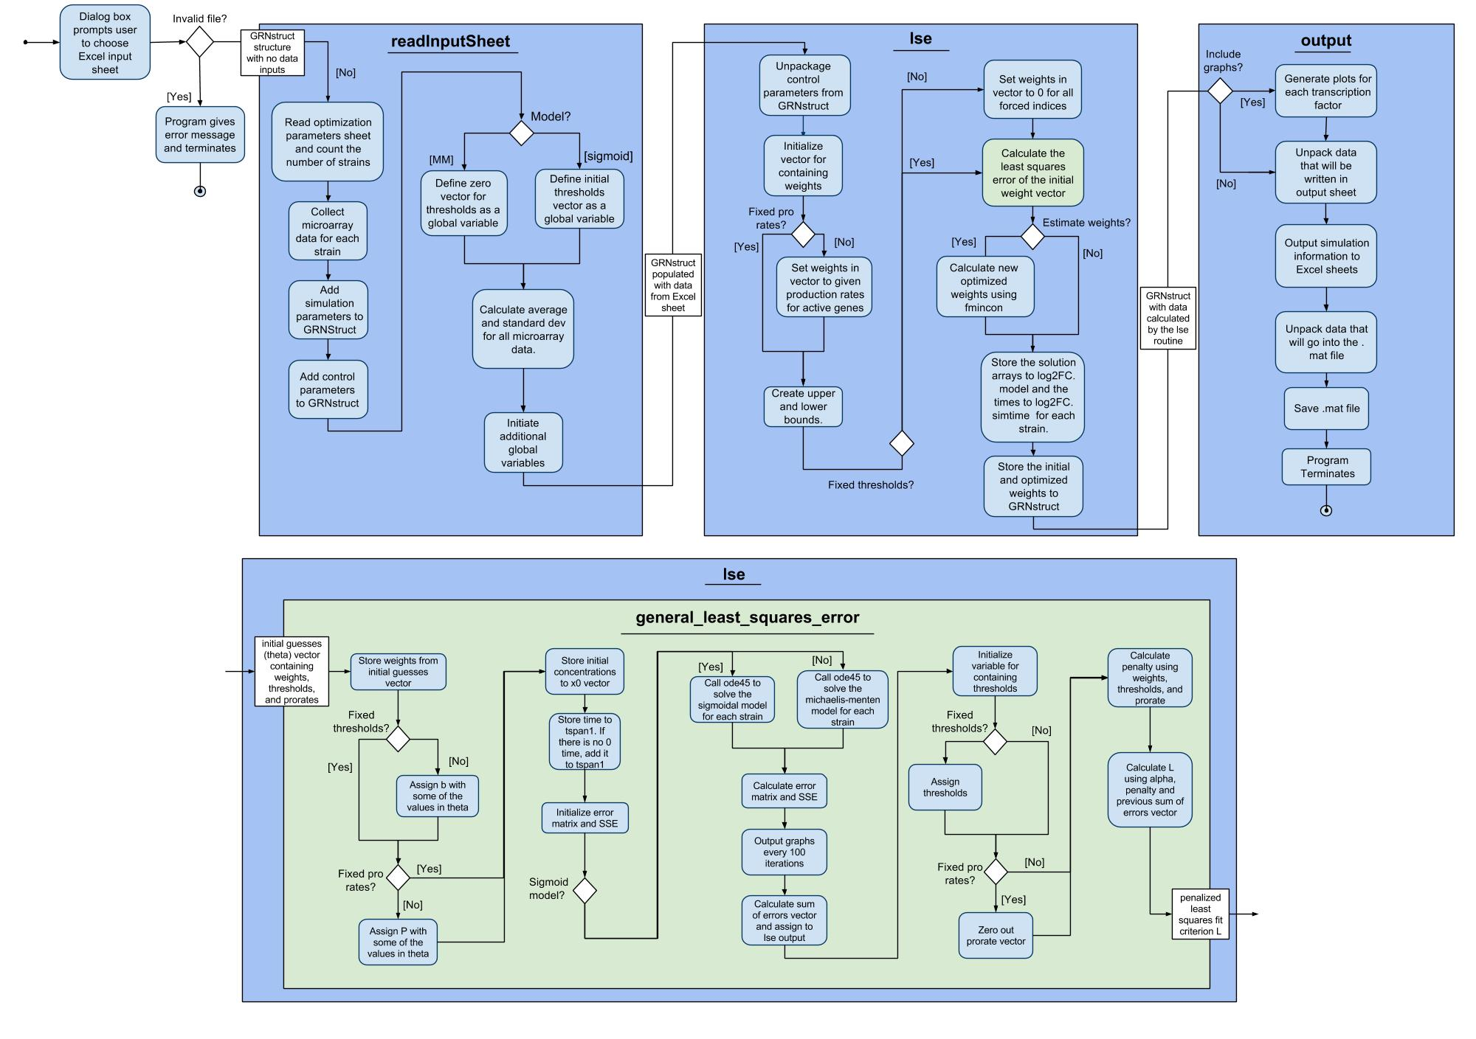
UML Activity Diagram Documents the Flow of the Program

Slide 20
UML Activity Diagram Documents the Flow of the Program

Slide 21
Input Workbooks Were Designed to Test the Sixteen Ways GRNmap Can be Run
Sigmoidal
Michaelis-Menten
Estimate + Forward
Forward Only
Fix p
Estimate p
Graph
No Graph
Graph
No Graph
Graph
No Graph
Estimate + Forward
Estimate b, Estimate p
Graph
No Graph
Estimate b, Fix p
Graph
No Graph
Fix b, Estimate p
Graph
No Graph
Fix b, Fix p
Graph
No Graph
Forward Only
Graph
No Graph

Slide 22
We Added New Features, Fixed Bugs, and Documented the Changes to GRNmap
New Features and Fix Bugs
Testing
Document
Updated activity diagram, GitHub wiki, and GRNmap website
Testing Framework
Currently working to automate testing
Manual tests were performed to verify changes and check for bugs before releasing
Including changing names of worksheets, computing standard deviations, and creating optimization diagnostics output

Slide 23

Parameters Were Estimated for a 21-gene, 50-edge Gene Regulatory Network
Do the model parameters accurately represent what is happening in the cell during cold shock?
Notes:
Working Hypothesis network

Slide 24
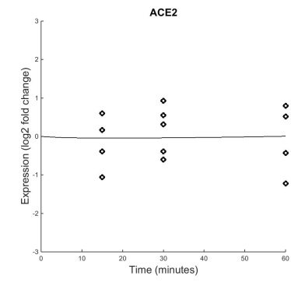
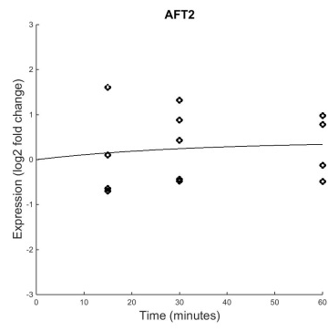
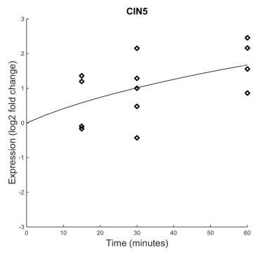
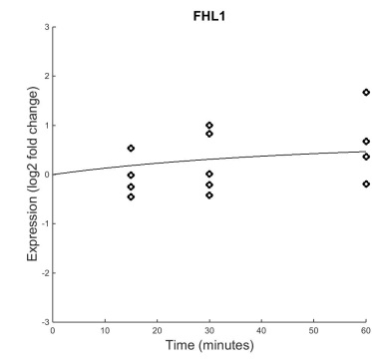
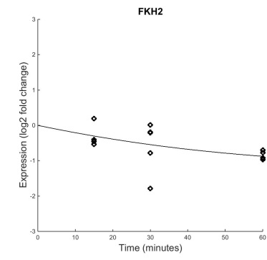
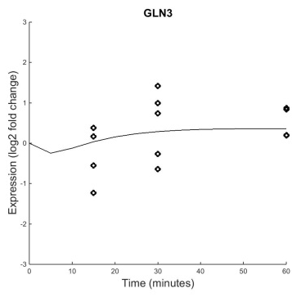
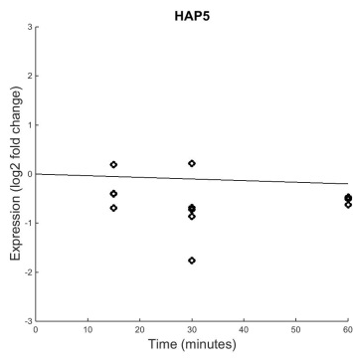
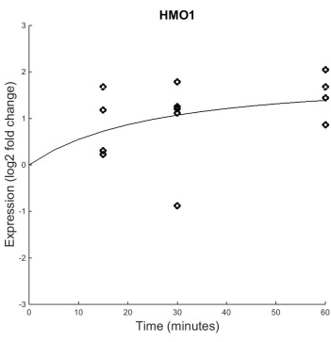
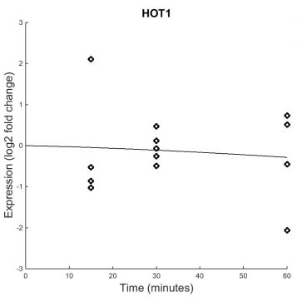
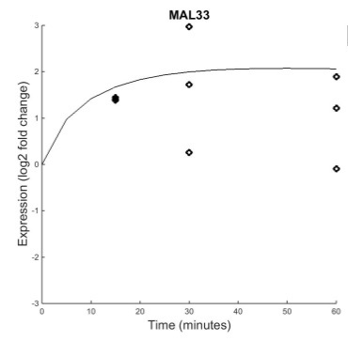
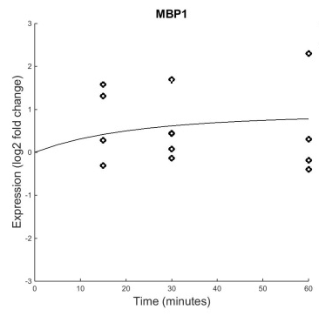
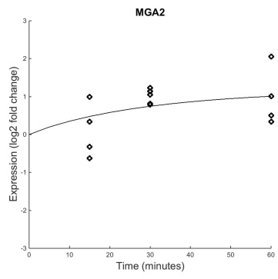
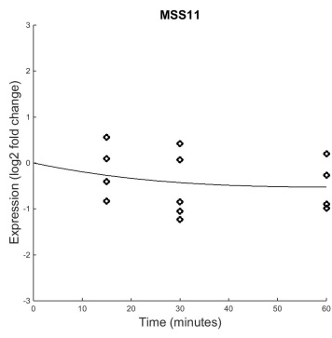
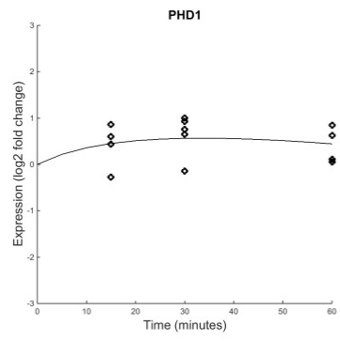
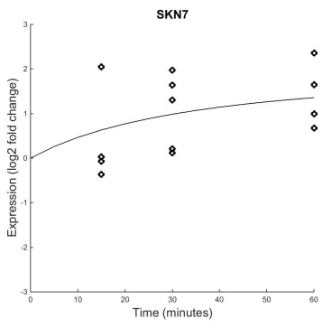
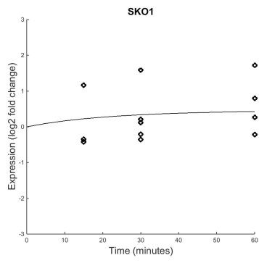
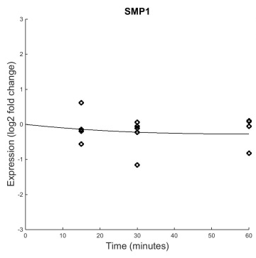
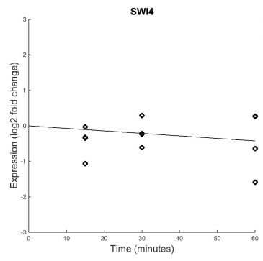
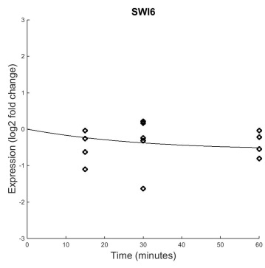
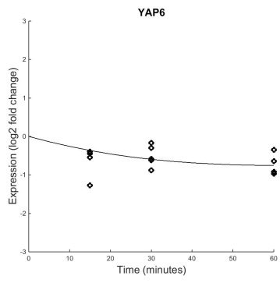
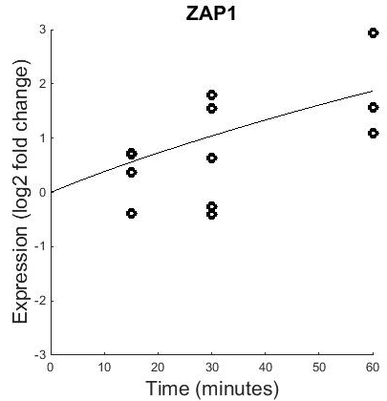
B&H p=0.8702
B&H p=0.7161
B&H p=0.0642
B&H p=0.4454
B&H p=0.1274
B&H p=0.4125
B&H p=0.1539
B&H p=0.0409
B&H p=0.6387
B&H p=0.0101
B&H p=0.5240
B&H p=0.1028
B&H p=0.4275
B&H p=0.0017
B&H p=0.0228
B&H p=0.1330
B&H p=0.6046
B&H p=0.6367
B&H p=0.1178
B&H p=0.0003
B&H p=0.0086
Generally, the model fits the experimental data well.
Notes:
dCIN5

Slide 25
B&H p=0.8702
B&H p=0.7161
B&H p=0.0642
B&H p=0.4454
B&H p=0.1274
B&H p=0.4125
B&H p=0.1539
B&H p=0.0409
B&H p=0.6387
B&H p=0.0101
B&H p=0.5240
B&H p=0.1028
B&H p=0.4275
B&H p=0.0017
B&H p=0.0228
B&H p=0.1330
B&H p=0.6046
B&H p=0.6367
B&H p=0.1178
B&H p=0.0003
B&H p=0.0086
Generally, the model fits the experimental data well.
Notes:
dCIN5

Slide 26
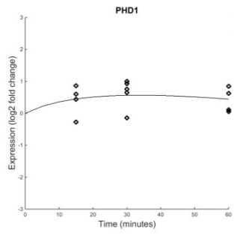
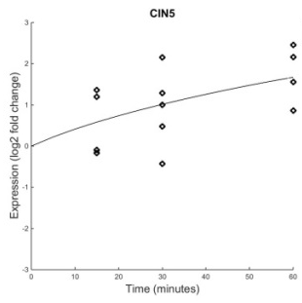





PHD1 Has Significant Dynamics and a Good Fit in the Model
B&H p=0.0017
Regulators: PHD1, CIN5, FHL1, SKN7, SKO1, SWI4, SWI6
Weight: 0.16
B&H p=0.0017
B&H p=0.0642
Weight: -0.28
B&H p=0.4454
Weight: 0.062
B&H p=0.0228
Weight: -0.10
B&H p=0.1330
Weight: 0.085
B&H p=0.6367
Weight: 0.16
Most regulators also have significant dynamics, making the weights easier to estimate
B&H p=0.1178
Weight: 0.14
Total repression: -0.38
Total activation: 0.61
Notes:
Analyze fit of gene, dynamics of gene, dynamics of regulators

Slide 27
Systems Biology Workflow
DNA microarray data:
wet lab-generated
New experimental questions
Statistical analysis,
clustering
Anindita Varshneya
Visualizing the results
Generate gene regulatory network
Modeling dynamics of the network

Slide 28
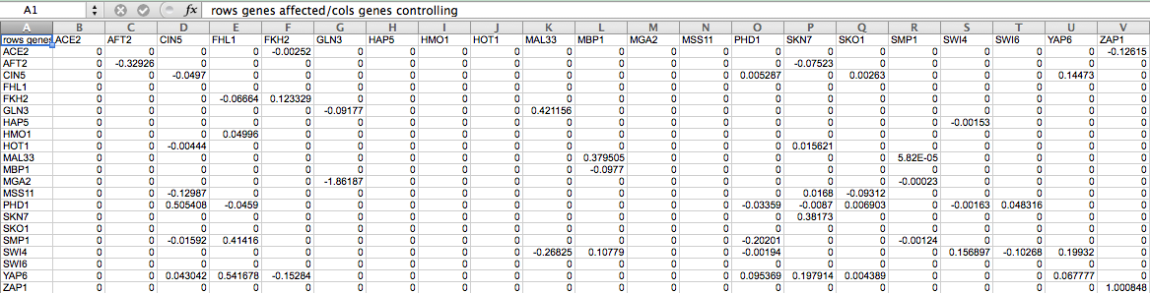
GRNmap Produces an Excel Spreadsheet with an Adjacency Matrix Representing the Network
0 represents no relationship.
A positive number shows activation.
A negative weight signifies repression.
The magnitude of the weight is the strength of the relationship.
However, GRNmap does not generate any visual representation of the Gene Regulatory Network.

Slide 29
GRNsight Has Sophisticated Architecture and Follows Open Source Development Practices
GRNsight has two parts a server and a web client.
GRNsight implementation takes advantage of other open source tools, such as D3
GRNsight follows an open development model using an open source github.com code repository and issue tracking.
We have implemented test-driven development using mocha testing framework.
With 140 automated unit tests in place, we are close to closing off development of version 1.

Slide 30

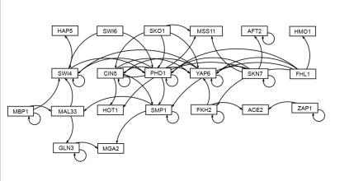
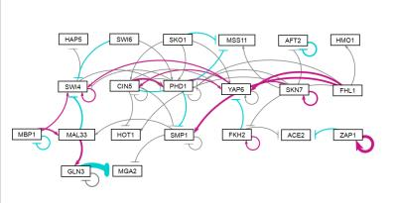
GRNsight Automatically Lays Out Unweighted and Weighted Graphs
Adobe Illustrator: several hours to create
GRNsight: 10 milliseconds to generate, 5 minutes to arrange
GRNsight: colored edges for weights reveal patterns in data

Slide 31
Systems Biology Workflow
DNA microarray data:
wet lab-generated
New experimental questions
Statistical analysis,
clustering
Kevin McGee
Generate gene regulatory network
Visualizing the results
Modeling dynamics of the network

Slide 32
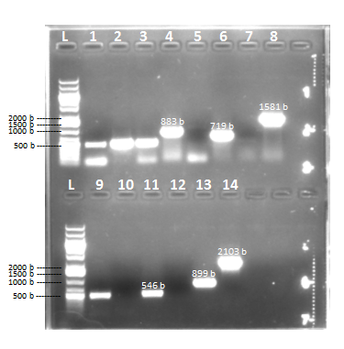
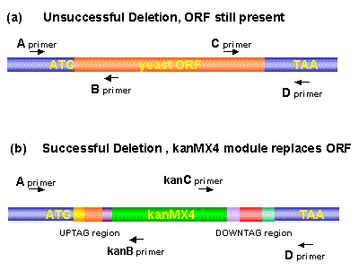
Genotype of Strains Confirmed by PCR and DNA Sequencing
The mutant strains genotyped include: Δnrg1, Δphd1, Δrsf2, Δrtg3, Δyhp1, Δyox1
Genotyping of ∆yhp1 by Colony PCR

Slide 33
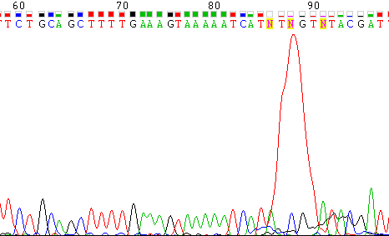
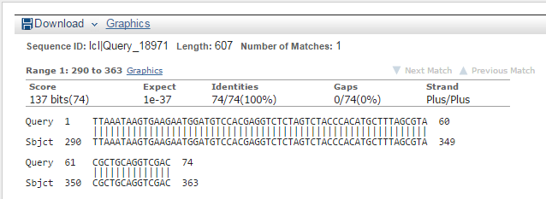
Genotype of Strains Confirmed by PCR and DNA Sequencing
Sequencing data for Δnrg1 A-kanB Primer A
BLAST Alignment for Δrtg3 A-kanB Primer A

Slide 34
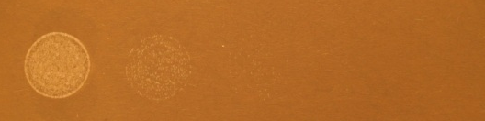
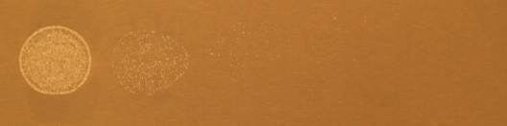
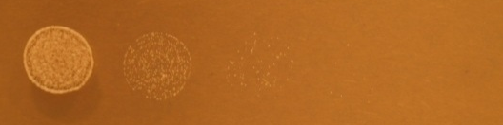
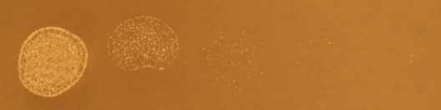
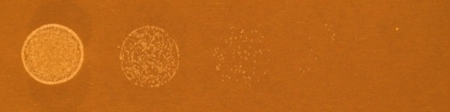
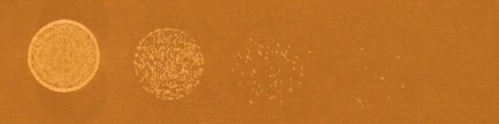


Δphd1 is Impaired for Growth at All Temperatures
Δphd1
wild-type
15ºC
day 4
20ºC
day 3
30ºC
day 1
37ºC
day 1

Slide 35
Determining the Identity and Dynamics of the Gene Regulatory Network Controlling the Response to Cold Shock in Saccharomyces cerevisiae
DNA microarray data:
wet lab-generated
New experimental questions
Statistical analysis,
clustering
Generate gene regulatory network
Visualizing the results
Modeling dynamics of the network

Slide 36
Thank you!
June 24, 2015

