Slide 1
The Digestive System and Body Metabolism
Digestion
Breakdown of ingested food
Absorption of nutrients into the blood
Metabolism
Production of cellular energy (ATP)
Synthesis and decomposition of molecules

Slide 2
Five Tasks of the Digestive System
Mechanical processing
Chewing
Peristalsis (squeezing of digestive tube)
Secretion of enzymes
Chemical digestion of food
Absorption of nutrients
Elimination of feces (unwanted stuff)

Slide 3
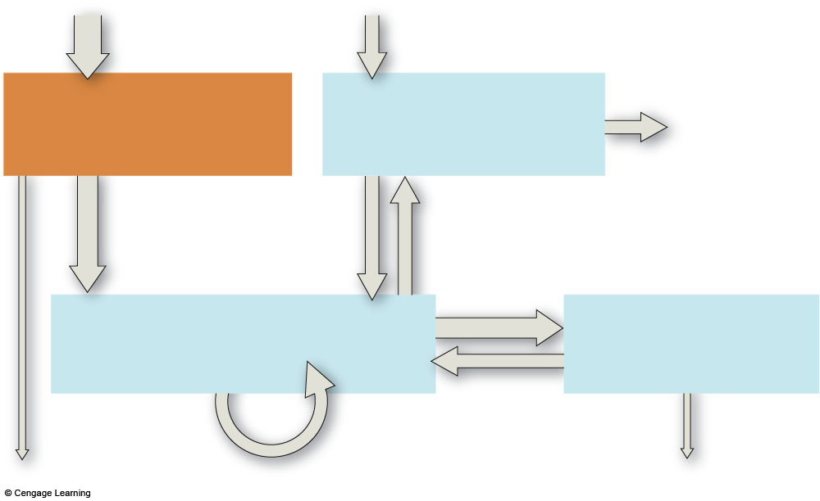
food, water intake
oxygen intake
Digestive
System
Respiratory
System
elimination
of carbon
dioxide
nutrients,
water,
salts
oxygen
carbon
dioxide
Circulatory
System
Urinary
System
water,
solutes
elimination
of food
residues
rapid transport
to and from all
living cells
elimination of
excess water,
salts, wastes
Fig. 37.3, p.618

Slide 4
Organs of the Digestive System
Two main groups
Alimentary canal – continuous coiled hollow tube
Accessory digestive organs

Slide 5
Organs of the Alimentary Canal
Mouth
Pharynx
Esophagus
Stomach
Small intestine
Large intestine
Anus

Slide 6
Accessory Digestive Organs
Salivary glands
Teeth
Pancreas
Liver
Gall bladder

Slide 7
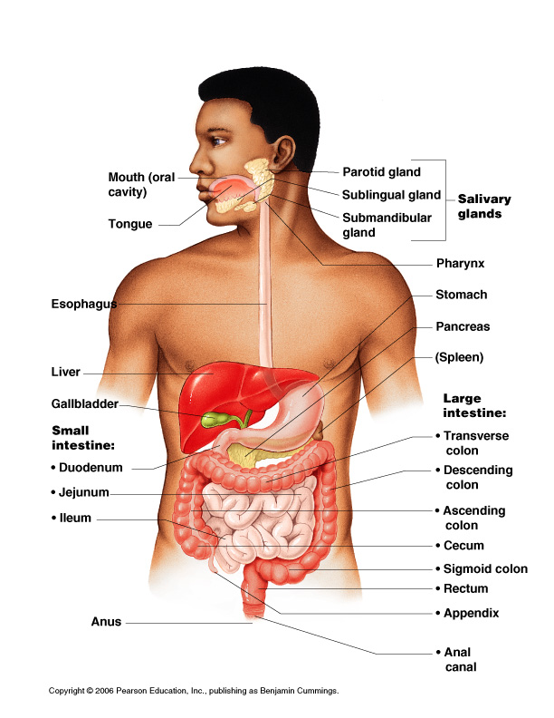
Organs of the Digestive System
Figure 14.1

Slide 8
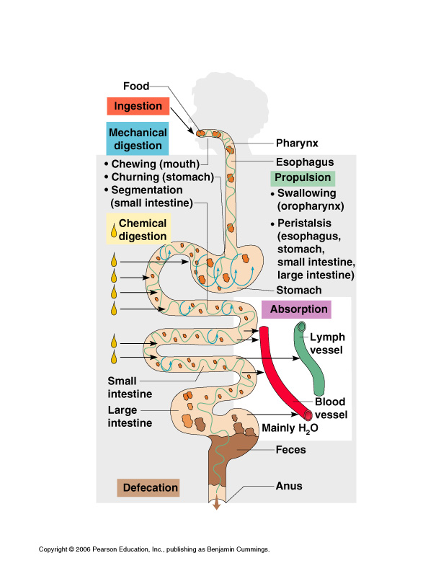
Figure 14.11

Slide 9
Processes of the Digestive System
Ingestion – getting food into the mouth
Propulsion – moving foods from one region of the digestive system to another

Slide 10
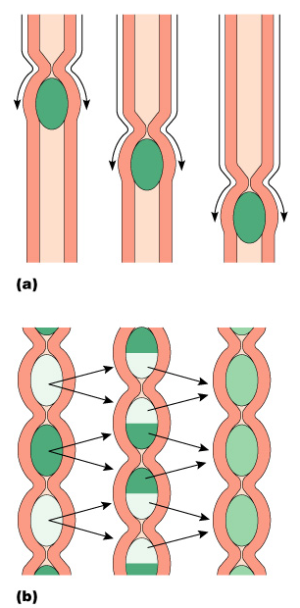
Processes of the Digestive System
Peristalsis – alternating waves of contraction
Segmentation – moving materials back and forth to aid in mixing
Figure 14.12

Slide 11
Processes of the Digestive System
Mechanical digestion
Mixing of food in the mouth by the tongue
Churning of food in the stomach
Segmentation in the small intestine

Slide 12
Processes of the Digestive System
Chemical Digestion
Enzymes break down food molecules into their building blocks
Each major food group uses different enzymes
Carbohydrates are broken to simple sugars
Proteins are broken to amino acids
Fats are broken to fatty acids and alcohols

Slide 13
Processes of the Digestive System
Absorption
End products of digestion are absorbed in the blood or lymph
Food must enter mucosal cells and then into blood or lymph capillaries
Defecation
Elimination of indigestible substances as feces

Slide 14
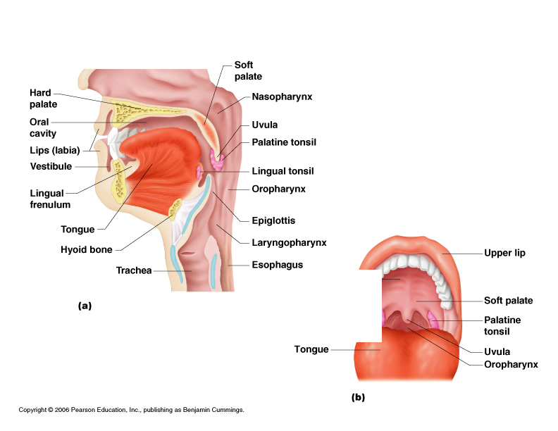
Mouth (Oral Cavity) Anatomy
Lips (labia) – protect the anterior opening
Cheeks – form the lateral walls
Hard palate – forms the anterior roof
Soft palate – forms the posterior roof
Uvula – fleshy projection of the soft palate
Figure 14.2a

Slide 15
Mouth (Oral Cavity) Anatomy
Vestibule – space between lips externally and teeth and gums internally
Oral cavity – area contained by the teeth
Tongue – attached at hyoid and styloid processes of the skull, and by the lingual frenulum
Figure 14.2a

Slide 16
Mouth (Oral Cavity) Anatomy
Tonsils
Palatine tonsils
Lingual tonsil
Figure 14.2a

Slide 17
Teeth
The role is to masticate (chew) food
Humans have two sets of teeth
Deciduous (baby or milk) teeth
20 teeth are fully formed by age two

Slide 18
Teeth
Permanent teeth
Replace deciduous teeth beginning between the ages of 6 to 12
A full set is 32 teeth, but some people do not have wisdom teeth

Slide 19
Classification of Teeth
Incisors
Canines
Premolars
Molars

Slide 20
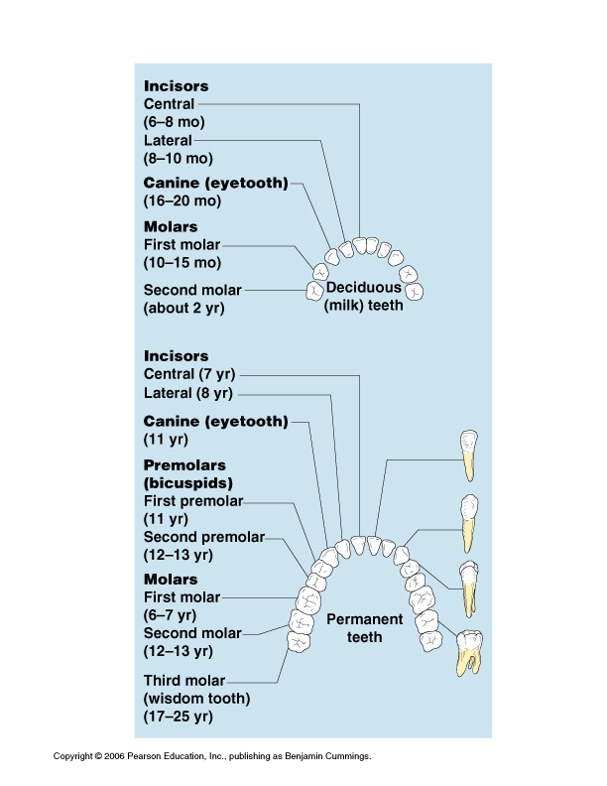
Classification of Teeth
Figure 14.9

Slide 21
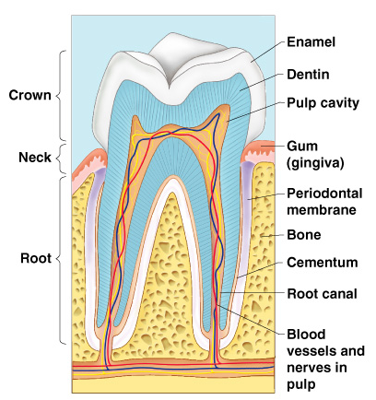
Regions of a Tooth
Crown – exposed part
Outer enamel
Dentin
Pulp cavity
Neck
Region in contact with the gum
Connects crown to root
Figure 14.10

Slide 22
Regions of a Tooth
Root
Periodontal membrane attached to the bone
Root canal carrying blood vessels and nerves
Figure 14.10

Slide 23
Salivary Glands
Saliva-producing glands
Parotid glands – located anterior to ears
Submandibular glands
Sublingual glands

Slide 24
Saliva
Mixture of mucus and serous fluids
Helps to form a food bolus
Contains salivary amylase to begin starch digestion
Dissolves chemicals so they can be tasted

Slide 25
Processes of the Mouth
Mastication (chewing) of food
Mixing masticated food with saliva
Initiation of swallowing by the tongue
Allowing for the sense of taste

Slide 26
Digestive Activities of the Mouth
Mechanical breakdown
Food is physically broken down by chewing
Chemical digestion
Food is mixed with saliva
Breaking of starch into maltose by salivary amylase

Slide 27
Pharynx Anatomy
Nasopharynx – not part of the digestive system
Oropharynx – posterior to oral cavity
Laryngopharynx – below the oropharynx and connected to the esophagus
Figure 14.2a

Slide 28
Pharynx Function
Serves as a passageway for air and food
Food is propelled to the esophagus by two muscle layers
Longitudinal inner layer
Circular outer layer
Food movement is by alternating contractions of the muscle layers (peristalsis)

Slide 29
Deglutition (Swallowing)
Buccal phase
Voluntary
Occurs in the mouth
Food is formed into a bolus
The bolus is forced into the pharynx by the tongue

Slide 30
Deglutition (Swallowing)
Pharyngeal-esophageal phase
Involuntary transport of the bolus
All passageways except to the stomach are blocked
Tongue blocks off the mouth
Soft palate (uvula) blocks the nasopharynx
Epiglottis blocks the larynx

Slide 31
Deglutition (Swallowing)
Pharyngeal-esophogeal phase (continued)
Peristalsis moves the bolus toward the stomach
The cardioesophageal sphincter is opened when food presses against it

Slide 32
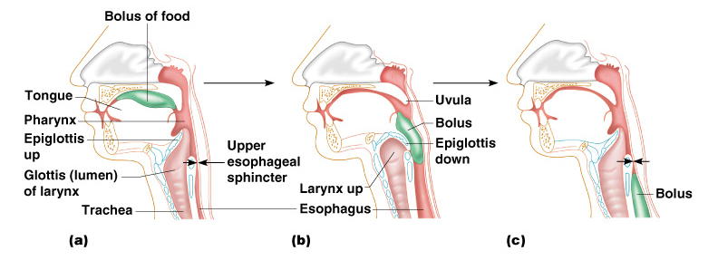
Deglutition (Swallowing)
Figure 14.14

Slide 33
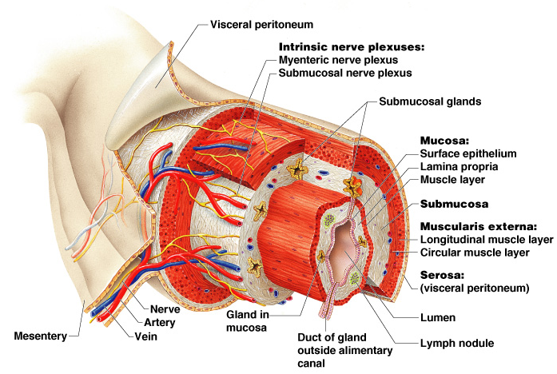
Layers of Alimentary Canal Organs
Figure 14.3

Slide 34
Layers of Alimentary Canal Organs
Mucosa
Innermost layer
Moist membrane
Surface epithelium
Small amount of connective tissue (lamina propria)
Small smooth muscle layer

Slide 35
Layers of Alimentary Canal Organs
Submucosa
Just beneath the mucosa
Soft connective tissue with blood vessels, nerve endings, and lymphatics

Slide 36
Layers of Alimentary Canal Organs
Muscularis externa – smooth muscle
Inner circular layer
Outer longitudinal layer
Serosa
Outermost layer – visceral peritoneum
Layer of serous fluid-producing cells

Slide 37
Esophagus
Runs from pharynx to stomach through the diaphragm
Conducts food by peristalsis (slow rhythmic squeezing)
Passageway for food only (respiratory system branches off after the pharynx)

Slide 38
Activities of the Pharynx and Esophagus
These organs have no digestive function
Serve as passageways to the stomach

Slide 39
Stomach Anatomy
Located on the left side of the abdominal cavity
Food enters at the cardioesophageal sphincter

Slide 40
Stomach Anatomy
Regions of the stomach
Cardiac region – near the heart
Fundus
Body
Phylorus – funnel-shaped terminal end
Food empties into the small intestine at the pyloric sphincter

Slide 41
Stomach Anatomy
Rugae – internal folds of the mucosa
External regions
Lesser curvature
Greater curvature

Slide 42
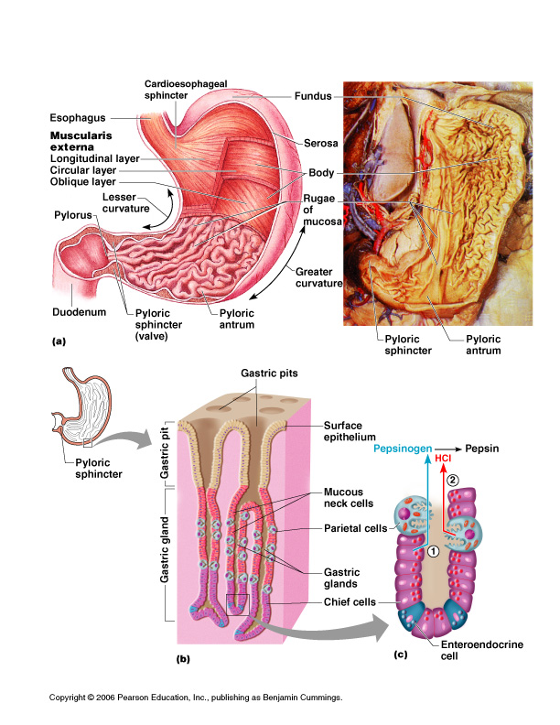
Stomach Anatomy
Figure 14.4a

Slide 43
Stomach Functions
Acts as a storage tank for food
Site of food breakdown
Chemical breakdown of protein begins
Delivers chyme (processed food) to the small intestine

Slide 44
Structure of the Stomach Mucosa
Figure 14.4b–c

Slide 45
Specialized Mucosa of the Stomach
Simple columnar epithelium
Mucous neck cells – produce a sticky alkaline mucus
Gastric glands – secrete gastric juice
Chief cells – produce protein-digesting enzymes (pepsinogens)
Parietal cells – produce hydrochloric acid
Endocrine cells – produce gastrin

Slide 46
Structure of the Stomach Mucosa
Gastric pits formed by folded mucosa
Glands and specialized cells are in the gastric gland region

Slide 47
Food Breakdown in the Stomach
Gastric juice is regulated by neural and hormonal factors
Presence of food or falling pH causes the release of gastrin
Gastrin causes stomach glands to produce protein-digesting enzymes
Hydrocholoric acid makes the stomach contents very acidic

Slide 48
Necessity of an Extremely Acid Environment in the Stomach
Activates pepsinogen to pepsin for protein digestion
Provides a hostile environment for microorganisms

Slide 49
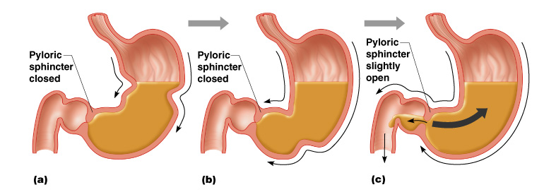
Propulsion in the Stomach
Food must first be well mixed
Rippling peristalsis occurs in the lower stomach
Figure 14.15

Slide 50
Propulsion in the Stomach
The pylorus meters out chyme into the small intestine (30 ml at a time)
The stomach empties in four to six hours
Figure 14.15

Slide 51
Digestion and Absorption in the Stomach
Protein digestion enzymes
Pepsin – an active protein digesting enzyme
Rennin – works on digesting milk protein
The only absorption that occurs in the stomach is of alcohol and aspirin

Slide 52
Small Intestine
The body’s major digestive organ
Site of nutrient absorption into the blood
Muscular tube extending from the pyloric sphincter to the ileocecal valve
Suspended from the posterior abdominal wall by the mesentery

Slide 53
Subdivisions of the Small Intestine
Duodenum
Attached to the stomach
Curves around the head of the pancreas
Jejunum
Attaches anteriorly to the duodenum
Ileum
Extends from jejunum to large intestine

Slide 54
Chemical Digestion in the Small Intestine
Source of enzymes that are mixed with chyme
Intestinal cells
Pancreas
Bile enters from the gall bladder

Slide 55
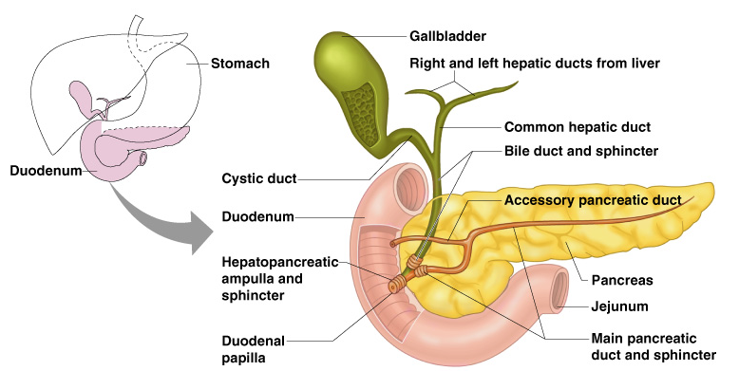
Chemical Digestion in the Small Intestine
Figure 14.6

Slide 56
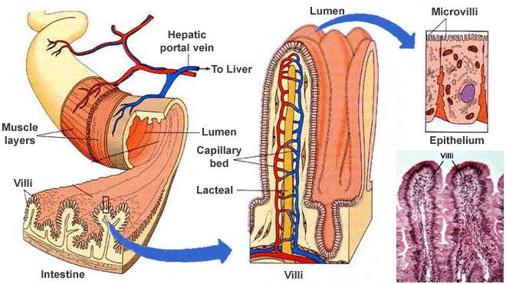

Slide 57
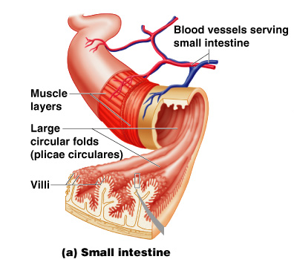
Villi of the Small Intestine
Fingerlike structures formed by the mucosa
Give the small intestine more surface area
Figure 14.7a

Slide 58
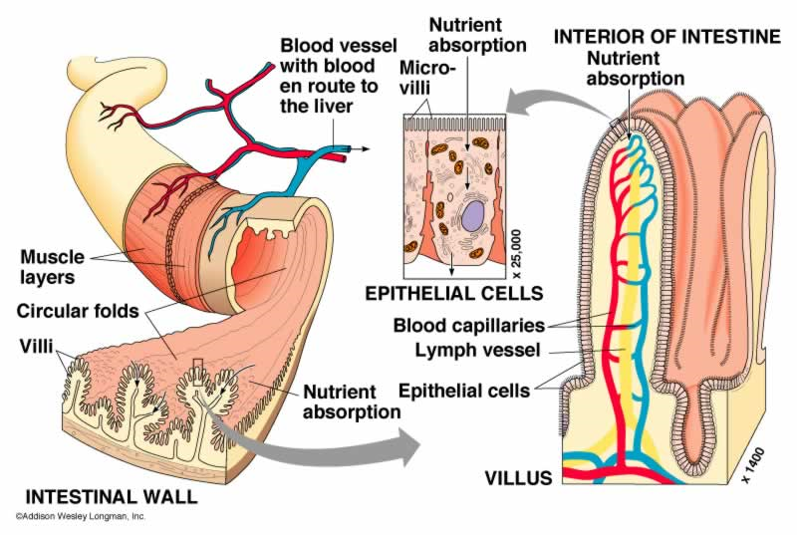

Slide 59
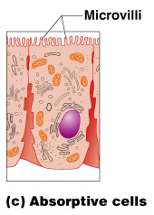
Microvilli of the Small Intestine
Small projections of the plasma membrane
Found on absorptive cells
Figure 14.7c

Slide 60
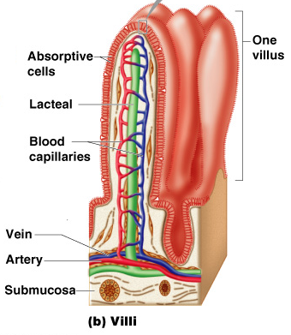
Structures Involved in Absorption of Nutrients
Absorptive cells
Blood capillaries
Lacteals (specialized lymphatic capillaries)
Figure 14.7b

Slide 61
Folds of the Small Intestine
Called circular folds or plicae circulares
Deep folds of the mucosa and submucosa
Do not disappear when filled with food
The submucosa has Peyer’s patches (collections of lymphatic tissue)

Slide 62
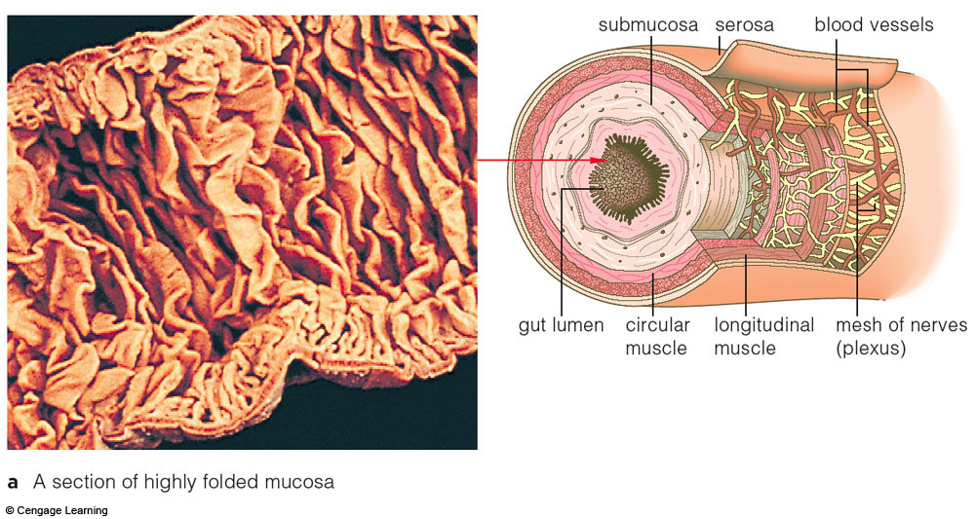
Fig. 37.9a, p.623

Slide 63
Digestion in the Small Intestine
Enzymes from the brush border
Break double sugars into simple sugars
Complete some protein digestion
Pancreatic enzymes play the major digestive function
Help complete digestion of starch (pancreatic amylase)
Carry out about half of all protein digestion (trypsin, etc.)

Slide 64
Digestion in the Small Intestine
Pancreatic enzymes play the major digestive function (continued)
Responsible for fat digestion (lipase)
Digest nucleic acids (nucleases)
Alkaline content neutralizes acidic chyme

Slide 65
Absorption in the Small Intestine
Water is absorbed along the length of the small intestine
End products of digestion
Most substances are absorbed by active transport through cell membranes
Lipids are absorbed by diffusion
Substances are transported to the liver by the hepatic portal vein or lymph

Slide 66
Propulsion in the Small Intestine
Peristalsis is the major means of moving food
Segmental movements
Mix chyme with digestive juices
Aid in propelling food

Slide 67
Chemical Digestion in the Small Intestine
Figure 14.6

Slide 68
Pancreas
Produces a wide spectrum of digestive enzymes that break down all categories of food
Enzymes are secreted into the duodenum
Alkaline fluid introduced with enzymes neutralizes acidic chyme
Endocrine products of pancreas
Insulin
Glucagons

Slide 69
Liver
Largest gland in the body
Located on the right side of the body under the diaphragm
Consists of four lobes suspended from the diaphragm and abdominal wall by the falciform ligament
Connected to the gall bladder via the common hepatic duct

Slide 70
Bile
Produced by cells in the liver
Composition
Bile salts
Bile pigment (mostly bilirubin from the breakdown of hemoglobin)
Cholesterol
Phospholipids
Electrolytes

Slide 71
Chemical Digestion in the Small Intestine
Figure 14.6

Slide 72
Gall Bladder
Sac found in hollow fossa of liver
Stores bile from the liver by way of the cystic duct
Bile is introduced into the duodenum in the presence of fatty food
Gallstones can cause blockages

Slide 73
Large Intestine
Larger in diameter, but shorter than the small intestine
Frames the internal abdomen

Slide 74
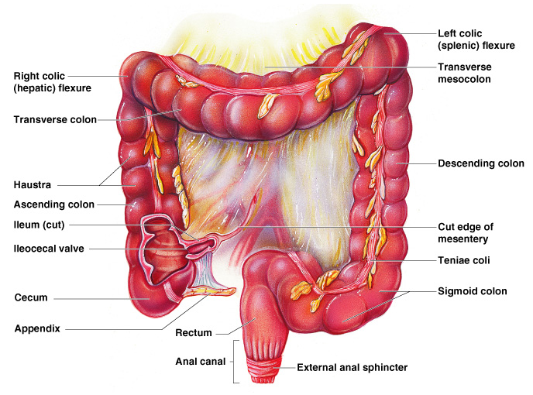
Large Intestine
Figure 14.8

Slide 75
Functions of the Large Intestine
Absorption of water
Eliminates indigestible food from the body as feces
Does not participate in digestion of food
Goblet cells produce mucus to act as a lubricant

Slide 76
Structures of the Large Intestine
Cecum – saclike first part of the large intestine
Appendix
Accumulation of lymphatic tissue that sometimes becomes inflamed (appendicitis)
Hangs from the cecum

Slide 77
Structures of the Large Intestine
Colon
Ascending
Transverse
Descending
S-shaped sigmoidal
Rectum
Anus – external body opening

Slide 78
Food Breakdown and Absorption in the Large Intestine
No digestive enzymes are produced
Resident bacteria digest remaining nutrients
Produce some vitamin K and B
Release gases
Water and vitamins K and B are absorbed
Remaining materials are eliminated via feces

Slide 79
Propulsion in the Large Intestine
Sluggish peristalsis
Mass movements
Slow, powerful movements
Occur three to four times per day
Presence of feces in the rectum causes a defecation reflex
Internal anal sphincter is relaxed
Defecation occurs with relaxation of the voluntary (external) anal sphincter

Slide 80
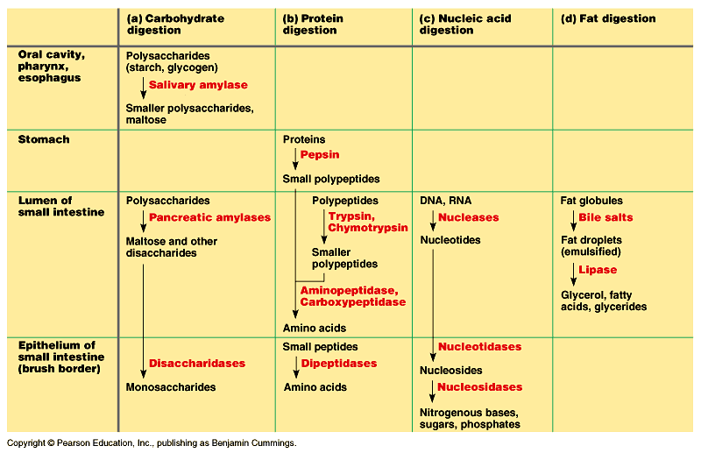
Figure 41.17 Enzymatic digestion in the human digestive system

Slide 81
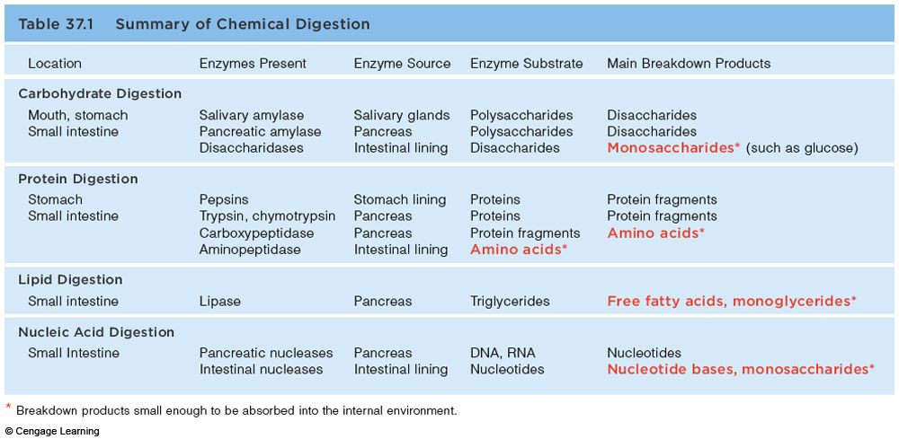
Chemical Digestion

Slide 82
Figure 14.11

Slide 83
Control of Digestive Activity
Mostly controlled by reflexes via the parasympathetic division
Chemical and mechanical receptors are located in organ walls that trigger reflexes

Slide 84
Control of Digestive Activity
Stimuli include:
Stretch of the organ
pH of the contents
Presence of breakdown products
Reflexes include:
Activation or inhibition of glandular secretions
Smooth muscle activity

Slide 85
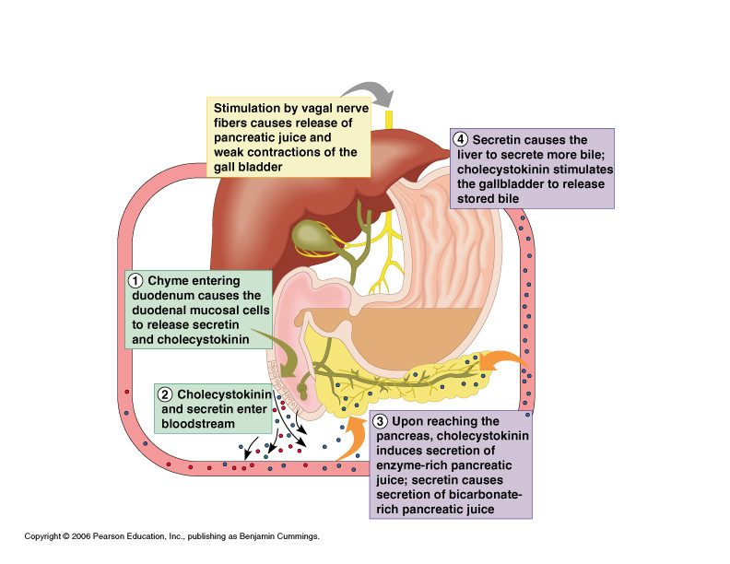
Stimulation of the Release of Pancreatic Juice
Vagus nerve
Local hormones
Secretin
Cholecystokinin
Figure 14.16

Slide 86
Nutrition and Metabolism
You are what you eat. Literally.
We use our food for:
energy
to build our bodies
biochemical processes (metabolism)
We need a certain amount of nutrients to have proper metabolism

Slide 87
Nutrition and Metabolism
We need to balance energy intake with expenditure (activity)
So, you need to take in the amount of food calories equal to the amount of calories you use during the day.
But, those food calories must contain the proper amounts of nutrients.
Calories are the unit of energy measurement

Slide 88
Nutrition
Nutrient – substance used by the body for growth, maintenance, and repair
Categories of nutrients
Carbohydrates
Lipids
Proteins
Vitamins
Mineral
Water

Slide 89
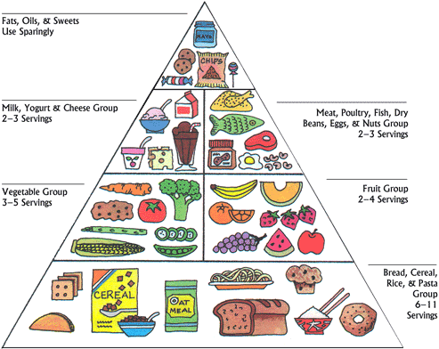
FDA Pyramid

Slide 90
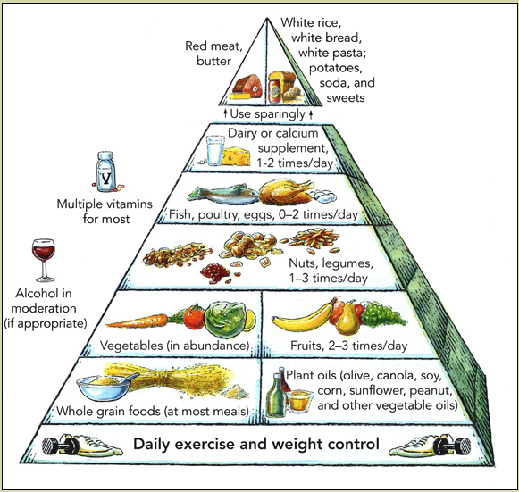
Harvard School of Public Health Pyramid

Slide 91
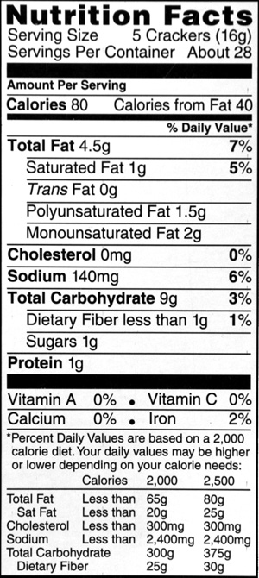
5 crackers = 1 serving
Low fat!
You could eat 30 servings to get your total calories
But would that be balanced?
How much fat?
How much protein?
How many carbs?
How much Vitamin A?

Slide 92
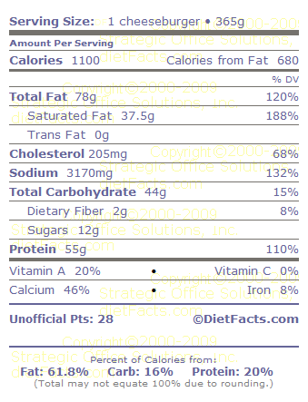
It’s just a 5 Guys cheeseburger
You could eat 2 servings to get your total calories
But would that be balanced?
How much fat?
How much protein?
How many carbs?
How much Vitamin A?
If you ate this, what else should you eat that day?
Fast food nutrition facts

Slide 93
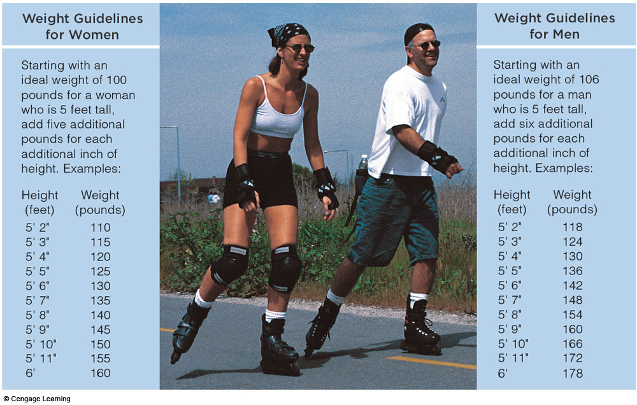
“Ideal” Adult Weights

Slide 94
Body Weight
To maintain body weight, energy (caloric) intake must balance with energy (caloric) output
Obesity increases the risk of health problems and shortens life expectancy
Body mass index (BMI) of 30 or more

Slide 95
Body mass index (BMI)
A measure of your size
Takes into account both height and weight
Flawed but better than just weight alone
BMI= weight (lbs) x 703/height (inches)²
BMI calculator

Slide 96
BMI values
Below 18.5 Underweight
18.5-24.9 Normal
25-29.9 Overweight
30 and above Obese

Slide 97
BMR
Basal Metabolic Rate
The amount of calories you use per day just to survive
Breath
Maintain body temp
Minimal biochemical reactions
BMR Calculator

Slide 98
Body Energy Balance
Energy intake = total energy output (heat + work + energy storage)
Energy intake is liberated during food oxidation (cell respiration)
Energy output
Heat is usually about 60% (BMR)
Work is about 40%
Excess energy is stored in the form of fat or glycogen

Slide 99
How many calories do you need?
Caloric need (energy intake) should equal your metabolic demands during the day
Harris Benedict Formula:
Caloric need=BMR x activity factor
If you are sedentary (little or no exercise) : BMR x 1.2
If you are lightly active (light exercise/sports 1-3 days/week) : BMR x 1.375

Slide 100
How many calories do you need?
If you are moderately active (moderate exercise/sports 3-5 days/week) : BMR x 1.55
If you are very active (hard exercise/sports 6-7 days a week) : BMR x 1.725
If you are extra active (very hard exercise/sports & physical job or 2x training) : BMR x 1.9
Calorie Calculator

Slide 101
Why the freshman 15?
Your metabolic (caloric) intake lessons after you stop growing and as you age)
In college you may continue eating as you did in HS
Or more
Or less balanced
And consume high calorie beverages

Slide 102
You are what you eat!
BMI calculator http://www.nhlbisupport.com/bmi/
BMR Calculator http://www.bmi-calculator.net/bmr-calculator/
Calorie Calculator http://www.freedieting.com/tools/calorie_calculator.htm
Fast food nutrition facts http://www.dietfacts.com/fastfood.asp

Slide 103
Dietary Sources of Major Nutrients
Carbohydrates
Most are derived from plants
Exceptions: lactose from milk and small amounts of glycogens from meats
Lipids
Saturated fats from animal products
Unsaturated fats from nuts, seeds, and vegetable oils
Cholesterol from egg yolk, meats, and milk products

Slide 104
Dietary Sources of Major Nutrients
Proteins
Complete proteins – contain all essential amino acids
Most are from animal products
Legumes and beans also have proteins, but are incomplete
Vitamins
Most vitamins are used as cofactors and act with enzymes
Found in all major food groups

Slide 105
Dietary Sources of Major Nutrients
Minerals
Play many roles in the body
Most mineral-rich foods are vegetables, legumes, milk, and some meats

Slide 106
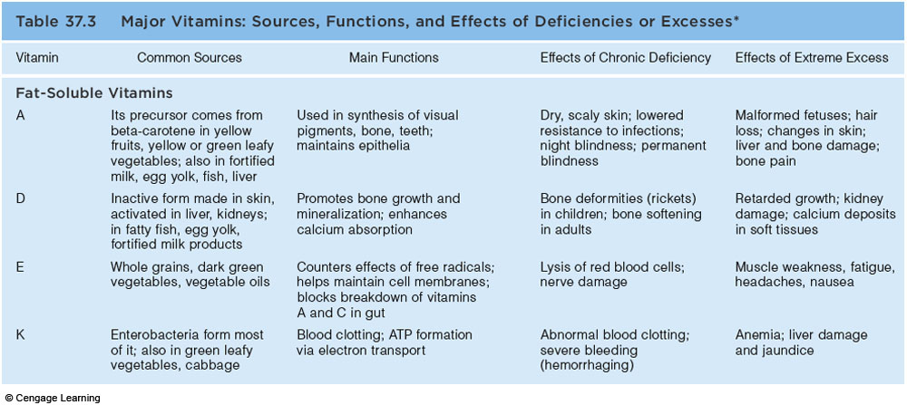
Major Vitamins

Slide 107
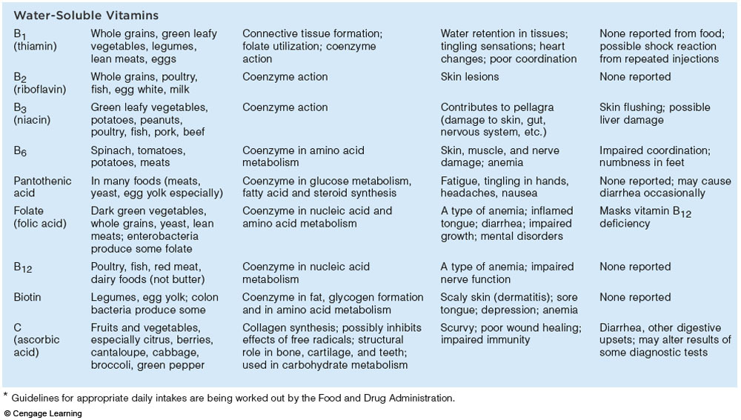
Major Vitamins

Slide 108
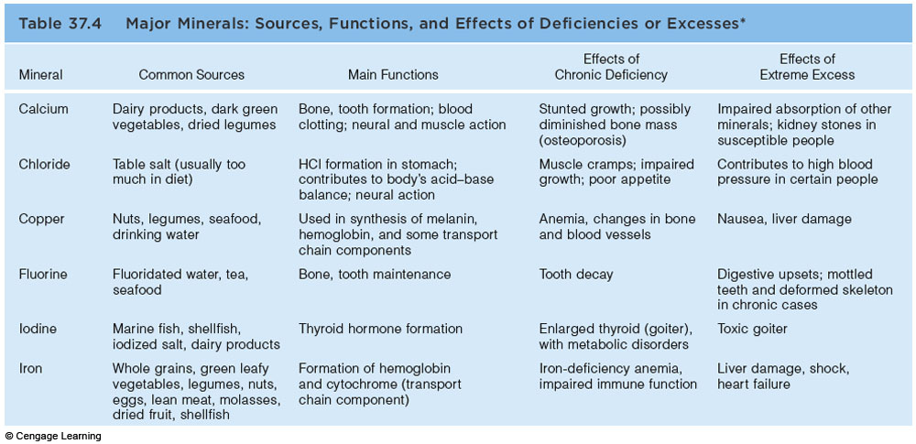
Major Minerals

Slide 109
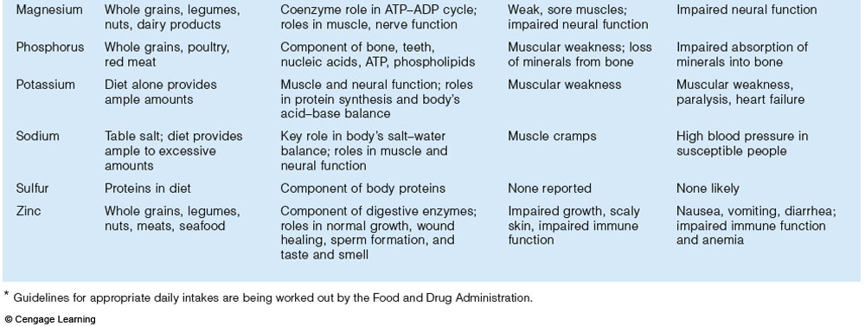
Major Minerals

Slide 110
Metabolism
Chemical reactions necessary to maintain life
Catabolism – substances are broken down to simpler substances
Anabolism – larger molecules are built from smaller ones
Energy is released during catabolism

Slide 111
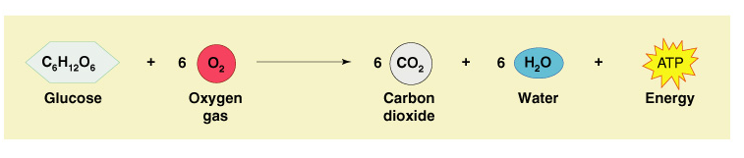
Carbohydrate Metabolism
The body’s preferred source to produce cellular energy (ATP)
Glucose (blood sugar) is the major breakdown product and fuel to make ATP
Figure 14.17

Slide 112
Cellular Respiration
Oxygen-using events take place within the cell to create ATP from ADP
Carbon leaves cells as carbon dioxide (CO₂)
Hydrogen atoms are combined with oxygen to form water
Energy produced by these reactions adds a phosphorus to ADP to produce ATP
ATP can be broken down to release energy for cellular use

Slide 113
Metabolic Pathways Involved in Cellular Respiration
Glycolysis – energizes a glucose molecule so that it can be split into two pyruvic acid molecules and yield ATP

Slide 114
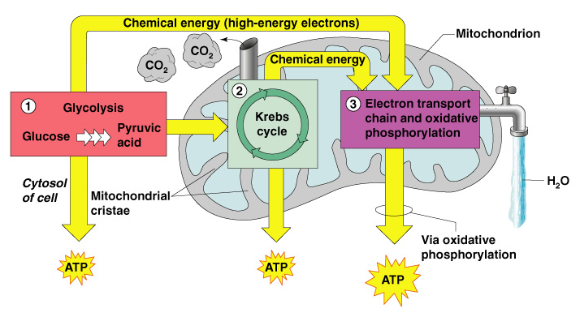
Metabolic Pathways Involved in Cellular Respiration
Figure 14.18

Slide 115
Metabolic Pathways Involved in Cellular Respiration
Krebs cycle
Produces virtually all the carbon dioxide and water resulting from cell respiration
Yields a small amount of ATP

Slide 116
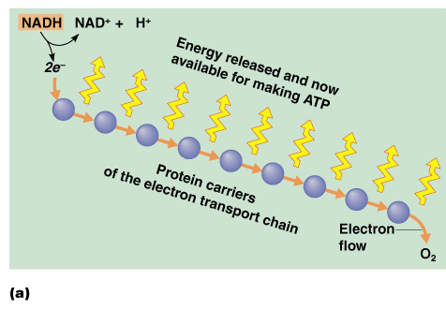
Metabolic Pathways Involved in Cellular Respiration
Electron transport chain
Hydrogen atoms removed during glycolysis and the Krebs cycle are delivered to protein carriers
Figure 14.19a

Slide 117
Metabolic Pathways Involved in Cellular Respiration
Electron transport chain (continued)
Hydrogen is split into hydrogen ions and electrons in the mitochondria
Figure 14.19a

Slide 118
Fat Metabolism
Handled mostly by the liver
Use some fats to make ATP
Synthesize lipoproteins, thromboplastin, and cholesterol
Release breakdown products to the blood
Body cells remove fat and cholesterol to build membranes and steroid hormones

Slide 119
Use of Fats for ATP Synthesis
Fats must first be broken down to acetic acid
Within mitochondria, acetic acid is completely oxidized to produce water, carbon dioxide, and ATP

Slide 120
Protein Metabolism
Proteins are conserved by body cells because they are used for most cellular structures
Ingested proteins are broken down to amino acids

Slide 121
Role of the Liver in Metabolism
Several roles in digestion
Detoxifies drugs and alcohol
Degrades hormones
Produce cholesterol, blood proteins (albumin and clotting proteins)
Plays a central role in metabolism

Slide 122
Metabolic Functions of the Liver
Glycogenesis
Glucose molecules are converted to glycogen
Glycogen molecules are stored in the liver
Glycogenolysis
Glucose is released from the liver after conversion from glycogen
Gluconeogenesis
Glucose is produced from fats and proteins

Slide 123
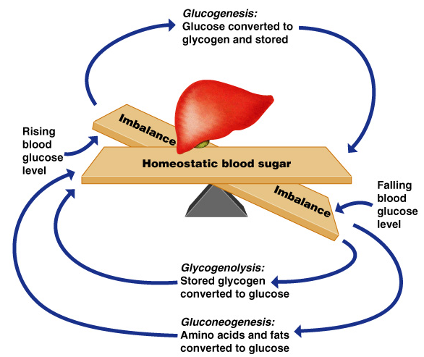
Metabolic Functions of the Liver
Figure 14.21

Slide 124
Metabolic Functions of the Liver
Fats and fatty acids are picked up by the liver
Some are oxidized to provide energy for liver cells
The rest are broken down into simpler compounds and released into the blood

Slide 125
Cholesterol Metabolism
Functions of cholesterol
Serves as a structural basis of steroid hormones and vitamin D
Is a major building block of plasma membranes
Most cholesterol is produced in the liver and is not from diet

Slide 126
Cholesterol Transport
Cholesterol and fatty acids cannot freely circulate in the bloodstream
They are transported by lipoproteins (lipid-protein complexes)
Low-density lipoproteins (LDLs) transport to body cells
High-density lilpoproteins (HDLs) transport from body cells to the liver

Slide 127
Regulation of Food Intake
Body weight is usually relatively stable
Energy intake and output remain about equal
Mechanisms that may regulate food intake
Levels of nutrients in the blood
Hormones
Body temperature
Psychological factors

Slide 128
Metabolic Rate and Body Heat Production
Basic metabolic rate (BMR) – amount of heat produced by the body per unit of time at rest
Factors that influence BMR
Surface area – small body usually has higher BMR
Gender – males tend to have higher BMR

Slide 129
Metabolic Rate and Body Heat Production
Factors that influence BMR (continued)
Age – children and adolescents have a higher BMR
The amount of thyroxine produced is the most important control factor
More thyroxine means higher metabolic rate

Slide 130
Total Metabolic Rate (TMR)
Total amount of kilocalories the body must consume to fuel ongoing activities
TMR increases with an increase in body activity
TMR must equal calories consumed to maintain homeostasis and maintain a constant weight

Slide 131
Body Temperature Regulation
Most energy is released as foods are oxidized
Most energy escapes as heat

Slide 132
Body Temperature Regulation
The body has a narrow range of homeostatic temperature
Must remain between 35.6° to 37.8°C (96° to 100° F)
The body’s thermostat is in the hypothalamus
Initiates heat-loss or heat-promoting mechanisms

Slide 133
Heat Promoting Mechanisms
Vasoconstriction of blood vessels
Blood is rerouted to deeper, more vital body organs
Shivering – contraction of muscles produces heat

Slide 134
Heat Loss Mechanisms
Heat loss from the skin via radiation and evaporation
Skin blood vessels and capillaries are flushed with warm blood
Evaporation of perspiration cools the skin

Slide 135
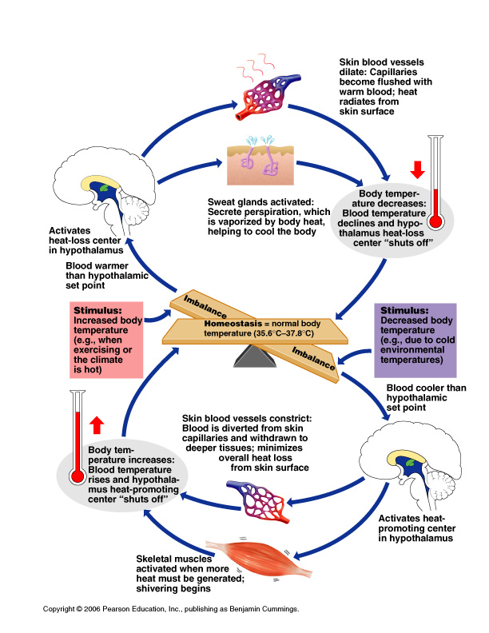
Body Temperature Regulation
Figure 14.22

Slide 136
Protein Metabolism
Cells remove amino acids to build proteins
Synthesized proteins are actively transported across cell membranes
Amino acids are used to make ATP only when proteins are overabundant or there is a shortage of other sources

Slide 137
Production of ATP from Protein
Amine groups are removed from proteins as ammonia
The rest of the protein molecule enters the Krebs cycle in mitochondria
The liver converts harmful ammonia to urea which can be eliminated in urine

Slide 138
Developmental Aspects of the Digestive System
The alimentary canal is a continuous tube by the fifth week of development
Digestive glands bud from the mucosa of the alimentary tube
The developing fetus receives all nutrients through the placenta
In newborns, feeding must be frequent, peristalsis is inefficient, and vomiting is common

Slide 139
Developmental Aspects of the Digestive System
Teething begins around age six months
Metabolism decreases with old age
Middle age digestive problems
Ulcers
Gall bladder problems

Slide 140
Developmental Aspects of the Digestive System
Activity of digestive tract in old age
Fewer digestive juices
Peristalsis slows
Diverticulosis and cancer are more common

Slide 141
Alimentary Canal Nerve Plexuses
All are part of the autonomic nervous system
Three separate networks of nerve fibers
Submucosal nerve plexus
Myenteric nerve plexus
Subserous plexus

Slide 142
Stomach Anatomy
Layers of peritoneum attached to the stomach
Lesser omentum – attaches the liver to the lesser curvature
Greater omentum – attaches the greater curvature to the posterior body wall
Contains fat to insulate, cushion, and protect abdominal organs

Slide 143
Modifications to the Muscularis Externa in the Large Intestine
Smooth muscle is reduced to three bands (teniae coli)
Muscle bands have some degree of tone
Walls are formed into pocketlike sacs called haustra

