Slide 1
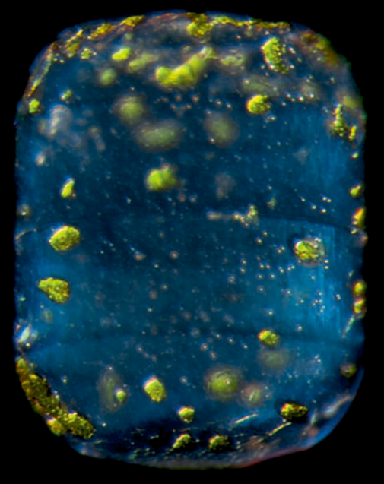
Biomineralization in Diatoms:
Haeckel’s Legacy Meets APEX2
Jernej Turnšek, Silver Lab
Synthetic Biology Platform Meeting
In: Plankton: Wonders of The Drifting World by Christian Sardet
Mar 01, 2016

Slide 2
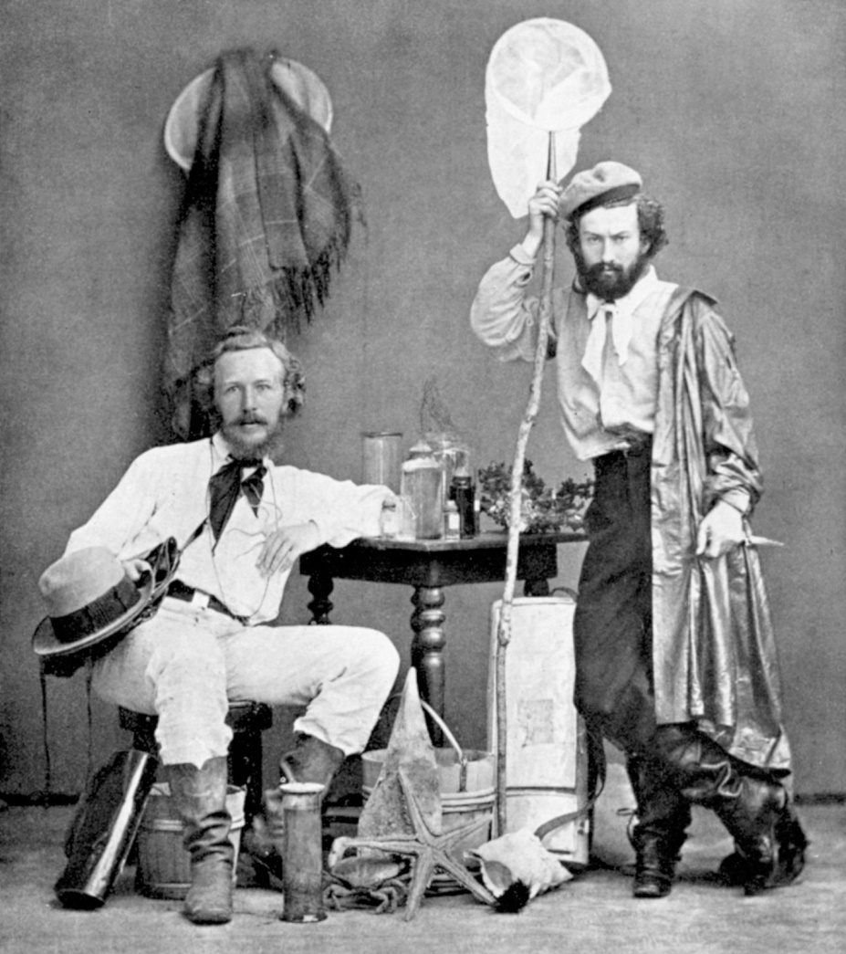
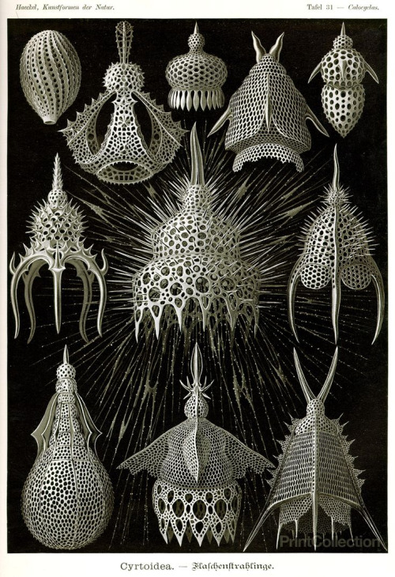
Back in time to Ernst Haeckel
On Canary Islands with his assistant Nicholas
Miklouho-Macklay in 1867.
Kunstformen der Natur (1904).
Source
Source

Slide 3
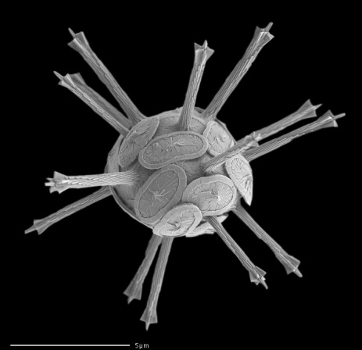
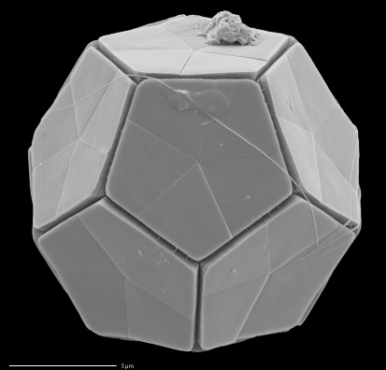
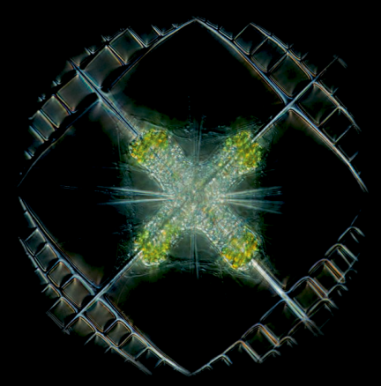

Chemical and morphological diversity of planktonic skeletons
Rhabdosphaera clavigera (CaCO₃)
Braarudosphaera bigelowii (CaCO₃)
Source
Source
Acantherian Lithoptera fenestrata (SrSO₄)
Diatom Lauderia annulata (SiO₂)
In: Plankton: Wonders of …
In: Plankton: Wonders of …

Slide 4
Why planktonic skeletons?
Paleobiology and environmental change.
  “Improved knowledge of the cellular mechanisms of biomineralization will allow us to understand the impact of past climatic events on the major phytoplankton lineages and better predict their response to future environmental change.”
Synthetic biology and nanotechnology.
  Designer (nano)materials via genetic engineering of skeletonized unicellular planktonic species.
  Biomimetic synthesis of (nano)materials using (more) common model organisms.
Durak, G. M. et al. A role for diatom-like silicon transporters in calcifying coccolithophores. Nature Communications 7, 10543 (2016).

Slide 5
Parts list?

Slide 6
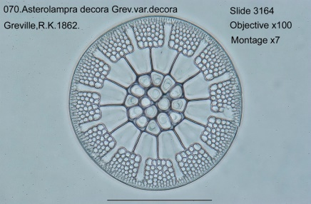
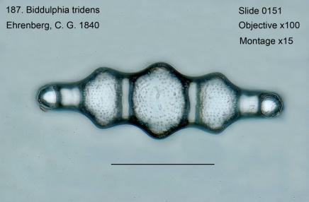
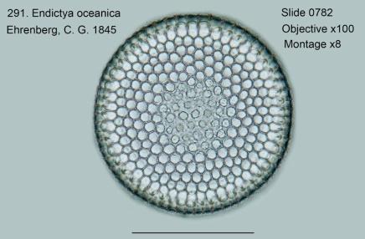
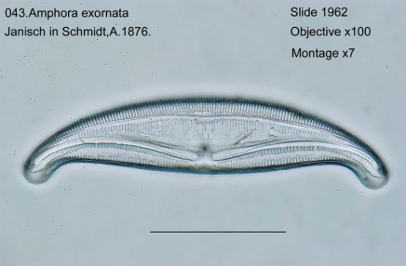
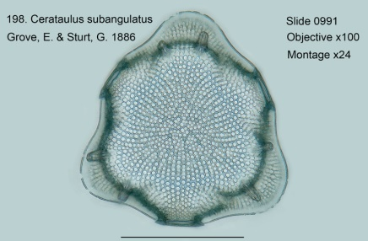
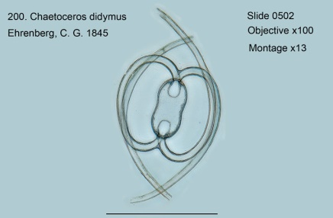
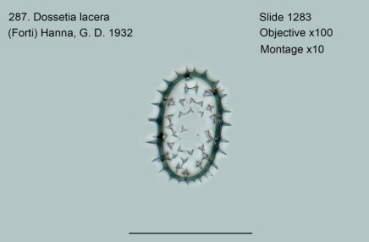
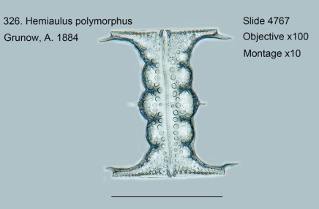
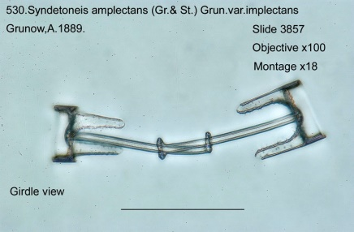
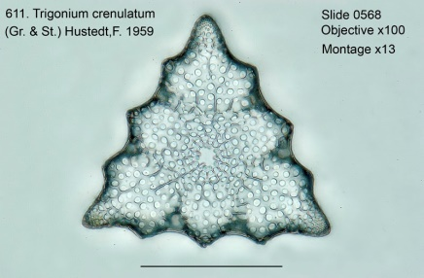
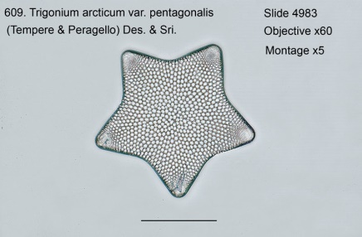
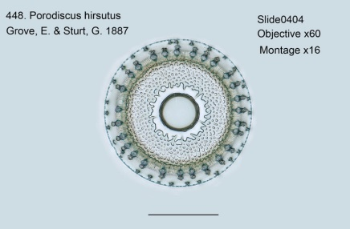
Diatoms: Nature’s Nanotechnologists
Scale bar: 45 µm.
Source.

Slide 7
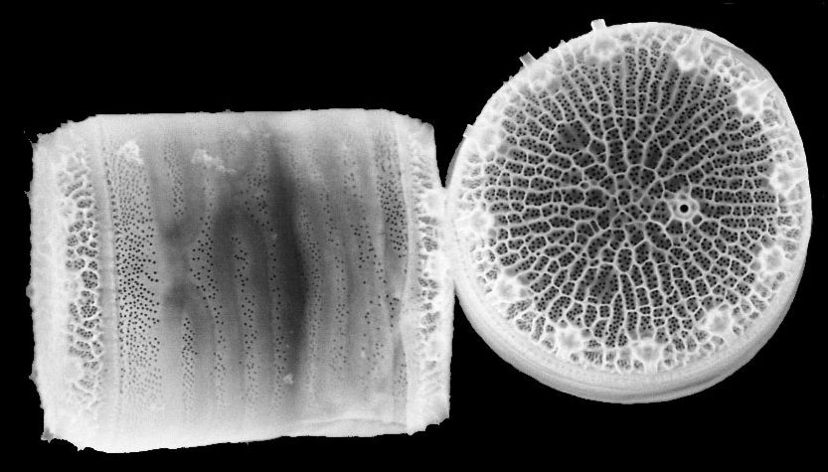
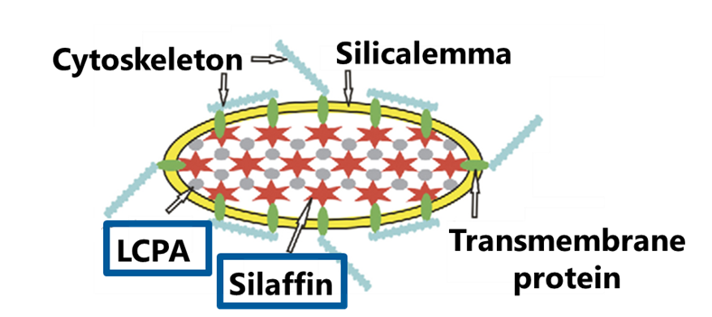



Thalassiosira pseudonana (Tp)
First sequenced marine phytoplankton
(Armbrust et al., Science, 2004).
Model organism for biomineralization studies.
Nils Kröger, B-CUBE, TU Dresden
1. Kröger, N. Prescribing diatom morphology: toward genetic engineering of biological nanomaterials. Current Opinion in Chemical Biology 11, 662–9 (2007).
2. Kröger, N. & Poulsen, N. Diatoms-From Cell Wall Biogenesis to Nanotechnology. Annual Review of Genetics 42, 83–107 (2008).

Slide 8
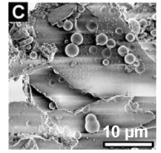
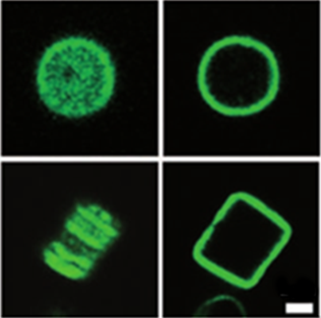
Silaffin TpSil3
Cell wall associated protein from T. pseudonana
that directs silica morphogenesis in vitro.
Surface
Center
A
B
Top
Side
2 µm
TpSil3-LCPA mixture.
TpSil3-GFP fusion.
1. Poulsen, N. & Kröger, N. Silica Morphogenesis by Alternative Processing of Silaffins in the Diatom Thalassiosira pseudonana. The Journal of Biological Chemistry 279, 42993–9 (2004).
2. Poulsen, N. et al. Silica Immobilization of an Enzyme through Genetic Engineering of the Diatom Thalassiosira pseudonana. Angewandte Chemie 46, 1843–6 (2007).

Slide 9
Use silaffin TpSil3 to pull down and identify interacting proteins.

Slide 10
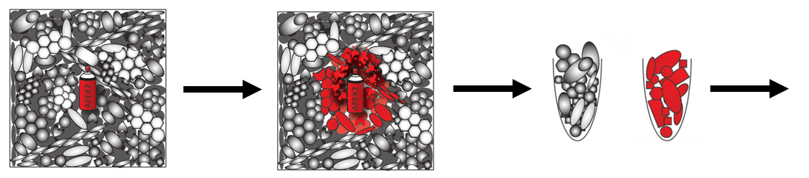
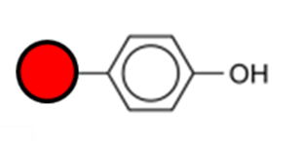
Proximity labeling with APEX2
Engineered soybean ascorbate peroxidase.
Enables identification of unknown proteins via proximity labeling from a protein of interest.
Label
w/ biotin
Harvest
Identify
Unlabeled
Labeled
1. S. Lam et al., Directed evolution of APEX2 for electron microscopy and proximity labeling. Nature Methods
12, 51–54 (2015).
2. Marx, V. Mapping proteins with spatial proteomics. Nature Methods 12, 815–819 (2015).

Slide 11


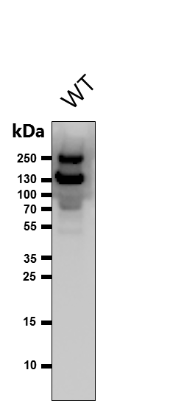
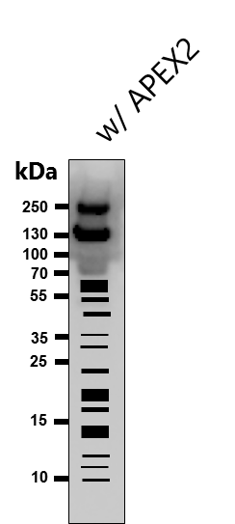
Proximity labeling fromTpSil3
HRP
streptavidin
endogenous biotinylated
protein
?

Slide 12
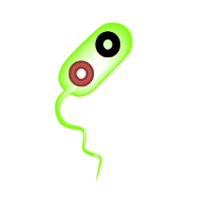
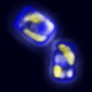

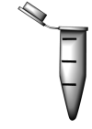
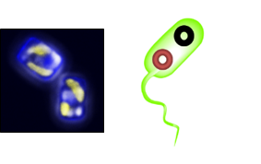
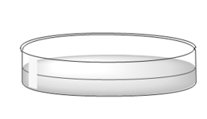
Plasmid delivery via bacterial conjugation
+
Escherichia coli (donor)
1. pTA-Mob: mobilization plasmid
2. pTpPuc3: Diatom Artificial Chromosome (DAC)
T. pseudonana (recipient)
½L1, 1.0% agar
50/100 µg/mL nourseothricin (Nou)
~18⁰ C | light | colonies after ~14 days
B. J. Karas et al., Designer diatom episomes delivered by bacterial conjugation. Nature Communications 6, 6925
(2015).

Slide 13
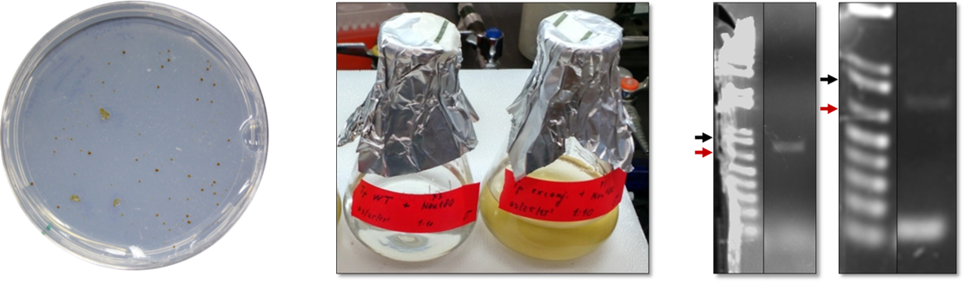
First to replicate the paper
Escherichia coli (donor)
pTA-Mob, pTpPuc3
Liquid culture
Purified DNA
WT
Engineered
A
B
C
0.85 kb
0.65 kb
0.85 kb
0.65 kb

Slide 14

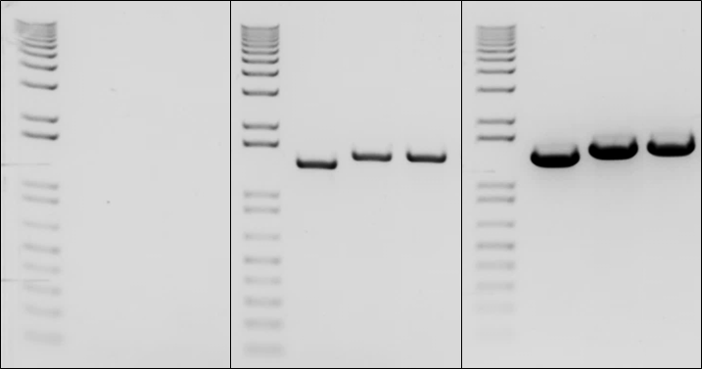
Making TpSil3p-APEX2-FLAG
T. pseudonana strain
A
NouR
TpSil3p
Link
APEX2
FLAG
B
Escherichia coli (donor)
pTA-Mob, pTpPuc3
w/ TpSil3p-APEX2-FLAG
WT
APEX2
Donor
1.65 kb
1.00 kb

Slide 15
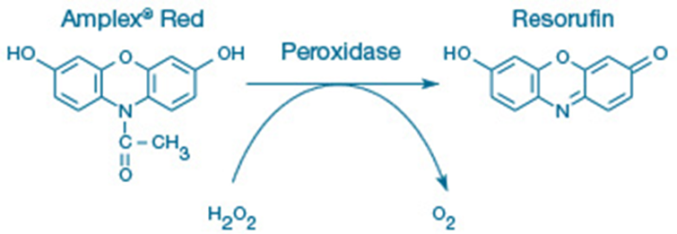
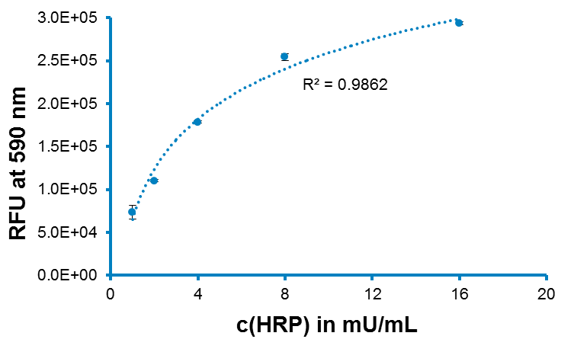
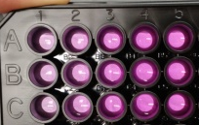
Expression and activity assays in progress
Anti-FLAG Western blot.
Amplex UltraRed assay.
Streptavidin blot after biotin-phenol addition.
Horseradish peroxidase
Ex/Em: 492/590

Slide 16


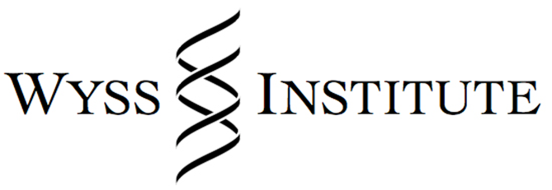


Thank you
Pamela Silver
James Russell (PhD Candidate in Julie Theriot’s Lab at Stanford)
Authors of the conjugation paper (Bogumil Karas, Rachel Diner, Jeff McQuaid, John I. Glass, Andrew E. Allen, Philip Weyman)

Slide 17
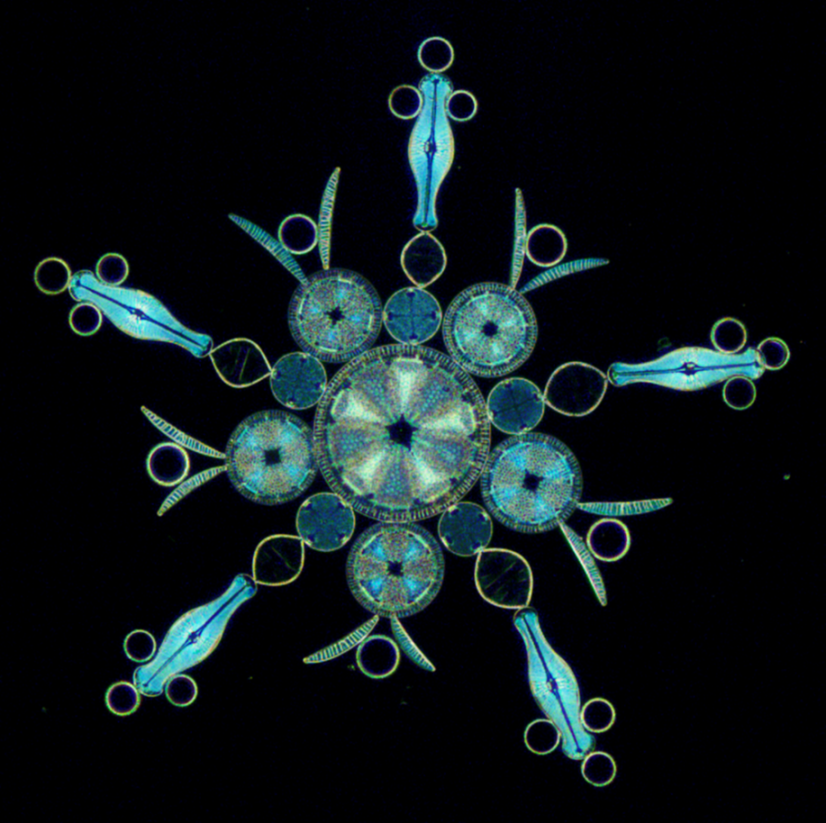
Questions?
MSI microscopy workshop, Jan 2016 (diatoms mounted by Klaus Kemp).

Slide 18
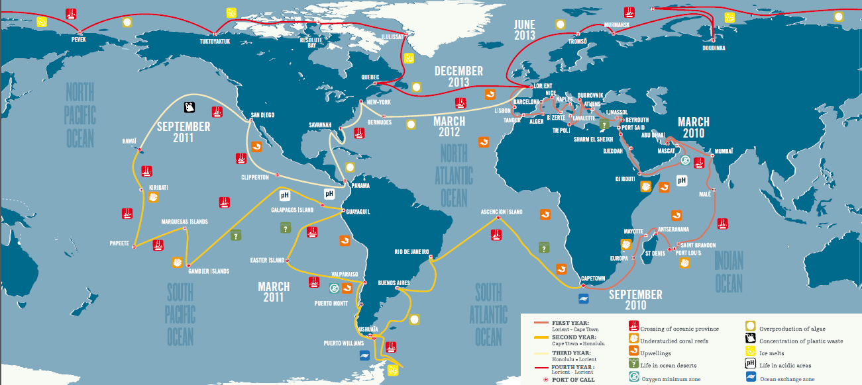
Tara Oceans
~3 years, 140,000 km, 40 nations, 210 stations, 35,000 samples of plankton and water

Slide 19
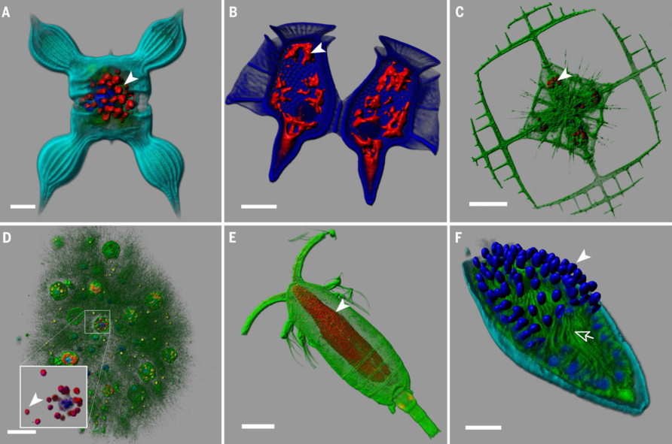
Planktonic zoo in the world’s oceans
phototrophic diatom
Chaetoceros bulbosus
heterotrophic dinoflagellate
Dinophysis caudata
acantharian Lithoptera sp.
w/ endosymbionts
network of interconnected
Collodaria sp. cells
cepopod with the parasitic
dinoflagellate Blastodinium
dinoflagellate cell infected
by the alveolate Amoebophrya
Vargas, C. De et al. Eukaryotic plankton diversity in the sunlit ocean. Science 348, 1–12 (2015).

Slide 20
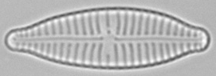
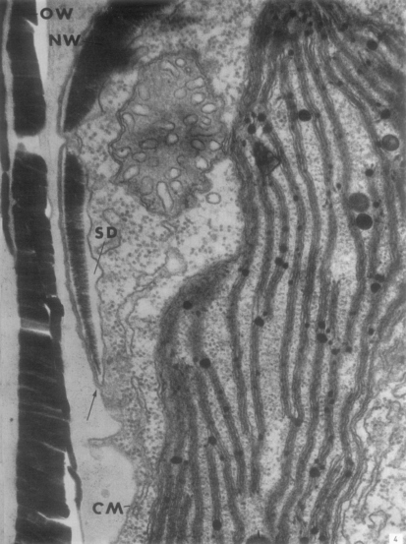
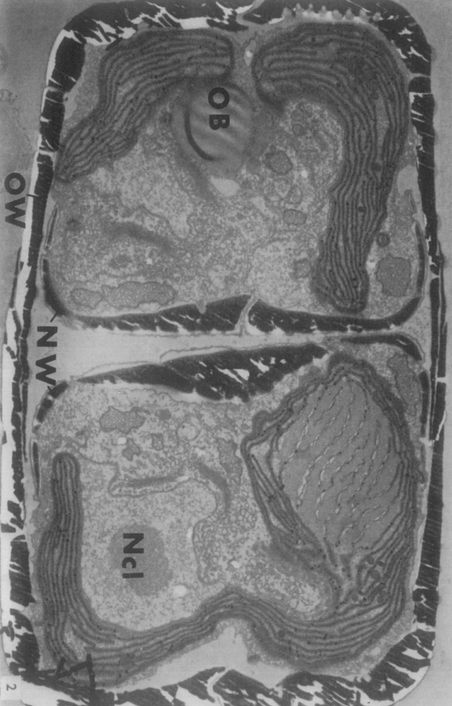
Silica Deposition Vesicle (SDV)
Gomphonerna parvalum Kützing
OB: amorphous oil body
OW: parent cell wall
Ncl: nucleolus
NW: new cell wall
SD: silica deposition vesicle
CM: cell membrane
Drum, R. W. & Stuart, H. Post Mitotic Fine Structure of Gomphonerna parvulum Journal of Ultrastructure Research 10, 217–223 (1964).

Slide 21
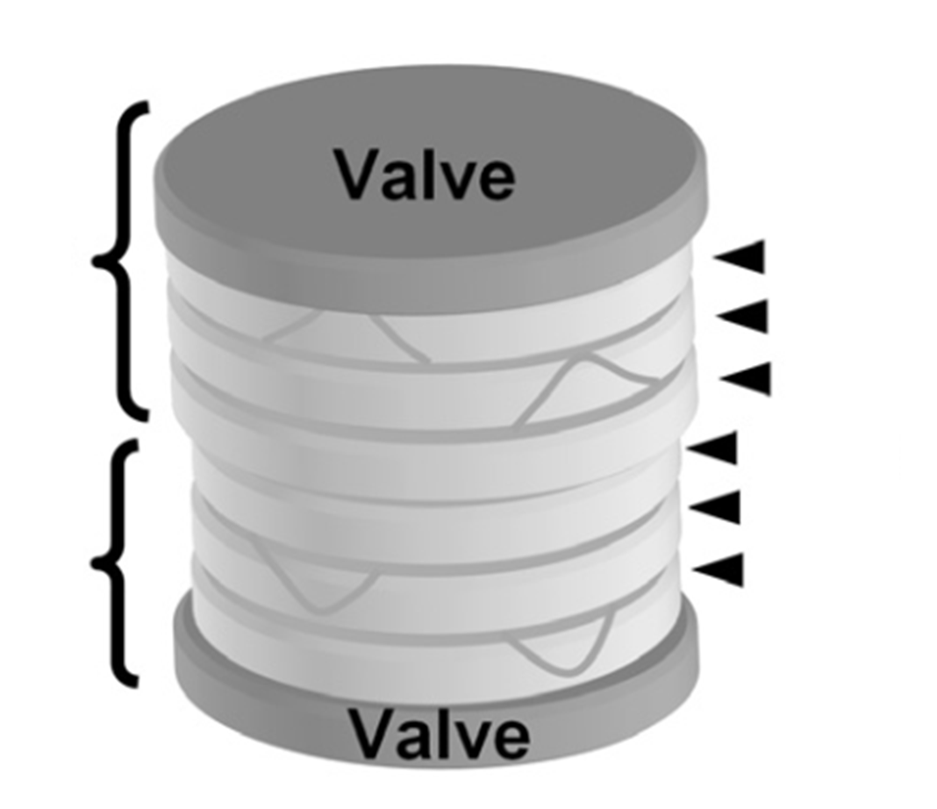
Epitheca
Girdle bands
Hypotheca
Hildebrand, M. & Lerch, S. J. L. Diatom silica biomineralization: Parallel development of approaches and understanding. Seminars in Cell & Developmental Biology 46, 27–35 (2015).

Slide 22
Missing parts inferred from the literature
Silaffin-modifying enzymes (e.g. glycosyltransferases).
Pentalysine cluster-specific receptor(s).
Other proteins involved in directing silica morphogenesis.
Si(OH)₄-interacting/capture proteins.
Chitin-associated (scaffold) proteins.
SDV-associated proteins involved in vesicle transport and/or interactions with cytoskeleton.
Diatom lysil oxidase(s).
Diatom antizyme.

Slide 23
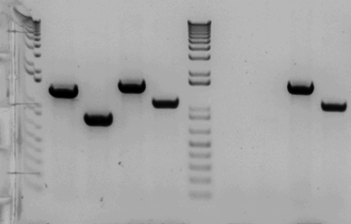
Making TpSil3p-APEX2-FLAG donor
A
NouR
TpSil3p
Link
APEX2
FLAG
pTpPuc3
pTA-Mob
B
1.65 kb
Escherichia coli (donor)
pTA-Mob, pTpPuc3 w/ TpSil3p-APEX2-FLAG
1.00 kb

Slide 24
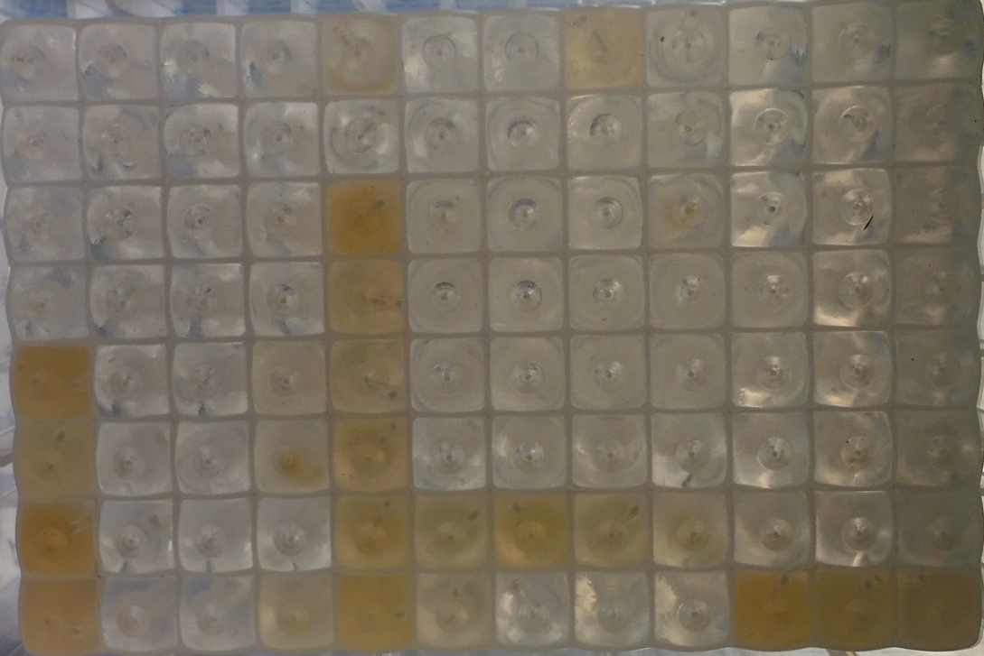
~20% of exconjugants are real
WT
TpSil3p-APEX2-FLAG candidate exconjugantes
½ L1, 1.0% agar, Nou50
1 mL L1, Nou50
1. Pour plating (Chris Dupont, JCVI).
2. Spread Nou50 on plates without antibiotic.

