Slide 1

Programmed population control by cell-cell communication and regulated killing
Zhang Junqiu
Paper presentation
Nature 2004, 428:868-871

Slide 2
Introduction
We want to build a quorum-sensing system which can control cell density at a constant amount autonomously.
Mechanism similar to natural circuit (Streptococcus pneumoniae肺炎链球菌)

Slide 3
How to create such a cell?
Gene that can produce toxic protein
The gene that can produce something that can be a signal
The signaling molecule can be sensed by other cells
Then the killer gene can be activated by the signaling molecule
Reality can be very difficult!

Slide 4
Explanation of some words
AHL: acyl-homoserine lactone（酰基高丝氨酸内酯）;
LuxI, LuxR, LacZα, ccdB: protein;
pluxI , plac/ara-1: promoters;
pLuxRI2, pluxCcdB3: plasmids;
LacZα-ccdB: killer gene;

Slide 5
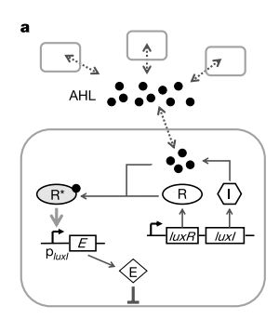
The circuit
LuxI→ AHL (accumulate)→ LuxR→ E
I: LuxI
R: LuxR
R*: active LuxR
E: killer gene
pluxI: promoter

Slide 6
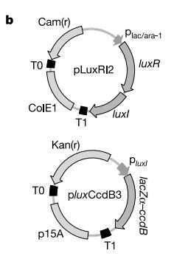
Implement the circuit
Two-plasmid system
Isopropyl-β-D-thiogalactopyranoside (IPTG)→ pLuxRI2; activated LuxR→ pluxCcdB3
T0, T1: transcription terminators

Slide 7
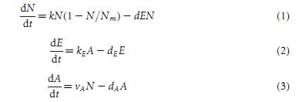
Mathematical modelling
Cell density: N; carrying capacity: Nm; concentration of killer protein: E; concentration of AHL: A;
Growth constant: k; killing constant: d; (production rate of E/A): kE; (AHL production rate/N): vA; degradation of AHL& killer protein: dA& dE.

Slide 8
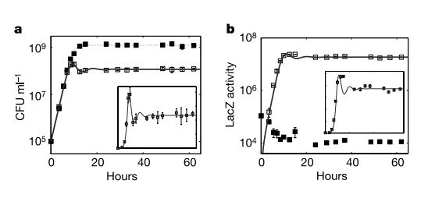
Experiment result

Slide 9
Q & A

Slide 10
Thank you !

