Slide 1
Improved Reconstruction of In Silico Gene Regulatory Networks by Integrating Knockout and Perturbation Data
Yip, K. Y., Alexander, R. P., Yan, K. K., & Gerstein, M. (2010). I PloS one, 5(1), e8121.
Grace Johnson, Tessa Morris, and Trixie Roque
Loyola Marymount University
June 10, 2015
Notes:
TR

Slide 2
Integration of Models from Deletion and Perturbation Data Resulted in Successfully Modeling GRNs
Won the DREAM3 Challenge, a competition for reverse engineering GRNs, by combining a Noise Model from deletion data and Differential Equation Model from perturbation data
Created their integrated model from their two types of data and made their prediction in seven batches
Summary: It is beneficial to use multiple data sources
Implications: It would be advantageous to look at a noise model in our work
Notes:
TR

Slide 3
Integration of Models from Deletion and Perturbation Data Resulted in Successfully Modeling GRNs
Won the DREAM3 Challenge, a competition for reverse engineering GRNs, by combining a Noise Model from deletion data and Differential Equation Model from perturbation data
Created their integrated model from their two types of data and made their prediction in seven batches
Summary: It is beneficial to use multiple data sources
Implications: It would be advantageous to look at a noise model in our work
Notes:
TR

Slide 4
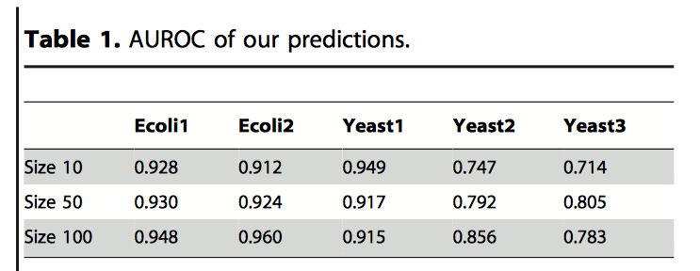
Constructed GRNs for Fifteen Known Regulatory Networks
Computationally reconstructed GRNs using provided data from Yeast and E. Coli
  Each node represents a TF (gene and protein)
  Edges show regulatory relationships between nodes
Attempted to model 15 known regulatory networks
Notes:
TR

Slide 5
Found Simple Regulatory Relationships from Deletion Data and More Complex Ones from Perturbation Data
Deletion data may not be sufficient for decoding complicated regulation (gene is expressed as long as one of the TFs is active)
Traditional time course data can be used to detect missing edges (low abundance and impaired expression rate)
Learned simple regulatory relationships from deletion data by noise models
  Homozygous vs. Heterozygous deletion data
Learned more complex regulatory relationships from perturbation data by differential equation models
Integrate the two models to predict the GRNs
Notes:
TM

Slide 6
Noise Model Determines if the Deviation Between Expression Level in the Deletion Strain and WT is Due to Noise
Calculate the probability of regulation for each pair of genes based on the current reference points.
  Observed deviation must be less than 0.05 to be treated as a potential regulation
Using the set P to re-estimate the variance of the Gaussian noise
Re-estimate each gene’s wild-type expression level by the mean of its observed expression levels in strains in which its expression level is unaffected by the deletion
After the iterations the probability of regulation is computed by using the final estimate of the reference points and the variance of the Gaussian noise
Notes:
TM
The larger the change of expression of gene “a” from wild type to the deletion strain of gene “b”, the more unlikely that the deviation is due to the Gaussian noise only, and thus the larger chance that “a” is directly or indirectly regulated by “b”.

Slide 7
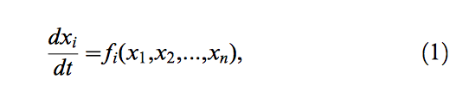
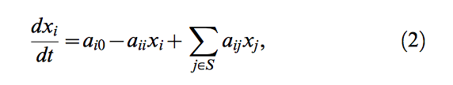
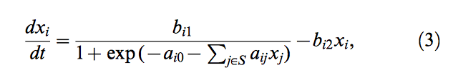

Two Differential Equations Were Used to Model Perturbation Data
General form
Linear model: assumes a linear relationship between the expression level of the regulators and the resulting expression rate of the target
  Advantage: small number of parameters (|S| +2)
  Disadvantage: Real biological regulatory systems seem to exhibit nonlinear characteristics
Sigmoidal Model: assumes a sigmoidal relationship between the regulators and the target (|S| +3) parameters
Least Square Optimizer: used to determine which regulator set (S) predicts the observed expression levels well
Notes:
GJ

Slide 8
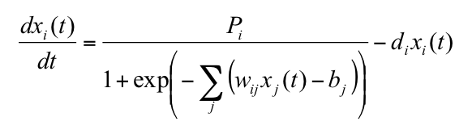
We Use a Similar Differential Equation to Model Gene Expression for Cold Shock
Our Sigmoidal model Their Sigmoidal model
Notes:
TM

Slide 9
Integration of Models from Deletion and Perturbation Data Resulted in Successfully Modeling GRNs
Won the DREAM3 Challenge, a competition for reverse engineering GRNs, by combining a Noise Model from deletion data and Differential Equation Model from perturbation data
Created their integrated model from their two types of data and made their prediction in seven batches
Summary: It is beneficial to use multiple data sources
Implications: It would be advantageous to look at a noise model in our work
Notes:
TR

Slide 10
Performance of the Integrated Model was Determined by Grouping Predictions in Batches
Batches were created to rank pairwise predictions according to confidence
  Batch 1: all predictions from noise model homozygous data with probability of regulation greater than 0.99
  Batch 2: significant predictions according to both differential equation models (linear and sigmoidal)
  Batch 3: significant predictions according to both differential equation models, where the regulator sets are guided by predictions made from the previous batches
  Batch 4: same as Batch 2, except predictions can be made by either linear OR sigmoidal
  Batch 5: same as Batch 3, except predictions can be made by either linear OR sigmoidal
  Batch 6: all predictions from both heterozygous and homozygous noise models with a probability of regulation greater that 0.95 and the same sign prediction
  Batch 7: all remaining predicted regulation pairs
Notes:
GJ

Slide 11
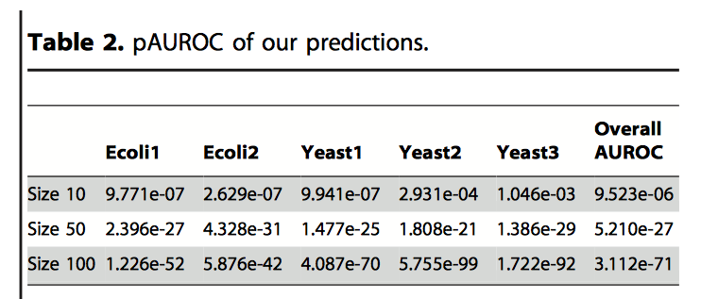
Pairwise Predictions were Significantly Better than Random, Regardless of Network Size
AUROC: area under the receiver-operator characteristics curve
pAUROC: the p-value of AUROC based on the distribution of AUROC values in 100,000 random network link permutations
Notes:
GJ

Slide 12
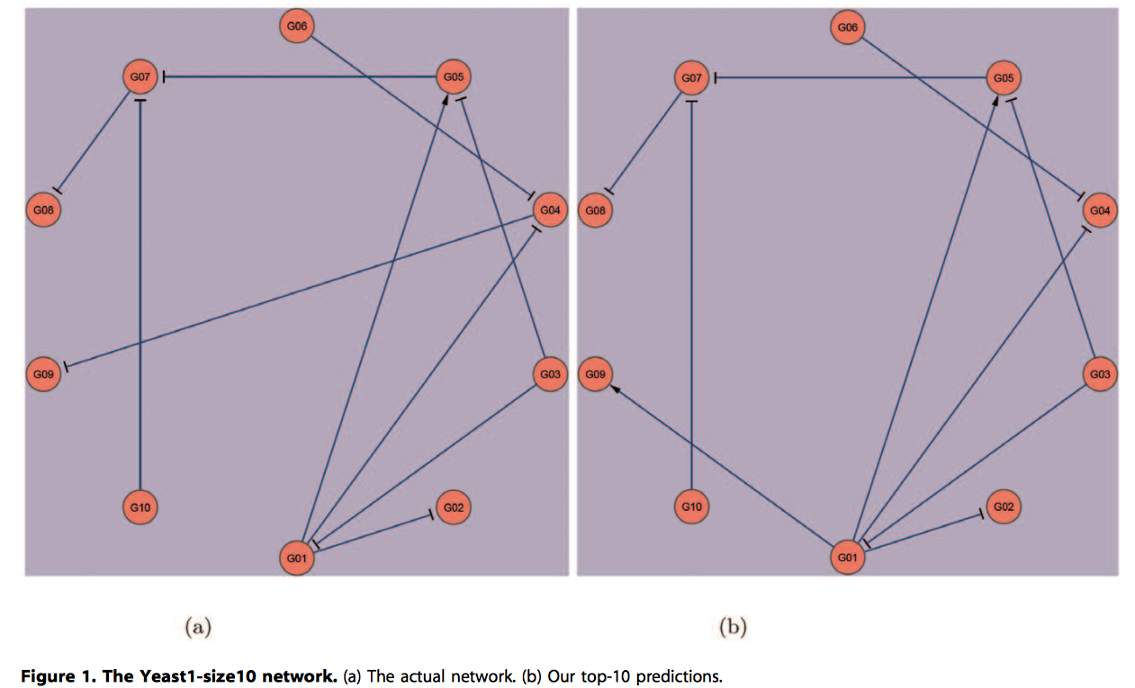
Their Model Cannot Distinguish Between Direct and Indirect Data
Actual network
Their top 10 predictions
Their model fails to distinguish between the direct and indirect regulation.
Their model: G01 activates G09 and represses G04
Actual network: G01 represses G04 which represses G09
Notes:
TM

Slide 13
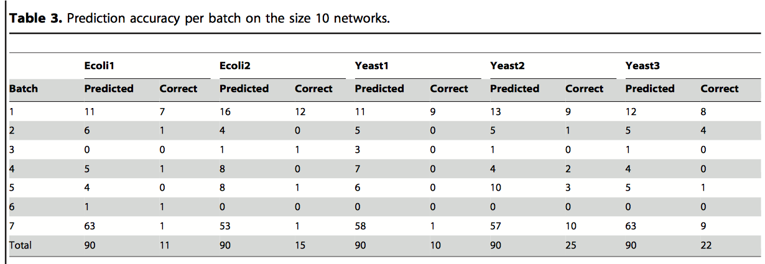
The Best Predictions are Made by Batch 1 from the Noise Model
For size 10 networks, overall predictions are 18% accurate.
Predictions made by Batch 1 are 71% accurate
Notes:
TR

Slide 14
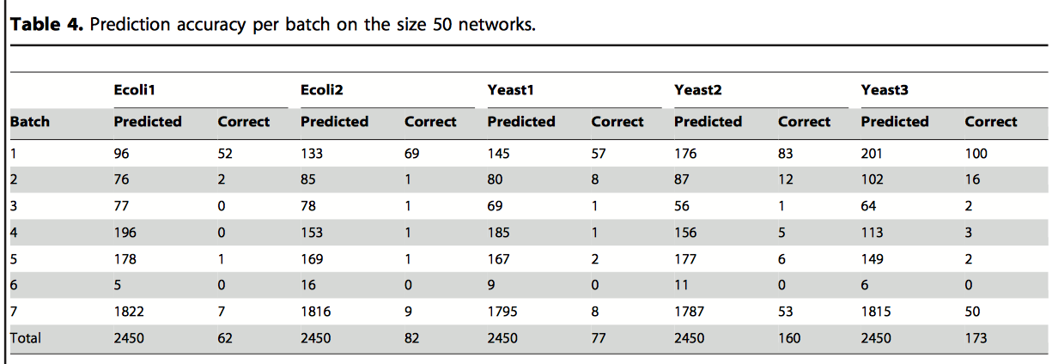
The Best Predictions are Made by Batch 1 from the Noise Model
For size 50 networks, overall predictions are 4.5% accurate
Predictions made by Batch 1 are 48% accurate
Notes:
TR

Slide 15
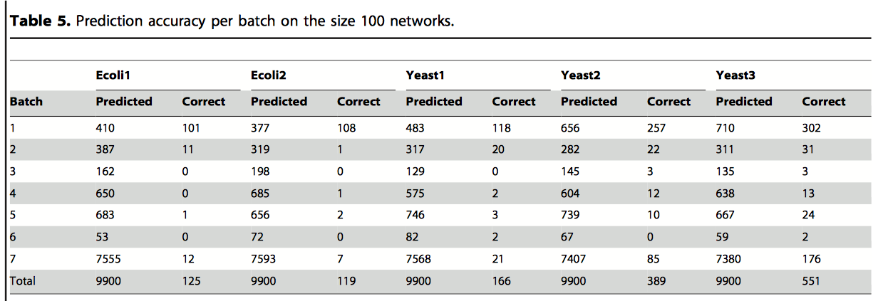
The Best Predictions are Made by Batch 1 from the Noise Model
For size 100 networks, overall predictions are 2.7% accurate
Predictions made by Batch 1 are 34% accurate
Notes:
TR

Slide 16
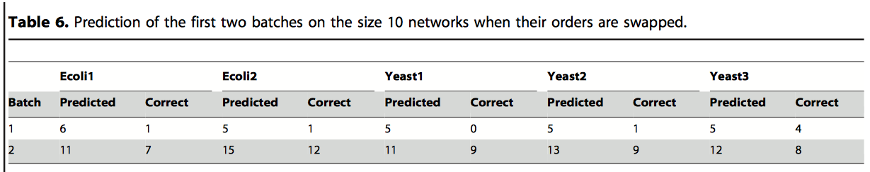
Switching the Order of Batches 1 and 2 Does Not Change the Number of Correct Predictions
In addition, it was found that most predictions previously made by the noise model were not predicted by the differential equation models. These are hypothesized as unique predictions due to indirect or more complex regulation events
Notes:
GJ

Slide 17
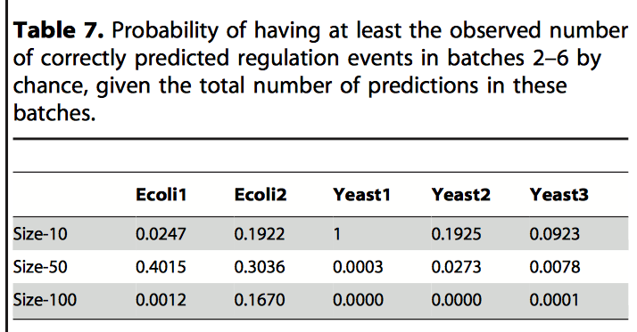
The Qualitative Importance of the Differential Equation Models is Shown by p-values of Batches 2-6
In half the cases, predictions made in batches 2-6 are significantly better than random at the 0.05 level.
Notes:
GJ

Slide 18
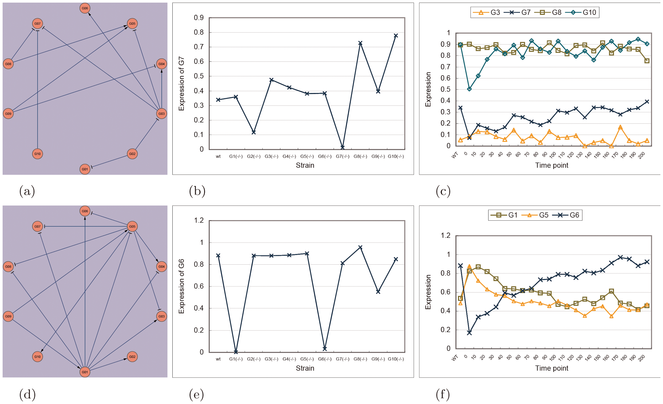
Predictions Made from the Two Models are Complementary
(b) Deleting G3 results a small increase in expression of G7 that is difficult to detect
(c) Expression of G7 increases even though expression of G8 and G10 remains high
(e) Deleting G5 has a negligible effect on G6 because this interaction is masked by G1
(f) Expression of G6 is anti-correlated with G1 (suppressor)
Notes:
GJ

Slide 19
Integration of Models from Deletion and Perturbation Data Resulted in Successfully Modeling GRNs
Won the DREAM3 Challenge, a competition for reverse engineering GRNs, by combining a Noise Model from deletion data and Differential Equation Model from perturbation data
Created their integrated model from their two types of data and made their prediction in seven batches
Summary: It is beneficial to use multiple data sources
Implications: It would be advantageous to look at a noise model in our work
Notes:
TR

Slide 20
Summary
Most correct predictions come from Batch 1 based on noise model
  A more accurate statement is that the noise model is supplemented by the differential equation model
  It does, to some extent, demonstrate the advantage of combining multiple types of data -- correct predictions made by the noise model were not made by the differential equation model, and vice versa, showing the two models are complementary
Benefit of noise model: takes much less computation power and time
Results demonstrate the advantages of combining multiple types of data
Notes:
TR

Slide 21
Integration of Models from Deletion and Perturbation Data Resulted in Successfully Modeling GRNs
Won the DREAM3 Challenge, a competition for reverse engineering GRNs, by combining a Noise Model from deletion data and Differential Equation Model from perturbation data
Created their integrated model from their two types of data and made their prediction in seven batches
Summary: It is beneficial to use multiple data sources
Implications: It would be advantageous to look at a noise model in our work
Notes:
TR

Slide 22
Though Their Approach is Slightly Different, We Could Benefit by Adopting Some of their Methods
Their differential equation was extremely similar to ours
Each regulatory relationship is considered independently of the other connections in the network
Perturbation and deletion data are analyzed separately with different models, then their predictions are combined
  In our work, we combine perturbation and deletion in our raw data, and analyze with one model
Where ours is a differential equation model, theirs is essentially a noise model supplemented by differential equation model
It could be beneficial to use their noise model the initial process of choosing which genes to go in our network
Notes:
TM

Slide 23
Acknowledgments
Dr. Dahlquist
Dr. Fitzpatrick
Dondi

