Slide 1
Global network analysis of drug tolerance, mode of action and virulence in methicillin-resistant S. aureus
Chloe Jones
Loyola Marymount University
BIOL368: Bioinformatics Laboratory
October 28, 2014

Slide 2
Outline
MRSA infections rising due to resistant strains
Antimicrobial peptides, a potential source to combat resistant bacteria
Understanding the mechanism of antimicrobials, transcriptome profiling
Novel virulence factors discovered
Analysis with microarrays, and functional network analysis
Therapeutic strategies against S. aureus

Slide 3
MRSA infections rising due to resistant strains
Methicillin Resistant Staphylococcus aureus (MRSA): human pathogen with strains resistant to existing treatments
Major global problem
  Prevention and treatment strategies are imperative

Slide 4
Antimicrobial peptides, a potential source to combat resistant bacteria
Antimicrobial peptides (AMPs) possible method of unique antibiotic
  Part of the innate immune response
Ranelexin (20a.a. peptide, isolated from bullfrog)
  Activity against Gram-positive bacteria (Especially S. Aureus), in vitro
  Therapeutic potential against MRSA

Slide 5
Understanding the mechanism of antimicrobials, transcriptome profiling
Examines the expression level of mRNAs in a given cell population
  DNA microarrays
mRNA generated in response to antimicrobial stress reflect the change in particular cell functions, provide marker for the type of stress
Expression profiling, analysis of drug mode of action, examples drug interactions or gene regulation

Slide 6
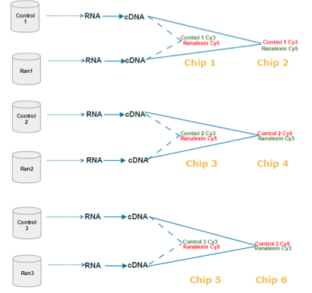
Microarray hybridisation and analysis
Used samples form MRSA-252
Hybridized 6 microarray chips: they performed three biological replicates, with each having two technical replicates
Paired samples on the chip were: Control 1 and Ranaflexin 1, Control 2 and Ranaflexin 2, Control 3 and Ranaflexin 3

Slide 7
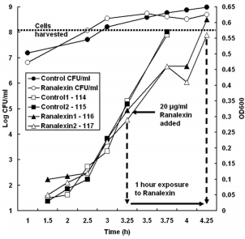
Presence of Ranaflexin on MRSA
MRSA-252 exposed to sublethal ranalexin concentration ( 20μgml-1)
Showed that in the presence of ranalexin had a brief reduction in growth rate

Slide 8
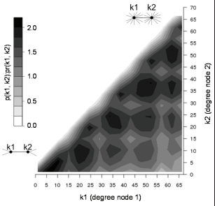
Degree of Interacting Nodes (Genes)
Axes represent the degree of interacting nodes (genes) in MRSA network.
Bottom left can be considered low degree values (less interaction), top right higher degree values (more interaction). Z-axis is the ratio.

Slide 9
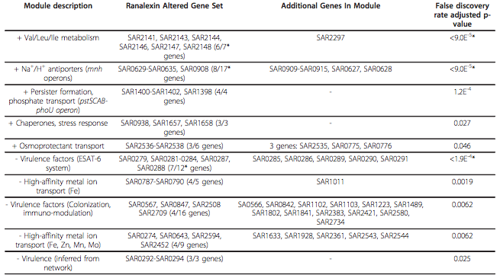
Ranalexin Response Modules (11)

Slide 10
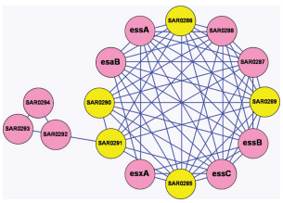
ESAT-6 system plays important role in pathogenesis
Genes downregulated by ranalexin (RanaDown) are shown in pink, other in yellow
If named considered a gene that has been characterized, otherwise locus identifier
Seven uncharacterized genes in ESAT- 6 module

Slide 11
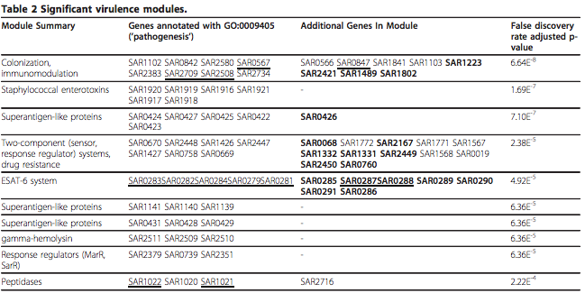
Modules that are significant in virulence, Marked with ‘Pathogenesis’

Slide 12
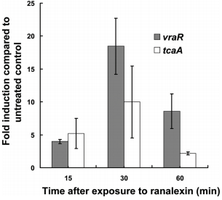
Upregulation of vraR and tcaA by Ranalexin
Showing the upregulation of vraR and tcaA expression at different exposure times when exposed to ranaflexin
Peaked at 30 minutes (upregulation) and then declined after an hour
VraR: involved in the control of the cell wall peptidoglycan biosynthesis

Slide 13
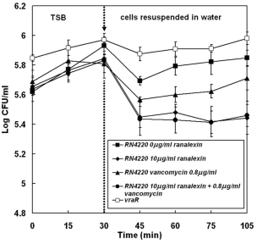
Hyposomotic stress in response to ranalexin and/or vancomycin
Hyposomotic stress (swelling) in response to ranalexin and/or vancomycin at different concentrations
Control experienced the least amount of stress
Combination of vancomycin and ranalaexin experienced the most as well as ranalexin on its own

Slide 14
Summary
Ranalexin affects bacterial cell wall and membrane
Cationic AMPs exert inhibitory actions
FtsH membrane chaperone -- upregulated in response to ranalexin , potential drug target
VraRS -- may be two component staphylococcal response regulator that is involved with cationic peptide resistance
Evidence for PhoU-mediated persister switching as a mech. of drug tolerance in MRSA

Slide 15
Acknowledgements
Loyola Marymount University
Kam D. Dahlquist, Ph. D
Stephen, TA

Slide 16
Citation
  Overton et al., 2011 I.M. Overton, S. Graham, K.A. Gould, J. Hinds, C.H. Botting, S. Shirran,
  G.J. Barton, P.J. Coote Global network analysis of drug tolerance, mode of action and virulence in methicillin-resistant S. aureus

