Slide 1
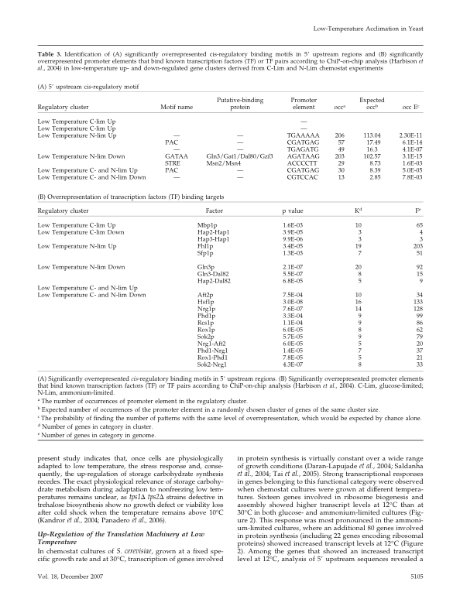
Table 3: 5’ upstream cis-regulatory motif
Significantly overrepresented cis-regulatory binding motifs in 5’ upstream regions.
occ= number of occurrences
Expected occ= expected number of occurrences
occ E= the probability of find number of patterns with same overrepresentation

