Slide 1
Analyzing the Graph Properties of a 13node, 16edge Network Derived from Cold-Shock Response Data of Wild-Type Saccharomyces cerevisiae
Margaret ONeil
Department of Biology
Loyola Marymount University
BIOL-398-05/S17

Slide 2
Outline
Yeast respond to cold shock by changing gene expression, but which transcription factors remains unknown.
To address this, microarray data was generated for yeast under cold shock conditions.
Data from the WT strain was used to create gene regulatory networks generated from the YEASTRACT database.
A random network was generated based on this network using an R-script
Edges were knocked out based on the identification of feed-forward motifs
The dynamics of each gene in each network was modeled using ordinary differential equations.

Slide 3
Outline
Yeast respond to cold shock by changing gene expression, but which transcription factors remains unknown.
To address this, microarray data was generated for yeast under cold shock conditions.
Data from the WT strain was used to create gene regulatory networks generated from the YEASTRACT database.
The dynamics of each gene in each network was modeled using ordinary differential equations.
A random network was generated based on this network using an R-script
ACE2 was deleted to determine impact on the network
Edges were knocked out based on the identification of feed-forward motifs
Network dynamics indicate ASH1 -> YHP1 might be a highly influential connection in the network

Slide 4
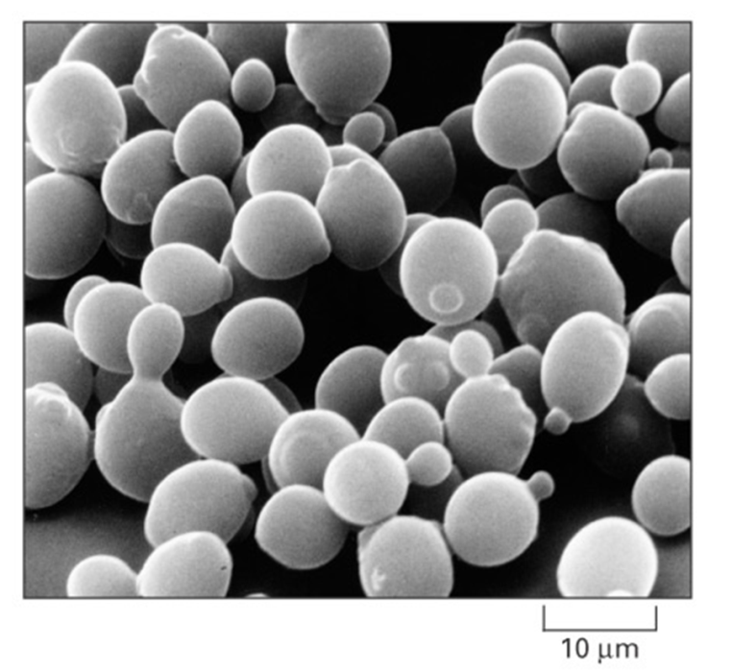
Saccharomyces cerevisiae is an Ideal Model Organism for Systems Biology
Small genome size of approximately 6000 genes.
These 6000 genes are regulated by ~250 transcription factors
Yeast deletion strains and other molecular genetic tools are readily available online
Cold shock (10-18ºC) response is not as well documented or studied as heat shock
Alberts et al. (2004)

Slide 5
The Response to the Environmental Stress Cold Shock is not Well Studied
Heat Shock | Cold Shock (10-18℃)
Proteins denature | Decreases fluidity of membranes
Induction of heat shock proteins that assist in protein folding | Stabilizes DNA and RNA secondary structures
Conserved in all organisms | Impairs ribosome function and protein synthesis
 | Decreased enzymatic activities
 | No equivalent set of cold shock proteins that are conserved in all organisms

Slide 6
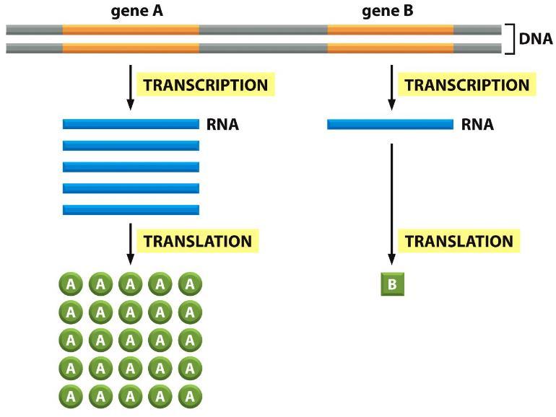
Yeast Respond to Cold Shock by Changing the Level of Gene Expression
Alberts et al. (2014)

Slide 7
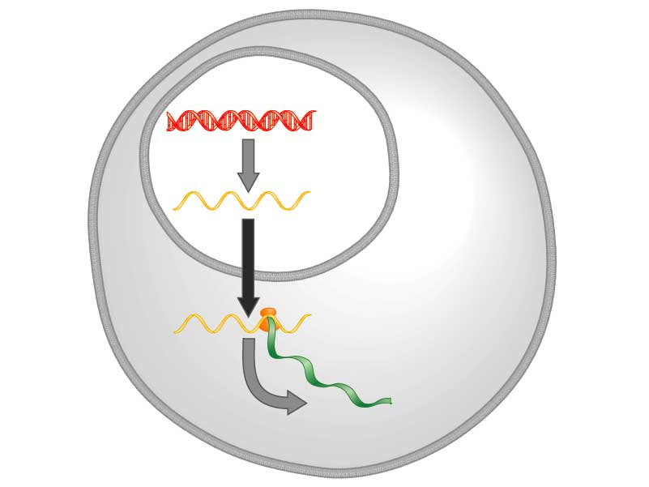
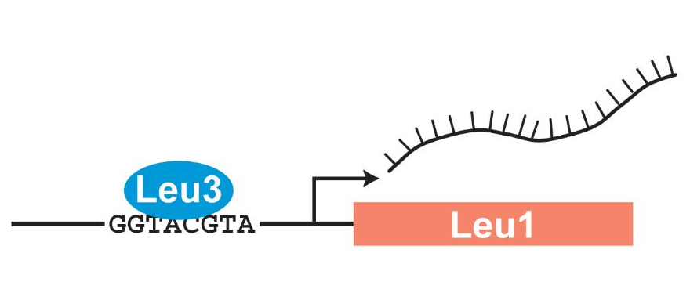
Transcription Factors Control Gene Expression by Binding to Regulatory DNA Sequences
Transcription factors control gene expression by binding to regulatory DNA sequences.
Activators increase expression while repressors decrease expression
Transcription factors are themselves proteins encoded by genes.
DNA
Transcription
mRNA
Translation
Protein
Freeman (2003)

Slide 8
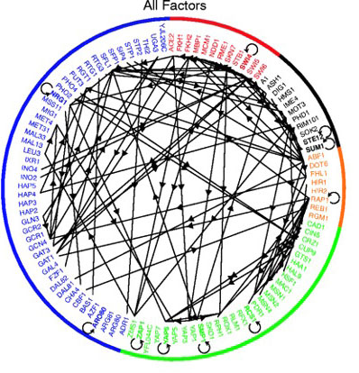
A Gene Regulatory Network (GRN) is a Set of Transcription Factors that Regulate the Expression of Genes Encoding Other Transcription Factors
1. Which transcription factors regulate the cold shock response in yeast?
2. What is the indirect effect of other transcription factors?
3. Can we make predictions based on our understanding of the network?
Lee et al. (2002)
Notes:
Half of the GRN in yeast; it’s complicated and difficult to study. Study a subset of the network related to cold shock response
We focused our attention on green set of TFs related to environmental stress response

Slide 9
Outline
Yeast respond to cold shock by changing gene expression, but which transcription factors remains unknown.
To address this, microarray data was generated for yeast under cold shock conditions.
Data from the WT strain was used to create gene regulatory networks generated from the YEASTRACT database.
The dynamics of each gene in each network was modeled using ordinary differential equations.
A random network was generated based on this network using an R-script
ACE2 was deleted to determine impact on the network
Edges were knocked out based on the identification of feed-forward motifs
Network dynamics indicate ASH1 -> YHP1 might be a highly influential connection in the network

Slide 10
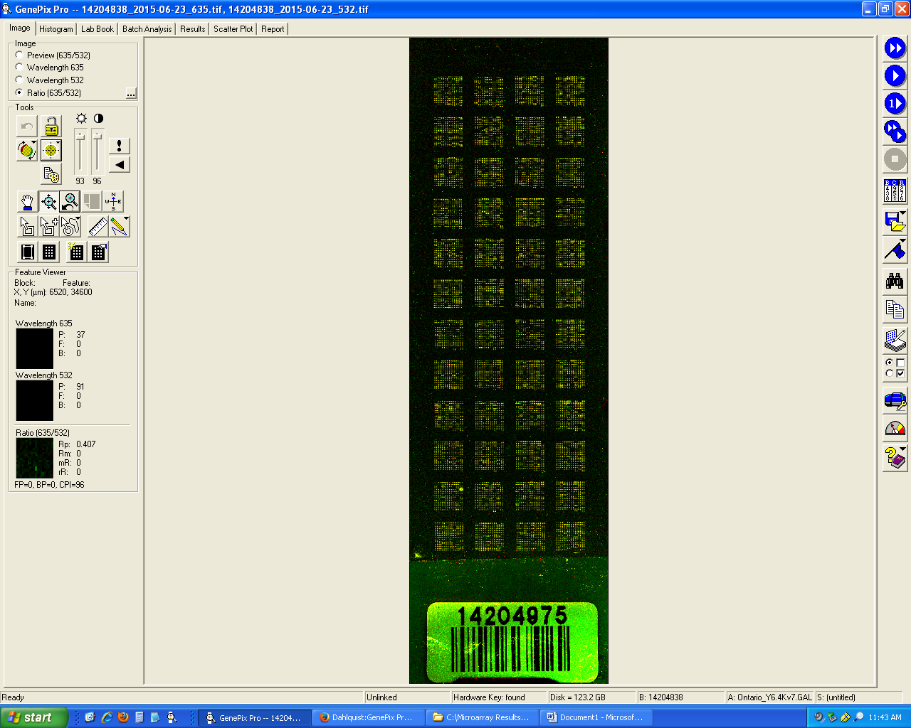
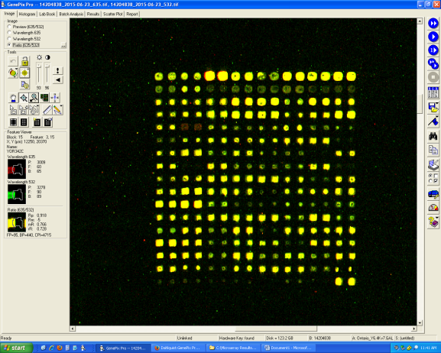
Microarray data is used to observe changes in gene expression for all 6000 genes in yeast
Each spot contains DNA from one gene.
For each spot:
Increase Expression
Decrease Expression
No Change in Expression
DNA microarray experiments were performed for the wild type and five transcription factor deletion strains (Δcin5, Δgln3, Δhap4, Δhmo1, and Δzap1).
For this analysis, only the Δhap4 data was used.
Sample Microarray Slide from the Dahlquist Lab

Slide 11
The Microarray Data was Used to Derive a Family of Related GRNs from the YEASTRACT Database
Indicates which genes had significant changes in expression at any time point
YEASTRACT Database
These genes were input into the YEASTRACT database, which returned a list of potential regulatory transcription factors that may regulate those target genes, in order of significance.
Within-strain ANOVA
Generate “Family” of Related Networks
Notes:
Change title

Slide 12
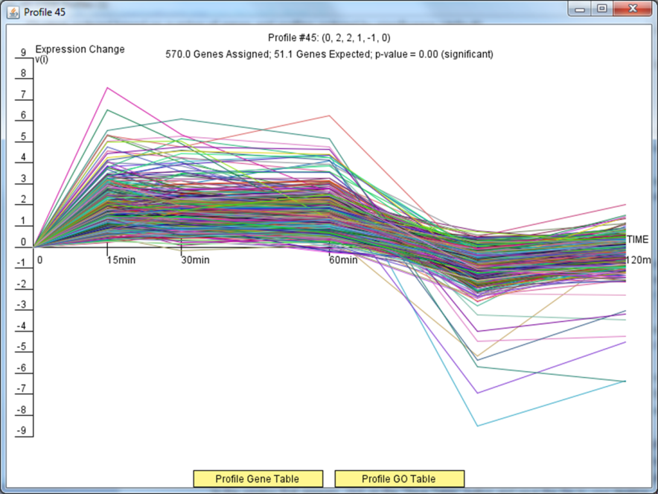
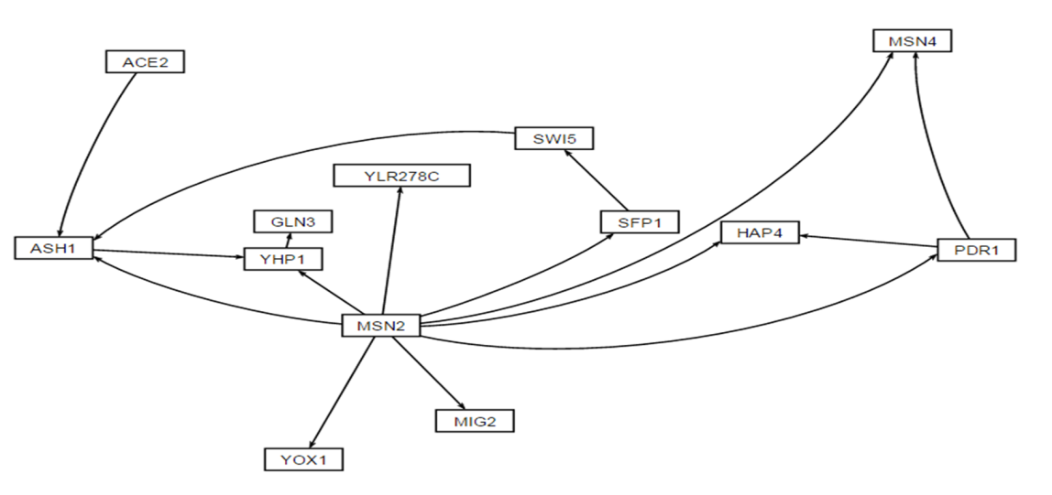
Cluster 45 Data was used to Generate a 13-node, 16-edge Gene Regulatory Network
ANOVA | WT
p < 0.05 | 2528 (40.8%)
p < 0.01 | 1652 (26.7%)
p < 0.001 | 919 (14.8%)
p < 0.0001 | 496 (8%)
B & H p < 0.05 | 1822 (29.4%)
Bonferroni p < 0.05 | 248 (4%)

Slide 13
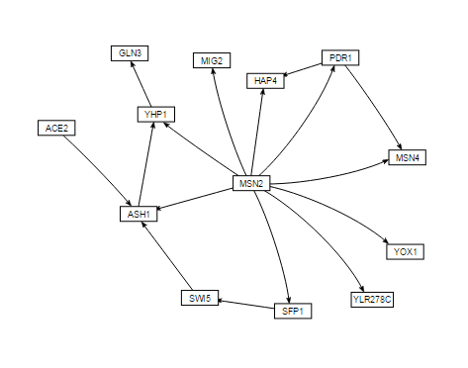
Visualization of the GRN Reveals a Spoke-Wheel Model with MSN2 at the Center

Slide 14
Outline
Yeast respond to cold shock by changing gene expression, but which transcription factors remains unknown.
To address this, microarray data was generated for yeast under cold shock conditions.
Data from the WT strain was used to create gene regulatory networks generated from the YEASTRACT database.
The dynamics of each gene in each network was modeled using ordinary differential equations.
A random network was generated based on this network using an R-script
ACE2 was deleted to determine impact on the network
Edges were knocked out based on the identification of feed-forward motifs
Network dynamics indicate ASH1 -> YHP1 might be a highly influential connection in the network

Slide 15
GRNmap uses Ordinary Differential Equations to Model the Dynamics of each Gene
Weight parameter, w, gives the direction and the magnitude of regulatory relationship.
Positive weights are activation.
Negative weights are repression.
The magnitude of the weight represents the strength of the regulation.
expression of gene
mRNA production rate
mRNA degradation rate
weight term
threshold unique
to each gene

Slide 16
A Penalized Least Squares Approach is Used to Estimate Parameters
Penalty Term: combined production rate, weight, and threshold parameters
alpha: determined empirically from the “elbow” of L curve
Experimental
Theoretical
We added alpha and the penalty term to force the function to minimize on a single solution
The theoretical is the log2 expression of the solution to the differential equation (previous slide)
LSE or E value describes how well the overall GRN was modeled by GRNmap program
Notes:
LSE = E added term to force function to a minimum
Derived alpha empirically by running model through all possible values to generate the L curve (can get rid of L curve)
No reduction of error with making parameter values too crazy
Point out → theoretical of the log2 to the solution of the differential equation; summation over time &
If close together = model fits the data well
Ratio of LSE observed to the theoretical LSE

Slide 17
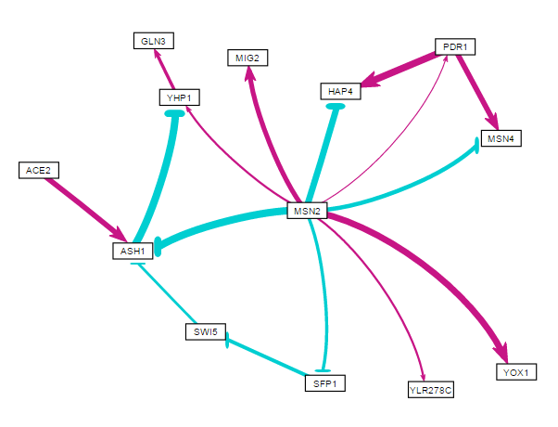
Optimized Output of the Network Suggests Novel Graph has been Generated
LSE/minLSE ratio = 2.17, higher than has been seen previously
This network is also one of the small with few nodes and edges
Further Investigation
How does this compare to a random network?
What will happen if ACE2 is removed?
How does breaking the feed forward loops effect how the network is modeled?

Slide 18
Outline
Yeast respond to cold shock by changing gene expression, but which transcription factors remains unknown.
To address this, microarray data was generated for yeast under cold shock conditions.
Data from the WT strain was used to create gene regulatory networks generated from the YEASTRACT database.
The dynamics of each gene in each network was modeled using ordinary differential equations.
A random network was generated based on this network using an R-script
ACE2 was deleted to determine impact on the network
Edges were knocked out based on the identification of feed-forward motifs
Network dynamics indicate ASH1 -> YHP1 might be a highly influential connection in the network

Slide 19
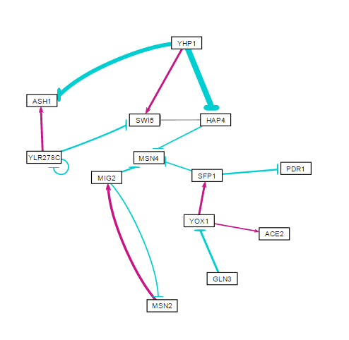
Comparison to a Random Network Shows Similar Properties Between Networks
LSE:minLSE ratio – 2.17
LSE:minLSE ratio – 2.11

Slide 20
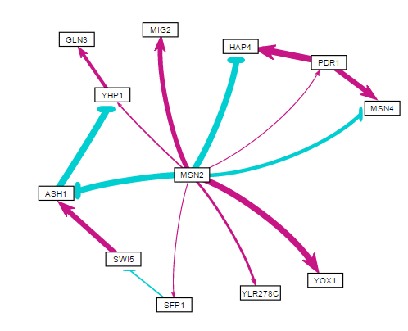
12-node, 15-edge Network has a Higher LSE:minLSE Ratio than the Original Network
LSE:minLSE ratio – 2.17
LSE:minLSE ratio – 2.23

Slide 21
12-node, 15-edge Network has a Higher LSE:minLSE Ratio than the Original Network
LSE:minLSE ratio – 2.17
LSE:minLSE ratio – 2.23

Slide 22
Optimized Parameters Show Similarities between 13-node and 12-node Networks

Slide 23
Outline
Yeast respond to cold shock by changing gene expression, but which transcription factors remains unknown.
To address this, microarray data was generated for yeast under cold shock conditions.
Data from the WT strain was used to create gene regulatory networks generated from the YEASTRACT database.
The dynamics of each gene in each network was modeled using ordinary differential equations.
A random network was generated based on this network using an R-script
ACE2 was deleted to determine impact on the network
Edges were knocked out based on the identification of feed-forward motifs
Network dynamics indicate ASH1 -> YHP1 might be a highly influential connection in the network

Slide 24
Feed Forward Loops were Identified and Systematically Broken to Determine their Role in the Network
ACE2 Deletion network used in order to analyze the role of feed forward loops on a specifically spoke and wheel network
Edges Deleted:
ASH1 -> YHP1
PDR1 -> MSN4
PDR1 -> HAP4
SWI5 -> ASH1

Slide 25
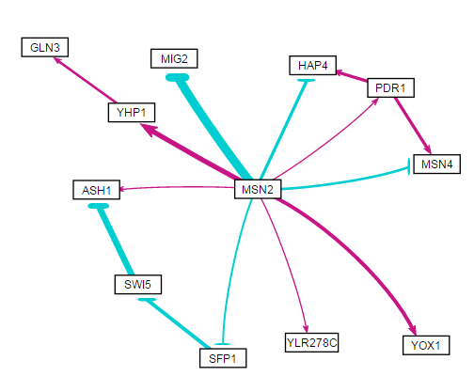
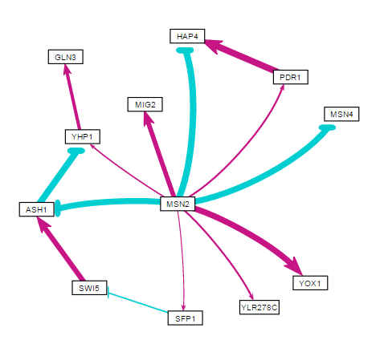
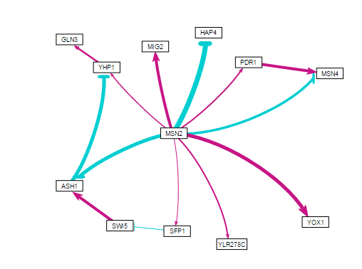
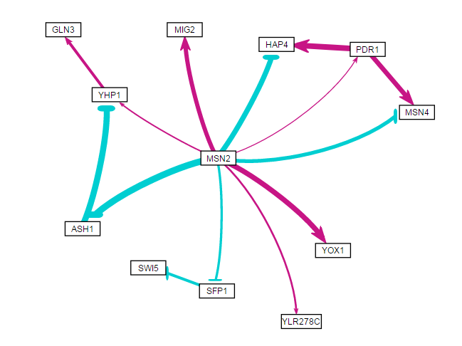
LSE:minLSE Ratios Show Similar Modeling Regardless of Deleted Edges
ACE2 Deleted
LSE:minLSE ratio – 2.23
ASH1 -> YHP1 Broken
LSE:minLSE ratio – 2.10
PDR1 -> MSN4 Broken
LSE:minLSE ratio – 2.23
PDR1 -> HAP4 Broken
LSE:minLSE ratio – 2.23
SWI5 -> ASH1 Broken
LSE:minLSE ratio – 2.23

Slide 26
Optimized Production Rates Show Some Connections more Important than others

Slide 27
Optimized Production Rates Show Some Connections more Important than others

Slide 28
Comparison of Optimized Threshold b Measurements also Indicates Importance of ASH1 -> YHP1 Edge

Slide 29
Looking at Optimized Weights Shows Similar Trend in ASH1 -> YHP1 Playing an Important Role in the GRN

Slide 30
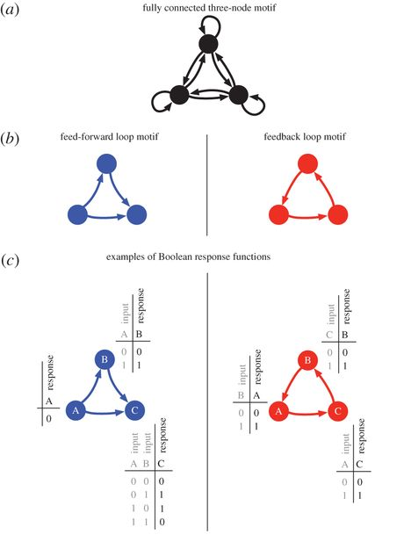
Feed Forward Loops shown to be an Important Motif in GRNs (Anhert 2016)
As Anhert found, the data from this study shows that feed-forward loops play an important role in gene regulatory networks
If graph statistics were run on this network, would be interesting to see how the feed forward loops impact the centrality measures
Network could be a real-world example of a network with multiple feed-forward loops

Slide 31
Summary
Yeast respond to cold shock by changing gene expression, but which transcription factors remains unknown.
To address this, microarray data was generated for yeast under cold shock conditions.
Data from the WT strain was used to create gene regulatory networks generated from the YEASTRACT database.
The dynamics of each gene in each network was modeled using ordinary differential equations.
A random network was generated based on this network using an R-script
ACE2 was deleted to determine impact on the network
Edges were knocked out based on the identification of feed-forward motifs
Network dynamics indicate ASH1 -> YHP1 might be a highly influential connection in the network

Slide 32

Acknowledgments
Dr. Kam Dahlquist and Dr. Ben Fitzpatrick
Classmates in BIOL-398/05
GRNmap data analysis current team: Kristen Horstmann, Natalie Williams, and Brandon Klein
GRNmap current coding team: Trixie A. Roque, Chukwuemeka (Edward) Azinge, and Justin Torres
GRNsight current team: Anindita Varshneya, Nicole A. Anguiano, Mihir Samdarshi, Eileen Choe, and Edward Bachoura, Jen Shin
Wet lab team: Monica Hong, Nika Vafadari, and Katherine Scheker

Slide 33
References
Ahnert, S. E., & Fink, T. M. A. (2016).
Form and function in gene regulatory networks: the structure of network motifs determines fundamental properties of their dynamical state space. Journal of The Royal Society Interface, 13(120), 20160179. DOI: 10.1098/rsif.2016.0179
Dahlquist, Kam D. (2017) BIOL398-05/S17:Week 10. Retrieved from http://www.openwetware.org/wiki/BIOL398-05/S17:Week_10 on 28 March 2017.
Dahlquist, K., Fitzpatrick, B., Camacho, E., Entzminger, S., & Wanner, N. (2015).
Parameter Estimation for Gene Regulatory Networks from Microarray Data: Cold Shock Response in Saccharomyces cerevisiae. Bulletin Of Mathematical Biology, 77(8), 1457-1492. http://dx.doi.org/10.1007/s11538-015-0092-6.
Dário Abdulrehman, Pedro T. Monteiro, Miguel C. Teixeira, Nuno P. Mira, Artur B. Lourenço, Sandra C. dos Santos, Tânia R. Cabrito,
Alexandre P. Francisco, Sara C. Madeira, Ricardo S. Aires, Arlindo L. Oliveira, Isabel Sá-Correia, Ana T. Freitas (2011). YEASTRACT: providing a programmatic access to curated transcriptional regulatory associations in Saccharomyces cerevisiae through a web services interface Nucl. Acids Res., 39: D136-D140, Oxford University Press.
Freeman, S. (2002). Biological science. Upper Saddle River, NJ: Prentice Hall.
GRNsight. (n.d.). Retrieved May 3, 2017, from http://dondi.github.io/GRNsight/
GRNmap. (n.d.). Retrieved March 3, 2017, from https://github.com/kdahlquit/GRNmap

