Slide 1
Dahlquist Lab Joint Research Meeting
Trixie Anne M. Roque
June 10, 2015

Slide 2
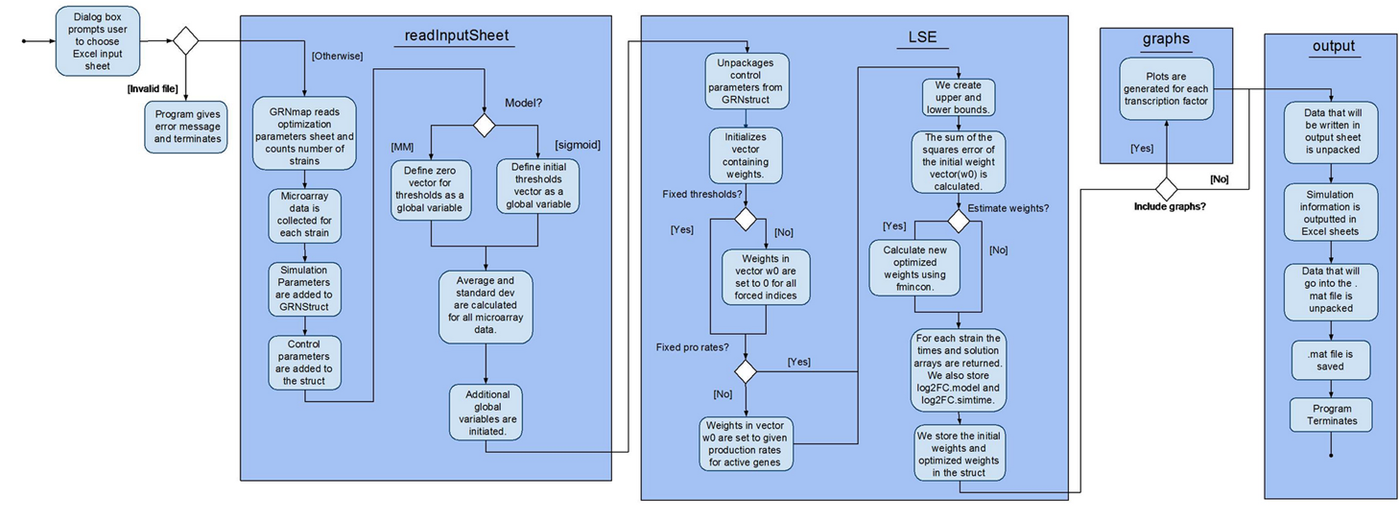
Previous Activity Diagram Separates the “graphs” Function from the “output” Function

Slide 3
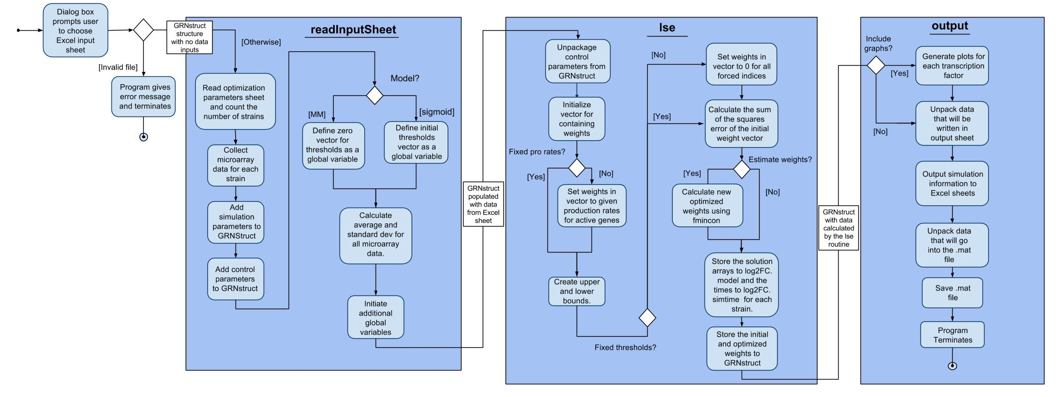
Revised Activity Diagram Merges “graphs” into “output”

Slide 4
Side-by-side Comparison of the 2 Diagrams

Slide 5
List of Global Variables and What They Hold
adjacency_mat: adjacency matrix from worksheet "network" in Excel input spreadsheet; matrix form of gene regulatory network
alpha: number that adjusts the penalty term so that estimation does not increase too much
b: column vector; if parameter "Sigmoid" = 1, b reads from worksheet "threshold_b", else b becomes a column vector of zeros with the same dimensions as the degradation rates
degrate: column vector that is read from Excel input spreadsheet in the worksheet "degradation_rates"
fix_b: number that is read from Excel input spreadsheet in the worksheet "optimization_parameters"; if fix_b = 0, worksheet "optimized_threshold_b" is outputted, else b = threshold_b
fix_P: number that is read from Excel input spreadsheet in the worksheet "optimization_parameters"; if fix_P = 0, worksheet "optimized_production_rates" is outputted else

Slide 6
List of Global Variables and What They Hold
is_forced: column vector corresponding to which genes are being controlled by other genes (numbered in ascending order)
log2FC: structure that contains the microarray data, timepoints (with repetitions), average, standard deviation, positions of deleted strain (if any), strain names, and simtime.
num_genes: number that shows how many genes there are
num_times: number that shows how many unique time points there are.
prorate: column vector read from the Excel worksheet "production_rates"
Sigmoid: number that shows which model to use (sigmoid or michaelis-menten)

Slide 7
List of Global Variables and What They Hold
Strain: cell array that contains the name of each strain
wtmat: matrix read from Excel input sheet "network_weights" whose values are the magnitude of the regulatory relationship between each genes
time: row vector read from Excel input sheet "optimization_parameters" which contains each unique timepoints
counter: number that shows how many iterations were made by the model until it stops estimating
deletion: row vector the contains the position of the deleted genes

Slide 8
List of Global Variables and What They Hold
lse_out: least squares error calculated for each iteration
SSE: matrix (column vector for each strain) that represents the sum of squares error
penalty_out: number calculated from (wts'*wts + (b-bp)'*(b-bp) + proratep(:)'*proratep(:) )/length(theta)
wts: column vector whose size shows how many edges there are
no_inputs: (I don't think this is being assigned anything; there is a GRNstruct.GRNParams.no_inputs in readInputSheet (where it is calculated/determined) but there is no GRNstruct.GRNParams.no_inputs = no_inputs anywhere)

Slide 9
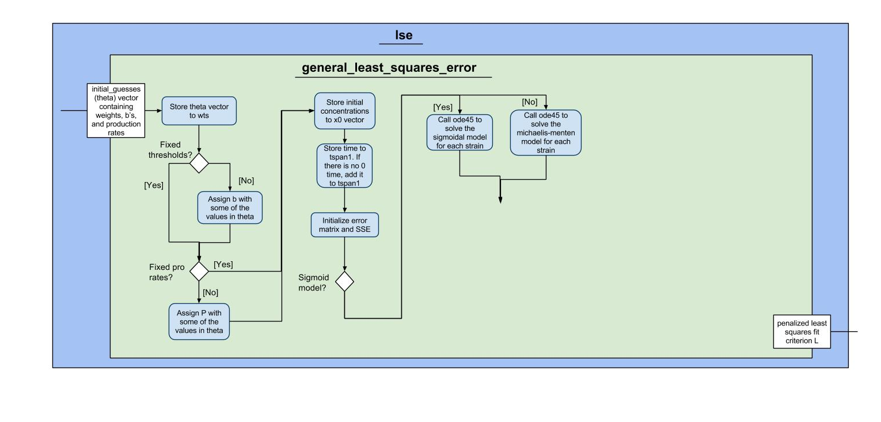
Work in Progress…

