Slide 1
  Global network analysis of drug tolerance, mode of action and virulence in methicillin-resistant S.aureus
  Overton et al., 2011 I.M. Overton, S. Graham, K.A. Gould, J. Hinds, C.H. Botting, S. Shirran, G.J. Barton, P.J. Coote Global network analysis of drug tolerance, mode of action and virulence in methicillin-resistant S. aureus
Chloe Jones
Loyola Marymount University
BIOL368: Bioinformatics Laboratory
December 9, 2014

Slide 2
Outline
MRSA infections rising due to resistant strains
Antimicrobial peptides are a potential solution to combat resistant bacteria
Microarrays measure response of MRSA to Ranalexin
Analysis of data agree with findings of Overton et al.
Notes:
-Antimicrobial peptides combat resistant bacteria by increasing the permeability of the cell wall and membrane through osmotic stress

Slide 3
MRSA infections are rising due to strains resistant to existing treatments
MRSA=Methicillin Resistant Staphylococcus aureus
Major global problem
  Prevention and treatment strategies are imperative
Notes:
Methicillin Resistant Staphylococcus aureus also known as MRSA is a human pathogen that has become a major problem because: strains resistant to existing treatments continue to emerge which is a global concern
-because of MRSA ability to adapt, treatment strategies are necessary to discover the mechanism of the microbe

Slide 4
Antimicrobial peptides are a potential solution to combat resistant bacteria
Antimicrobial peptides are part of the innate immune response
Ranelexin is a 20 a.a. peptide isolated from a bullfrog
  Activity against Gram-positive bacteria,especially S. Aureus, in vitro
  Therapeutic potential against MRSA
Notes:
-AMPS are produced by virtually all living creatures as part of there innate defenses
-your body producing a defense mechanism in the presence of microbes, essentially human antibiotics ..more pertinent because they reside in your body so know there way around

Slide 5
Overton et al (2011) used DNA microarrays to measure response of MRSA to ranalexin
Understanding the mechanism of antimicrobials leads to developing new therapeutic strategies
Transcriptome profiling
  Examines the expression level of mRNAs in a given cell population
  “RanaUp” or “Ranadown”
mRNA generated in response to antimicrobial stress reflect the change in particular cell functions, provide marker for the type of stress
Notes:
genes classified as “rana up” “rana down”

Slide 6
Outline
MRSA infections rising due to resistant strains
Antimicrobial peptides are a potential solution to combat resistant bacteria
Microarrays measure response of MRSA to Ranalexin
Analysis of data agree with findings of Overton et al.
Notes:
-Antimicrobial peptides combat resistant bacteria by increasing the permeability of the cell wall and membrane through osmotic stress

Slide 7
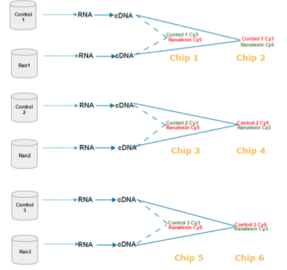
Experimental Design
Used samples form MRSA-252
Hybridized 6 microarray chips: they performed three biological replicates, with each having two technical replicates
Paired samples on the chip were: Control 1 and Ranalexin 1, Control 2 and Ranalexin 2, Control 3 and Ranalexin 3
Notes:
-inverting the red and green dye

Slide 8
Outline
MRSA infections rising due to resistant strains
Antimicrobial peptides are a potential solution to combat resistant bacteria
Microarrays measure response of MRSA to Ranalexin
Analysis of data agree with findings of Overton et al.
Notes:
-Antimicrobial peptides combat resistant bacteria by increasing the permeability of the cell wall and membrane through osmotic stress

Slide 9
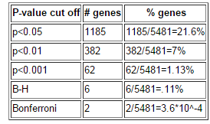
Sanity Check: Number of genes significantly changed
Figure1. This table lists the number of genes at various p-value
cut-offs. Percentage of genes that are larger than the cutoff.
Notes:
-Smaller p is indicative of a higher confidence interval.
-p value cut-off should not be thought of as some magical number at which data becomes "significant". Instead, it is a movable confidence level. If we want to be very confident of our data, use a small p value cut-off. If we are OK with being less confident about a gene expression change and want to include more genes in our analysis, we can use a larger p value cut-off. For the GenMAPP analysis below, we will use the fold change cut-off of greater than 0.25 or less than -0.25 and the p value cut off of p < 0.05 for our analysis because we want to include several hundred genes in our analysis.

Slide 10
Understanding how Ranalexin works to combat MRSA
Disrupting the cell wall and membrane
  Determined by strong upregulation of peptidoglycan synthesis genes.
  Cation influx
Osmotic fragility is a hallmark of cell wall disruption
Notes:
The response to ranalexin included strong upregulation
of several peptidoglycan synthesis genes, which suggests
that ranalexin may act on the cell wall (
-The upregulation of
these ‘electrogenic monovalent cation proton antiporter-
3’ operons [77] implies that membrane permeabilisation
leading to cation influx and possible dissipation of transmembane
electrochemical gradient is a major effect of
ranalexin exposure.

Slide 11
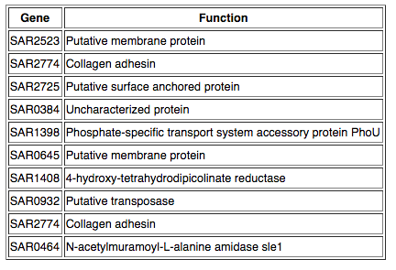
Significant Genes Based on Data Analysis

Slide 12
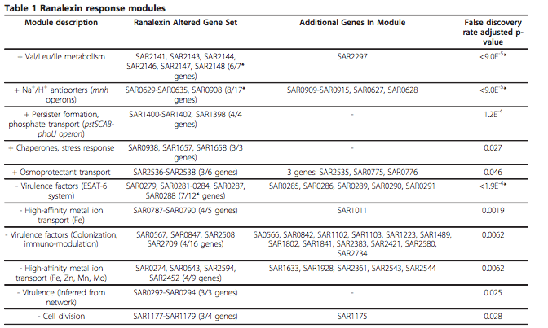
Ranlexin response modules that were upregulated

Slide 13
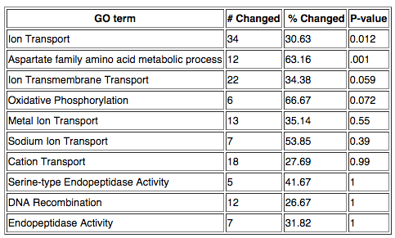
Analysis of GO terms “RanaUp”
Table 2. MAPPFinder results for increased “RanaUp” gene expression of 10 GO terms.
Notes:
GO term ‘aspartate family amino acid
biosynthesis’ in the RanaUp. Aspartate metabolism produces essential components
for pepdidoglycan biosynthesis, such as diaminopimelic
acid, and components of the aspartate
pathway represent possible drug targets.
-ion transport, -The upregulation of
these ‘electrogenic monovalent cation proton antiporter-
3’ operons [77] implies that membrane permeabilisation
leading to cation influx and possible dissipation of transmembane
electrochemical gradient is a major effect of
ranalexin exposure

Slide 14
What does MRSA do to combat Ranalexin
VraRS two-component system
  Participates in cell wall biosynthesis
PhoU-mediated persister formation
  Thickening of wall and loss of virulence factors
Notes:
The VraR (SAR1974) regulator protein of
the vancomycin-resistance associated two-component
system (VraSR) was RanaUp (2.45 fold). VraSR controls
the expression of genes that are induced by vancomycin,
many of which function in cell wall biosynthesis
-Combined with the proteome profiling and network
analysis this data suggests that MRSA adopts a
PhoU-mediated persister phenotype to acquire antimicrobial
tolerance, a
-persister bacteria
exhibit thickening of the cell wall and loss of virulence
factors

Slide 15
Ranalexin response modules that were downregulated
Notes:
-Two significant RanaDown modules (p ≤ 1.9E-3, 4/5
nodes RanaDown; p ≤ 6.2E-3, 4/9 nodes RanaDown)
were associated with high-affinity metal ion transport
[32,40], which is crucial for establishment of infection

Slide 16
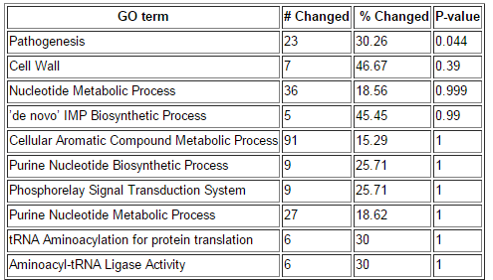
Analysis of GO terms “RanaDown”
Table 3. MAPPFinder results for decreased “RanaDown” gene expression of 10 GO terms.
Notes:
Most significant GO term was pathogenissis which relates MRSA ability to combat the antibiotic
-after filtering the data only received 10 pop ups but did not correlate to items in the paper

Slide 17
Summary
Antimicrobial peptides are a potential solution to combat resistant bacteria
Target “RanaUp” in the presence of Ranalexin
  contributed to the strength of cell wall/membrane
Results proved to be significant. “Ranaup” and “Ranadown” compared to Overton et. al coincided with data analyzed.

Slide 18
Acknowledgments
Loyola Marymount University
Kam D. Dahlquist, PhD
Stephen, TA

