Slide 1
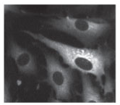
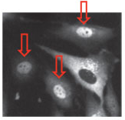
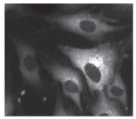
Single-cell NF-κB dynamics reveal digital activation and analogue information processing
Savas Tay, Jacob J. Hughey, Timothy K. Lee, Tomasz Lipniacki, Stephen R. Quake,
Markus W. Covert
Max Wu, Jonathan Gootenberg
20.309
December 8th 2011
Notes:
J

Slide 2
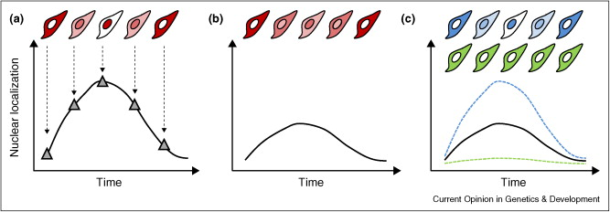
Diversity in single cell responses can be masked by population dynamics
T Lee, M Covert. Current Opinion in Genetics and Development 20, 677-683 (December 2010) doi:10.1016/j.gde.2010.08.005
Notes:
J

Slide 3
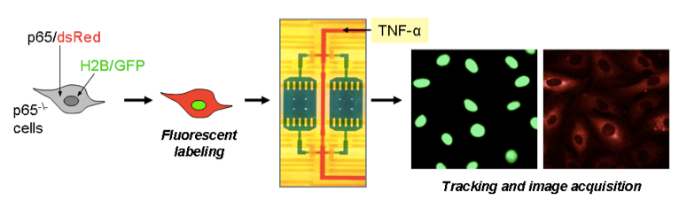
Microfluidic culturing allows for single cell analysis
Notes:
J

Slide 4
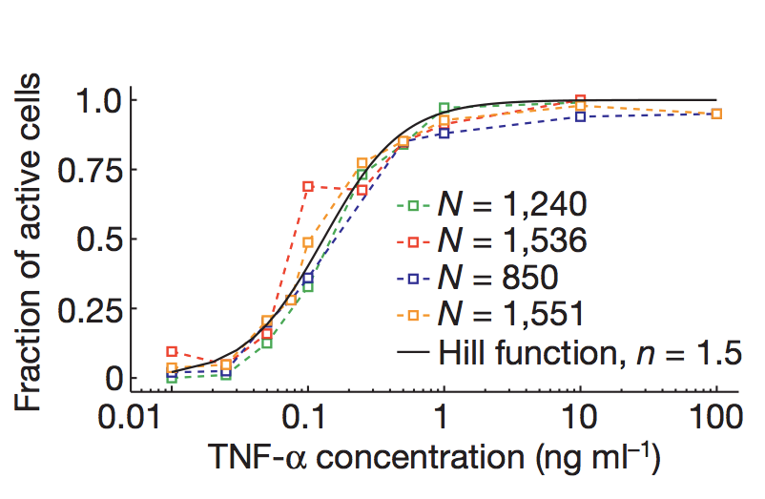
NF-κB activation is digital
Notes:
J

Slide 5
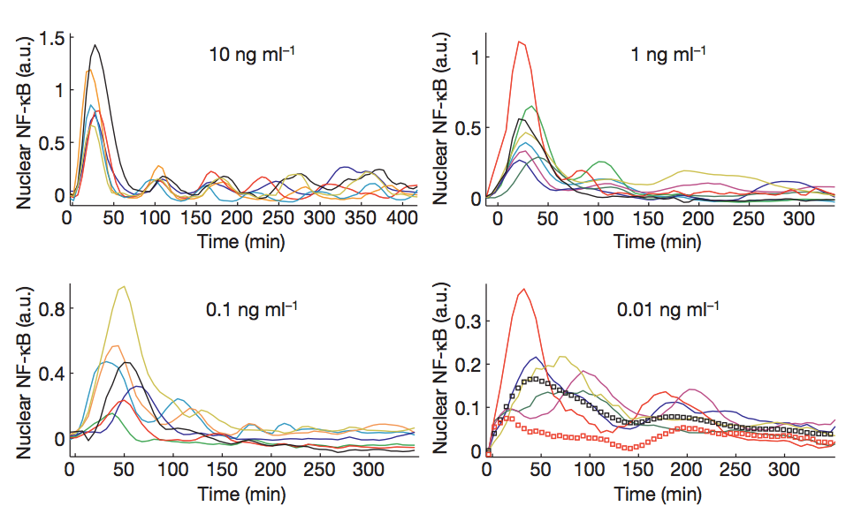
Nuclear NF-κB oscillates based on TNF-α dose
Notes:
J

Slide 6
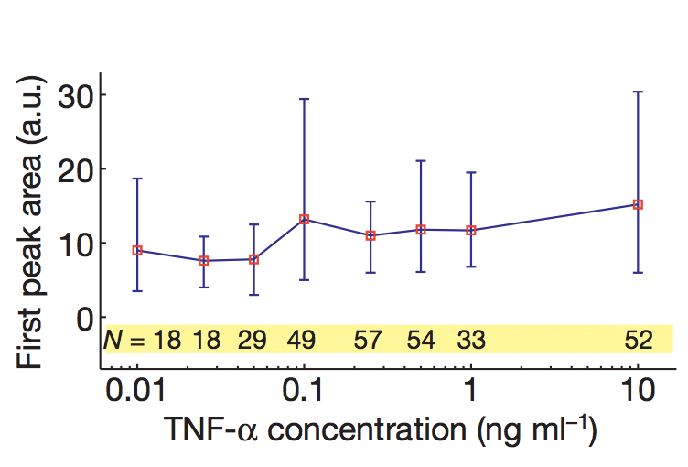
First peak of NF-κB is independent of TNF-α
Notes:
M

Slide 7
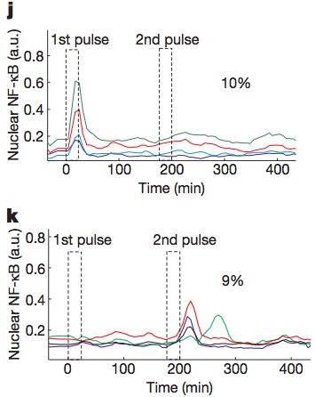
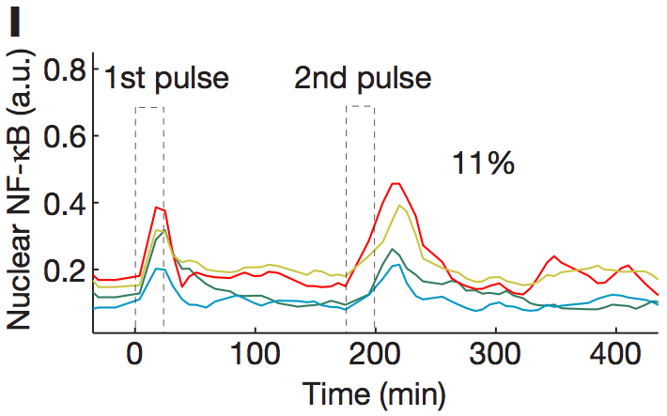
Activation is not entirely stochastic, but dependent on existing cellular state
Notes:
M

Slide 8
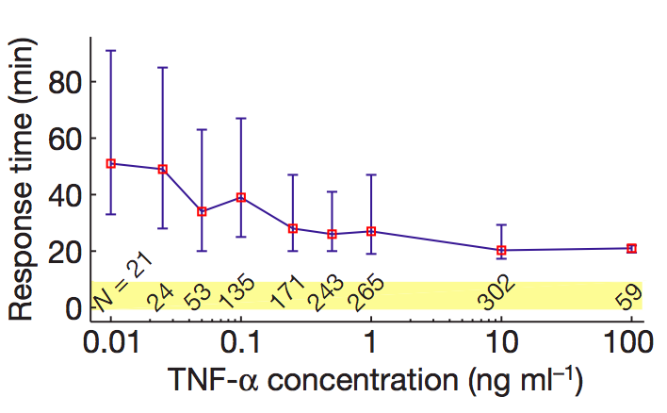
Lower doses of TNF-α lead to longer delay of activation
Notes:
M

Slide 9
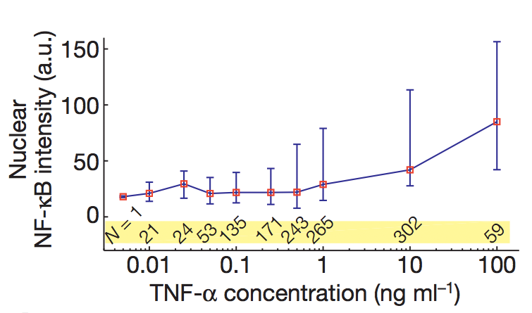
Lower doses of TNF-α lead to lower mean nuclear NF-κB intensity
Notes:
M

Slide 10
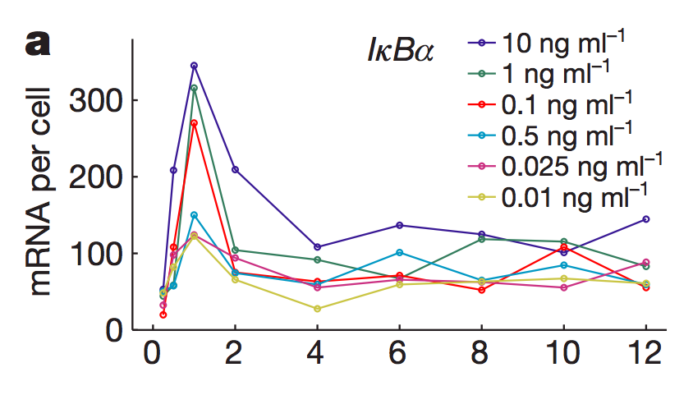
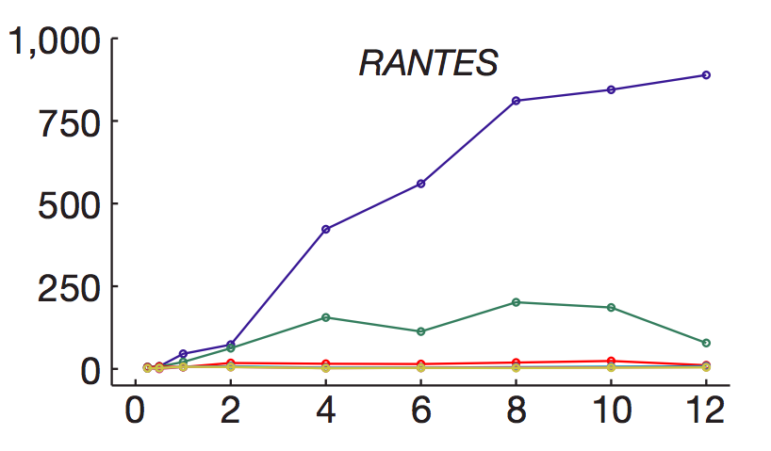
NF-κB drives waves of gene expression
Early genes follow first NF-κB peak closely
Late genes require sustained oscillations of NF-κB
Notes:
M

Slide 11
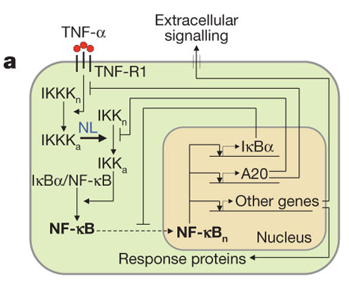
Stochastic-deterministic hybrid model
Reaction channels split into slow (stochastic; receptor binding and gene activation/inactivation) and fast (deterministic; mRNA and protein interactions) processes
Notes:
M

Slide 12
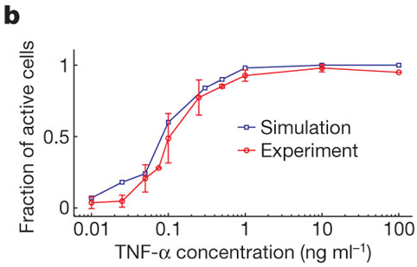
The stochastic model successfully reproduces experimental dose response
Notes:
M

Slide 13
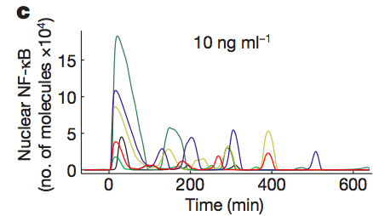
The stochastic model successfully reproduces experimental oscillations
Notes:
M

Slide 14
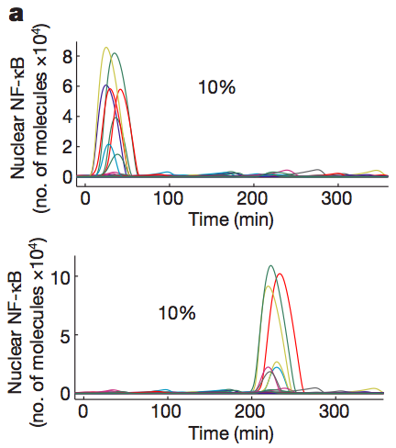
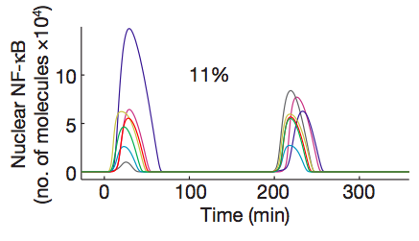
The stochastic model successfully reproduces experimental stochasticity
Notes:
M

Slide 15
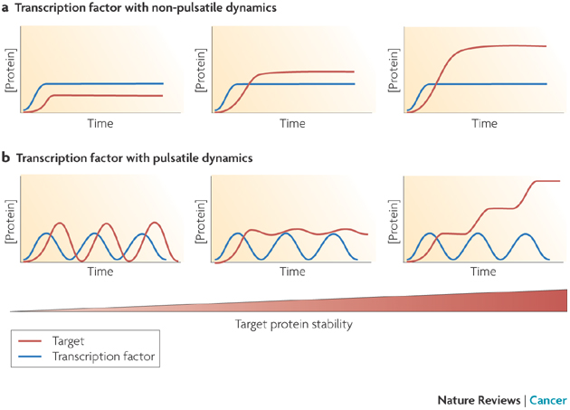
Digital, pulsed responses can lead to a broad range of target behaviors
E Batchelor et al. Nature Reviews Cancer 9, 371-377 (May 2009) | doi:10.1038/nrc2604
Notes:
J

Slide 16
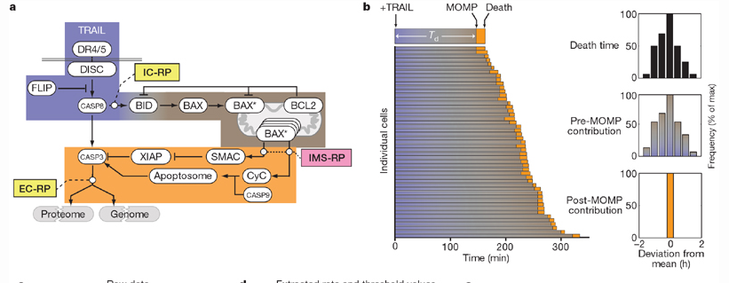
Single cell heterogeneity is important for explaining phenotypic response
SL Spencer et al. Nature 459, 428-432 (21 May 2009) doi:10.1038/nature08012
Notes:
J

Slide 17
The stochastic model successfully reproduces experimental data
In resting cells, un-phosphorylated IκBα sequesters NF-κB in cytoplasm
Active IKK phosphorylates IκBα, freeing NF-κB to localize to nucleus and drive transcription
  Nonlinear IKK activation profile yields digital activation in single cells (IKK must be phosphorylated at S177 and S181 to achieve full activity)
  Successfully reproduces important aspects of experimental data

