Slide 1
Emergent Properties of Reduced-Genome Escherichia coli
G Posfai, G Plunkett III, T Feher, D Frisch, GM Keil, K Umenhoffer, V Kolisnychenko, B Stahl, SS Sharma, M de Arruda, V Burland, SW Harcum, FR Blattner
Presented by Tina Stutzman
20.385 April 13, 2011

Slide 2
Background: E. coli and Genome Reduction
E. coli K-12
  genetically and biochemically well understood
  Used for production of therapeutic and commercial metabolites and DNA
Genome Reduction
  Improve metabolic efficiency
  Decrease redundancy

Slide 3
Introduction: Reduced-Genome E. coli overview
E. coli
MDS strain
E. coli
Rationally delete genes
MDS: Multiple-deletion series
Benefits of MDS Strains:
High electroporation efficiency
Accurate propagation of recombinant genes that were unstable in other strains

Slide 4
Rational deletion of genes
Mobile DNA Elements
  Insertion sequence (IS) elements, transposases, integrases, site-specific recombinases
  DNA sequence repeats used in homologous recombination
Target genes not present in other E. coli
  100 proposed deletions, 900 genes, 20% genome
  Target large islands and IS sequences

Slide 5
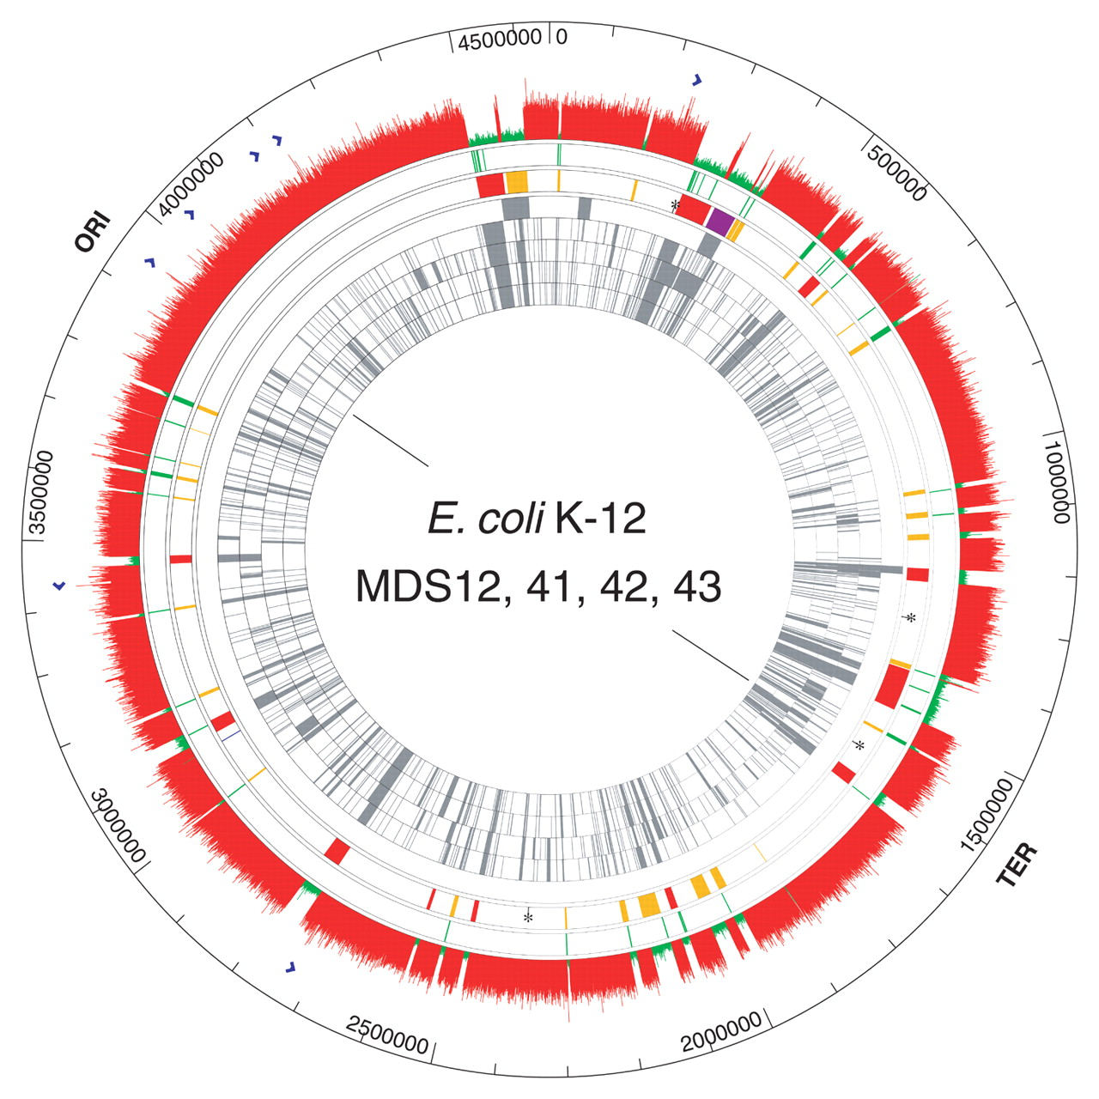
Rational Deletion of Genes
Ring 6: Regions targeted for deletion
Ring 1-5: regions of K-12 MG1655 absent in other E. coli
Ring 8: DNA microarray results of MDS43 strain (15.27%)
Ring 7: Native IS and Rhs repeat elements
Outer Ring:
MG1655 original strain

Slide 6
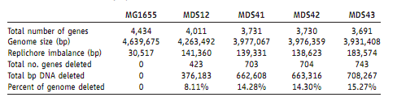
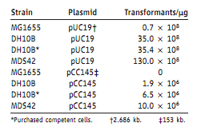
MSD strains had increased electroporation efficiencies
WT
DH10B – regarded as best for electroporation
pUC19 – small, multicopy plasmid
pCC145 – bacterial artificial chromosome
MDS
WT
MDS

Slide 7
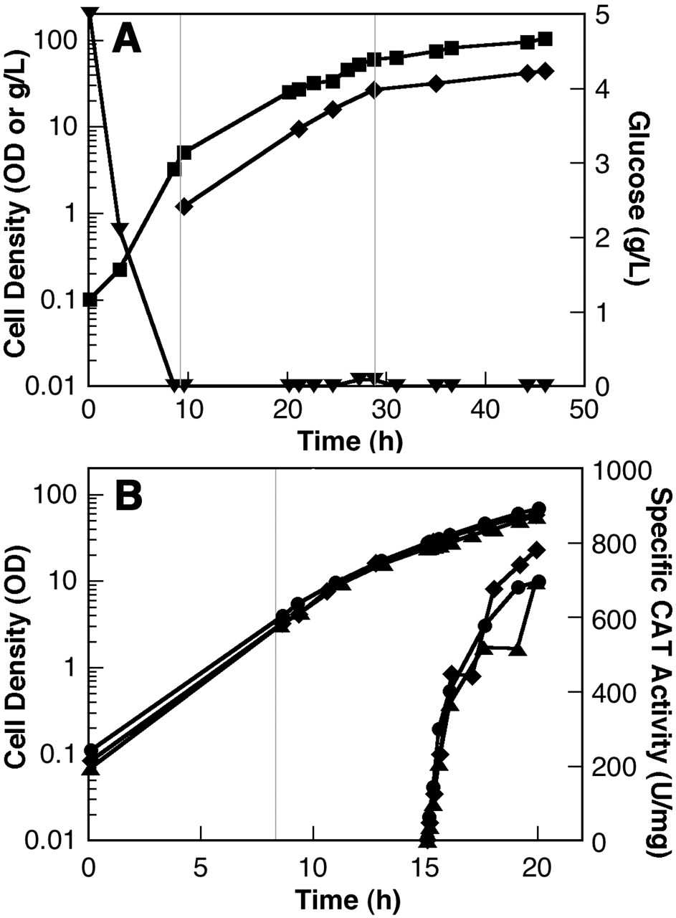
MDS Strains had similar growth and protein production compared to WT
MDS41 Growth
Square - optical density
Diamond - dry cell weight
Triangle - glucose
MDS41 vs MG1655 Growth and CAT protein production
Square and Triangle – MDS41
Circle - MG1655 (WT)

Slide 8
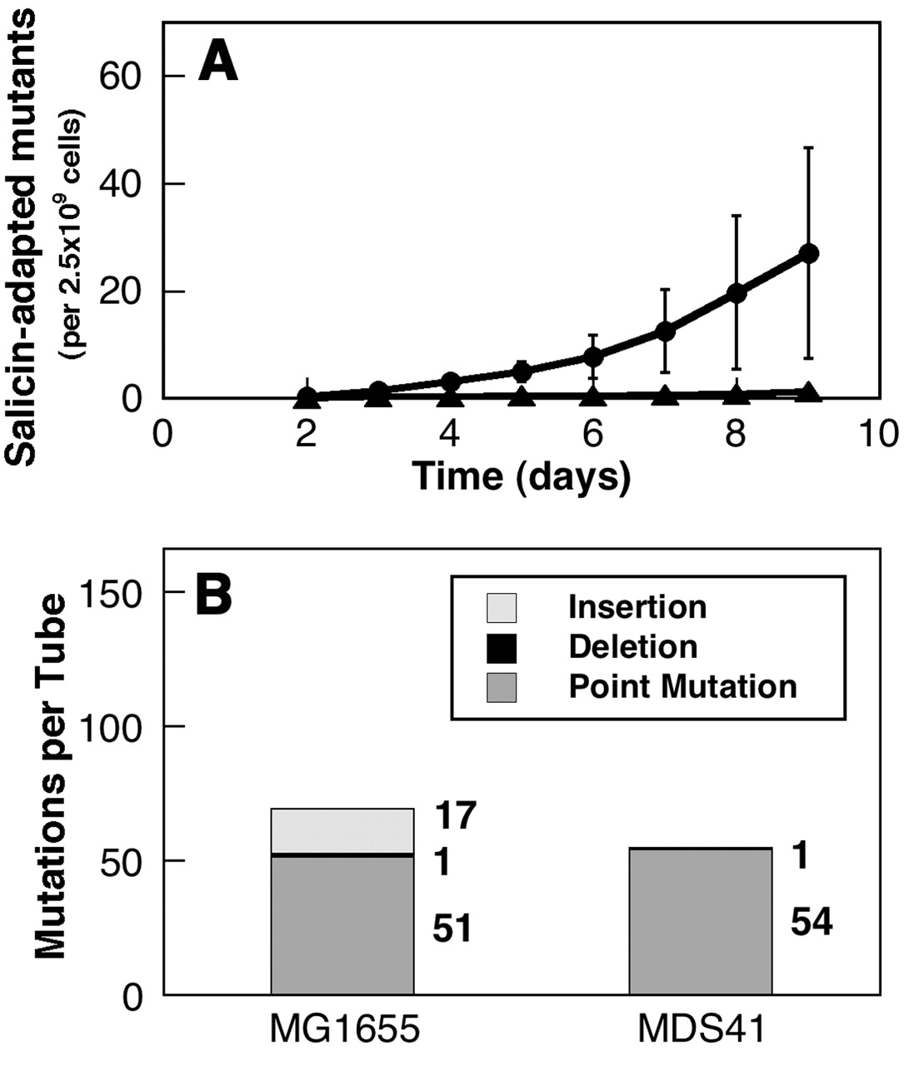
Mutation rates from IS mutagenesis lowered in MDS strains
IS insertions activate salicin metabolism
Circle – MG1655 (WT)
Triangle – MDS41
MDS41 has less IS insertions
MDS41 has no IS related mutations (insertions)

Slide 9
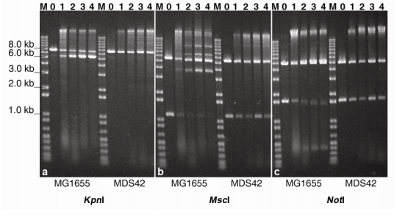
MDS mutants express deleterious products more efficiently and stably
A chimeric gene composed of rabbit hemorrhagic disease virus (VP60) fused to cholera toxin (CTX) was stable in MDS and unstable in WT plasmids.
The inverted terminal repeat sequences of adeno-associated viruses are deleted in WT but not in MDS42 (gel)

Slide 10
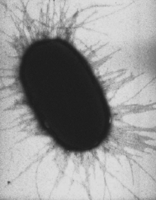
Possible reasons for increased electroporation efficiency
Deleted 180 membrane protein genes, membrane synthesis enzymes, and regulatory factors, including fimbriae

Slide 11
Significance
  These specific deletions seem useful for producing stable biological agents
  Greater efficiency in plasmid delivery
Assessment of reduced genome chasse
Pros –
Can possibly match synthetic circuit needs to what chasse provides
Cons –
Not always clear what demands a circuit will place on the cell
Are “emergent” properties desirable in biology?
Authors goals – reduce genome to improve metabolic efficiency
Results – no mention of metabolic efficiency, but my chance made deletions that cause increased electroporation efficiency and foreign protein expression

Slide 12
Chassis
Minimum cell versus cell-free system
Modern cells
Reduce
Complexity
Self-replicating entity
Build-up
function
Pure molecules
Jewett M. SynBio 4.0 Conference. March 9, 2009

