Slide 1
Journal Review
Rho family GTPases
Thuy Nguyen
3/6/2012

Slide 2
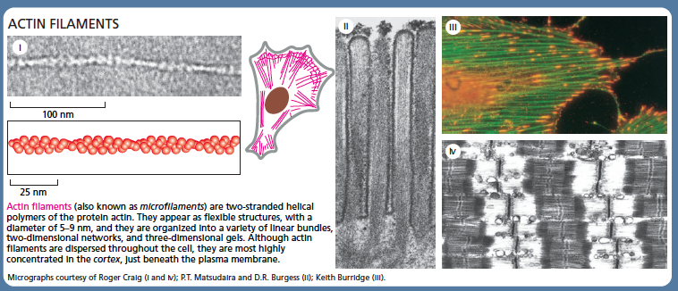
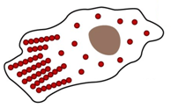
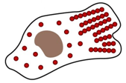
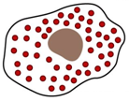
Actin filaments: critical role in cell migration
Actin
depolymerization
Actin
polymerization

Slide 3
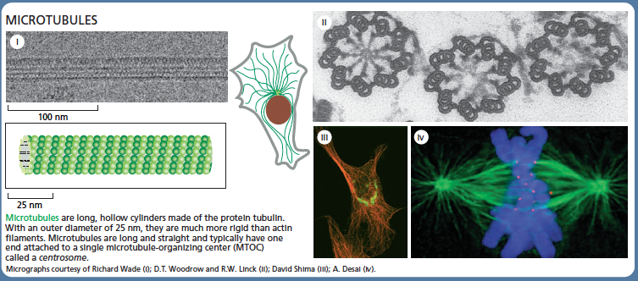
Microtubule: critical role in mitosis and vesicle transports

Slide 4
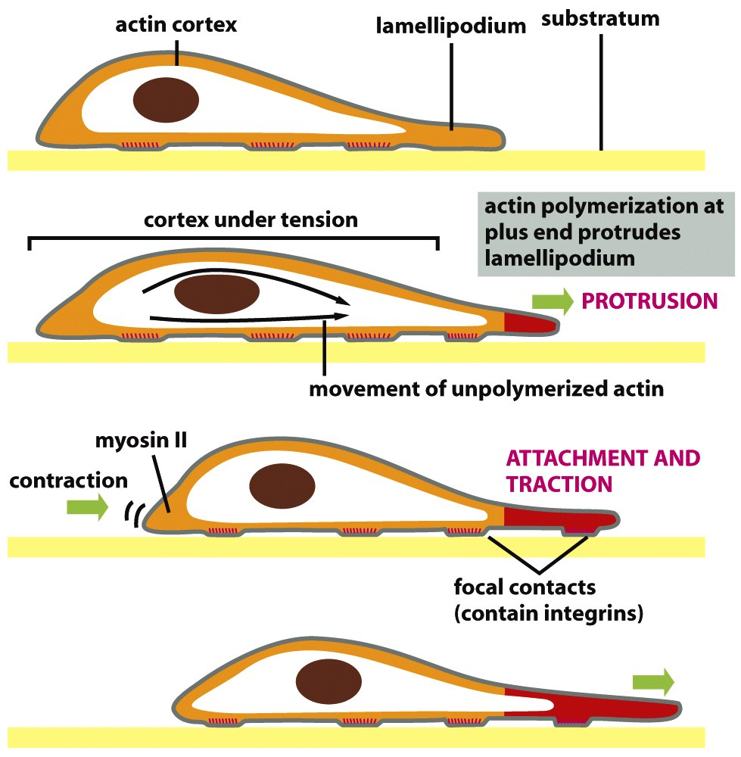
Cell migration
New substrate adhesion sites are formed at the edge of lamellipodium.
Old adhesion sites are broken down at the rear of the cell.
The cell body contracts.
Molecular Biology of the cell

Slide 5
Rho GTPase family
They are key regulatory molecules that control the assembly of actin cytoskeletons.
Many members of the Rho family have been identified.
Rho, Rac, Cdc42 are the most well-characterized members.
Regulation the Rho family proteins are controlled by GTP-binding.

Slide 6
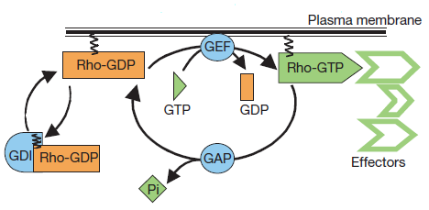
GEF/GAP activate/deactivate Rho family proteins
Rho family proteins are in their active conformation with GTP bound and flip to the inactive conformation when GTP is hydrolized to GDP.
GEFs: guanine nucleotide exchange factors, Rho GTPase activators
GAPs: GTPase-activating proteins, Rho GTPase inactivators
Binding with GDI (guanine nucleotide dissociation inhibitors) prevents Rho proteins from interacting with the plasma membrane
Manneville, S. and Hall, A. (2002). Rho GTPases in cell biology

Slide 7
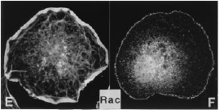
Rac
Activation of Rac induces lamellipodia (actin-rich surface protrusions) and associated adhesion complexes.
Hall, et al. (1998). Rho GTPases and the Actin Cytoskeleton.

Slide 8
Activation of Rac
Rac can be activated by tyrosine kinase receptors or G-protein couple receptors.
Rac can also be activated by Crk/DOCK180 adaptor proteins and PtdIns(3,4,5)P₃/PtdIns(3,4)P₂, which are products of PI3K.
Rac can be activated by integrin engagement (β3).

Slide 9
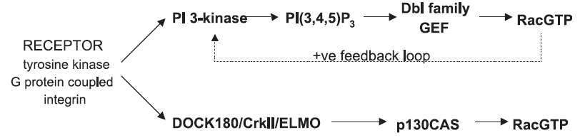
Activation of Rac
Raftopoulou, M. and Hall, A. (2003). Cell migration: Rho GTPases lead the way.

Slide 10
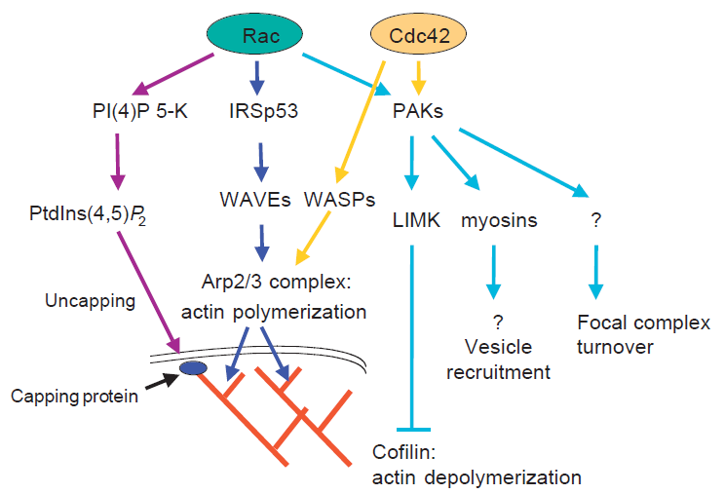
Rac regulate actin polymerization
When Rac is inhibited, cells cannot migrate.
Ridley, A. (2001). Rho GTPases and cell migration.

Slide 11
Rac is required for focal complex assembly
Small focal complex structures are localized in the lamellipodia of most migrating cells. These complexes mediate the attachment of the lamellipodium to the ECM.
Continuous formation of new interactions between integrins and ECM at the leading edge can provide a positive feedback loop.
Rac can also regulate the turn-over of focal complexes.
Focal complexes can mature into Rho-induced focal adhesions.
Ridley, A. (2001). Rho GTPases and cell migration.

Slide 12
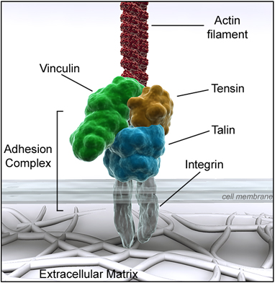
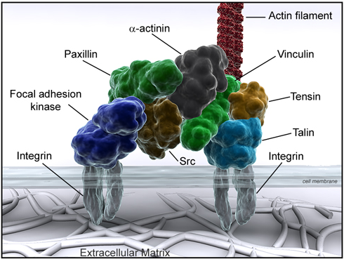
Focal complex vs. focal adhesion
http://www.reading.ac.uk/cellmigration/adhesion.htm
Notes:
Focal complex is smaller than a focal adhesion, which has integrin clustering.

Slide 13
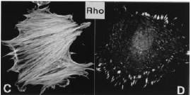
Rho
Activation of Rho induce the formation of stress fiber (contractile actin and myosin filaments) and focal adhesion. Rho activity is also required to maintain focal adhesion.
Hall, et al. (1998). Rho GTPases and the Actin Cytoskeleton.

Slide 14
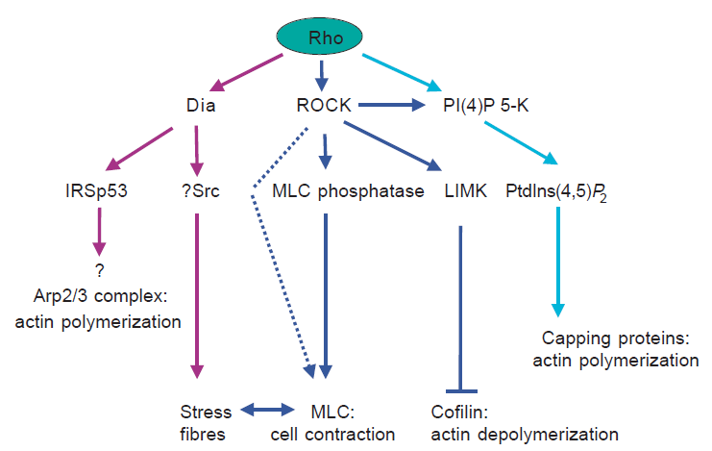
Rho regulates cell body contraction
Cell body contraction is dependent on actomyosin contractility.
Rho via ROCK can inactivate MLC phosphatase to stimulate myosin light chain (MLC) .
Rho via Dia might induce actin polymerization, and Rho via ROCK might regulate actin depolymerization.
Ridley, A. (2001). Rho GTPases and cell migration.

Slide 15
Rho regulates formation of focal adhesion
High-level of Rho activity will result in a high level of integrin-mediated adhesion, and that will inhibit cell migration due to stronger adhesion to ECM.
Reducing Rho activity can lower adhesion and promote migration. However, it can also decrease the cell migration by inhibiting cell body contraction.
In less adherent cells that lacks of focal adhesion, Rho does not affect adhesion.
Ridley, A. (2001). Rho GTPases and cell migration.

Slide 16
Distribution of Rho and Rac
It is found that a gradient of activated Rac is distributed from the front to the rear of migrating cells.
Rac and Rho activitity might be localized to opposite ends of the cell.
Both papers by Buchsbaum and Wittmann indicates that activation of Rac results in down-regulation/inhibition of Rho.
Buchsbaum, R. (2007). Rho activation at a glance.
Wittmann, T. and Storer, C. (2001). Cell motility: can Rho GTPases and microtubules point the way?

Slide 17
Rho/Rac and ECM
Hotchin showed that addition of PDGF and LPA (Lisophosphatidic acid) induces formation of focal complexes when cells are plated on ECM.
Without interaction with ECM, Rho and Rac are not enough to induce focal complexes. ECM alone is not enough to cause clustering of integrins and formation of focal complexes.
Hotchin, N. and Alan, H. (1995). The assembly of integrin adhesion complexes requires both ECM and intracellular rho/rac GTPases

Slide 18
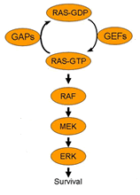
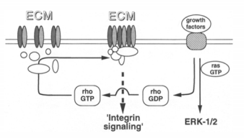
Rho/Rac and ECM
Integrin-matrix interactions are not sufficient to activate the MAPK cascade
The MAPK cascade
Hotchin, N. and Alan, H. (1995). The assembly of integrin adhesion complexes requires both ECM and intracellular rho/rac GTPases.

Slide 19
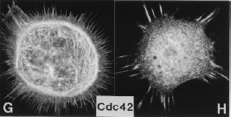
Cdc42
Activation of Cdc42 induces filopodia (actin-rich, finger-like membrane extension) and associated adhesion complexes.
Hall, et al. (1998). Rho GTPases and the Actin Cytoskeleton.

Slide 20
Role of Cdc42
Cdc42 establishes correct cell polarity with respect to the external environment.
Cdc42 acts at the front to control direction in response to extracellular cues and give the cells directional movements.
Receptors on filopodia could detect changes in extracellular signals.
Cdc42 can stimulate the actin polymerization via its interaction with WASp and N-WASp, leading to activation of the Arp2/3 complex.
Ridley, A. (2001). Rho GTPases and cell migration.
Manneville, S. and Hall, A. (2002). Rho GTPases in cell biology.

Slide 21
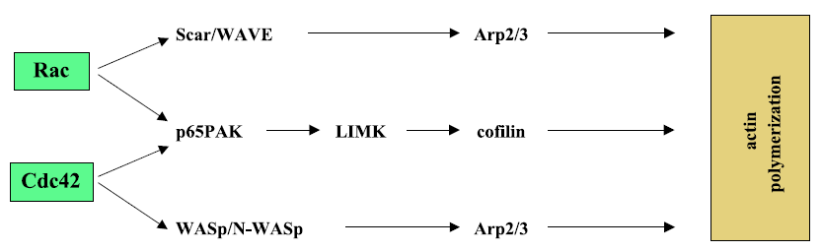
Role of Cdc42
Raftopoulou, M. and Hall, A. (2003). Cell migration: Rho GTPases lead the way.

Slide 22
Role of Cdc42
In a study of macrophage migration up the chemotactic gradient, Allen showed that inhibition of Cdc42 made macrophages revert to a random walk. Inhibition of Rac blocked all cell movement.
In the scratch assays, inhibition of Cdc42 leads to misdirected protrusive activity and a random orientation of microtubule organizing centre.
Manneville, S. and Hall, A. (2002). Rho GTPases in cell biology.
Allen, W. et al. (1998). A role for Cdc42 in Macrophage chemotaxis.

Slide 23
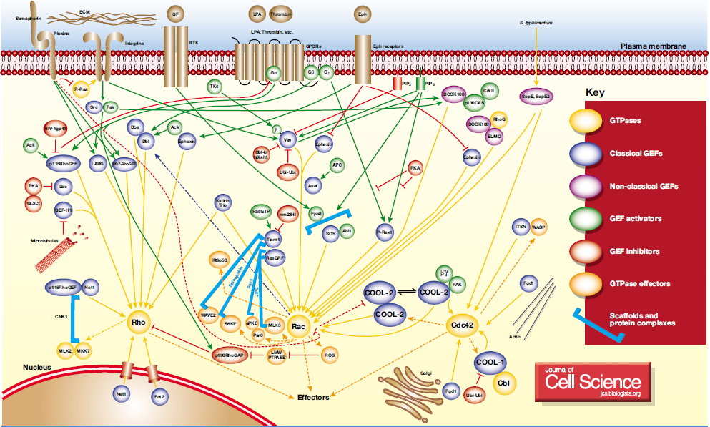
Pathways of Rho, Rac, Cdc42 activation
Buchsbaum, R. (2007). Rho activation at a glance.

Slide 24
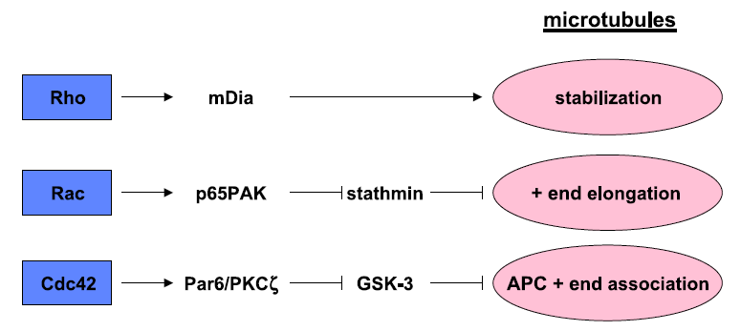
Role of Rho, Rac, Cdc42 in modulating the microtubule cytoskeleton
Persistent long-range migration requires stabilization of cell polarity, which can be achieved through reorganization of the microtubule cytoskeleton.
Raftopoulou, M. and Hall, A. (2003). Cell migration: Rho GTPases lead the way.

Slide 25
Role of Rho, Rac, Cdc42 in cell proliferation
Inhibit the expression of cyclin-dependent kinase inhibitors, permitting G1-S phase progression and DNA synthesis.
Activated of RhoA alone is not sufficient to induce DNA synthesis, it acts synergistically with activated Ras.
Sah, V. et al. (2000). The Role of Rho in G Protein-coupled receptor signal transduction.

Slide 26
References
Manneville, S. and Hall, A. (2002). Rho GTPases in cell biology.
Hall, et al (1998). Rho GTPases and the Actin Cytoskeleton.
Ridley, A. (2001). Rho GTPases and cell migration.
Hotchin, N. and Alan, H. (1995). The assembly of integrin adhesion complexes requires both ECM and intracellular rho/rac GTPases.
Buchsbaum, R. (2007). Rho activation at a glance.
Wittmann, T. and Storer, C. (2001). Cell motility: can Rho GTPases and microtubules point the way?
Allen, W. et al. (1998). A role for Cdc42 in Macrophage chemotaxis.
Sah, V. et al. (2000). The Role of Rho in G Protein-coupled receptor signal transduction.
Raftopoulou, M. and Hall, A. (2003). Cell migration: Rho GTPases lead the way.

