Slide 1
Comparison of wild type S. cerevisiae and S. paradoxus
Natalie Williams and Karina Alvarez

Slide 2
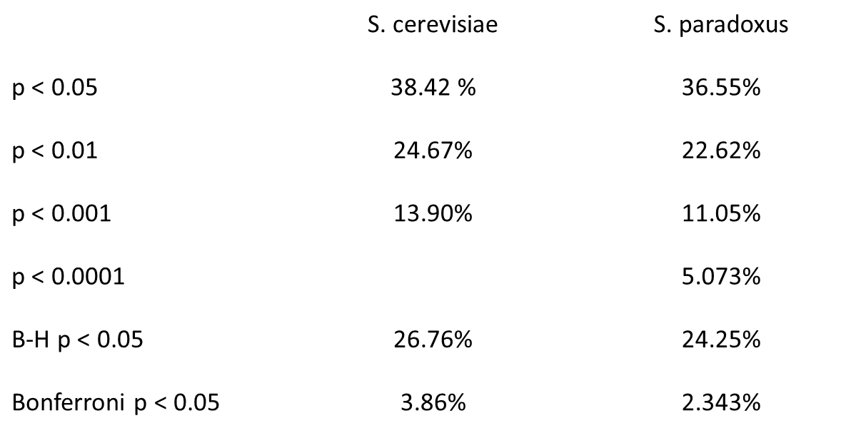
Wildtype S. cerevisiae has a higher percentage of signifcance in the NSR1 gene compared to S. paradoxus

Slide 3
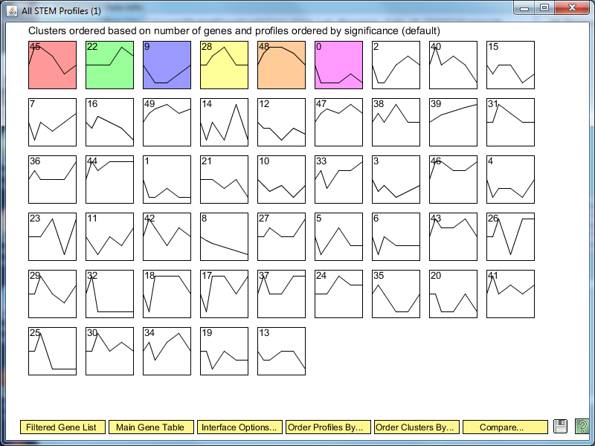
STEM results: wild-type S. cerevisiae has 6 profiles that have significant changes in response to cold shock

Slide 4
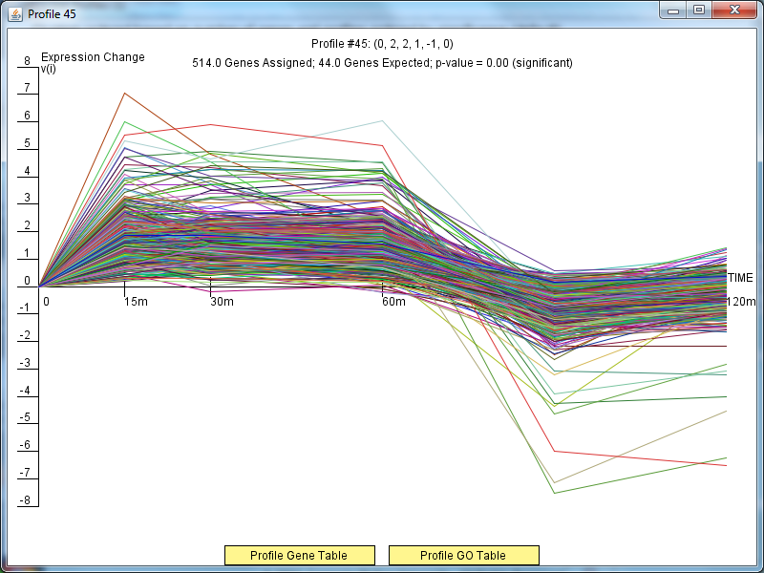
Profile 45 genes initially increase expression, then decrease in the recovery phase

Slide 5
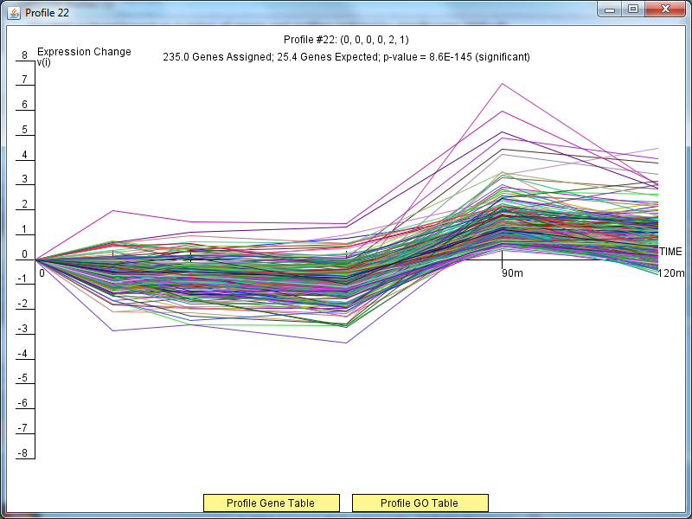
Profile 22 genes initially decrease in expression, then increase in recovery phase

Slide 6
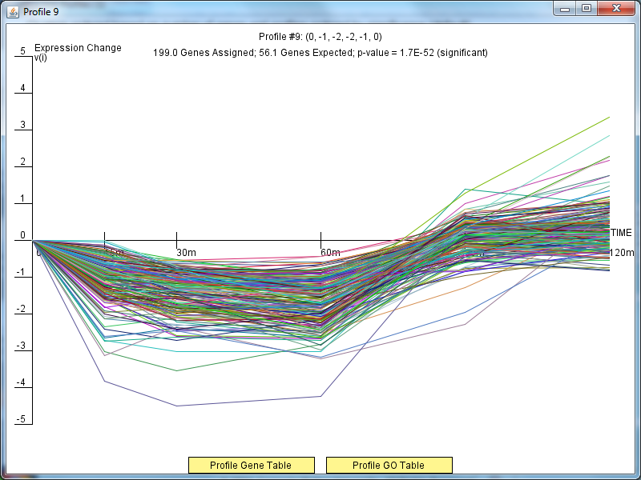
Profile 9 genes have a significant decrease in expression, then increase in the recovery phase.

Slide 7
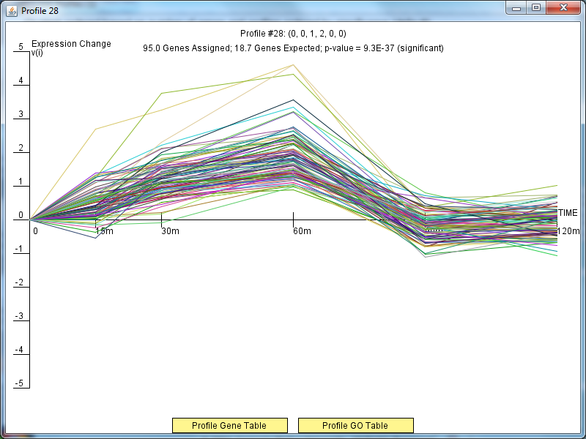
Profile 28 genes steadily increase in expression before decreasing sharply in the recovery phase.
Notes:
Select this one because it rises steadily for the first three time points then drops at 60 minutes
95 genes belong to this profile
18.7 genes expected to belong to this profile
P value = 9.3E-37
44 have a p <0.05
5 have corrected p<0.05
Terms:
cellular amino acid biosynthesis process:
cellular amino acid metabolic process:
carboxylic acid biosynthesis process:
organic acid biosynthesis process:

Slide 8
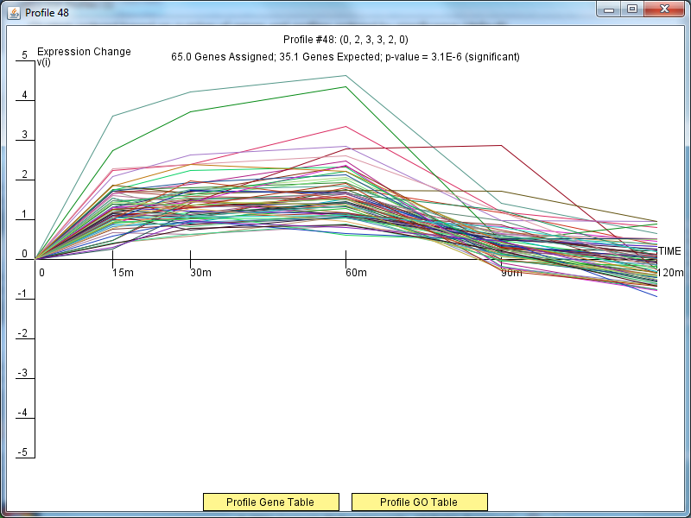
Profile 48 genes have a slight increase in expression before decreasing steadily in the recovery phase.

Slide 9
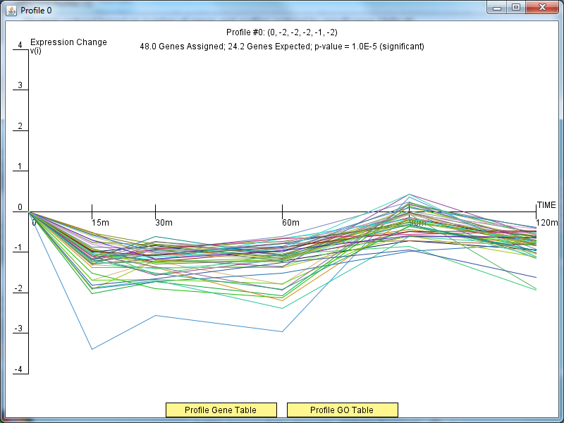
Profile 0 genes generally decrease throughout the cold shock experiment. They exhibit a slight increase in the recovery phase, but expression is generally decreased throughout the entire 120m.

