Slide 1
ANOVA Within Strain P-values
Wild-type data had overall more significant gene expression changes.
ANOVA | WILD-TYPE | DCIN5 | DGLN3 | DHAP4 | DSWI4
p < 0.05 | 2377 (38.41%) | 1995 (32.23%) | 1856 (30.00%) | 2387 (38.57%) | 2583 (41.74%)
p < 0.01 | 1531 (24.74%) | 1157 (18.69%) | 1007 (16.27%) | 1489 (24.06%) | 1679 (27.13%)
p < 0.001 | 850 (13.73%) | 566 (9.15%) | 398 (6.43%) | 679 (10.97%) | 869 (14.04%)
p < 0.0001 | 449 (7.25%) | 280 (4.52%) | 121 (1.96%) | 240 (3.88%) | 446 (7.21%)
B&H p < 0.05 | 1673 (31.88%) | 1117 (18.05%) | 889 (14.36%) | 1615 (20.09%) | 1855 (29.97)
Bonferroni p < 0.05 | 226 (3.65%) | 109 (1.76%) | 20 (0.32%) | 61 (0.99%) | 179 (2.89%)

Slide 2
For the T-test, T60 had the most significant gene expression values; however, T30 had the most significant p-values for the B&H criterion.
 | Cold Shock |  | Recovery
t test | t₁₅ | t₃₀ | t₆₀ | t₉₀ | t₁₂₀
Average Log Fold Change > 0.25 and p < 0.05 | 582 (9.4%) | 865 (14.0%) | 933 (15.1%) | 439 (7.1%) | 230 (3.7%)
Average Log Fold Change < -0.25 and p < 0.05 | 486 (7.9%) | 717 (11.6%) | 867 (14.0%) | 309 (5.0%) | 247 (4.0%)
Total p < 0.05 | 1075 (17.4%) | 1587 (25.6%) | 1814 (29.3%) | 749 (12.1%) | 509 (8.2%)
Total B & H p < 0.05 | 0 (0%) | 85 (1.4%) | 0 (0%) | 0 (0%) | 1 (0.016%)
Total Bonferroni p < 0.05 | 1 (0.016%) | 0 (0%) | 0 (0%) | 1 (0.016%) | 0 (0%)

Slide 3
T-test Comparisons
dHAP4 saw an overall higher change within the individual time points than the wild-type resulted.
 | Cold Shock |  | Recovery
t test | t₁₅ | t₃₀ | t₆₀ | t₉₀ | T₁₂₀
WILD TYPE | 1075 (17.4%) | 1587 (25.6%) | 1814 (29.3%) | 749 (12.1%) | 509 (8.2%)
DCIN5 | 1393 (22.5%) | 756 (12.2%) | 1250 (30.2%) | 634 (10.2%) | 351 (5.6%)
DGLN3 | 1027 (16.6%) | 1622 (26.2%) | 628 (10.1%) | 558 (9.0%) | 403 (6.5%)
DHAP4 | 1197 (19.3%) | 1772 (28.6%) | 2006 (32.4%) | 234 (3.7%) | 515 (8.3%)
DSWI4 | N/A | 1497 (24.2%) | 1757 (28.4%) | 1075 (17.4%) | 705 (11.4%)

Slide 4
Between Strain ANOVA Comparison Results
Looking between the two different species, there was more significant differences in the gene expression levels than within the wt and a deletion strain.
Comparison | p < 0.05 | B&H p <0.05
wt vs. dCIN5 | 563 | 4
wt vs. dGLN3 | 720 | 36
wt vs. dHAP4 | 640 | 23
wt vs. dHMO1 | 556 | 5
wt vs. ZAP1 | 553 | 31
wt vs. S. par | 1498 | 703

Slide 5
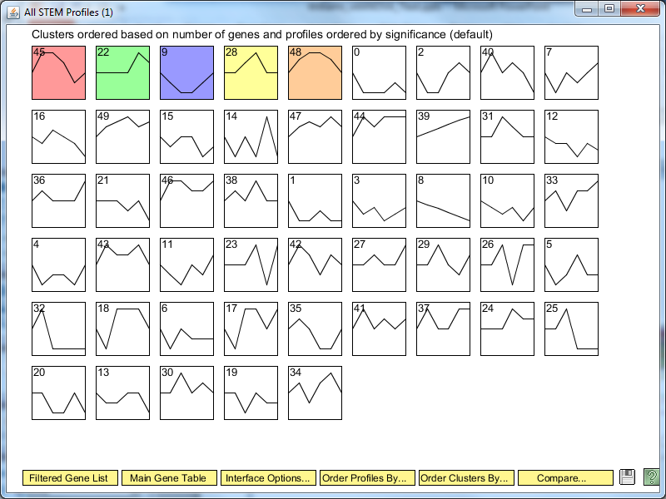
There were 5 significant profiles that STEM identified from the statistical analysis of the significant changes in gene expression.

Slide 6
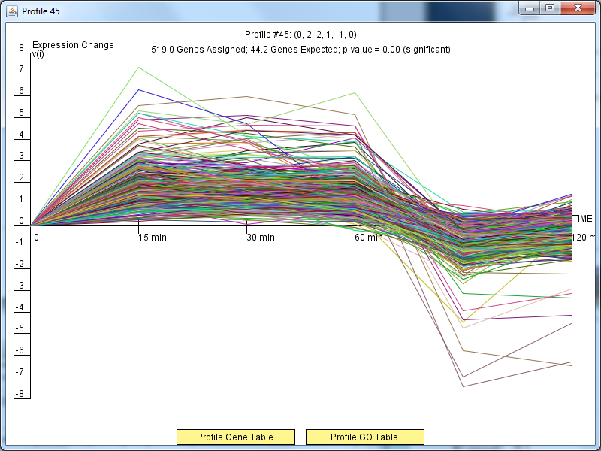
Profile#45 saw up-regulation during cold shock and down regulation during recovery time.

Slide 7
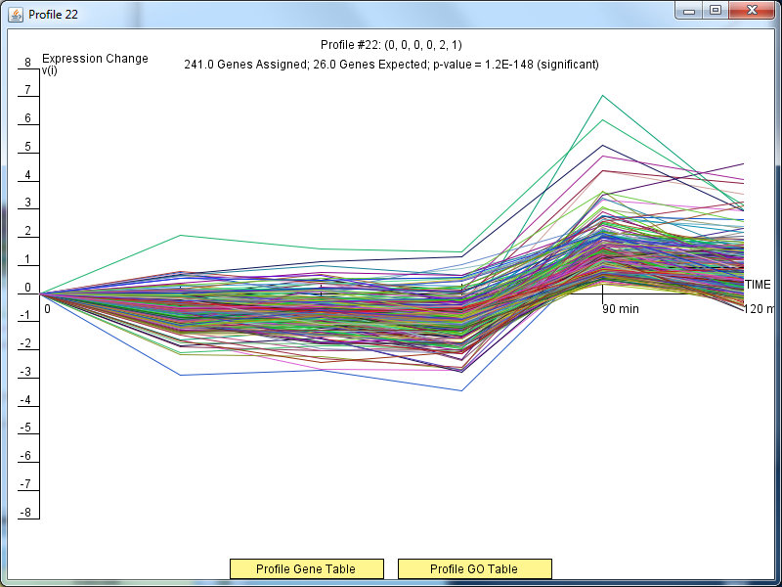
Profile#22 had little to no change in expression during cold shock and up-regulation during recovery time.

Slide 8
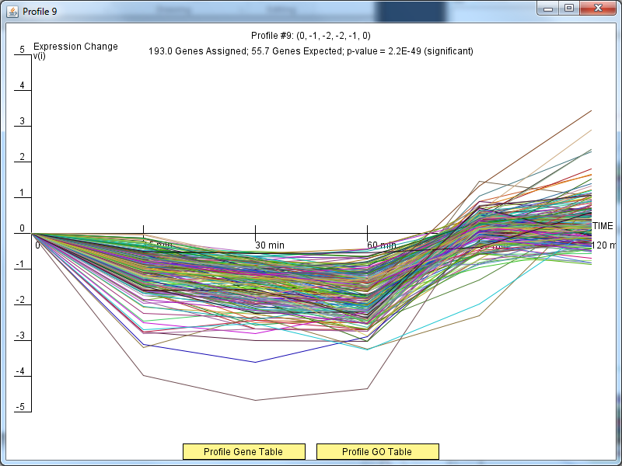
Profile#9 saw down-regulation when the yeast was induced to cold shock and up-regulation during recovery time.

Slide 9
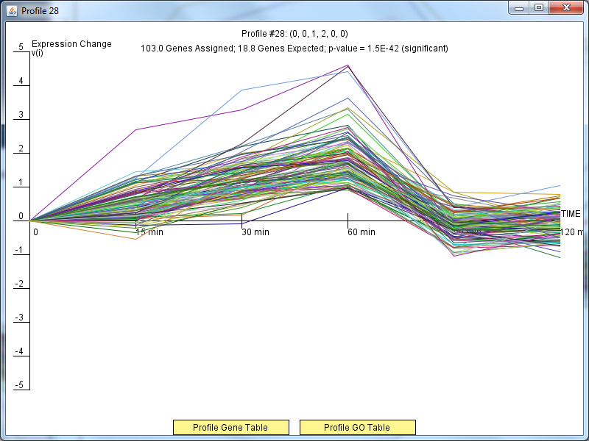
Profile#28 was up-regulated during cold shock while its expression level reached its initial state in recovery time.

Slide 10
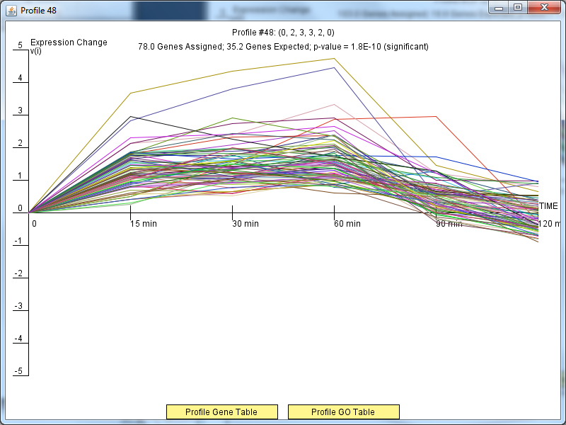
Profile#48 was up-regulated during cold shock and was approaching its initial state during recovery time

Slide 11
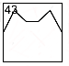
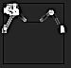
Kittens made from Profile #43

