Slide 1
THINK ABOUT IT
  Homeostasis is hard work. Organisms and the cells within them have to grow and develop, move materials around, build new molecules, and respond to environmental changes.
  What powers so much activity, and where does that power come from?

Slide 2

Chemical Energy and ATP
  Why is ATP useful to cells?
  ATP can easily release and store energy by breaking and re-forming the bonds between its phosphate groups. This characteristic of ATP makes it exceptionally useful as a basic energy source for all cells.

Slide 3
ENERGY MOLECULES in the CELL
Glucose- Good for long term storage but not to power cell metabolism
ATP- Good to power cell metabolism but not for long term storage
NADP, FADH2, NADH- Good for shuttling energy to and within the mitochondria and chloroplast but not for other purposes

Slide 4
Chemical Energy and Food
  Food provides living things with the chemical building blocks they need to grow and reproduce.
  Food molecules contain chemical energy that is released when its chemical bonds are broken.

Slide 5
Chemical Energy and Food
  Energy stored in food is expressed in units of calories. A Calorie is the amount of energy needed to raise the temperature of 1 gram of water by 1 degree Celsius. 1000 calories = 1 kilocalorie, or Calorie.
  Cells use all sorts of molecules for food, including fats, proteins, and carbohydrates. The energy stored in each of these molecules varies because their chemical structures, and therefore their energy-storing bonds, differ.
  Cells break down food molecules gradually and use the energy stored in the chemical bonds to produce compounds such as ATP that power the activities of the cell.

Slide 6
Chemical Energy and ATP
  Energy is the ability to do work.
  Your cells are busy using energy to build new molecules, contract muscles, and carry out active transport.
  Without the ability to obtain and use energy, life would cease to exist.

Slide 7

Chemical Energy and ATP
  One of the most important compounds that cells use to store and release
  energy is adenosine triphosphate (ATP).
  ATP consists of adenine, a 5-carbon sugar called ribose, and three
  phosphate groups.

Slide 8
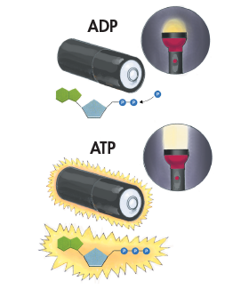
Storing Energy
  Adenosine diphosphate (ADP) looks almost like ATP, except that it has two phosphate groups instead of three. ADP contains some energy, but not as much as ATP.
  When a cell has energy available, it can store small amounts of it by adding phosphate groups to ADP, producing ATP.
  ADP is like a rechargeable battery that powers the machinery of the cell.

Slide 9
Releasing Energy
  Cells can release the energy stored in ATP by breaking the bonds between the second and third phosphate groups.
  Because a cell can add or subtract these phosphate groups, it has an efficient way of storing and releasing energy as needed.

Slide 10

Using Biochemical Energy
  One way cells use the energy provided by ATP is to carry out active transport.
  ATP powers movement, providing the energy for motor proteins that contract muscle and power the movement of cilia and flagella.
  .

Slide 11
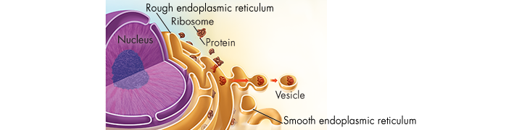
Using Biochemical Energy
  Energy from ATP powers the synthesis of proteins and responses to chemical signals at the cell surface.

Slide 12
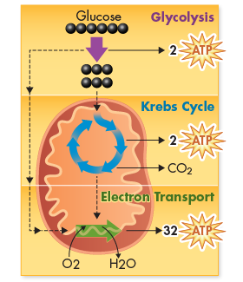
Using Biochemical Energy
  ATP is not a good molecule for storing large amounts of energy over the long term.
  It is more efficient for cells to keep only a small supply of ATP on hand.
  Cells can regenerate ATP from ADP as needed by using the energy in foods like glucose.

Slide 13
Heterotrophs and Autotrophs
  What happens during the process of photosynthesis?
  In the process of photosynthesis, plants convert the energy of sunlight into chemical energy stored in the bonds of carbohydrates.

Slide 14
Heterotrophs and Autotrophs
  Organisms that obtain food by consuming other living things are known as heterotrophs.
  Some heterotrophs get their food by eating plants.
  Other heterotrophs, such as this cheetah, obtain food from plants indirectly by feeding on plant-eating animals.
  Still other heterotrophs, such as mushrooms, obtain food by decomposing other organisms.

Slide 15
Heterotrophs and Autotrophs
  Organisms that make their own food are called autotrophs.
  Plants, algae, and some bacteria are able to use light energy from the sun to produce food. The process by which autotrophs use the energy of sunlight to produce high-energy carbohydrates that can be used for food is known as photosynthesis.

Slide 16
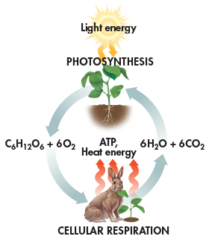
Photosynthesis and Cellular Respiration
  Photosynthesis and cellular respiration are opposite processes
  Energy flows in opposite directions
  Photosynthesis “deposits” energy; cellular respiration “withdraws” energy

Slide 17
Photosynthesis and Cellular Respiration
  Cellular respiration takes place in plants, animals, fungi, protists, and most bacteria
  Energy capture by photosynthesis occurs only in plants, algae, and some bacteria

Slide 18
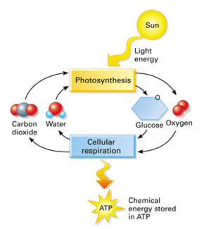

Slide 19
Investigating Photosynthesis
  What did the experiments of van Helmont, Priestley, and Ingenhousz reveal about how plants grow?

Slide 20
Investigating Photosynthesis
  Van Helmont’s Experiment
    In the 1600s, Jan van Helmont wanted to find out if plants grew by taking material out of the soil.
    He determined the mass of a pot of dry soil and a small seedling, planted the seedling in the pot, and watered it regularly.
    After five years, the seedling was a small tree and had gained 75 kg, but the soil’s mass was almost unchanged.

Slide 21
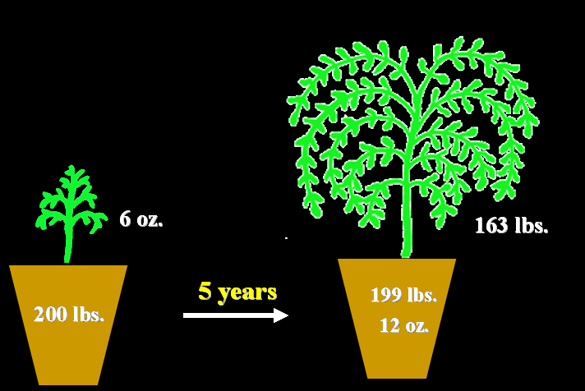

Slide 22
Investigating Photosynthesis
    Van Helmont concluded that the gain in mass came from water because water was the only thing he had added.
    His experiment accounts for the “hydrate,” or water, portion of the carbohydrate produced by photosynthesis.
    But where does the carbon of the “carbo-” portion come from?

Slide 23
Investigating Photosynthesis
    Although van Helmont did not realize it, carbon dioxide in the air made a major contribution to the mass of his tree.
    In photosynthesis, the carbon in carbon dioxide is used to make sugars and other carbohydrates.
    Van Helmont had only part of the story, but he had made a major contribution to science.

Slide 24
Investigating Photosynthesis
  Priestley’s Experiment
    More than 100 years after van Helmont’s experiment, Joseph Priestley provided another insight into the process of photosynthesis.
    Priestley took a candle, placed a glass jar over it, and watched as the flame gradually died out.
    He reasoned that the flame needed something in the air to keep burning and when it was used up, the flame went out. That substance was oxygen.

Slide 25
Investigating Photosynthesis
    Priestley then placed a live sprig of mint under the jar and allowed a few days to pass.
    He found that the candle could be relighted and would remain lighted for a while.
    The mint plant had produced the substance required for burning. In other words, it had released oxygen.

Slide 26
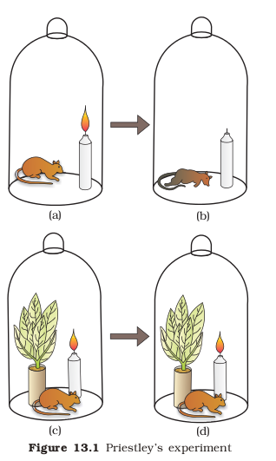

Slide 27
Investigating Photosynthesis
  Jan Ingenhousz
    Later, Jan Ingenhousz showed that the effect observed by Priestley occurred only when the plant was exposed to light.
    The results of both Priestley’s and Ingenhousz’s experiments showed that light is necessary for plants to produce oxygen.

Slide 28
Investigating Photosynthesis
  The experiments performed by van Helmont, Priestley, and Ingenhousz led to work by other scientists who finally discovered that, in the presence of light, plants transform carbon dioxide and water into carbohydrates, and they also release oxygen.

Slide 29
How is a plant structured to do photosynthesis?

Slide 30
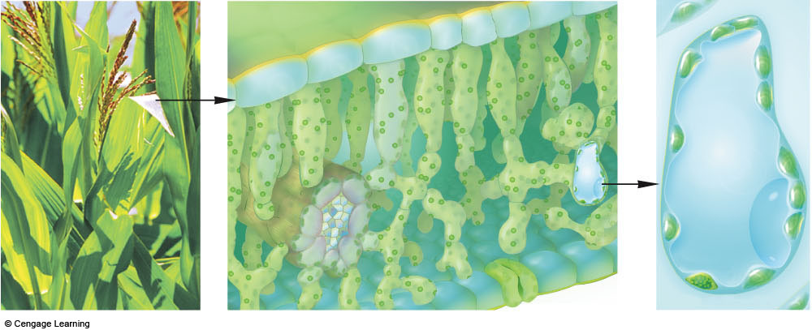
upper epidermis
photosynthetic cells
leaf vein
a Zooming in on a
photosynthetic cell.
lower epidermis
Fig. 6.6a, p.97

Slide 31
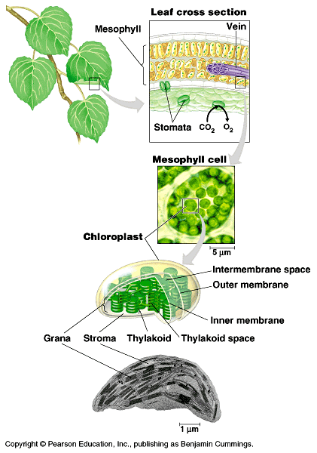
Figure 10.2 Focusing in on the location of photosynthesis in a plant

Slide 32
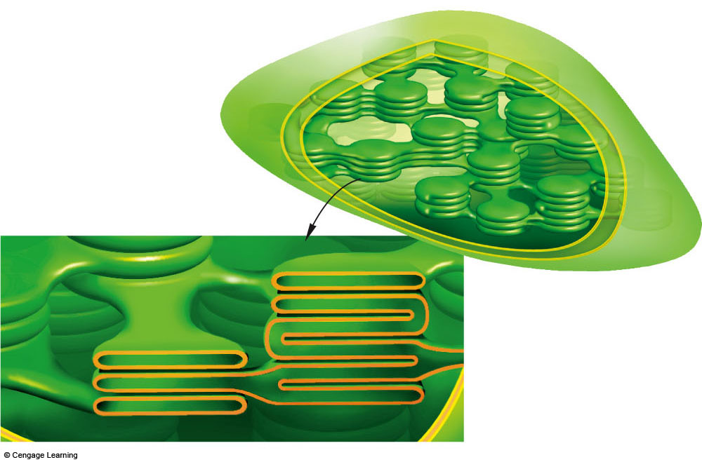
two outer membranes
of chloroplasts
stroma
part of thylakoid membrane
system bathed in stroma:
thylakoid
compartment,
cutaway view
b Chloroplast structure. No matter how highly folded, its thylakoid membrane system forms a single, continuous compartment in the stroma.
Fig. 6.6b, p.97

Slide 33
Chlorophyll and Chloroplasts
  What role do pigments play in the process of photosynthesis?
  Photosynthetic organisms capture energy from sunlight with pigments.

Slide 34
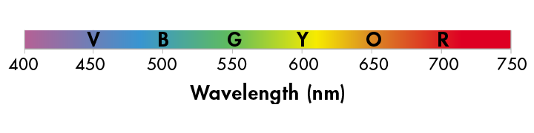
Light
  Energy from the sun travels to Earth in the form of light.
  Sunlight is a mixture of different wavelengths, many of which are visible to our eyes and make up the visible spectrum.

Slide 35
Light
  Our eyes see the different wavelengths of the visible spectrum as different colors: red, orange, yellow, green, blue, indigo, and violet.

Slide 36
Pigments
  Plants gather the sun’s energy with light-absorbing molecules called pigments.
  The plants’ principal pigment is chlorophyll.

Slide 37

Chloroplasts
  Photosynthesis takes place inside organelles called chloroplasts.
  Chloroplasts contain saclike photosynthetic membranes called thylakoids, which are interconnected and arranged in stacks known as grana.

Slide 38
Chloroplasts
  Pigments are located in the thylakoid membranes.
  The fluid portion outside of the thylakoids is known as the stroma.

Slide 39
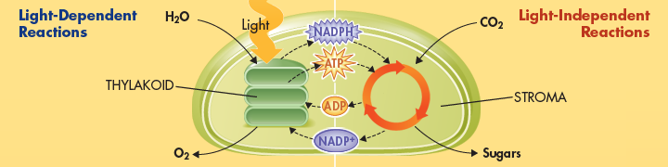
Energy Collection
  Because light is a form of energy, any compound that absorbs light absorbs energy. Chlorophyll absorbs visible light especially well.
  When chlorophyll absorbs light, a large fraction of the light energy is transferred to electrons. These high-energy electrons make photosynthesis work.

Slide 40
An Overview of Photosynthesis
  What are the reactants and products of photosynthesis?
  Photosynthesis uses the energy of sunlight to convert water and carbon dioxide (reactants) into high-energy sugars and oxygen (products).

Slide 41
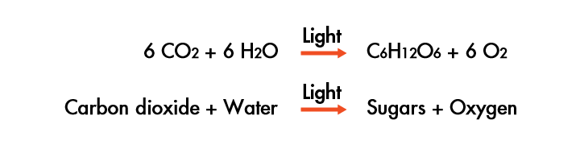
An Overview of Photosynthesis
  Photosynthesis uses the energy of sunlight to convert water and carbon dioxide into high-energy sugars and oxygen.

Slide 42
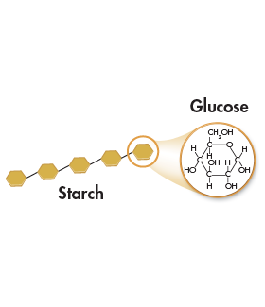
An Overview of Photosynthesis
  Plants use the sugars generated by photosynthesis to produce complex carbohydrates such as starches, and to provide energy for the synthesis of other compounds, including proteins and lipids.

Slide 43
The End Results
  The two sets of photosynthetic reactions work together—the light-dependent reactions trap the energy of sunlight in chemical form, and the light-independent reactions use that chemical energy to produce stable, high-energy sugars from carbon dioxide and water.
  In the process, animals, including humans, get food and an atmosphere filled with oxygen.

Slide 44
THINK ABOUT IT
  Why do chloroplasts contain so many membranes?
  When most pigments absorb light, they eventually lose most of that energy as heat. Chloroplasts avoid such losses. Membranes are the key to capturing light energy in the form of high-energy electrons.

Slide 45
The Light-Dependent Reactions: Generating ATP and NADPH
  What happens during the light-dependent reactions?

Slide 46
The Light-Dependent Reactions: Generating ATP and NADPH
  What happens during the light-dependent reactions?
  The light-dependent reactions use energy from sunlight to produce oxygen
  and convert ADP and NADP⁺ into the energy carriers ATP and NADPH.

Slide 47
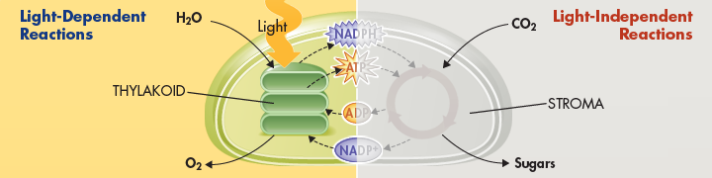
The Light-Dependent Reactions: Generating ATP and NADPH
  The light-dependent reactions encompass the steps of photosynthesis that directly involve sunlight.
  The light-dependent reactions occur in the thylakoids of chloroplasts.

Slide 48
The Light-Dependent Reactions: Generating ATP and NADPH
  Thylakoids contain clusters of chlorophyll and proteins known as photosystems.
  Photosystems absorb sunlight and generate high-energy electrons that are then passed to a series of electron carriers embedded in the thylakoid membrane.

Slide 49
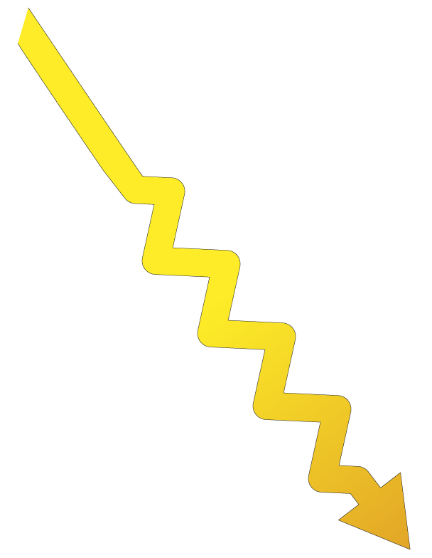

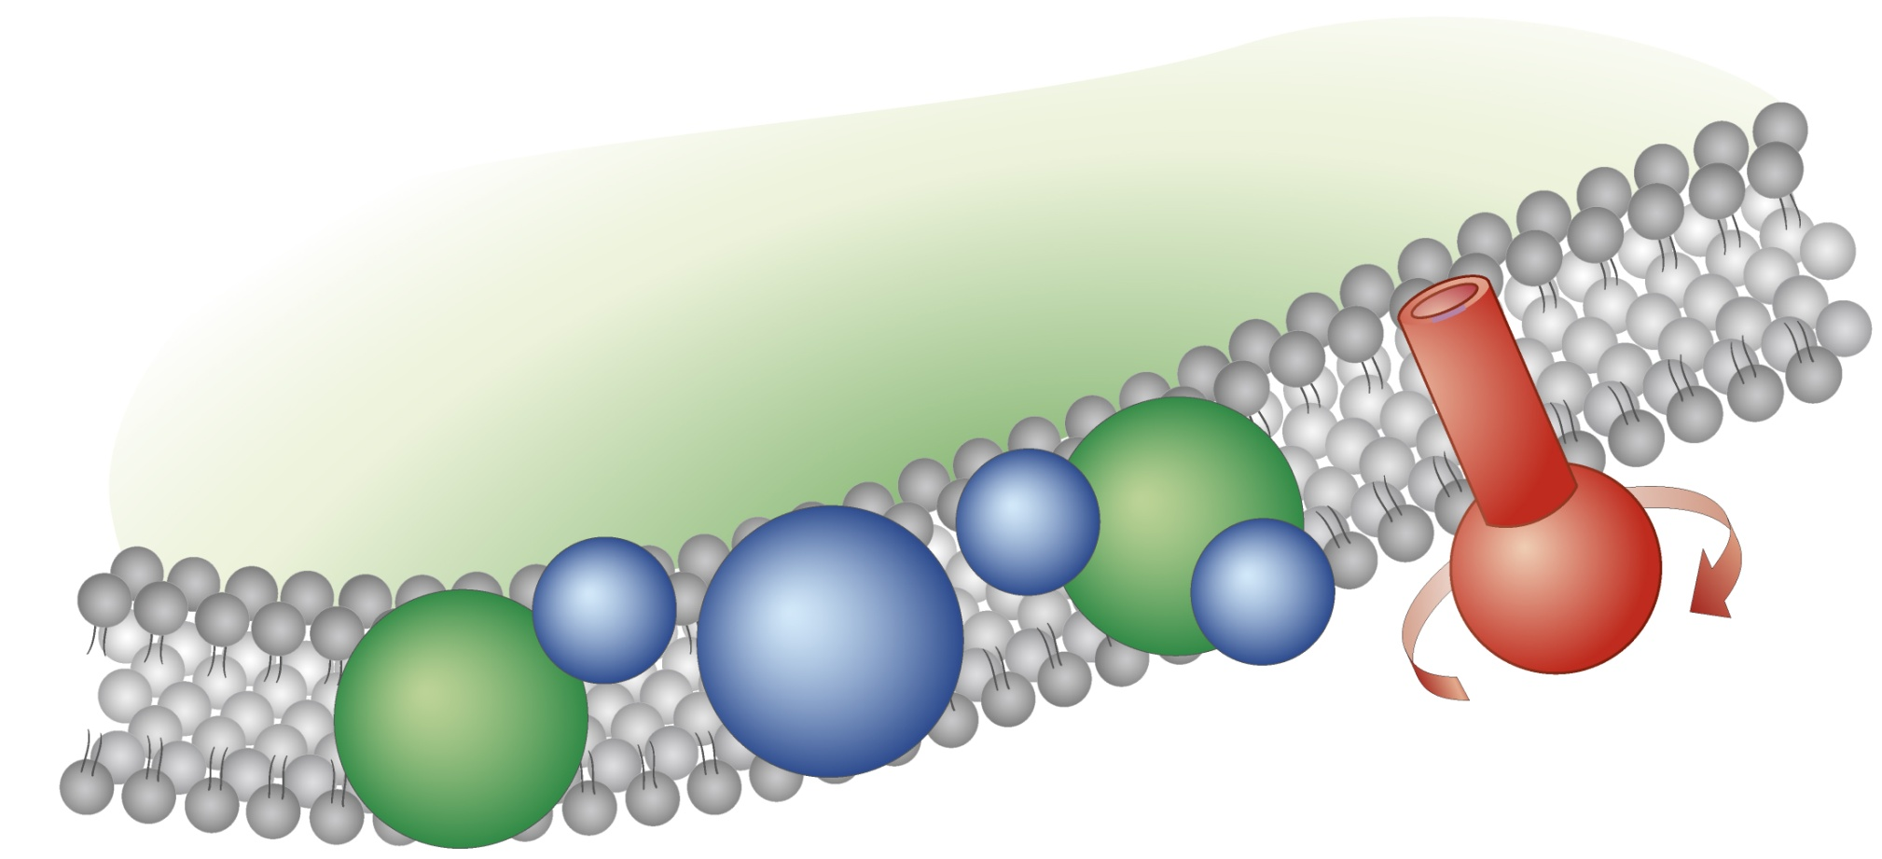
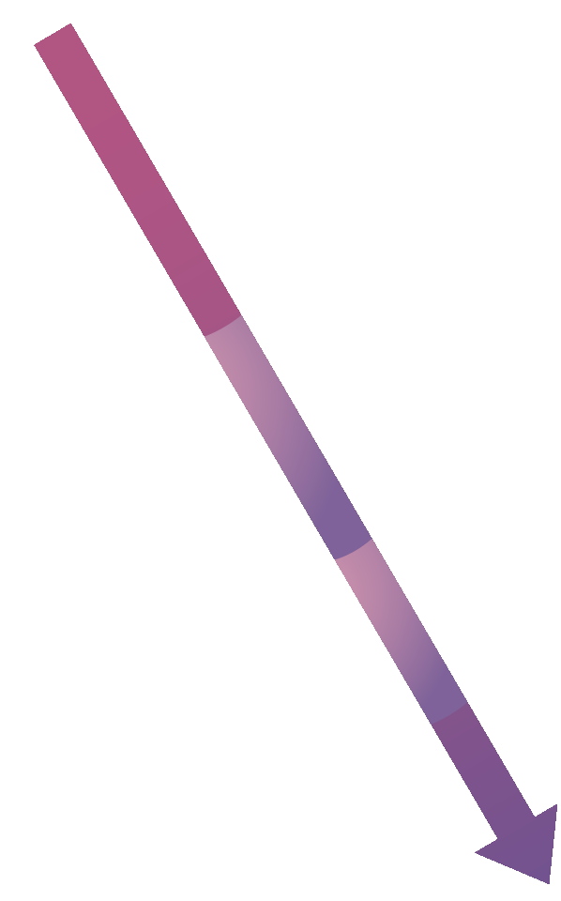
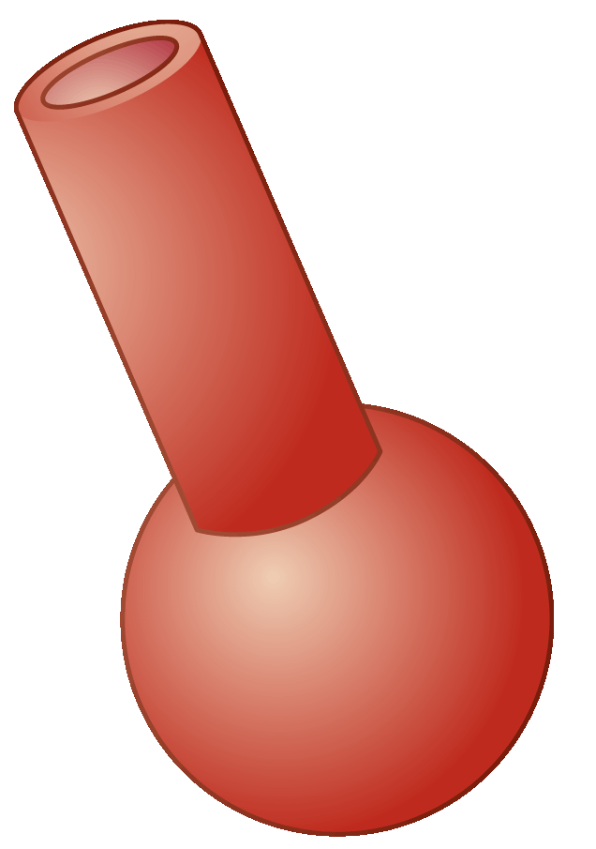
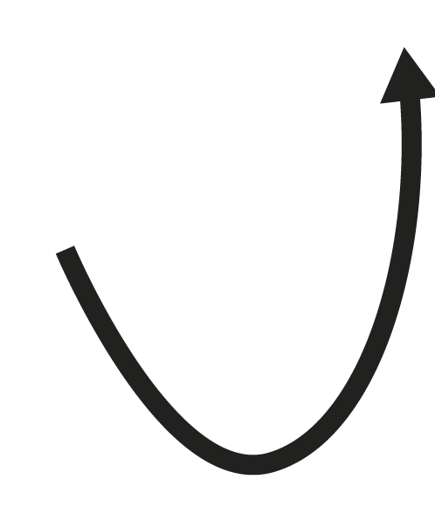
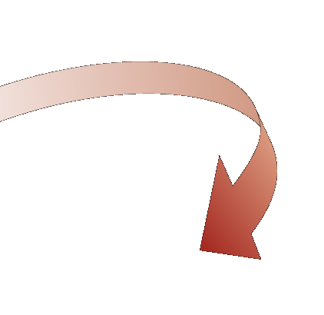
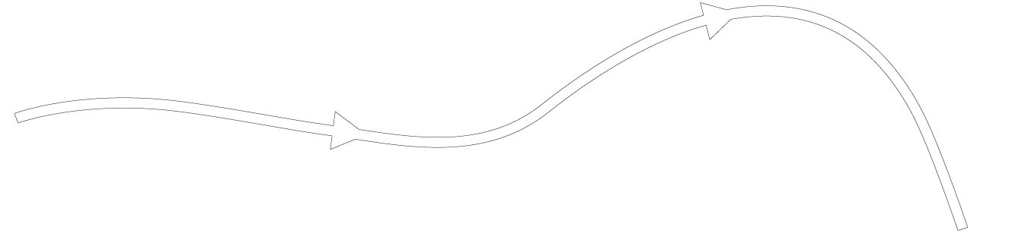
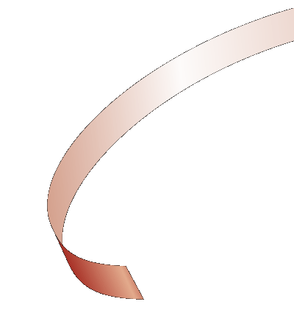





Light-Dependent Reactions
ATP synthase
+ O₂
2H₂O
ADP
2 NADP⁺
2
2
NADPH
Notes:
The light-dependent reactions use energy from sunlight to produce ATP, NADPH, and oxygen.

Slide 50
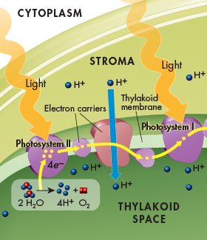
Photosystem II
  Light energy is absorbed by electrons in the pigments within photosystem II, increasing the electrons’ energy level.
  The high-energy electrons are passed to the electron transport chain, a series of electron carriers that shuttle high-energy electrons during ATP-generating reactions.

Slide 51
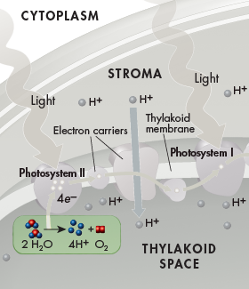
Photosystem II
  The thylakoid membrane provides new electrons to chlorophyll from water molecules.
  Enzymes of the inner surface of the thylakoid break up water molecules into 2 electrons, 2 H⁺ ions, and 1 oxygen atom.

Slide 52
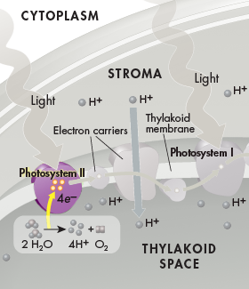
Photosystem II
  The 2 electrons replace the high-energy electrons that have been lost to the electron transport chain.
  Oxygen is released into the air. This reaction is the source of nearly all of the oxygen in Earth’s atmosphere.
  The H⁺ ions are released inside the thylakoid.

Slide 53
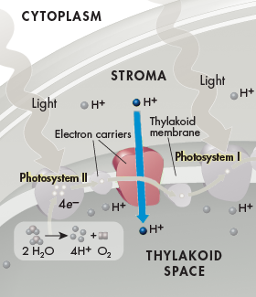
Electron Transport Chain
  Energy from the electrons is used by proteins in the electron transport chain to pump H⁺ ions from the stroma into the thylakoid space.

Slide 54
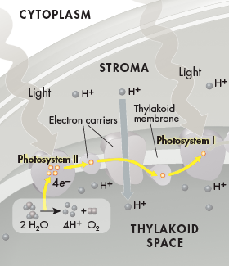
Electron Transport Chain
  At the end of the electron transport chain, the electrons pass to photosystem I.

Slide 55
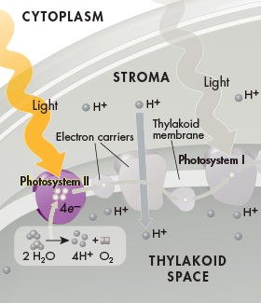
Photosystem I
  Because some energy has been used to pump H⁺ ions across the thylakoid membrane, electrons do not contain as much energy as they used to when they reach photosystem I.
  Pigments in photosystem I use energy from light to reenergize the electrons.

Slide 56
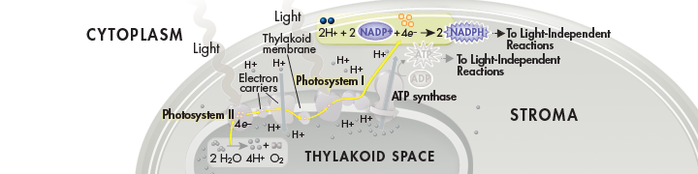
Photosystem I
  At the end of a short second electron transport chain, NADP⁺ molecules in the stroma pick up the high-energy electrons and H⁺ ions at the outer surface of the thylakoid membrane to become NADPH.

Slide 57
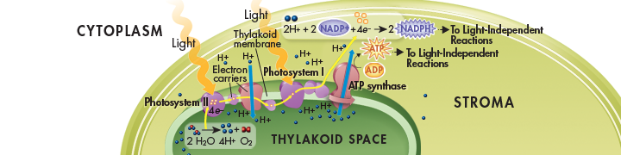
Hydrogen Ion Movement and ATP Formation
  H⁺ ions accumulate within the thylakoid space from the splitting of water and from being pumped in from the stroma.
  The buildup of H⁺ ions makes the stroma negatively charged relative to the space within the thylakoids.

Slide 58
Hydrogen Ion Movement and ATP Formation

Slide 59
Light-Dependent Reactions
ATP synthase
+ O₂
2H₂O
ADP
2 NADP⁺
2
2
NADPH
Notes:
The light-dependent reactions use energy from sunlight to produce ATP, NADPH, and oxygen.

Slide 60
Hydrogen Ion Movement and ATP Formation
  This gradient, the difference in both charge and H⁺ ion concentration across the membrane, provides the energy to make ATP.

Slide 61
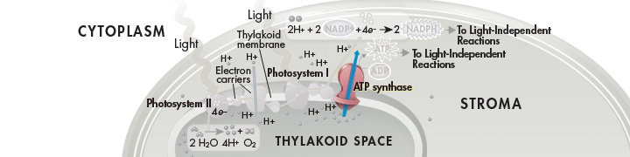
Hydrogen Ion Movement and ATP Formation
  H⁺ ions cannot directly cross the thylakoid membane. However, the thylakoid membrane contains a protein called ATP synthase that spans the membrane and allows H⁺ ions to pass through it.

Slide 62
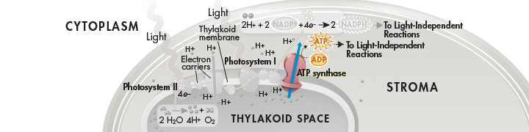
Hydrogen Ion Movement and ATP Formation
  Powered by the gradient, H⁺ ions pass through ATP synthase and force it to rotate.
  As it rotates, ATP synthase binds ADP and a phosphate group together to produce ATP.

Slide 63
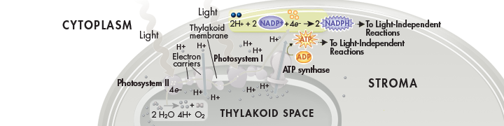
Hydrogen Ion Movement and ATP Formation
  This process, called chemiosmosis, enables light-dependent electron transport to produce not only NADPH (at the end of the electron transport chain), but ATP as well.

Slide 64
Summary of Light-Dependent Reactions
  The light-dependent reactions produce oxygen gas and convert ADP and NADP⁺ into the energy carriers ATP and NADPH.
  ATP and NADPH provide the energy needed to build high-energy sugars from low-energy carbon dioxide.

Slide 65
Light-Dependent Reactions
ATP synthase
+ O₂
2H₂O
ADP
2 NADP⁺
2
2
NADPH
Notes:
The light-dependent reactions use energy from sunlight to produce ATP, NADPH, and oxygen.

Slide 66
The Light-Independent Reactions: Producing Sugars
  What happens during the light-independent reactions?

Slide 67
The Light-Independent Reactions: Producing Sugars
  What happens during the light-independent reactions?
  During the light-independent reactions, ATP and NADPH from the light
  dependent reactions are used to produce high-energy sugars.

Slide 68
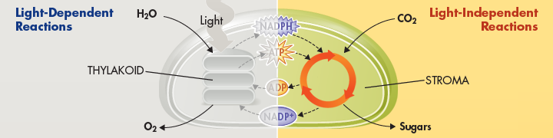
The Light-Independent Reactions: Producing Sugars
  During the light-independent reactions, commonly referred to as the Calvin cycle, plants use the energy that ATP and NADPH contains to build stable high-energy carbohydrate compounds that can be stored for a long time.

Slide 69

Carbon Dioxide Enters the Cycle
  Carbon dioxide molecules enter the Calvin cycle from the atmosphere.
  An enzyme in the stroma of the chloroplast combines carbon dioxide molecules with 5-carbon compounds that are already present in the organelle, producing 3-carbon compounds that continue into the cycle.

Slide 70
Carbon Dioxide Enters the Cycle
  For every 6 carbon dioxide molecules that enter the cycle, a total of twelve 3-carbon compounds are produced.

Slide 71
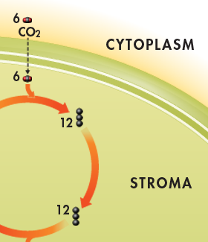
Carbon Dioxide Enters the Cycle
  Other enzymes in the chloroplast then convert the 3-carbon compounds into higher-energy forms in the rest of the cycle, using energy from ATP and high-energy electrons from NADPH.

Slide 72
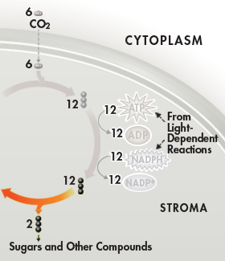
Sugar Production
  At midcycle, two of the twelve 3-carbon molecules are removed from the cycle.
  These molecules become the building blocks that the plant cell uses to produce sugars, lipids, amino acids, and other compounds.

Slide 73
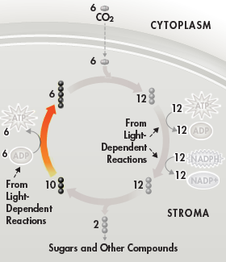
Sugar Production
  The remaining ten 3-carbon molecules are converted back into six 5-carbon molecules that combine with six new carbon dioxide molecules to begin the next cycle.

Slide 74
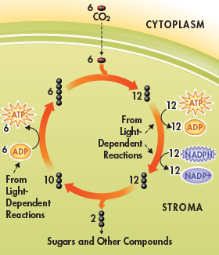
Summary of the Calvin Cycle
  The Calvin cycle uses 6 molecules of carbon dioxide to produce a single 6-carbon sugar molecule.

Slide 75
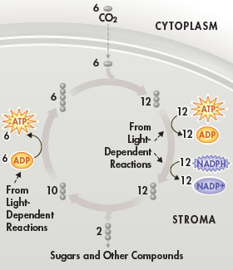
Summary of the Calvin Cycle
  The energy for the reactions is supplied by compounds produced in the light-dependent reactions.

Slide 76
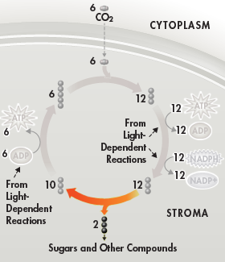
Summary of the Calvin Cycle
  The plant uses the sugars produced by the Calvin cycle to meet its energy needs and to build macromolecules needed for growth and development.
  When other organisms eat plants, they can use the energy and raw materials stored in these compounds.

Slide 77
The End Results
  The two sets of photosynthetic reactions work together—the light-dependent reactions trap the energy of sunlight in chemical form, and the light-independent reactions use that chemical energy to produce stable, high-energy sugars from carbon dioxide and water.
  In the process, animals, including humans, get food and an atmosphere filled with oxygen.

Slide 78
Factors Affecting Photosynthesis
  What factors affect photosynthesis?

Slide 79
Factors Affecting Photosynthesis
  What factors affect photosynthesis?
  Among the most important factors that affect photosynthesis are
  temperature, light intensity, and the availability of water.

Slide 80
Temperature, Light, and Water
  The reactions of photosynthesis are made possible by enzymes that function best between 0°C and 35°C.
  Temperatures above or below this range may affect those enzymes, slowing down the rate of photosynthesis or stopping it entirely.

Slide 81

Temperature, Light, and Water
  High light intensity increases the rate of photosynthesis.
  After the light intensity reaches a certain level, however, the plant reaches its maximum rate of photosynthesis, as is seen in the graph.

Slide 82
Temperature, Light, and Water
  Because water is one of the raw materials in photosynthesis, a shortage of water can slow or even stop photosynthesis.
  Water loss can also damage plant tissues.
  Plants that live in dry conditions often have waxy coatings on their leaves to reduce water loss. They may also have biochemical adaptations that make photosynthesis more efficient under dry conditions.

Slide 83
Photosynthesis Under Extreme Conditions
  In order to conserve water, most plants under bright, hot conditions close the small openings in their leaves that normally admit carbon dioxide.
  This causes carbon dioxide within the leaves to fall to very low levels, slowing down or even stopping photosynthesis.
  C4 and CAM plants have biochemical adaptations that minimize water loss while still allowing photosynthesis to take place in intense sunlight.

Slide 84
C4 Photosynthesis
  C4 plants have a specialized chemical pathway that allows them to capture even very low levels of carbon dioxide and pass it to the Calvin cycle.
  The name “C4 plant” comes from the fact that the first compound formed in this pathway contains 4 carbon atoms.
  The C4 pathway requires extra energy in the form of ATP to function.
  C4 organisms include crop plants like corn, sugar cane, and sorghum.

Slide 85
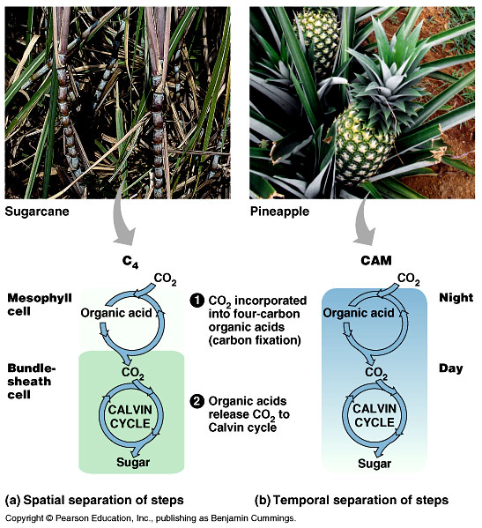

Slide 86
CAM Plants
  Members of the Crassulacae family, such as cacti and succulents, incorporate carbon dioxide into organic acids during photosynthesis in a process called Crassulacean Acid Metabolism (CAM).

Slide 87
CAM Plants
  CAM plants admit air into their leaves only at night, where carbon dioxide is combined with existing molecules to produce organic acids, “trapping” the carbon within the leaves.
  During the daytime, when leaves are tightly sealed to prevent water loss, these compounds release carbon dioxide, enabling carbohydrate production.
  CAM plants include pineapple trees, many desert cacti, and “ice plants”.

Slide 88
Overview of Cellular Respiration
  If oxygen is available, organisms can obtain energy from food by a process called cellular respiration. The summary of cellular respiration is presented below.
  In symbols:
  6 O₂ + C₆H₁₂O₆ → 6 CO₂ + 6 H₂O + Energy
  In words:
  Oxygen + Glucose → Carbon dioxide + Water + Energy
  The cell has to release the chemical energy in food molecules (like glucose) gradually, otherwise most of the energy would be lost in the form of heat and light.

Slide 89
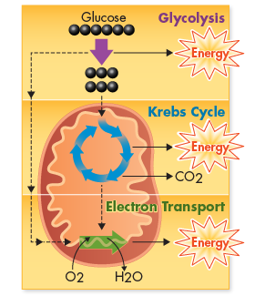
THREE Stages of Cellular Respiration
  Glycolysis
  Krebs cycle
  Electron transport chain

Slide 90
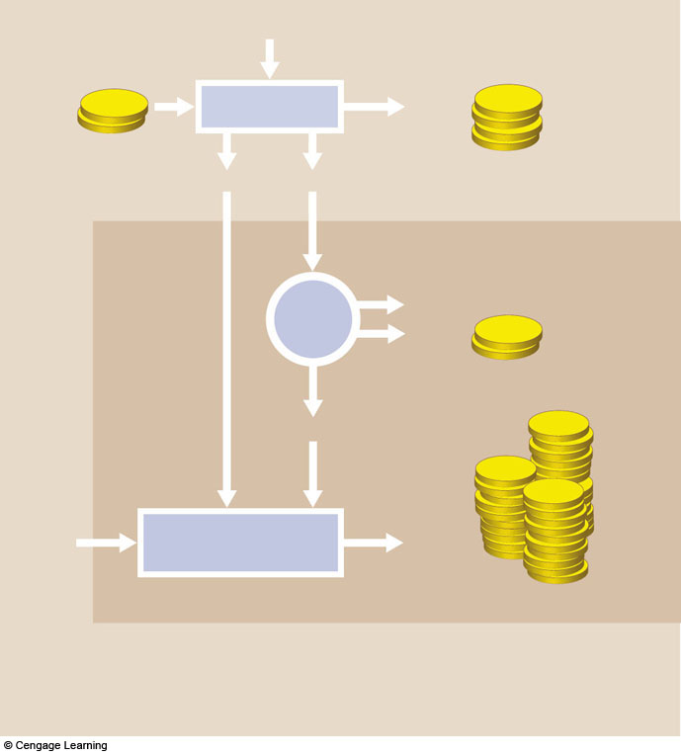
Cytoplasm
glucose
a The first stage, glycolysis, occurs
in the cell’s cytoplasm. Enzymes convert a glucose molecule to 2 pyruvate for a net yield of 2 ATP. During the reactions, 2 NAD+ pick
up electrons and hydrogen atoms,
so 2 NADH form.
2 ATP
ATP
GLYCOLYSIS
4 ATP
(2net)
ATP
2 NADH
2 pyruvate
Mitochondrion
Krebs
Cycle
6 CO2
ATP
b The second stage, the Krebs cycle and a few steps before it, occurs inside mitochondria. The 2 pyruvates are broken down to CO2, which leaves the cell. During the reactions, 8 NAD+ and 2 FAD pick up electrons and hydrogen atoms, so 8 NADH and 2 FADH2 form. 2 ATP also form.
2 ATP
8 NADH, 2 FADH₂
ATP
oxygen
Electron Transfer
Phosphorylation
32 ATP
c The third and final stage, electron transfer phosphorylation, occurs inside mitochondria. 10 NADH and 2 FADH2 donate electrons and hydrogen ions at electron transfer chains.
Electron flow through the chains sets up H+ gradients that drive ATP formation. Oxygen
Fig. 7.3, p.109

Slide 91
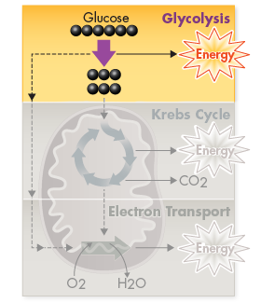
Glycolysis
  Anaerobic - no oxygen
  Takes place in cytoplasm

Slide 92
Stages of Cellular Respiration
  Glycolysis produces only a small amount of energy. Most of glucose’s energy (90%) remains locked in the chemical bonds of pyruvic acid at the end of glycolysis.

Slide 93
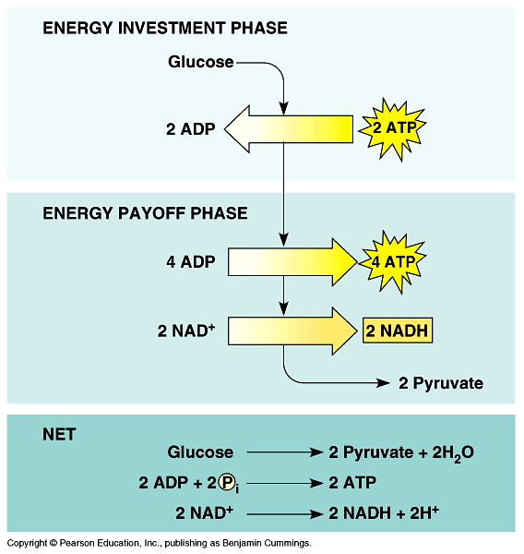

Slide 94
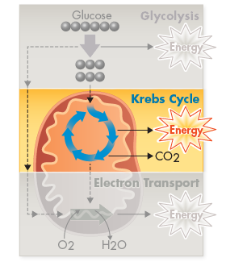
Stages of Cellular Respiration
  During the Krebs cycle, a little more energy is generated from pyruvic acid.

Slide 95
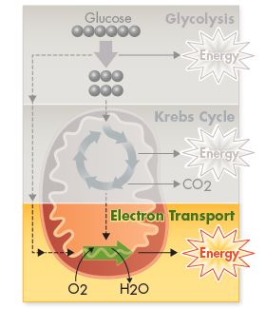
Stages of Cellular Respiration
  The electron transport chain produces the bulk of the energy in cellular respiration by using oxygen, a powerful electron acceptor.

Slide 96
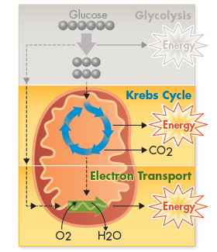
Oxygen and Energy
  Pathways of cellular respiration that require oxygen are called aerobic. The Krebs cycle and electron transport chain are both aerobic processes. Both processes take place inside the mitochondria.

Slide 97
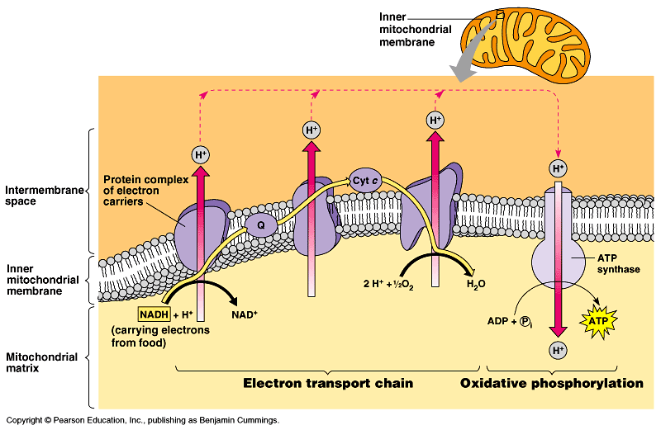
Figure 9.15 Chemiosmosis couples the electron transport chain to ATP synthesis

Slide 98


Slide 99
Cytoplasm
glucose
a The first stage, glycolysis, occurs
in the cell’s cytoplasm. Enzymes convert a glucose molecule to 2 pyruvate for a net yield of 2 ATP. During the reactions, 2 NAD+ pick
up electrons and hydrogen atoms,
so 2 NADH form.
2 ATP
ATP
GLYCOLYSIS
4 ATP
(2net)
ATP
2 NADH
2 pyruvate
Mitochondrion
Krebs
Cycle
6 CO2
ATP
b The second stage, the Krebs cycle and a few steps before it, occurs inside mitochondria. The 2 pyruvates are broken down to CO2, which leaves the cell. During the reactions, 8 NAD+ and 2 FAD pick up electrons and hydrogen atoms, so 8 NADH and 2 FADH2 form. 2 ATP also form.
2 ATP
8 NADH, 2 FADH₂
ATP
oxygen
Electron Transfer
Phosphorylation
32 ATP
c The third and final stage, electron transfer phosphorylation, occurs inside mitochondria. 10 NADH and 2 FADH2 donate electrons and hydrogen ions at electron transfer chains.
Electron flow through the chains sets up H+ gradients that drive ATP formation. Oxygen
Fig. 7.3, p.109

Slide 100

Fermentation
  Glycolysis (2 ATP/glucose)
  Energy can be released from food molecules without oxygen
  Occurs in the cytoplasm of cells

Slide 101


Slide 102

Alcoholic Fermentation
  Yeast produce ethyl alcohol and carbon dioxide after glucose is split once

Slide 103

Lactic Acid Fermentation
  Humans produce lactic acid after glucose is split once

Slide 104

Disposition of Organic Compounds

Slide 105

FOOD
fats
COMPLEX CARBOHYDRATES
PROTEINS
fatty acids
glycerol
glucose, other simple sugars
amino acids
acetyl-coA
PGAL
acetyl-coA
Glycolysis
NADH
pyruvate
oxaloacetate
or another
intermediate
of the Krebs
Krebs
Cycle
NADH, FADH²
Electron Transfer
Phosphorylation
Fig. 7.12a, p.119

Slide 106
Comparing Photosynthesis and
Cellular Respiration
  What is the relationship between photosynthesis and cellular respiration?
  Photosynthesis removes carbon dioxide from the atmosphere, and cellular respiration puts it back. Photosynthesis releases oxygen into the atmosphere, and cellular respiration uses that oxygen to release energy from food.

Slide 107
Comparing Photosynthesis and Cellular Respiration
  Photosynthesis and cellular respiration are opposite processes.
  The energy flows in opposite directions. Photosynthesis “deposits” energy, and cellular respiration “withdraws” energy.
  The reactants of cellular respiration are the products of photosynthesis and vice versa.

Slide 108
Comparing Photosynthesis and Cellular Respiration
  The release of energy by cellular respiration takes place in plants, animals, fungi, protists, and most bacteria.
  Energy capture by photosynthesis occurs only in plants, algae, and some bacteria.

