Slide 1
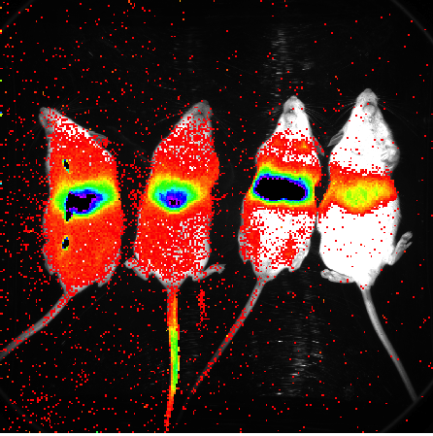
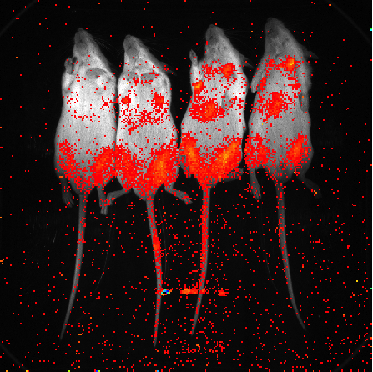
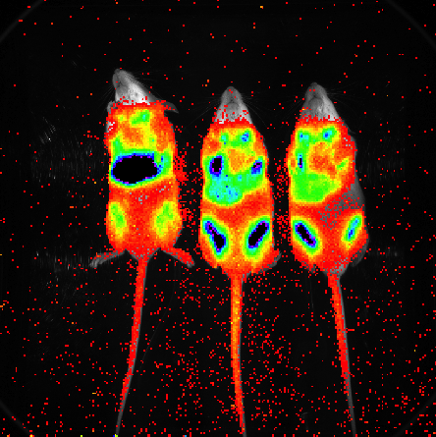
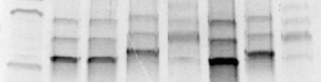
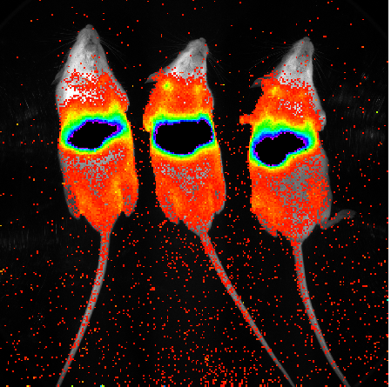
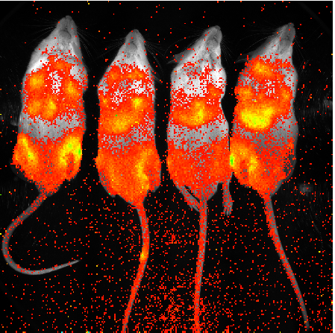
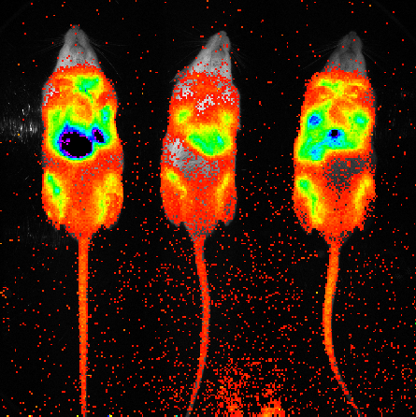
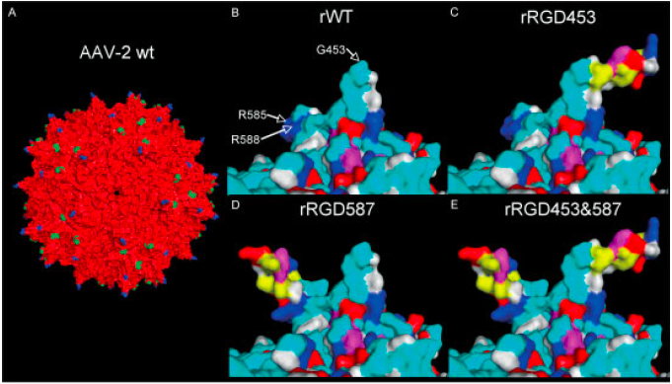
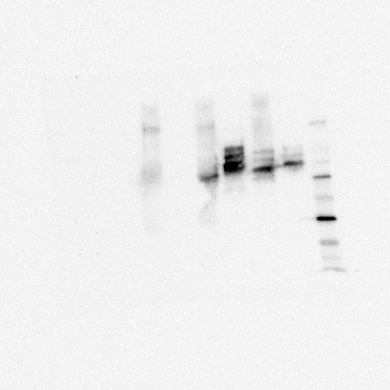
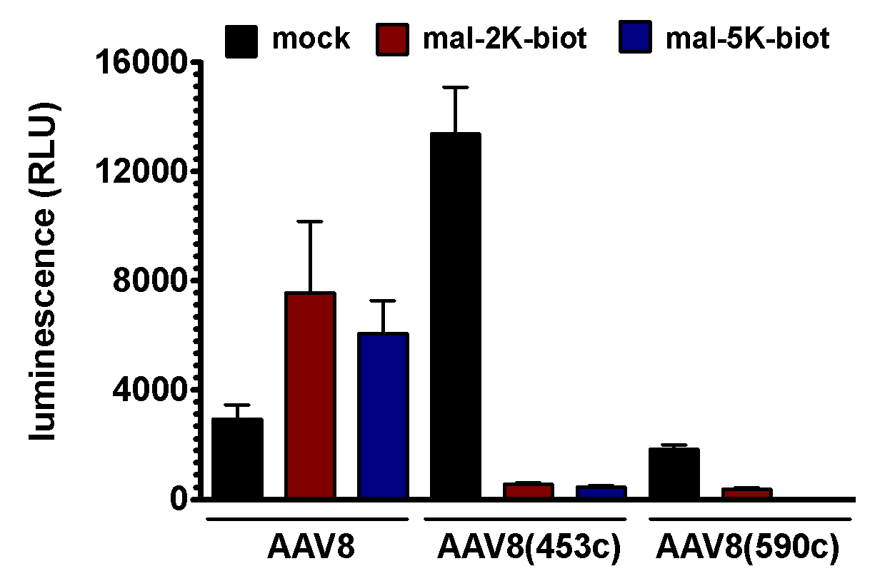
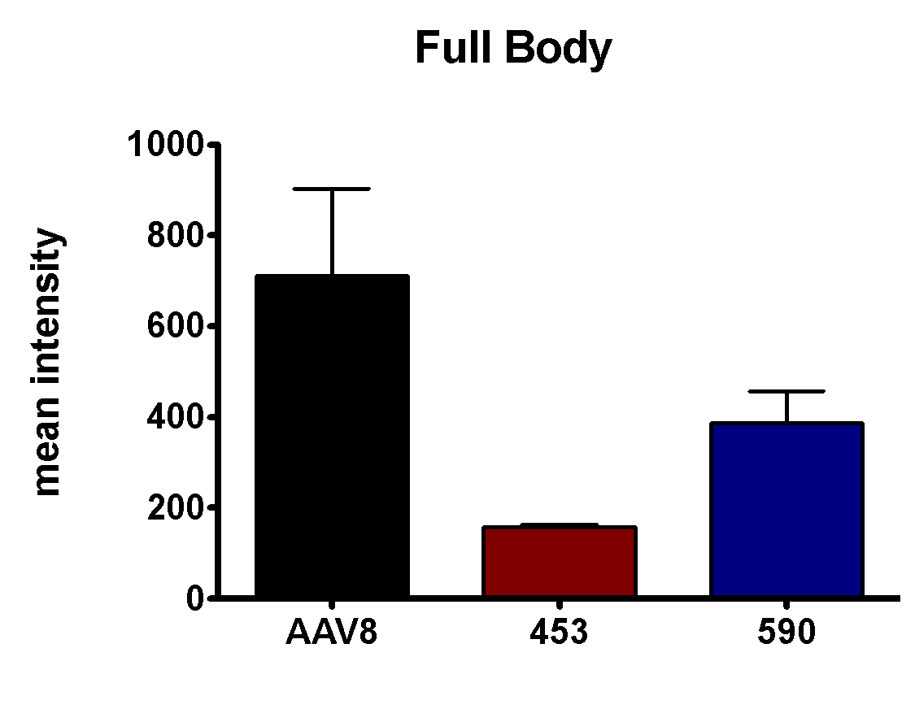
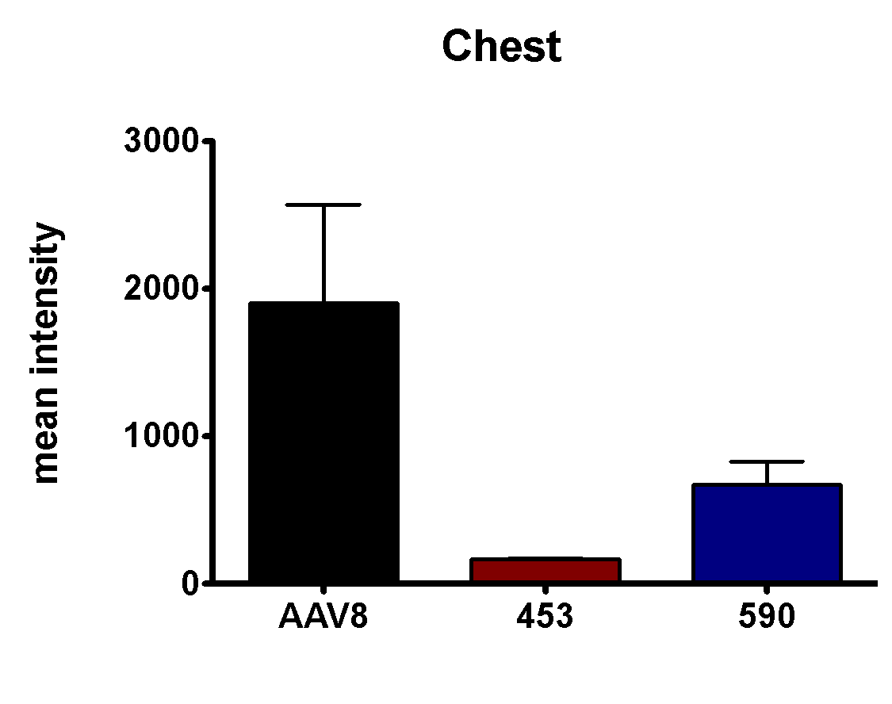
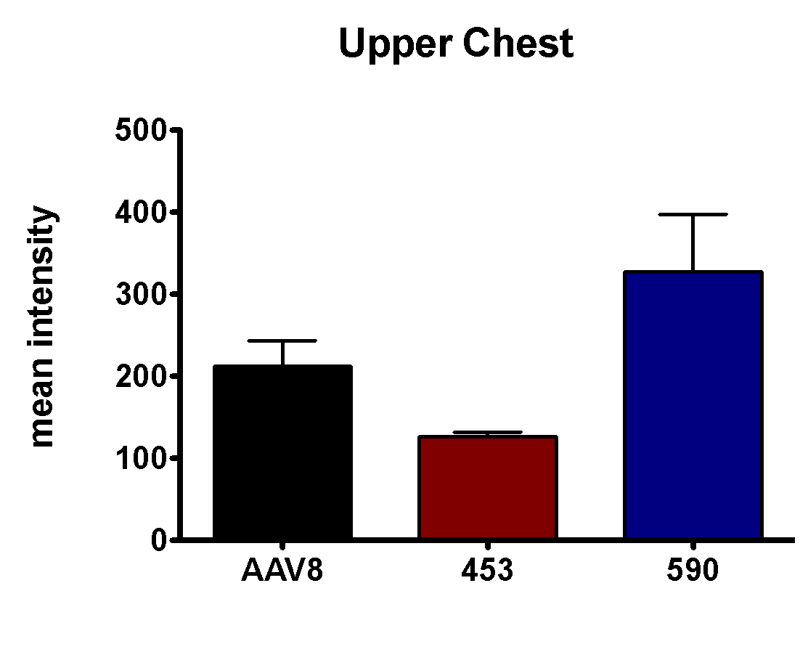
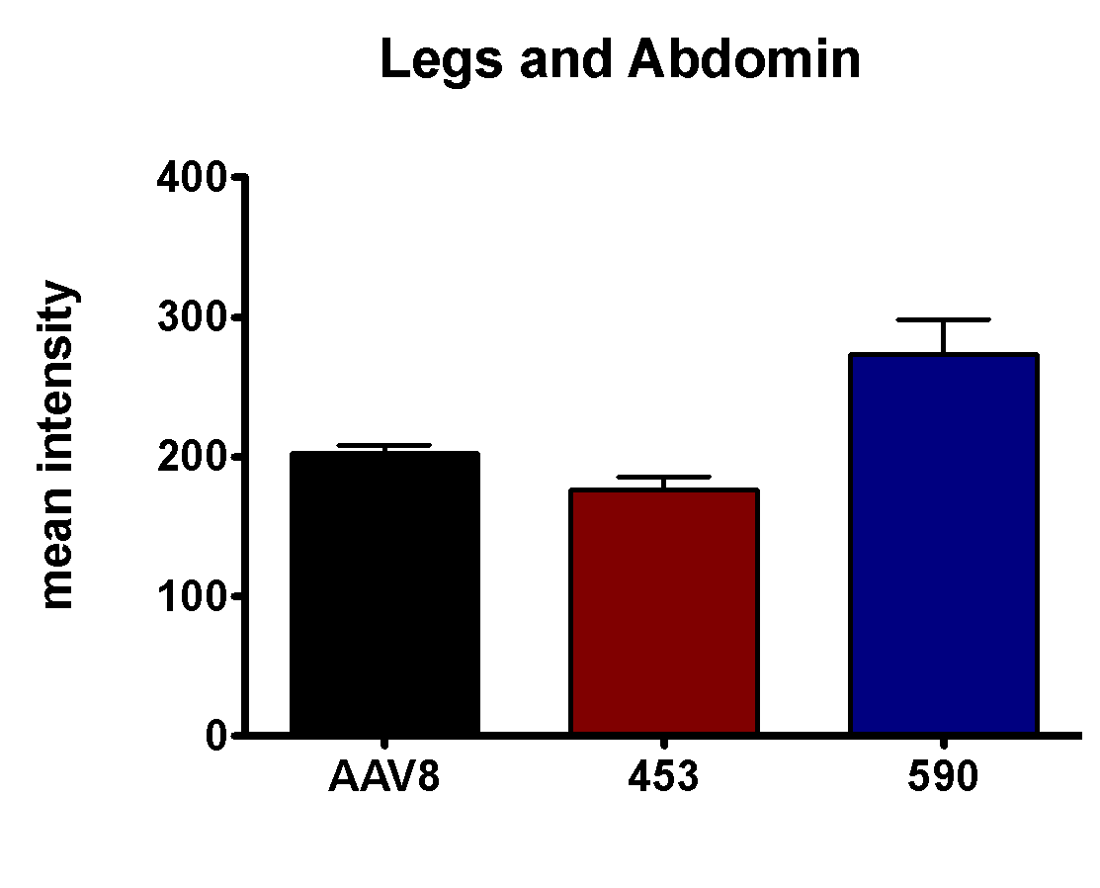
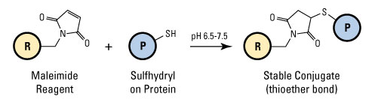
Adeno-Associated Virus Capsid Modification and Resulting Viability and Tropism
DFADFA
William Gendron, Adam Guenze², Matthew Hillestad, and Michael A. Barry,
Mayo Clinic, Rochester, MN
Abstract
Methods and Results
Discussion
Figure 7: Future Plans
  Adeno-associated viruses (AAVs) are parvoviruses used frequently in gene therapy studies since the 1990’s. They have the capacity to transduce multiple tissue types, illicit a minimal immune response upon single injection, and have a good safety profile with expanding use in human clinical trials. They also have some limitations, primarily: small DNA carrying capacity, limited transduction of certain tissues, and vulnerability to the immune system upon repeat administration (Martino, AT et al). AAV8 primarily targets the liver. In this work, we expanded on previous studies in adenovirus where cysteine residues were added to the viral capsid to allow targeted attachment of molecules using maleimide. In this case cysteine residues were inserted at position 453 and 590 in the AAV8 capsid and used to generate AAV8(453c) and AAV8(590c) viruses carrying cDNA for GFP and luciferase transgene (Figure 1). These vectors were then analyzed both in vitro and in vivo and found to maintain their ability to transduce cells. Additionally, our data indicate that both the 453 and 590 vectors can be covalently modified in a targeted manner by maleimide-containing compounds (Figure 2). This kind of targeted modification is not possible with wild type AAV8 capsids.
Wild type and cysteine-modified AAV vectors were produced by triple transfection of HEK-293 cells and purified by tangential flow filtration and ultracentrifugation through an iodixanol gradient. All AAV8 variants were modified by attachment of maleimide-PEG-biotin polymers with either a 2 kDa or 5 kDa PEG linker. While maleimide-PEG-Biotin did not bind to the wild type AAV8, the cysteines in both AAV8(453c) and AAV8(590C) did facilitate attachment of maleimide-PEG-Biotin molecules as shown by Sypro Ruby stain and Western Blot with Neutravidin (Figure 3). These AAV8 variants were first tested in vitro by adding 10,000 vg per cell of each virus to HEK-293 cells in a 96 well plate. After 3 days of incubation the plate was analyzed for luciferase activity (Figure 4). Since the AAV8, AAV8(453c), and AAV8(590c) vectors all displayed some in vitro activity in the absence of PEG these vectors were tested in vivo as well. 2x10^11 vg of each vector was administered to 5 –week-old FVB mice via intravenous tail vein injection. Luciferase activity in the mice was then assayed 1 and 2 weeks after injection (Figure 5). The activity was compared between the groups (Figure 6 and 7).
Future plans | Preliminary | Amine to Sulfhydryl(cysteine) | Carbohydrate to Sulfhydryl | Sulfhydryl to Hydroxyl
Test: | Maleimide | Imject Maleimide-Activated BSA | N-B-Maleimidopropionic Acid Hydrazide | p-Maleimidophenyl isocyanate
 | Maleimide-Biotin | Anti-Sialic Acid | Glucose | Antihistamine
 |  | Glucosamine | Glycoproteins
 |  | Antibodies
Figure 3: Blot Stains
Figure 5: Luciferase in vivo
Listed above are the possible ideas for future research. Maleimide and maleimide-biotin would be the first test to check if blocking these sites will inactivate the viruses.
453+2 kDa PEG
453 (no PEG)
590+5 kDa PEG
453+5 kDa PEG
Wildtype
590+2 kDa PEG
Biotin Ladder
590 (no PEG)
Sypro Ruby Stain
(detects protein)
Conclusions
AAV8
AAV8(453c)
AAV8(590c)
We are able to selectively attach molecules to the AAV8 capsid using introduced cysteine residues and maleimide.
Unmodified AAV8(453c) virus has higher activity in vitro than wildtype AAV8 or AAV8(590c), however, the efficacy of PEGylated viruses was decreased.
Unmodified AAV8(590c) has a high level of in vivo activity comparable to wild type AAV8, with a slightly altered pattern of expression while AAV8(453c) had significantly reduced expression in vivo.
Week 1 of in vivo imaging of the un-PEGylated. Mild issues with the AAV8 image.
453+2 kDa PEG
Biotin Ladder
453 (no PEG)
453+5 kDa PEG
590+2 kDa PEG
590+5 kDa PEG
Figure 1: Modification Site
Avidin Western Blot
(detects biotin on PEG)
AAV8
AAV8(453c)
AAV8(590c)
Week 2 of in vivo imaging of the un-PEGylated. 453 was imaged for twice as long.
Figure 4: in vitro Effectivity
Figure 6: Week 1 Activity
References
This is a model of AAV2 from a previous paper. A similar addition of a cysteine was created and used in AAV8 in this project (citation).
Khare R, Reddy VS, Nemerow GR, Barry MA. 2012. Identification of adenovirus serotype 5 hexon regions that interact with scavenger receptors. J. Virol. 86:2293–2301.
Martino AT, Basner-Tschakarjan E, Markusic DM, Finn JD, Hinderer C, Zhou S, et al. Engineered AAV vector minimizes in vivo targeting of transduced hepatocytes by capsid-specific CD8 + T cells. Blood(2013) 121(12):2224–3310.1182/blood-2012-10-460733.
Basner-Tschakarjan E, Bijjiga E and Martino AT (2014) Pre-clinical assessment of immune responses to adeno-associated virus (AAV) vectors. Front. Immunol. 5:28.
Boucas J. et al. Engineering adeno-associated virus serotype 2-based targeting vectors using a new insertion site-position 453-and single point mutations. J. Gene Med. 11, 1103–13 (2009). [PubMed]
Figure 2: Maleimide Rxn
Image from Thermo Scientific: Pierce Protein Biology Products.
The relative luminescence(RLU) was determined for each lane and then averaged and compared to each other lane of virus.
No artifacts in images used. All mice were imaged for the same amount of time for this data. Noticeable drop in mean intensity of the 590 mice
© 2014 Mayo Foundation for Medical Education and Research

