Slide 1
Frequent mutations of genes encoding ubiquitin-mediated proteolysis pathway components in clear cell renal carcinoma
BACKGROUND
Presented by
Nathalie Javidi-Sharifi
Druker Lab

Slide 2
What you will learn:
Clear Cell Renal Cell Carcinoma
Genetic pathways
Therapy options
Sequencing strategies
Sequencing technologies
Exome sequencing
Mutation detection
Validation
Study Design
Pilot and expansion, or discovery and validation
Mutational analysis
Evaluation of mutated genes

Slide 3
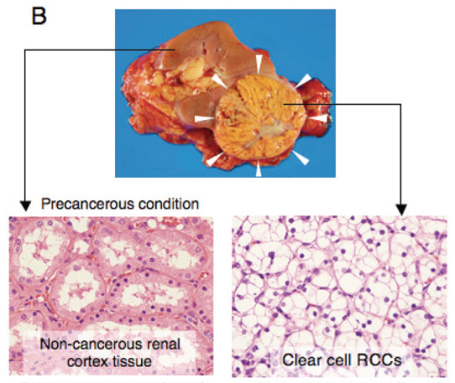
Clear Cell Renal Cell Carcinoma (ccRCC)
RCC incidence 58,000 in United States
ccRCC predominant type (75%)
Von Hippel-Lindau (VHL) silencing
accumulation of hypoxia-inducible factors (HIFs)
production of angiogenic/ growth factors
Aria et. al., Int J Clin Exp Pathol 2011;4(1):58-73
Notes:
Kidney cancers account for 2% of adult malignancies. 80-90% of kidney cancers are renal cell carcinomas.

Slide 4
Von Hippel-Lindau protein (pVHL)
Tumor-suppressor gene
Loss of function detected in 50-90% of sporadic ccRCCs
Somatic mutations
Promoter hypermethylation 5-20%
Loss of heterozygosity up to 98%
Ubiquitination of HIF-α
Transcriptional regulation and stabilization of p53
Regulation of apoptosis
ECM assembly
VHL silencing in ccRCC
Accumulation of HIF-α
Deregulation of apoptosis
Invasive capabilities
Angiogenesis
Glucose metabolism
Invasive capabilities
Proliferation and survival

Slide 5
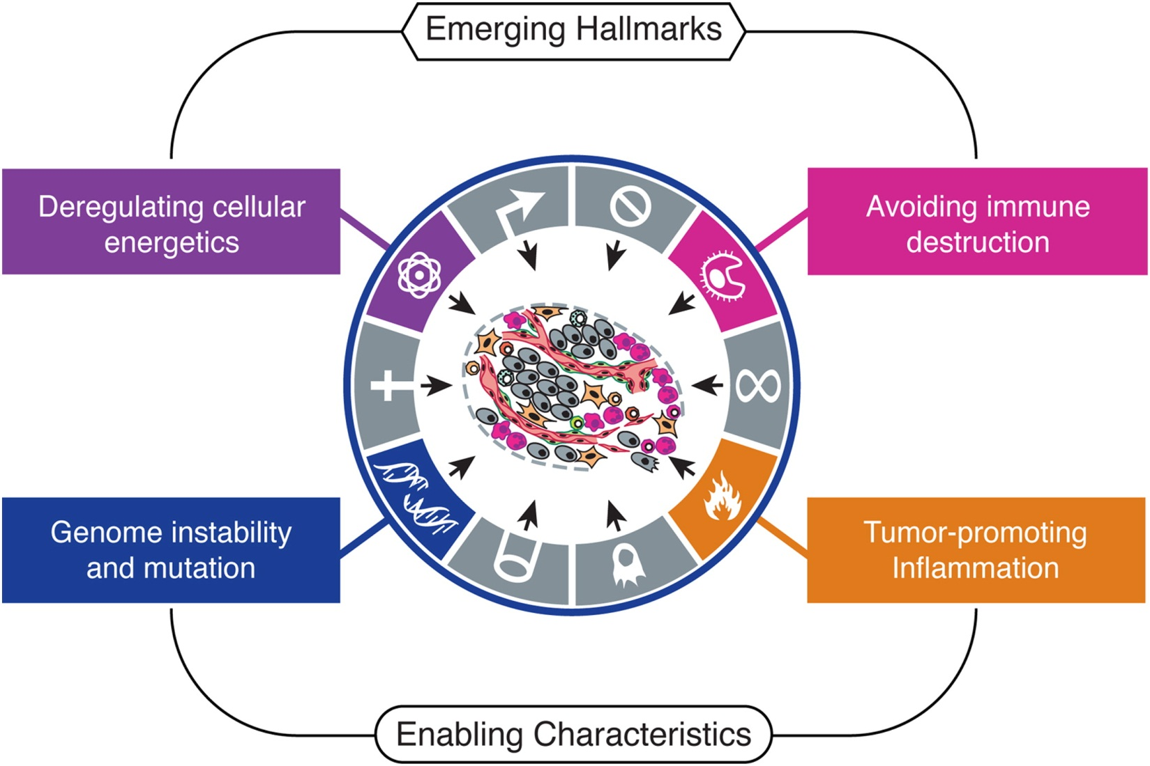
Reminder: Hallmarks of Cancer
Sustaining proliferative signaling
Evading growth suppressors
Resisting cell death
Enabling replicative immortality
Inducing angiogenesis
Activating invasion and metastasis

Slide 6
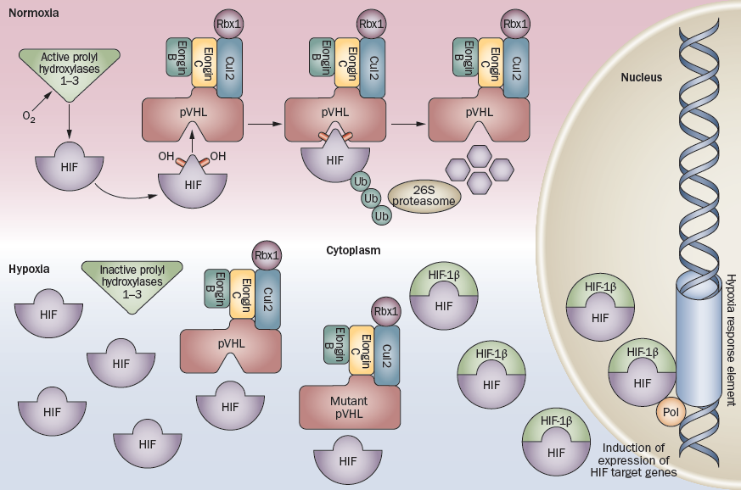
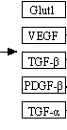
HIF regulation
Gossage, L. & Eisen, T. Nat. Rev. Clin. Oncol. 7, 277–288 (2010)

Slide 7
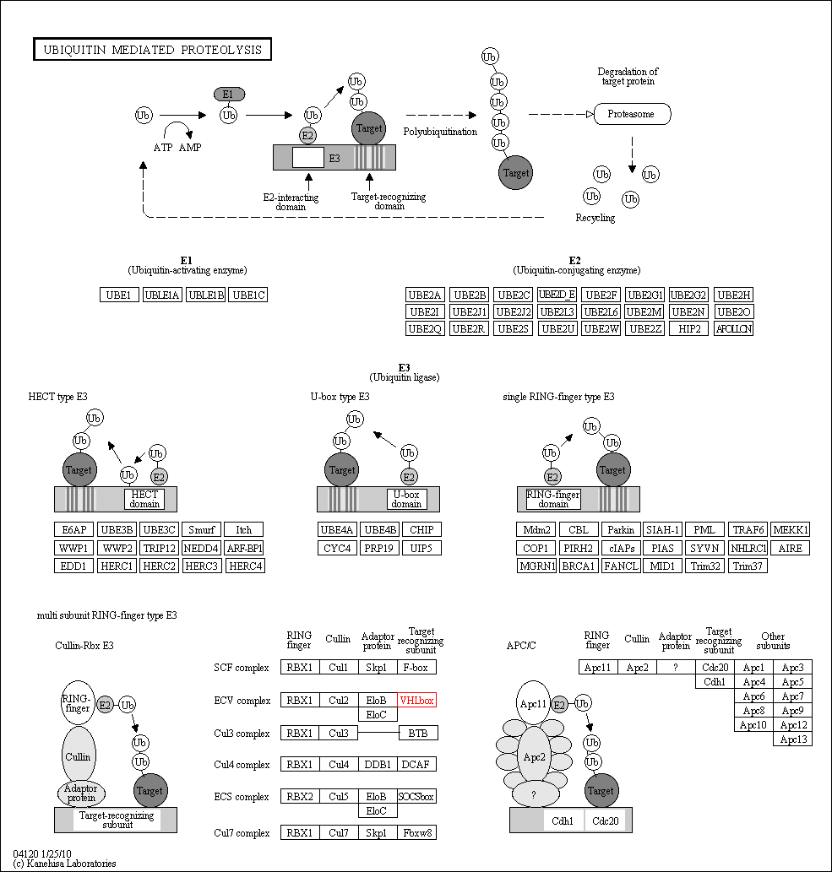
Ubiquitin-mediated proteolysis pathway (UMPP)
VHL
KEGG reference pathway © Kanehisa Laboratories
Notes:
VHL is part of a multi subunit RING-finger type E3, a Cullin-Rbx-E3, specifically, the ECV complex. So, the ring finger is RBX1, the cullin is Cul2, the adaptor proteins are elongin B and C, and the target recognizing substrate is VHL.
Mutations found in the UMPP involved other complexes, not ECV. Two more target recognizing subunits, a cullin, and a deubiquitinating enzyme were found to contain significant mutations.

Slide 8
Other ccRCC-associated genes
old |  | new
UTX | Histone demethylase | BAP1 | deubiquitinating enzyme
JARID1C | Histone demethylase | SYNE2 | Component of the nuclear envelope
SETD2 | Histone methyltransferase | SPTBN4 | Spectrin (cytoskeletal protein)
PBRM1 | Part of transcription machinery | AHNAK | nucleoprotein
AKAP13 | Protein kinase A anchor protein | TSC1 | Tuberous sclerosis 1 (part of mTOR signaling)
 |  | SHANK1 | Part of glutamatergic synapse
 |  | ASB15 | Target recognition subunit of ESC complex
 |  | Cul7 | Cullin
 |  | BTRC | Target recognition subunit in SCF complex
Notes:
Histone-modifying enzymes and transcription machinery: genome instability and mutation (enabling characteristic)
PKA anchor protein: PKA involved in countless signaling pathways, so could affect sustaining proliferative signaling and deregulation of cellular energetics
Cytoskeletal and nuclear proteins: perhaps enabling replication and invasive capacities?

Slide 9
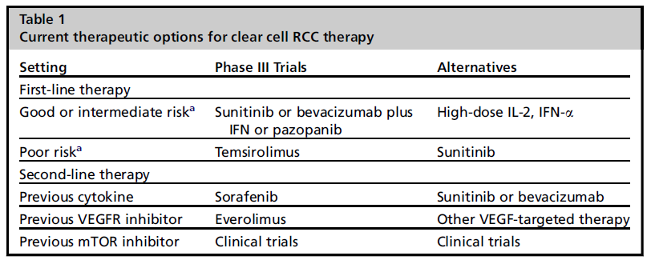
Therapy options
IFN or IL-2 immunotherapy
VEGF (antiangiogenic) therapy (sunitinib, pazopanib, sorafenib, bevacizumab)
mTOR targeted therapy (temsirolimus, everolimus)
Co, D. & Atkins, M. Hematol Oncol Clin N Am 25 (2011) 917–935
Notes:
Immunotherapy, particularly HD IL-2, has highest and most durable response rates.
mTOR: mTORC1 regulates transcription of HIF1a, but not HIF2a, which may be the more important. Therefore limited and short lived efficacy.

Slide 10
Second Generation Sequencing Strategies
Platform | Template | NGS chemistry
Roche/454’2 GS FLX Titanium | Emulsion PCR | Pyrosequencing
Illumina/ Solexa’s GAII | Solid-phase | Reversible termination
Life/ APG’s SOLiD 3 | Emulsion PCR | Cleavable probe sequencing by ligation
Polonator G.007 | Emulsion PCR | Non-cleavable probe sequencing by ligation
Helicos BioScienceses HeliScope | Single molecule | Reversible termination
Pacific Biosciences’ PacBio RS | Single molecule | Real-time
Notes:
Recent developments: Life Technology announced that with the semiconductor technology from Ion Torrent, they could sequence a genome for $1,000 (the machine will be called Ion Proton Sequencer). At the same time, Illumina announced their HiSeq2500, which can sequence a genome in a day. This will be again based on sequencing by synthesis (reversible termination).

Slide 11
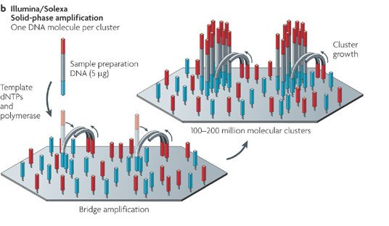
Template preparation strategies
Metzker, M. Nature Reviews Genetics 11, 31-46 (January 2010)
Notes:
Emulsion PCR:
Every droplet contains 1 bead, 1 template, and all components for PCR
Every bead will contain several thousand copies of the same template
Beads are either attached to slides or placed in picotitre plates
Solid-phase amplification:
Primed template anneals to immobilized primer, which is extended
Immobilized template undergoes bridge amplification
Clusters of the same template

Slide 12
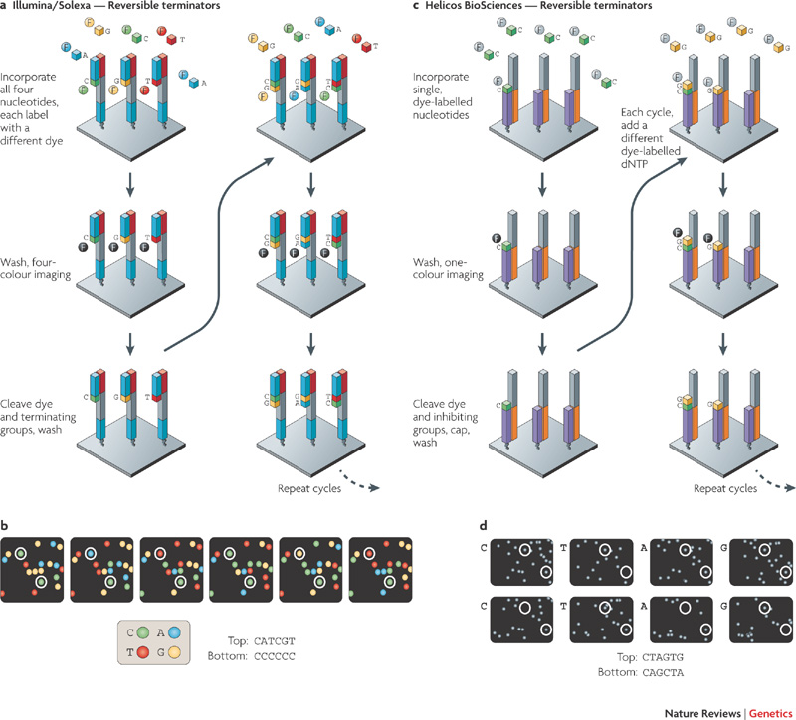
Reversible Termination

Slide 13
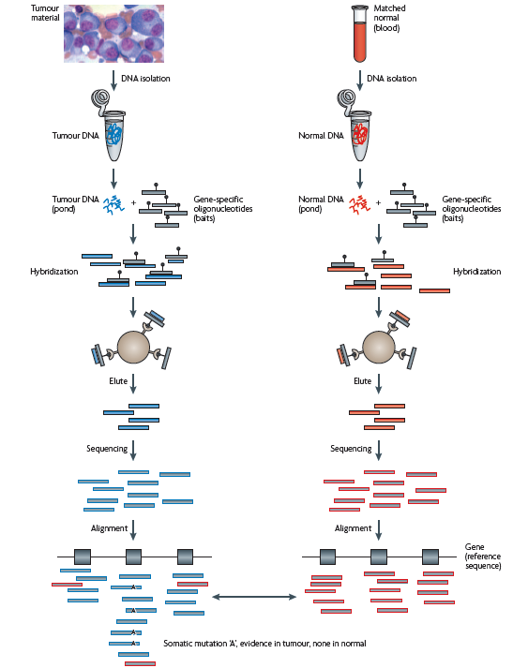
Exome Sequencing: hybrid selection

Slide 14
Considerations for cancer genome analysis
Sample characteristics
Nucleic acid quantity
Nucleic acid quality
Sample heterogeneity
Incorporation of normal tissue
Tumor heterogeneity
How to identify significant somatic mutations:
Compare to matched normal DNA to distinguish from germ line mutations
Compare to sample-specific background mutation rate
Validate by mass spectrometry or Sanger sequencing, or another round of directed second generation sequencing
Assess functional significance (computation or transformation assay)

Slide 15
Study design
Goal: Find and validate driver mutations and place them in the context of pathways
Primer design for directed sequencing (f. e. all transcripts in the RefSeq database)
Discovery Screen: limited sample number, complete primer set
Mutational analysis:
Remove nonsynonymous changes that occur in normal
Remove known single-nucleotide polymorphisms
Remove false positive artifacts by visual inspection
Re-amplify in tumor and normal
Validation Screen: sequence genes from discovery screen in more samples
Again mutational analysis

Slide 16
Study design continued
Determine passenger mutation rates
Mutation rate in noncoding regions
Rate of synonymous mutations
Evaluate mutated genes
CaMP score: ranks genes by type and frequency of mutation
Predicing effect on protein function
Sequence based: SIFT (Sorting Intolerant From Tolerant)
Structural: LS-SNP software
Evaluate pathways
Assign “pathway CaMP” score using the Metacore database

Slide 17
“Pathways, rather than individual genes, appear to govern the course of tumorigenesis.”
Laura D. Wood, et al.
Science 318, 1108 (2007)

Slide 18
Frequent mutations of genes encoding ubiquitin-mediated proteolysis pathway components in clear cell renal carcinoma
Results
Presented by
Tim Butler
Spellman Lab

Slide 19
Overview
Sequencing based study of frequent mutations in ccRCC
Pilot phase of 10 tumor exomes
Expansion phase of 88 tumors focusing on 1,100+ genes
Samples collected from Chinese patients and sequenced by BGI

Slide 20
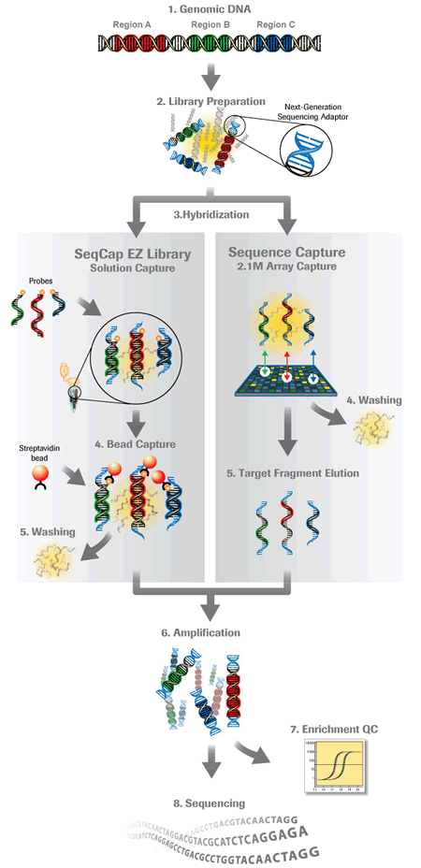
Sequencing Overview
Illumina GAII sequencer used for all sequencing
Exome capture relied on NimbleGen exome array kit
Gene enrichment used custom NimbleGen kits

Slide 21
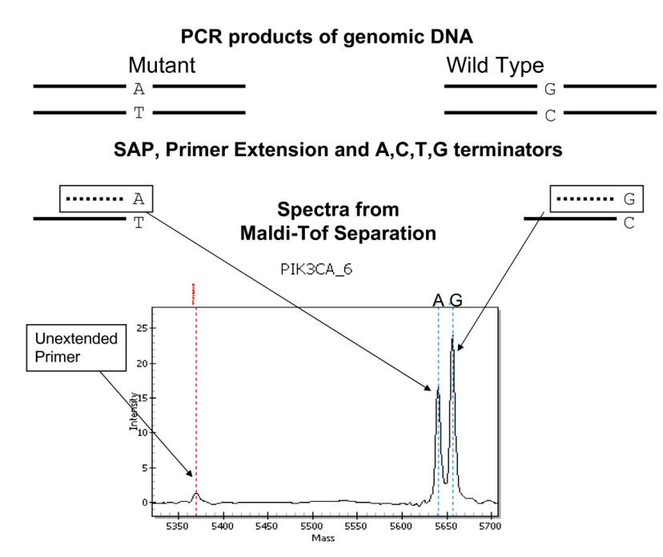
Sequencing Overview
Illumina GAII sequencer used for all sequencing
Exome capture relied on NimbleGen exome array kit
Gene enrichment used custom NimbleGen kits
Mutation validation conducted with Sanger sequencing and Sequenom MassARRAY
Fumagalli et. al. BMC Cancer 2010, 10:101

Slide 22
Sequencing Overview
Illumina GAII sequencer used for all sequencing
Exome capture relied on NimbleGen exome array kit
Gene enrichment used custom NimbleGen kits
Mutation validation conducted with Sanger sequencing and Sequenom MassARRAY
Minimum coverage depth of 10x
Accounts for error rate, ensuring both copies sequenced, and detected mutation somatic vs germline

Slide 23
Experimental Design
10 ccRCC exomes
10 matched normal exomes
Identify significance of pathway alteration
Sequence
Sequence
Identify genes harboring somatic mutations
Enrich for all genes in significant pathways (135)
88 ccRCC samples
Identify significantly mutated pathways
Enrich for somatic mutation containing genes (234), genes containing ccRCC mutations in COSMIC(367), and cancer genes (413)
Sequence
Identify significantly mutated genes

Slide 24
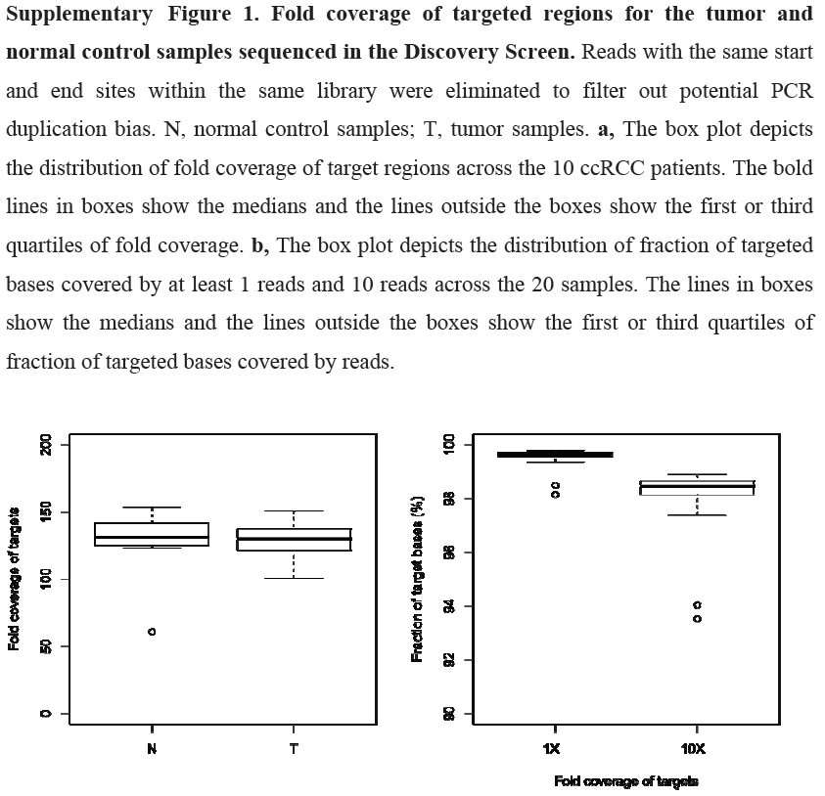
Exome Sequencing
Average coverage 127x
>92% exonic bp covered >10x

Slide 25
Experimental Design
10 ccRCC exomes
10 matched normal exomes
Identify significance of pathway alteration
Sequence
Sequence
Identify genes harboring somatic mutations
Enrich for all genes in significant pathways (135)
88 ccRCC samples
Identify significantly mutated pathways
Enrich for somatic mutation containing genes (234), genes containing ccRCC mutations in COSMIC(367), and cancer genes (413)
Sequence
Identify significantly mutated genes

Slide 26
Significantly Mutated Genes
23 Significant genes
5 previously identified in ccRCC
VHL mutation prevalence much lower than expected
Previous studies identified prevalence >50%

Slide 27
Low VHL mutation prevalence
Several possible causes
Experimental error, low overall mutation rate
Mutation rate of 1.3/MB is in line with other studies
VHL can be inactivated through hypermethylation
Measured to be 6%, still too low
Samples collected from Chinese patients
Population specific somatic mutation profiles

Slide 28
Heterogeneous Mutation Rates
Background mutation rate assumed to be the same for all genes
Low expressed genes have higher mutation rates
Transcription coupled repair
Late replicating genes have higher mutation rates
Insufficient time for repair machinery to act

Slide 29
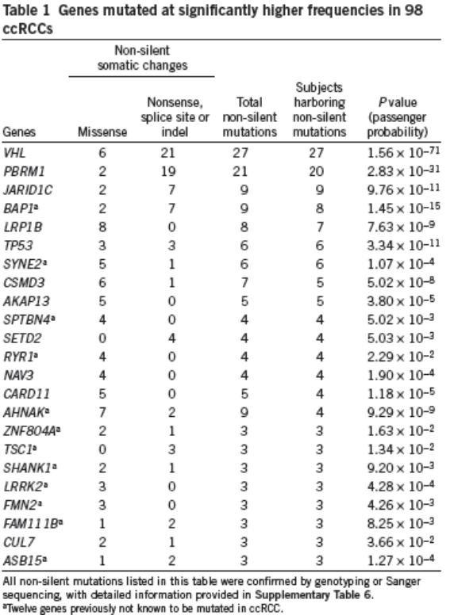
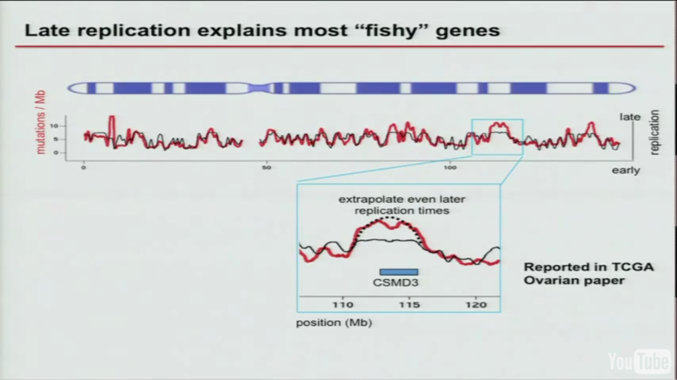
Late Replicating Genes
CSMD3 “Cub and Sushi Domain” protein
Significantly mutated in ovarian, lung, GBM, colorectal, and most other cancers studied by TCGA
Lander, Eric. "TCGA Symposium." 17 Nov. 2011.

Slide 30
Experimental Design
10 ccRCC exomes
10 matched normal exomes
Identify significance of pathway alteration
Sequence
Sequence
Identify genes harboring somatic mutations
Enrich for all genes in significant pathways (135)
88 ccRCC samples
Identify significantly mutated pathway (UMPP)
Enrich for somatic mutation containing genes (234), genes containing ccRCC mutations in COSMIC(367), and cancer genes (413)
Sequence
Identify significantly mutated genes

Slide 31
Ubiquitin-mediated proteolysis pathway
Half of all samples show mutations in UMPP

Slide 32
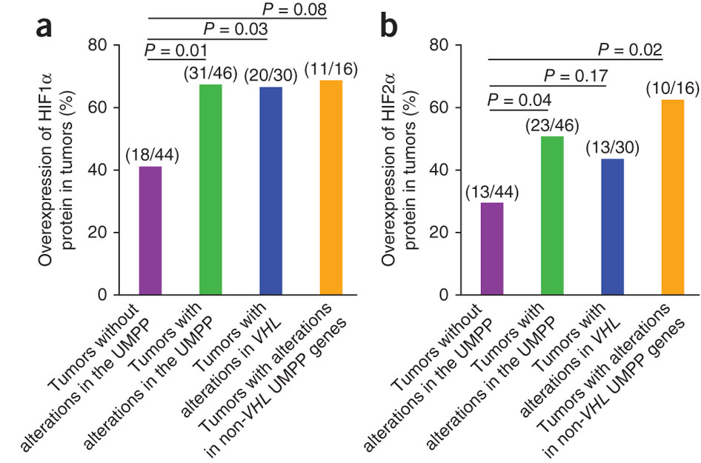

Slide 33
Conclusions
23 significantly mutated genes identified in ccRCC
VHL mutation rate less than expected
Several suspicious late-replicating genes significant (CSMD3, RYR1)
Half of all samples had mutations in the UMPP
UMPP mutations significantly correlate with HIF1/2^{α} expression
Subtype could be informative clinically
Study only looked at HIF ^{α} likely many other proteins affected by UMPP mutation

Slide 34
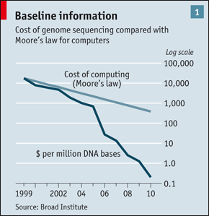
Advances in Sequencing
Previous study conducted with Illumina GAII
Current Illumina HiSeq platform has >10x sequencing output
Allows for faster study, and/or increased sample size
As sequencing continues to become cheaper more clinically significant subtypes will be identified

Slide 35
Sequencing Considerations
Glenn, Molecular Ecology Resources 2011, 11:5

Slide 36
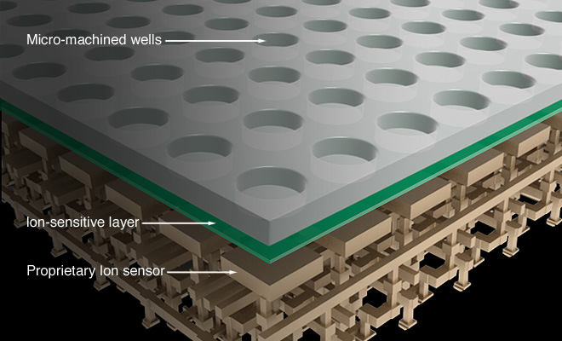
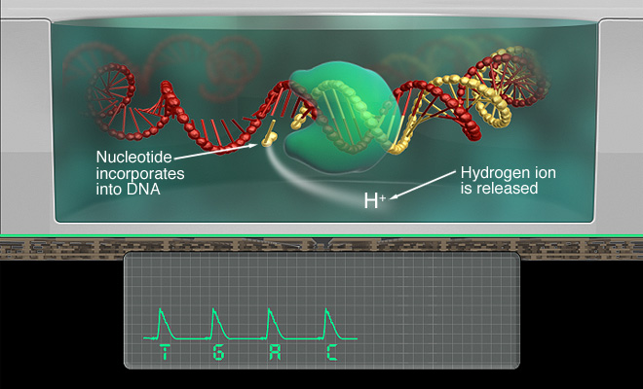
Ion Torrent
“Semiconductor Sequencing”
Lower cost per run, lower throughput
New machine announced claiming to sequence a $1,000 genome per day
Would allow the previous study’s sequencing to be completed in 3-4 days

